Slide 1

Lending Club Case Study
space for
your logo
How to minimize Defaults

Slide 2
Some people use one half of their ingenuity to get into debt, and the other half to avoid paying it.
“
—George Dennison Prentice

Slide 3
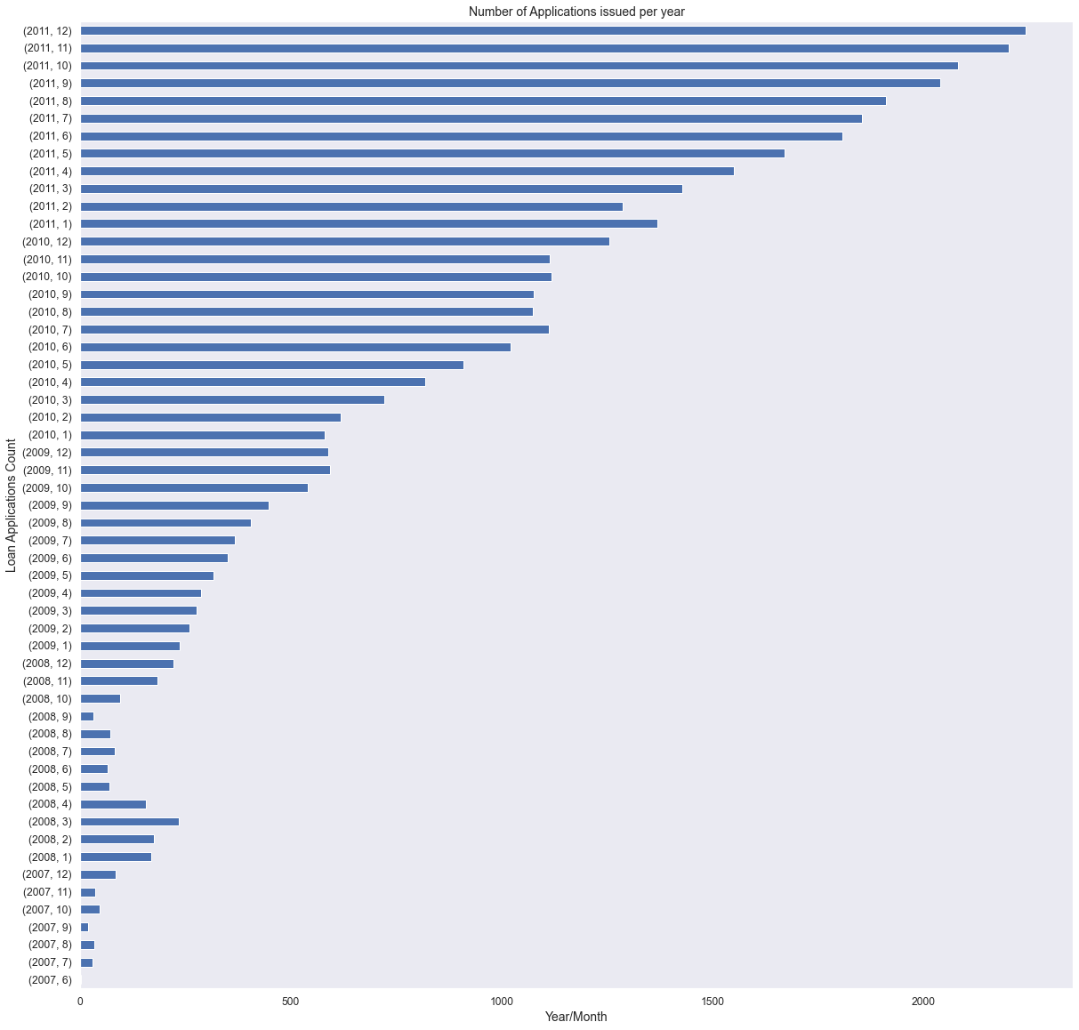

Each year Lending Club handles Thousands of loan applications, and this number is increasing every year

Slide 4
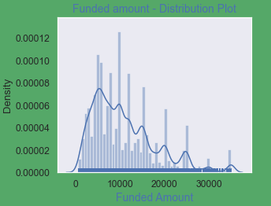
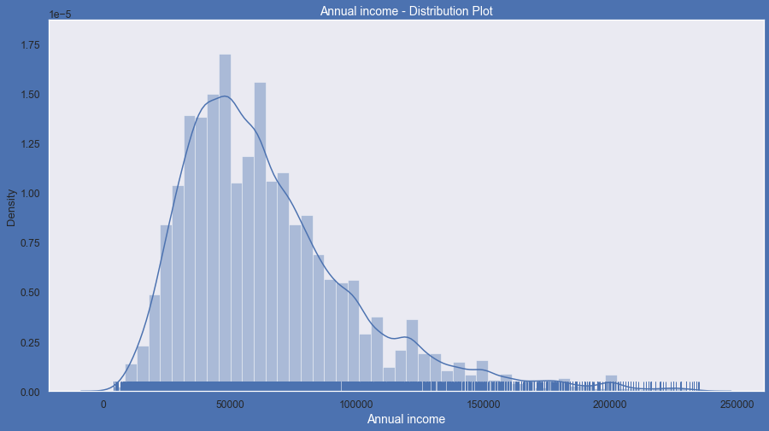
The lending club caters to populace of all income levels and lends all ranges of amounts of money
MERCURY
VENUS

Slide 5

But alas!
Not every loan gets paid. And this situation hurts everyone equally:
The lender suffers financial loss
The borrower sees his credit score go down
The unpleasant experience results in decreased probability of repeat traffic on the Platform!
Let us see how many of the loans actually are charged off..

Slide 6
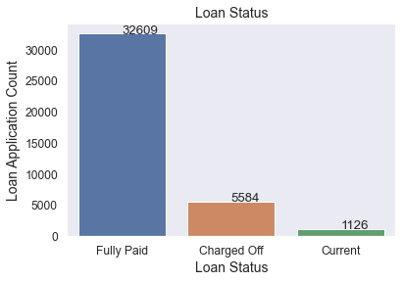

A picture always reinforces the concept

Slide 7

Let’s get together to figure out how to minimize these losses

Slide 8
Because
The key to making money is to stay invested

Slide 9
Traffic on the platform
Mean Loan amount
Mean Total Payment
Loans Paid vs Charged off
The mean loan amount over the years is 11219.44
The mean total Payment is 12153.60
Fully paid 82.96%
Charged off 14.17%

Slide 10
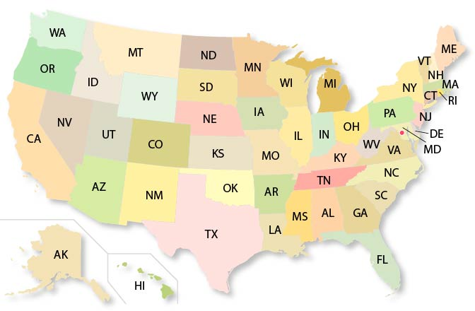
Which of these 50 US States is the riskiest?

Slide 11
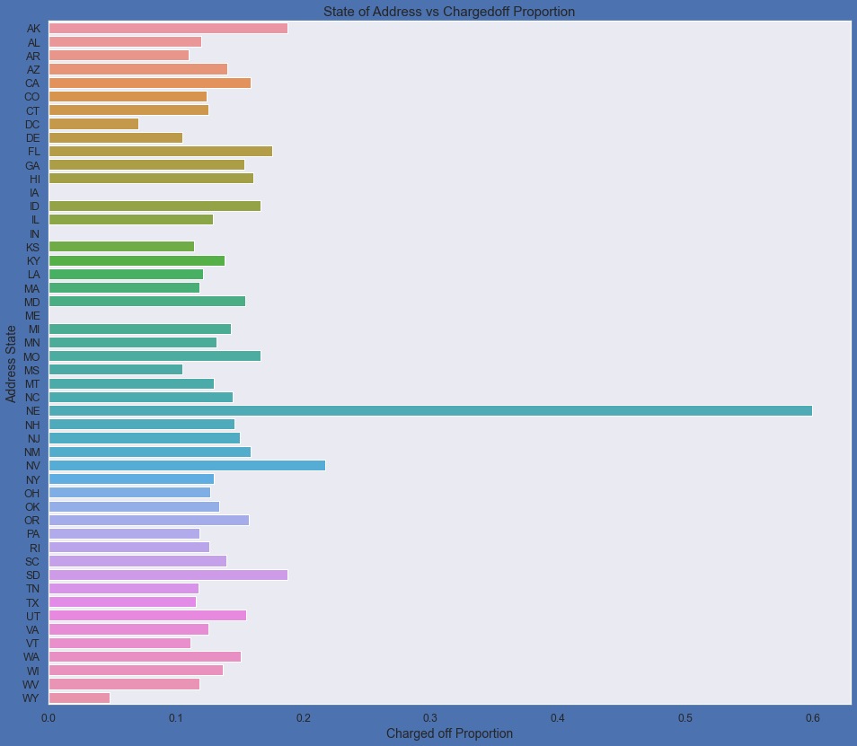
Nebraska seems to be the riskiest state to give loans to

Slide 12
Income groups vs risks
$ 0 - 2000
$ 2000 - 4000
$ 4000 - 6000
$ 6000 - 8000
Lowest income group, earning 0 to 2000 $ are the riskeist group of population
A person with such low income would hardly have any scope to pay back the loan
This could be better explained as correlation rather than causation
Regardless, this lowest income category i at highest risk of defaulting

Slide 13
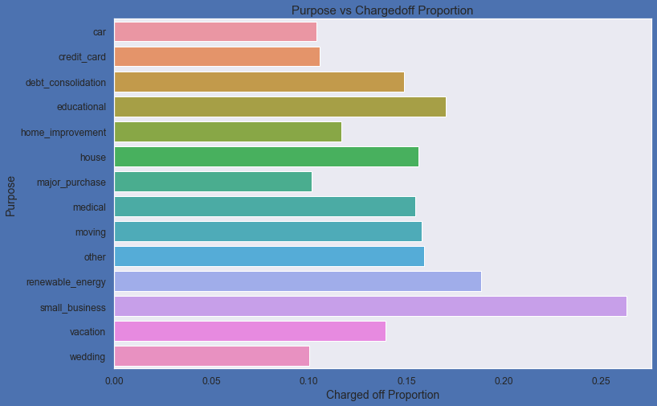
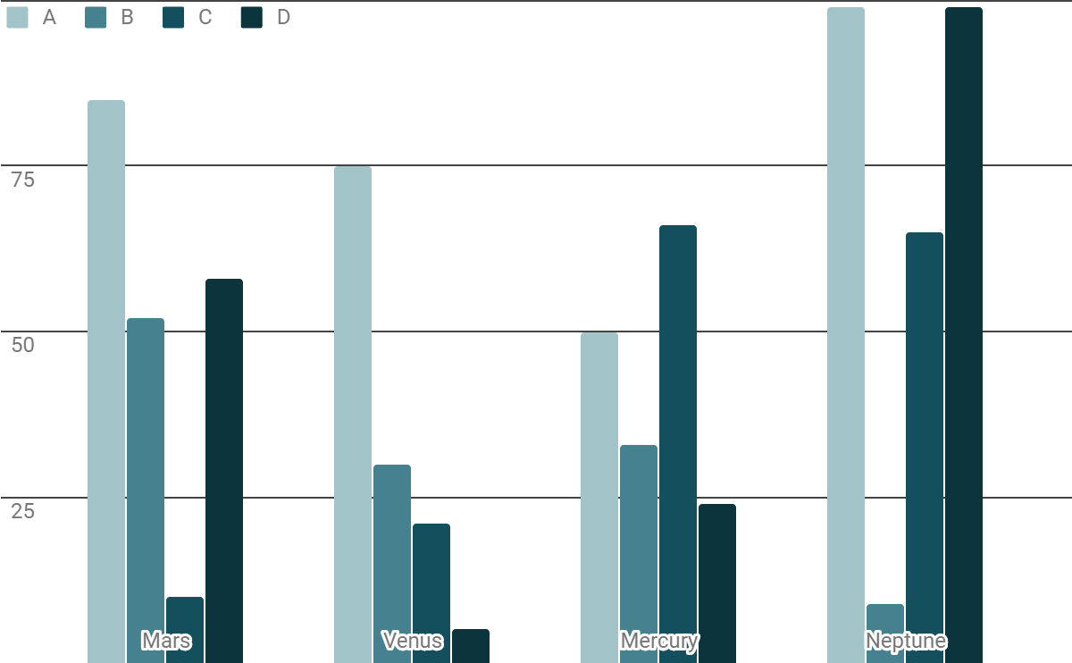
Display data in graphs
Small busnesses are the most likely to default on their loans
Loans raised for renewable energy and education are also considerably higher risk loans
Loans raised for a major purchase, cars, wedding etc are fairly safe bets.
DAY 4

Slide 14
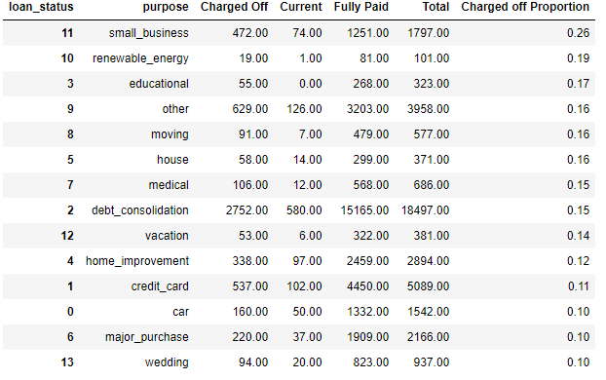
… as shown in the table below

Slide 15
472 out of 1796
Loans given to small businesses default. That is about one fourth of the Total loans

Slide 16

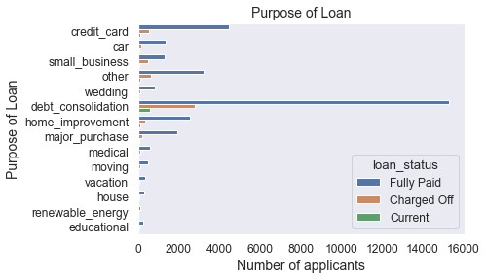
Most of the loans given for debt consolidation are Paid off
Small business looks the riskiest loan segment
is Jupiter’s rotation period

Slide 17
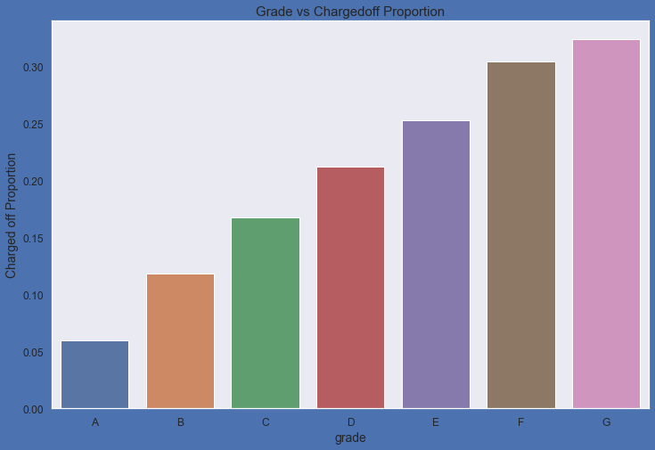
Borrowers with higher Grade rating have a higher risk of defaulting
Day 1
Day 2

Slide 18
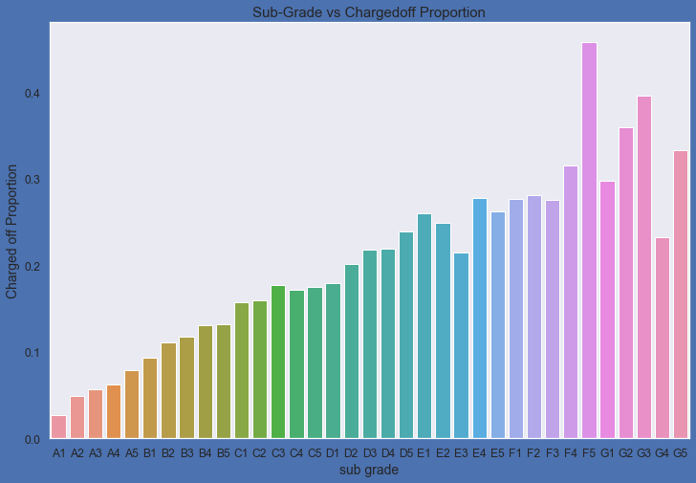
Subgrades
SATURN
Subgrade F5, G3, G2 and G5 are most likely to default
Yes, this is the ringed one. It’s a gas giant, composed mostly of hydrogen and helium
MERCURY
Whereas Subgrades A1, A2, A3, A4 and A5 are the safest
Mercury is the closest planet to the Sun and the smallest one in the Solar System

Slide 19

A good credit score is highly underrated
SUGGESTION - The lending club could assist borrowers with counselling regarding tips to improve their credit score.

Slide 20
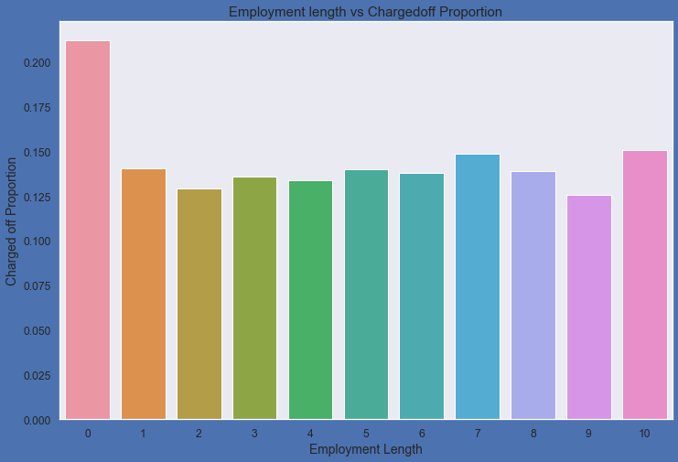
Smaller Employment Length has a hugely negative impact on loan guarantee

Slide 21
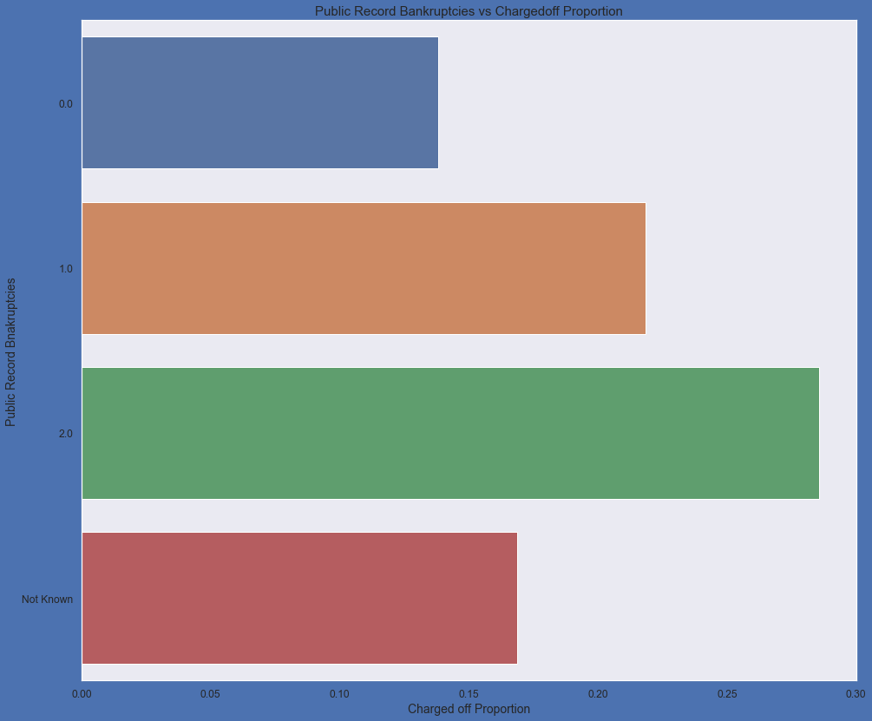
Public Record Bankruptcies and their impact
Use an image instead
of long texts
Do you know what helps you make your point clear? Lists like this one:
1. Because they’re simple
2. You can organize your ideas clearly
Clients with more than one Public record Bankruptcies are very high risk borrowers

Slide 22
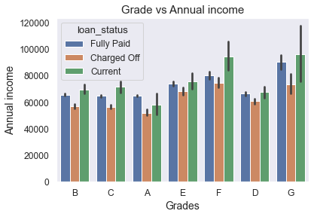
Beware!
Some combinations that need to be looked out for -
Borrowers with credit rating E & F and annual income between 6000 – 8000 $
Borrowers with credit rating D and annual income around 6000$

Slide 23

When you don’t have a debt, your money can do anything you want it to do.”
“
—

Slide 24
Conclusions
PURPOSE
INCOME GROUP/ EMPLOYMENT LENGTH
GRADING
Small businesses are more likely to default on their loans
Lower income groups (0-20000) are more likely to default on the loan
Clients with Employment lengths less than 1 year and more than 10 years are most likely to default on their loan
Clients/Customers with rating G are most likely to default on their loans
Clients with subgrade F5, G2, G4, G5 are more likely to default on their loans
INTEREST RATE
LOCATION
BANKRUPTCIES
Loans with interest rate 10 - 13% are more likely to default on their loans
The State of Nebraska (NE) has the highest ratio of defaulters
Clients with two or more Public Record Bankruptcies are more likely to default on their loans

Slide 25
Suggestion:
The lending club could assist borrowers with counselling regarding tips to improve their credit score.

Slide 26

Thanks!
Does anyone have any questions?
pragyakothyari@gmail.com
+91 - 9739251345

