Slide 1


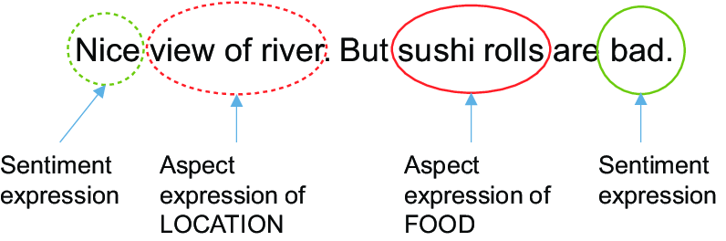
Review of Modern Computational Algorithms and Techniques for Aspect Based Fine-Grained Sentiment Analysis.
Suchet Agarwal, Ujjwal Singh, Pragya Sethi
Indraprastha Institute of Information Technology, Delhi
METHODS
RESULTS
DISCUSSION
Rule-Based
(Before 2013)
SVM / Logistic Regression
(2013-2016)
Neural Networks
(2016-2020)
Precision, Recall, F1-score and accuracy are used to report results.
The rule-based model proposed in (Hu et al. 2004), had average precision and recall of 0.68, 0.56, for frequent. Such models have limited scope.
Click here to insert your Introduction text. Type it in or copy and paste from your Word document or other source. Click once on the dashed border to highlight then drag the bottom edge up to fit. Or change the font size to fill the box.
To have the box automatically re-size to your text: Double-click near the edge to open the Format tool, and select ‘Text Box’, then check “Resize AutoShape to Fit Text”.
To change the background color of this text box: Double-click near the edge to open the Format tool, select ‘Colors and Lines’, and change the fill color to whatever you like.
To change the font style of this text box: Click on the border once to highlight the entire text box, then select a different font or font size that suits you. This text is in Arial 32pt and is easily readable up to 6 feet away. Try to stay between 28pt – 40pt for best viewing.
We considered algorithms devised from 2004 to 2020 for ABSA. The models evolved from rule-based, simple machine learning models to neural networks.
Introduction
Aspect Based Sentiment Analysis (ABSA) is the study of identifying aspects of a product and finding the sentiments expressed towards it.
It consists of two tasks
Aspect Extraction
Aspect Sentiment Prediction
Consumers and end-users use the internet to share their experiences about products, services, or destinations they visit.
ABSA uses user’s reviews and provide valuable insights for both businesses and consumers.
This study collates the existing works and computational algorithms tailored for this task. We highlight the key features and contributions of the various studies.
Study | LAPTOP |  |  |  | RESTAURANT
 | Acc | P | R | F1 | Acc | P | R | F1
Kiritchenko et al, 2014 | 0.70 | 0.78 | 0.60 | 0.68 | 0.80 | 0.84 | 0.76 | 0.80
Toh et al, 2014 | 0.63 | 0.81 | 0.67 | 0.73 | 0.67 | 0.85 | 0.82 | 0.84
Liu et al., 2016 | - | 61.88 | 60.47 | 61.12 | - | 72.92 | 76.72 | 74.72
Ruder et al., 2016 | 80.1 | - | - | - | 85.3 | - | - | -
Tang et al., 2016 | 80.89 | - | - | - | 72.10 | - | - | -
Sun et al 2019 | 77.19 | - | - | 72.99 | 82.30 | - | - | 74.02
Li et al. 2020 | - | 61.88 | 60.47 | 61.12 | - | 72.92 | 76.72 | 74.72
Rietzler et al 2020 | 77.92 | - | - | 72.99 | 87.14 | - | - | 80.05
Phan, M. H., et. al. 2020 | 80.52 | - | - | 77.13 | 86.71 | - | - | 80.31
CONCLUSIONS
Click here to insert your Conclusions text. Type it in or copy and paste from your Word document or other source.
Click on the border once to highlight and select a different font or font size that suits you. This text is in Arial 32pt and is easily readable up to 6 feet away. Try to stay between 28pt – 40pt for best viewing.
REFERENCES
Table 1: Results of the models under study
** Empty blocks imply that metric was not considered in the paper
[1] Radoslav, Ch. (2020) How Many Blogs Are There? We Counted Them All! [Online]. Available at: https://hostingtribunal.com/blog/how-many-blogs/ (Accessed: 23 Nov 2020)
[2] Pontiki, S. (2014) SemEval-2014 Task 4: Aspect Based Sentiment Analysis, In Proceedings of the 8th International Workshop on Semantic Evaluation (SemEval 2014), (pp. 27–35)
[3] Hu, M. and Liu, B. (2004) Mining and Summarizing Customer Reviews, In Proceedings of the 19th national conference on Artificial intelligence, (pp. 755–760). DOI: 10.1145/1014052.1014073
[4] Jakob, N., and Gurevych, I. (2010) Extracting Opinion Targets in a Single- and Cross-Domain Setting with Conditional Random Fields, In Proceedings of the 2010 Conference on Empirical Methods in Natural Language Processing, (pp. 1035–1045)
[5] Kiritchenko, S., Zhu, X., Cherry, C., and Mohammad, S. (2014) NRC-Canada-2014: Detecting Aspects and Sentiment in Customer Reviews, In Proceedings of the 8th International Workshop on Semantic Evaluation (SemEval 2014), (pp. 437-442)
[6] Toh, Z., and Wang, W. (2014) DLIREC: Aspect Term Extraction and Term Polarity Classification System, In Proceedings of the 8th International Workshop on Semantic Evaluation (SemEval 2014), (pp. 235-240) DOI: 10.3115/v1/S14-2038
[7] Wang, B. and Liu, M. (2015) Deep Learning for Aspect-Based Sentiment Analysis. [Online] Available at: https://cs224d.stanford.edu/reports/WangBo.pdf (Accessed: 20 Nov 2020)
[8] Liu, Q., Gao, Z., Liu, B., and Zhang, Y. (2016) Automated Rule Selection for Opinion Target Extraction, Knowledge-Based Systems, 104(1) DOI: 10.1016/j.knosys.2016.04.010.
[9] Ruder, S., Ghaffari, P., and Breslin, J. (2016) A Hierarchical Model of Reviews for Aspect-based Sentiment Analysis, In Proceedings of the 2016 Conference on Empirical Methods in Natural Language Processing, (pp. 999-1005).
[10] Hochreiter, S. and Schmidhuber, J. (1997) Long Short-Term Memory, Neural Computation, DOI: https://doi.org/10.1162/neco.1997.9.8.1735
[11] Tang, D., Qin, B., and Liu, T. (2016) Aspect Level Sentiment Classification with Deep Memory Network, In Proceedings of the 2016 Conference on Empirical Methods in Natural Language Processing, (pp. 214-224)
[12] Devlin, J., Chang, M.W., Lee, K., and Toutanova, K. (2018) BERT: Pre-training of Deep Bidirectional Transformers for Language Understanding, In Proceedings of the 2019 Conference of the North American Chapter of the Association for Computational Linguistics: Human Language Technologies, Volume 1 (Long and Short Papers), (pp. 4171–4186)
[13] Huang B. and Carley F. (2019) Parameterized Convolutional Neural Networks for Aspect Level Sentiment Classification, In Proceedings of the 2018 Conference on Empirical Methods in Natural Language Processing, (pp.1091–1096)
[14] Sun K., Zhang R., Mensah S., Mao Y. and Liu X. (2019) Aspect-Level Sentiment Analysis Via Convolution over Dependency Tree, In Proceedings of the 2019 Conference on Empirical Methods in Natural Language Processing and the 9th International Joint Conference on Natural Language Processing (EMNLP-IJCNLP), (pp.5679–5688) DOI: 10.18653/v1/D19-1569
[15] Li, X., Bing, L., Zhang, W., and Lam, W. (2019) Exploiting BERT for end-to-end aspect-based sentiment analysis. In Proceedings of the 5th Workshop on Noisy User-generated Text (W-NUT 2019), (pp. 34–41)
[16] Rietzler, A., Stabinger, S., Opitz, P. and Engl, S. (2020) Adapt or Get Left Behind: Domain Adaptation through BERT Language Model Fine Tuning for Aspect-Target Sentiment Classification, In Proceedings of the 12th Language Resources and Evaluation Conference, (pp. 4933–4941)
[17] Phan M. H. and Ogunbona P. O. (2020) Modelling Context and Syntactical Features for Aspect-based Sentiment Analysis, In Proceedings of the 58th Annual Meeting of the Association for Computational Linguistics, (pp.3211–3220)

Slide 2
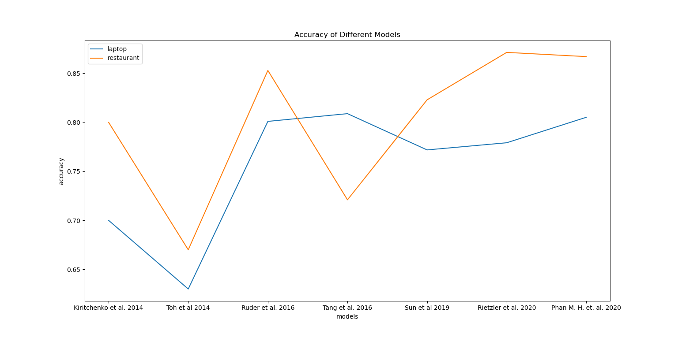
Review of Modern Computational Algorithms and Techniques for Aspect Based Fine-Grained Sentiment Analysis.
Suchet Agarwal, Ujjwal Singh, Pragya Sethi
Indraprastha Institute of Information Technology, Delhi
INTRODUCTION
METHODS AND MATERIALS
RESULTS
DISCUSSION
Rule-Based
(Before 2013)
SVM / Logistic Regression
(2013-2016)
Neural Networks
(2016-2020)
Study | LAPTOP |  |  |  | RESTAURANT
 | Acc | P | R | F1 | Acc | P | R | F1
Kiritchenko et al. 2014 | 0.70 | 0.78 | 0.60 | 0.68 | 0.80 | 0.84 | 0.76 | 0.80
Toh et al 2014 | 0.63 | 0.81 | 0.67 | 0.73 | 0.67 | 0.85 | 0.82 | 0.84
Liu et al. 2016 | - | 0.6188 | 0.6047 | 0.6112 | - | 0.7292 | 0.7672 | 0.7472
Ruder et al. 2016 | 0.801 | - | - | - | 0.853 | - | - | -
Tang et al. 2016 | 0.8089 | - | - | - | 0.7210 | - | - | -
Sun et al 2019 | 0.7719 | - | - | 0.7299 | 0.8230 | - | - | 0.7402
Rietzler et al. 2020 | 0.7792 | - | - | 0.7299 | 0.8714 | - | - | 0.8005
Phan M. H. et. al. 2020 | 0.8052 | - | - | 0.7713 | 0.8671 | - | - | 0.8031
We considered algorithms devised from 2004 to 2020 for ABSA. The models evolved from rule-based, simple machine learning models to neural networks.
Rule-Based Models
(Hu et al., 2004) used a rule-based approach to tag individual sentences that contain opinion words and used several other syntactic features such as presence/ absence of part-of-speech tags to assign sentiment to predefined Aspect Categories.
Support Vector Machine (SVM) and Logistic Regression Models
(Kiritchenko et al, 2014), trained a multi-class linear support vector machine (SVM) classifier using the LibSVM software for aspect term polarity detection.
(Toh et al, 2014) extracted aspect terms using CRF based classifiers. For aspect polarity, they used LIBLINEAR, a multi-class Logistic Regression classifier.
Neural Network Models without BERT
(Ruder et al., 2016) - Hierarchical Bidirectional LSTM model, that tries to capture inter dependencies between words within the sentence.
(Huang B et al. 2019) Parameterized CNNs. They proposed parametrized gates and filters to incorporate aspect information to CNNs.
Neural Networks with BERT Embeddings
(Devlin et al., 2018) created BERT that are pre-trained contextual embeddings for words. They proved to be very efficient in representing words as vectors for ABSA. Models using BERT are
(Rietzler et al 2020) – Fine-tuned the pre-trained BERT model on domain-specific reviews.
(Phan, M. H., et. al. 2020) took into account the grammatical aspects like part of speech of the expressed statements. Aspect terms in the reviews had specific syntactic features that influenced the relation between the aspect terms and the context words through which the polarity is gauged.
Aspect Based Sentiment Analysis (ABSA) is the study of identifying aspects of a product and finding the sentiments expressed towards it.
It consists of two tasks
Aspect Extraction
Aspect Sentiment Prediction
Consumers and end-users use the internet to share their experiences about products, services, or destinations they visit.
ABSA uses user’s reviews and provide valuable insights for both businesses and consumers.
This study collates the existing works and computational algorithms tailored for this task. We highlight the key features and contributions of the various studies.
Table 1: Results of the models under study
** Empty blocks imply that metric was not considered in the paper
CONCLUSIONS
REFERENCES

