Slide 1


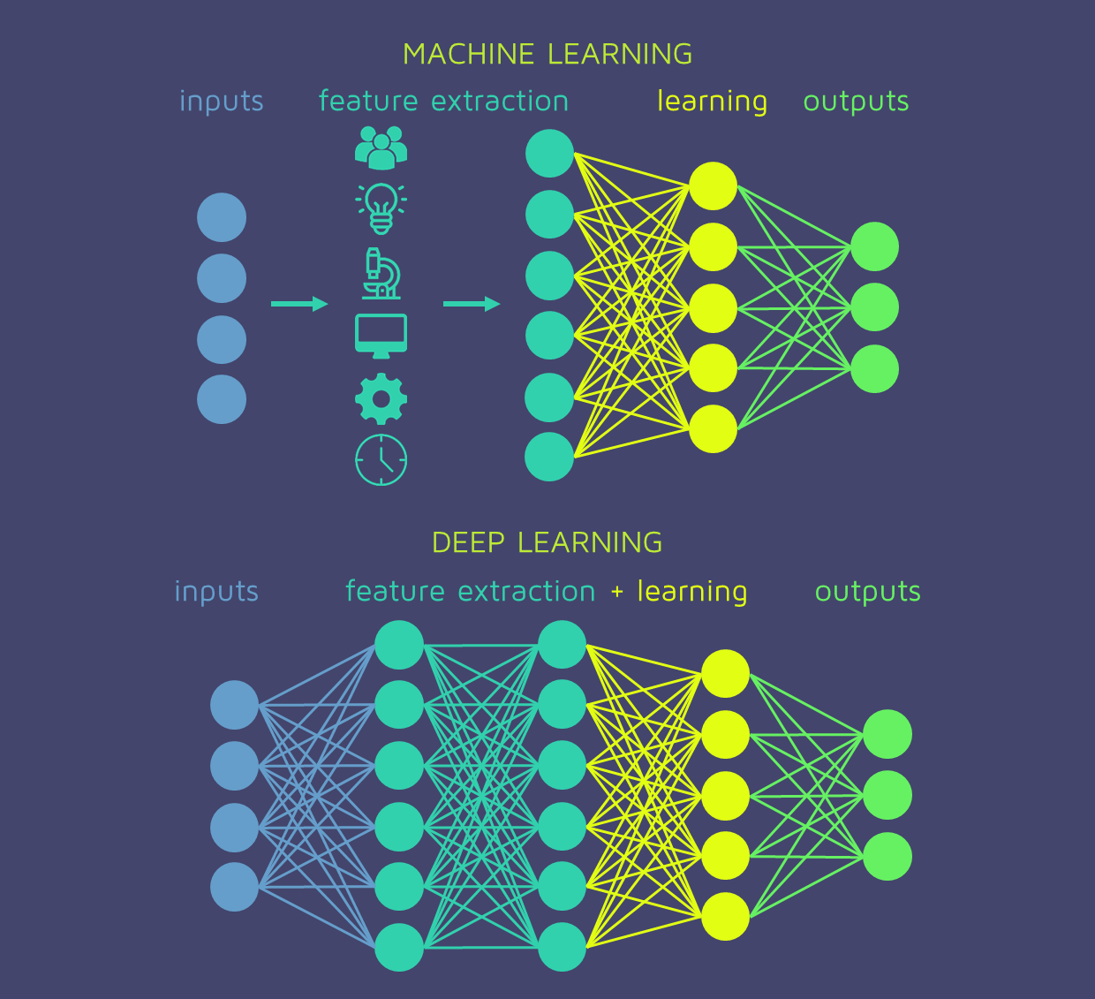
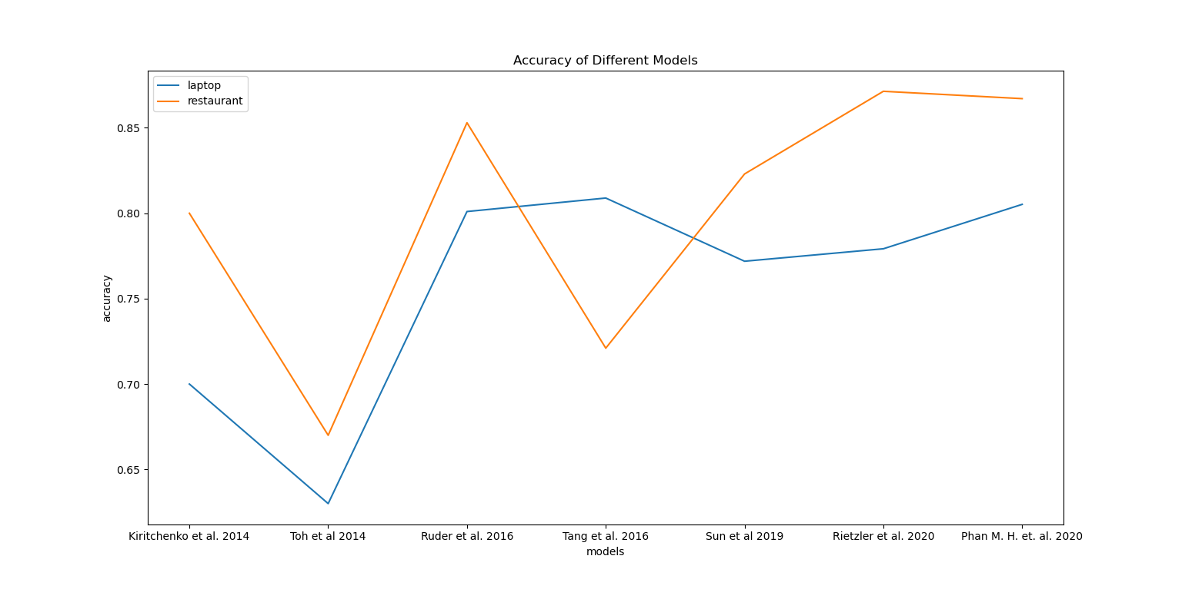
Review of Modern Computational Algorithms and Techniques for Aspect Based Fine-Grained Sentiment Analysis.
Suchet Agarwal, Ujjwal Singh, Pragya Sethi
Indraprastha Institute of Information Technology, Delhi
INTRODUCTION
METHODS
Rule-Based
(Before 2013)
SVM / Logistic Regression
(2013-2016)
Neural Networks
(2016-2020)
DISCUSSION
We considered algorithms devised from 2004 to 2020 for ABSA. The models evolved from rule-based, simple machine learning models to neural networks.
Rule-Based Models
(Hu et al., 2004) used a rule-based approach to tag individual sentences that contain opinion words and syntax features like presence/ absence of part-of-speech tags to assign sentiment to predefined Aspect Categories.
Support Vector Machine (SVM) and Logistic Regression(LR) Models
(Kiritchenko et al, 2014), trained a multi-class linear support vector machine (SVM) classifier using the LibSVM software for aspect term polarity detection.
(Toh et al, 2014) extracted aspect terms using CRF based classifiers. For aspect polarity, they used LIBLINEAR, a multi-class Logistic Regression classifier.
Neural Network (NN) Models without BERT
NN combine the task of aspect extraction and sentiment predictin.
(Ruder et al., 2016) - Hierarchical Bidirectional LSTM model. It captures inter dependencies between words within the sentence. Forward and backward direction measure influence of preceding and succeeding sentences respectively on sentiment of current sentence.
(Huang B et al. 2019) Parameterized CNNs. They proposed parametrized gates and filters to incorporate aspect information to CNNs.
Neural Networks with BERT Embeddings
(Devlin et al., 2018) created BERT that are pre-trained contextual embeddings for words. They proved to be very efficient in representing words as vectors for ABSA. Models using BERT are the following.
(Rietzler et al 2020) – Fine-tuned the pre-trained BERT model on domain-specific reviews.
(Phan, M. H., et. al. 2020) took into account the grammatical aspects like part of speech. Aspect terms in the reviews had specific syntactic features that influenced the relation between the aspect terms and the context words through which the polarity is gauged.
Aspect based sentiment analysis is one of the most utilitarian tool for the design of a target audience specific computational system.
The in-depth analysis helps entities like companies, public speakers, in gauging the reaction, improving their products and services.
Deep Learning have achieved state of the art results, and some systems have been able to model the given multi-step task as a single shot learning problem and have developed end-to-end models.
RESULTS
Study | LAPTOP |  |  |  | RESTAURANT
 | Acc | P | R | F1 | Acc | P | R | F1
Kiritchenko et al. 2014 | 0.70 | 0.78 | 0.60 | 0.68 | 0.80 | 0.84 | 0.76 | 0.80
Toh et al 2014 | 0.63 | 0.81 | 0.67 | 0.73 | 0.67 | 0.85 | 0.82 | 0.84
Liu et al. 2016 | - | 0.6188 | 0.6047 | 0.6112 | - | 0.7292 | 0.7672 | 0.7472
Ruder et al. 2016 | 0.801 | - | - | - | 0.853 | - | - | -
Tang et al. 2016 | 0.8089 | - | - | - | 0.7210 | - | - | -
Sun et al 2019 | 0.7719 | - | - | 0.7299 | 0.8230 | - | - | 0.7402
Rietzler et al. 2020 | 0.7792 | - | - | 0.7299 | 0.8714 | - | - | 0.8005
Phan M. H. et. al. 2020 | 0.8052 | - | - | 0.7713 | 0.8671 | - | - | 0.8031
CONCLUSIONS
Rule-based techniques are limited to specific structure of sentences and domain of reviews.
SVM and LR model perform well and can be made domain independent unlike rule-based approaches.
Neural networks perform best. They are able to capture context and interdependence relation between sentences are words as seen in (Ruder et al. BiLSTM).
(Phan, M. H., et. al. 2020) proved that incorporating grammatical aspects in NNs improves efficiency.
Aspect Based Sentiment Analysis (ABSA) is the study of identifying aspects of a product and finding the sentiments expressed towards them.
It mainly consists of two tasks
Aspect Extraction
Aspect Sentiment Prediction
Consumers and end-users use the internet to share their experiences about products, services, or destinations they visit.
ABSA uses user’s reviews and provide valuable insights for both businesses and consumers.
Our study collates the existing works and computational algorithms tailored for this task. We highlight the key features and contributions of the various studies.
Limitations
Table 1: Results of the models under study
** Empty blocks imply that metric was not considered in the paper
Most studies benchmark their models on datasets in English, and only a handful of studies use languages like Hindi and other native languages.
Huge chunks of data for the relevant domain to achieve decent performance.
Neural networks computationally expensive
The current models often fail to detect complicated contexts expressed like sarcasm and irony and perform poorly.
F1-score, precision, recall and accuracy are used to report efficiency. The closer the values are to 1, the better is the model.
The rule-based model proposed in (Hu et al. 2004), had average precision and recall of 0.68, 0.56, respectively for frequent features and 0.80, 0.72, respectively for infrequent features.
Neural networks like CNN and Bi-LSTM give F1-score higher than 70% without adding constraints on features.
Pre-trained models like BERT, achieve F1-scores scores of around 75% for diverse datasets.
(Xin Li et al. 2020) report 0.7472 F1-score for restaurant dataset outperforming it for ML models like SVM and LR for this dataset. It makes the ABSA task domain independent.
(Phan et al, 2020) has outperformed other models with F1-score of 0.77 for Laptop reviews and 0.80 for restaurant reviews. It is the current state-of-the-art.
Reviews – “Good coffee, but no WIFI.”
Preprocess Data – “good coffee but no wifi”
Represent sentences or words as vectors of numbers
Extract aspect terms from sentence – “coffee, wifi”
Find sentiment towards each aspect – “coffee -> Positive, WIFI -> Negative”
REFERENCES
[1] Radoslav, Ch. (2020) How Many Blogs Are There? We Counted Them All! [Online]. Available at: https://hostingtribunal.com/blog/how-many-blogs/ (Accessed: 23 Nov 2020)
[2] Pontiki, S. (2014) SemEval-2014 Task 4: Aspect Based Sentiment Analysis, In Proceedings of the 8th International Workshop on Semantic Evaluation (SemEval 2014), (pp. 27–35)
[3] Hu, M. and Liu, B. (2004) Mining and Summarizing Customer Reviews, In Proceedings of the 19th national conference on Artificial intelligence, (pp. 755–760). DOI: 10.1145/1014052.1014073
[4] Jakob, N., and Gurevych, I. (2010) Extracting Opinion Targets in a Single- and Cross-Domain Setting with Conditional Random Fields, In Proceedings of the 2010 Conference on Empirical Methods in Natural Language Processing, (pp. 1035–1045)
[5] Kiritchenko, S., Zhu, X., Cherry, C., and Mohammad, S. (2014) NRC-Canada-2014: Detecting Aspects and Sentiment in Customer Reviews, In Proceedings of the 8th International Workshop on Semantic Evaluation (SemEval 2014), (pp. 437-442)
[6] Toh, Z., and Wang, W. (2014) DLIREC: Aspect Term Extraction and Term Polarity Classification System, In Proceedings of the 8th International Workshop on Semantic Evaluation (SemEval 2014), (pp. 235-240) DOI: 10.3115/v1/S14-2038
[7] Wang, B. and Liu, M. (2015) Deep Learning for Aspect-Based Sentiment Analysis. [Online] Available at: https://cs224d.stanford.edu/reports/WangBo.pdf (Accessed: 20 Nov 2020)
[8] Liu, Q., Gao, Z., Liu, B., and Zhang, Y. (2016) Automated Rule Selection for Opinion Target Extraction, Knowledge-Based Systems, 104(1) DOI: 10.1016/j.knosys.2016.04.010.
[9] Ruder, S., Ghaffari, P., and Breslin, J. (2016) A Hierarchical Model of Reviews for Aspect-based Sentiment Analysis, In Proceedings of the 2016 Conference on Empirical Methods in Natural Language Processing, (pp. 999-1005).
[10] Hochreiter, S. and Schmidhuber, J. (1997) Long Short-Term Memory, Neural Computation, DOI: https://doi.org/10.1162/neco.1997.9.8.1735
[11] Tang, D., Qin, B., and Liu, T. (2016) Aspect Level Sentiment Classification with Deep Memory Network, In Proceedings of the 2016 Conference on Empirical Methods in Natural Language Processing, (pp. 214-224)
[12] Devlin, J., Chang, M.W., Lee, K., and Toutanova, K. (2018) BERT: Pre-training of Deep Bidirectional Transformers for Language Understanding, In Proceedings of the 2019 Conference of the North American Chapter of the Association for Computational Linguistics: Human Language Technologies, Volume 1 (Long and Short Papers), (pp. 4171–4186)
[13] Huang B. and Carley F. (2019) Parameterized Convolutional Neural Networks for Aspect Level Sentiment Classification, In Proceedings of the 2018 Conference on Empirical Methods in Natural Language Processing, (pp.1091–1096)
[14] Sun K., Zhang R., Mensah S., Mao Y. and Liu X. (2019) Aspect-Level Sentiment Analysis Via Convolution over Dependency Tree, In Proceedings of the 2019 Conference on Empirical Methods in Natural Language Processing and the 9th International Joint Conference on Natural Language Processing (EMNLP-IJCNLP), (pp.5679–5688) DOI: 10.18653/v1/D19-1569
[15] Li, X., Bing, L., Zhang, W., and Lam, W. (2019) Exploiting BERT for end-to-end aspect-based sentiment analysis. In Proceedings of the 5th Workshop on Noisy User-generated Text (W-NUT 2019), (pp. 34–41)
[16] Rietzler, A., Stabinger, S., Opitz, P. and Engl, S. (2020) Adapt or Get Left Behind: Domain Adaptation through BERT Language Model Fine Tuning for Aspect-Target Sentiment Classification, In Proceedings of the 12th Language Resources and Evaluation Conference, (pp. 4933–4941)
[17] Phan M. H. and Ogunbona P. O. (2020) Modelling Context and Syntactical Features for Aspect-based Sentiment Analysis, In Proceedings of the 58th Annual Meeting of the Association for Computational Linguistics, (pp.3211–3220)

