Slide 1


Smart Irrigation
PRAGYA
AICTE ID- INTERNSHIP_1748923002683e727a876ea
Student Registration ID- STU681dcf66bfd2c1746784102

Slide 2

Learning Objectives
Understand the integration of AI/ML techniques in smart agriculture systems.
Learn to preprocess and analyze environmental data such as soil moisture, humidity, and temperature.
Develop and train machine learning models to predict irrigation needs.
Apply Python libraries for data handling, visualization, and prediction.
Enhance problem-solving skills by building a real-world, sustainable solution.
GOAL
Source :
www.freepik.com/

Slide 3
Tools and Technology used
Programming Language: Python
Libraries: pandas, numpy, matplotlib, scikit-learn
ML Algorithms: (e.g., Decision Tree / Random Forest)
Data: Sensor dataset / Simulated data
Tools: Jupyter Notebook / Google Colab

Slide 4
Methodology
Data Collection
Collected or simulated environmental data (e.g., soil moisture, temperature, humidity).
Data can come from sensors or public agricultural datasets.
2) Data Preprocessing
Cleaned the dataset by handling missing values and removing outliers.
Performed normalization and feature selection for better model performance.
3) Model Selection & Training
Selected suitable ML models (e.g., Decision Tree, Random Forest,).
Split the dataset into training and testing sets.
4) Result Evaluation
Assessed model performance using confusion matrix, accuracy, precision, and recall.

Slide 5
Problem Statement:
Traditional irrigation methods often result in overwatering or under watering of crops.
Manual monitoring of soil moisture and weather conditions is time-consuming and inefficient.
Excessive water usage leads to wastage of water resources and higher costs for farmers.
There is a lack of intelligent, data-driven decision-making in existing irrigation systems.
A need exists for a smart, automated irrigation system that uses environmental data and AI/ML to optimize water usage.

Slide 6
Solution:
Develop a machine learning-based system to predict whether irrigation is needed or not.
Use environmental data such as soil moisture, temperature, and humidity for decision-making.
Train an ML model (e.g., Decision Tree, Random Forest) to classify data into “Irrigate” or “Don’t Irrigate.”
Implement a system that can automatically control water flow based on model predictions (optional IoT integration).
Github Link- https://github.com/Pragya930/Smart_Irrigation_week-3.git

Slide 7
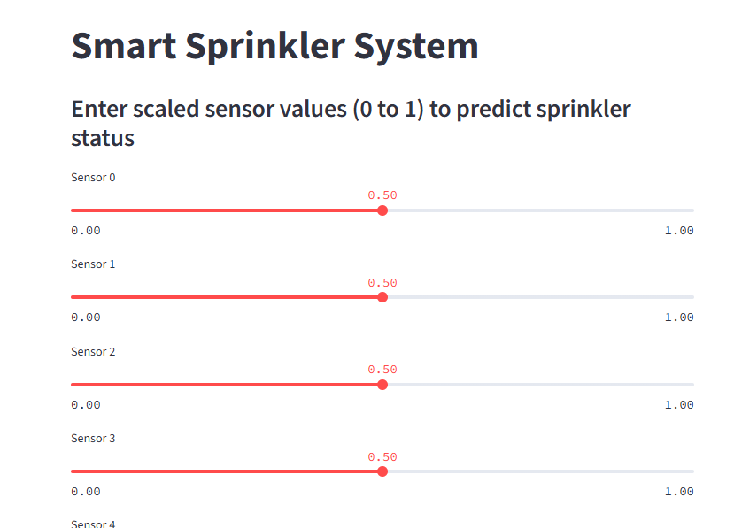
Screenshot of Output:

Slide 8
Conclusion:
The Smart Irrigation system using AI/ML provides an efficient and intelligent solution for modern agriculture. By analyzing environmental data such as soil moisture, temperature, and humidity, the system can accurately predict irrigation needs. This reduces water wastage, minimizes manual intervention, and promotes sustainable farming practices.
The use of machine learning models not only improves decision-making but also offers scalability for real-world implementation. Overall, this project demonstrates how AI/ML can be effectively applied to support smart and eco-friendly agricultural systems.

