Slide 1
Reliance Stock Price Prediction
Ayush Srivastava (MDS202113)
Pragya Jaiswal (MDS202129)
Rishika Tibrewal (MDS202135)
Ved Prakash (MDS202153)

Slide 2
Goal and Motivation
This project proposes to forecast the Reliance stock market closing price.
It is an attempt to determine whether the historical closing prices of the Reliance stock can efficiently help in calculating the closing price of the stock market for future dates.

Slide 3
Introduction
Reliance Industries Limited is an Indian multinational conglomerate company that operates in various sectors such as energy, petrochemicals, textiles, natural resources, retail, and telecommunications. The company's stock is highly valued in the Indian stock market, and investors are always looking for ways to predict its future price movements.
Time series analysis is a statistical technique that is used to analyze time series data. It is based on the assumption that past price movements can be used to predict future movements. Time series analysis involves the use of various statistical techniques such as moving averages, exponential smoothing, and autoregressive integrated moving average (ARIMA) models.

Slide 4
Data collection
We have used the Reliance Stock market data from the following website :
https://finance.yahoo.com
The range of dates used for this project:
Jan 2013- Dec 2022

Slide 5
Objectives of the project
Data Preparation
Data Visualization
Exploratory data analysis
Feature Engineering
Anomaly Detection
Fitting a Linear Regression
Using XGBoost to predict the stock prices
Using an LSTM model to predict the stock prices
Comparison of the results obtained using both models

Slide 6
Insight into the data
Date - Date of trade
Open - The open is the starting period of trading on a securities exchange or organized over-the-counter market.
Low - Lowest price at which a stock traded during the course of the trading day.
Close - The close is a reference to the end of a trading session in the financial markets when the markets close for the day.
High - Highest price at which a stock traded during the course of the trading day.
Volume - It is the amount of a security that was traded during a given period of time.

Slide 7
Visualization
Plotting Closing Price of Reliance Stock against time.
Notes:
As we know, all these parameters follow the same pattern without much deviation
Theres a dip in between 2020-2021. It signifies a sudden dip in the market for Reliance.

Slide 8
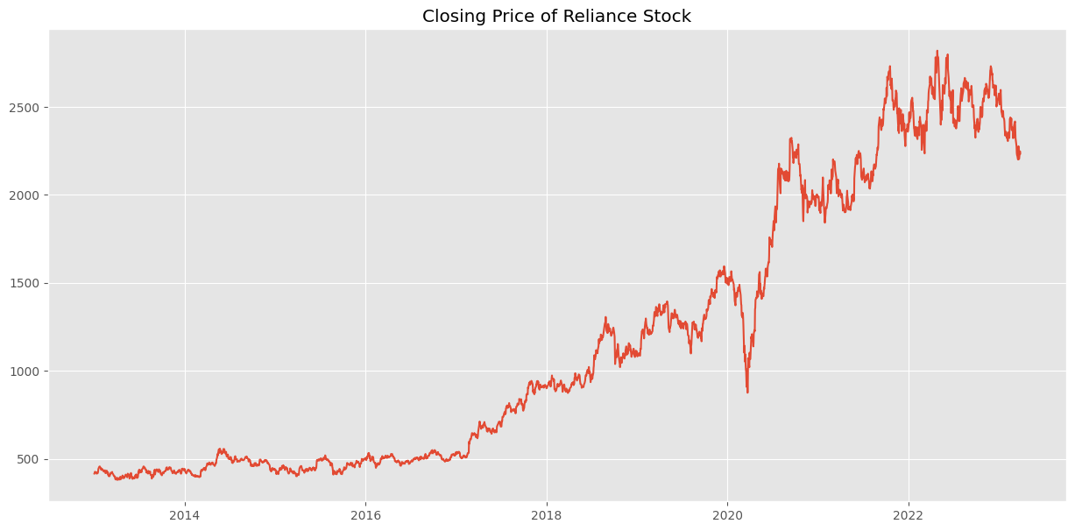

Slide 9
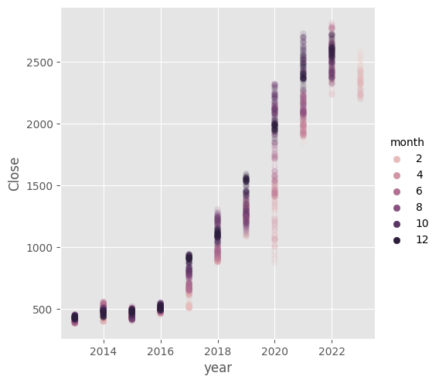
Feature Engineering
Notes:
As we know, all these parameters follow the same pattern without much deviation
Theres a dip in between 2020-2021. It signifies a sudden dip in the market for Reliance.

Slide 10
Anomaly Detection
First we created some feature from the lagged close price of the stock
Then we perform the PCA on the data
Then we choose the two most important feature which explain the most variability in the data
We use k mean clustering algorithm to detect anomaly.
Notes:
As we know, all these parameters follow the same pattern without much deviation
Theres a dip in between 2020-2021. It signifies a sudden dip in the market for Reliance.

Slide 11
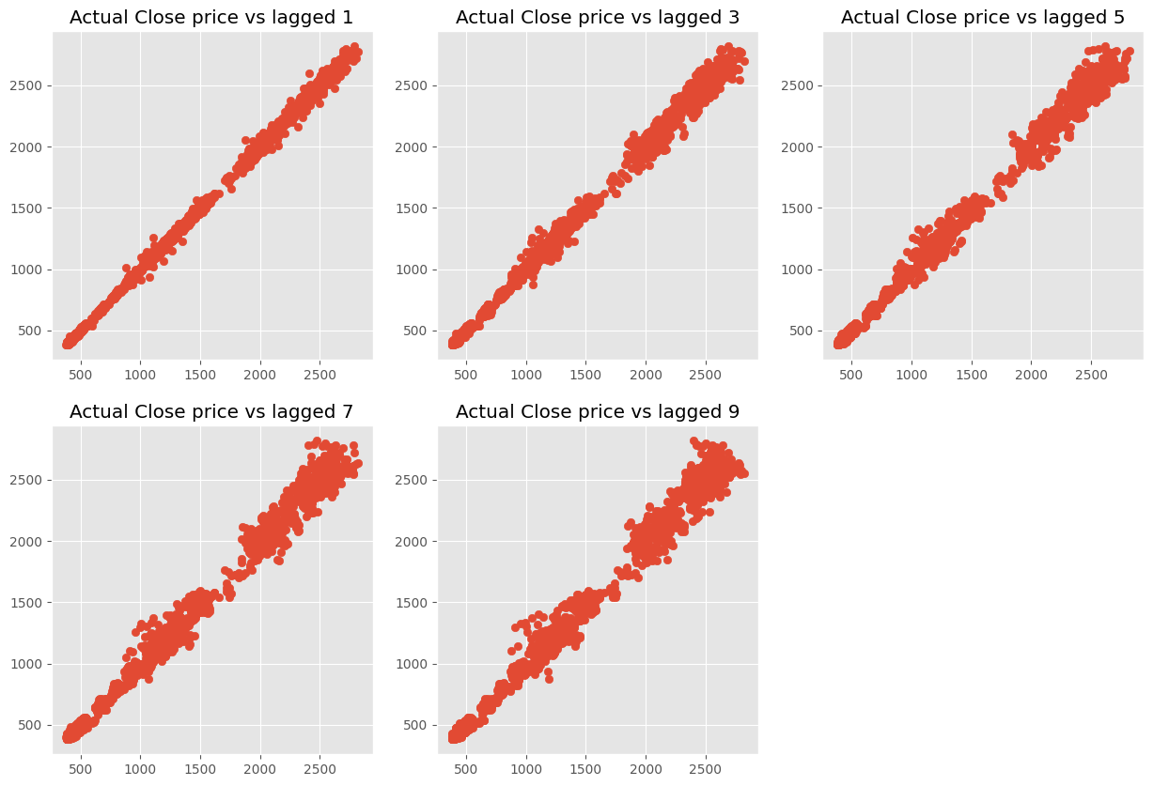
Close vs Shifted

Slide 12
Close vs Shifted

Slide 13
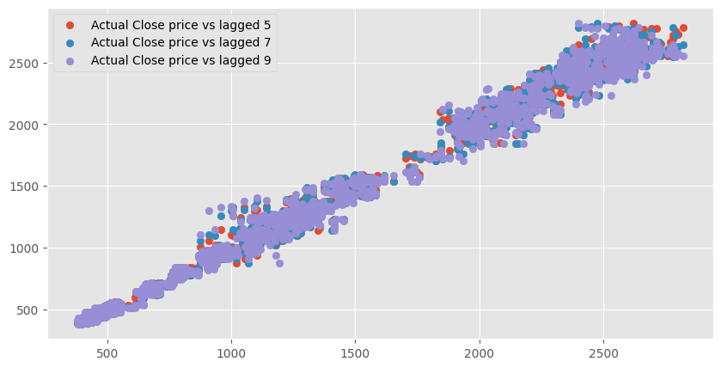
Close vs Shifted (contd.)

Slide 14
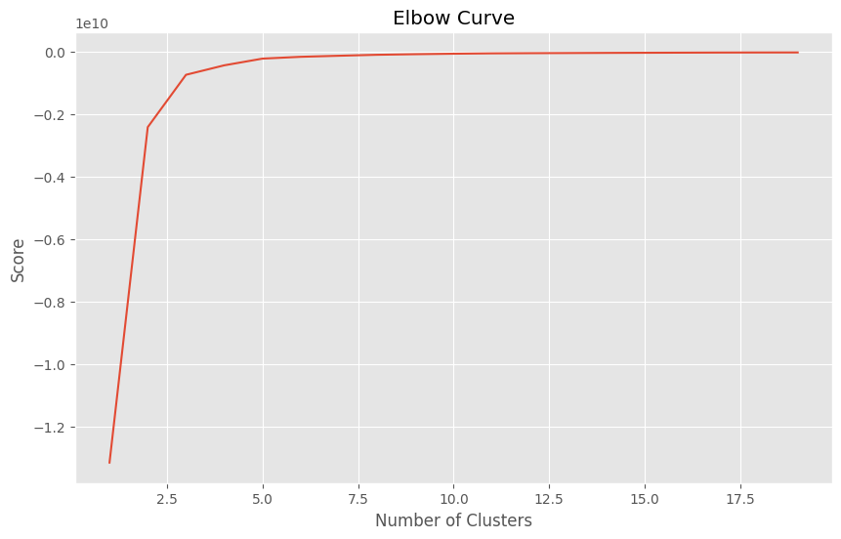
Elbow curve
From the elbow curve, we can say that we need 3 clusters for the data.

Slide 15
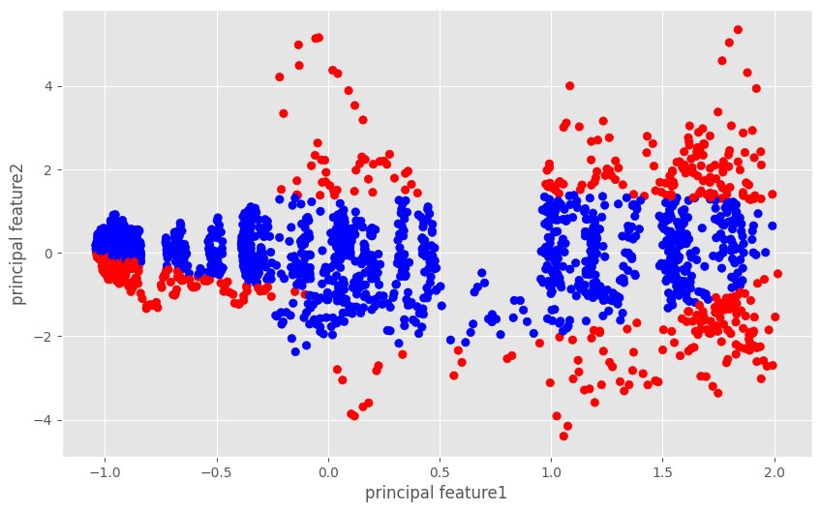
PCA
Red values are anomalies, whereas the blue ones aren't.

Slide 16
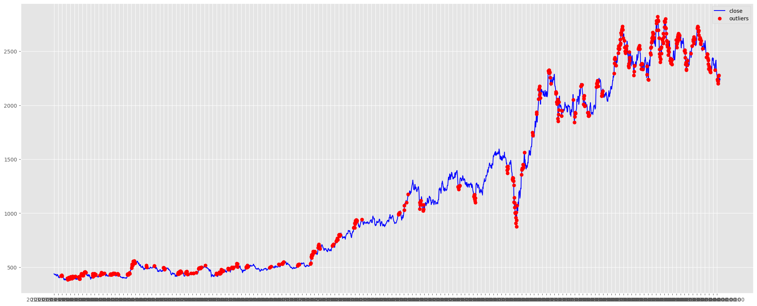
Anomalies in the data

Slide 17
Fitting a regression line
Notes:
As we know, all these parameters follow the same pattern without much deviation
Theres a dip in between 2020-2021. It signifies a sudden dip in the market for Reliance.

Slide 18
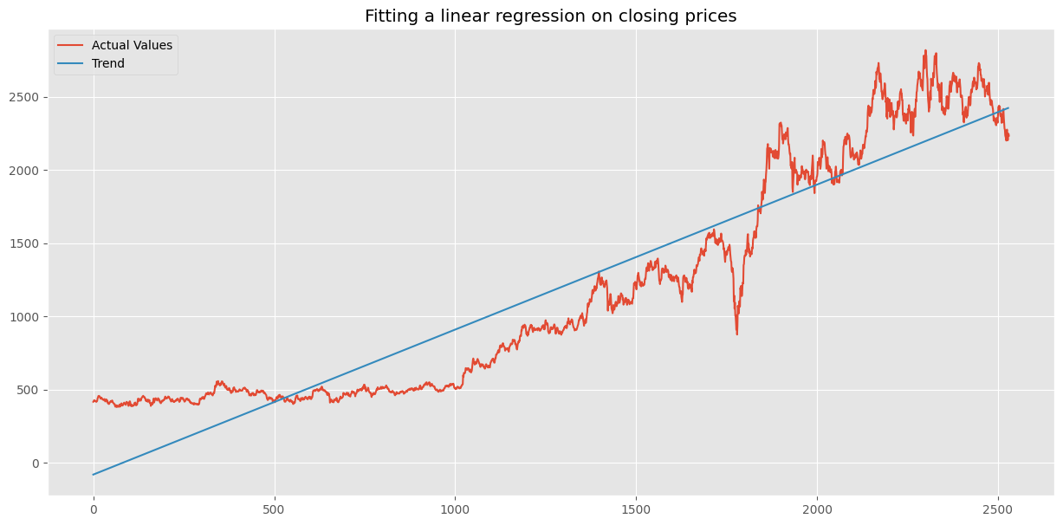
reg.coef_ = 0.99073177

Slide 19
Time series decomposition
There are the components of a time series
Trend
Seasonality
Cycle
Noise
These components can be visualized using decomposition techniques, such as seasonal decomposition of time series (STL) or seasonal decomposition using moving averages (SMA).
Notes:
I will proceed with seeing how a time series is decomposed.These are the components of a time series
Trend: The trend component represents the long-term changes in the time series data. It can be upward, downward, or flat.
Seasonality: The seasonality component represents the repeating patterns or cycles in the time series data that occur at fixed intervals, such as daily, weekly, or yearly.
Cycle: The cycle component represents the longer-term, non-repeating patterns in the time series data that occur over several years or more.
Irregularity or noise: The irregularity component represents the random fluctuations or noise in the time series data that cannot be explained by the other components
These components can be visualized using decomposition techniques, such as seasonal decomposition of time series (STL) or seasonal decomposition using moving averages (SMA).STL decomposes a time series into trend, seasonal, and irregular components using a non-parametric approach, while SMA decomposes a time series into trend, seasonal, and irregular components using a moving average approach.

Slide 20
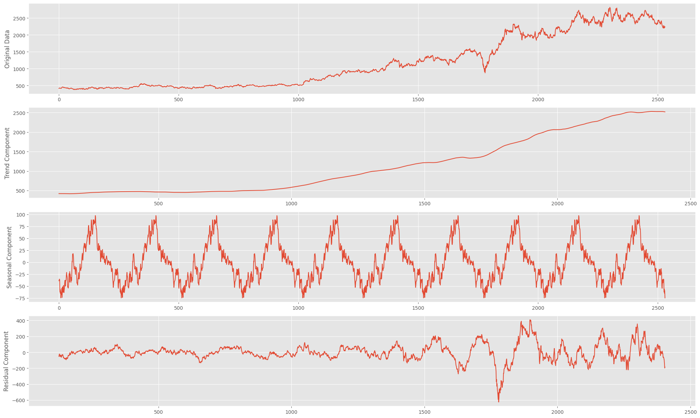
Decomposition of the closing prices of the data set:
Notes:
This plotted graph depicts the decomposition of the closing prices as given in the dataset.
The trend,seasonal and the residuals are shown in the figures.

Slide 21
Augmented Dickey Fuller Test
Null Hypothesis (H0): If failed to be rejected, it suggests the time series has a unit root, meaning it is non-stationary. It has some time dependent structure.
Alternate Hypothesis (H1): The null hypothesis is rejected; it suggests the time series does not have a unit root, meaning it is stationary. It does not have time-dependent structure.
Interpretation of p-value :
p-value > 0.05: Fail to reject the null hypothesis (H0), the data has a unit root and is non-stationary.
p-value <= 0.05: Reject the null hypothesis (H0), the data does not have a unit root and is stationary.
Results of Dickey Fuller test
Test Statistics -7.098251
p-value 4.233675e-10
Notes:
Augmented Dickey Fuller Test
The Augmented Dickey-Fuller test is a type of statistical test called a unit root test.The intuition behind a unit root test is that it determines how strongly a time series is defined by a trend. There are a number of unit root tests and the Augmented Dickey-Fuller may be one of the more widely used. The null hypothesis of the test is that the time series can be represented by a unit root, that it is not stationary (has some time-dependent structure). The alternate hypothesis (rejecting the null hypothesis) is that the time series is stationary.
We interpret this result using the p-value from the test. A p-value below a threshold (such as 5% or 1%) suggests we reject the null hypothesis (stationary), otherwise a p-value above the threshold suggests we fail to reject the null hypothesis (non-stationary).After performing the dickey fuller test, this is the results we got. Given the p value > 0.05 we can conclude that the dataset is not stationary.

Slide 22
XGBoost
XGBoost stands for extreme gradient boosting machine. It is a tree based ensemble machine
learning algorithm which is a scalable machine learning system for tree boosting. It uses more
accurate approximations to find the best tree model. Using XGBoost for time-series analysis
is an advanced approach of time series analysis that helps in improving our results and speed
of modelling.
We can consider using XGBoost for any supervised machine learning task when it satisfies the
following criteria:
• When we have large number of observations in training data.
• When Number of features is less than the number of observations in training data.
• When the model performance metrics are to be considered.
Since we have a large data and fewer features, we can adopt a XGBoost model for our purpose.

Slide 23
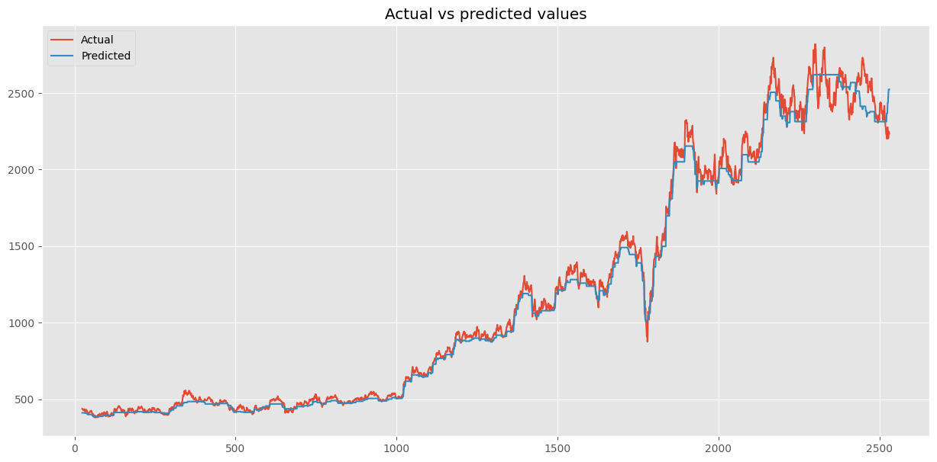
XGBoost
Notes:
This plotted graph depicts the decomposition of the closing prices as given in the dataset.
The trend,seasonal and the residuals are shown in the figures.

Slide 24
LSTM
Long Short-Term Memory (LSTM) networks are a type of recurrent neural network (RNN) designed to overcome the limitations of traditional RNNs, such as the vanishing and exploding gradient problems. They are particularly effective in learning long-range dependencies in sequence data.
LSTM networks consist of specialized memory cells that enable them to remember and process information over longer time steps. These cells contain three key components, called gates:
Input gate: Decides which information from the current input will be stored in the cell state.
Forget gate: Determines which information from the previous cell state will be discarded or retained.
Output gate: Controls which information from the cell state will be passed to the next hidden state.
By using these gates, LSTM networks can selectively store, update, and access information, making them capable of handling complex, long-range dependencies in various applications, such as natural language processing, time-series prediction, and speech recognition.

Slide 25
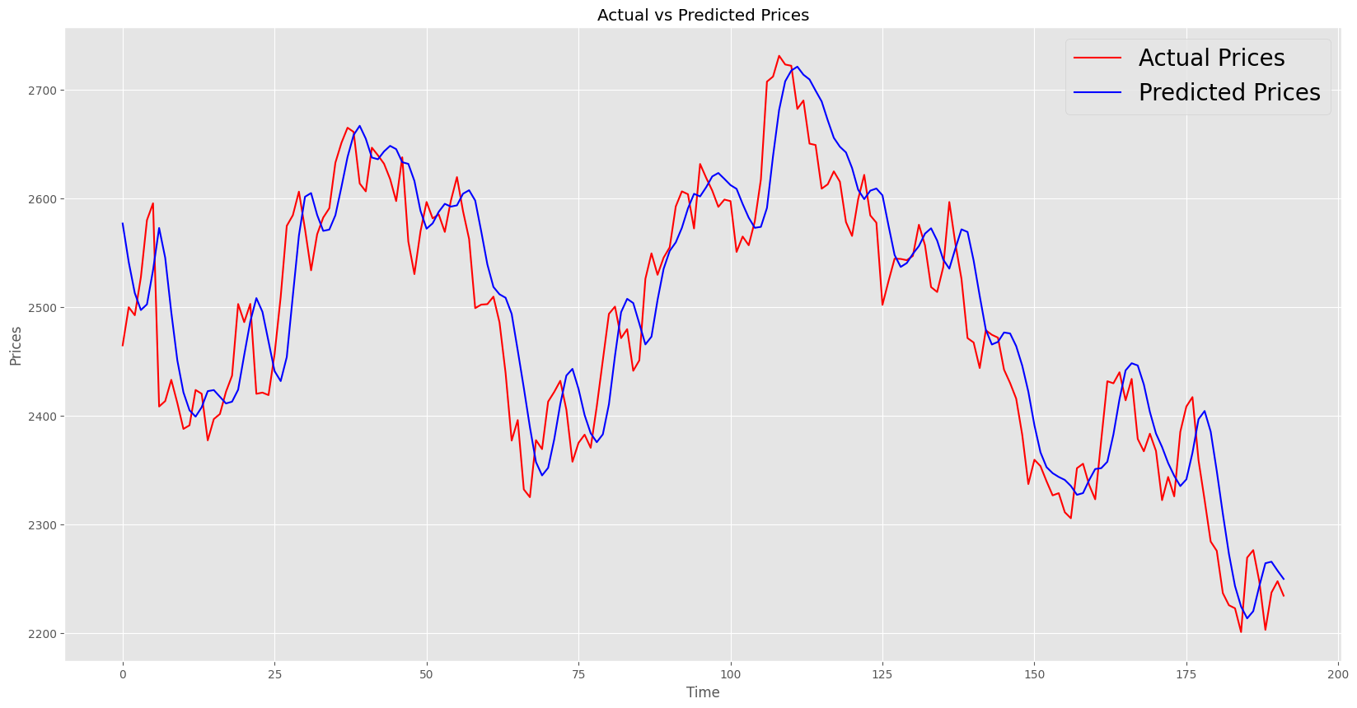
Decomposition of the closing prices of the data set:
LSTM
Notes:
This plotted graph depicts the decomposition of the closing prices as given in the dataset.
The trend,seasonal and the residuals are shown in the figures.

Slide 26
Comparison of Evaluation Metrics of XGBoost vs LSTM
Evaluation Metric | XGBoost | LSTM
MAE | 41.797 | 40.184
MSE | 3818.215 | 2483.097
MAPE | 3.424% | 1.629%

Slide 27
Conclusion
Both XG Boost and LSTM were fitted and reliance stock prices were predicted.
From the metrics we used to evaluate, we can see that for all, MAE, MSE and MAPE, the values for LSTM are lesser.
Hence, LSTM performs better.

