Slide 1
Project Presentation on the topic
AI-Powered Clinical Trial Qualification System
(CTQ — Clinical Trial Qualifier)
Yogesh Chauhan (202400474) · Gaurav Gurung (202400007) · Pragya Jain (202400385) · Aditya Srivastava (202400102)
Department of AI&DS
Sikkim Manipal Institute of Technology, SMU
Under the supervision of: Dr. Saharul Alom Barlaskar
Notes:
One line: CTQ takes a patient profile - a guided form, uploaded notes, a photo or a PDF - and returns, for every trial in the database, a clear verdict with itemised reasons.

Slide 2
Department of AI&DS
Sikkim Manipal Institute of Technology, SMU
CONTENTS
1. | Introduction | 1
2. | Literature Survey | 2 - 7
3. | Problem Definition | 8
4. | Possible Solution Strategy | 9
5. | Tools & Technologies Used | 10 - 11
6. | Methodology & Workflow | 12 - 13
7. | Output (live demos) | 14 - 15
8. | Results | 16
9. | Future Scope | 17
10. | References | 18
Notes:
Structure mirrors the progress presentation; all screenshots in Output are live captures of the finished system.

Slide 3
Department of AI&DS
Sikkim Manipal Institute of Technology, SMU
1
Introduction
▪ Clinical trials are essential for developing and validating new medical treatments - yet finding eligible patients remains slow, manual and error-prone.
▪ Screening is manual: coordinators read every patient record against long, free-text eligibility criteria - for every trial, every time.
▪ Patients search blindly: most never learn which trials they could join, and trial sites are concentrated in a few big cities.
▪ Our solution - CTQ: an AI-powered web application that reads a patient's profile (guided form OR uploaded unstructured notes/PDF/photo), screens it against a CTRI-format trial database, and returns a clear verdict with itemised reasons.
▪ India-first: CTRI-format trials, Indian states/cities, and locally common conditions (T2DM, hypertension, anaemia in pregnancy, asthma…).
What the user sees• 1. Structured · Unstructured · Hybrid tabs
• 2. Upload notes - PDF / CSV / Excel / photo
• 3. ML NER reads the facts; Hindi notes auto-translate
• 4. Find Trials for one patient or all N patients
• 5. Verdict cards with reasons + CSV/Excel export
• 6. Model Evaluation page scores the system
Goal: turn hours of manual eligibility reading into seconds - without losing transparency or safety.
Notes:
Frame it as a two-sided discovery problem: sites can't find patients, patients can't find trials. CTQ attacks the screening step end to end.

Slide 4
Department of AI&DS
Sikkim Manipal Institute of Technology, SMU
2
Literature Survey (1/6)
SL. No. | Author Name, Journal Name, Vol., Page, Year | Title of paper | Inference | Research Gap | Relevance with the present work / Motivation
1 | AUTHORS:- Long Chen, Yu Gu, Xin Ji, Chao Lou, Zhiyong Sun, Haodan Li, Yuan Gao, Yang Huang JOURNAL:- Journal of the American Medical Informatics Association YEAR:- 2019 | Clinical Trial Cohort Selection based on Multi-Level Rule-Based Natural Language Processing System. | • Hybrid system: • Rule-based: lexical (keywords), syntactic (structure), meta (context: patient vs family history) • General cNLP: UMLS + pre-trained NER (LSTM-CRF) • Rule-based ensures precision; cNLP improves robustness and coverage | • Language mismatch between task-specific clinical terms and standardized UMLS terms • Automating trial processing; extracting useful information from EHRs is hard | • Directly motivates our design: deterministic rules for precision • CTQ uses sentence embeddings instead of UMLS to close the vocabulary gap • ML NER + rule engine hybrid, exactly as they recommend
Notes:
Survey table for paper 1 of 6 - same format as the progress presentation.

Slide 5
Department of AI&DS
Sikkim Manipal Institute of Technology, SMU
3
Literature Survey (2/6)
SL. No. | Author Name, Journal Name, Vol., Page, Year | Title of paper | Inference | Research Gap | Relevance with the present work / Motivation
2 | AUTHOR:- Chun Yuan, Patrick B. Ryan, et al. JOURNAL:- Journal of the American Medical Informatics Association, Vol. 26(4), pp. 294-305 YEAR:- 2019 | Criteria2Query: a natural language interface to clinical databases for cohort definition. | • Translates free-text eligibility criteria into executable OMOP-CDM cohort queries • Human-computer collaboration: NLP drafts, humans refine • Shows free-text criteria can be parsed into structured logic | • Generates cohort queries, not patient-level eligibility verdicts • Requires structured OMOP data warehouses, rarely available for Indian patient records | • Motivates our rule engine that parses criteria (age bands, lab cut-offs, medications) directly and applies them to a patient profile
Notes:
Survey table for paper 2 of 6 - same format as the progress presentation.

Slide 6
Department of AI&DS
Sikkim Manipal Institute of Technology, SMU
4
Literature Survey (3/6)
SL. No. | Author Name, Journal Name, Vol., Page, Year | Title of paper | Inference | Research Gap | Relevance with the present work / Motivation
3 | AUTHORS:- Yizhao Ni, Stephanie Kennebeck, Judith W. Dexheimer, Constance M. McAneney, Huaxiu Tang, Todd Lingren, Qi Li, Haijun Zhai, Imre Solti JOURNAL:- Journal of the American Medical Informatics Association YEAR:- 2014 | Automated clinical trial eligibility prescreening: increasing the efficiency of patient identification for clinical trials in the emergency department. | • Logical constraint filters on structured data (age, gender) alone reduced workload by 49% • Adding NLP reduced it by 86% • Screening systems become more valuable as they accumulate knowledge | • Never tested in a live, real-time clinical environment • Paediatric-only trials (misses adult trials) • Limited EHR fields | • Patient-centric matching with transparent justifications (their stated motivation) • CTQ deploys as a live web app for adult profiles
Notes:
Survey table for paper 3 of 6 - same format as the progress presentation.

Slide 7
Department of AI&DS
Sikkim Manipal Institute of Technology, SMU
5
Literature Survey (4/6)
SL. No. | Author Name, Journal Name, Vol., Page, Year | Title of paper | Inference | Research Gap | Relevance with the present work / Motivation
4 | AUTHOR:- Victor M. Murcia, Vinod Aggarwal, et al. JOURNAL:- Journal of Biomedical Informatics YEAR:- 2023 | Automating Clinical Trial Matches via Natural Language Processing of Synthetic Electronic Health Records and Clinical Trial Eligibility Criteria. | • TrialMatcher's SDI scores achieved up to 80% match for certain trials • Stack: ClinicalTrials.gov API, spaCy/CoreNLP, biomedical NER, Sørensen-Dice similarity, Python | • Errors with negation • Errors extracting numerical quantities • Synthetic dataset only | • Patient-centric matching; practical NLP in healthcare • CTQ's rule engine parses numeric lab cut-offs (HbA1c, eGFR…) and is negation-aware
Notes:
Survey table for paper 4 of 6 - same format as the progress presentation.

Slide 8
Department of AI&DS
Sikkim Manipal Institute of Technology, SMU
6
Literature Survey (5/6)
SL. No. | Author Name, Journal Name, Vol., Page, Year | Title of paper | Inference | Research Gap | Relevance with the present work / Motivation
5 | AUTHORS:- Kunyuan Wang, Hao Cui, Yun Zhu, et al. JOURNAL:- BMC Cancer, Vol. 24 YEAR:- 2024 | Evaluation of an Artificial Intelligence-Based Clinical Trial Matching System in Chinese Patients with Hepatocellular Carcinoma. | • AI system (CTMS) checks patient records and finds who qualifies for specific cancer trials • Achieved 92-98% accuracy • Reduced manual screening time from 150 hours to just 2 hours | • Still took 2 hours whereas other systems finish in <10 minutes • Divergence between how the AI interpreted data and how human reviewers did | • Patient-centric matching; reduces manual workload; demonstrates AI in healthcare • CTQ outputs seconds per patient with itemised, auditable reasons
Notes:
Survey table for paper 5 of 6 - same format as the progress presentation.

Slide 9
Department of AI&DS
Sikkim Manipal Institute of Technology, SMU
7
Literature Survey (6/6)
SL. No. | Author Name, Journal Name, Vol., Page, Year | Title of paper | Inference | Research Gap | Relevance with the present work / Motivation
6 | AUTHORS:- Qiao Jin, Zifeng Wang, Charalampos S. Floudas, Jimeng Sun, Zhiyong Lu JOURNAL:- Nature Communications, Vol. 15, Art. 9074 YEAR:- 2024 | Matching patients to clinical trials with large language models (TrialGPT). | • Zero-shot LLM framework for patient-to-trial matching • TrialGPT-Retrieval recalls >90% of relevant trials using <6% of candidates • Expert-validated; predicted to cut screening time by ~42% | • LLM-only decisions risk hallucinated eligibility • Large token/context needs; no deterministic guarantees on safety-critical criteria | • Motivates CTQ's design rule: the deterministic rule engine keeps veto power over any AI component, so no hallucinated eligibility
Notes:
Survey table for paper 6 of 6 - same format as the progress presentation.

Slide 10
Department of AI&DS
Sikkim Manipal Institute of Technology, SMU
8
PROBLEM DEFINITION
Clinical trial patient recruitment is painfully slow and inefficient. Matching a patient to a trial relies on a human reading every eligibility criterion of every trial. This manual approach:
Research questionCan an AI system screen a patient against many trials in seconds - with decisions that are safe, explained, and honest about missing data?
Success = every verdict traceable to a specific criterion, not a black-box score.
▪ Takes too long - screening one patient against one trial means reading dozens of free-text criteria; full cohorts take weeks, delaying entire trials.
▪ Costs heavily - recruitment consumes a large share of trial timelines and administrative labour.
▪ Is inconsistent and error-prone - humans miss details; criteria buried in unstructured notes are easy to overlook.
▪ Faces unstructured data - Indian patient records are largely free-text notes, printed prescriptions and scans, not machine-readable fields.
Notes:
Safety angle: a wrong 'eligible' wastes a site visit; a wrong 'not eligible' denies a patient a therapy. That's why CTQ has an Insufficient Information verdict instead of guessing.

Slide 11
Department of AI&DS
Sikkim Manipal Institute of Technology, SMU
9
POSSIBLE SOLUTION STRATEGY
Clinical Trial Qualifier (CTQ) — an AI-powered clinical trial qualification system that automates patient eligibility screening, with a localized focus on Indian healthcare.
1 Understand the patient
Structured form (60+ fields), structured CSV, unstructured notes (PDF / photo-OCR / CSV / Excel) or BOTH merged (Hybrid tab); Hindi notes auto-translate to English first; DistilBERT ML NER extracts the facts
2 Find relevant trials
Semantic search over 32 CTRI/NCT-format trials using sentence embeddings (all-MiniLM-L6-v2)
3 Apply every rule
Deterministic rule engine checks age, gender, lab cut-offs, medications, comorbidities - criterion by criterion
4 Explain the decision
Itemised pass / fail / missing reasons quoting the trial's own criteria; three honest verdicts
5 Measure itself
One-click Model Evaluation: bundled sample patients + labels → accuracy, precision, recall, F1, confusion matrix - against ALL trials or only each patient's top-K best matches
Verdicts: Potentially Eligible · Not Eligible · Insufficient Information
ML extracts · rules decide · missing data is surfaced, never guessed.
Notes:
The five jobs map one-to-one onto the architecture: profile builder (ML NER), retrieval, rule engine, explanation, evaluation.

Slide 12
Department of AI&DS
Sikkim Manipal Institute of Technology, SMU
10
TOOLS & TECHNOLOGIES USED (1/2)
▪ DistilBERT extractive-QA (distilbert-base-cased-distilled-squad) - the ML NER engine: asks the model targeted clinical questions per note (“What is the patient's HbA1c level?”), then maps span answers into profile fields. ML-only extraction - no regex discovery; negation guards reject spans like “No history of liver disease” as a diagnosis. Non-English notes (Hindi + 12 more scripts) are auto-translated to English first.
▪ Groq LLM (openai/gpt-oss-120b) - two jobs: a low-effort multilingual translator (Hindi/Indic notes → English before extraction) and an adversarial second opinion on eligibility - behind a rate-limit circuit breaker with rule-engine fallback.
▪ RapidOCR (ONNX) - reads photos/scans of prescriptions and summaries; PyMuPDF rasterises scanned PDF pages so the same OCR can read them.
▪ Custom Rule Engine - parses every eligibility criterion (age bands, gender, lab cut-offs such as HbA1c 7.5-10.5 / eGFR ≥ 45, medication requirements, comorbidity exclusions, pregnancy, smoking) and issues Pass / Fail / Missing per criterion; any hard exclusion vetoes the match; missing INCLUSION-side facts produce “Insufficient Information”, missing EXCLUSION-side facts stay “Potentially Eligible” with gaps listed.
▪ sentence-transformers (all-MiniLM-L6-v2) - encodes the patient profile and every trial's criteria into 384-dimension vectors locally; cosine similarity ranks all 32 trials (semantic matching, no internet or GPU needed).
▪ Pandas, openpyxl, pypdf - parse uploaded CSV / Excel / PDF notes with column aliasing (notes / clinical_notes / summary…); build the Excel cohort export and CSV result downloads.
Notes:
Keep it to one sentence per tool; the next slide covers the web stack and persistence.

Slide 13
Department of AI&DS
Sikkim Manipal Institute of Technology, SMU
11
TOOLS & TECHNOLOGIES USED (2/2)
▪ React 18 + Vite - single-page frontend: Home, Find Trials (Structured / Unstructured / Hybrid tabs, cohort mode), Model Evaluation (with top-K ranking scope); client-side routing with react-router; production build served by the API server.
▪ axios - API client with friendly error mapping; builds the structured profile payload from the form and downloads CSV/Excel blobs.
▪ FastAPI + Uvicorn - REST API: /patient/analyze, /patient/analyze-batch (evaluation), /extract/document, /cohort/analyze, /cohort/export, /evaluation/sample-data; one origin serves app + API (no CORS issues).
▪ Pydantic - request/response validation and schemas; rejects impossible values before any AI runs (age ≤ 0, impossible lab values).
▪ SQLite - stores evaluation runs; trials.json (32 CTRI/NCT-format trials, 200+ criteria) is loaded at startup; TOP_K_TRIALS=0 checks every trial.
▪ Playwright + matplotlib - automated end-to-end UI runs that produced the live screenshots in this deck; matplotlib draws the confusion matrix.
Notes:
Stack summary: real client-server web app - validated API, persistence, production build - not a notebook.

Slide 14
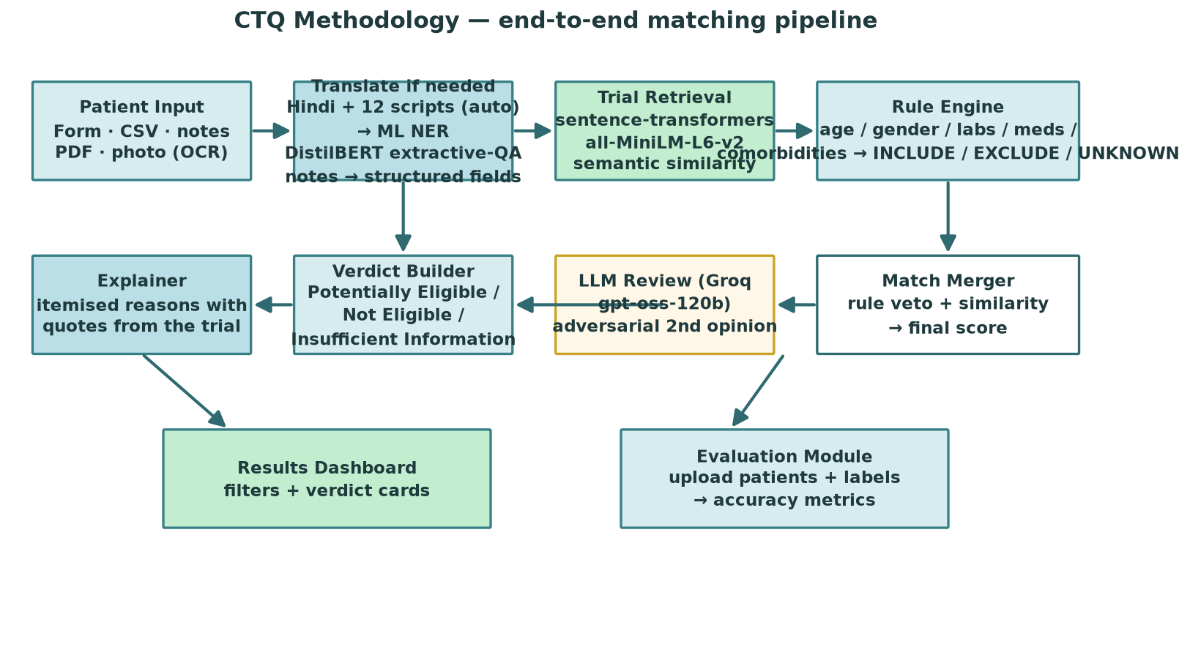
Department of AI&DS
Sikkim Manipal Institute of Technology, SMU
12
METHODOLOGY & WORKFLOW — How everything works
Patient input (form / notes / PDF / photo) → DistilBERT ML NER → semantic retrieval → rule engine (veto) → verdict + explanation → downloads / evaluation
Notes:
Master slide for 'how everything is working'. Follow one patient left to right; the same pipeline feeds the evaluation module.

Slide 15
Department of AI&DS
Sikkim Manipal Institute of Technology, SMU
13
METHODOLOGY — Pipeline stages with a worked example
Stage 1-2 · Input & DistilBERT ML NER• “48-year-old male with Type 2 Diabetes Mellitus diagnosed 4 years ago… HbA1c 8.5 percent, eGFR 80, ALT 25 U/L. No history of liver disease.”
• A Hindi note (“उम्र 48 वर्ष… मेटफ़ॉर्मिन 500 मिग्रा…”) is auto-translated to English first → the same facts come out (age 48, Metformin, HbA1c 8.5…).
• The QA model answers one question per field → age 48, condition T2DM, duration 48 mo, HbA1c 8.5, eGFR 80, ALT 25; “No history of…” is negation-guarded.
Stage 3 · Semantic Retrieval• all-MiniLM-L6-v2 embeds profile and all 32 trials; cosine similarity ranks them (top match 87% for the T2DM add-on trial).
• TOP_K_TRIALS=0: every trial is checked - ranking only sets the display order.
Stage 4 · Deterministic Rule Engine• Example verdicts: “HbA1c 8.5 satisfies ‘HbA1c between 7.5 and 10.5’”; “BMI 28.4 does not satisfy ‘BMI between 30 and 45’”.
• Hard exclusion → Not Eligible; missing inclusion fact → Insufficient Information; missing exclusion-side fact → stays Potentially Eligible.
Stage 5 · Verdict, Explanation & Outputs• Verdict cards quote the trial's own criteria; CSV result download, Excel cohort export, PDF report.
• Model Evaluation runs the same pipeline over labelled pairs and scores itself (next slide).
Notes:
The worked example is the live P001 demo: same facts appear in the screenshots that follow.

Slide 16
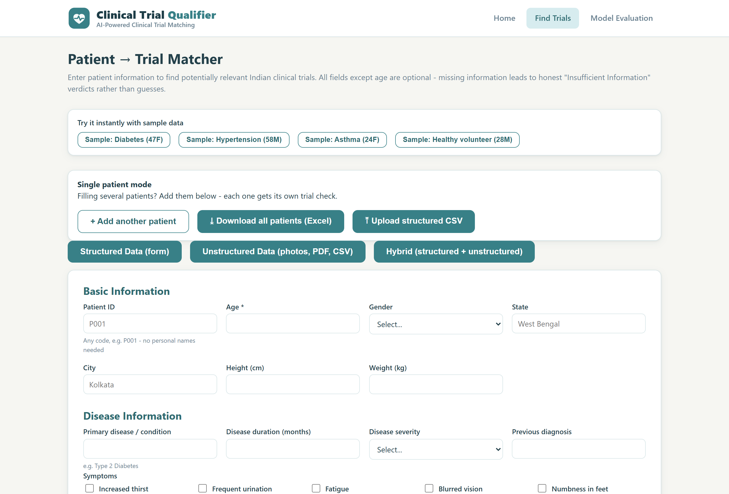
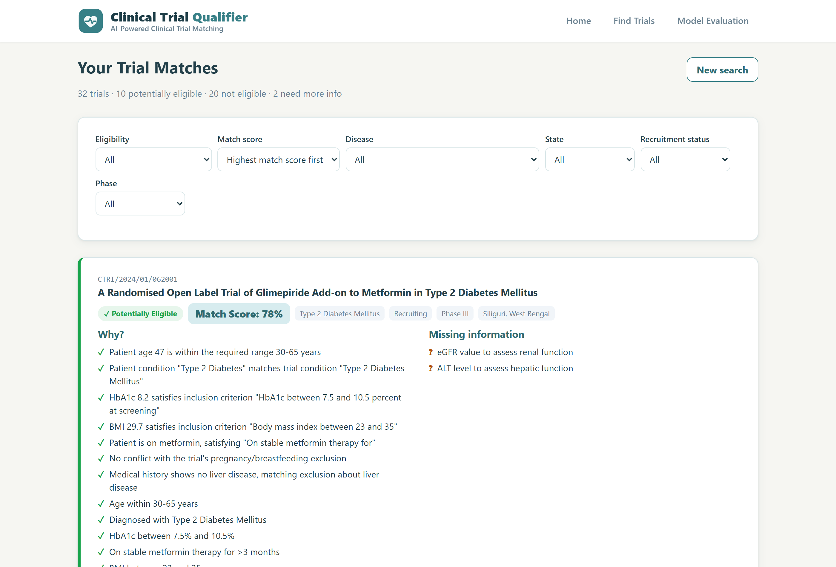
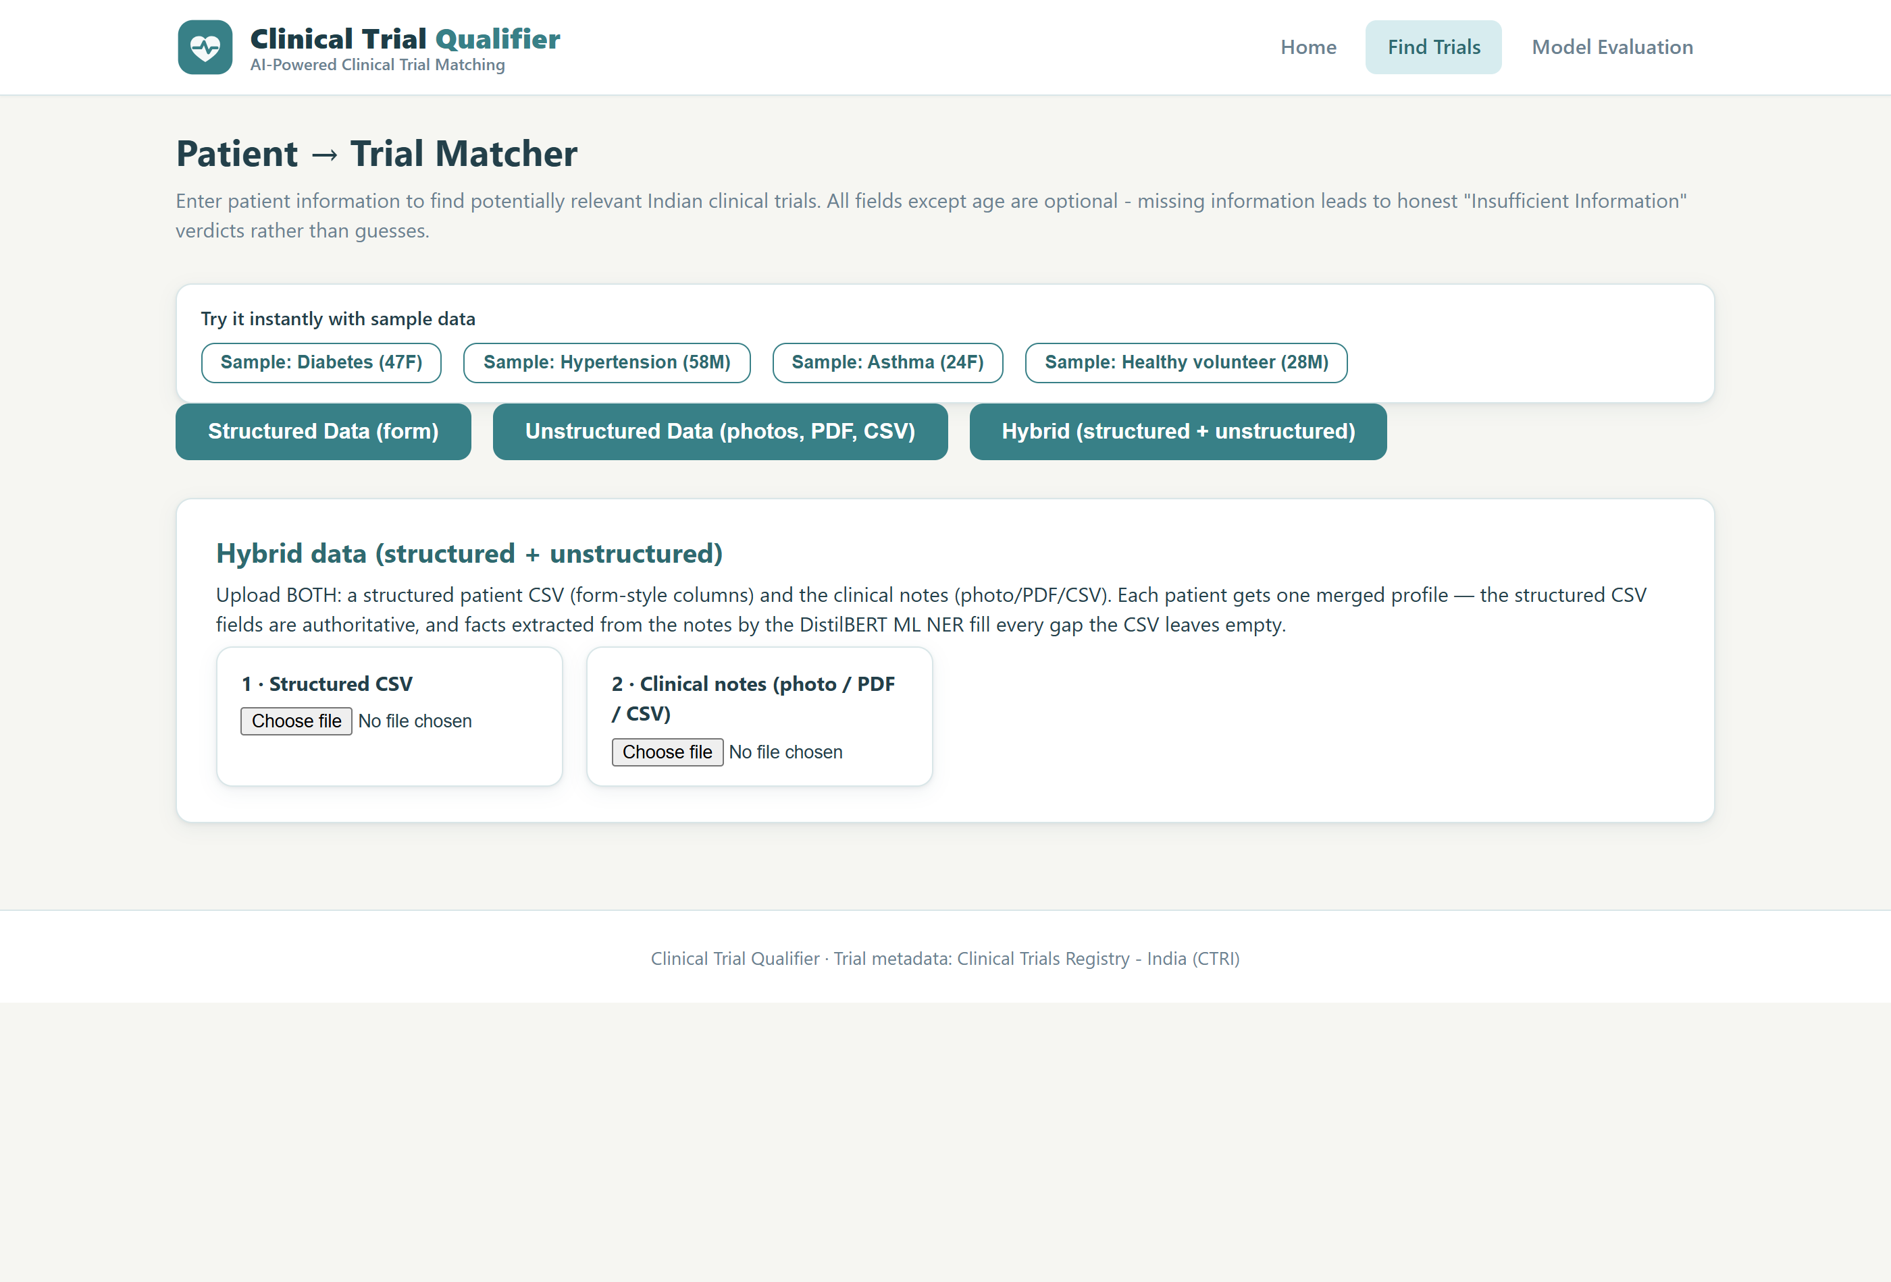
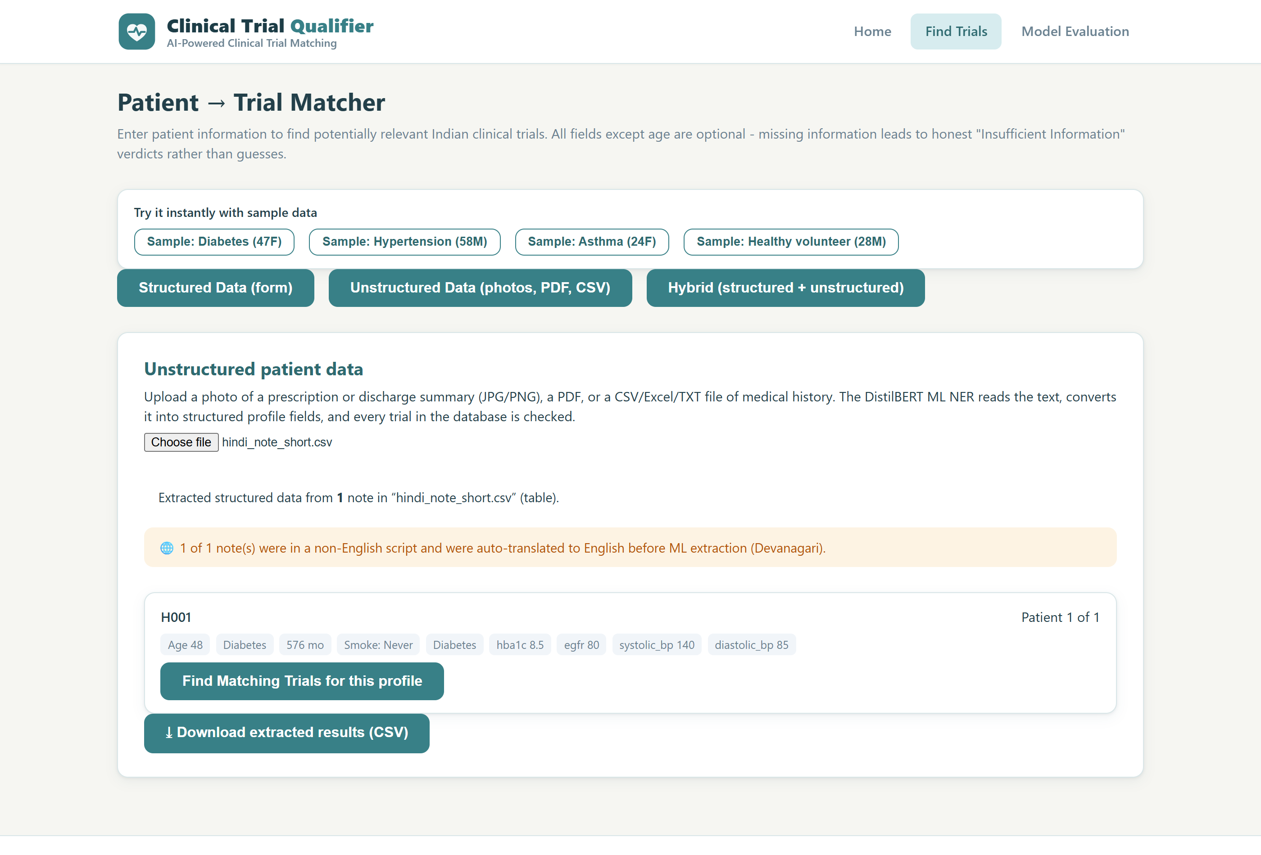
Department of AI&DS
Sikkim Manipal Institute of Technology, SMU
14
OUTPUT (1/2) — Live demo: matching & cohort
Fig: Find Trials - Structured / Unstructured / Hybrid tabs, cohort controls, one-click samples
Fig: Results - all 32 trials checked, ranked, colour-coded verdicts
Bottom: Hybrid tab (structured CSV + notes merged per patient) and a Hindi clinical note auto-translated to English, then extracted by the ML NER.
Notes:
All four shots are live captures of the current build. Demo script: load sample → results → Hybrid tab → Hindi note upload.

Slide 17
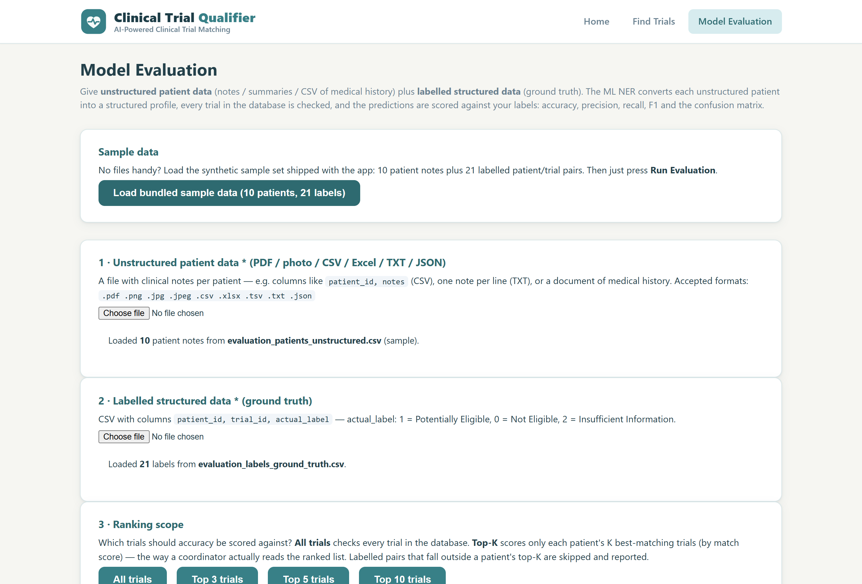
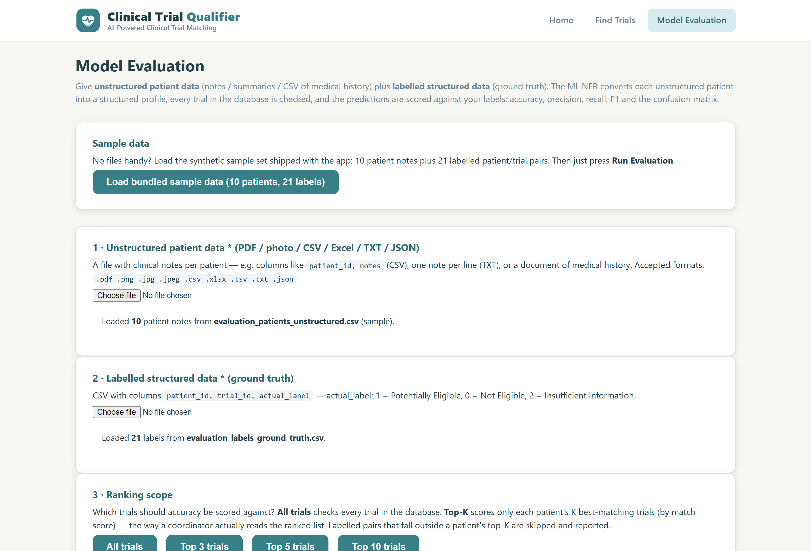
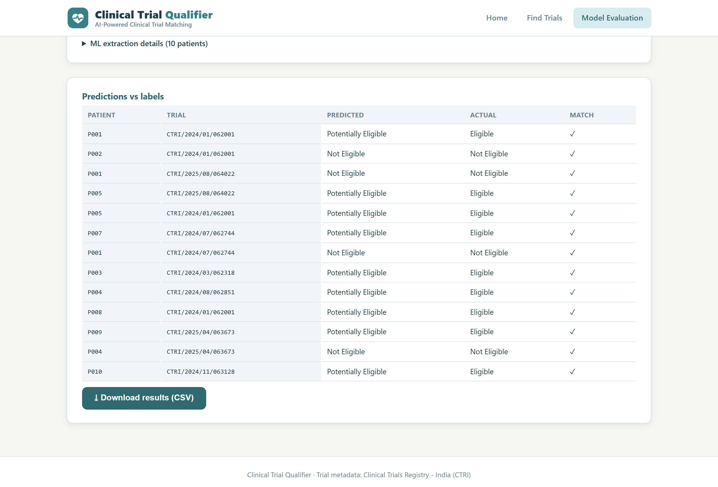
Department of AI&DS
Sikkim Manipal Institute of Technology, SMU
15
OUTPUT (2/2) — Live demo: evaluation dashboard
Fig: Model Evaluation - one-click bundled sample + ranking scope (All / Top 3 / Top 5 / Top 10)
Fig: Live top-5 run - pairs outside a patient's top-5 matches are skipped and counted
Bottom: per-pair predictions vs labels - every row ✓; downloadable as CSV. ML extraction details (facts per patient) are expandable above the table.
Notes:
The evaluation screen doubles as the project's own test harness - press one button, get scored results.

Slide 18
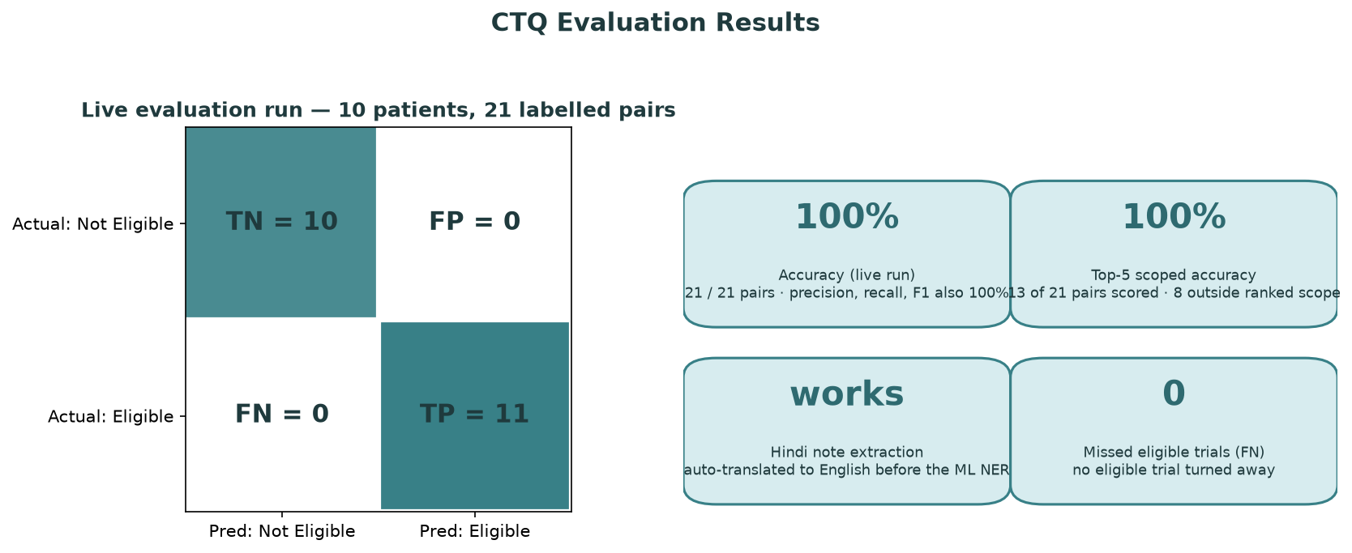
Department of AI&DS
Sikkim Manipal Institute of Technology, SMU
16
RESULTS
▪ Live evaluation run (this build): 10 synthetic patients, 21 labelled patient-trial pairs → Accuracy 100%, Precision 100%, Recall 100%, F1 100% (TP 11 · FP 0 · FN 0 · TN 10; 0 pairs excluded as insufficient).
▪ Top-5 ranked scope: scoring only each patient's 5 best-matching trials (the way a coordinator reads the list) keeps accuracy at 100% - 13 pairs scored, 8 reported as outside the ranked scope.
▪ Multilingual extraction: a fully Hindi discharge note auto-translates to English and yields the same complete profile (age, gender, condition, Metformin, HbA1c 8.5, eGFR 80, BP 140/85) - previously only Latin-anchored lab values survived.
▪ Honest by design: notes that genuinely lack a fact degrade to “Insufficient Information” instead of a guess - such rows are reported separately, never counted as a class.
▪ Same pipeline everywhere: single matching, cohort screening and evaluation share one code path, so the score reflects what users actually get.
Notes:
Lead with FN=0 (clinically most important). Explain the honesty rule, then note the shared code path.

Slide 19
Department of AI&DS
Sikkim Manipal Institute of Technology, SMU
17
FUTURE SCOPE
1. Domain-specific NER
Swap DistilBERT-QA for BioBERT / PubMedBERT fine-tuned on CTRI criteria for higher recall on rare entities
2. Dose-threshold parsing
Handle criteria like “metformin ≥ 1500 mg/day” in the rule engine
3. Live trial ingestion
Pull real trials from the CTRI / ClinicalTrials.gov APIs instead of the bundled database
4. Cohort analytics
Per-site recruitment funnels and auto-screening schedules for coordinators
5. Doctor feedback loop
Human-in-the-loop corrections that feed back into rules and the evaluation set
6. More languages + voice
Hindi ships today (13 scripts detected); add regional speech-to-text and ICD / LOINC coding
Notes:
Tie future work to the documented limitations - each limitation has a matching item here.

Slide 20
Department of AI&DS
Sikkim Manipal Institute of Technology, SMU
18
References
• Chen, L., Gu, Y., Ji, X., et al. “Clinical Trial Cohort Selection based on Multi-Level Rule-based Natural Language Processing System.” Journal of the American Medical Informatics Association, 2019.
• Yuan, C., Ryan, P. B., et al. “Criteria2Query: a natural language interface to clinical databases for cohort definition.” JAMIA 26(4), 2019, 294-305.
• Ni, Y., Kennebeck, S., Dexheimer, J. W., et al. “Automated clinical trial eligibility prescreening: increasing the efficiency of patient identification for clinical trials in the emergency department.” JAMIA 22(1), 2015, 166-178.
• Murcia, V. M., Aggarwal, V., et al. “Automating clinical trial matches via natural language processing of synthetic electronic health records and clinical trial eligibility criteria.” Journal of Biomedical Informatics, 2023.
• Wang, K., Cui, H., Zhu, Y., et al. “Evaluation of an artificial intelligence-based clinical trial matching system in Chinese patients with hepatocellular carcinoma: a retrospective study.” BMC Cancer 24(1), 2024, 246.
• Jin, Q., Wang, Z., Floudas, C. S., Sun, J., Lu, Z. “Matching patients to clinical trials with large language models (TrialGPT).” Nature Communications 15, 2024, 9074.
• Miotto, R., Weng, C. “Case-based reasoning using electronic health records efficiently identifies eligible patients for clinical trials.” JAMIA 22(e1), 2015, e141-e150.
• Devlin, J., Chang, M.-W., Lee, K., Toutanova, K. “BERT: Pre-training of Deep Bidirectional Transformers for Language Understanding.” NAACL-HLT, 2019. (DistilBERT: Sanh et al., 2019)
Notes:
Same six core papers from the progress presentation, plus the BERT/DistilBERT citation for the ML NER engine.

Slide 21
Thank You
Questions?
Live demohttps://ctq-clinical-trial-qualifier.onrender.com
(live deployment - first load after 15 min idle wakes the free-tier server in ~50 s; the PDF report CTQ_Full_Project_Report.pdf shows the same screens)
Notes:
Demo script: Home → Find Trials → load Diabetes sample → Find Matching Trials → open an eligible card → Evaluation → Load bundled sample data → Run.

