Slide 1





Plant Disease Detection System using Deep Learning
Name: Pragya Pandey
AICTE Student ID: STU67696a0987fc41734961673

Slide 2

Learning Objectives
Train and develop a Convolutional Neural Network (CNN) to classify images of plant leaves as healthy or diseased.
Implement data preprocessing, such as resizing, normalization, and validation split, to clean and prepare images for model training.
Measure model performance with metrics like accuracy, precision, and recall on actual plant disease datasets.
Visualize training outcomes and interpret the predictions of models for real-world agricultural applications.
GOAL
Source :
www.freepik.com/

Slide 3
Tools and Technology used
Python – Core programming language used for model development.
Jupyter Notebook – Development environment for writing and testing code.
TensorFlow / Keras – Deep learning libraries utilized to develop and train the CNN model.
OpenCV / PIL – Image processing libraries to process plant leaf images.
NumPy & Pandas – For data processing and manipulation.
Matplotlib & Seaborn – Visualization libraries for plotting model metrics and results.
Google Colab – Cloud-based environment for training the model using GPU support.
Dataset – Dataset from open Source like Kaggle . (https://drive.google.com/file/d/12OS3a0bLn1zDnhqv5KRRH_BfFml6gCVX/view?usp=sharing )

Slide 4
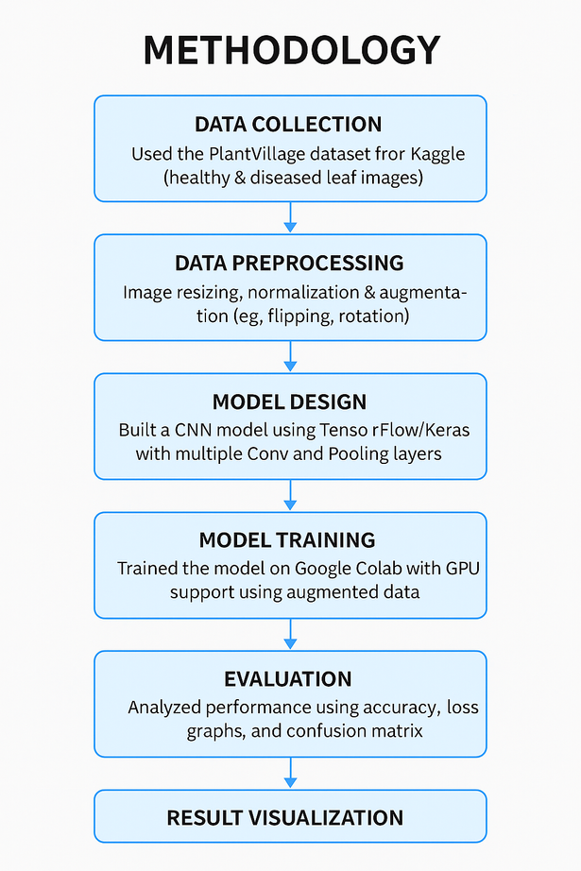
Methodology
Dataset Acquisition
Collected the PlantVillage dataset from dataset provided with labeled images of healthy and diseased leaves.
Data Preprocessing
Resized images, applied augmentation (rotation, flipping), and normalized pixel values.
Model Building
Built a CNN using TensorFlow/Keras with convolutional, pooling, and dense layers.
Model Training
Trained on Google Colab with GPU using categorical cross-entropy and Adam optimizer.
Model Evaluation
Tested with accuracy and confusion matrix; performed hyperparameter tuning.
Result Visualization
Plotted accuracy/loss graphs and tested predictions on sample images.
Conclusion
Attained excellent accuracy, affirming the model's real-time disease detection ability.

Slide 5
Problem Statement:
Traditional farming often faces challenges in the early detection of plant diseases, leading to reduced crop yield, increased pesticide use, and unsustainable practices.
To address this, there is a growing need for an AI/ML-based intelligent system that can:
Automatically detect plant diseases from leaf images using deep learning.
Recommend suitable crops and fertilizers by analyzing environmental factors such as soil quality and weather conditions.
Such a system will empower farmers with data-driven decision-making tools, promote precision agriculture, and support sustainable farming practices for enhanced productivity and environmental impact.

Slide 6
Solution:
To address the challenges in early plant disease diagnosis and sustainable agriculture, the proposed Machine Learning-based Plant Disease Detection System:
Applies Convolutional Neural Networks (CNN):
Diagnoses diseases directly from images of plant leaves with high accuracy.
Uses image processing libraries (OpenCV, PIL):
Performs efficient preprocessing and feature extraction to improve model performance.
Integrates environmental data (planned/future enhancement):
Considers soil health and climate data to recommend:
The most optimal crops to be planted
Ideal fertilizers for enhanced soil quality and productivity
Trains models on Google Colab:
Leverages scalable, GPU-based training for faster and more efficient model development.
Provides a simple user interface:
Allows farmers and agronomists to upload leaf images and receive real-time diagnosis and suggestions.
Promotes precision agriculture:
Minimizes human reliance in disease tracking
Encourages sustainable farming practices and improved crop management

Slide 7
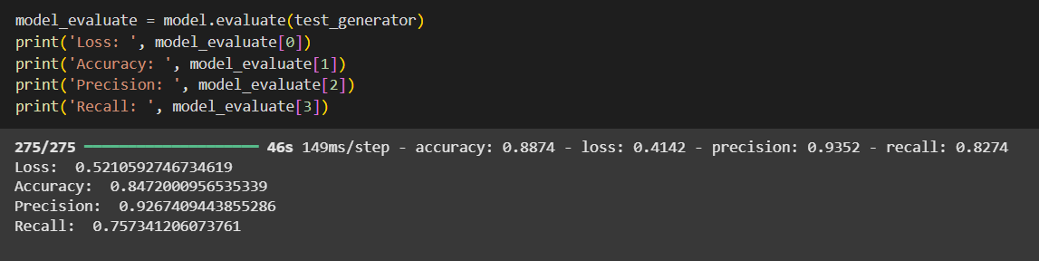
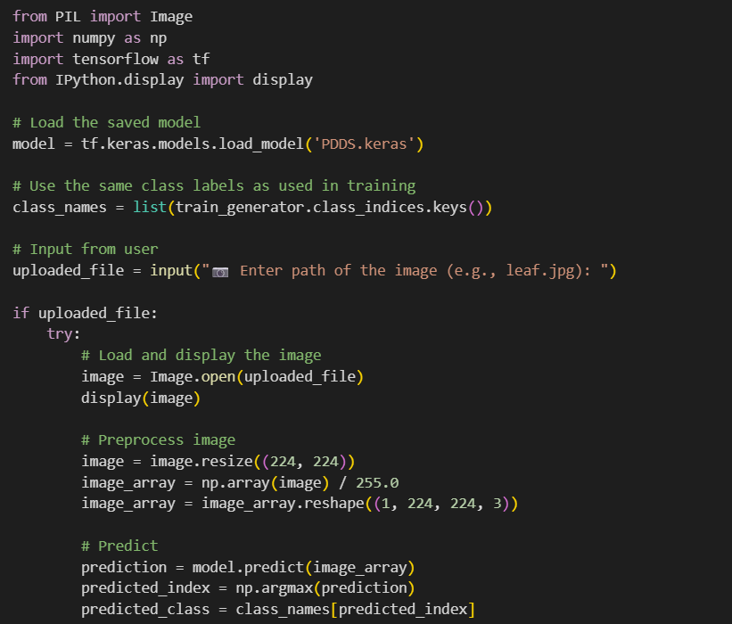
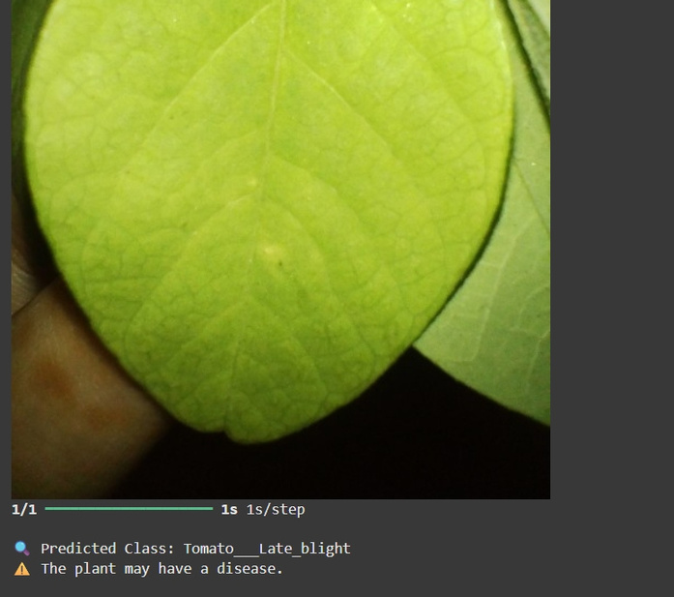
Screenshot of Output:

Slide 8
Conclusion:
The Plant Disease Detection System uses deep learning and computer vision to effectively classify plant leaf diseases from image.
Employing an in-house Convolutional Neural Network (CNN) with a trained model on an enlarged dataset, the model recorded high accuracy, precision, and recall for training and validation sets.
The system identifies disease automatically, allowing quicker and more consistent diagnosis than with eye inspection.
Such an approach can assist farmers and agricultural professionals in taking timely measures, possibly minimizing crop losses and enhancing yield.
The project proves that AI can be effectively applied to agriculture and further strengthened by increasing the dataset, refining the model, and implementing the solution in real-world conditions.

