Slide 1

Handwritten Digit Recognition using Artificial Neural Network
By
Kumari Pooja & Pragya Shah
Under the guidance of
Dr. Deepak Mishra

Slide 2
Outline
Introduction
Artificial Neural Network (ANN)
Back Propagation & Gradient Descent
Mini-batch Learning
Recognition Algorithm
Results & Discussions
Conclusion

Slide 3
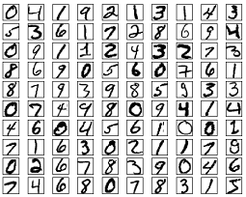
Introduction
We people effortlessly understands the shown digits but recognizing handwritten digits are not easy task for computer.
Our brain uses visual cortex containing millions of neurons and billions of connections to understand the visual world.
In this project, we used the same analogy on a lighter basis but it still gives promising results as we will see in further discussions.
For the recognition, Artificial Neural Network has been used with the feedforward structure along with gradient descent for reducing the error and updating the weights.
To get an insight about the effect of various parameters used, accuracies were analysed for different sets of conditions.
Handwritten Segmented digits

Slide 4
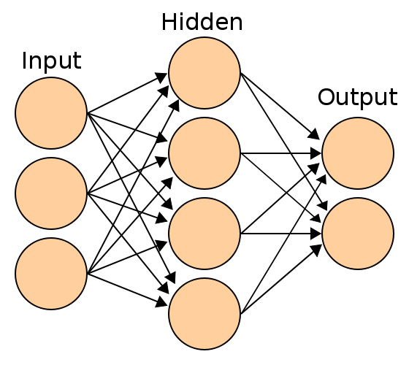
Artificial Neural Network (ANN)
It is a parallel distributed information processor made up of simple processing units that has a propensity for acquiring problem solving knowledge through experience.
ANN has two types
Recurrent network
Feed forward networks
In this project, Feed forward network is used followed by mini batch learning, gradient descent minimization and back propagation algorithm.
Feed Forward Neural Network

Slide 5
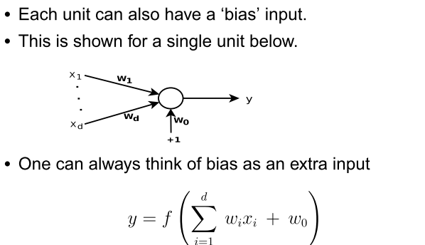
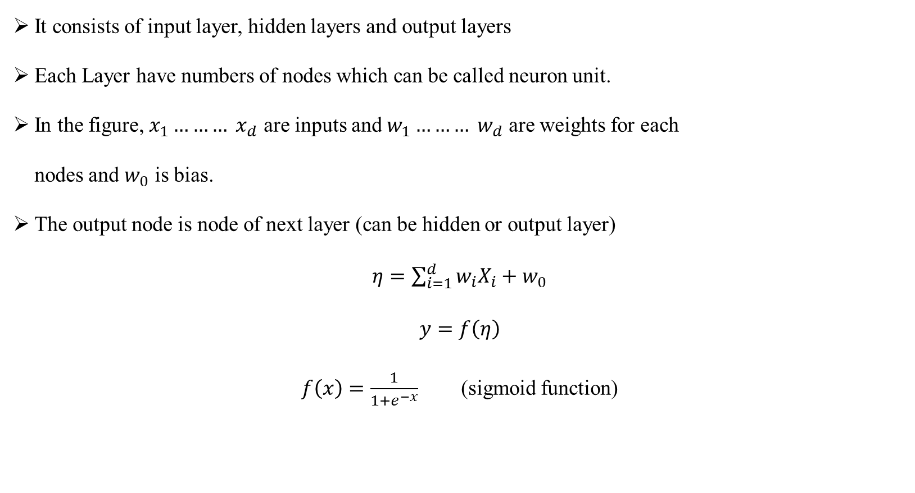
ANN Contd.. (Feed Forward Neural Network)
It consists of input layer, hidden layers and output layers
Each Layer have numbers of nodes which can be called neuron unit.
In the figure, $x_{1}……… x_{d}$ are inputs and $w_{1}……… w_{d}$ are weights for each
nodes and $w_{0}$ is bias.
The output node is node of next layer (can be hidden or output layer)
$η=\sum_{i=1}^{d}{w_{i}X_{i}+w_{0}}$
$$y=f\left(η\right)$$
$f\left(x\right)=\frac{1}{1+e^{−x}}$ (sigmoid function)

Slide 6
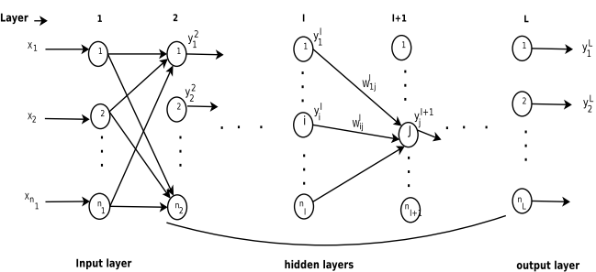
Back Propagation and Gradient Descent

Slide 7
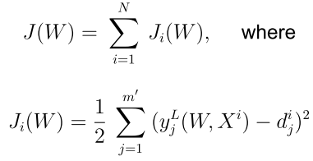
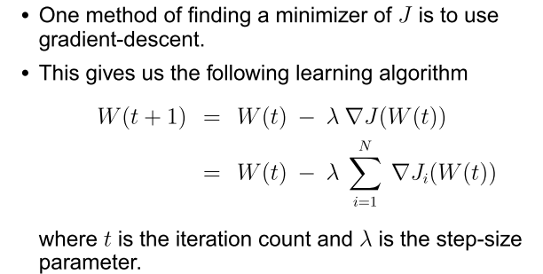
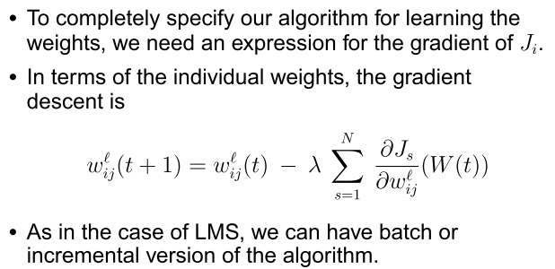
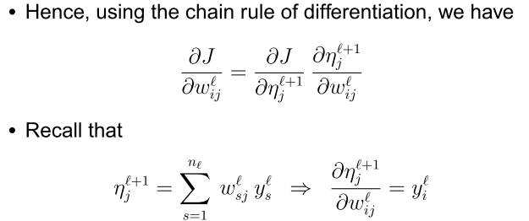
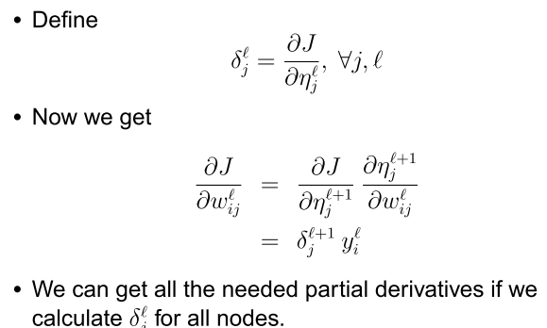
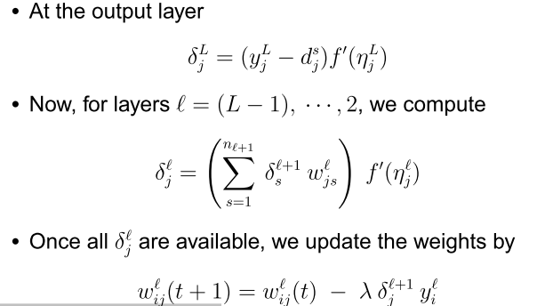
Back Propagation and Gradient Descent

Slide 8
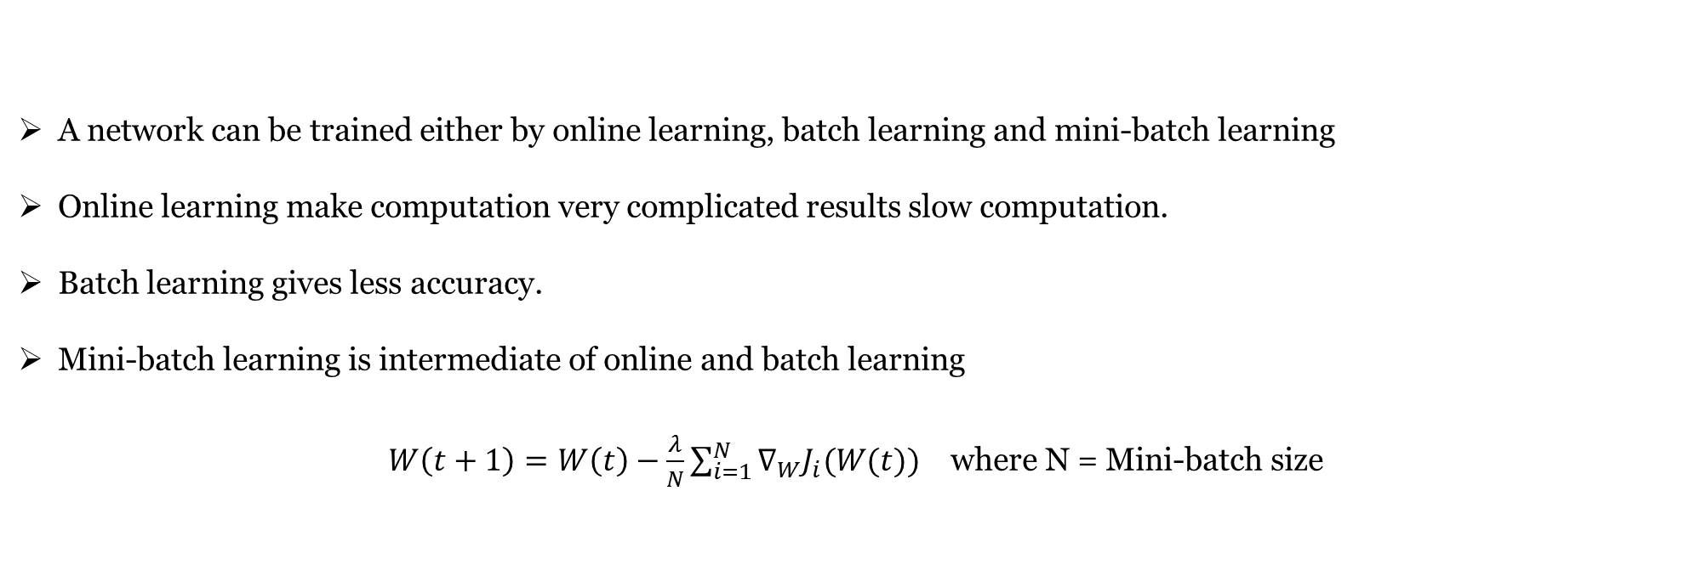
Mini-batch Learning
A network can be trained either by online learning, batch learning and mini-batch learning
Online learning make computation very complicated results slow computation.
Batch learning gives less accuracy.
Mini-batch learning is intermediate of online and batch learning
$W\left(t+1\right)=W\left(t\right)−\frac{λ}{N}\sum_{i=1}^{N}{∇_{W}J_{i}(W(t))}$ where N = Mini-batch size

Slide 9
Handwritten Digits Recognition Algorithm
It consists of two parts.
Loading Data
ANN implementation
Loading Data
MNIST segmented handwritten image containing 70,000 images
60,000 images used for training and 10,000 images for testing
Each image size 28×28 and changed to 784×1 as an input layer
Output layer have 10 nodes each node corresponds to digits 0 to 9
The nodes give outputs ranging from 0 to 1
The node with maximum value gives the indication of the digit in image

Slide 10
Handwritten Digits Recognition Algorithm
ANN Implemetation
Initialization
Weights and biases are initialized using random numbers from normal distribution
Propagation
Feed forward propagation using sigmoid as an activation function
Backward propagation to calculate error in weights and biases
Updating
Updating weights and biases using mini-batch gradient descent learning
Training and Testing
Take training and testing data
Give number of times the network is to be trained, batch length and learning rate
Do batch-wise update on whole training data and find the performance with test data
Get the accuracy and repeat previous process according to no. of iterations

Slide 11
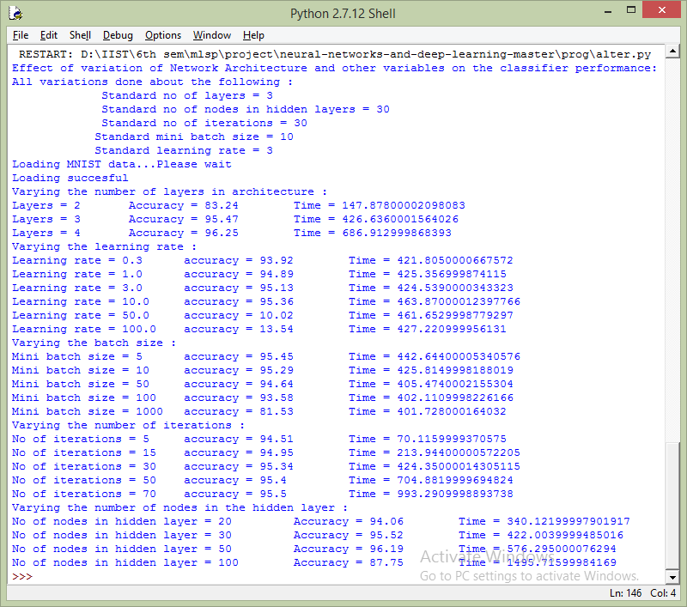
Estimating the Best Paramerters for Training
Varying Parameters
No. of layers: Number of hidden layers improve the accuracy but increases the computation time as well.
Learning rate: can’t decide exactly which learning rate will give more accuracy but interval can be estimated while doesn’t effect much the computation time.
Batch size: Lesser the batch size, enhances the accuracy, with minor increment in computation time.
Iteration: Greater No. of iterations will improve the accuracy at the cost of computational time.
No. of nodes in hidden layer: Give higher accuracy to some extent but increases computational time multifolds.

Slide 12
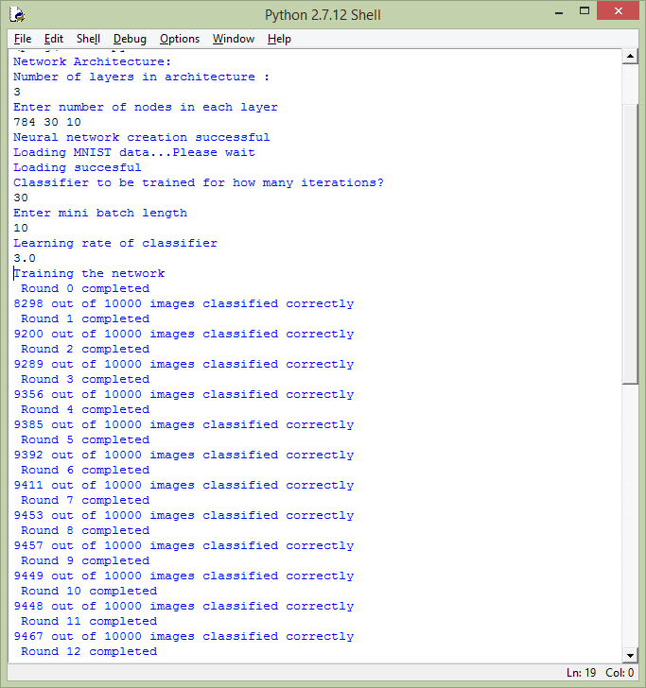
Results and Discussion
Custom Architecture (3 layers)
Input (image size=28X28) and 784 nodes
Hidden layer = 30 nodes
Output = 10 nodes
Initially, accuracy increased rapidly with succesive iterations

Slide 13
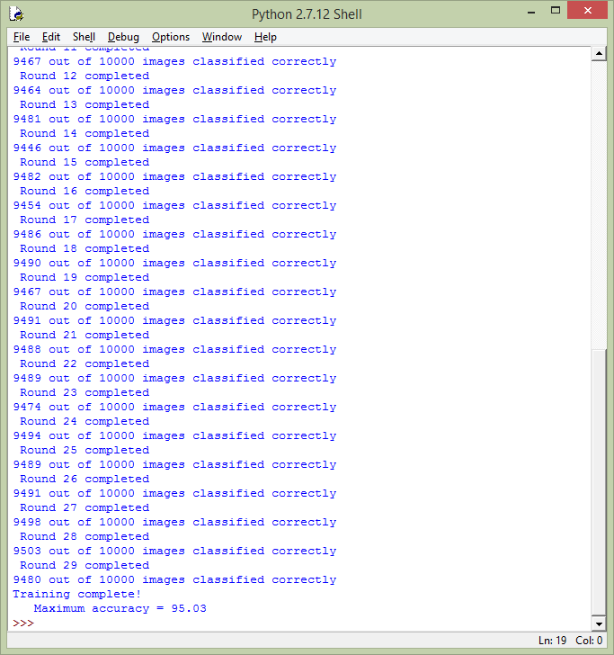
Results and Discussion
After sometimes, it starts fluctuating which infers that the accuracy and no. of iteration doesn’t go hand in hand.
This might be because the set of data points are not lineraly separable.
Best accuracy is obtained to be fairly high (95.03%).

Slide 14
Conclusions
ANN is a lighter neural network which works efficiently w.r.t to CNN in terms of time and memory consumption.
It works well for small computation and can get better accuracy.
By employing this, we can recognize the hand-written digits with promising accuracy but some specific parameters need to be taken in consideration.
By varying parameter, we can conclude the ANN accuracy till now more based on trial & error and pattern observation.

Slide 15


