Slide 1
Applied Machine Learning
Sumeet Suley Pragya Shukla
Presentation

Slide 2
Table of Contents

Slide 3
Part 2
Demo for Transfer Learning for NLP using BERT
Part 1
Transformers - Motivation behind transformers - Transformers overview
Some of today’s popular NLP models
GPT - What is GPT? - Transformers, GPT and BERT - GPT2 and GPT2 vs BERT - BERT vs GPT - GPT Training

Slide 4
Motivation behind introducing Transformers

Slide 5
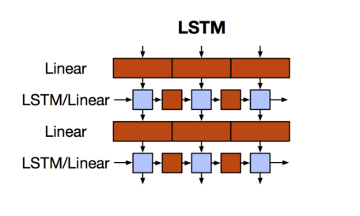
Motivation behind Transformers
Recurrent Neural Networks, Long Short-Term Memory and Gated Recurrent Neural Networks are the state-of-art approaches in sequence modeling and transduction problems such as language modeling and machine translation.
Sequential computation prevents parallelization.
Despite GRUs and LSTMs, RNNs still need attention mechanism to deal with long range dependencies – path length for co-dependent computation between states grows with sequence.
But if attention gives us access to any state… then we don’t need the RNN

Slide 6
Transformers overview

Slide 7
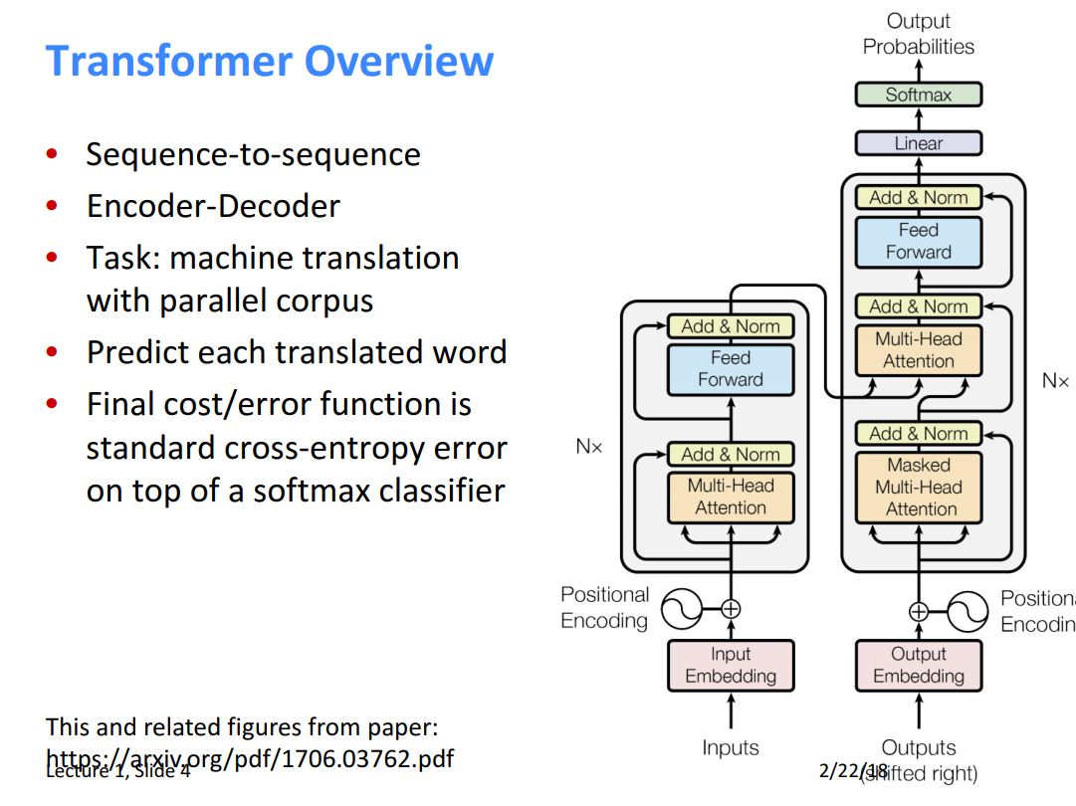


Slide 8
Some of today’s popular NLP models

Slide 9
BERT
Roberta
T5
GPT

Slide 10
GPT
Generative Pre-trained Transformer

Slide 11
What is GPT ?
GPT is a transformers model pre-trained on a very large corpus of English data in a self-supervised fashion. This means it was pretrained on the raw texts only, with no humans labelling them in any way with an automatic process to generate inputs and labels from those texts. More precisely, it was trained to guess the next word in sentences.

Slide 12
Transformers, GPT, and BERT
1.A transformer uses Encoder stack to model input, and uses Decoder stack to model output (using input information from encoder side).
2.But if we do not have input, we just want to model the “next word”, we can get rid of the Encoder side of a transformer and output “next word” one by one. This gives us GPT.
3.If we are only interested in training a language model for the input for some other tasks, then we do not need the Decoder of the transformer, that gives us BERT.

Slide 13
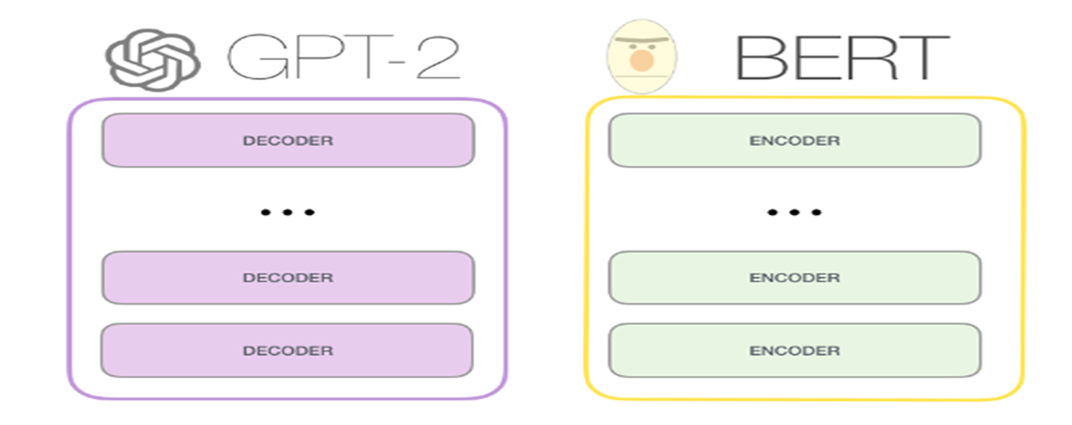
GPT-2 vs BERT

Slide 14
GPT2 Model Architecture
GPT-2 consists of solely stacked Decoder blocks from the transformer architecture.
In GPT-2 masked self-attention is used instead: the decoder is only allowed (via obfuscation masking of the remaining word positions) to glean information from the prior words in the sentence.
Besides that GPT-2 is a close copy of the basic transformer architecture.

Slide 15
GPT2 Model Architecture
GPT-2 had 1.5 billion parameters. which was 10 times more than GPT-1 (117M parameters). Major differences from GPT-1 were:
GPT-2 had 48 layers and used 1600 dimensional vectors for word embedding.
Larger vocabulary of 50,257 tokens was used.
Larger batch size of 512 and larger context window of 1024 tokens were used.

Slide 16
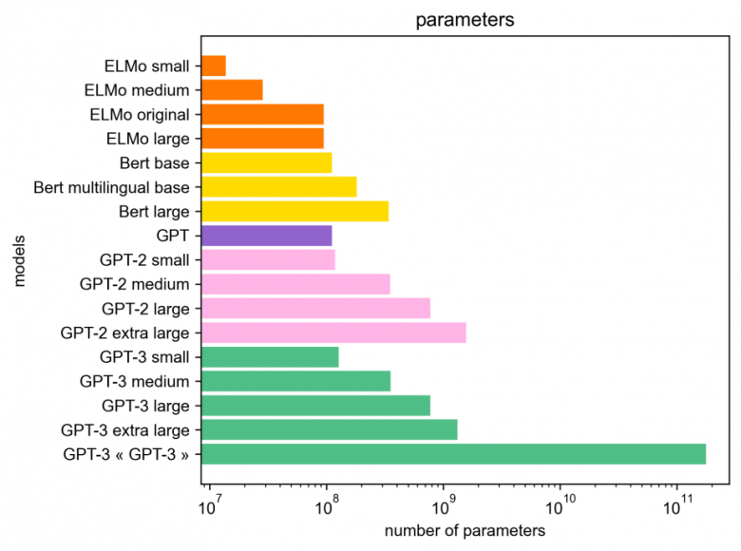
Comparison of Parameters

Slide 17
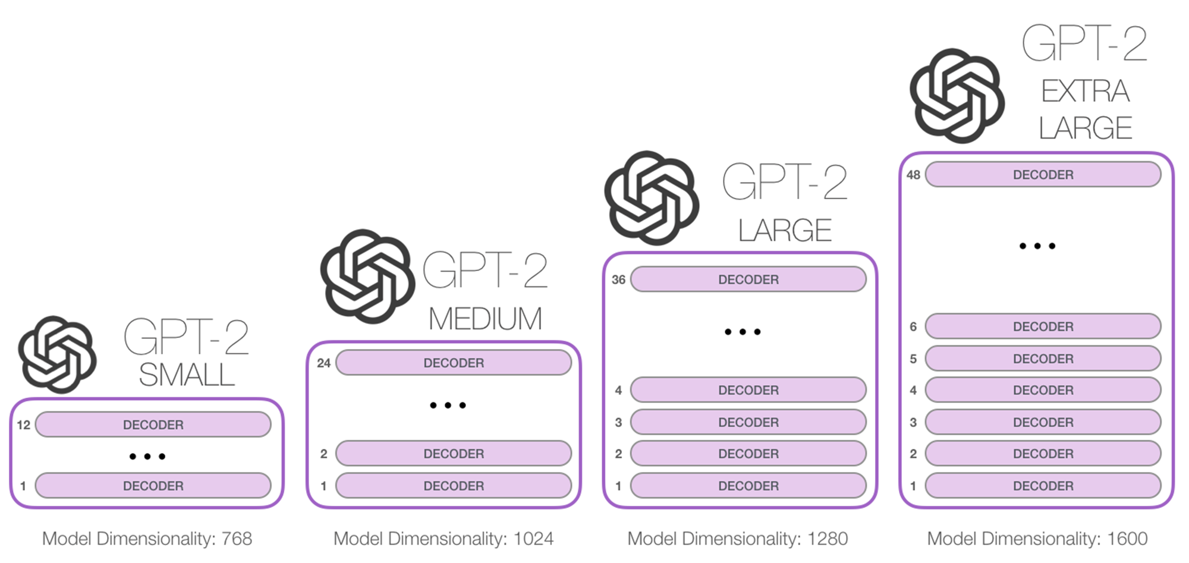

Slide 18
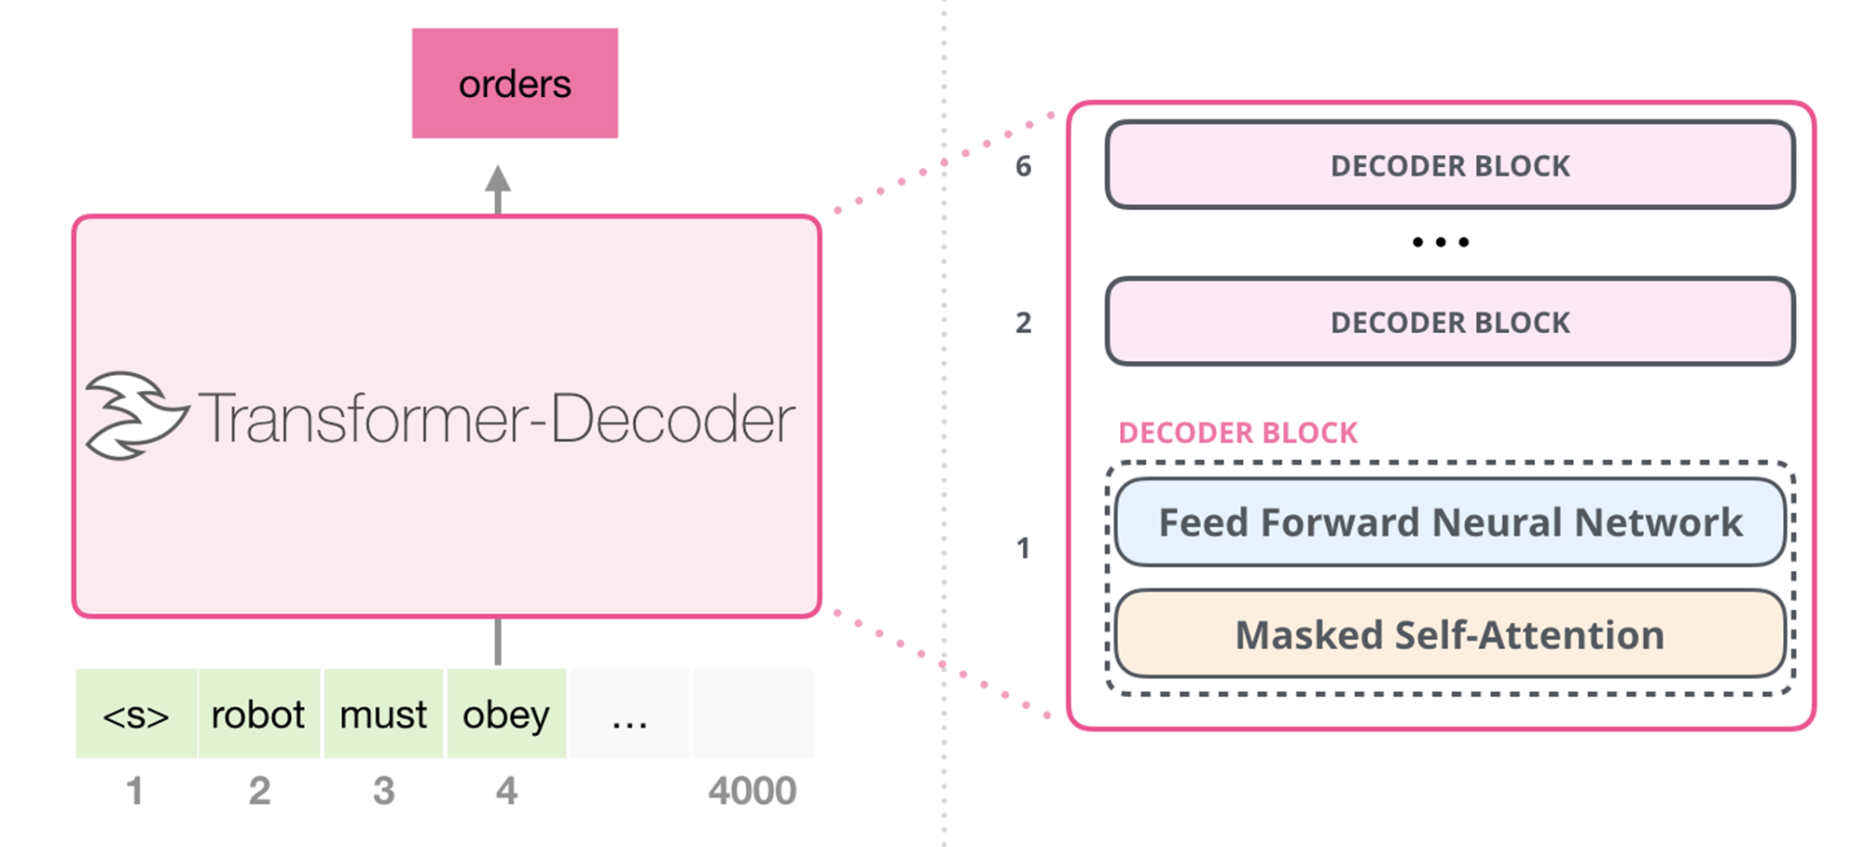
Masked Self Attention

Slide 19
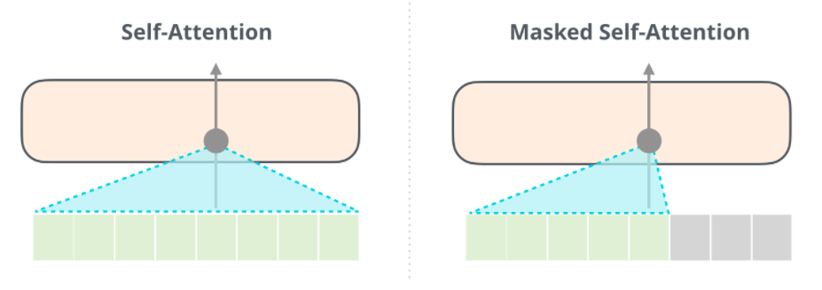
BERT vs GPT: Self Attention
It’s important that the distinction between self-attention (what BERT uses) and masked self-attention (what GPT-2 uses) is clear. A normal self-attention block allows a position to peak at tokens to its right. Masked self-attention prevents that from happening

Slide 20
GPT Training
GPT-2 uses unsupervised learning approach to training the language model.
There is no custom training for GPT-2, no separation of pre-training and fine-tuning like BERT.

Slide 21
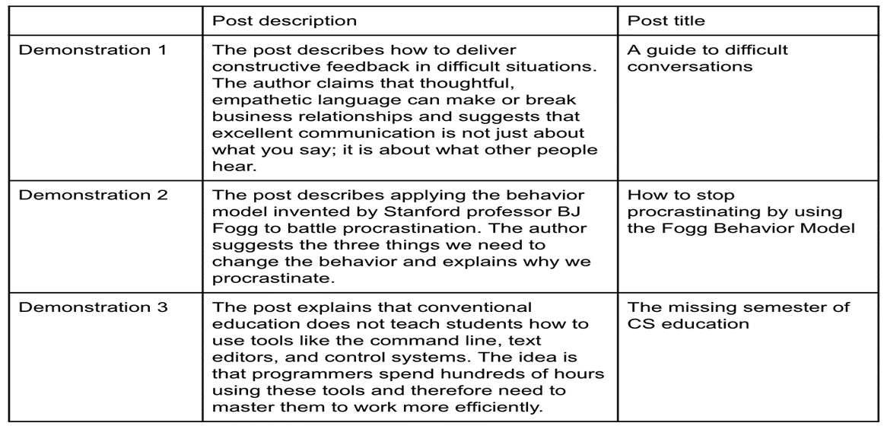
Application of GPT: Text Titling

Slide 22

Application of GPT: Text Summarization

Slide 23
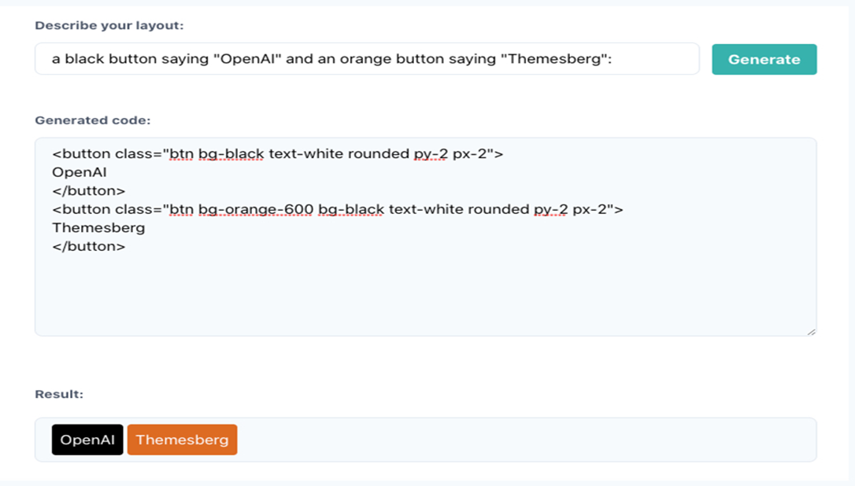
Application of GPT: Text to Code

Slide 24
Demo (Transfer Learning for NLP using BERT)

Slide 25
Thank you all !!

