Slide 1
Topological Data Analysis
Pragya Shukla

Slide 2
Sliding Windows and Persistence: An application of Topological Methods to Signal Analysis

Slide 3
Sliding Windows and Persistence: An application of Topological Methods to Signal Analysis
JOSE A. PEREA AND JOHN HARE

Slide 4
An Introduction

Slide 5
WHAT is it?

Slide 6
WHAT is it?
A framework for recurrence detection using sliding window embedding and persistent homology.

Slide 7
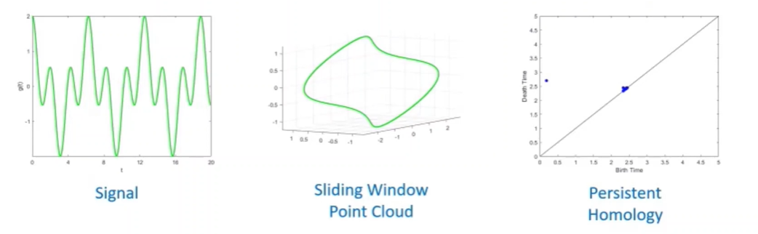
WHAT is it?
A framework for recurrence detection using sliding window embedding and persistent homology.

Slide 8
HOW is it defined?

Slide 9
HOW is it defined?
Suppose that f is a function defined on an interval of the real numbers. Choose an integer d (or M) and a real number τ , both greater than 0. The sliding window embedding of f based at t ∈ R into R^{d+1} is the point

Slide 10
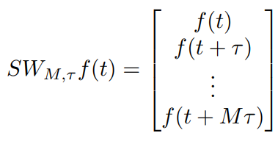
HOW is it defined?
Suppose that f is a function defined on an interval of the real numbers. Choose an integer d (or M) and a real number τ , both greater than 0. The sliding window embedding of f based at t ∈ R into R^{d+1} is the point

Slide 11
Example

Slide 12


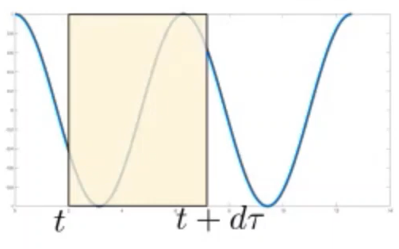
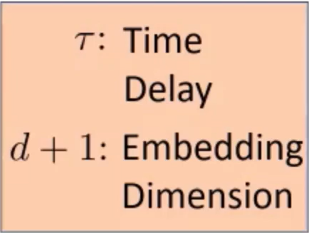
Example:

Slide 13
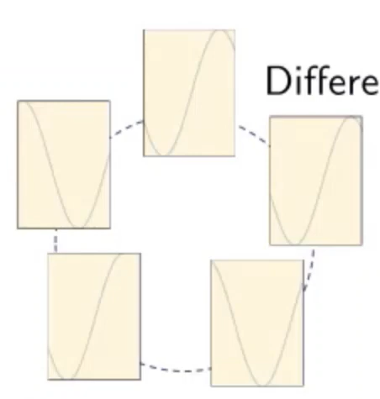

Example:

Slide 14
Example:
Different windows of size dτ

Slide 15
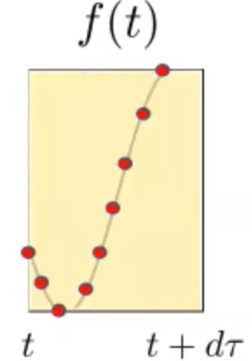
Example:
Different windows of size dτ

Slide 16

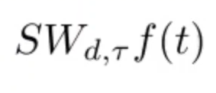
Example:
Different windows of size dτ

Slide 17
WHY does it work?

Slide 18
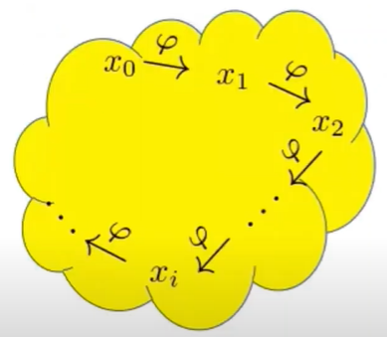
WHY does it work?
Dynamical system on a manifold

Slide 19
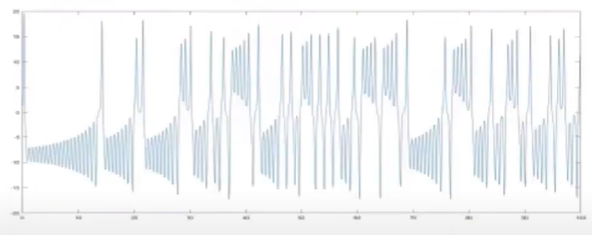

WHY does it work?
Time Series
Dynamical system on a manifold

Slide 20
WHY does it work?
Time Series
Dynamical system on a manifold
Given a time series observed, how do we get information about the original attractor?

Slide 21
Takens’ Embedding Theorem

Slide 22

Takens’ Embedding Theorem

Slide 23
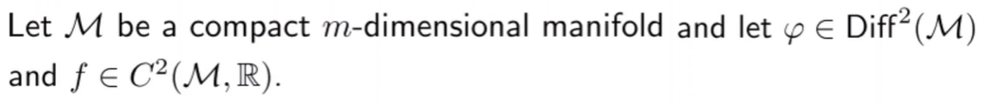
Takens’ Embedding Theorem

Slide 24
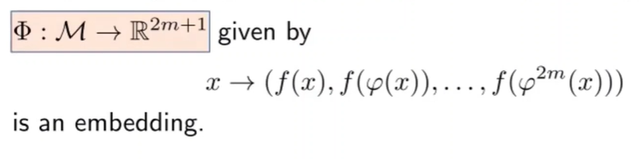
Takens’ Embedding Theorem

Slide 25
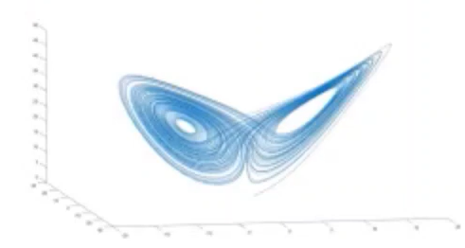
Takens’ Embedding Theorem

Slide 26
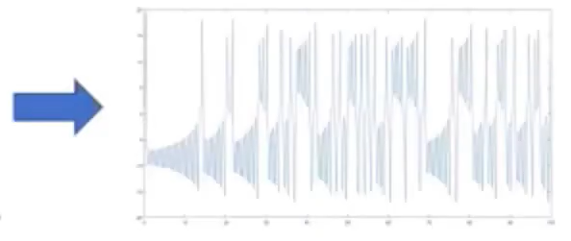
Takens’ Embedding Theorem

Slide 27
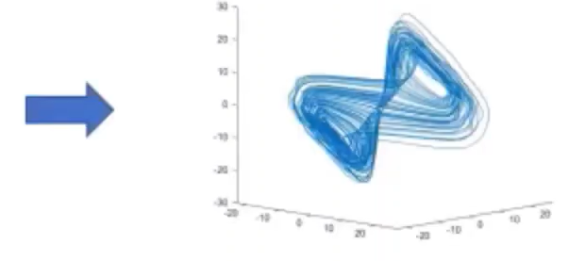
Takens’ Embedding Theorem

Slide 28
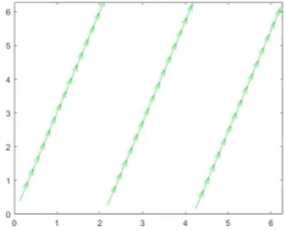
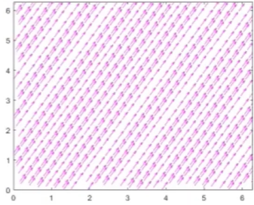
Dynamical Systems on a Torus
Slope = 3 Circular Trajectory
Slope = √3 Dense Trajectory

Slide 29
Dynamical Systems on a Torus
Slope = 3 Circular Trajectory
Slope = √3 Dense Trajectory
Observations of these dynamical systems give rise to recurrent functions!!

Slide 30

Recurrent Functions

Slide 31
Recurrent Functions
Two prominent types
Characterized by a collection of real numbers (frequencies)

Slide 32
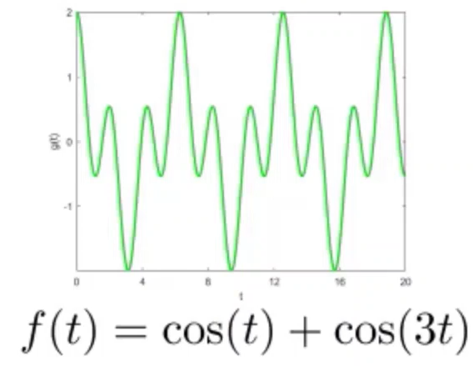
Recurrent Functions
Two prominent types
Characterized by a collection of real numbers (frequencies)
Periodicity
all pairwise ratios are rational

Slide 33
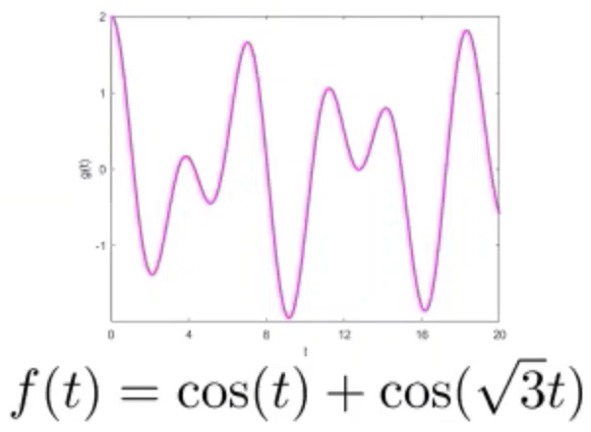
Recurrent Functions
Two prominent types
Characterized by a collection of real numbers (frequencies)
Periodicity
Quasiperiodicity
all pairwise ratios are rational
at least one irrational ratio

Slide 34
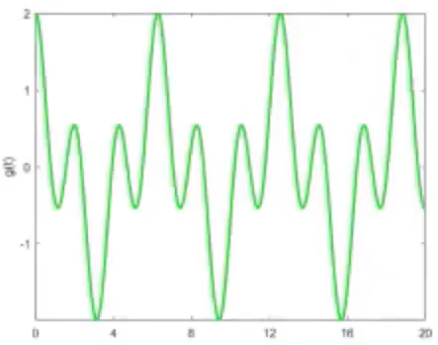
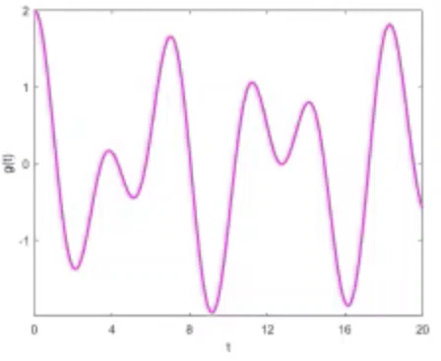
Recurrent Signals
Appropriate choices of embedding parameters
Sliding Window Point Cloud

Slide 35
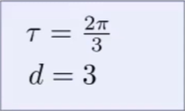
Recurrent Signals
Appropriate choices of embedding parameters
Sliding Window Point Cloud

Slide 36
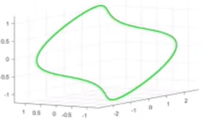
Recurrent Signals
Appropriate choices of embedding parameters
Sliding Window Point Cloud

Slide 37
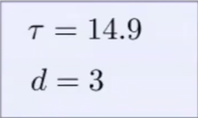
Recurrent Signals
Appropriate choices of embedding parameters
Sliding Window Point Cloud

Slide 38
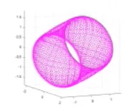
Recurrent Signals
Appropriate choices of embedding parameters
Sliding Window Point Cloud

Slide 39
Recurrent Signals
Sliding Window Point Cloud
Rips Persistent Homology

Slide 40
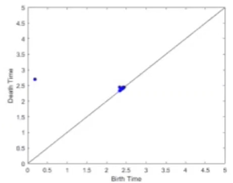
Recurrent Signals
Sliding Window Point Cloud
Rips Persistent Homology

Slide 41
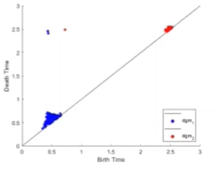
Recurrent Signals
Sliding Window Point Cloud
Rips Persistent Homology

Slide 42
HOW do we choose d and τ ?

Slide 43
HOW do we choose d and τ ?
Briefly,
The dimension d:
Needs to be big enough to allow the circular and toroidal features to survive (but not too big)
The time delay τ :
Needs to be chosen carefully to amplify the circular and toroidal features (typically obtained by solving a minimization problem)

Slide 44
Demo

Slide 45
Part 1
Part 2
From time series to sliding window embeddings - Periodic Examples
- Non - Periodic Examples

Slide 46
Part 1
Part 2
From time series to sliding window embeddings - Periodic Examples
- Non - Periodic Examples
From sliding window embeddings to persistence diagrams

Slide 47
Part 1
Part 2
From time series to sliding window embeddings - Periodic Examples
- Non - Periodic Examples
From sliding window embeddings to persistence diagrams
Deciding the embedding dimension and time delay

Slide 48
Part 1
Part 2
From time series to sliding window embeddings - Periodic Examples
- Non - Periodic Examples
From sliding window embeddings to persistence diagrams
Deciding the embedding dimension and time delay
Takens’ Embedding Theorem
- Applying the theorem for forecasting

Slide 49
Part 1
Part 2
From time series to sliding window embeddings - Periodic Examples
- Non - Periodic Examples
From sliding window embeddings to persistence diagrams
Deciding the embedding dimension and time delay
Takens’ Embedding Theorem
- Applying the theorem for forecasting
Nyquist - Shannon Sampling Theorem

Slide 50
Link
kaggle.com/pragyashukla19/topology-of-time-series/notebook#Part-1:-Topology-of-time-series

Slide 51
Thank You All!!

