Slide 1

Tishk International University
Computer Engineering Department
Electronics – CMPE 248/A
Lecture 2
Rectifier Circuits
Mr. Qusay H Ali

Slide 2
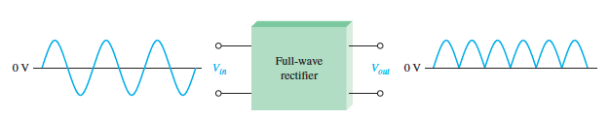
Full Wave Rectifier
The full-wave rectifier is the most commonly used type in dc power supplies, there is two types of full-wave rectifiers: center-tapped and bridge.
A full-wave rectifier allows unidirectional (one-way) current through the load during the entire of the input cycle, whereas a half-wave rectifier allows current through the load only during one-half of the cycle. The result of full-wave rectification is an output voltage with a frequency twice the input frequency and that pulsates every half-cycle of the input, as shown in Figure 7.
Fig.7: Full Wave Rectifier

Slide 3
Full Wave Rectifier
The number of positive alternations that make up the full-wave rectified voltage is twice that of the half-wave voltage for the same time interval. The average value, which is the value measured on a dc voltmeter, for a full-wave rectified sinusoidal voltage is twice that of the half-wave, as shown in the following formula: VAVG = 2Vp /π

Slide 4
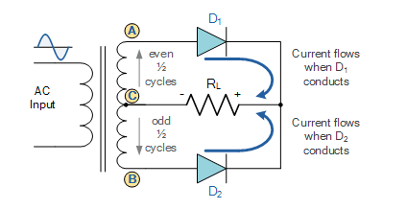
Center-Tapped Full Wave Rectifier
A center-tapped rectifier is a type of full-wave rectifier that uses two diodes connected to the secondary of a center-tapped transformer, as shown in Figure (8). The input voltage is coupled through the transformer to the center-tapped secondary. Half of the total secondary voltage appears between the center tap and each end of the secondary winding.
Fig. 8: Center-tapped Full Wave Rectifier

Slide 5
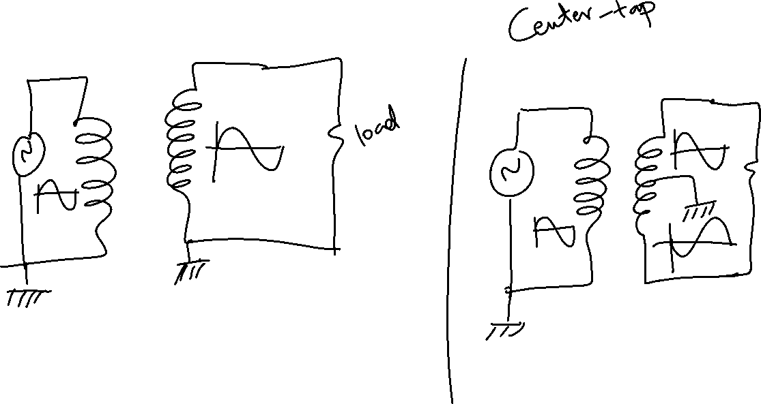

Slide 6
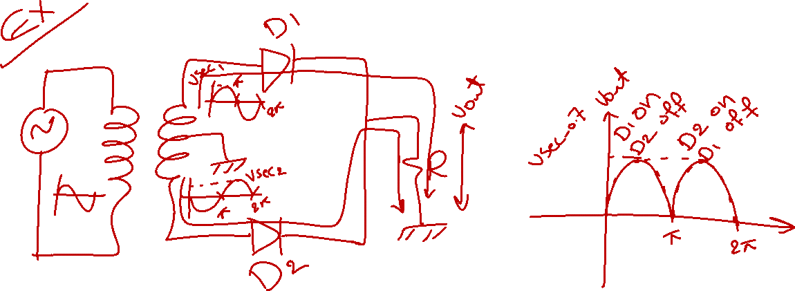

Slide 7
Center-Tapped Full Wave Rectifier
For a positive half-cycle of the input voltage. The D1 will be forward-biased diode and D2 will be reverse-biases. The current path is through D1 and the load resistor RL.
For a negative half-cycle of the input voltage. The D1 will be reverse-biases and D2 will be forward-biases. The current path is through D2 and RL.
Because the output current during both the positive and negative portions of the input cycle is in the same direction through the load, the output voltage developed across the load resistor is a full-wave rectified dc voltage.

Slide 8
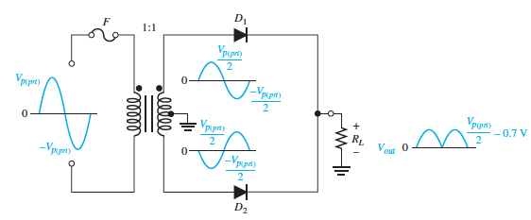
Center-Tapped Full Wave Rectifier
The effect of the Turns Ratio on the Output Voltage If the transformer turns ratio is 1, the peak value of the rectified output voltage equals half the peak value of the primary input voltage less the barrier potential, as illustrated in Figure 9. Half of the primary voltage appears across each half of the secondary winding (Vp(sec) = Vp(pri)). We will begin referring to the forward voltage due to the barrier potential as the diode drop.
Fig. 9

Slide 9
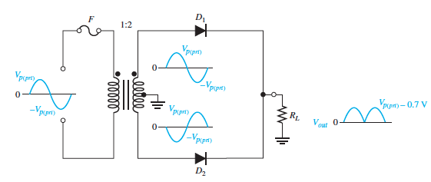
Center-Tapped Full Wave Rectifier
In order to obtain an output voltage with a peak equal to the input peak (less the diode drop), a step-up transformer with a turns ratio of n = 2 must be used, as shown in Figure 10. In this case, the total secondary voltage (Vsec) is twice the primary voltage (2Vpri), so the voltage across each half of the secondary is equal to Vpri.
Fig. 10

Slide 10
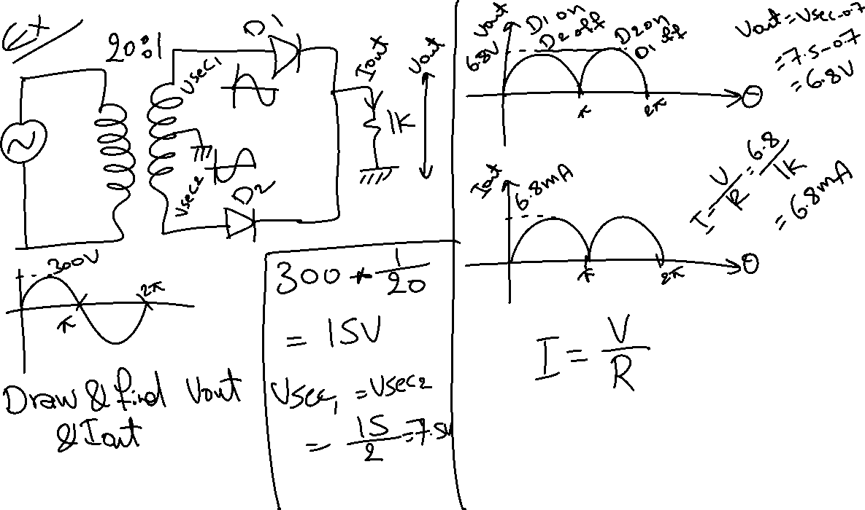

Slide 11
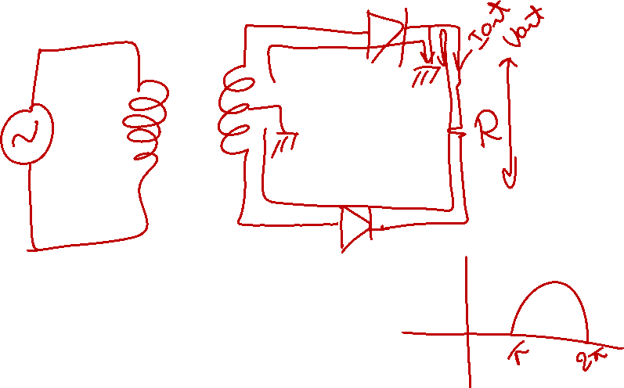

Slide 12
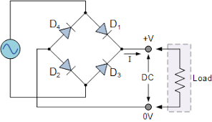
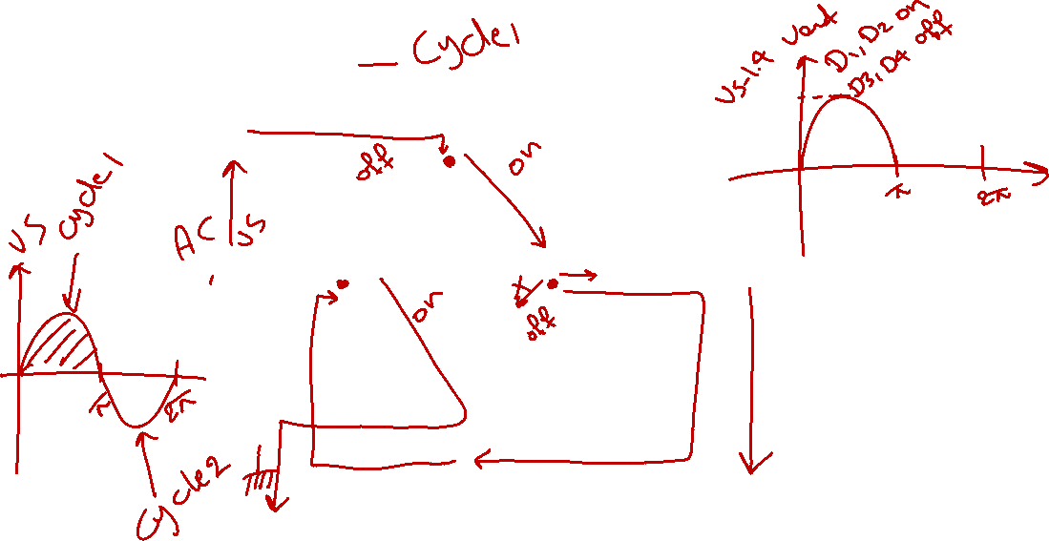
Bridge Rectifier

Slide 13
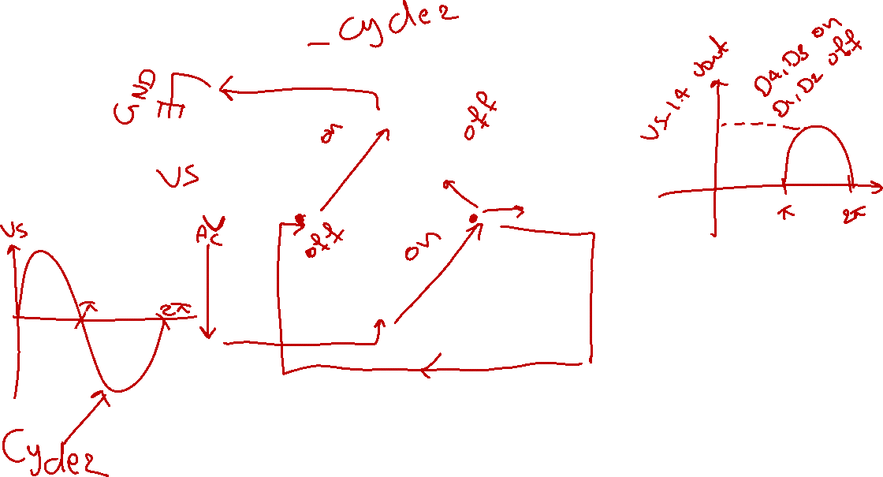
Bridge Rectifier

Slide 14
Bridge Rectifier
When the input cycle is negative, diodes D3 and D4 are forward biased and conduct current in the same direction through RL as during the positive half-cycle. During the negative half-cycle, D1 and D2 are reverse-biased. A full-wave rectified output voltage appears across RL as a result of this action.
Because there are two diodes two diodes are always in series with the load resistor during both the positive and negative half-cycles. The output voltage is: Vp(out) = Vp(in) - 1.4 V

Slide 15
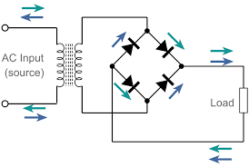
Bridge Rectifier with Transformer
A bridge rectifier with a transformer-coupled input is shown in Figure 12. During the positive half-cycle of the total secondary voltage, diodes D1 and D2 are forward-biased while diodes D3 and D4 are forward-biased during the negative half-cycle.
The output voltage across the load is: Vp(out) = Vp(sec) - 1.4 V
Fig. 12: Bridge rectifier with Transformer

Slide 16
Advantages of Bridge Rectifier
The rectification efficiency of full-wave rectifier is double of that of a half-wave rectifier.
Higher output voltage.
No center tap is required in the transformer secondary so in case of a bridge rectifier the transformer required is simpler. If stepping up or stepping down of voltage is not required, transformer can be eliminated even.
For a given power output, power transformer of smaller size can be used in case of the bridge rectifier because current in both primary and secondary windings of the supply transformer flow for the entire ac cycle.

Slide 17
Disadvantages of Bridge Rectifier
It requires four diodes.
The use of two extra diodes cause an additional voltage drop thereby reducing the output voltage.

Slide 18
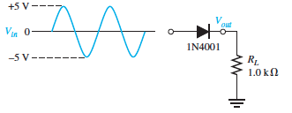
Classwork 1
Draw the output voltage of the rectifier circuit in the following figure, then find the peak output voltage and the average voltage:

Slide 19
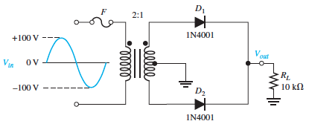
Classwork 2
Draw and find the output voltage across RL when a 100 V peak sine wave is applied to the primary winding in the following Figure.

Slide 20
Next Lecture
Root Mean Square and Average Values for Rectifier Circuits
Rectifier with Filters

Slide 21
Reference:
Thomas L. Floyed, 2012, Electronic Devices: Electron Flow Version, 9th Edition. Retrieved from: https://hristotrifonov.files.wordpress.com/2012/10/electronic-devices-9th-edition-by-floyd.pdf

