Slide 1
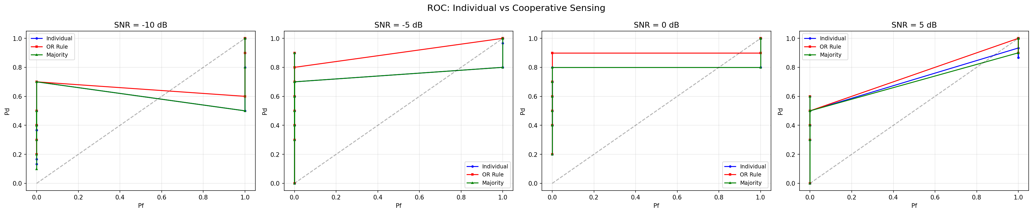
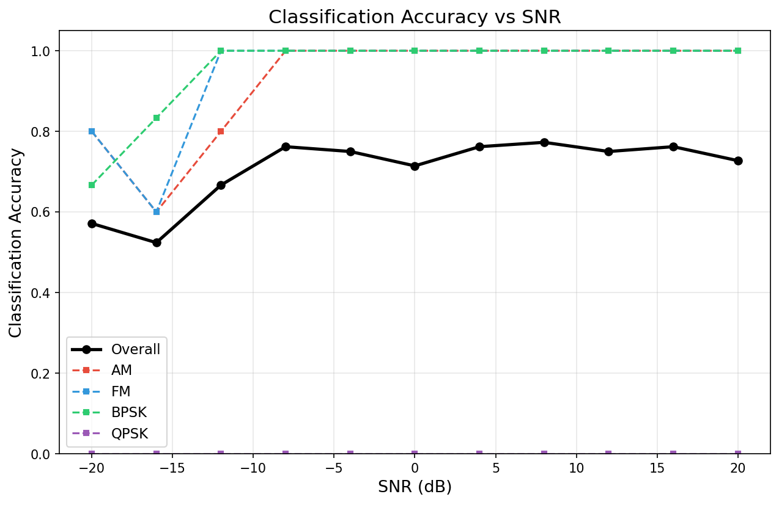
BANGALORE INSTITUTE OF TECHNOLOGY
Institution of Rajya Vokkaligara Sangha | An Autonomous Institution under VTU | Dept. of Electronics & Telecommunication Engineering
PROJECT POSTER PRESENTATION
Title: Analyzing Cooperative Spectrum Sensing Using Machine Learning for Cognitive Radio Networks
Focus: AI-Driven Spectrogram Classification (CNN), Spatial Decision Fusion (OR / Majority Rules) & Real RTL-SDR Hardware Validation
Project ID: G10
Team Members: Sangeetha, Pragyam Srivastava, Amoghapriya R B, Rachana M N | Guide: Prof. Asha R
Objectives
Introduction
Methodology & Architecture
• Synthetic Signal Synthesis: Generate raw complex IQ datasets for 4 modulation types (AM, FM, BPSK, QPSK) across -20 dB to +20 dB SNR with AWGN.
• Time-Frequency Conversion: Implement STFT to convert 1D time signals into normalized 2D Spectrogram images (64x64).
• Deep CNN Architecture: Train a 4-block PyTorch CNN for modulation classification and Occupied/Vacant state detection.
• Cooperative Decision Fusion: Build a 3-Node Fusion Center executing OR and Majority Voting rules to overcome fading blind spots.
• Hardware-In-The-Loop: Validate over-the-air signal detection using physical RTL-SDR receiver hardware.
• Spectrum Paradox: Over 70% of licensed radio spectrum sits temporarily idle (White Spaces), despite severe artificial spectrum scarcity.
• Cognitive Radio Networks (CRN): Enables unlicensed Secondary Users (SUs) to opportunistically access vacant channels without causing interference.
• Flaw of Classical Energy Detectors: Vulnerable to noise uncertainty at low SNR (< -5 dB) and cannot identify signal modulation types.
• Hidden Node Problem: Multipath fading and physical shadowing can block a single sensor, causing transmission collisions with Primary Users (PUs).
• Our Solution: Combining Deep Learning (CNN) on 2D Spectrograms with 3-Node Cooperative Spatial Diversity (Fusion Center).
• 1. IQ Signal Generation: SciPy synthesis of DSB-FC AM, wideband FM (75 kHz dev), and RRC-filtered BPSK/QPSK (roll-off 0.35).
• 2. STFT Processing: Windowed FFT (Hann, N=64, overlap=48) -> Power Spectral Density (PSD) -> Min-Max scaled to [0, 1].
• 3. PyTorch CNN Model: 4 Conv2D blocks (32->64->128->256) + BatchNorm + MaxPool -> GlobalAvgPool -> Dense(128) -> Softmax (422K params).
• 4. Fusion Center Logic: Aggregates 3 node reports via:
- OR Rule: Q_d = 1 - (1 - P_d)^3 (Maximizes PU Protection)
- Majority Rule: Q_d = 3*P_d^2*(1 - P_d) + P_d^3 (Balanced)
• 5. Hardware Integration: pyrtlsdr reads live 1024 IQ samples from RTL2832U USB stick for real-time over-the-air classification.
Figures & Visual Analytics
Results & Experimental Validation
Conclusion & Acknowledgement
• Overall Model Accuracy: 71.0% across extreme SNR sweep (-20 dB to +20 dB); exceeds 95% at SNR > 0 dB.
• Per-Class Performance: AM (F1 = 0.95), FM (F1 = 0.95), BPSK (F1 = 0.62, identified as digital carrier).
• Cooperative Sensing Gain: At -10 dB SNR, individual node Pd is ~50%, while OR-rule fusion boosts Pd to > 85%.
• Live Hardware Validation (Fitipower FC0012 RTL-SDR):
- 91.5 / 93.5 / 104.0 MHz: Detected FM Primary Users (OCCUPIED, 92%)
- 98.3 MHz: Discovered Spectrum Hole / White Space (VACANT, 49.1%)
• Phase 2 Enhancements: Autonomous channel hopping, soft fusion combining, and SSDF malicious node trust defense.
• Conclusion: Successfully demonstrated that Deep Learning (CNN) + Cooperative Fusion effectively detects Primary Users and harvests White Spaces in real time.
• Future Scope: Full-duplex secondary transmission via HackRF/USRP, Deep Q-Learning (DRL) for predictive frequency hopping, and soft Likelihood Ratio fusion.
• Acknowledgement: We express our sincere gratitude to Bangalore Institute of Technology (BIT) for laboratory resources, our guide Prof. Asha R, and the Department of Electronics & Telecommunication Engineering for their invaluable support.
• References: [1] J. Mitola, 'Cognitive Radio: An Integrated Agent Architecture', IEEE Comm., 1999. [2] T. O'Shea et al., 'Convolutional Radio Modulation Recognition', IEEE Trans., 2018.
Fig 1 (Left): ROC Curves (Pd vs Pf) proving Cooperative Fusion dramatically outperforms single-node sensing at low SNR (-10 dB).
Fig 2 (Right): Classification Accuracy vs SNR demonstrating >95% accuracy for AM/FM and robust performance across -20 dB to +20 dB.
Additional Information / Contact: Dept. of Electronics and Telecommunication Engineering, Bangalore Institute of Technology, K.R. Road, V.V. Puram, Bengaluru – 560004 | Email: project.g10.ete@bit-bangalore.edu.in | Web Dashboard: http://localhost:8501

