Slide 1
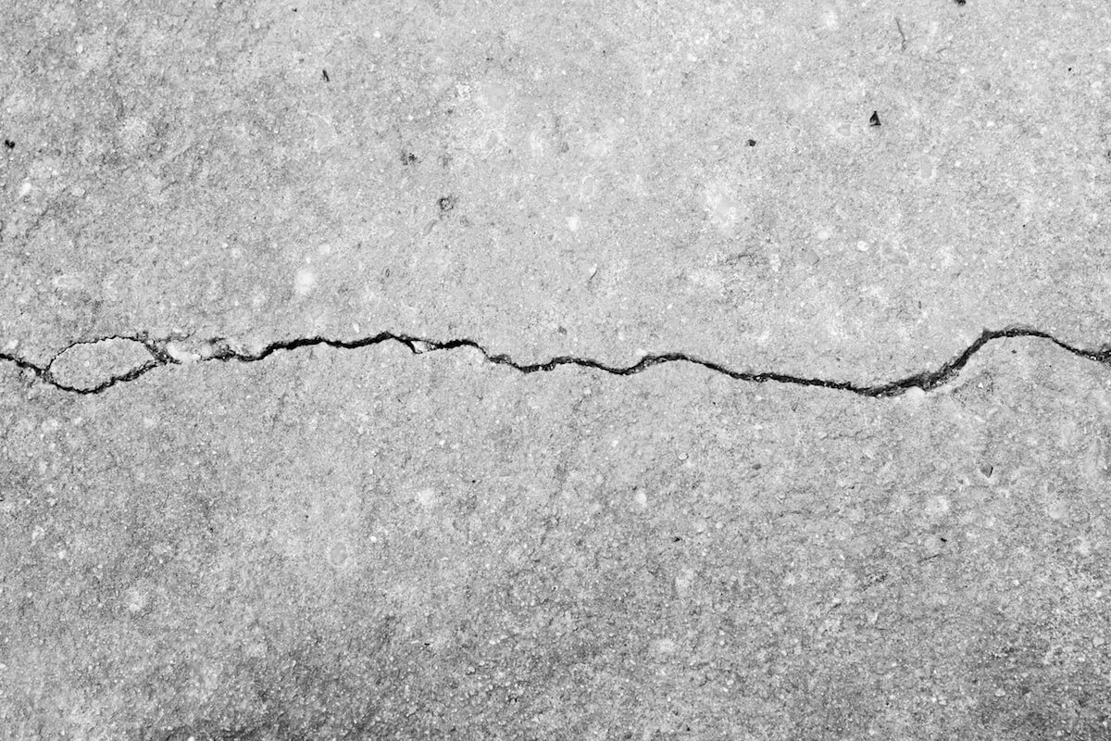
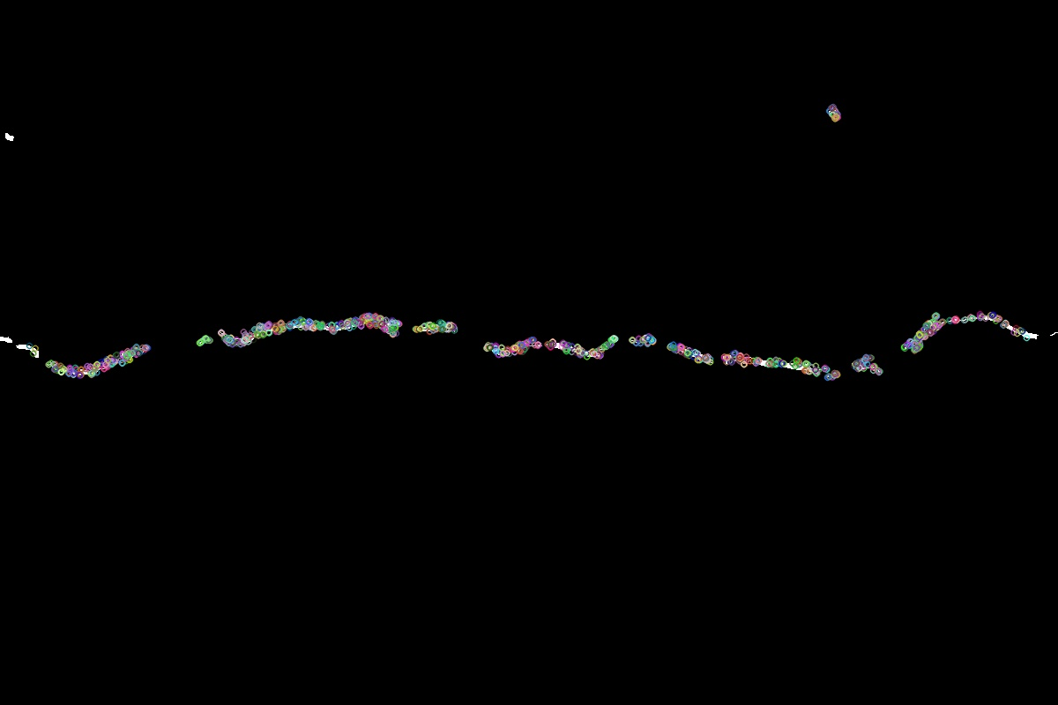
ROAD CRACK DETECTION
USING OPENCV
Traditional computer vision for road-surface inspection
INPUT IMAGE
Presented by :
Pragyan Garg (20233212)
Pushpraj Singh (20233226)
Nishan Patgiri (20233204)
Piyush Rai (20233210)
FEATURE OUTPUT
IMAGE PROCESSING · EDGE DETECTION · ORB FEATURES
01 / 20

Slide 2
The problem
Why early crack detection matters
Road cracks start small. Delayed inspection can make maintenance more expensive and difficult.
Manual inspection
Changing surfaces
Need for prioritisation
Large road networks take time and labour to inspect consistently.
Shadows, rough asphalt and lighting can make cracks hard to spot.
Potential defects should be found early so experts can assess and repair them.
Goal: help inspectors locate suspicious crack patterns from road images.
CRACK DETECTION • OPENCV
02 / 20

Slide 3
What is this project?
A lightweight, rule-based computer-vision pipeline
OpenCV pipeline
Enhance image, detect edges, connect gaps and extract features.
ROAD PHOTO
FEATURE OUTPUT
No model training is required: the script uses predefined image-processing algorithms and ORB feature extraction.
CRACK DETECTION • OPENCV
03 / 20

Slide 4
Objectives & scope
What the current implementation aims to do
01 Enhance the image
02 Highlight crack edges
Convert to grayscale and reduce unwanted pixel variation.
Use edge detection to expose thin, high-contrast structures.
03 Improve continuity
04 Extract visual features
Close small gaps in the detected edge map.
Use ORB keypoints/descriptors for further image analysis.
Scope note: the current script highlights candidate structures; it does not train a classifier or measure crack depth.
CRACK DETECTION • OPENCV
04 / 20

Slide 5
The methodology
From a road photograph to a feature-highlighted output
01
02
03
04
Input
Grayscale
Blur + log
Bilateral
Road image
Intensity image
Reduce noise / enhance
Smooth, preserve edges
05
06
07
08
Canny
Closing
ORB
Output
Detect edges
Connect small gaps
Extract keypoints
Save feature image
The script shown in the ZIP processes Cracked_07.jpg and writes CrackDetected-7.jpg.
CRACK DETECTION • OPENCV
05 / 20

Slide 6
System architecture
Four simple layers: input, processing, feature extraction and output
INPUT LAYER
Image file loaded with cv2.imread()
PRE-PROCESSING
Grayscale → 3×3 averaging blur → logarithmic transform → bilateral filter
DETECTION & FEATURES
Canny edge detection → morphological closing → ORB keypoints/descriptors
OUTPUT LAYER
Draw keypoints, save JPG with cv2.imwrite(), display with Matplotlib
Core libraries: Python · NumPy · OpenCV · Matplotlib
CRACK DETECTION • OPENCV
06 / 20

Slide 7
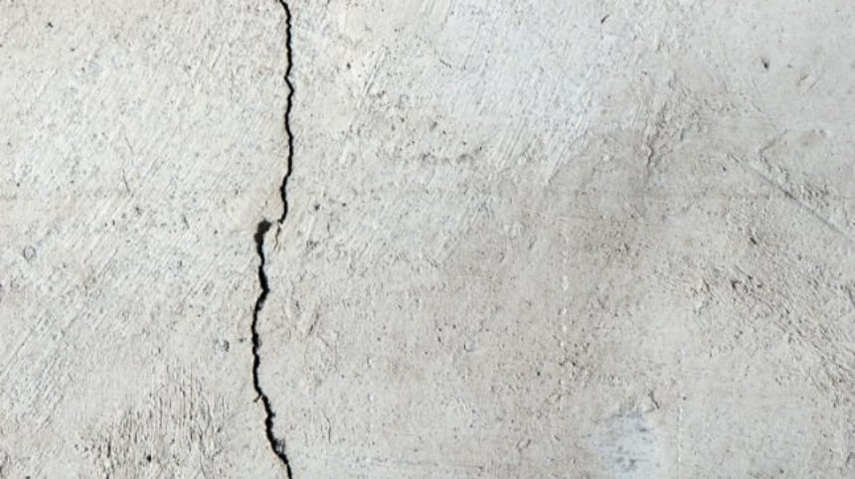
Stage 1: Image capture
High-quality input images are essential
Example input A
Example input B
Capture considerations
Good focus, sufficient resolution and even lighting improve the chance of detecting crack details.
CRACK DETECTION • OPENCV
07 / 20

Slide 8
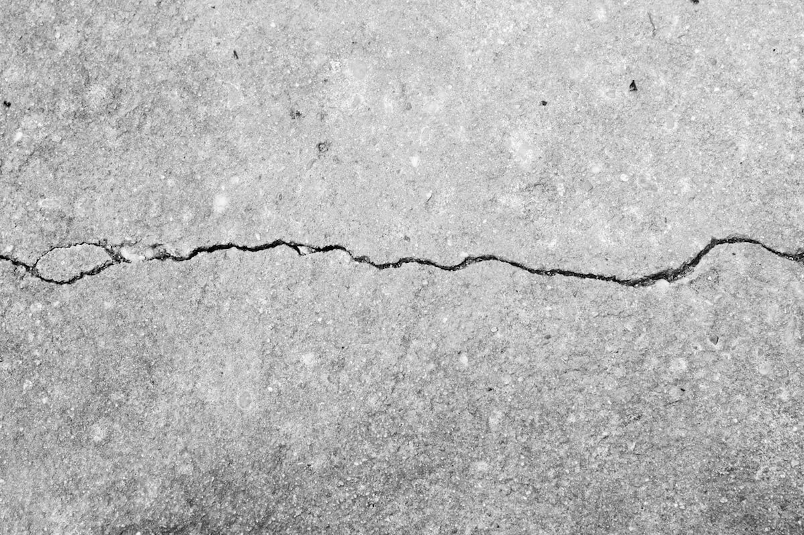

Stage 2: Grayscale & averaging blur
Simplify intensity information and reduce small-scale noise
Original image
Grayscale
3×3 average blur
Why grayscale?
Why blur?
Uses brightness instead of three colour channels.
Reduces small intensity variations before edge detection.
CRACK DETECTION • OPENCV
08 / 20

Slide 9
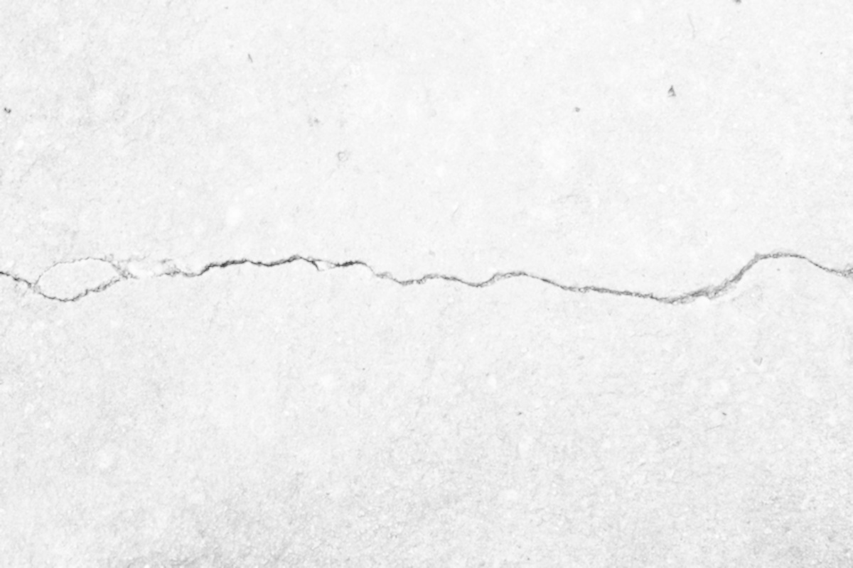
Stage 3: Logarithmic transformation
Enhance intensity differences in darker regions
Before: blurred grayscale
After: log-transformed
Typical formula: s = c · log(1 + r) | r = input intensity, c = scaling factor
It changes contrast; it does not identify a crack on its own.
CRACK DETECTION • OPENCV
09 / 20

Slide 10
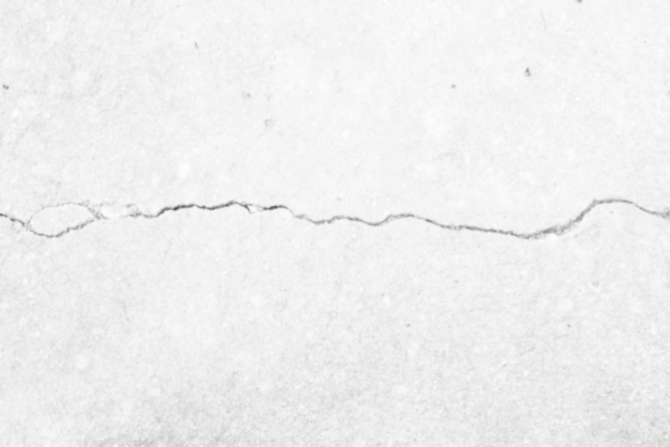
Stage 4: Bilateral filtering
Smooth similar pixels while preserving strong boundaries
Log transformed
Bilateral filtered
Key idea
The filter considers both spatial distance and intensity similarity, reducing blur across strong edges.
CRACK DETECTION • OPENCV
10 / 20

Slide 11
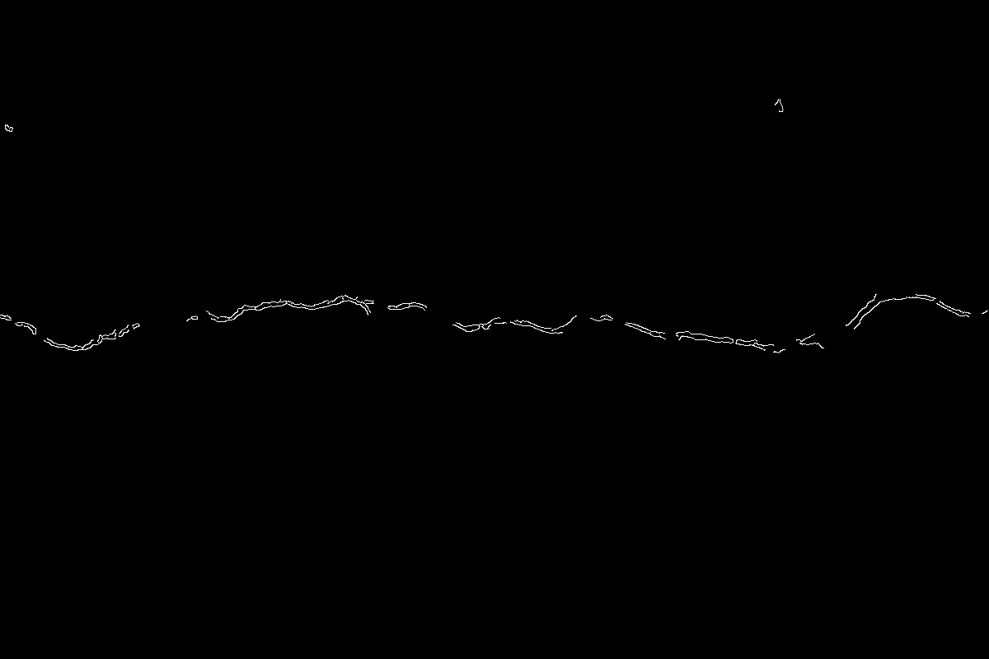
Stage 5: Canny edge detection
Find rapid changes in image intensity
Filtered image
Canny edge map
1 Gradient
2 Thin edges
3 Thresholds
Measure intensity change.
Non-maximum suppression.
Keep strong/connected edges.
CRACK DETECTION • OPENCV
11 / 20

Slide 12
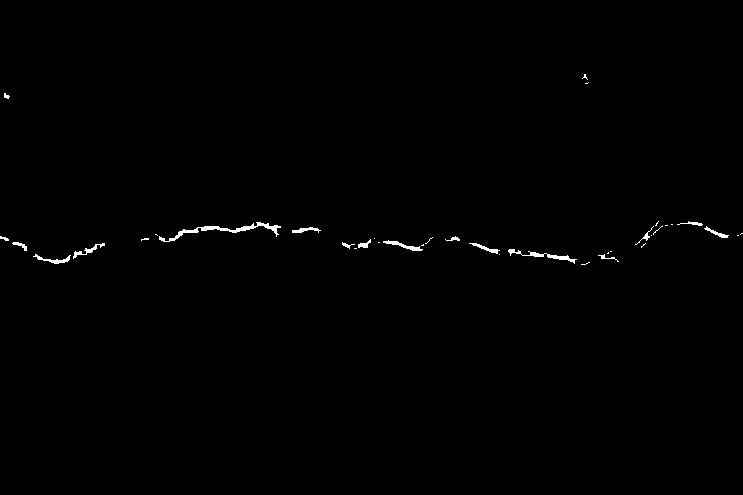
Stage 6: Morphological closing
Connect small gaps in the detected edge structures
Before closing
After closing
Dilation
Then erosion
Expands foreground pixels; nearby segments can join.
Shrinks the expanded result while retaining some connections.
CRACK DETECTION • OPENCV
12 / 20

Slide 13
Stage 7: ORB feature extraction
ORB = Oriented FAST and Rotated BRIEF
Closed edge map
Keypoints drawn on output
FAST
BRIEF descriptor
Finds distinctive keypoint locations.
Represents local appearance as a compact binary descriptor.
CRACK DETECTION • OPENCV
13 / 20

Slide 14
The full processing pipeline
What the script does in sequence
01
02
03
04
Read
Gray + blur
Log transform
Bilateral
cv2.imread
cv2.cvtColor / cv2.blur
NumPy log
cv2.bilateralFilter
05
06
07
08
Edges
Closing
ORB
Save
cv2.Canny
morphologyEx
detectAndCompute
cv2.imwrite
The current script reads one configured sample image and writes one output file.
CRACK DETECTION • OPENCV
14 / 20

Slide 15
Results & observations
Sample outputs included in the project ZIP
INPUT
CANNY EDGES
ORB OUTPUT
What the output shows
Reported performance
Candidate edges and visual keypoints are highlighted for inspection.
README suggests 80–90% may be possible on clear images; evaluation details are not provided.
CRACK DETECTION • OPENCV
15 / 20

Slide 16
How should performance be evaluated?
Visual output alone is not a validated accuracy score
Precision
Recall
F1-score
Of the regions marked as cracks, how many are truly cracks?
Of all real crack regions, how many did the system detect?
Balances precision and recall in one measure.
Recommended evaluation
• Create a labelled test set with cracked and non-cracked images.
• Compare detections against ground-truth crack masks or labels.
• Report false positives, false negatives, precision, recall and F1.
• Test under different lighting, textures and image resolutions.
The current README does not document this evaluation protocol.
CRACK DETECTION • OPENCV
16 / 20

Slide 17
Technology stack
Each library has a focused role
Python
OpenCV
Runs the processing script
Image transforms, Canny, closing, ORB
NumPy
Matplotlib
Logarithmic intensity transform and arrays
Displays original and output images
No training dataset, model weights, GPU, web server or database is required by this script.
CRACK DETECTION • OPENCV
17 / 20

Slide 18
Challenges & limitations
What can affect the quality of detection?
Shadows and lighting
Road texture
Strong shadows can resemble cracks; uneven light changes contrast.
Gravel, patches and rough asphalt may create unwanted edges.
Parameter sensitivity
Not a crack classifier
Canny thresholds and kernel sizes affect the output.
ORB detects keypoints; it does not decide whether a feature is a crack.
Current output should support inspection, not replace engineering assessment.
CRACK DETECTION • OPENCV
18 / 20

Slide 19
Future scope & key takeaways
A foundation that can be extended
Batch processing
Crack segmentation
Process all images in a folder rather than one hard-coded sample.
Produce a clearer crack mask and estimate affected area.
Classification
Better validation
Add a trained model if reliable crack/non-crack or crack-type labels are needed.
Benchmark against labelled data across diverse conditions.
TAKEAWAYS
• Traditional computer vision — no model training in the current script.
• Preprocessing → edge map → morphological closing → ORB features.
• Image quality matters; reported accuracy needs a documented test.
CRACK DETECTION • OPENCV
19 / 20

Slide 20
THANK YOU
Questions & Discussion
Crack Detection Using OpenCV · Traditional Image Processing
20 / 20

