Slide 1
Summer Camp Team C <Day 1> 境界領域の法線付きラベリングによる 部品単位の尤度計算法 Per object Likelihood Estimation from Labeling using Surface normal
Members
Caesar, Matsubara, Liang, Nicholas, Ueda, Pragyan
Notes:
これから、機能工学システム専攻4年画像情報研究室所属の武田隆雅が多視点画像から復元した３次元形状に基づく 建築物の倒壊判定法と題しまして発表します

Slide 2
Overview
ICP and choose shape
with minimum RMSE
Point Clouds
For each cluster
Problem Set Voxel
Labeled Voxels
Point Clouds
For each cluster
Point Clouds
For each cluster
Point Clouds
For each cluster
Point Clouds
For each object
Labels
Labels
Labels
Labels
Labels
Source Object Voxel
Point Clouds
For each object
Source Object Voxel
Point Clouds
For each object
Source Object Voxel
Point Clouds
For each object
Source Object Voxel
Point Clouds
For each object
Source Object Voxel
Point Clouds
For each object
Need to be done only once

Slide 3
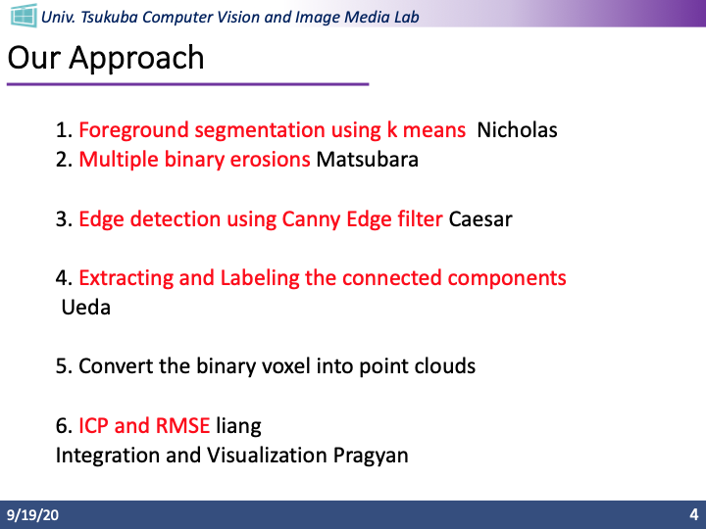
Our Approach
1. Foreground segmentation using k means
2. Multiple binary erosions
3. Edge detection using Canny Edge filter
4. Extracting and Labeling the connected components
5. Convert the binary voxel into point clouds
6. ICP and RMSE

Slide 4
Our Approach
Voxel
Using Kmeans, k = 2
Foreground segmentation
Canny Edge
Binary voxels
Edges with
Gradients
Binary Erosion
Binary voxels
Labeling
ICP
Point Clouds per parts
Evaluation using RMSE

Slide 5
Labeling
Connections loosened
1
2
From low intensity to high intensity
1
1
2

Slide 6


Progress
Coding Rules
Using Github for collaboration
Data mainly stored with numpy ndarray
Each of us code the functions component wise

Slide 7
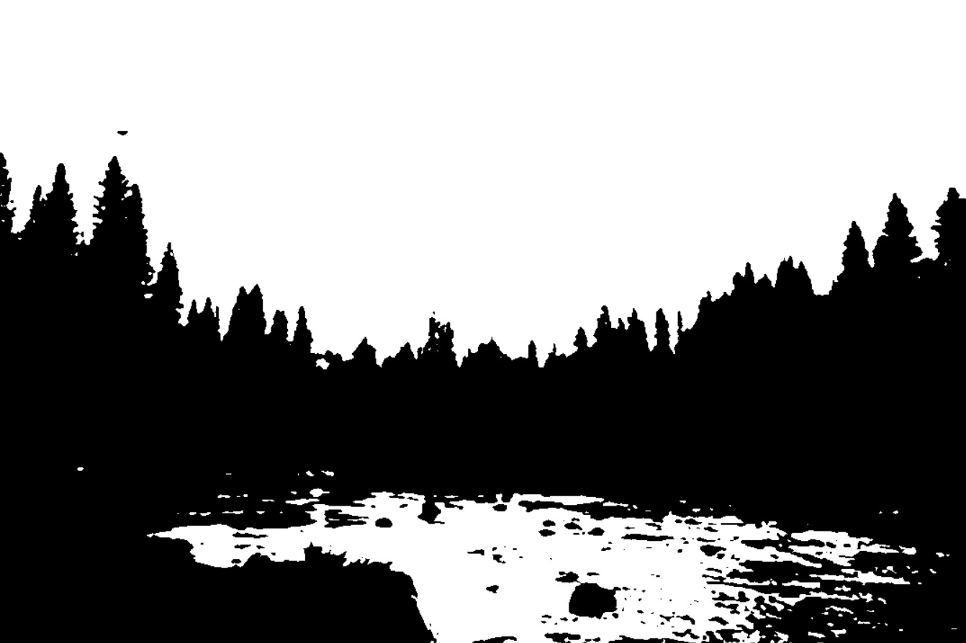
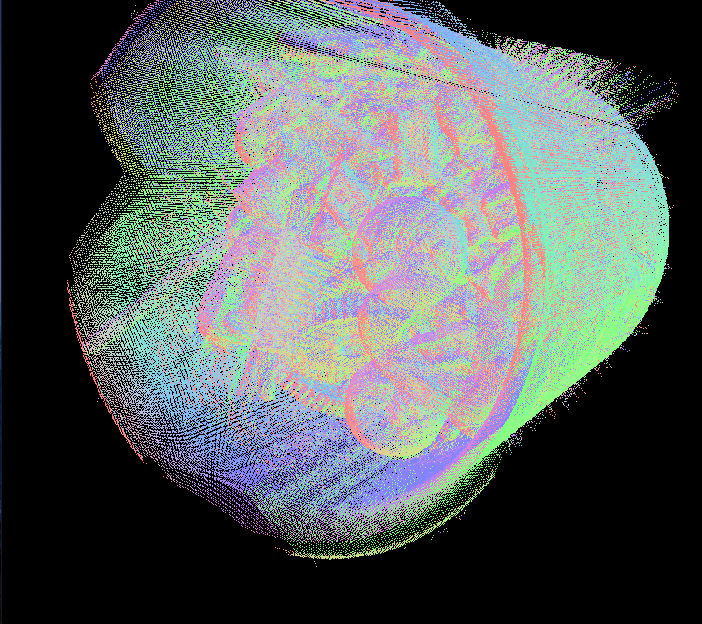
Progress
Foreground extracted
Foreground Segmentation:
OpenCV
Edge Detection:
3d approach
SimpleITK <- 3d medical image processing
Binary Erosion:
OpenCV
Labeling:
OpenCV
ICP:
Open3D
Computed Gradients

