Slide 1
Summer Camp Team C <Day 1> 境界領域の法線付きラベリングによる 部品単位の尤度計算法 Per object Likelihood Estimation from Labeling using Surface normal
Members
Caesar, Matsubara, Liang, Nicholas, Ueda, Pragyan
Notes:
これから、機能工学システム専攻4年画像情報研究室所属の武田隆雅が多視点画像から復元した３次元形状に基づく 建築物の倒壊判定法と題しまして発表します

Slide 2
Our Approach
Voxel
Using Kmeans, k = 2
Foreground segmentation
Canny Edge
Binary voxels
Edges with
Gradients
Binary Erosion
Binary voxels
Labeling
ICP
Point Clouds per parts
Evaluation using RMSE

Slide 3
Our Focus
Labeling

Slide 4
Our Approach
Voxel
Using Kmeans, k = 2
Foreground segmentation
Canny Edge
Binary voxels
Edges with
Gradients
Binary Erosion
Binary voxels
Labeling
ICP
Point Clouds per parts
Evaluation using RMSE

Slide 5
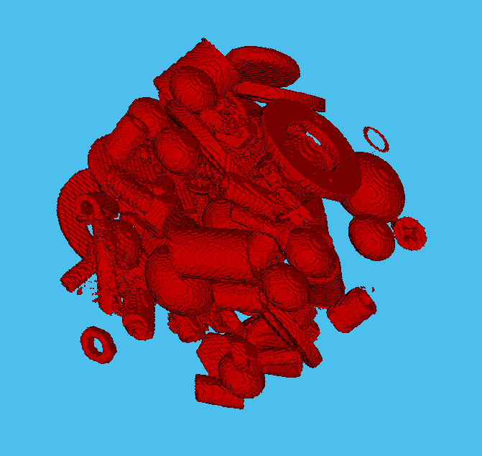

Results
Foreground Segmentation

Slide 6
Our Approach
Voxel
Using Kmeans, k = 2
Foreground segmentation
Canny Edge
Binary voxels
Edges with
Gradients
Binary Erosion
Binary voxels
Labeling
ICP
Point Clouds per parts
Evaluation using RMSE

Slide 7
Results
Binary Erosion

Slide 8
Our Approach
Voxel
Using Kmeans, k = 2
Foreground segmentation
Canny Edge
Binary voxels
Edges with
Gradients
Binary Erosion
Binary voxels
Labeling
ICP
Point Clouds per parts
Evaluation using RMSE

Slide 9


Results
Canny Edge

Slide 10
Our Approach
Voxel
Using Kmeans, k = 2
Foreground segmentation
Canny Edge
Binary voxels
Edges with
Gradients
Binary Erosion
Binary voxels
Labeling
ICP
Point Clouds per parts
Evaluation using RMSE

Slide 11
Results
Labeling

Slide 12
Our Approach
Voxel
Using Kmeans, k = 2
Foreground segmentation
Canny Edge
Binary voxels
Edges with
Gradients
Binary Erosion
Binary voxels
Labeling
ICP
Point Clouds per parts
Evaluation using RMSE

Slide 13
Results
ICP

Slide 14
Results
Evaluation

Slide 15
Conclusion

Slide 16
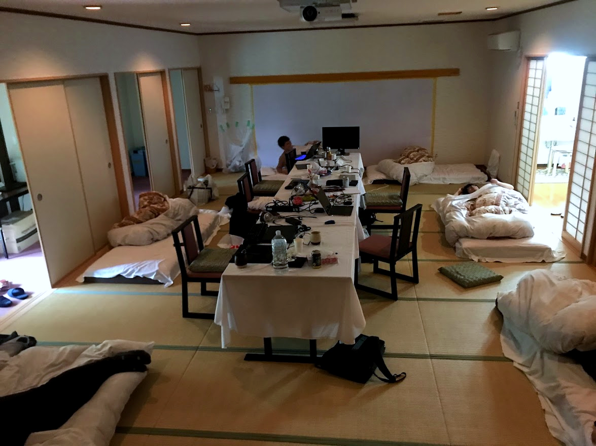
How we spent
Day 1
~12:00 Preparations
13:00 Power Nap
14:00~ Coding

Slide 17
How we spent
Day 1
~12:00 Preparations
13:00 Power Nap
14:00~ Coding

Slide 18
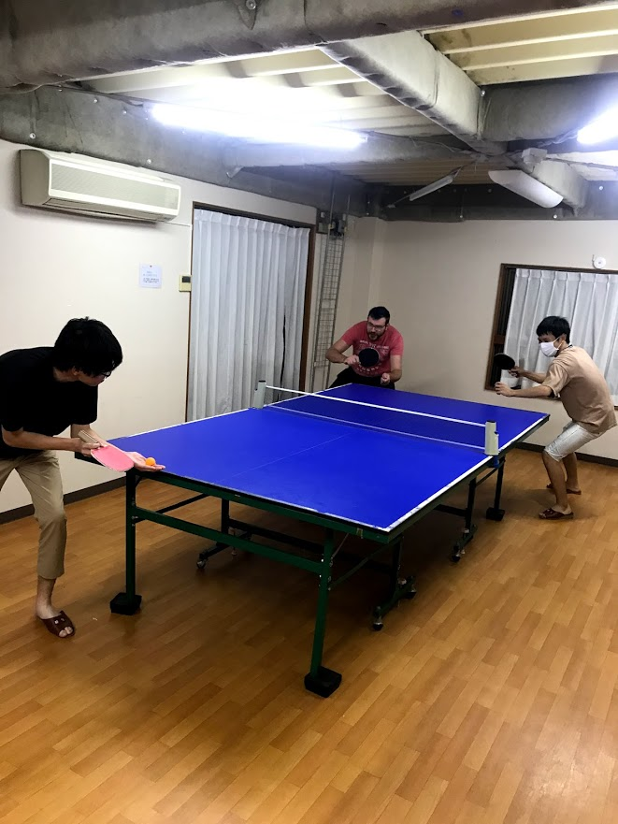
How we spent
Day 2
~09:00 Coding
?? Table Tennis

Slide 19
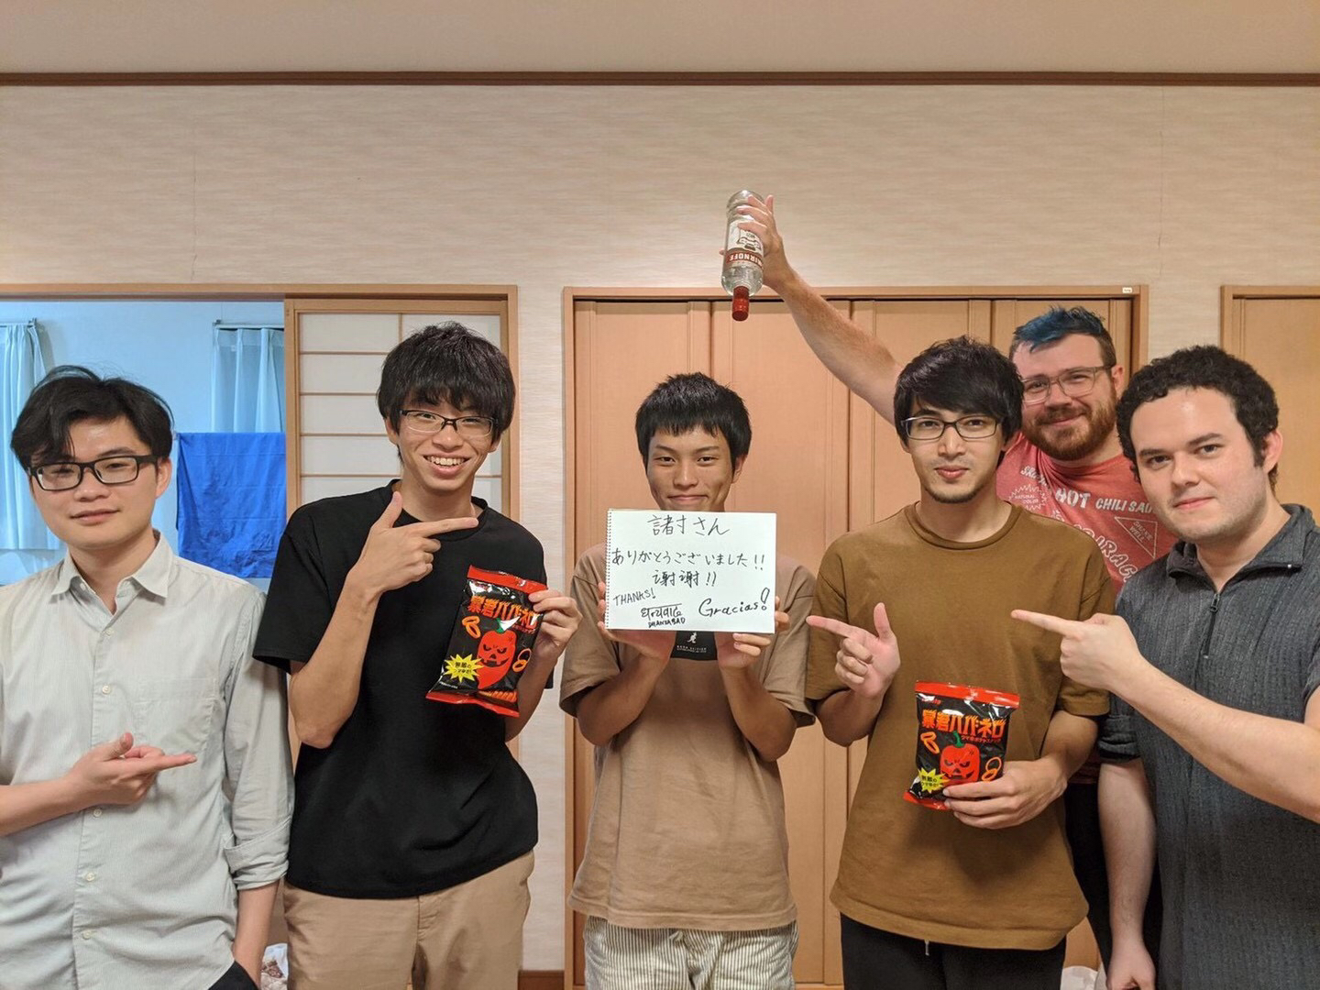
How we spent
Day 2
~09:00 Coding
?? Table Tennis

Slide 20


How we spent
Day 2
~09:00 Coding
?? Table Tennis

Slide 21
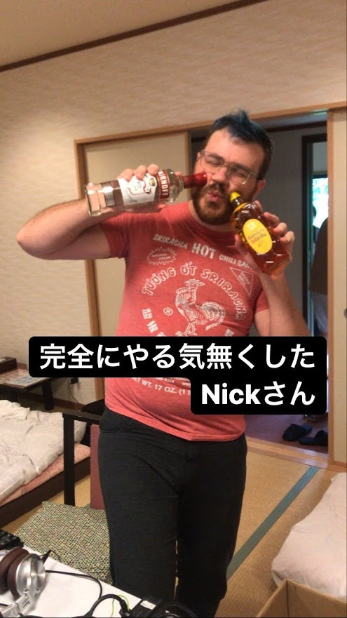
How we spent
Day 2
~09:00 Coding
?? Table Tennis

Slide 22
Overview
ICP and choose shape
with minimum RMSE
Point Clouds
For each cluster
Problem Set Voxel
Labeled Voxels
Point Clouds
For each cluster
Point Clouds
For each cluster
Point Clouds
For each cluster
Point Clouds
For each object
Labels
Labels
Labels
Labels
Labels
Source Object Voxel
Point Clouds
For each object
Source Object Voxel
Point Clouds
For each object
Source Object Voxel
Point Clouds
For each object
Source Object Voxel
Point Clouds
For each object
Source Object Voxel
Point Clouds
For each object
Need to be done only once

Slide 23
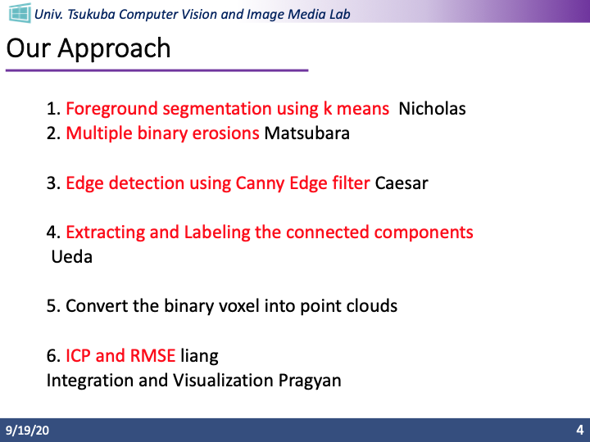
Our Approach
1. Foreground segmentation using k means
2. Multiple binary erosions
3. Edge detection using Canny Edge filter
4. Extracting and Labeling the connected components
5. Convert the binary voxel into point clouds
6. ICP and RMSE

