Slide 1

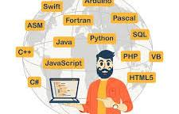
Top Programming Languages of 2025
The Future of Coding

Slide 2


Why Choose the Right Programming Language?
The programming world is constantly evolving.
Choosing the right language can shape your career.
Let’s explore the top programming languages for 2025.

Slide 3
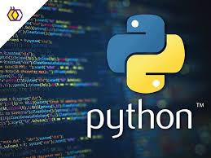
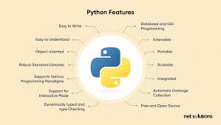
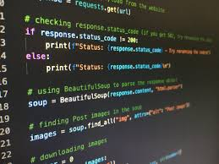
Python: The All-Rounder
Popular for AI, ML, web development, and data analysis.
Easy to learn with a vast community.
Trending frameworks: Django, Flask, TensorFlow.

Slide 4
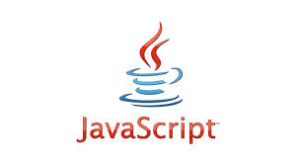
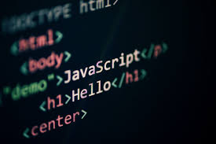
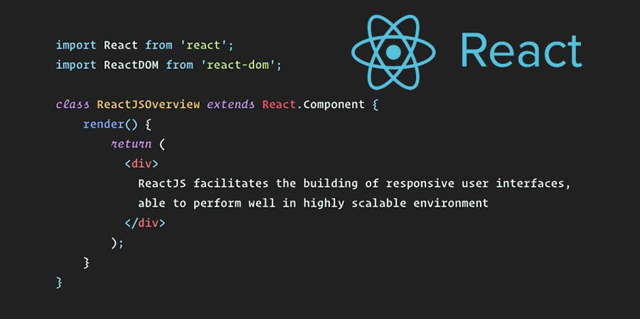
JavaScript: The Web Champion
Backbone of web development.
Essential for frontend and backend (Node.js).
Trending frameworks: React, Angular, Vue.js.

Slide 5
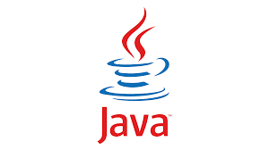
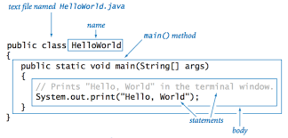
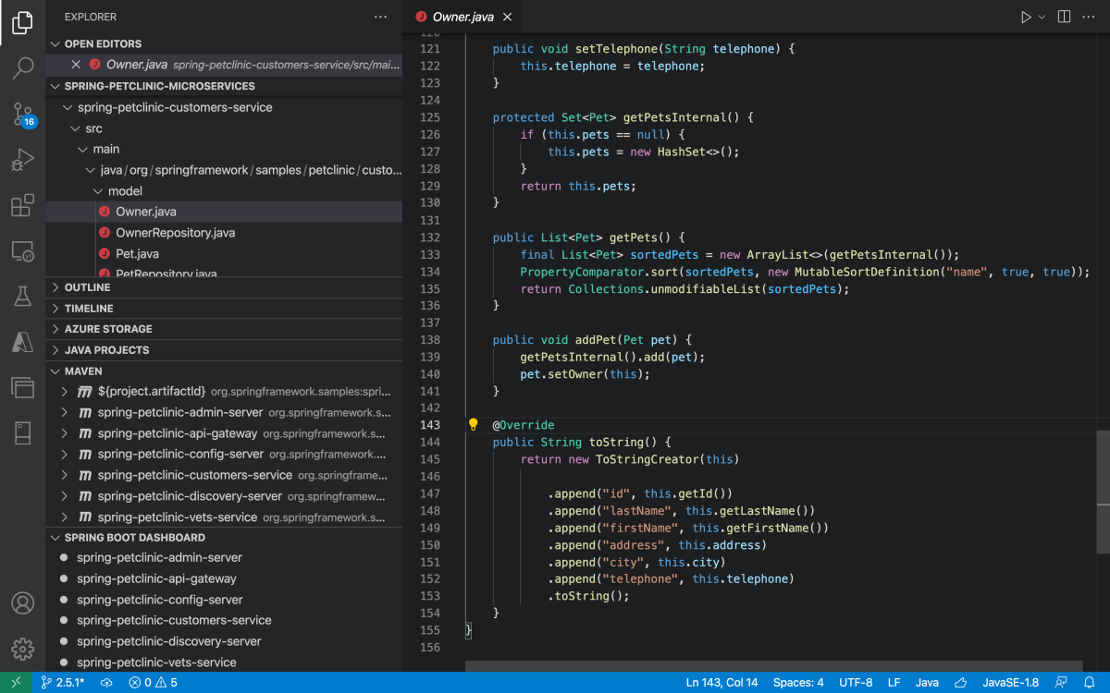
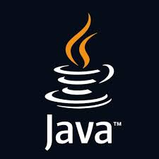
Java: The Enterprise Favorite
Widely used in enterprise-level applications.
Strong presence in Android app development.
Focus on scalability and security.

Slide 6
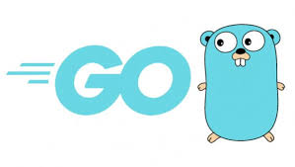
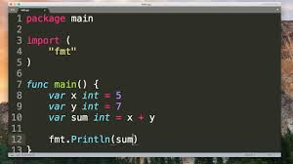
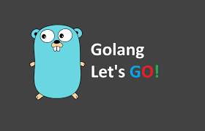
Go: The Performance Pro
Known for its simplicity and high performance.
Ideal for cloud computing and server-side projects.
Backed by Google.

Slide 7
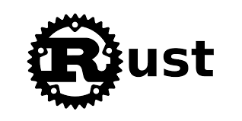
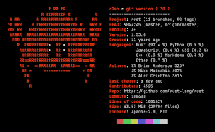
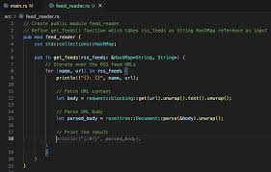
Rust: The Safe Bet
Focuses on safety and performance.
Excellent for systems programming.
Voted most loved language in developer surveys.

Slide 8
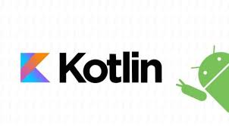
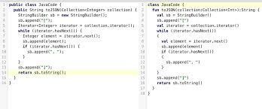
Kotlin: Android’s Companion
Preferred language for Android app development.
Modern, concise, and interoperable with Java.
Backed by Google.

Slide 9
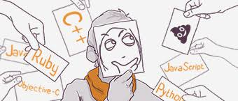
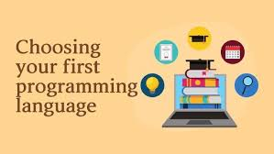
What’s Your Pick?
• The right programming language depends on your goals.
• Stay updated with trends to remain relevant.
• Explore, learn, and grow as a developer.

Slide 10



Ready to Dive In?
Like, Share, and Subscribe for more tech insights!
Comment your favorite programming language below!

