Slide 1

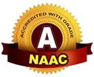
Bhoj Reddy Engineering College for Women
(Sponsored by Sangam Laxmibai Vidyapeet, Accredited by NAAC with A grade Approved by AICTE and Affiliated to JNTUH) Vinaynagar, IS Sadan Crossroads, Saidabad, Hyderabad – 500 059, Telangana. www.brecw.ac.in
Department of Computer Science and Engineering
Mini Project Execution Seminar on
DialectAI
Bridging Telugu Dialects to Global Understanding
Internal Guide: M Vinod Date : 30 May 2025
Associate Professor Batch No : 22MP28
CSE-B Coordinator: K Shireesha Kanathala Parnika 22321A0566
Associate Professor Kondour Praharsha 22321A0569
NV Sriraga Sathvika 22321A05A5
M Vinod Dr J Madhavan
Professor & Head Professor & Principal

Slide 2
Introduction
DialectAI aims to bridge communication gaps by recognizing and translating regional Telugu dialects into English. It leverages speech-to-text, and Machine Learning for accurate dialect translation. Designed to assist travelers, migrants, and non-native speakers, it helps in understanding informal speech and dialectal variations. Unlike standard translation tools, DialectAI focuses on dialect-specific nuances to ensure precise and meaningful translations.

Slide 3
Scope
Our project aims to classify 1-2 Telugu dialects from speech, converting dialect phrases into text. It translates dialect-specific words into standard Telugu and English, while suggesting context-aware replies. The user-friendly interface supports both text and voice input, and users can hear standardized phrases for better understanding.

Slide 4
Existing System
The existing system relies on formal language datasets, ignoring regional dialects. Google Translate and voice assistants like Siri struggle with dialect variations, slang, and informal speech. Manual methods, such as slang dictionaries, are inefficient and not scalable for real-time communication. Our project highlights the need for a solution that addresses dialect differences dynamically.

Slide 5
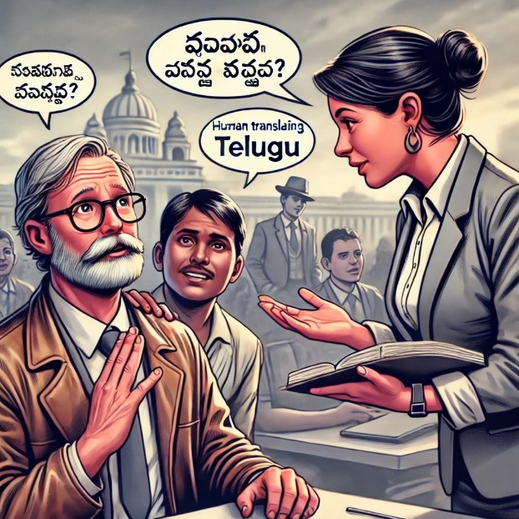
Disadvantages of Existing System
No Regional Dialect Detection
Lack of Context Awareness
Poor Speech Recognition for Dialects
Limited Dataset Availability
No Conversational Response Generation

Slide 6
Proposed System
DialectAI is an AI-powered web app that translates Telugu dialects into English using Python, SpeechRecognition, PyAudio, and the googletrans module. It processes both text and speech inputs, converting dialectal Telugu phrases into standard Telugu before translating them into English. The system includes a text-to-speech output feature, allowing users to hear the translations for improved accessibility and ease of use. Additionally, it offers a translation history feature, enabling users to review their previous inputs and translations for better continuity and reference.

Slide 7
Advantages of Proposed System
Accurate Dialect Recognition
Improved Translation Quality
Real-Time Processing
Context-Aware Responses
Multi-Modal Input Support

Slide 8
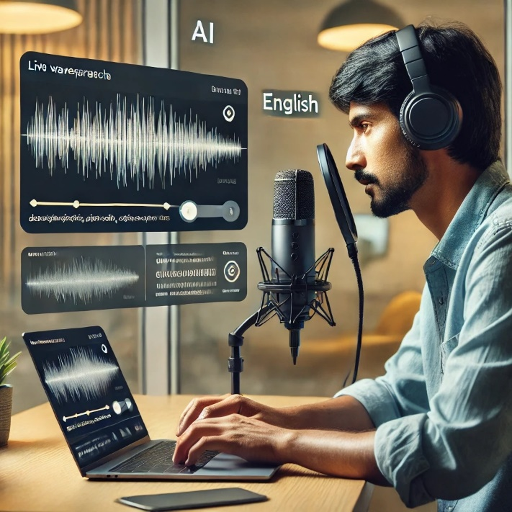
Requirement Analysis
Functional Requirements
User
Registration
Login
Speech input/ Text input
View the Detected Dialect
View the translated Dialect in English
View Translation History
Logout

Slide 9
Requirement Analysis
Non-Functional Requirements
Performance: DialectAI will classify dialects, convert speech to text, and translate within 7 seconds
Scalability: It will efficiently handle growing user traffic and speech data
Security: Implements end-to-end encryption and secure authentication
Usability: Provides a simple, intuitive UI with voice and text input across devices
Compatibility: Integrates with external APIs and supports multiple speech/text formats
Latency: Ensures a response time under 5 seconds for speech processing

Slide 10
Computational Resources
Software Requirements
Hardware Requirements
Operating System | : Windows 11
Frontend | : HTML5, CSS3, JavaScript
Programming Language | : Python 3.12.2
Speech Processing | : PyRecognition and PyTorch
Database | : MySQL
Processor | : Intel Core i5
RAM | : 8GB
HardDisk | : 128GB SSD
Microphone | : External USB Microphone

Slide 11
Design
In software engineering, "design" refers to the process of planning and defining how a software system will work.
It involves creating a blueprint for the software, including its structure, components, and how they will interact.
The goal of design is to solve problems and specify how the software will meet user requirements.

Slide 12
Software Architecture
Register
Login
Speech input/Text input
USER
View the Detected Dialect
View the translated Dialect in English.
View the translated history
Logout

Slide 13
Technical Architecture
HTML5
CSS3
JavaScript
Python

Slide 14
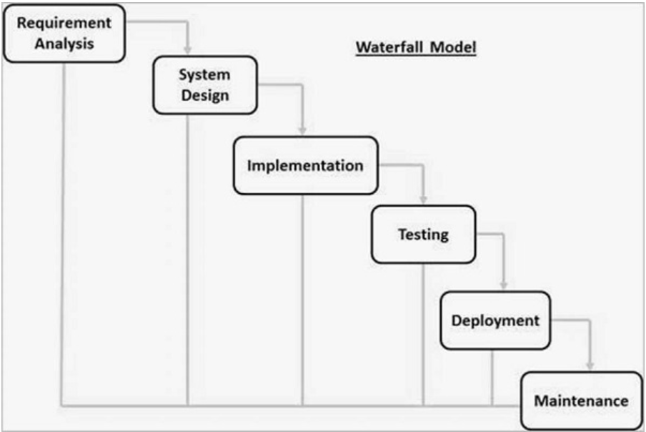
Software Model

Slide 15
Data Flow Diagram
A Data Flow Diagram (DFD) is a graphical representation used to depict the flow of data within a system, showing how data is processed, stored, and transmitted.
DFDs are used in system analysis and design to visualize data processes, and serve as a blueprint for system development.

Slide 16
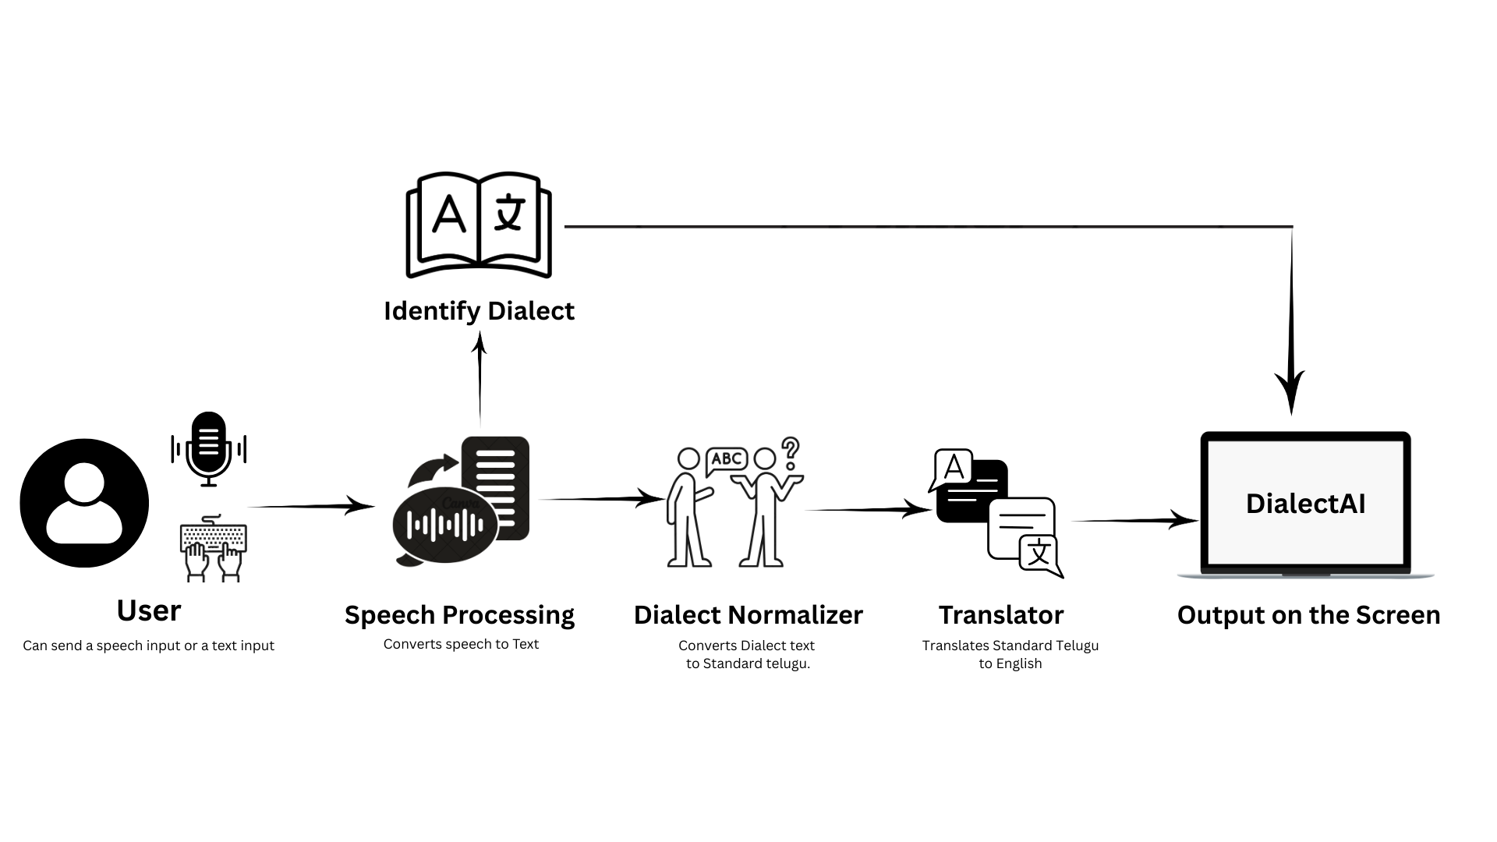

Data Flow Diagram- DialectAI

Slide 17
UML DIAGRAMS

Slide 18
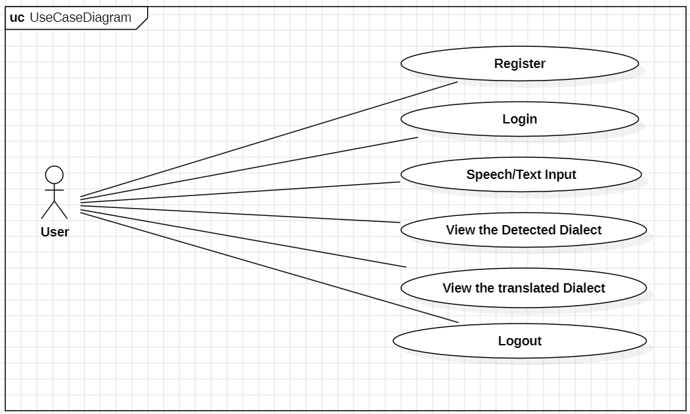

Slide 19
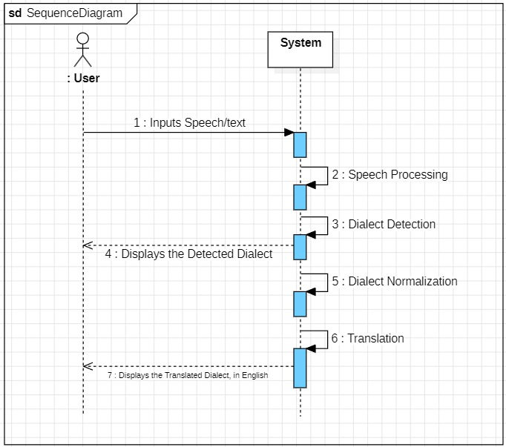

Slide 20
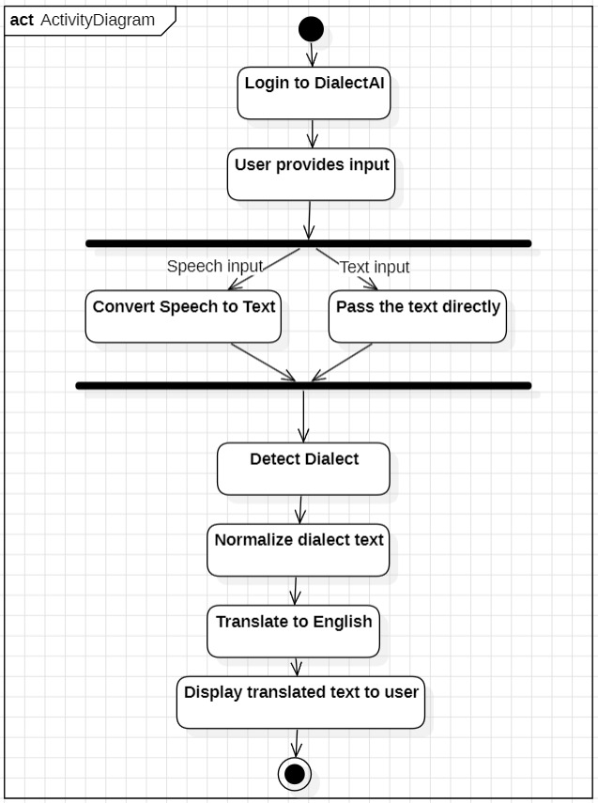

Slide 21
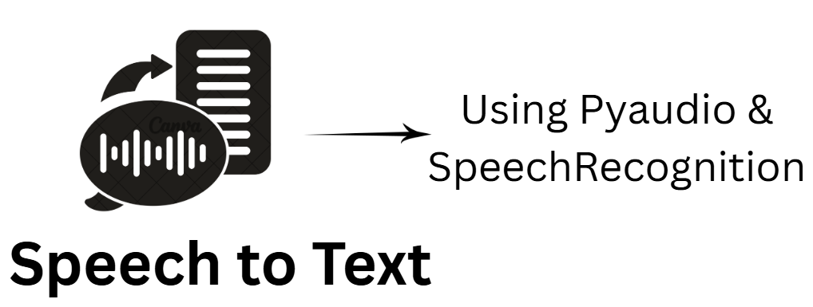
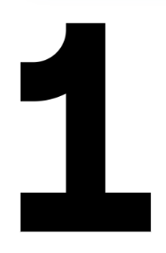
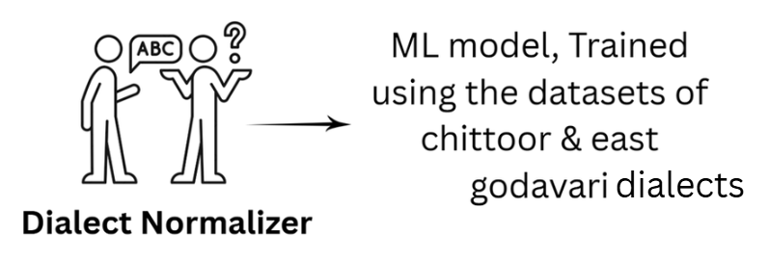
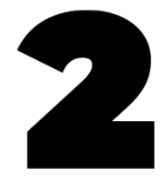
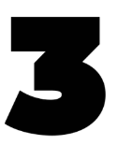
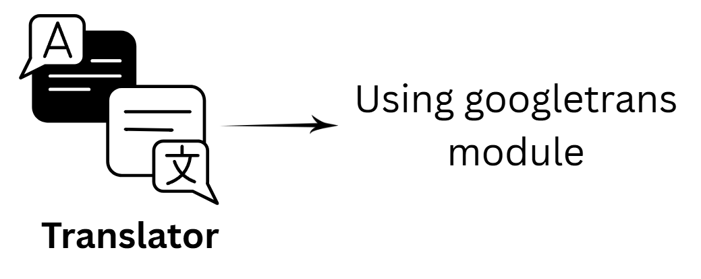
Implementation Steps & Algorithm

Slide 22
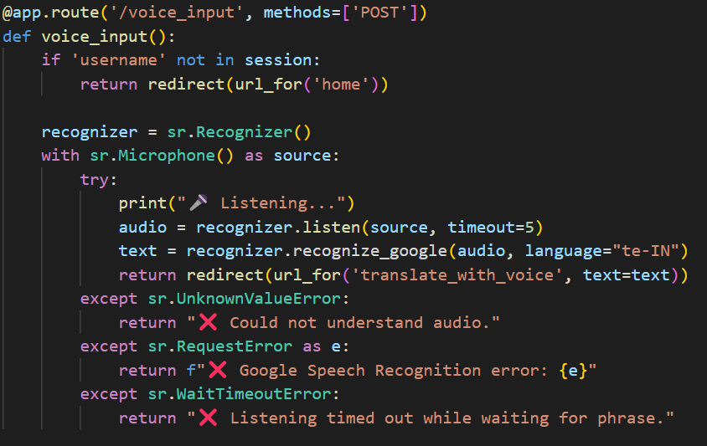
Speech Processing

Slide 23
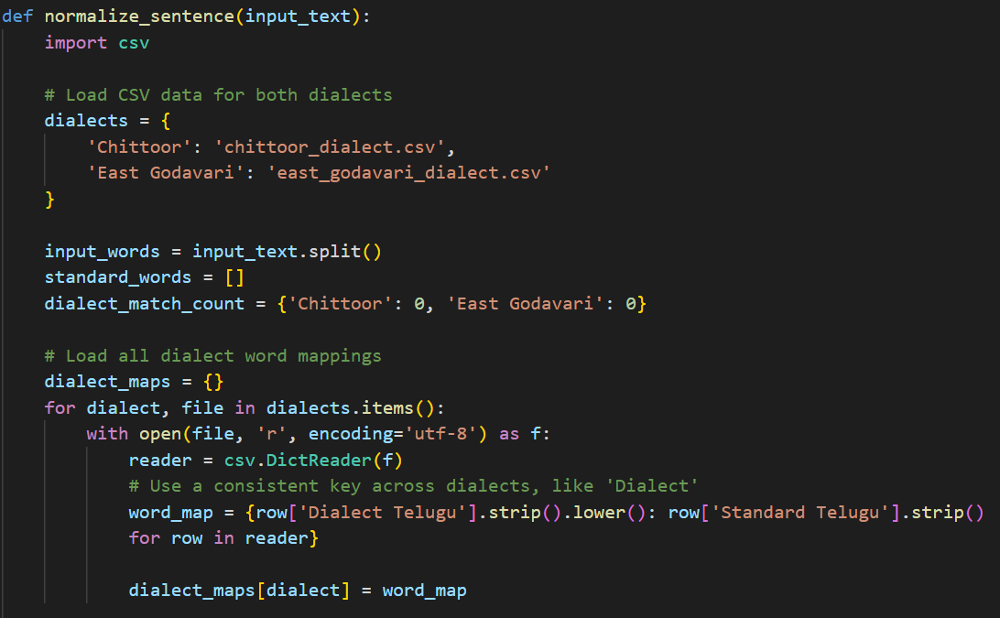
Dialect Normalization and Translation

Slide 24
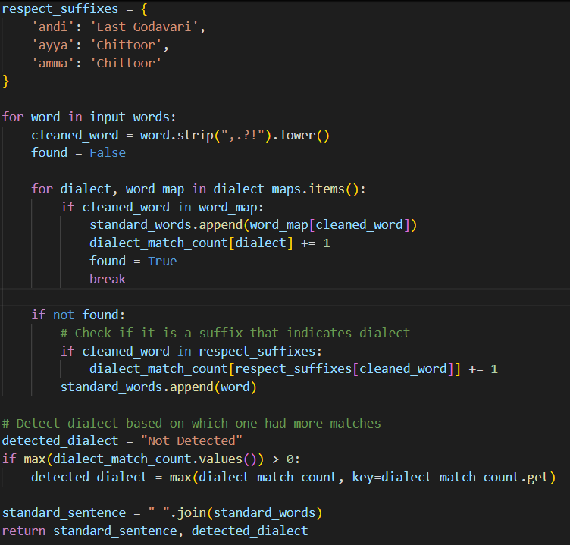

Slide 25
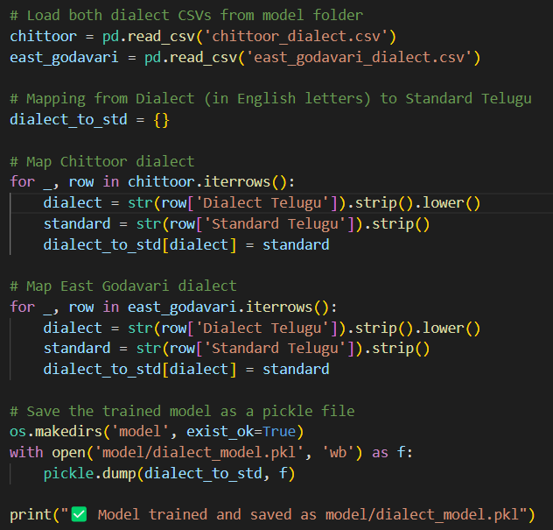
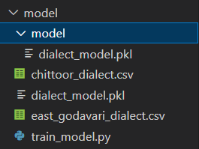
Model Training

Slide 26
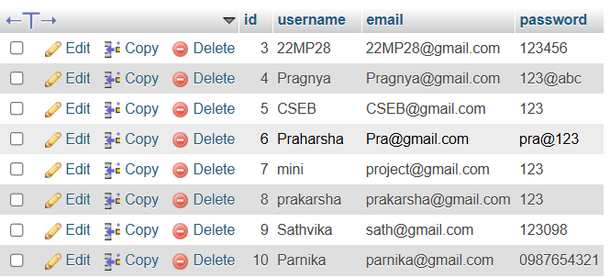
Database
Users

Slide 27
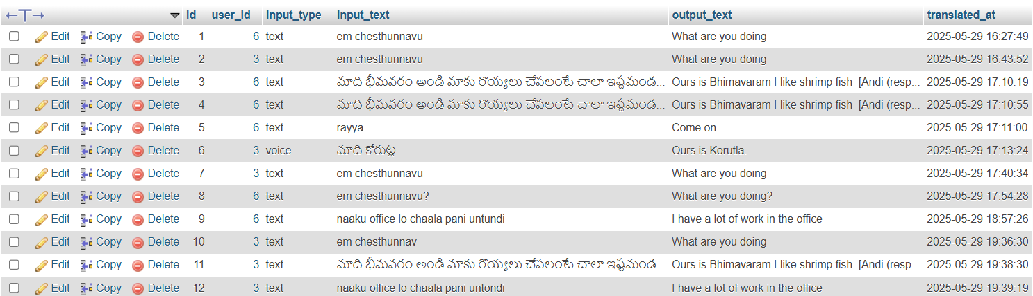
Translation History of Users

Slide 28
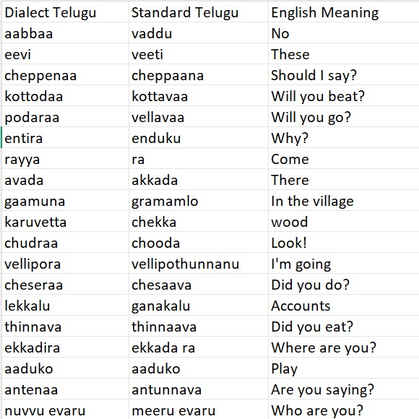
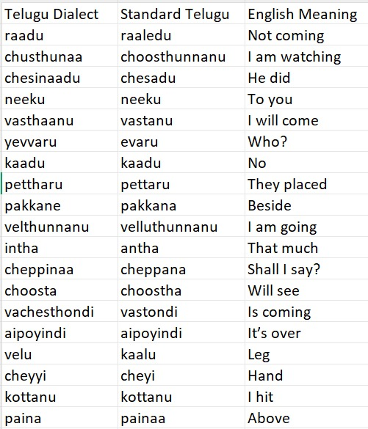
Dataset for Training
Chittoor_Dialect.csv
East_Godavari_Dialect.csv

Slide 29
Test Cases
Test ID | Test Name | Inputs | Process | Expected output | Actual Output | Status
1 | Login Credentials | Username Password | validate the credentials | Displays DialectAI | Displays the DialectAI | Success
2 | Login Credentials | Username Password | validate the credentials | Displays DialectAI | Incorrect username/ password! | Success

Slide 30
Test ID | Test Name | Inputs | Process | Expected output | Actual Output | Status
3 | Valid Dialect Text Translation | “Ledandi” | Detect dialect & Normalize translate | Telugu: Ledu English: No (Andi is for respect- in East Godavari) | Telugu: Ledu English: No (Andi is for respect- in East Godavari) | Success
4 | Case insensitive Text Processing | “em chesthunnarandi” | Detect dialect & Normalize translate | Telugu: Em chesthunnav English: What are you doing | Telugu: Em chesthunnav English: What are you doing | Success

Slide 31
Test ID | Test Name | Inputs | Process | Expected output | Actual Output | Status
5 | Voice input translation | “Naaku office lo chaala work untondi” | Speech to Text Normalize Translate | English: I am having a lot of work in the office. | English: I am having a lot of work in the office. | Success
6 | Case insensitive Text Processing | “EM chesthUNnarandi” | Normalize case, translate | Telugu: Em chesthunnav English: What are you doing | Telugu: Em chesthunnav English: What are you doing | Success

Slide 32
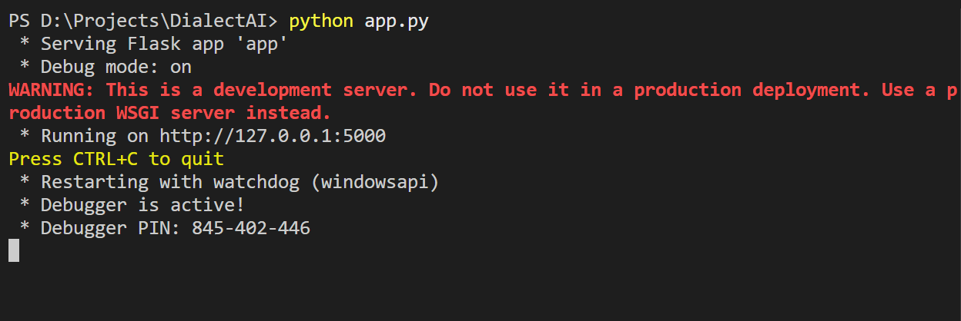
Output
Starting the Flask Application

Slide 33
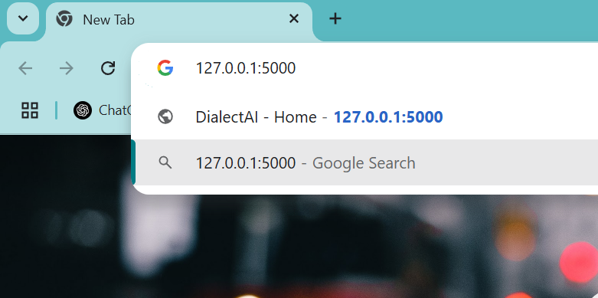

Slide 34
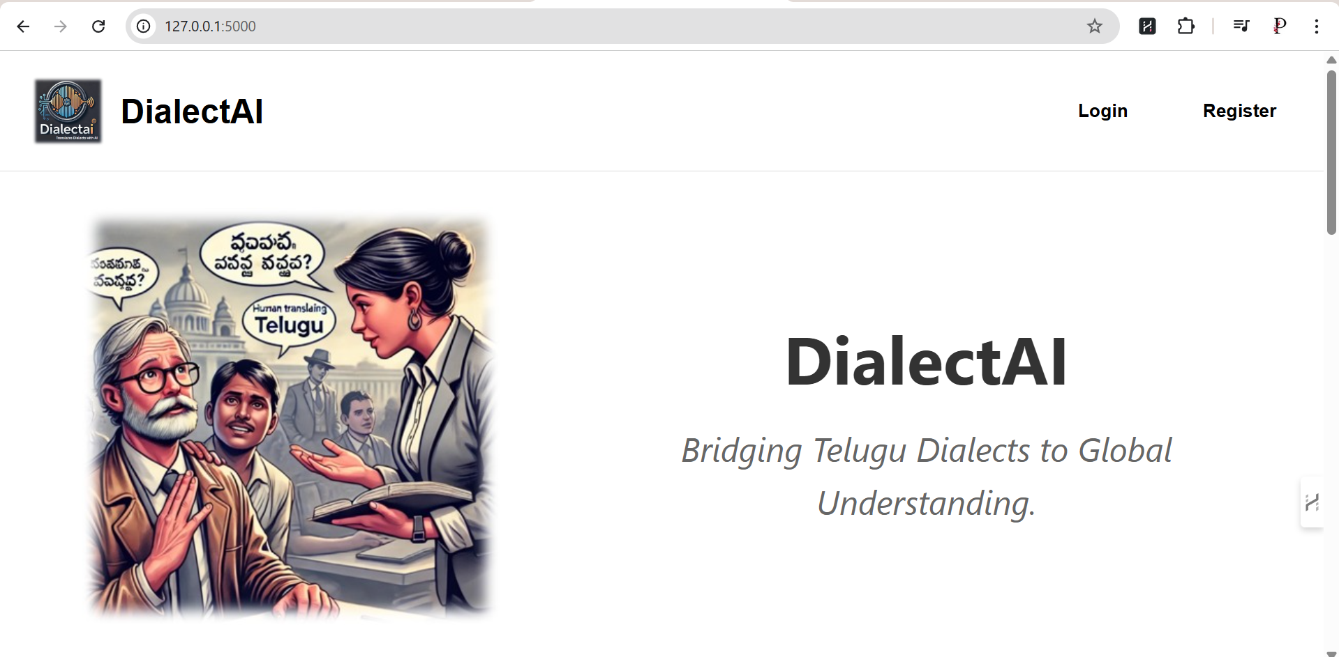

Slide 35
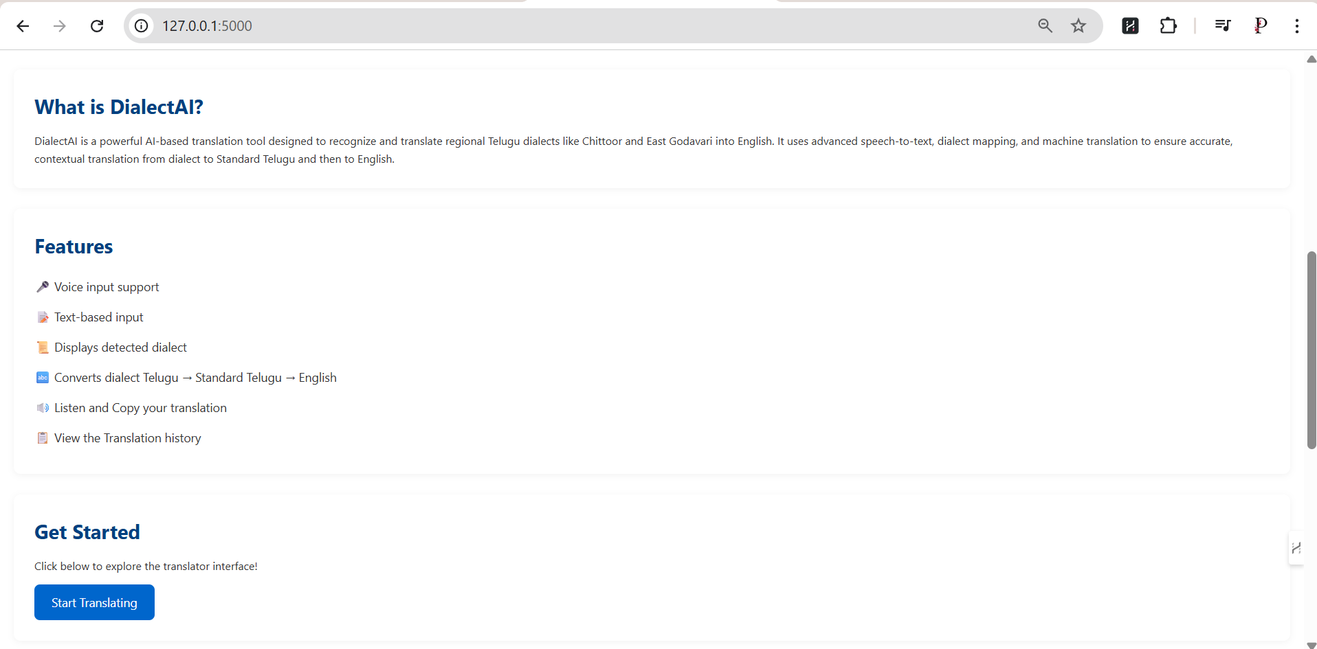

Slide 36
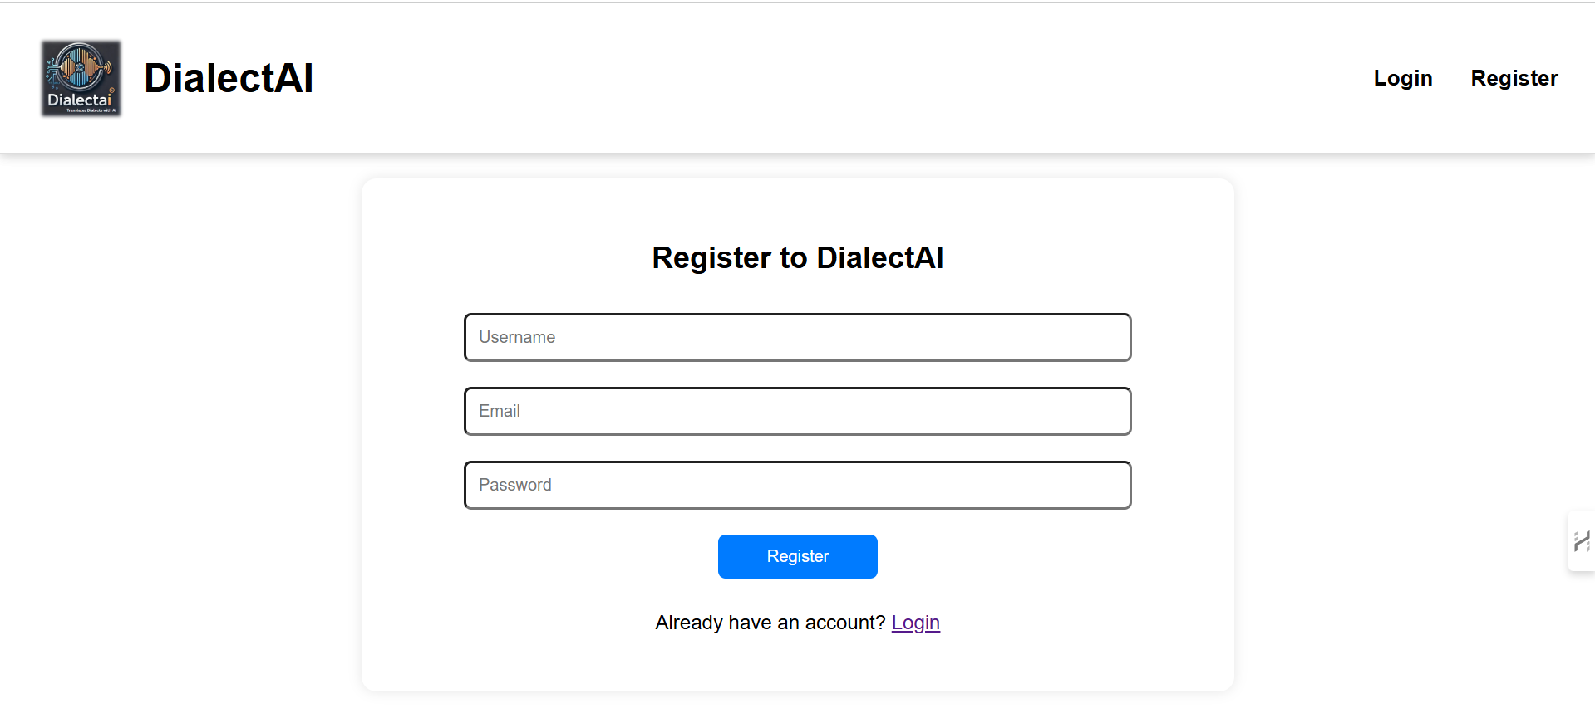

Slide 37
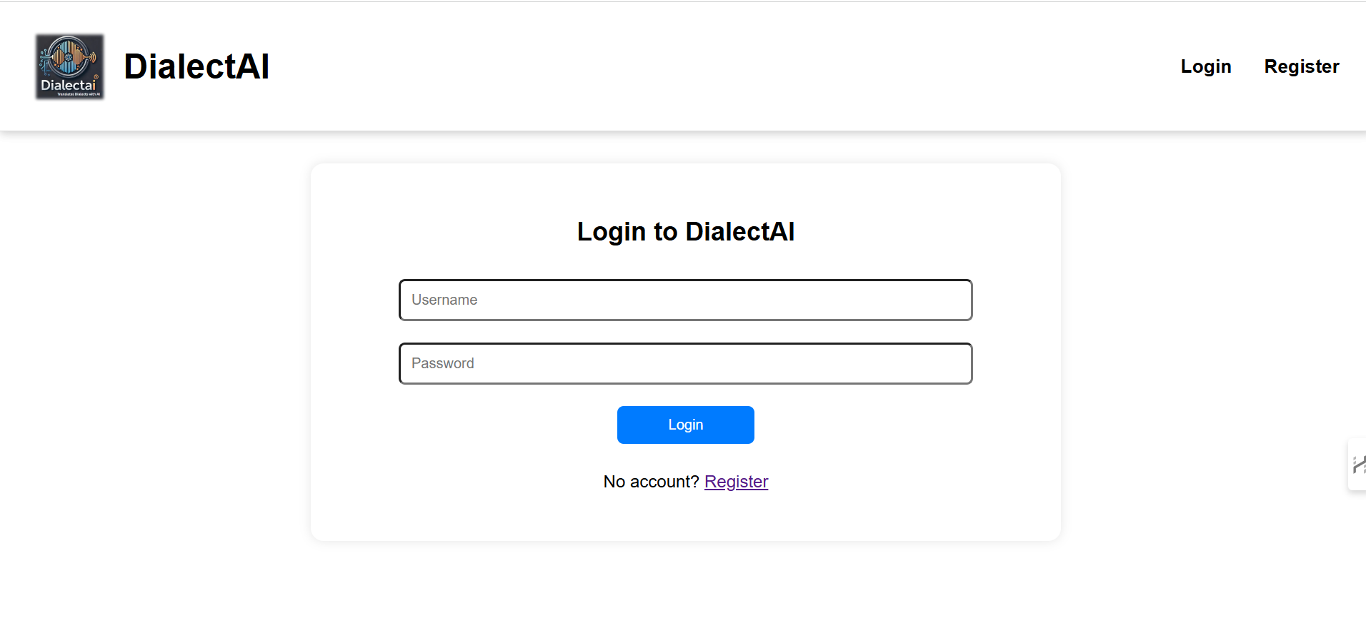

Slide 38
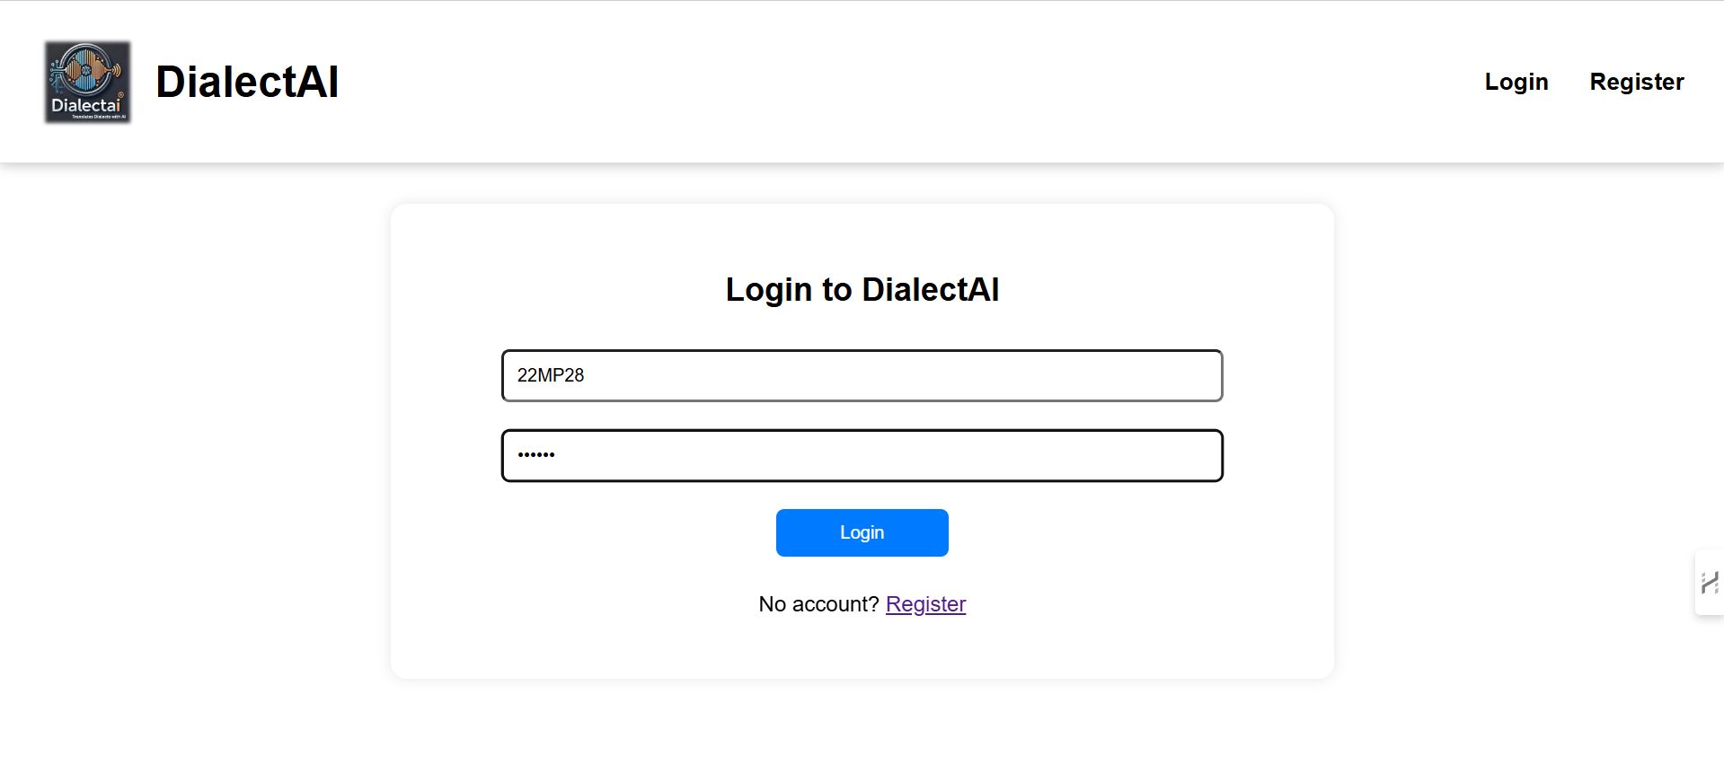

Slide 39
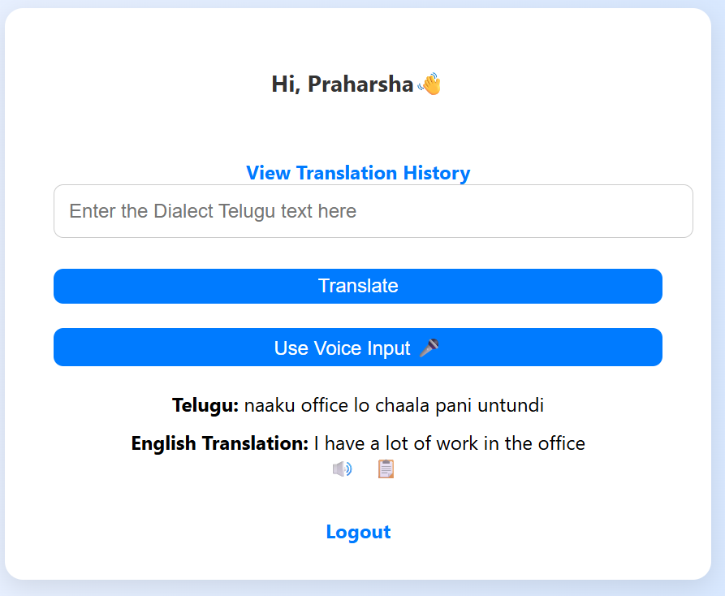

Slide 40
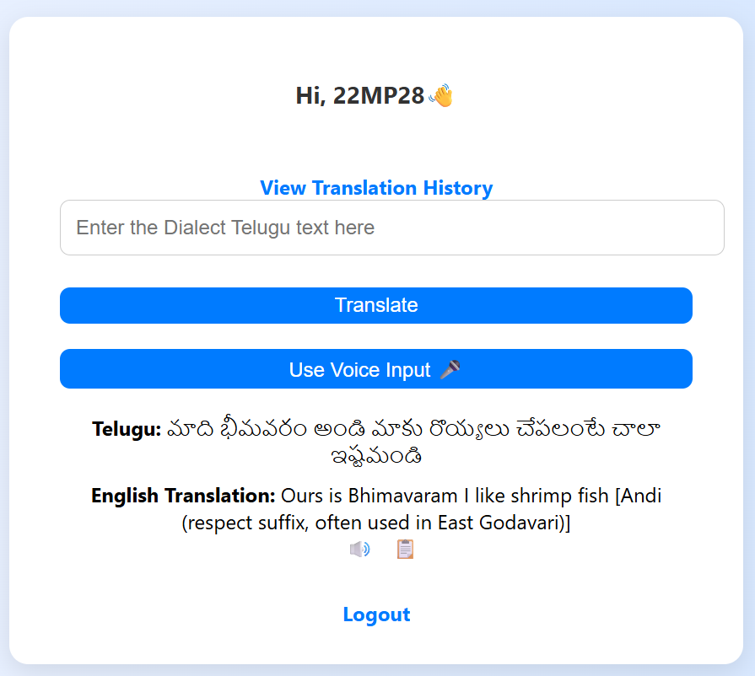

Slide 41
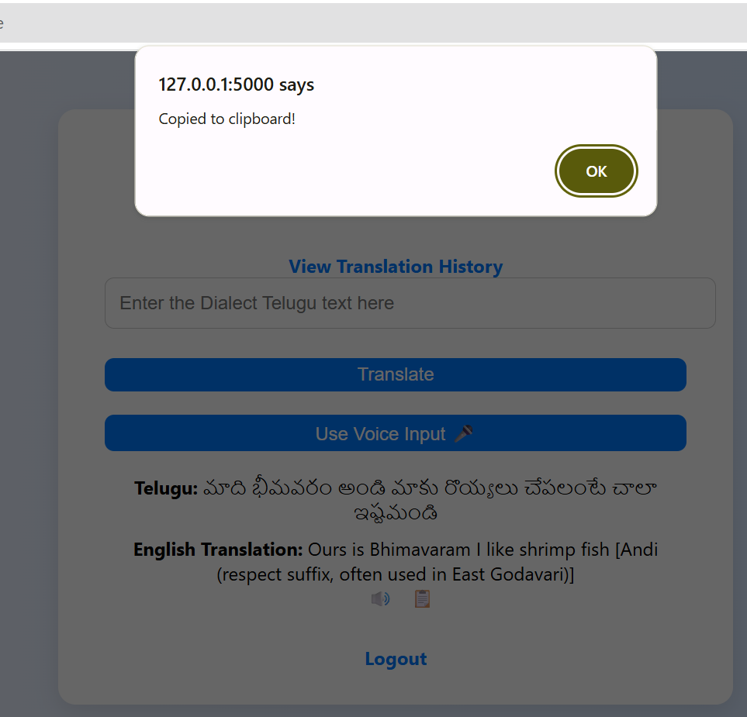

Slide 42
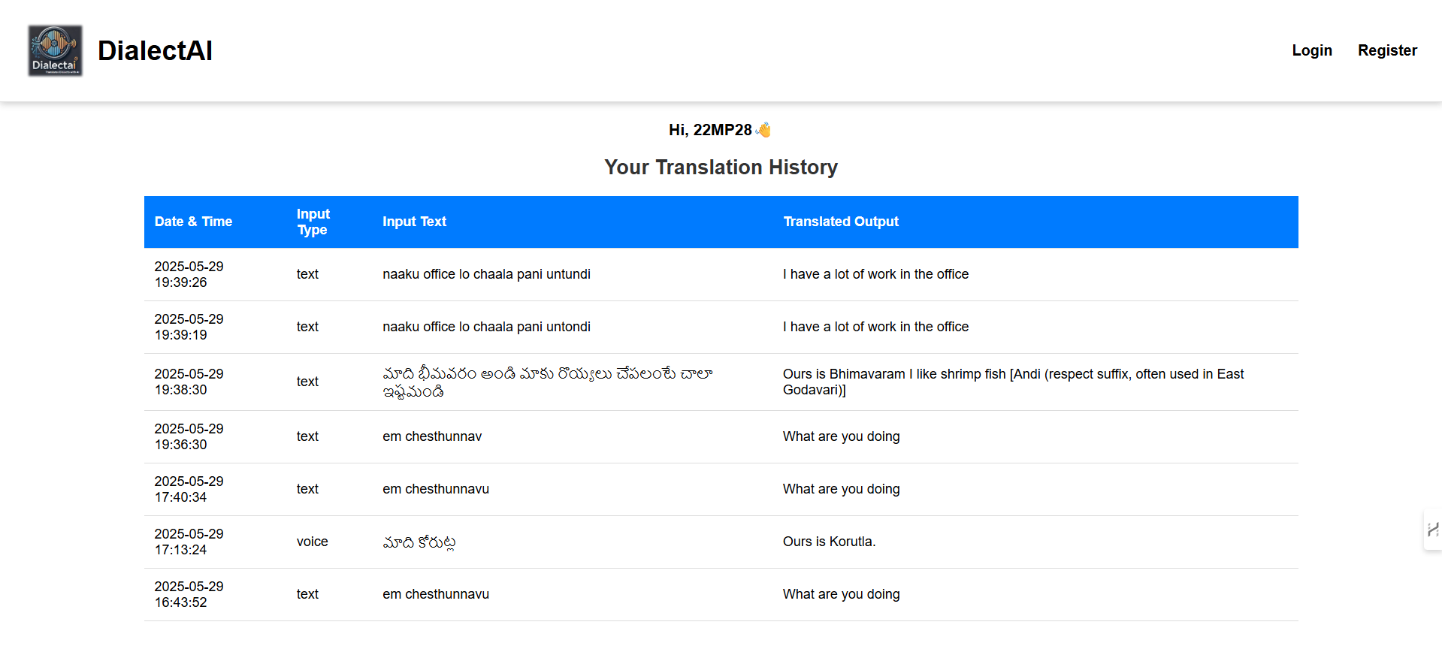

Slide 43
Conclusion
DialectAI bridges the gap between Telugu dialects and standard English using AI-powered speech-to-text and NLP. It enhances communication, preserves linguistic diversity, and paves the way for more inclusive and accurate translation tools.

Slide 44
References
Sastry, J. V. A study of Telugu regional and social dialects: A prosodic analysis. University of London, School of Oriental and African Studies (United Kingdom).
Joshi, A., et al. (2024). Natural language processing for dialects of a language: A survey. ACM Computing Surveys.
Shivaprasad, S., & Sadanandam, M. (2020). Identification of regional dialects of Telugu language using text independent speech processing models. International Journal of Speech Technology, 23(2), 251-258.
Bhaskararao, P., & Ray, A. (2017). Telugu. Journal of the International Phonetic Association, 47(2), 231-241.

Slide 45
Thank You!

