Slide 1
Capstone Project: Automated Testing Framework for SauceDemo Selenium | TestNG | Jenkins | Jira | GitHub | Maven Name – Prahlad Singh Aswal Batch – 3 Superset ID – 5357002 Email ID – prahladsinghaswal02@gmail.Com

Slide 2
Objective of Project
Develop a robust, end-to-end automated testing framework for a web application.
Validate key functionalities and ensure application stability using Selenium WebDriver and TestNG.
Integrate the framework into a CI/CD pipeline with Jenkins for automatic test execution on every code commit.
Use Git/GitHub for version control and collaboration among team members.
Incorporate JIRA for requirements, test case tracking, bug reporting, and task management across the SDLC.

Slide 3
Tools & Technology Stack
Java – Programming Language
Selenium WebDriver – Browser Automation
TestNG – Testing Framework
Maven – Build & Dependency Management
Jira – Test & Bug Tracking
GitHub – Version Control & Collaboration
Jenkins – CI/CD Pipeline
Extent Reports – HTML Reports

Slide 4
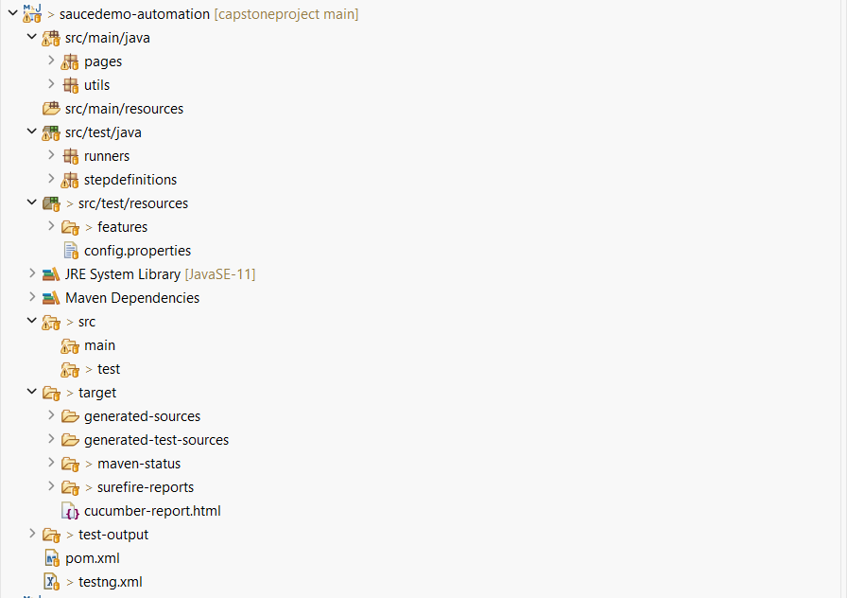
Project Structure

Slide 5
Test Scenarios
Login functionality
Form submission
Data-driven tests (Excel / Config-driven)
End-to-end workflow automation

Slide 6
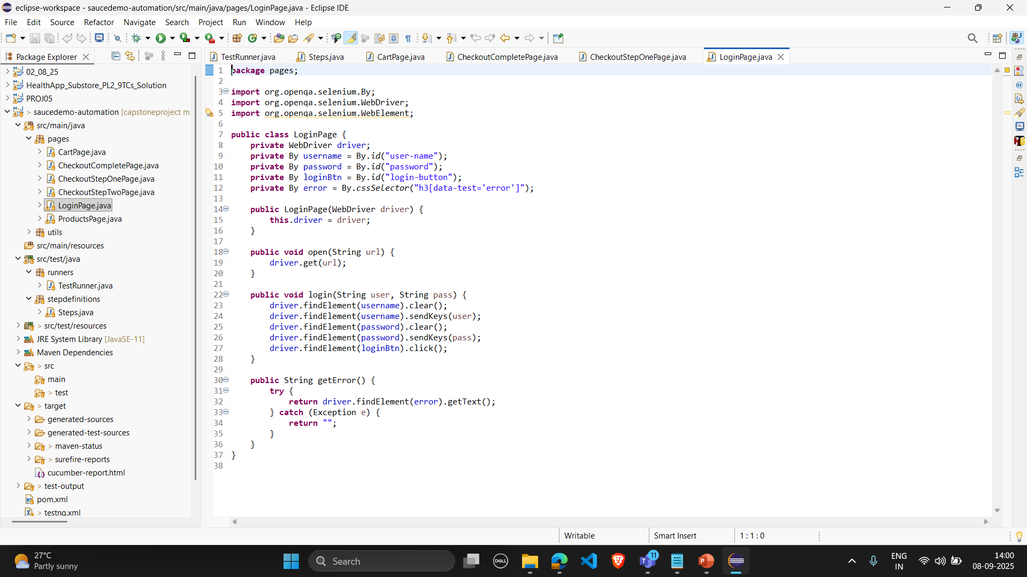
LoginPage Code

Slide 7
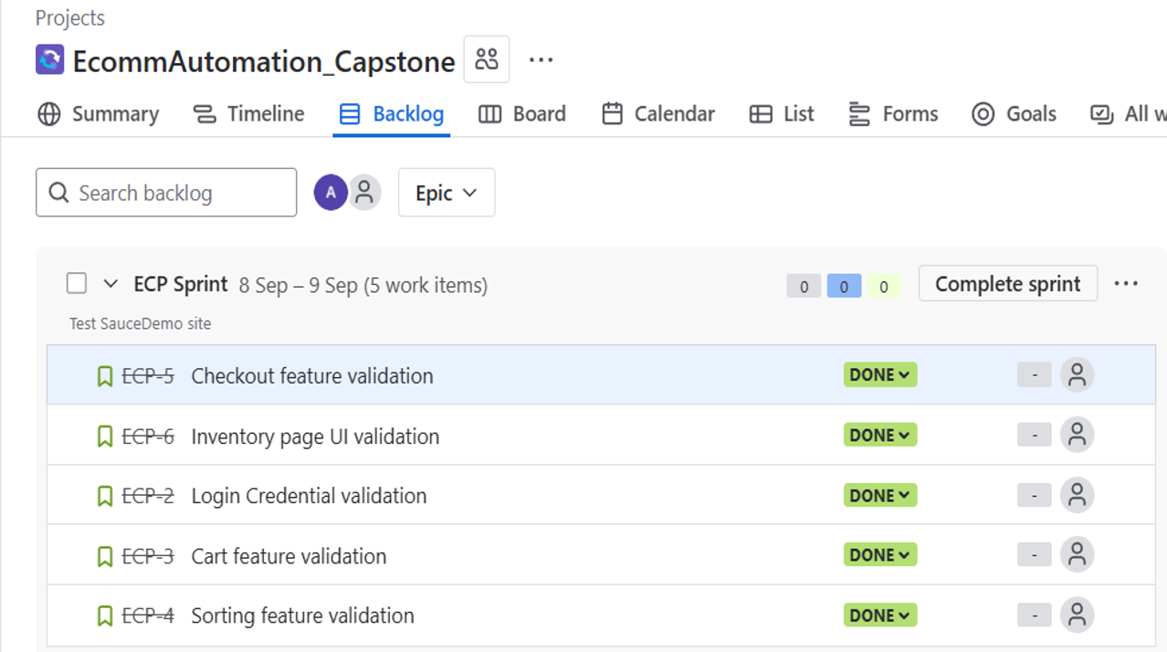
JIRA Sprint

Slide 8
CI/CD Integration
Jenkins setup for continuous testing
Automatic build + test execution
Notifications on failure/success

Slide 9
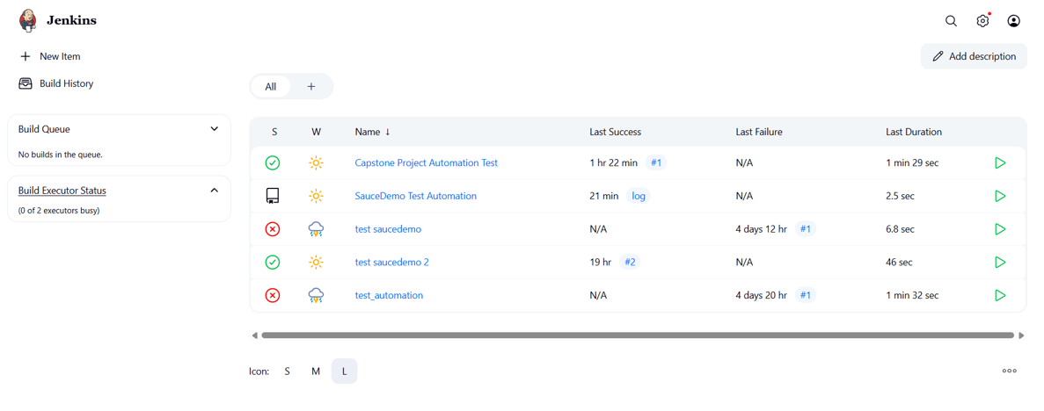
Jenkins Output

Slide 10
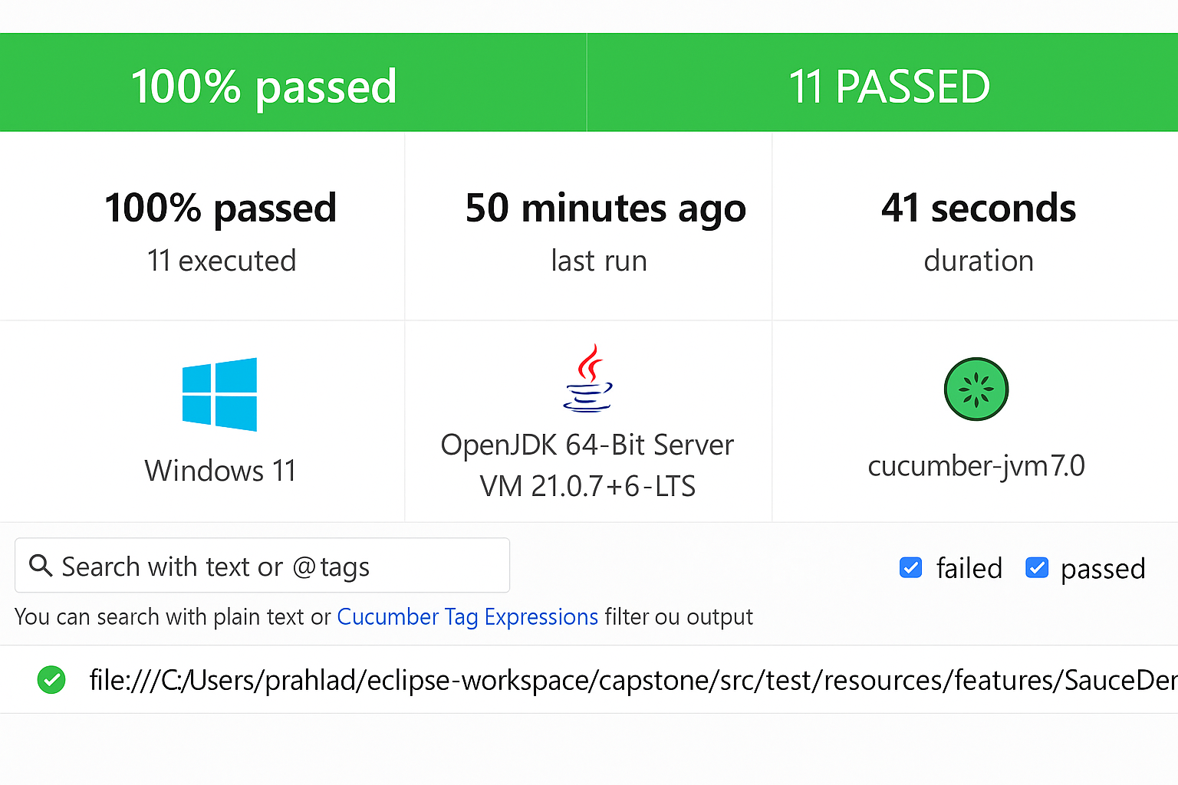
Cucumber HTML Report

Slide 11
Reporting & Analysis
Extent Reports with pass/fail highlights
Screenshots for failed steps
Logs for debugging
Helps in decision making

Slide 12
Challenges & Solutions
Handling dynamic locators → used explicit waits
Cross-browser testing → Selenium Grid
Managing test data → config-driven approach
Continuous monitoring via Jenkins

Slide 13
Conclusion
Benefits achieved:
Reduced manual effort
Faster regression cycles
Reliable test coverage
Future scope: integrate with Docker, cloud testing

Slide 14
THANK YOU

