Slide 1


Project Title:
TubeRate: YouTube Rating System
Acropolis Institute of Technology & Research
Guide:
Prof. Nisha Rathi
Coordinator:
Prof. Manoj Gupta

Slide 2


Project Idea
A YouTube video rating system based on the sentiments of its comment section.
It scans the comments of the video you’re interested in, performs NLP and generates rating based on what people in the comment sections have commented.
The user simply has to click the browser extension and the ratings of that current video will be displayed.

Slide 3
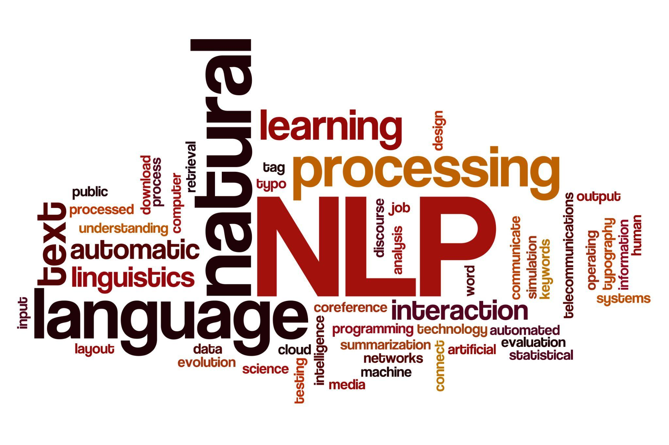
Category: Natural Language Processing
Natural Language Processing (NLP) is the ability of a computer program to understand human language as it is spoken and written -- referred to as natural language.
NLP drives computer programs that translate text from one language to another, respond to spoken commands, and summarize large volumes of text rapidly—even in real time.

Slide 4

Objectives
Optimizing the user’s experience on YouTube by providing optimal suggestions throughout the platform.
Rating the videos based on the comments gives a clear thought about the video content which is helpful if the user is searching for something specific in any genre.
Saving users’ feedback for further optimization of ratings.

Slide 5
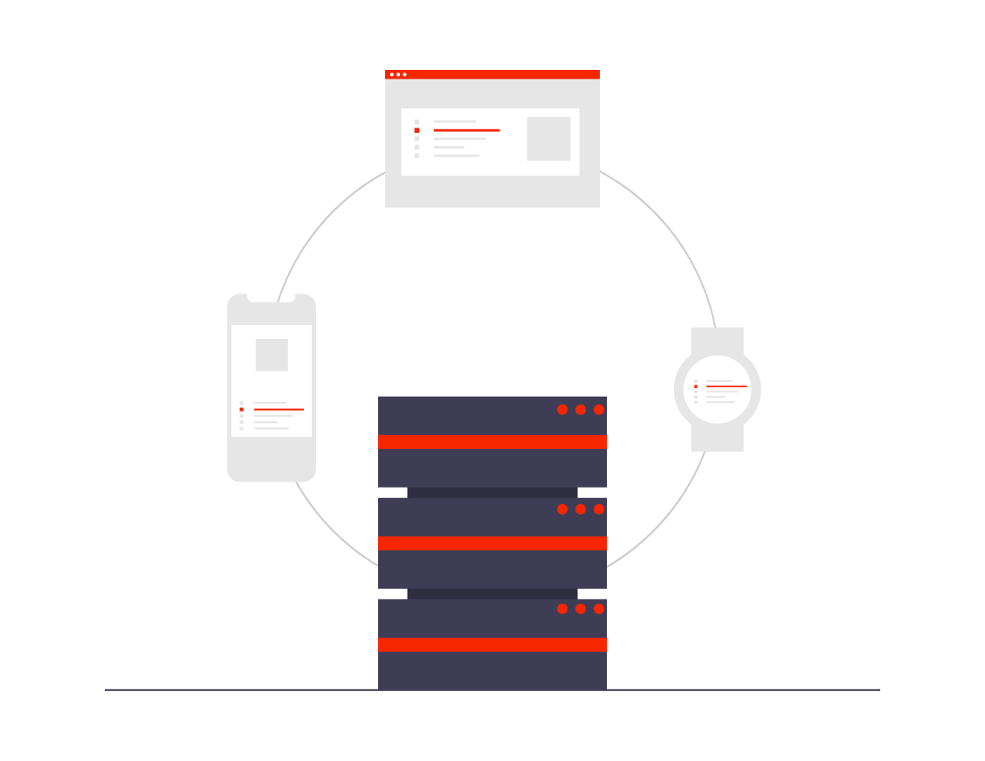


Requirements
Full-Stack Web Development
Machine Learning
Chrome Browser
Internet Connectivity
Laptop/PC

Slide 6
Motivation
When searching for something on YouTube, a few videos don’t even have the suitable information and don’t provide what the title suggests.
Some videos are really good and informative but are too long to decide whether they are worth watching.
Many videos contain adult language without proper disclaimer.

Slide 7



Architecture
1). Open a YouTube Video and click on the Chrome extension to create an HTTP request to the back-end.
5). Display the ratings on a web application.
4). Return ratings for the video ID as an HTTP response.
2). Request ratings for a given YouTube video ID.
3). Perform sentiment analysis on the comments of the video.

Slide 8


Modules
Front-end web design
Back-end web application
ML Model Deployment

Slide 9
Stakeholders
Every person who watches YouTube videos can be benefited from this project.
The interface will be easy to use for everyone.
If the users are not satisfied with the rating, they will be able to provide necessary feedback.

Slide 10
Team Members and their expertise
Ahimsa Jain (0827CI191004) : Front-end web development & UI design
Naitik Yadav (0827CI191038) : Back-end web development & ML
Prahlad Gurjar (0827CI191043) : Front-end & back-end web development

Slide 11
ABSTRACT
Thousands of hours worth of content is being created and shared on YouTube throughout the day. It has become really difficult to spend time watching such videos which may have a longer duration than expected and sometimes our efforts may become futile if we couldn't find relevant information out of it. There are times when we are searching for something on YouTube and there are a lot of videos about it and we can’t just rely on the number of likes/dislikes a particular video has. More often than not, people like/dislike certain videos randomly or without even watching them at all. The current YouTube algorithm only utilises the statistics of user engagement while suggesting content. Through the use of the TubeRate app, the user will be able to view ratings of the videos which will be based on sentiment analysis performed on the comments of those videos. The app will extract all the comments from the video, process them using NLP and show ratings to the user based upon the emotions present in them. These ratings will be on a scale from 1 to 5, where 1 means extremely dissatisfied and 5 means extremely pleased with the content of the video.

Slide 12
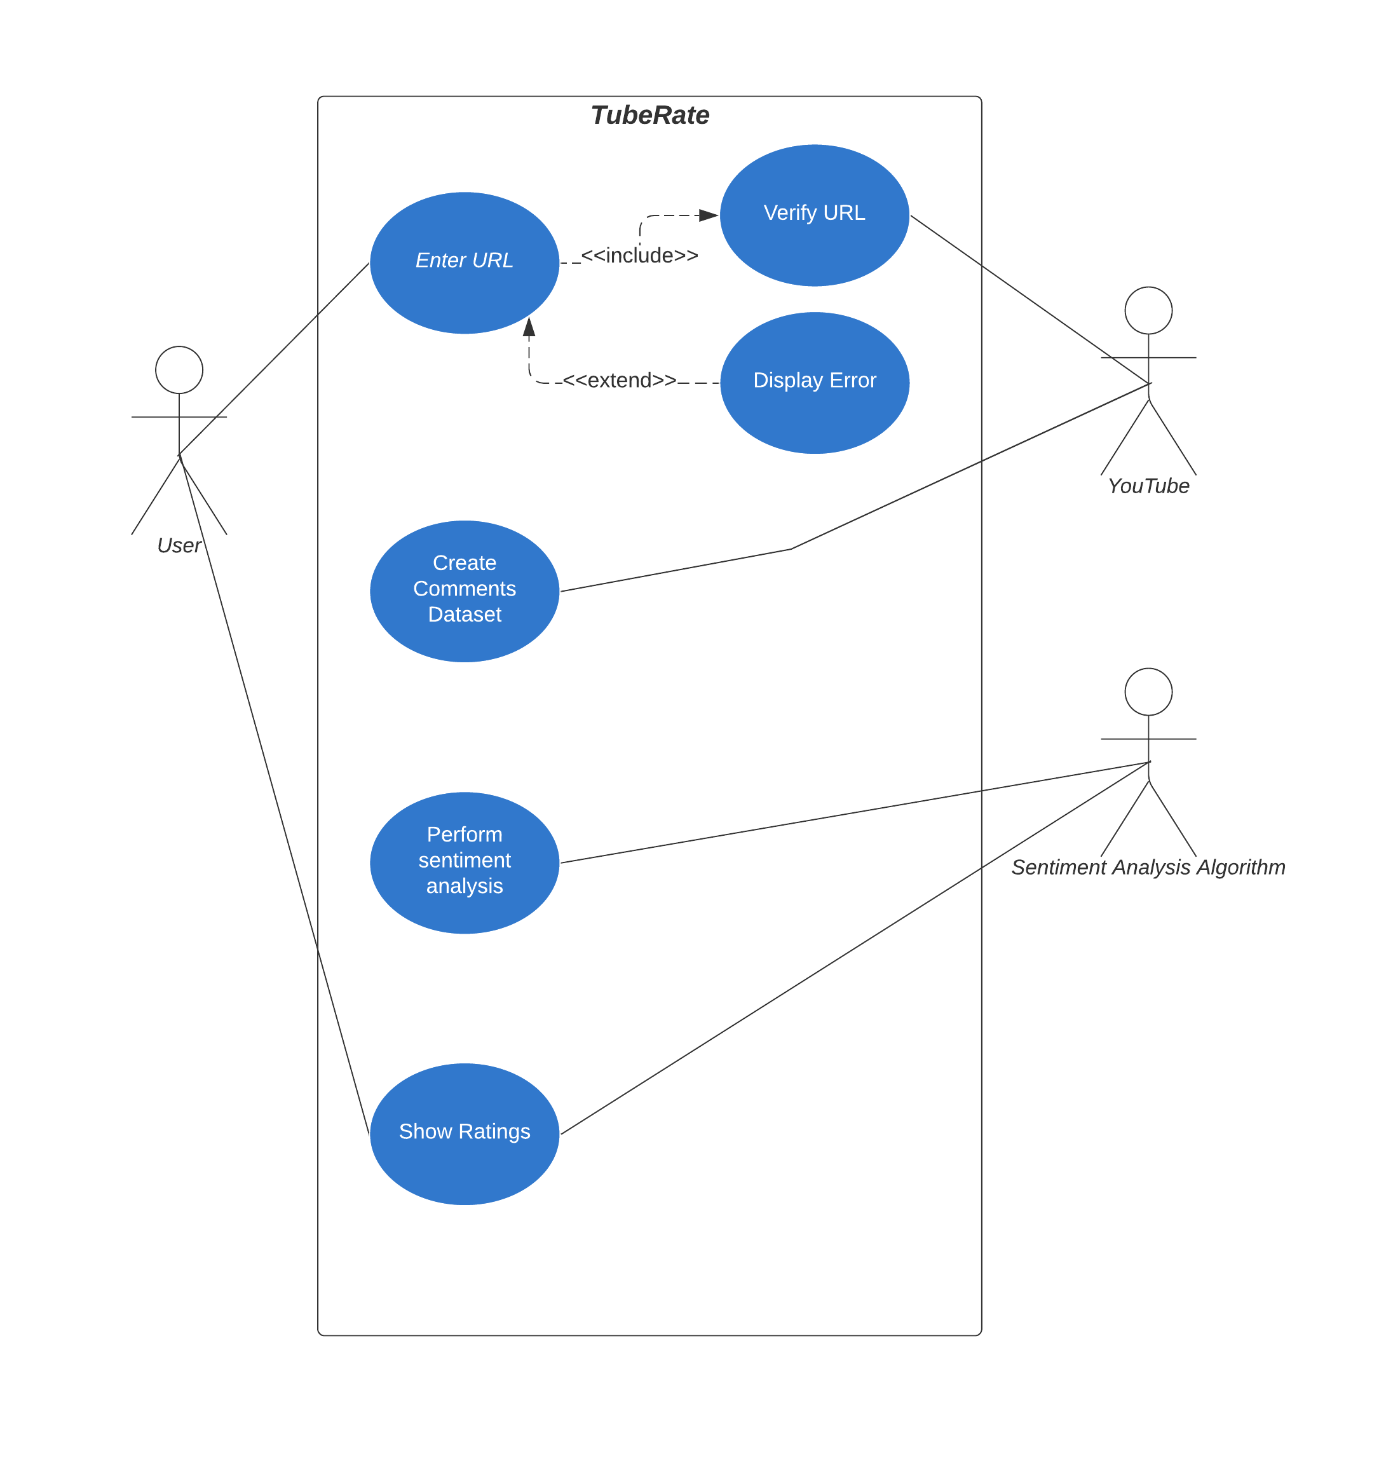
Use Case

Slide 13
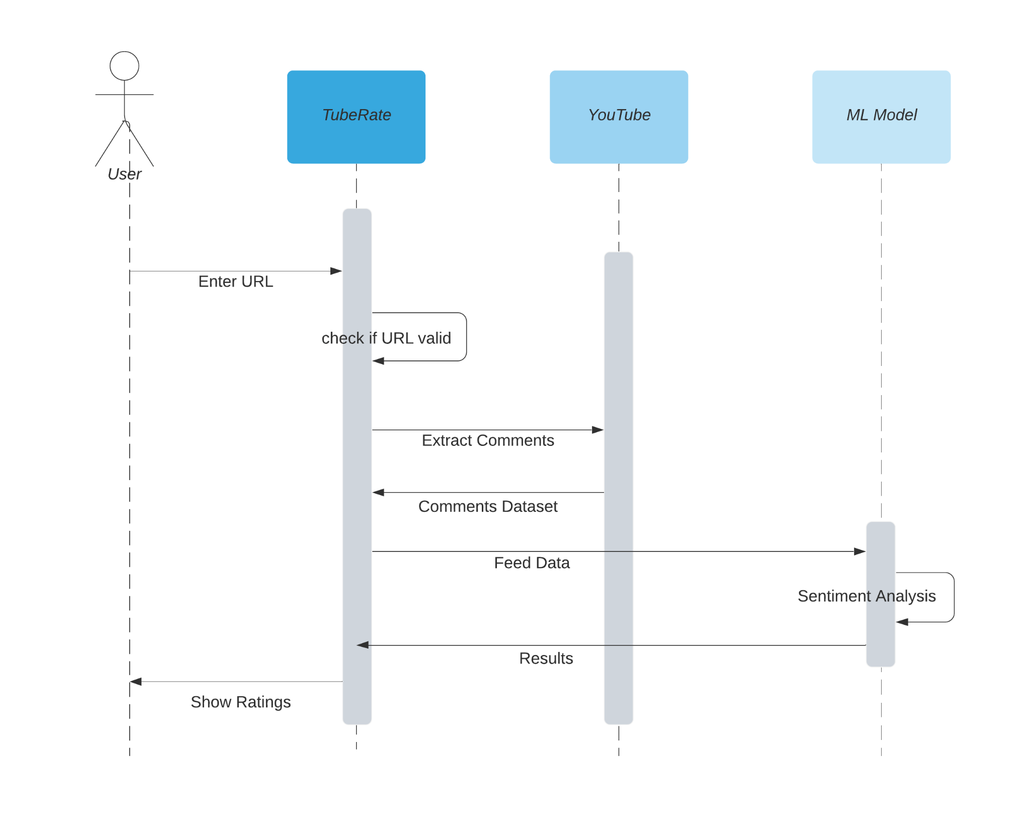
Sequence

Slide 14
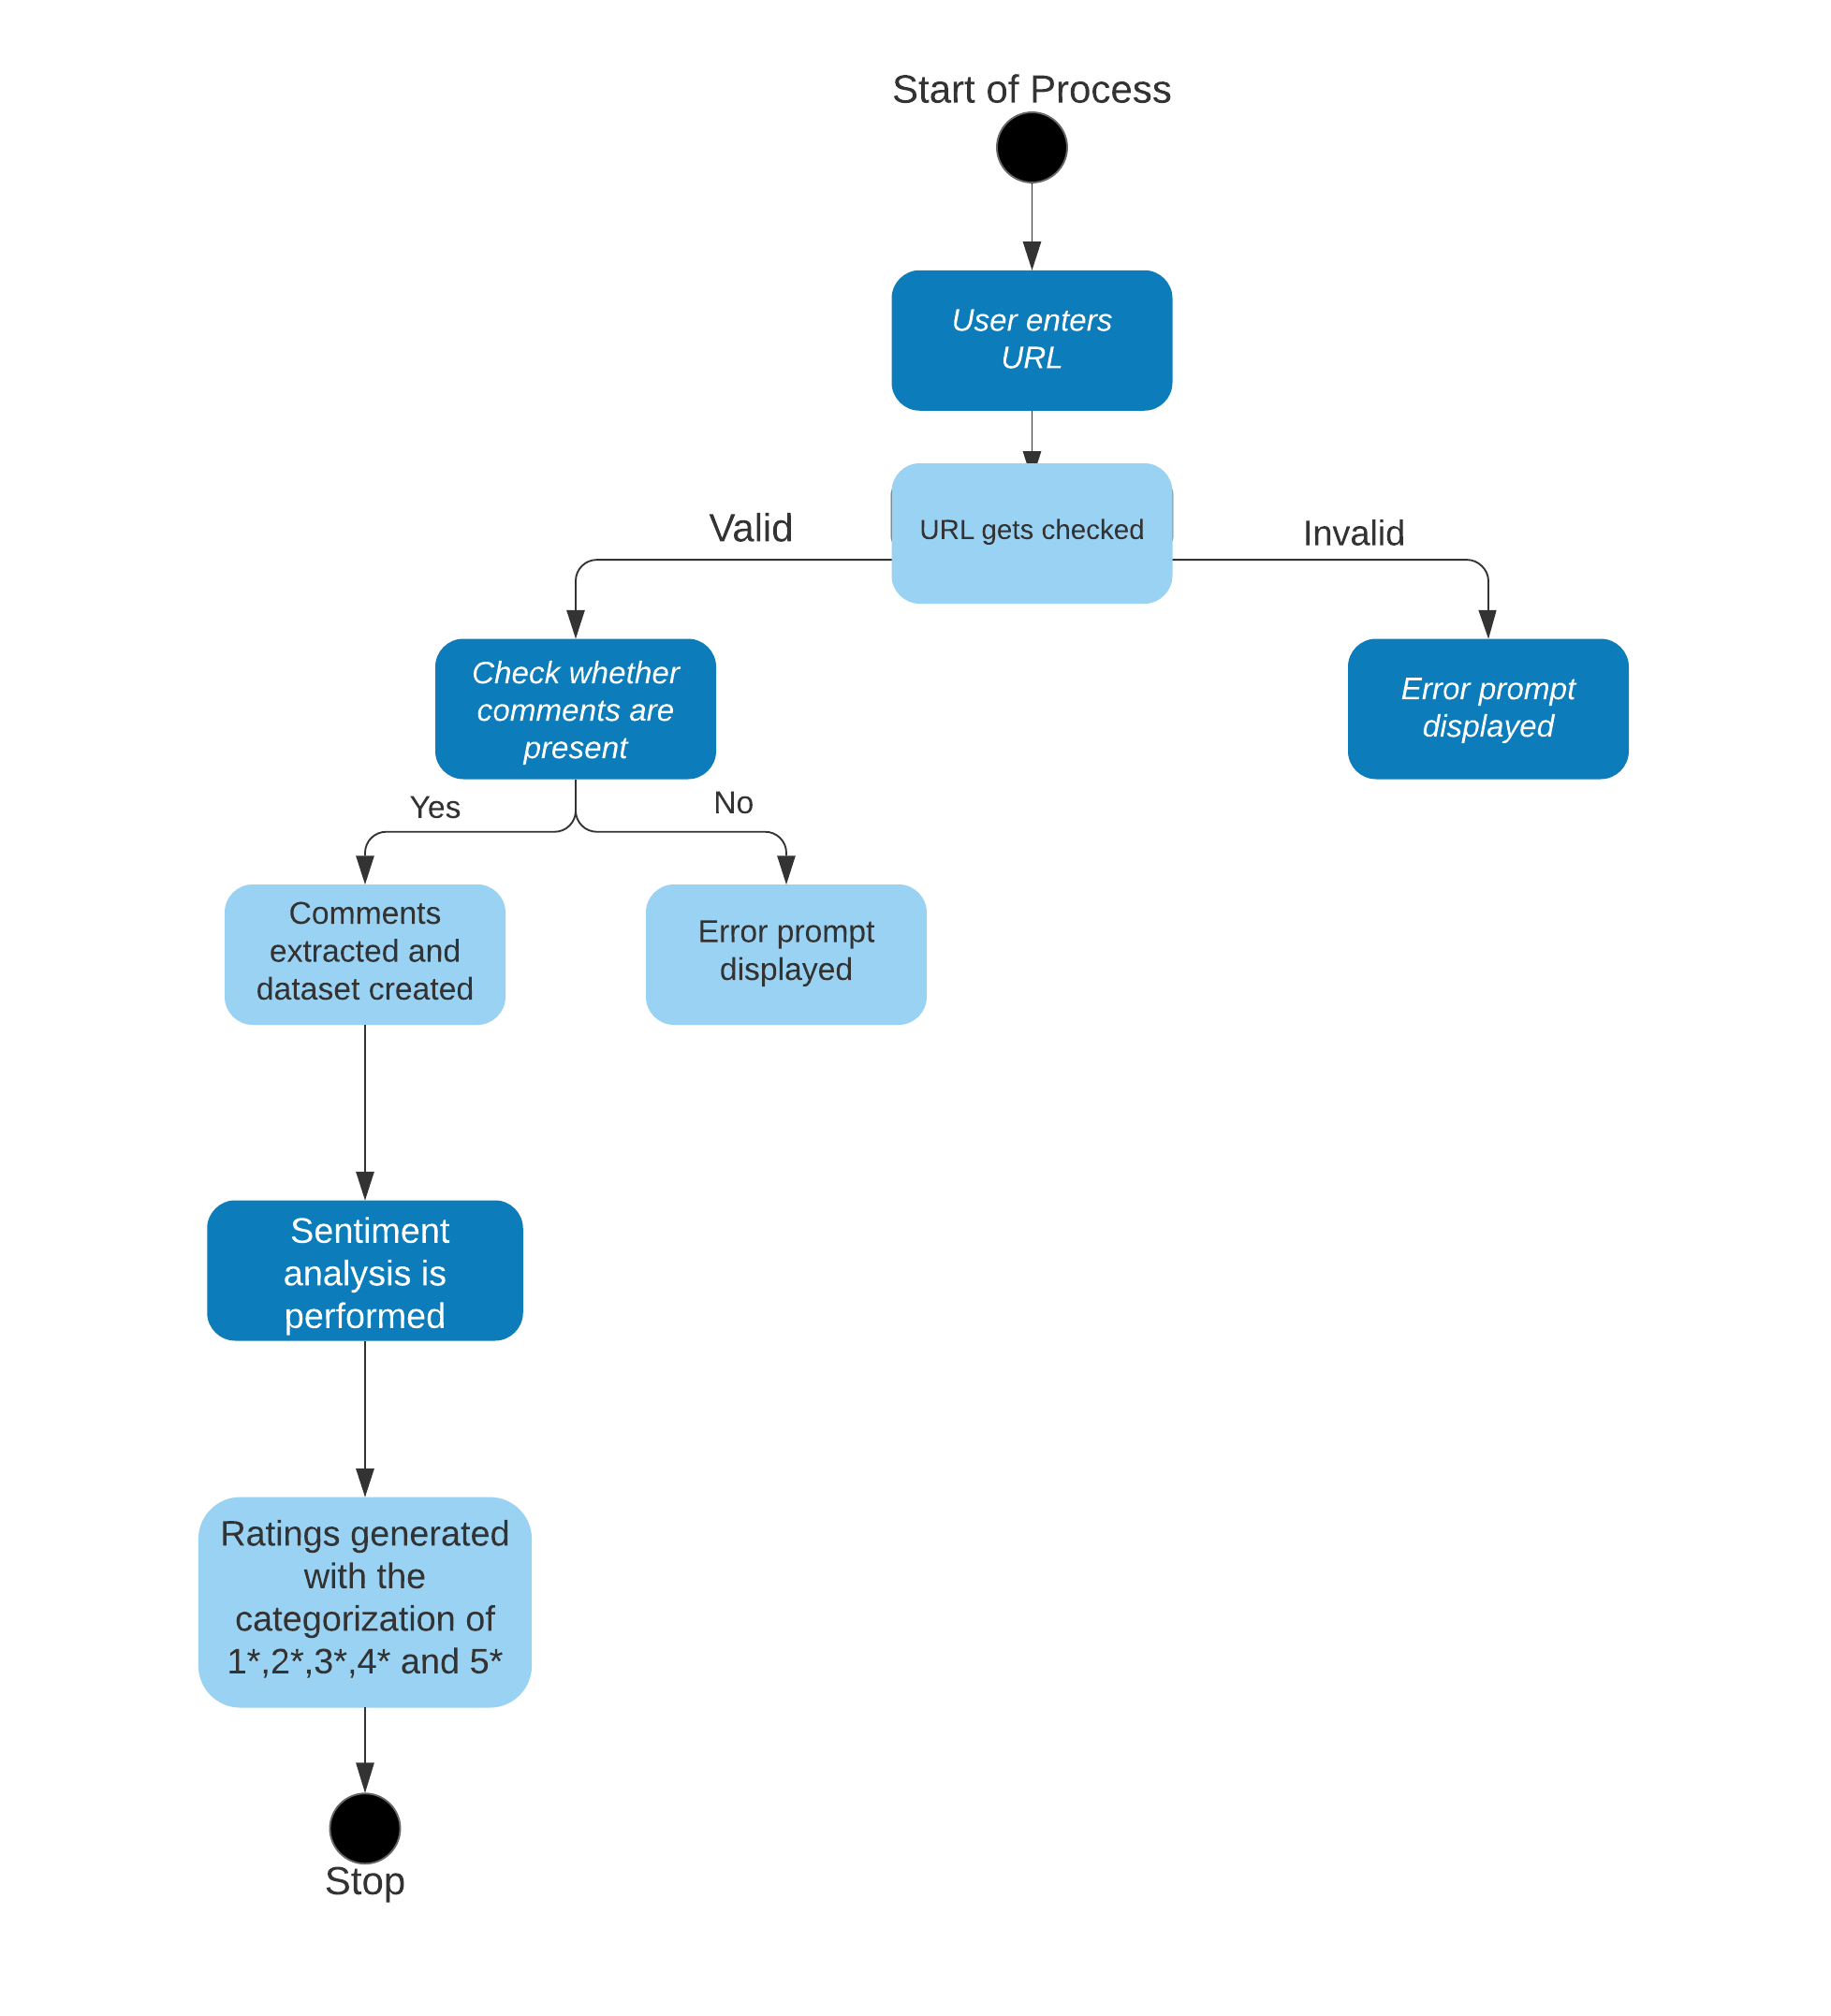
Activity

Slide 15
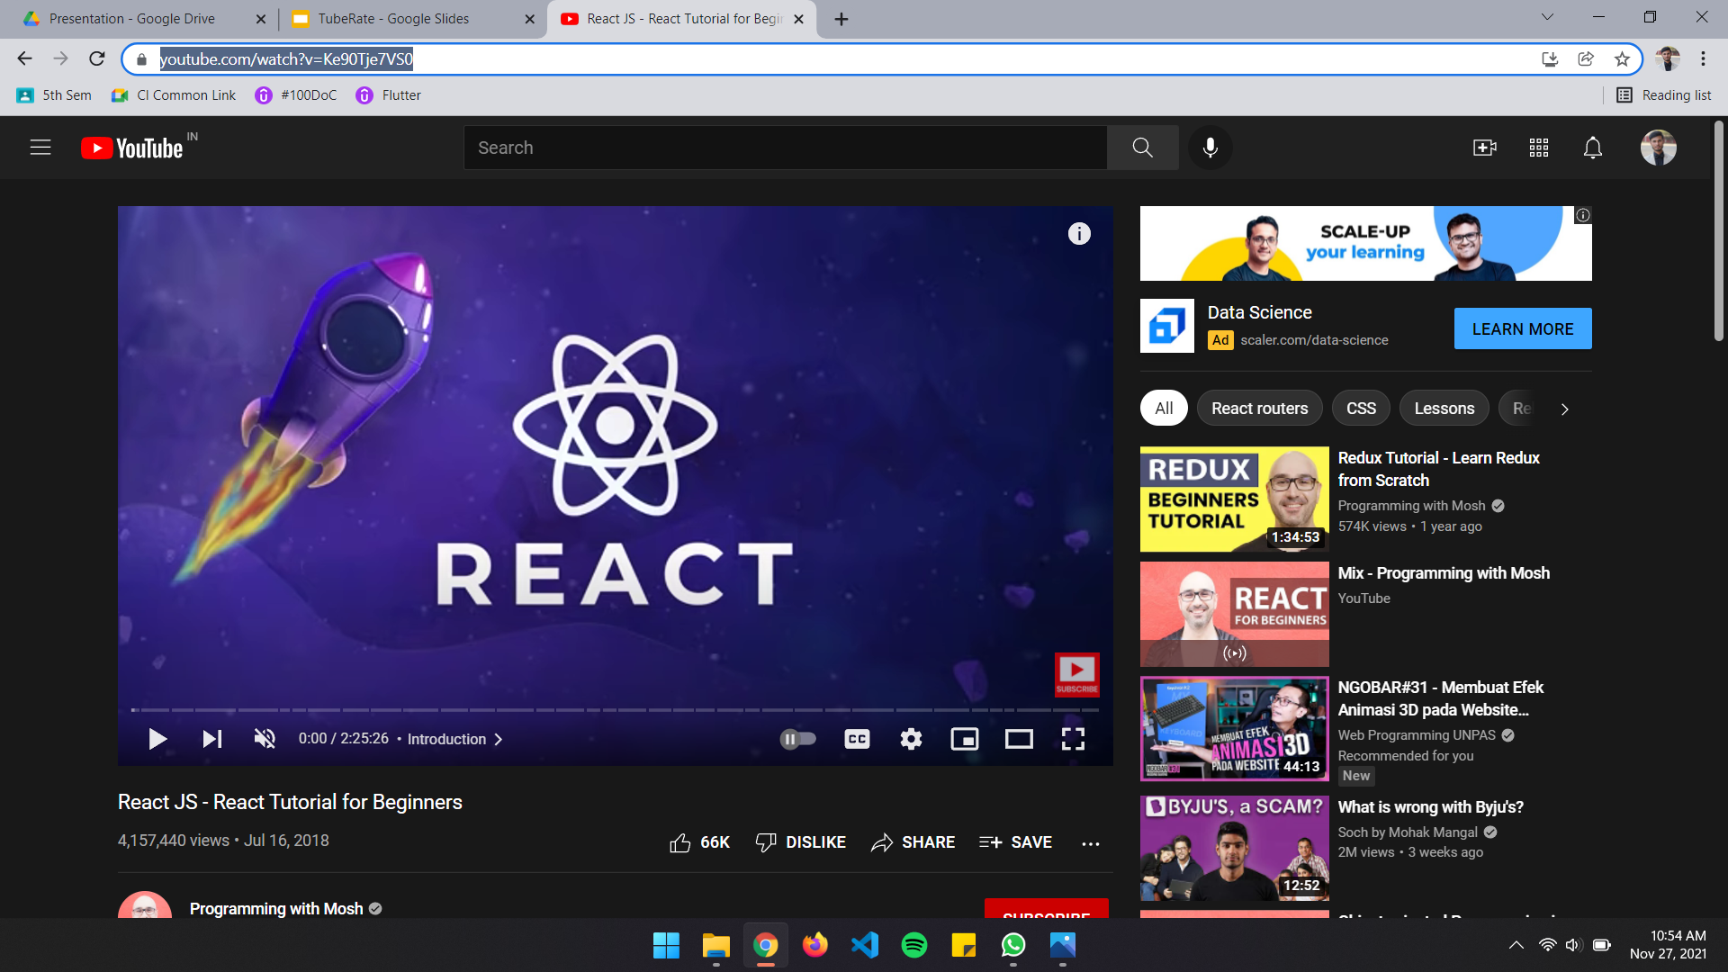
Working

Slide 16
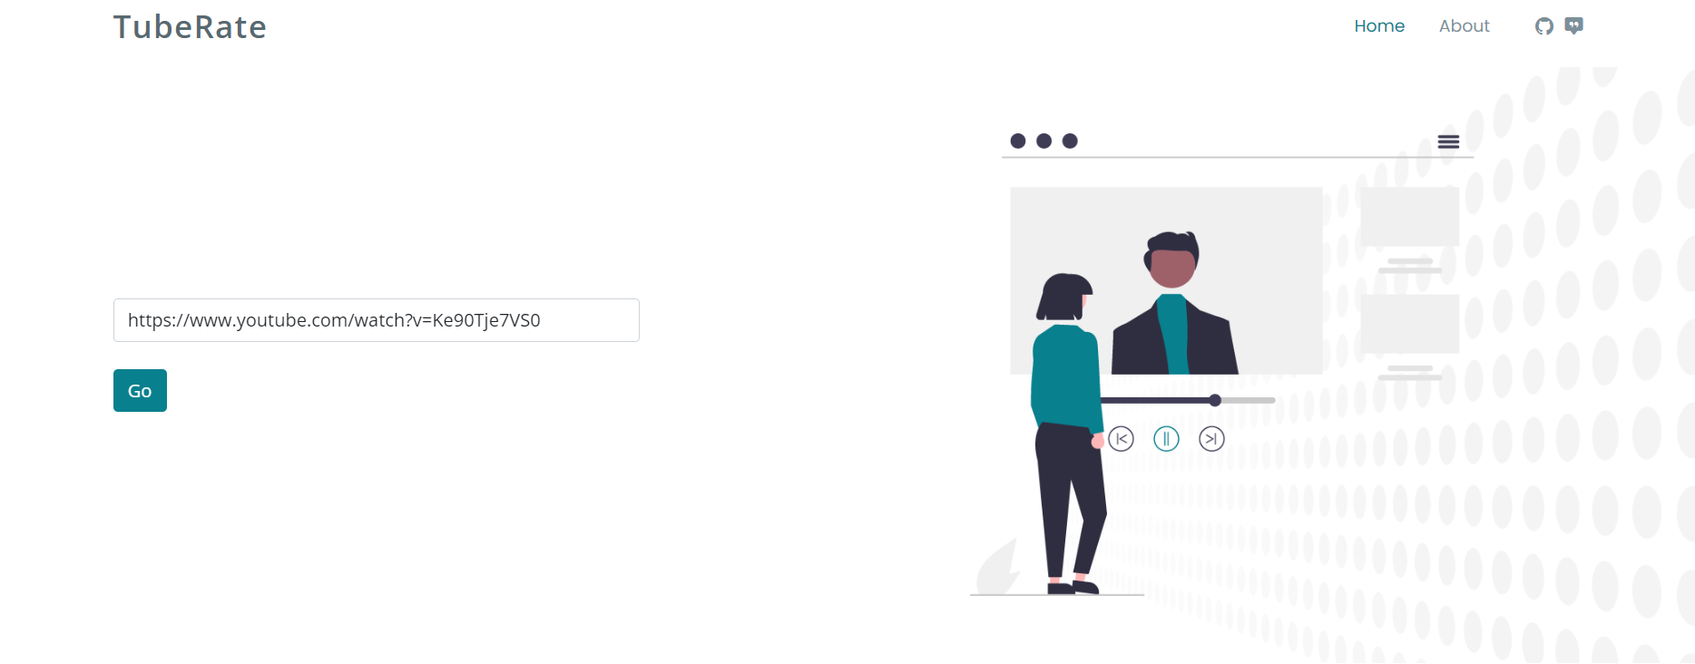
Working

Slide 17
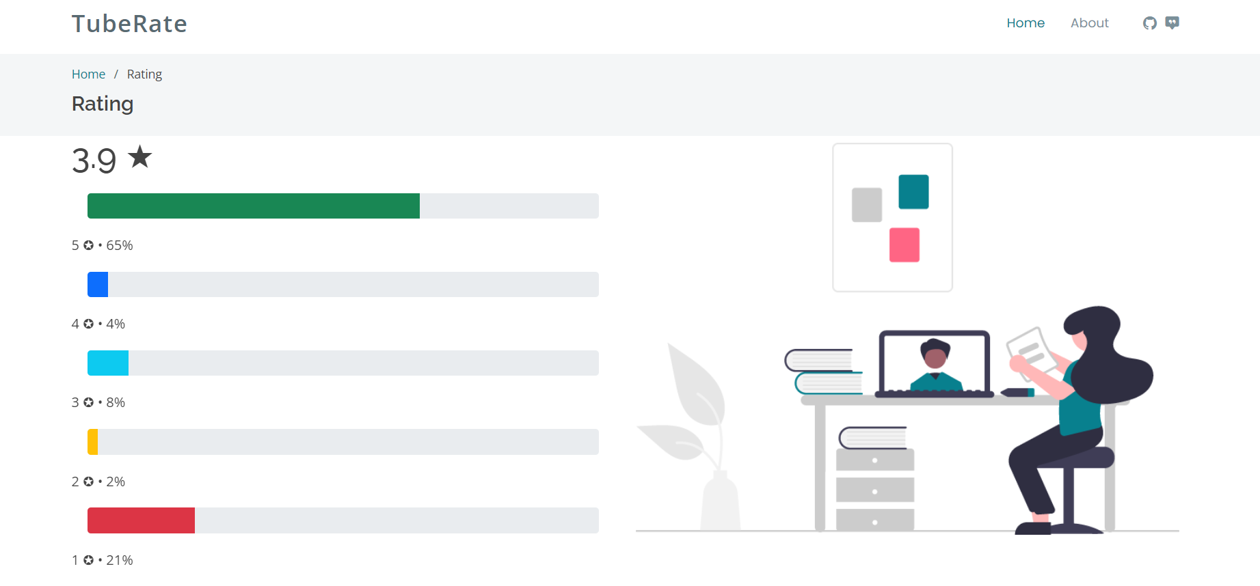
Working

Slide 18

THANK YOU

