Slide 1
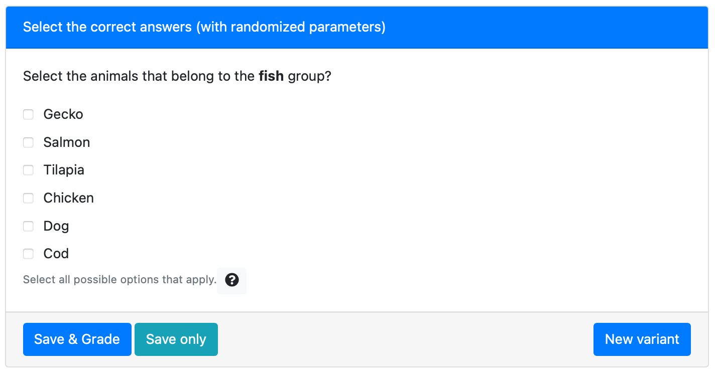
The group name is randomly selected from a list, for example (mammals, fish, bird, reptile)
The true answers and distractors are determined based on the choice of the group name.

