Slide 1
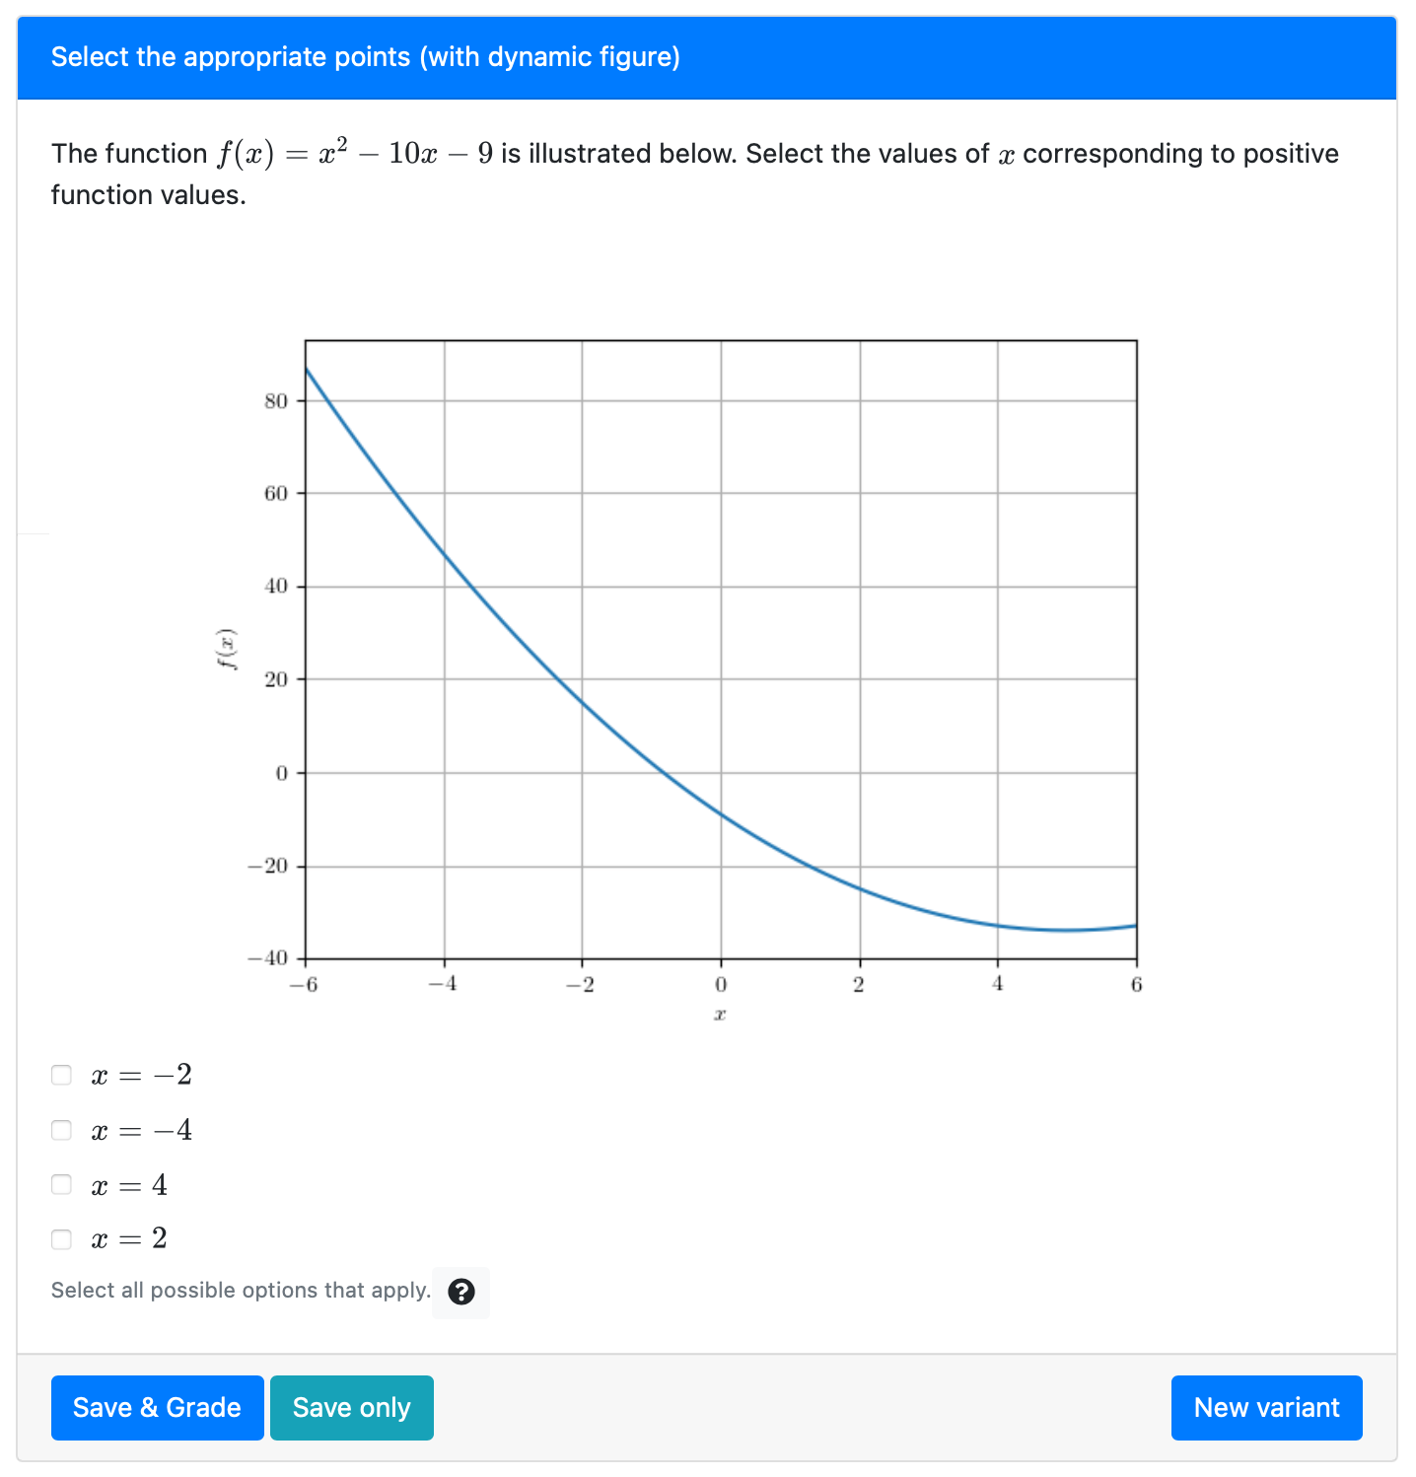

The equation is generated using randomized coefficients
The image is generated dynamically for the given function $f(x)$
The correct answers and distractors are determined based on the given function $f(x)$

