Slide 1
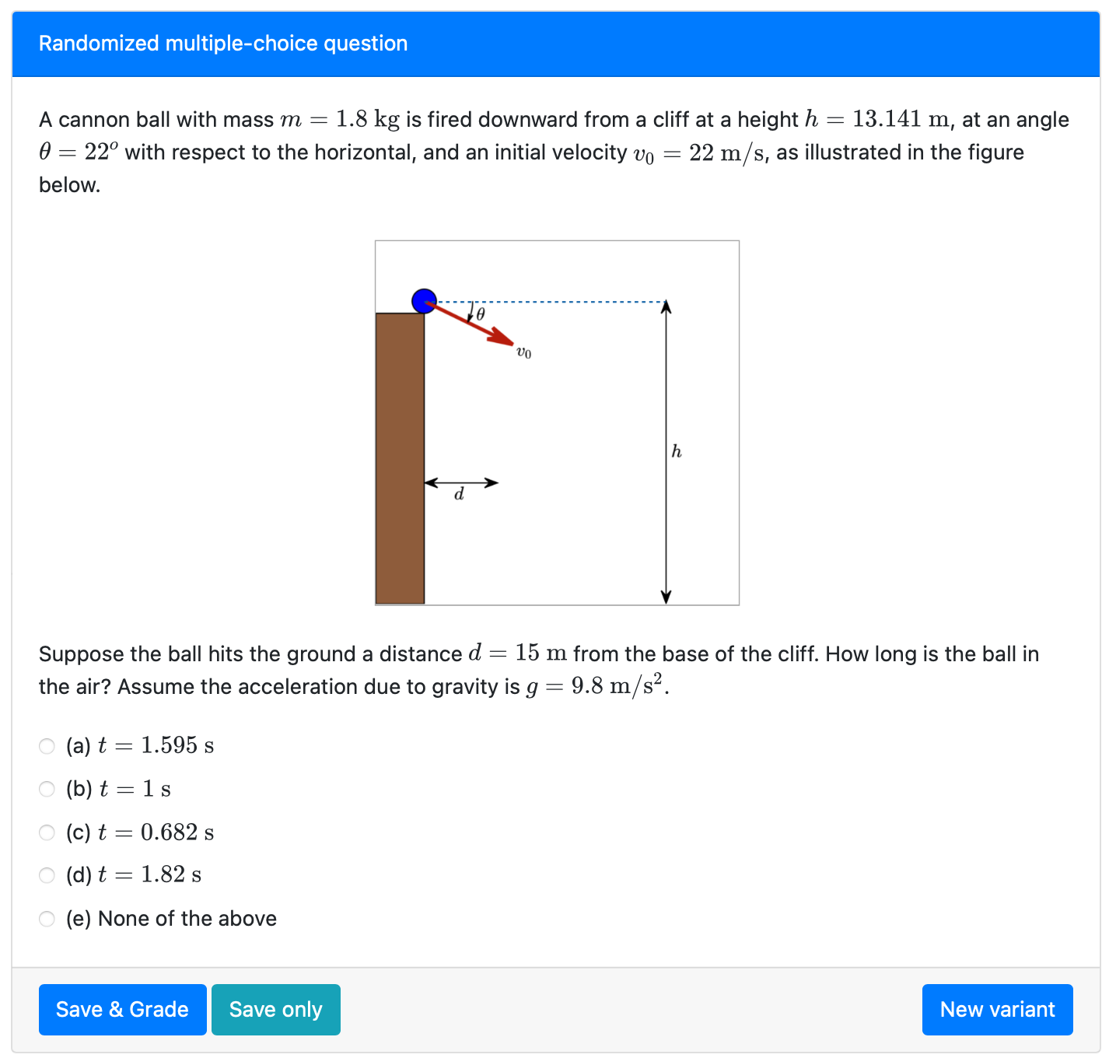
Randomized parameters
Randomized parameters
The correct answer and the distractors are computed based on the given parameters.

Slide 2
Dynamically-generated parameters

Slide 3
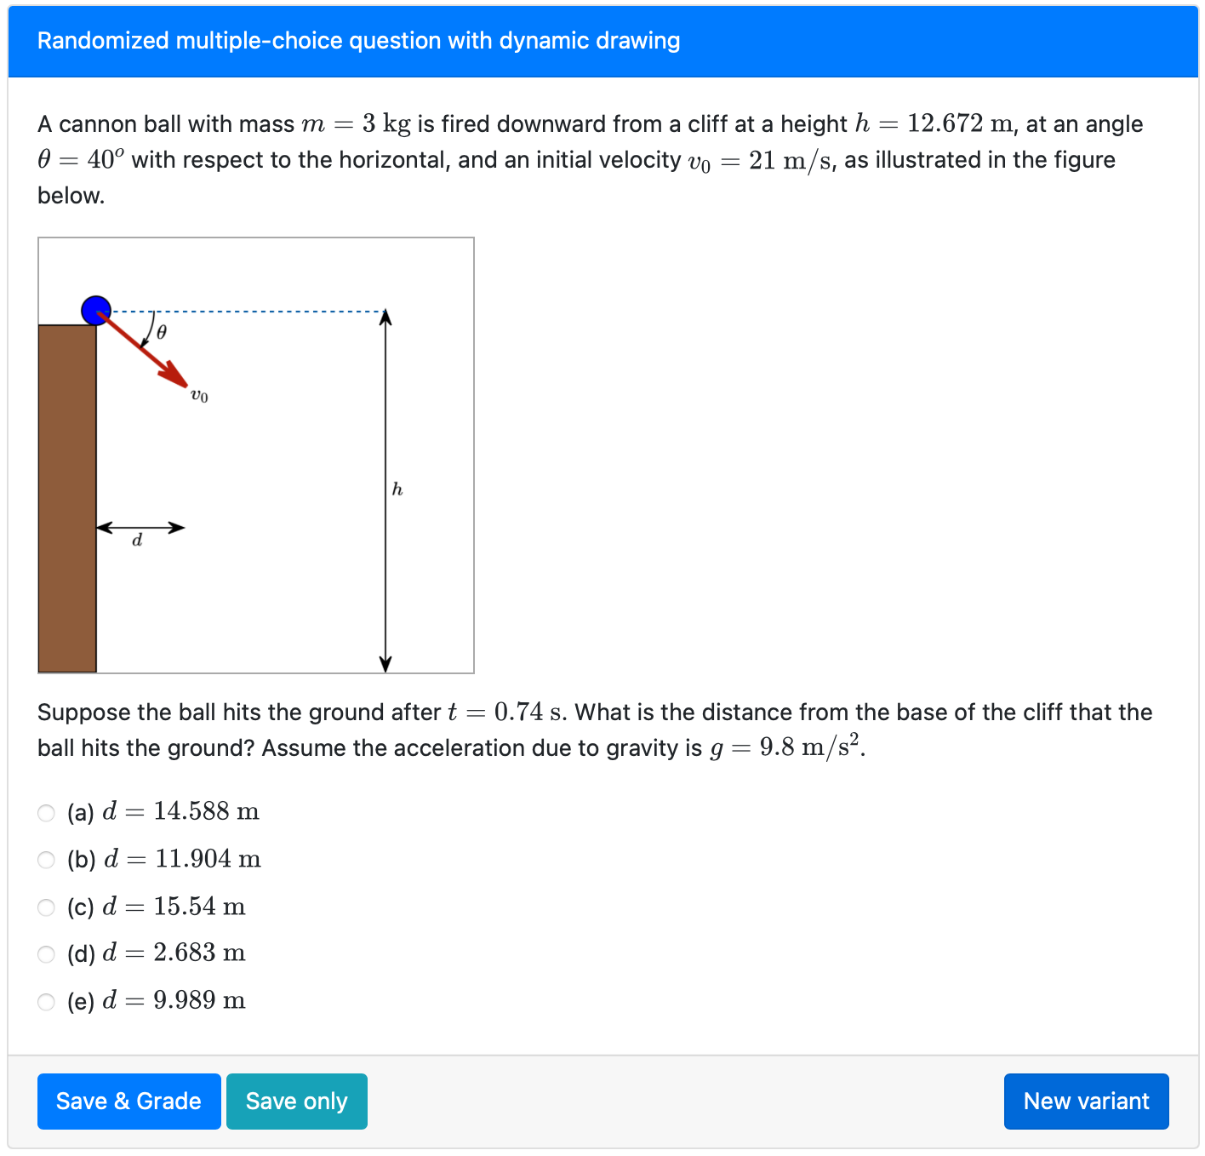

Randomized parameters
This image is generated dynamically using the provided angle.
The problem statement is selected at random (either given $t$ find $d$, or given $d$ find $t$)
The correct answer and the distractors are computed based on the given parameters.

Slide 4
Dynamically-generated features

