Slide 1
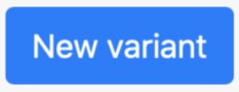
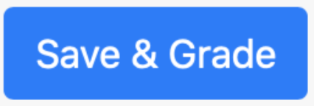


Question generator
Question Variant
👨‍🎓
👨‍🎓
Feedback

Slide 2



👩🏻‍🎓
Feedback
👩🏻‍🎓
Feedback
Question generator
Question Variant
$$⋯$$
$$⋯$$

Slide 3
Question generator
👩🏽‍🎓
Question Variant
👩🏽‍🎓
👩🏽‍🎓
Feedback
Feedback
Feedback
👩🏽‍🎓
👩🏽‍🎓
Number of retry attempts for the same question variant defined by the instructor

Slide 4
Question generator
Question Variant
👩🏽‍🎓
👩🏽‍🎓
👩🏽‍🎓
Feedback
Feedback
Feedback
👩🏽‍🎓
👩🏽‍🎓
👩🏽‍🎓
Number of retry attempts for the same question variant defined by the instructor

Slide 5










Question variant
Mean score
Quintiles
$$⋯$$
Question generator
Question variant
Question variant
Question variant
Exam question
Question variant
Question generator
$$⋯$$
Question variant
Question variant
Question generator
Question variant
$$⋯$$
Question variant

Slide 6
Mean score
Quintiles
Alternative groups
Choose one question
Question generator 1
Question generator 2
Question generator 3

Slide 7

Assessment Generator
Zone 1
Question generator 1
Student A exam
Student B exam
Question generator 2
Question 1
Question 1
Question generator 3
Question 2
Question 2
Question generator 4
Question 3
Question 3
Zone 2
Question 4
Question generator 5
Question 4
Question 5
Question generator 6
Question 5
Question generator 7
Question generator 8

Slide 8
Question generator 1
Choose one question
Student B exam
Question generator 2
Question generator 1
Question variant 1
Question generator 3
Question 1
Question generator 3
Question variant 3
Question generator 4
Randomly select generators
Randomized question order and renumbering
Randomized parameters
Question 2
Question generator 6
Question variant 6
Question 3
Question generator 8
Question 4
Choose two questions
Question variant 8
Question generator 5
Question generator 6
Question generator 7
Question generator 8

Slide 9
attempt 1
Feedback
attempt 2
Feedback
attempt 3
Feedback
Question generator
Question variant
👩🏻‍🎓
👩🏻‍🎓
👩🏻‍🎓
Number of attempts defined by the instructor. Retry attempts can be set for reduced credit.

Slide 10
Older images

Slide 11


Feedback
Feedback
Question generator
Question Variant
$$⋯$$
$$⋯$$
👩🏽‍🎓
👩🏽‍🎓
done
done

Slide 12

Question generator
Question Variant
Feedback
Feedback
$$⋯$$
$$⋯$$
👩🏽‍🎓
👩🏽‍🎓
👩🏽‍🎓
Question generator
Question Variant
👩🏽‍🎓
👩🏽‍🎓
Feedback
Feedback
Feedback
👩🏽‍🎓
👩🏽‍🎓

