Slide 1
Getting Started with PrairieLearn Agenda – 24 Jan 2020
PrairieLearn overview
“Why use it?”
Setting up your course content creation environment
“What do I need to use it?”
Software, Course directory, Questions and Assessments
Next workshop: Writing Good Questions
“How do I use it (well)?”
Getting help
Full slides are online at https://go.illinois.edu/plWorkshopSlides

Slide 2
Today in 4 slides (1/4) Important Addresses
PrairieLearn source code (and exampleCourse folder)
https://github.com/PrairieLearn/PrairieLearn
https://github.com/PrairieLearn/PrairieLearn/tree/master/exampleCourse
PrairieLearn User Guide content developer documentation
https://prairielearn.readthedocs.io/
Start with the “Installing and Running PrairieLearn” section
Work linearly down the list on the left
Production PrairieLearn server
https://prairielearn.engr.illinois.edu

Slide 3


Today in 4 slides (2/4) What software is needed?
Docker Desktop
https://www.docker.com/products/docker-desktop
Virtualization platform to run PrairieLearn locally
Plaintext editor
https://atom.io/ or https://code.visualstudio.com/
Sublime Text, Notepad++
Avoid rich txt format: Word, TextEdit
GitHub client
https://desktop.github.com/
Browser

Slide 4
Today in 4 slides (3/4) How to get started with content
Load your course folder into docker PrairieLearn so you can browse and edit it.
Get a feel for things.
Look at a question you want to mimic in the exampleCourse
See if you can copy it into your course.

Slide 5
Today in 4 slides (4/4) Getting Help
PL Office Hours
Spring 2020: Tuesdays 11am-1pm in 2124 Siebel Center
Next Workshop to-be-scheduled week of Jan 27
PrairieLearn Slack chat
https://prairielearn.slack.com
If you need an invite, let Dave know. mussulma@illinois.edu
The #pl-help channel is great for questions.

Slide 6
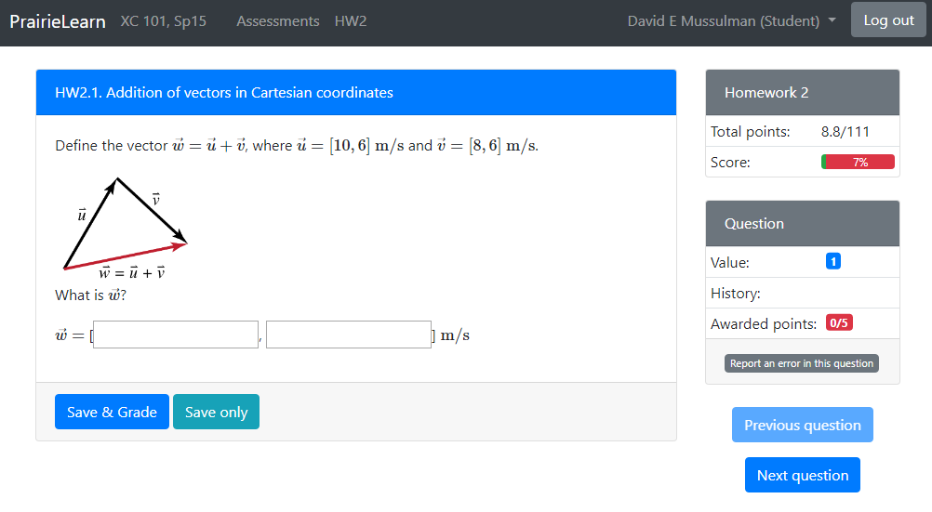
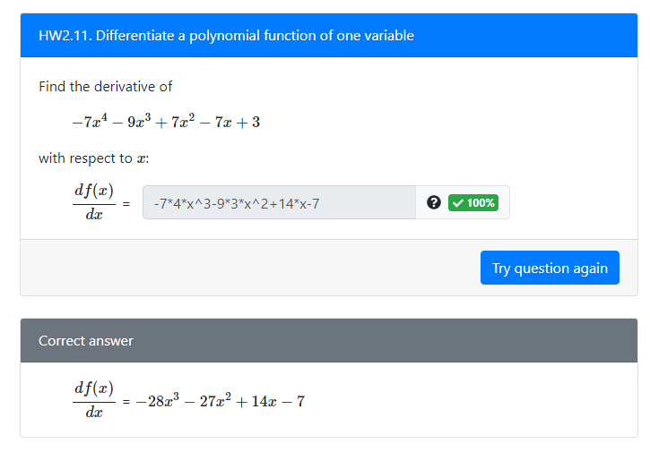
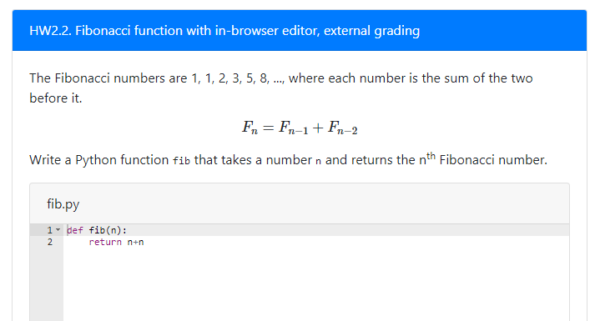
PrairieLearn

Slide 7
PrairieLearn questions
Craig demos a few things as part of a talk about CBTF/PL at Berkeley.
https://youtu.be/H6EHWmGZfpw?t=2216
Question demos ~ 36min – 45min in the talk

Slide 8
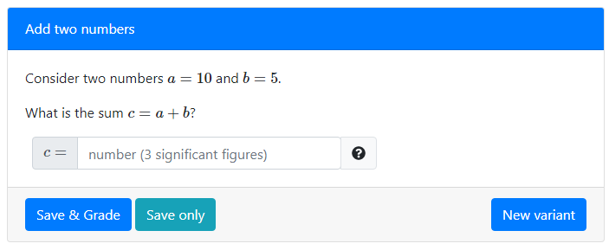
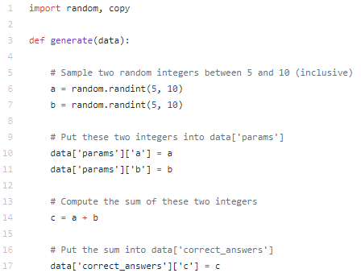
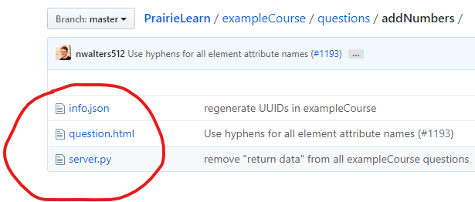
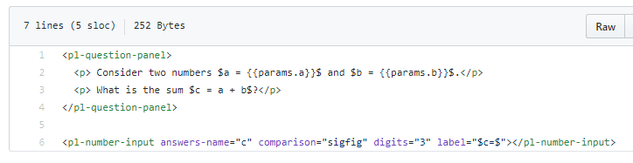
https://github.com/PrairieLearn/PrairieLearn/tree/master/exampleCourse/questions/addNumbers

Slide 9
PrairieLearn content
Text, folders and files
Languages used
HTML
JSON (structured text file, configuration, metadata)
Python (not always needed)
Questions are “question generators”, built-in randomization
Parameterized values (1 question with variation)
Traditional question pools (5 variations of a question, choose 2)

Slide 10
PrairieLearn questions
Good for objectively answered questions
STEM
Created by a Mechanical Engineering prof
Short answer, multiple choice
Drawing on things (free body diagrams, finite state machines, circuit logic)
Inline editor or file upload (coding problems)

Slide 11
PrairieLearn questions
“internally graded question”
Answer determined and stored when question is generated
Python or no-code-required
Grading is simple comparison
“externally graded question”
Question data, student submission shipped off to a Docker container
Do something with it (compile code, run tests, etc.)
Report grade result back to PL

Slide 12
Course content creation environment
Edit course directory, files locally with OS tools
Use GitHub to collaborate and submit those files
Run a development version of PrairieLearn on your laptop
“Sandbox” for content development and testing
Rapid prototyping, iterative (edit, test, edit, test)
Run as PrairieLearn admin, see error messages, etc.

Slide 13
What software is needed?
Docker Desktop
https://www.docker.com/products/docker-desktop
Virtualization platform to run PrairieLearn locally
Plaintext editor
https://atom.io/ or https://code.visualstudio.com/
Sublime Text, Notepad++
Avoid rich txt format: Word, TextEdit
GitHub client
https://desktop.github.com/
Browser

Slide 14
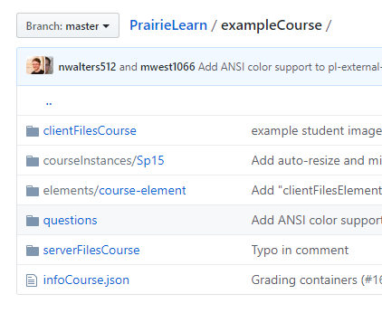
Course folder
Local folder on your system (can make a new one yourself)
Eventually a private GitHub repository
Under the PrairieLearn github organization
Will eventually look like: https://github.com/PrairieLearn/PrairieLearn/tree/master/exampleCourse

Slide 15
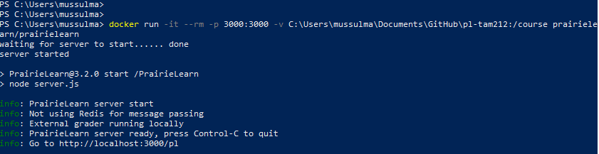
Workflow
Make sure docker is running (whale icon in the system tray)
Open a Terminal (MacOS) or Command Prompt (Win)
Launch the PrairieLearn docker from the command line
You can see it running in that window, but you don’t interact with it there.

Slide 16
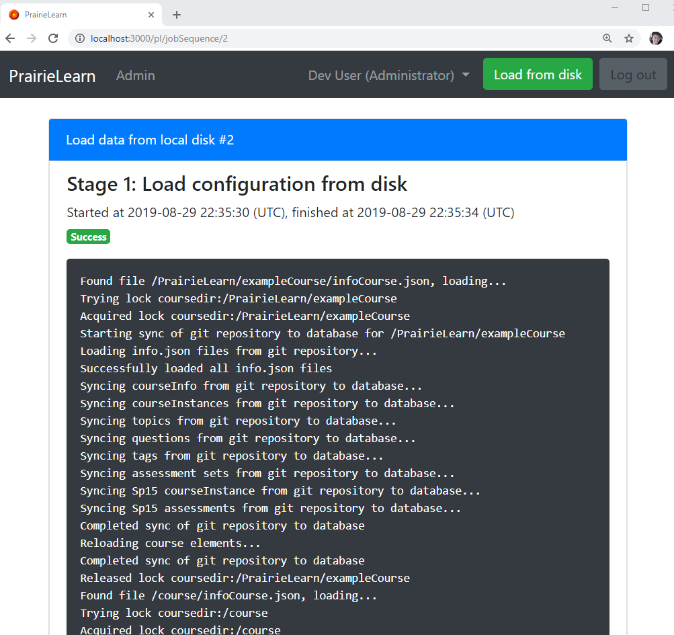
Interacting with PrairieLearn
Open your browser and point it at http://localhost:3000/pl
That’s the PrairieLearn running on your computer
Press the green “Load from Disk” button to import course content
Errors? Fix them and re-load.
Click the upper-left PrairieLearn to get back to main home screen.

Slide 17
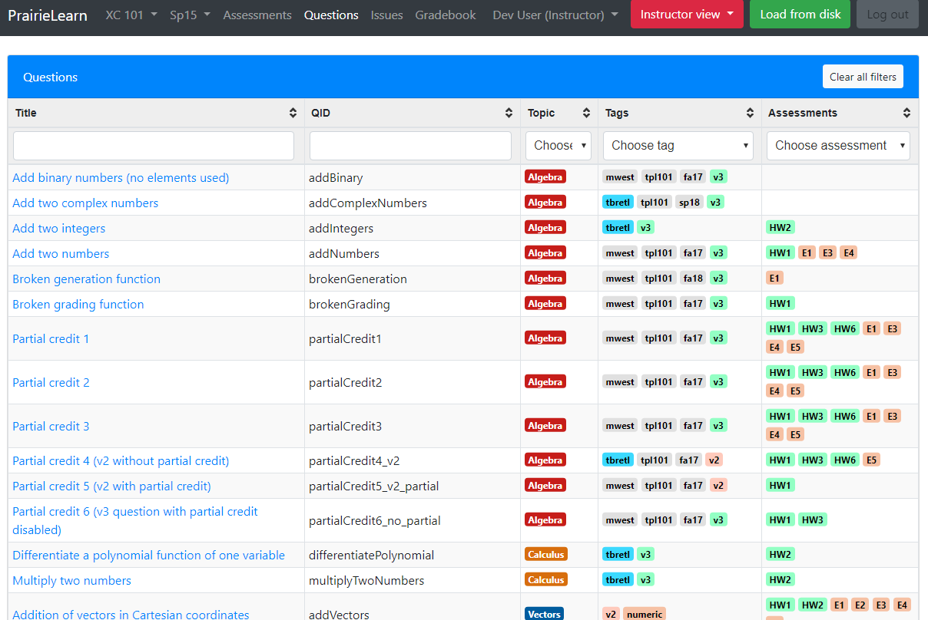
PrairieLearn Questions
This is the Questions tab in the Example Course.
You can browse questions here and try them out.
You can view the code that makes the questions in the exampleCourse folder.

Slide 18
Important Addresses
PrairieLearn source code (and exampleCourse folder)
https://github.com/PrairieLearn/PrairieLearn
https://github.com/PrairieLearn/PrairieLearn/tree/master/exampleCourse
PrairieLearn User Guide content developer documentation
https://prairielearn.readthedocs.io/
Start with the “Installing and Running PrairieLearn” section
Work linearly down the list on the left
Production PrairieLearn server
https://prairielearn.engr.illinois.edu

Slide 19
How to get started with content
Load your course folder into docker PrairieLearn so you can browse and edit it.
Get a feel for things.
Look at a question you want to mimic in the exampleCourse
See if you can copy it into your course.

Slide 20
UUIDs
The .json files for courses, courseInstances, assessments, and questions have a required “uuid” field.
Universally Unique Identifier
How do you get them?
https://www.uuidgenerator.net/ (copy/paste)
Atom has a uuid generator: https://atom.io/packages/uuidgen

Slide 21
Page reloading and Load from Disk
If you make a new question, courseInstance, assessment, course
Load from Disk
Tip: Any .json file edits probably need a Load from Disk to take effect
If you are only editing an existing question
question.html or server.py
Reloading the browser page is enough to see the changes!
Sometimes might have to do a “new variant” – reinitialize the question

Slide 22
Closing thoughts

Slide 23
GitHub course repository
Information we need to know:
Which course?
GitHub usernames who should have access
You can sign up for a free one at https://github.com
Workflow:
Make changes locally, commit to git, push to GitHub
Can collaborate with others from GitHub
Pushing to GitHub does not put the content in production

Slide 24
PrairieLearn in production
Assumes admins have created the course on prairielearn.engr.Illinois.edu
Admins also set the list of people who can sync content to the production server
Production “Sync” functionality is like “Load from Disk”
Gets the latest version from your course GitHub repo
Is live to students at this point
New January 2020: Edit all the content from inside PL

Slide 25
Getting Help
PL Office Hours
Spring 2020: Tuesdays 11am-1pm in 2124 Siebel Center
Writing good questions workshop(s) next week
Dave will follow up for signup times
PrairieLearn Slack chat
https://prairielearn.slack.com
If you need an invite, let mussulma@illinois.edu know.
The #pl-help channel is great for questions.

