Slide 1
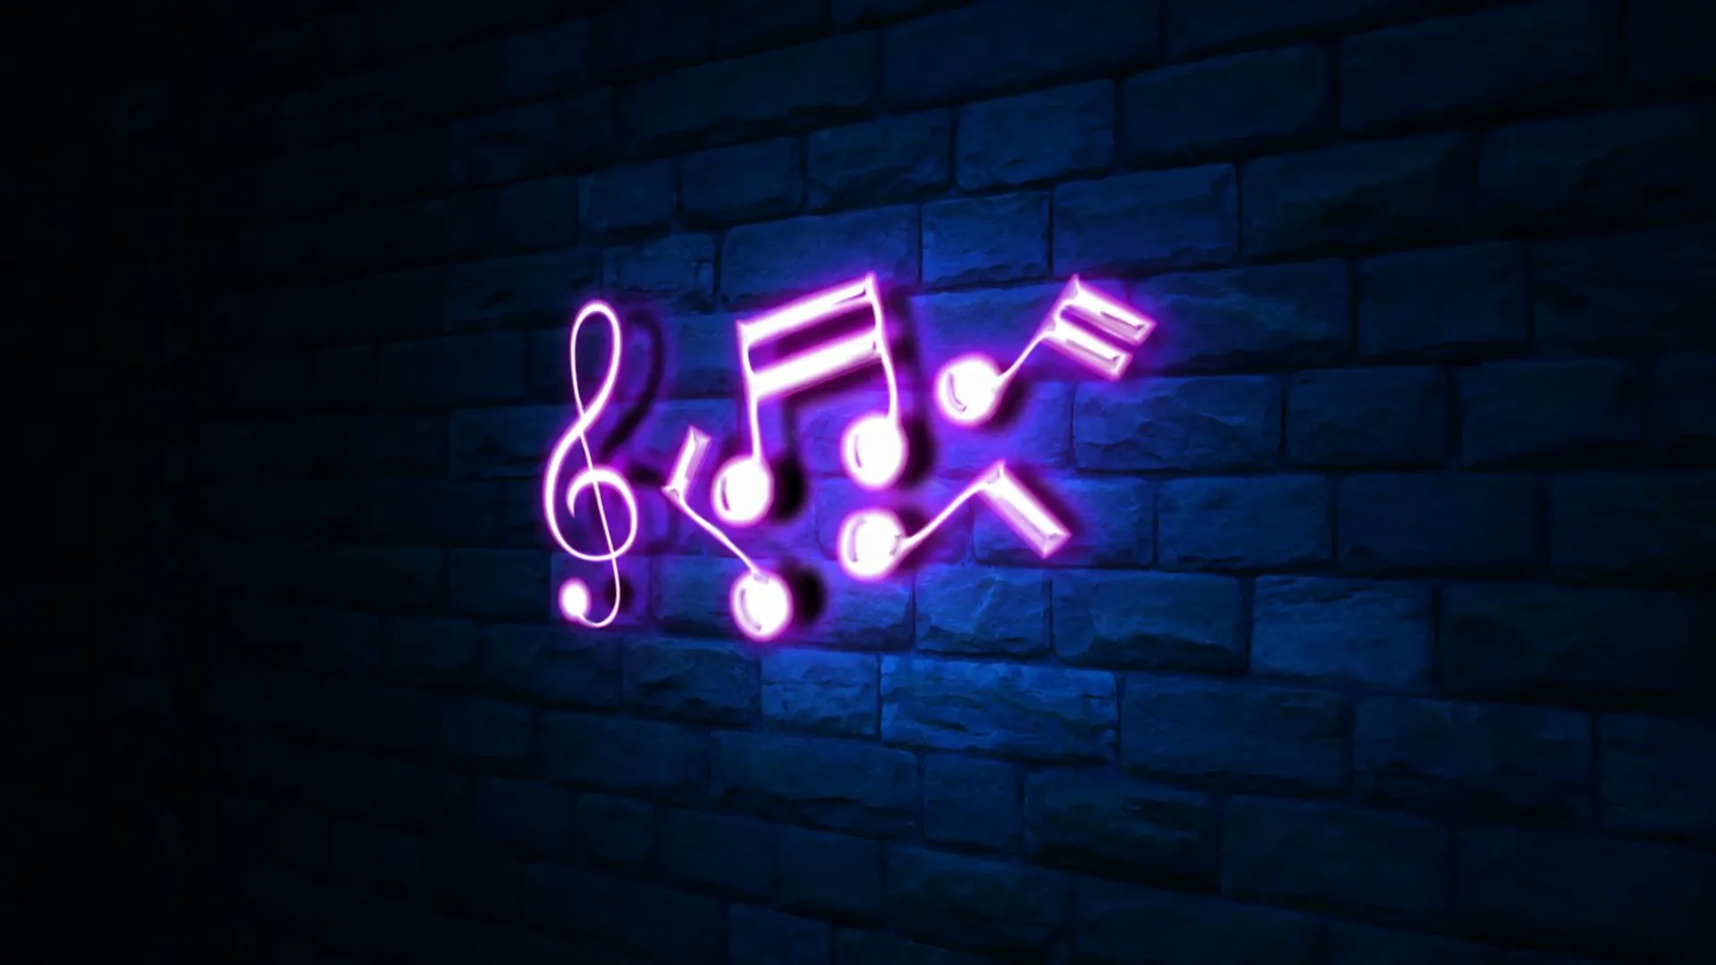

#music website
SYMPHONY

Slide 2

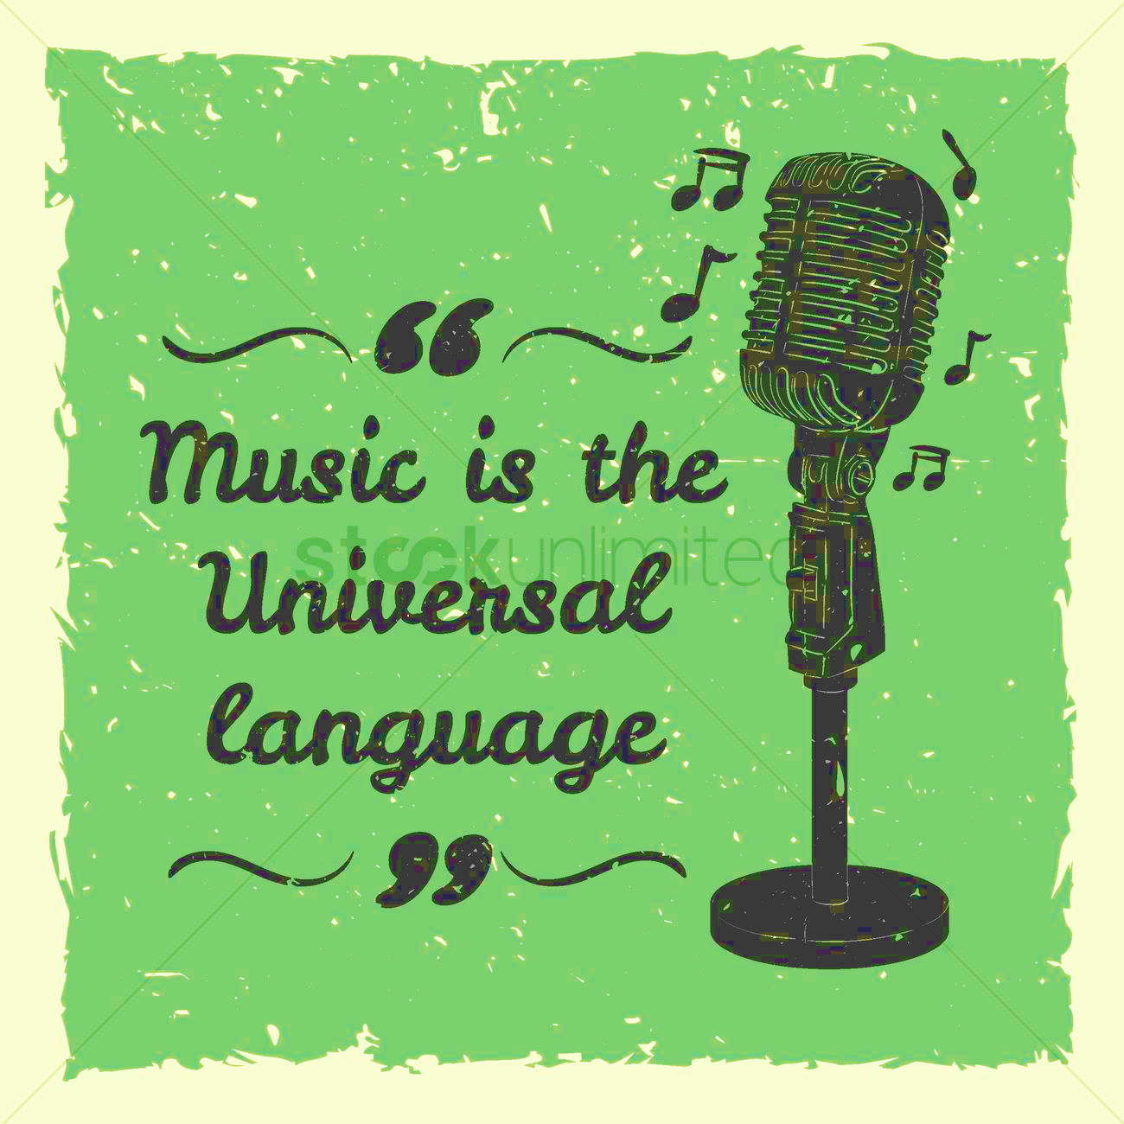

WHAT IS MUSIC?
Music is a vital part of different moments of human life. Music is the soul of life and gives immense peace to us. Music is a pleasant sound which is a combination of melodies and harmony and which soothes you.
Importance of Music:
Music has great qualities of healing a person emotionally and mentally. Music is a form of meditation. While composing or listening music ones tends to forget all his worries, sorrows and pains. Music has the ability to convey all sorts of emotions to people.
Magical Powers of Music:
It has the power to cure diseases such as anxiety, depression, insomnia, etc. It also helps in improving the concentration and is thus of great help to the students. Music is the essence of life. Everything that has rhythm has music. Our breathing also has a rhythm. We can conclude that music is the purest form of worship of God and to connect with our soul.

Slide 3

CONS of music industry which we want to implement and add to our website:
1. Lack of Lyrical Features: It is very difficult for people who are fond of reading the lyrics while listening to the songs and lyrics are not available.
2. Expensive: The premium costs are expensive can be bought thrice but not always.
3. Sound Quality: Non-subscribers have less sound quality.
4. Not Available in all Countries: Available juts within a small number of countries. One of the biggest flaws in many video and music streaming services is the fact that a limited number of countries can only have access to them.
5. Ads: Users have to listen to audio advertisements between their favourite songs and podcast shows. Plus, you can’t stream individual songs on demand, and you can skip just 6 tracks every hour. This is an extremely bad experience for users, especially when you hear things you don’t like.
6. Limitations and Music Collection: These are limited on aspects of artists ,languages.
[Taking all the above points our team will also add type of playlists where users can listen to particular songs while sleeping, relaxing, studying etc.]
7. Latest updates of liveshows, live concerts, live performances with place, time and tickets.

Slide 4




TECHNOLOGIES:
(will be used)
HTML
CSS
Java script
Bootstrap
THANK
YOU!
This Abstract (ppt)is done by:
Praisey & Pravalika
From 1^{st year} DATA SCIENCE…!

