Slide 1

Financial News Sentiment and Stock Price Prediction using NLP and Deep Learning: LSTM, Transformer & Explainable AI
CVR COLLEGE OF ENGINEERING
(An UGC Autonomous Institute, Accredited by NAAC with ‘A’ Grade)
Department of CSE(AI&ML)
B. Tech CSE(AI&ML)-B IV Year I Semester
Project Work Stage-1
PROJECT SUPERVISOR NAME:
Mrs.Farhana Bano,
Sr. Assistant Professor.
Presented By:-
B.Anirudh Reddy,23B81A6669
Y.Eeshanya,23B81A6679
Sk.Mehawish Fathima,23B81A6680

Slide 2
List of Contents to be Presented
Problem Statement
Project Objectives
Literature Survey / Related Work
Research Gap / Problem Identification
Proposed Methodology
System Architecture
Detailed System Design (Use Case, Activity, Sequence)
Technology Stack / Tools and Technologies
References

Slide 3
Problem Statement
Stock prices are highly volatile and are influenced by market trends, company performance, investor behavior, and financial news.
Existing methods may not fully consider news sentiment alongside historical market data.
Most existing models do not provide clear explanations for their predictions.
There is a need for a more comprehensive and interpretable stock-price prediction system that combines market data, news sentiment, and Explainable AI.

Slide 4
Project Objectives
To improve stock-price prediction accuracy by incorporating both market information and financial-news sentiment.
To capture the relationship between financial news and stock-price movements using NLP-based sentiment information.
To identify the most effective deep-learning approach for stock-price prediction by evaluating LSTM and Transformer models.
To enhance the transparency and interpretability of predictions by identifying the key factors that influence the model’s output using Explainable AI.

Slide 5
Literature Survey / Related Work
Study / Year | Modalities & Data | Core Method / Model | Key Findings | Limitation
Stock Price Prediction Using LSTM and News Sentiment Analysis (2022) | Stock data + financial news | LSTM + Sentiment Analysis | Combines news sentiment with stock data to predict stock prices. | Mainly focuses on LSTM; does not directly compare LSTM with Transformer.
Forecasting Equity Prices using LSTM and BERT with Sentiment Analysis (2023) | Stock data + financial news | LSTM + BERT | Uses BERT to understand financial news and LSTM for equity-price forecasting. | Limited focus on Transformer comparison and explainable prediction.
Explainable AI for Improved Financial Decision Support in Trading (2024) | Financial trading data | Explainable AI | Uses XAI to make financial AI decisions easier to understand. | Does not combine financial news sentiment with LSTM and Transformer prediction.
Fusion of Technical Indicators and Sentiment Analysis in a Hybrid Framework of Deep Learning Models for Stock Price Movement Prediction (2024) | Stock data + Twitter sentiment + technical indicators | CNN-LSTM, LSTM, GRU | Combines sentiment and technical indicators for stock-price movement prediction. | Does not compare LSTM with Transformer and has limited focus on SHAP.
Integrating Deep Learning and Econometrics for Stock Price Prediction (2025) | S&P 500 daily stock data | LSTM + Transformer + ARIMA + VAR | Compares LSTM and Transformer models; Transformer achieved the best overall performance. | Uses mainly historical stock data and does not integrate financial-news sentiment or FinBERT.

Slide 6
Research Gap / Problem Identification
Many existing studies use only historical stock data and do not integrate financial-news sentiment.
Studies that combine news sentiment with stock data mostly rely on a single model such as LSTM.
LSTM and Transformer models are rarely compared on the same combined dataset of market data, technical indicators and FinBERT sentiment.
Explainable AI (SHAP) is rarely applied to show which news and market features influence each prediction.
Hence, an integrated and interpretable framework is required.

Slide 7
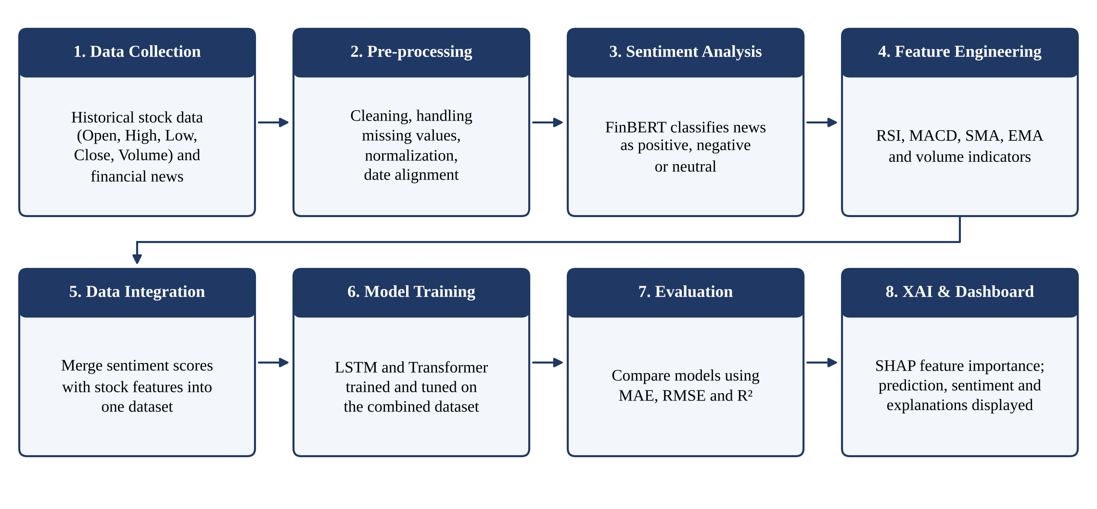
Proposed Methodology

Slide 8
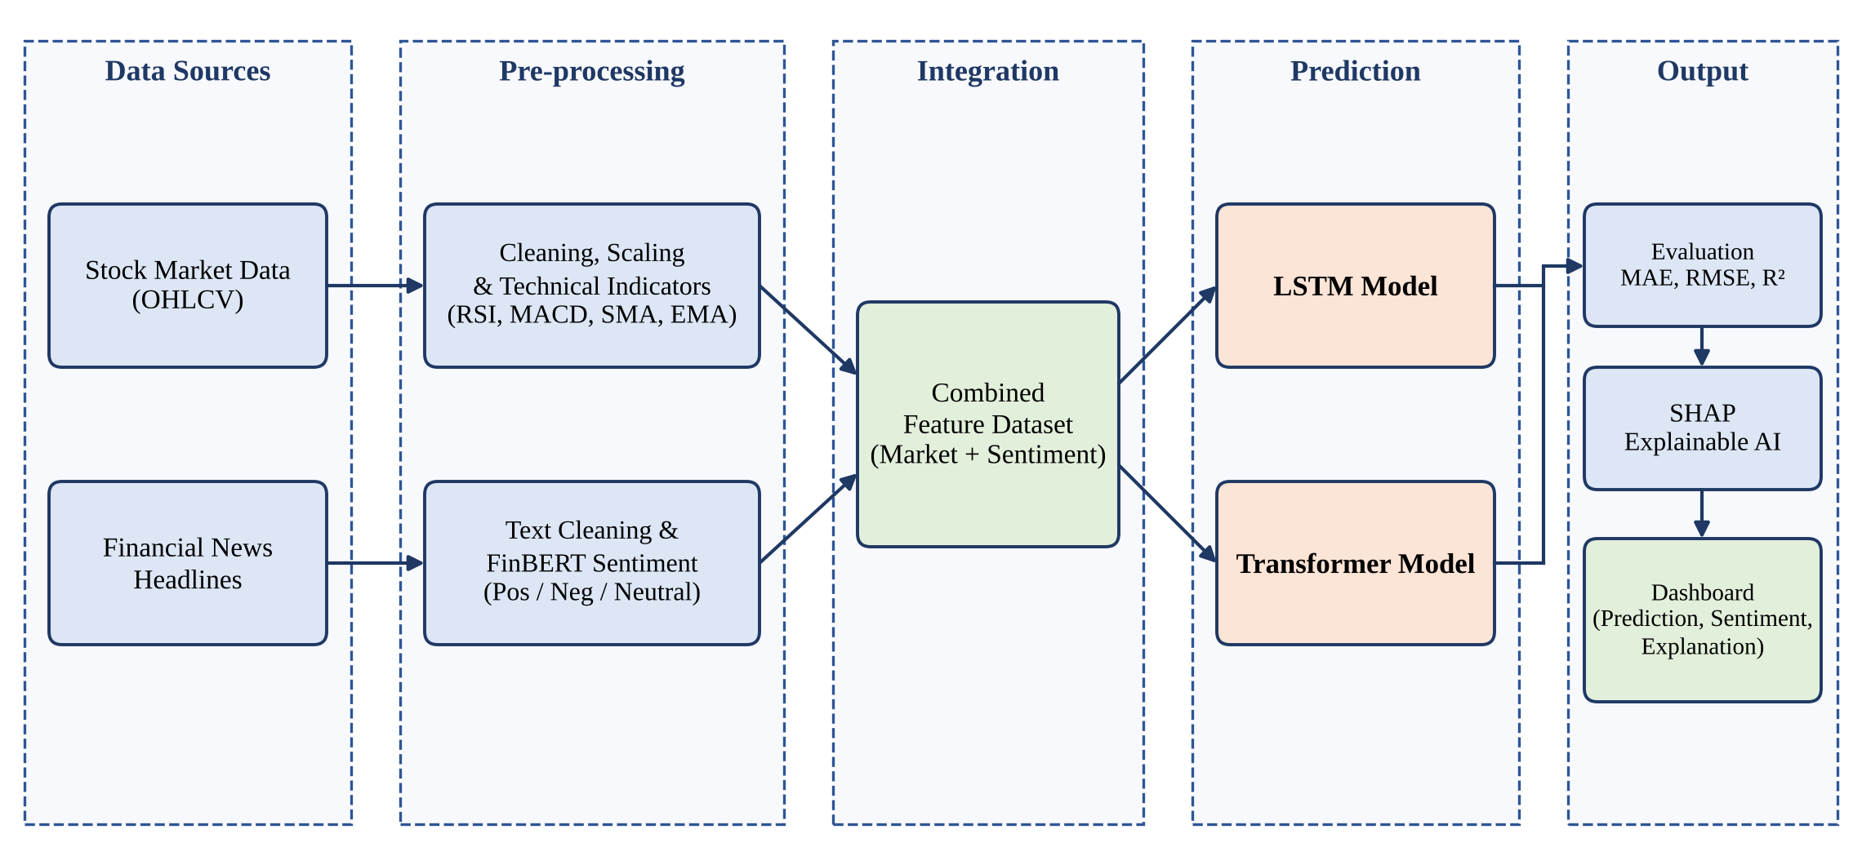
System Architecture

Slide 9
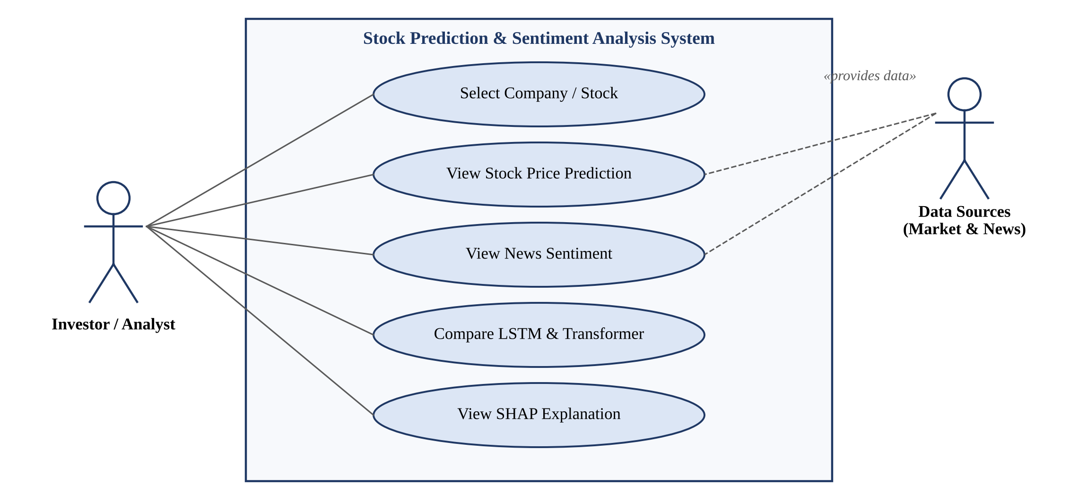
Detailed System Design: Use Case Diagram

Slide 10
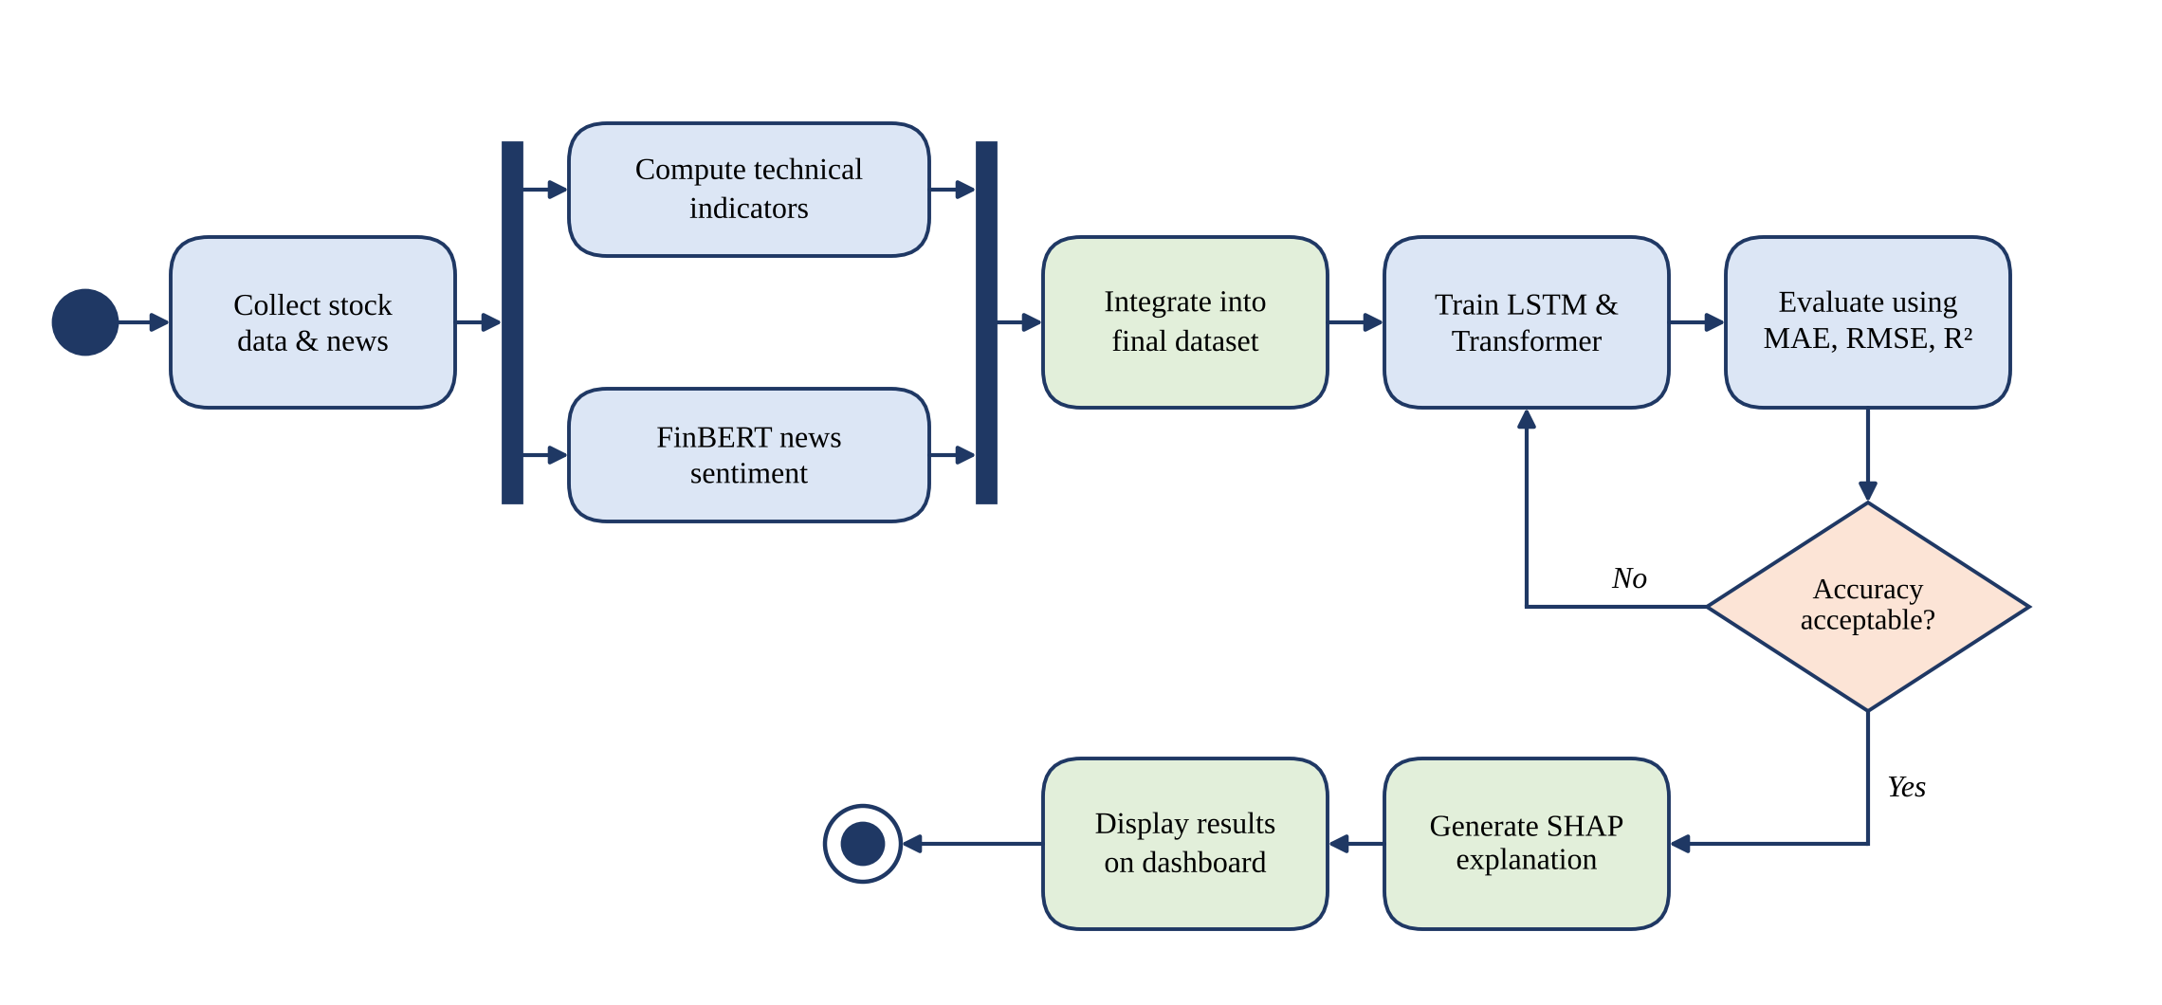
Detailed System Design: Activity Diagram

Slide 11
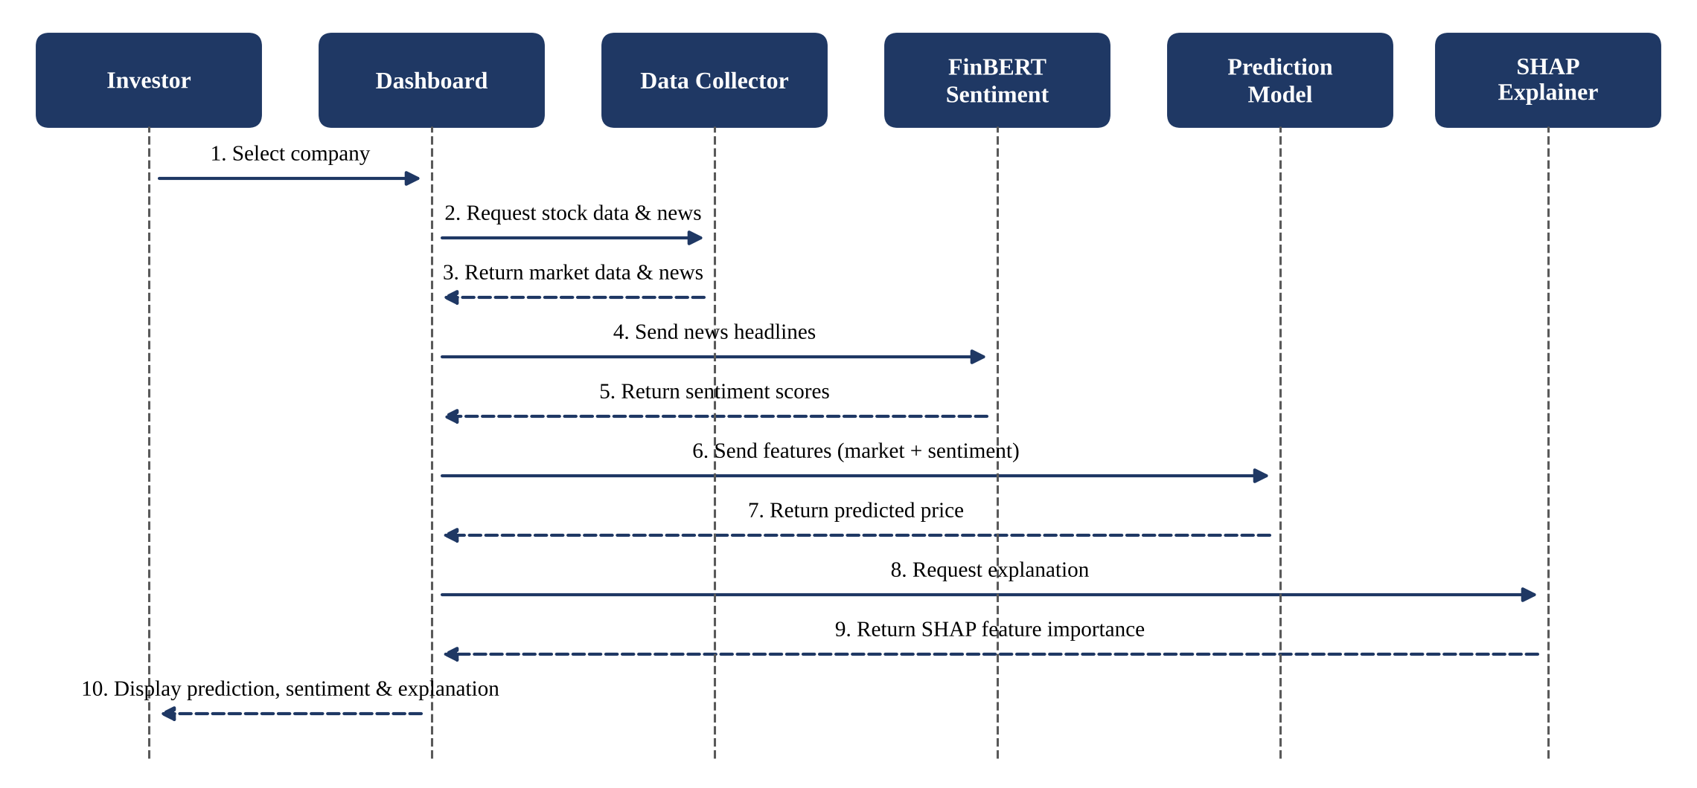
Detailed System Design: Sequence Diagram

Slide 12
Technology Stack / Tools and Technologies
Component | Tools / Technologies
Programming Language | Python
Data Collection | Yahoo Finance (yfinance) for stock data; financial news APIs / datasets
Data Processing | Pandas, NumPy, scikit-learn, technical-analysis library (RSI, MACD, SMA, EMA)
Sentiment Analysis (NLP) | FinBERT using Hugging Face Transformers
Deep Learning Models | LSTM and Transformer using TensorFlow / Keras or PyTorch
Explainable AI | SHAP (SHapley Additive exPlanations)
Visualization & Dashboard | Matplotlib, Plotly, Streamlit
Development Environment | Jupyter Notebook / Google Colab

Slide 13
References
[1] J. Yang, Y. Wang, and X. Li, “Prediction of stock price direction using the LASSO-LSTM model combines technical indicators and financial sentiment analysis,” PeerJ Computer Science, vol. 8, e1148, 2022. doi: 10.7717/peerj-cs.1148.
[2] Y. Ayyappa, V. K. Bandarapalli, S. Padma Priya, S. Akhila, et al., “Forecasting Equity Prices using LSTM and BERT with Sentiment Analysis,” in 2023 International Conference on Inventive Computation Technologies (ICICT), 2023. doi: 10.1109/ICICT57646.2023.10134443.

Slide 14
References
[3] A. Kalra and R. Mittal, “Explainable AI for Improved Financial Decision Support in Trading,” in 2024 11th International Conference on Reliability, Infocom Technologies and Optimization (ICRITO), 2024. doi: 10.1109/ICRITO61523.2024.10522366.
[4] F. Moodi, A. Jahangard Rafsanjani, S. Zarifzadeh, and M. A. Zare Chahooki, “Fusion of Technical Indicators and Sentiment Analysis in a Hybrid Framework of Deep Learning Models for Stock Price Movement Prediction,” IEEE Access, vol. 12, pp. 195696–195709, 2024. doi: 10.1109/ACCESS.2024.3519556.
[5] E. G. A. Osman and F. A. Otaibi, “Integrating Deep Learning and Econometrics for Stock Price Prediction: A Comprehensive Comparison of LSTM, Transformers, and Traditional Time Series Models,” Machine Learning with Applications, vol. 22, 100730, 2025. doi: 10.1016/j.mlwa.2025.100730.

Slide 15
THANK YOU

