Slide 1
Matplotlib Python

Slide 2
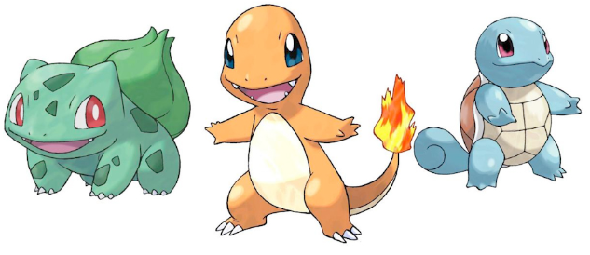
Download the data
Download the Pokemon dataset from:
https://gist.github.com/armgilles/194bcff35001e7eb53a2a8b441e8b2c6
Unzip the folder, and save the data file in a location you’ll remember.

Slide 3
Reading in the data
First we import the Python packages we are going to use.
Then we use Pandas to load in the dataset as a data frame.
NOTE: The argument index_col argument states that we'll treat the first column of the dataset as the ID column.
NOTE: The encoding argument allows us to by pass an input error created by special characters in the data set.

Slide 4
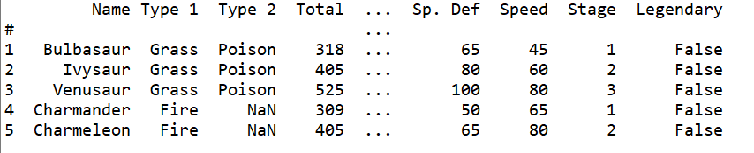
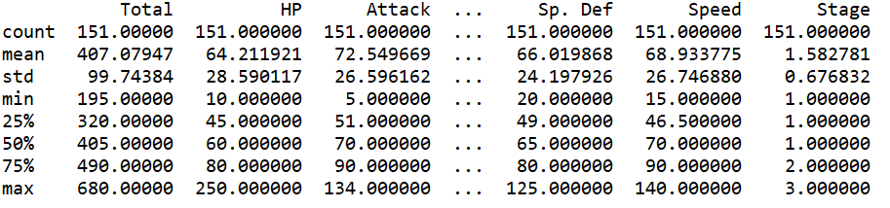
Examine the data set

Slide 5
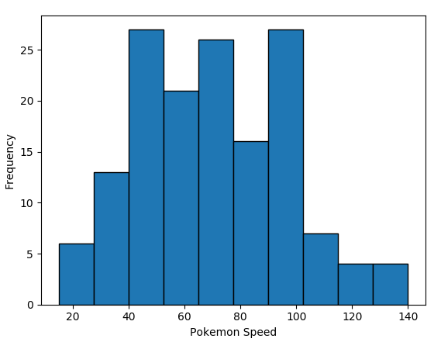

Plotting a histogram in Python

Slide 6
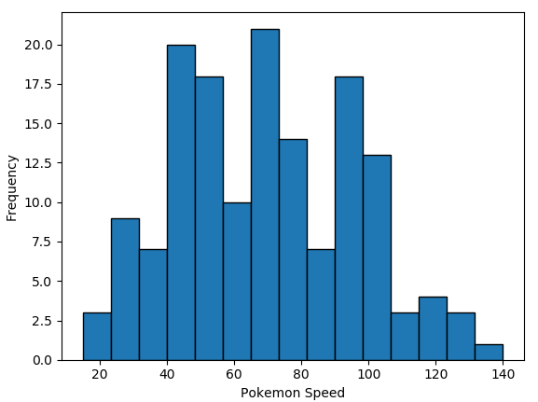
Bins
You may have noticed the two histograms we’ve seen so far look different, despite using the exact same data.
This is because they have different bin values.
The left graph used the default bins generated by plt.hist(), while the one on the right used bins that I specified.

Slide 7

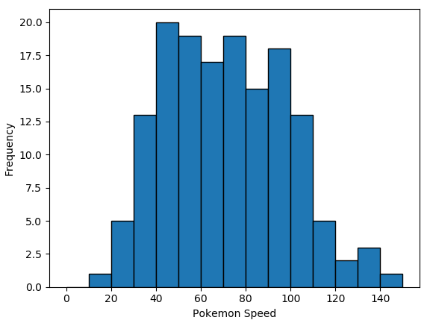
There are a couple of ways to manipulate bins in matplotlib.
Here, I specified where the edges of the bars of the histogram are; the bin edges.

Slide 8

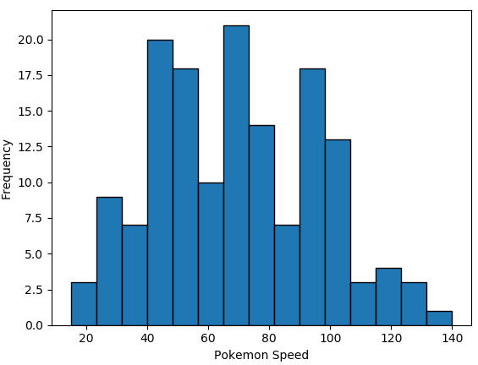
You could also specify the number of bins, and Matplotlib will automatically generate a number of evenly spaced bins.

Slide 9
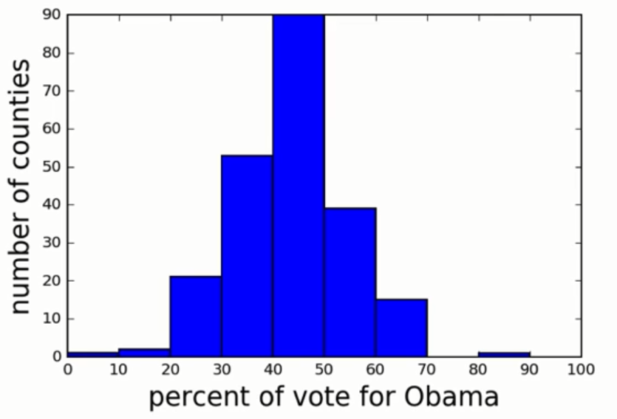
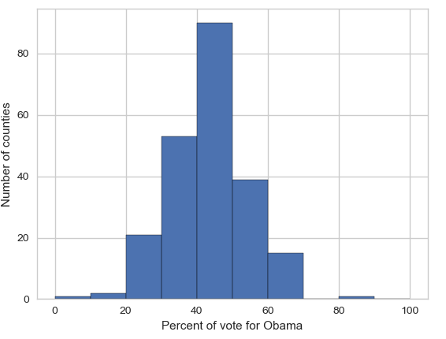
Seaborn
Matplotlib is a powerful, but sometimes unwieldy, Python library.
Seaborn provides a high-level interface to Matplotlib and makes it easier to produce graphs like the one on the right.
Some IDEs incorporate elements of this “under the hood” nowadays.

Slide 10
Benefits of Seaborn
Seaborn offers:
- Using default themes that are aesthetically pleasing.
- Setting custom colour palettes.
- Making attractive statistical plots.
- Easily and flexibly displaying distributions.
- Visualising information from matrices and DataFrames.
The last three points have led to Seaborn becoming the exploratory data analysis tool of choice for many Python users.

Slide 11
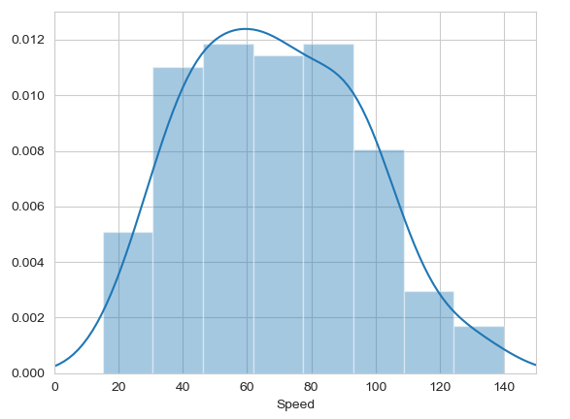

Histograms
Allow you to plot the distributions of numeric variables.

Slide 12
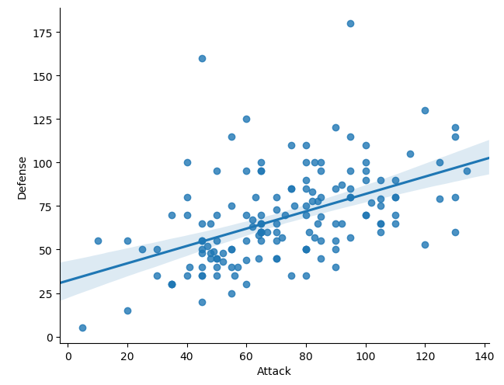
Other types of graphs: Creating a scatter plot
Name of our dataframe fed to the “data=“ command
Name of variable we want on the x-axis
Seaborn “linear model plot” function for creating a scatter graph
Name of variable we want on the y-axis

Slide 13
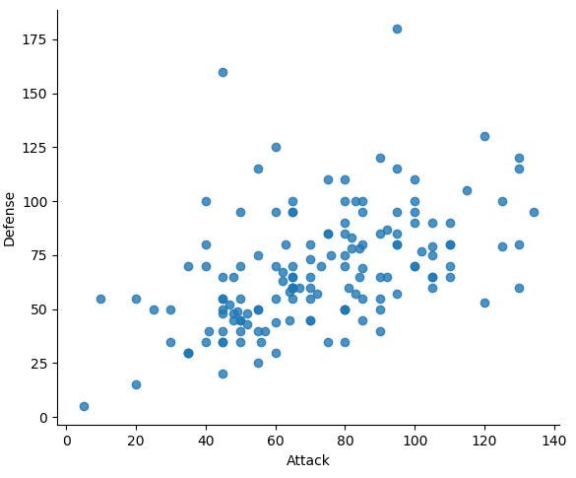
Seaborn doesn't have a dedicated scatter plot function.
We used Seaborn's function for fitting and plotting a regression line; hence lmplot()
However, Seaborn makes it easy to alter plots.
To remove the regression line, we use the fit_reg=False command

Slide 14
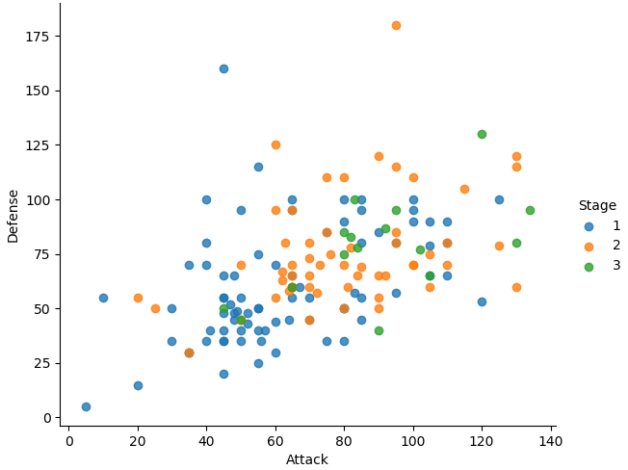

The hue function
Another useful function in Seaborn is the hue function, which enables us to use a variable to colour code our data points.

Slide 15
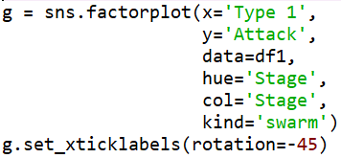
Factor plots
Make it easy to separate plots by categorical classes.
Colour by stage.
Separate by stage.
Generate using a swarmplot.
Rotate axis on x-ticks by 45 degrees.

Slide 16
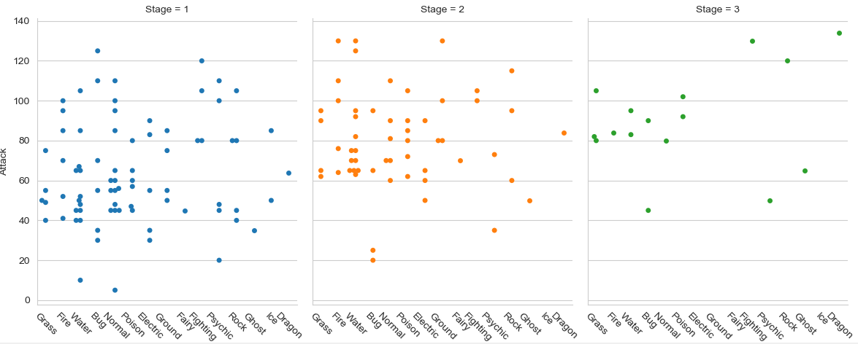

Slide 17
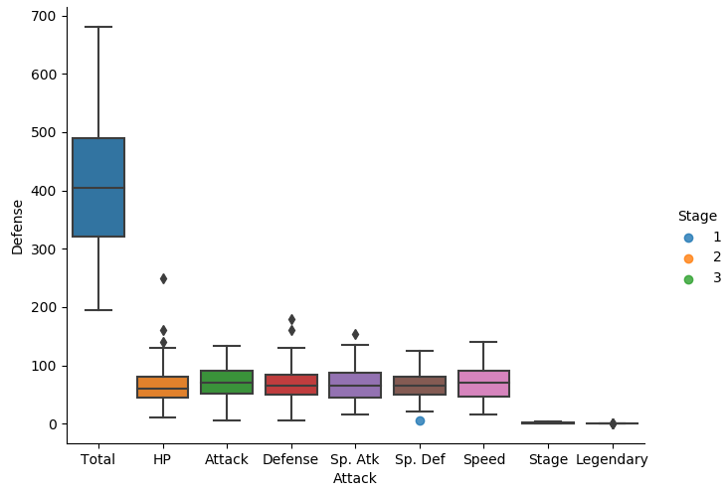

A box plot

Slide 18
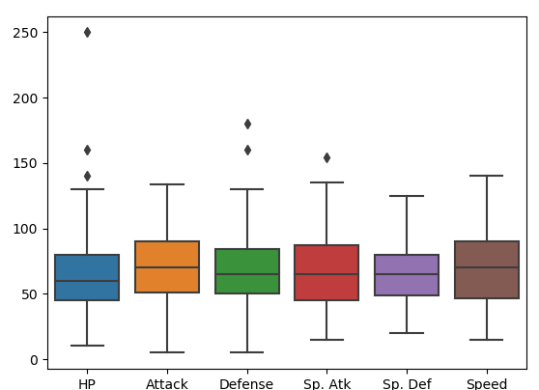
The total, stage, and legendary entries are not combat stats so we should remove them.
Pandas makes this easy to do, we just create a new dataframe
We just use Pandas’ .drop() function to create a dataframe that doesn’t include the variables we don’t want.

Slide 19
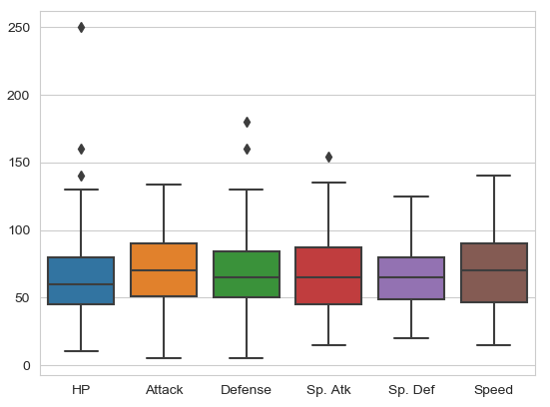

Seaborn’s theme
Seaborn has a number of themes you can use to alter the appearance of plots.
For example, we can use “whitegrid” to add grid lines to our boxplot.

Slide 20
Violin plots
Violin plots are useful alternatives to box plots.
They show the distribution of a variable through the thickness of the violin.
Here, we visualise the distribution of attack by Pokémon's primary type:

Slide 21
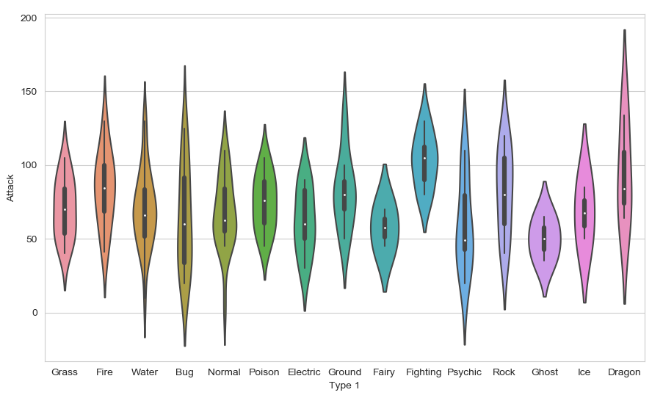
Dragon types tend to have higher Attack stats than Ghost types, but they also have greater variance. But there is something not right here….
The colours!

Slide 22
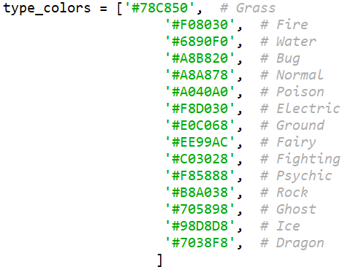
Seaborn’s colour palettes
Seaborn allows us to easily set custom colour palettes by providing it with an ordered list of colour hex values.
We first create our colours list.

Slide 23
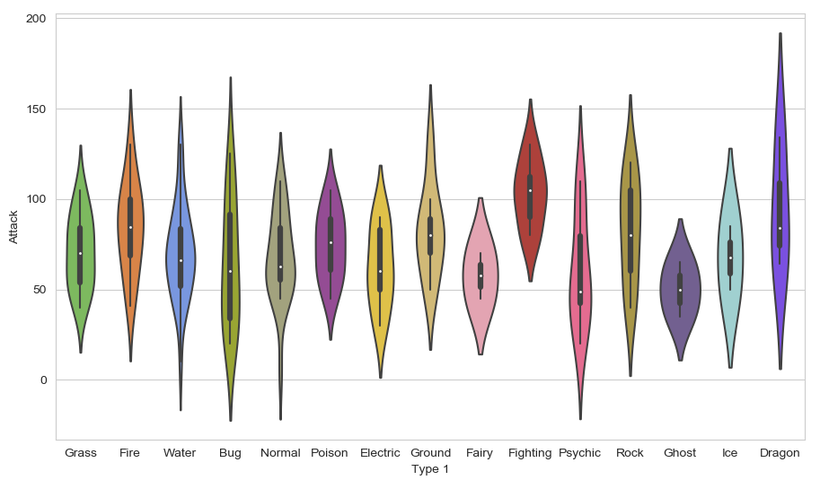
Then we just use the palette= function and feed in our colours list.

Slide 24
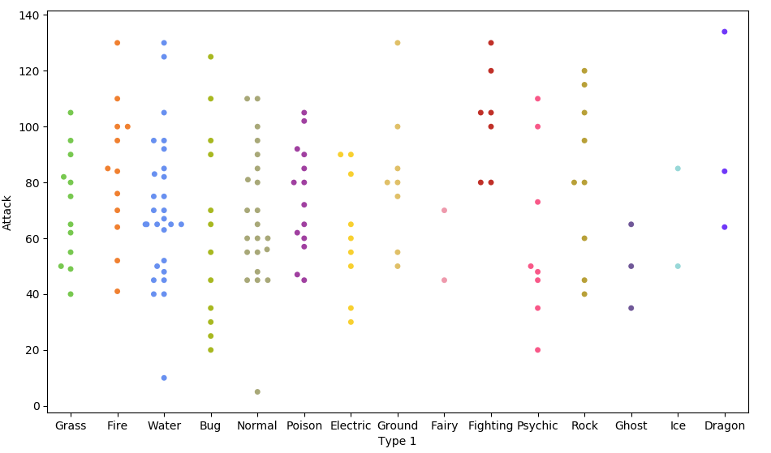

Because of the limited number of observations, we could also use a swarm plot.
Here, each data point is an observation, but data points are grouped together by the variable listed on the x-axis.

Slide 25
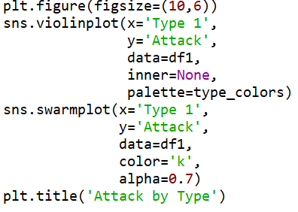
Overlapping plots
Both of these show similar information, so it might be useful to overlap them.
Set size of print canvas.
Remove bars from inside the violins
Make bars black and slightly transparent
Give the graph a title

Slide 26
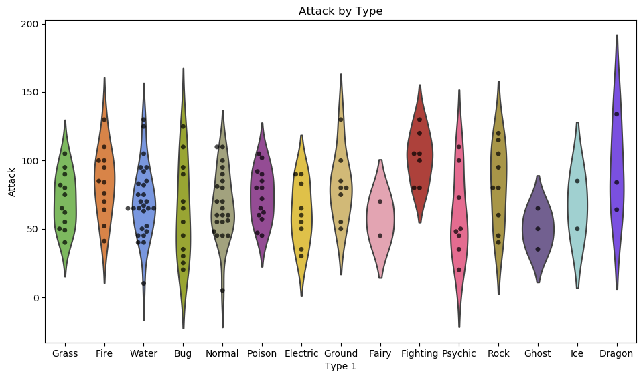

Slide 27
Data wrangling with Pandas
What if we wanted to create such a plot that included all of the other stats as well?
In our current dataframe, all of the variables are in different columns:

Slide 28
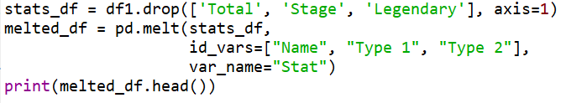
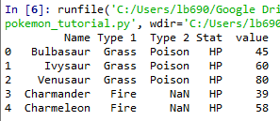


If we want to visualise all stats, then we’ll have to “melt” the dataframe.
We use the .drop() function again to re-create the dataframe without these three variables.
The dataframe we want to melt.
The variables to keep, all others will be melted.
A name for the new, melted, variable.
All 6 of the stat columns have been "melted" into one, and the new Stat column indicates the original stat (HP, Attack, Defense, Sp. Attack, Sp. Defense, or Speed).
It's hard to see here, but each pokemon now has 6 rows of data; hende the melted_df has 6 times more rows of data.

Slide 29
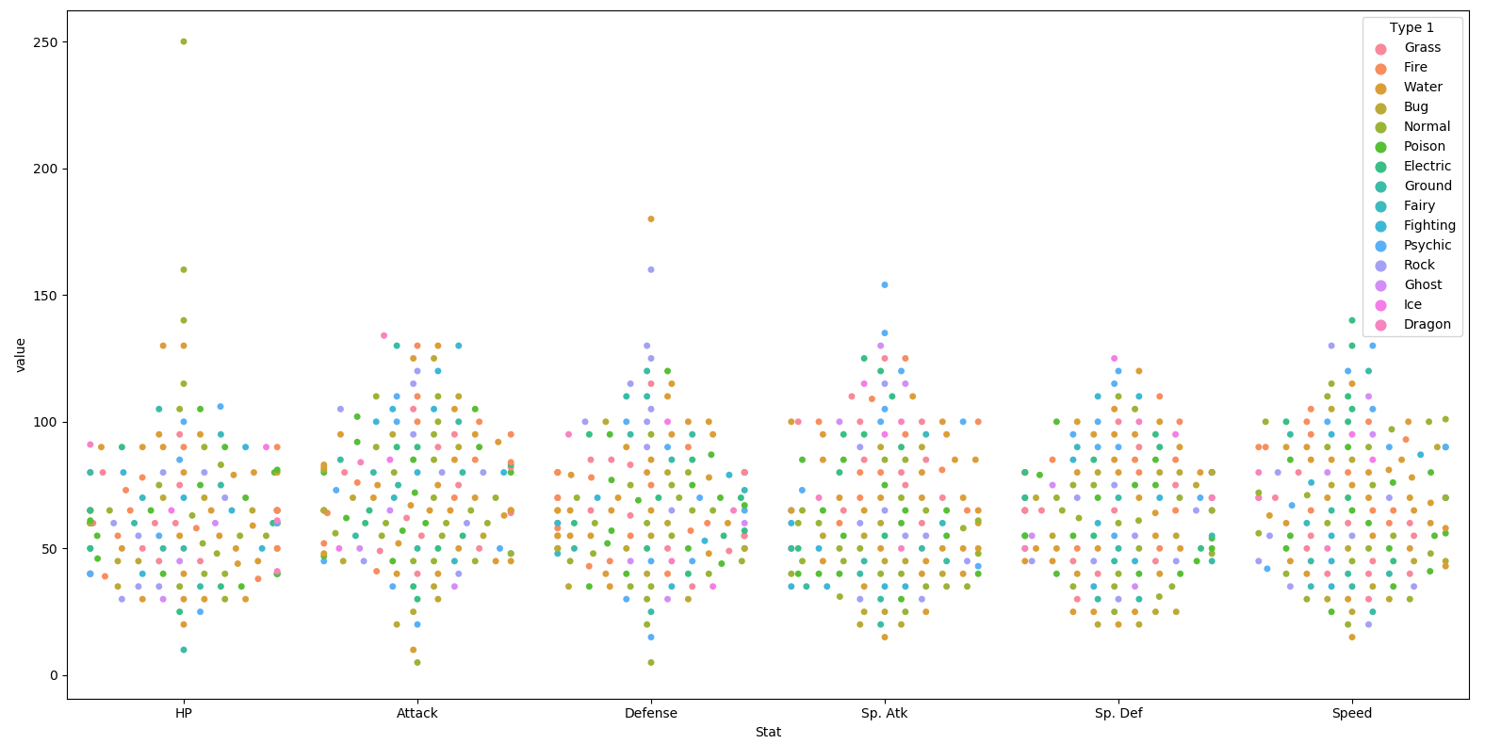

Slide 30
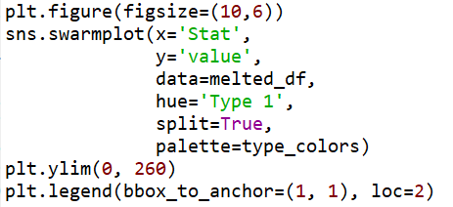
This graph could be made to look nicer with a few tweaks.
Enlarge the plot.
Separate points by hue.
Use our special Pokemon colour palette.
Adjust the y-axis.
Move the legend box outside of the graph and place to the right of it..

Slide 31
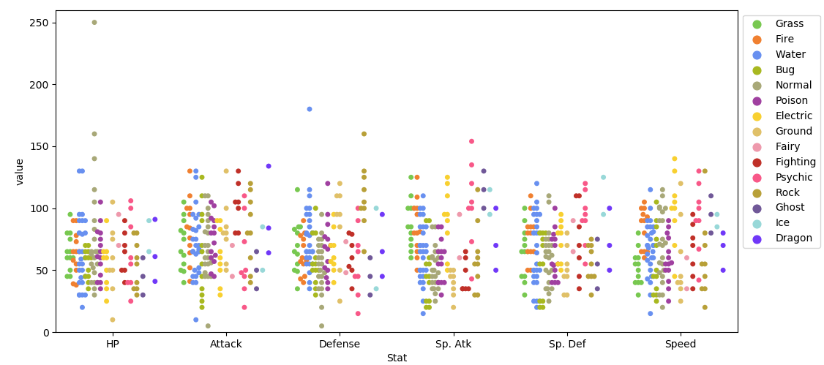

Slide 32
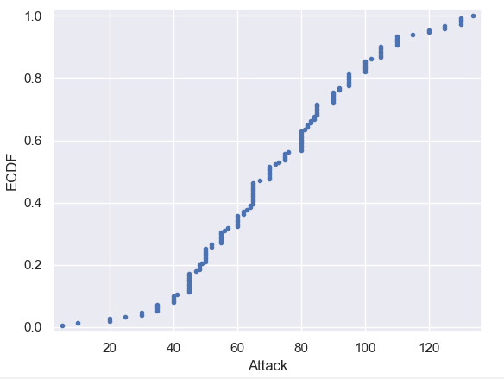
Plotting all data: Empirical cumulative distribution functions (ECDFs)
An alternative way of visualising a distribution of a variable in a large dataset is to use an ECDF.
Here we have an ECDF that shows the percentages of different attack strengths of pokemon.
An x-value of an ECDF is the quantity you are measuring; i.e. attacks strength.
The y-value is the fraction of data points that have a value smaller than the corresponding x-value. For example…

Slide 33
75% of Pokemon have an attack level of 90 or less
20% of Pokemon have an attack level of 50 or less.

Slide 34
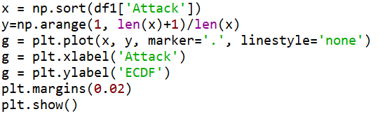
Plotting an ECDF
Notes:
The y-axis is evenly spaced data points with a maximum of 1.

Slide 35
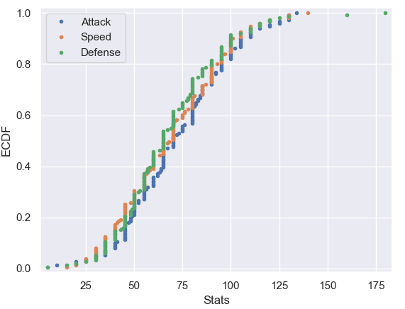
You can also plot multiple ECDFs on the same plot.
As an example, here with have an ECDF for Pokemon attack, speed, and defence levels.
We can see here that defence levels tend to be a little less than the other two.

Slide 36
The usefulness of ECDFs
It is often quite useful to plot the ECDF first as part of your workflow.
It shows all the data and gives a complete picture as to how the data are distributed.

Slide 37
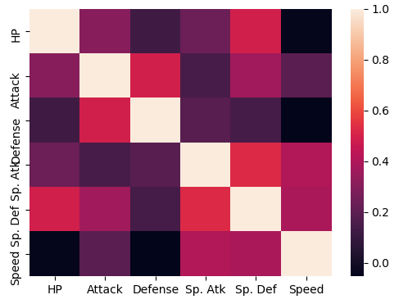

Heatmaps
Useful for visualising matrix-like data.
Here, we’ll plot the correlation of the stats_df variables

Slide 38
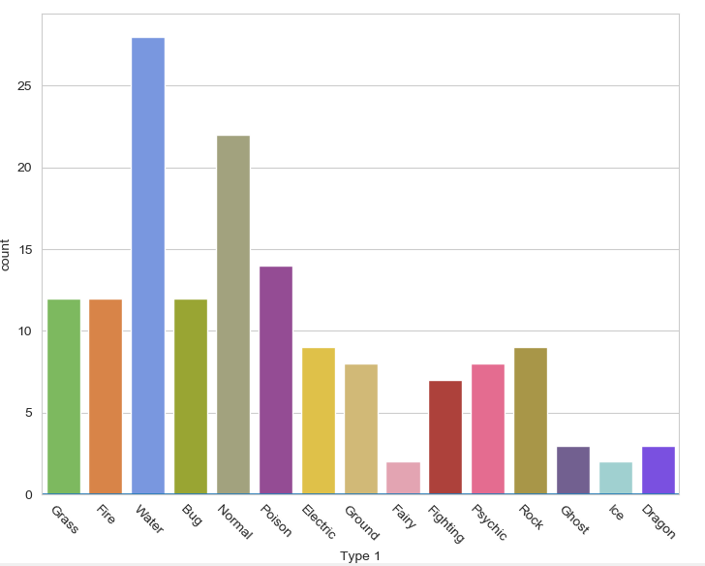

Bar plot
Visualises the distributions of categorical variables.
Rotates the x-ticks 45 degrees

Slide 39
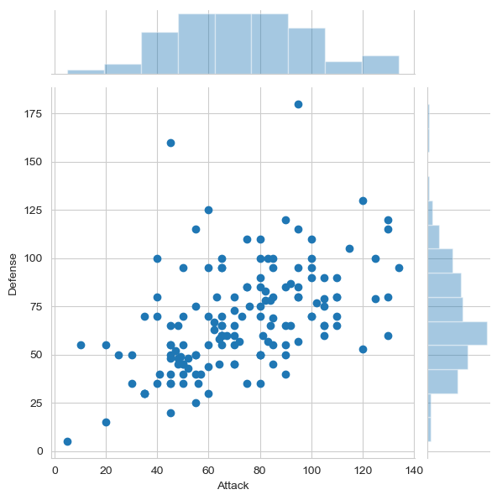

Joint Distribution Plot
Joint distribution plots combine information from scatter plots and histograms to give you detailed information for bi-variate distributions.

Slide 40
Any questions?

