Slide 1


Introduction to Machine Learning with Scikit-Learn

Slide 2




2017
Feature Engineering
Getting the most out of data for predictivemodels
Gabriel Moreira
@gspmoreira
Lead Data Scientist
DSc. student

Slide 3
"Feature engineering is the process of
transforming raw data into features that better
represent the underlying problem to the predictive models, resulting in improved model accuracy on unseen data."
– Jason Brownlee

Slide 4
“Coming up with features is difficult, time-consuming,
requires expert knowledge.
'Applied machine learning' isbasically
feature engineering.”
– Andrew Ng

Slide 5




The Dream...
Raw data
Dataset
Model
Task

Slide 6


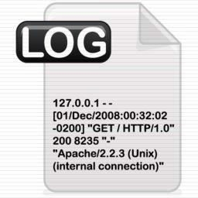





… The Reality
?
Features
?
Model
ML Ready dataset
Task
Raw data

Slide 7
… The Reality
ML Ready _{Model}
dataset
Deep Learnin?g
Task
Raw data
But what architecture?

Slide 8

More on scikit-learn
Data loading and pre-processing
Feature engineering
Hyperparameter tuning and Model evaluation
Pipelines

Slide 9
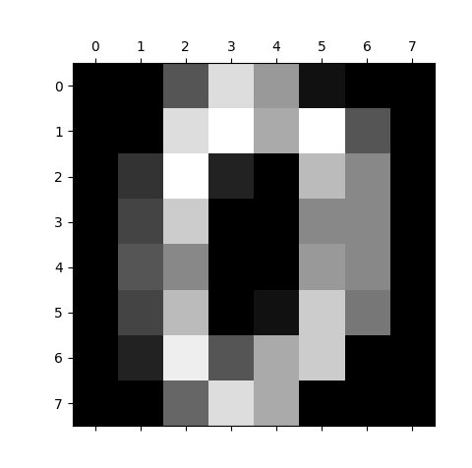
Load dataset
sklearn.datasets
Some „toy examples“ ready to use
datasets.load_iris()
datasets.load_wine()
Generate artificial data
>>> from sklearn.datasets import load_digits
>>> digits = load_digits()
>>> digits.data.shape
(1797, 64)
>>> digits.target_names
[0 1 2 3 4 5 6 7 8 9]
>>> import matplotlib.pyplot as plt
>>> plt.gray()
>>> plt.matshow(digits.images[0])
>>> plt.show()

Slide 10
Data pre-processing and transformation
Inputing for NaNs
Normalization / standardization
Transform nominals
Transform numeric
Data Aggregation
Feature extraction / combination
sklearn.preprocessing sklearn.feature_extraction sklearn.feature_selection

Slide 11
Exploratory Data Analysis (EDA)
Get the knowledge about your data
What does the data model look like?
What is the features distribution?
What are the features with missing or
inconsistent values?
What are the most predictive features?

Slide 12
Exploratory Data Analysis (EDA)
Get the knowledge about your data
get a basic description of the data
visualize it
identify patterns in it
identify challenges of using the data
form hypothesis about the data
- …

Slide 13
Exploratory Data Analysis (EDA)
Basic knowledge
Describe data (quantiles, med, mean, max, min…)
head(), tail()
Pd.Query(), sorting,
Challenges
NaNs, outliers, numeric -> nominal and vice versa Patterns
correlation, covariation, linear dependence, dimensionality reduction…
Visualization
boxpolots, histograms, cummulative distribution,
scatter plots, corr matrices, …

Slide 14
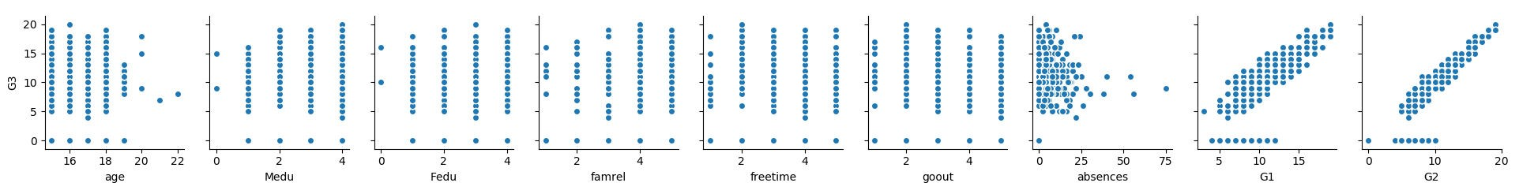
Exploratory Data Analysis (EDA) - pairplot
import pandas as pd
import seaborn as sns #statistical data visualization, based on matplotlib
import matplotlib.pyplot as plt
df = pd.read_csv("C:/Users/peska/Documents/uceni/2017_2018/NPRG065/cviceni/student-mat.csv", delimiter=";") sns.pairplot(data=df,
x_vars= ["age","Medu","Fedu","famrel","freetime","goout","absences","G1","G2"], y_vars= ['G3'])
plt.show()

Slide 15
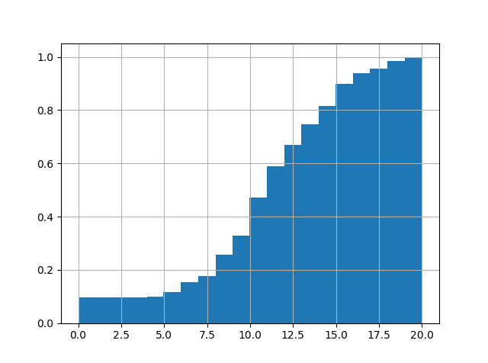
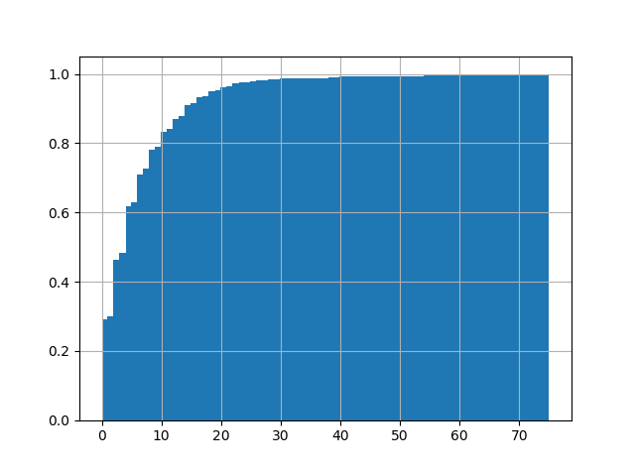
Exploratory Data Analysis (EDA) - CDF
import pandas as pd
import matplotlib.pyplot as plt
df = pd.read_csv("C:/Users/peska/Documents/uceni/2017_2018/NPRG065/cviceni/student-mat.csv", delimiter=";")
df.G3.hist(cumulative=True, normed=1, bins=len(df.G3))
#df.absences.hist(cumulative=True, normed=1, bins=len(df.absences)) plt.show()

Slide 16

Imputation for missing values
Datasets contain missing values, often encoded as blanks, NaNs or other placeholders
Ignoring rows and/or columns with missing values is possible, but at the price of
loosing data which might be valuable
Better strategy is to infer them from the known part of data
Strategies
Mean: Basic approach
Median: More robust to outliers
Mode: Most frequent value
Using a model: Can expose algorithmic bias

Slide 17
Imputation for missing values
>>> import numpy as np
>>> from sklearn.preprocessing import Imputer
>>> imp = Imputer(missing_values='NaN', strategy='mean', axis=0)
>>> imp.fit([[1, 2], [np.nan, 3], [7, 6]])
Imputer(axis=0, copy=True, missing_values='NaN', strategy='mean',
verbose=0)
>>> X = [[np.nan, 2], [6, np.nan], [7, 6]]
>>> print(imp.transform(X))
[[ 4.
[ 6.
[ 7.
2. ]
3.666...]
6. ]]
Missing values imputation with scikit-learn

Slide 18
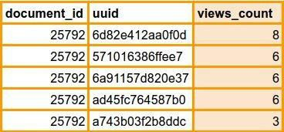
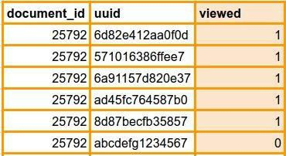
Binarization
Transform discrete or continuous numeric features in binary features
Example: Number of user views of the same document
>>> from sklearn import preprocessing
>>> X = [[ 1., -1., 2.],
... [ 2., 0., 0.],
... [ 0., 1., -1.]]
>>> binarizer = preprocessing.Binarizer(threshold=1.0)
>>> binarizer.transform(X)
array([[ 1., 0., 1.],
[ 1., 0., 0.],
[ 0., 1., 0.]])
Binarization with scikit-learn

Slide 19
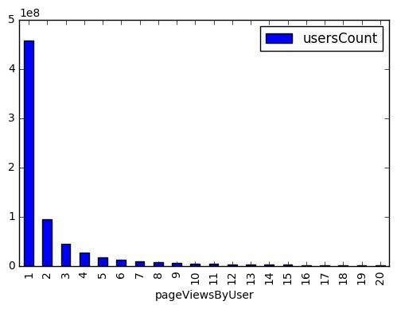
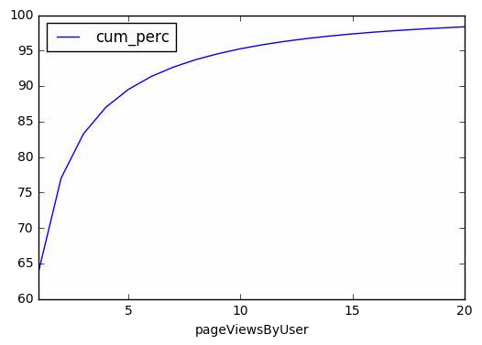
Binning
Split numerical values into bins and encode with a bin ID
Can be set arbitrarily or based on distribution
Fixed-width binning
Does fixed-width binning make sense for this long-tailed distribution?
Most users (458,234,809 ~ 5*10^8) had only 1 pageview during the period.
numpy.digitize

Slide 20
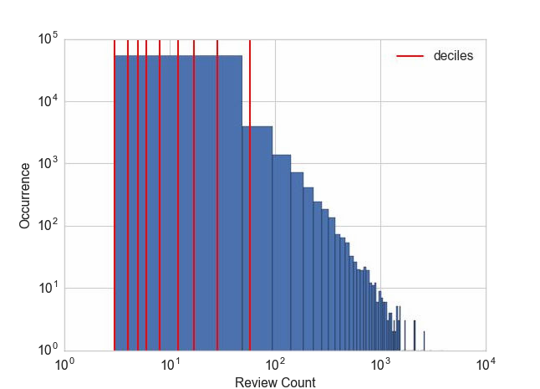
Binning
Adaptative or Quantile binning
Divides data into equal portions (eg. by median, quartiles, deciles)
>>> deciles = dataframe['review_count'].quantile([.1, .2, .3, .4, .5, .6, .7,
.8, .9])
>>> deciles 0.1 3.0
0.2 4.0
0.3 5.0
0.4 6.0
0.5 8.0
0.6 12.0
0.7 17.0
0.8 28.0
0.9 58.0
Quantile binning with Pandas

Slide 21
Scaling
Models that are smooth functions of input features are sensitive to the scale of the input (eg. Linear Regression)
Scale numerical variables into a certain range, dividing values by a normalization constant (no changes in single-feature distribution)
Popular techniques
MinMax Scaling
Standard (Z) Scaling

Slide 22
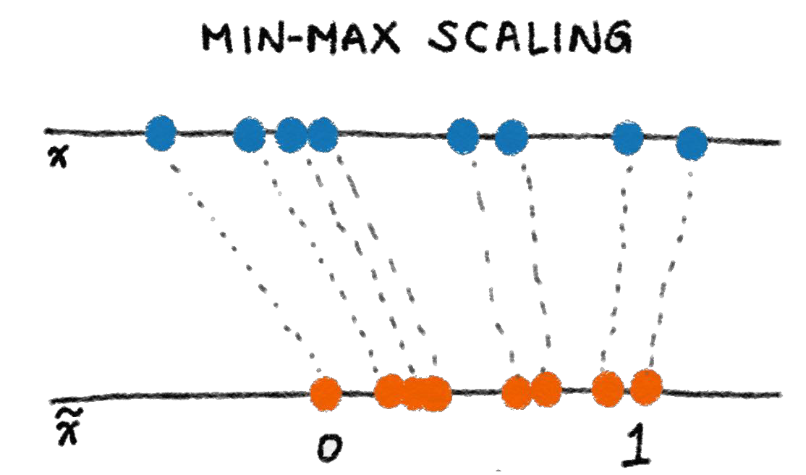
Min-max scaling
Squeezes (or stretches) all values within the range of [0, 1] to add robustness to very small standard deviations and preserving zeros for sparse data.
>>> from sklearn import preprocessing
>>> X_train = np.array([[ 1., -1., 2.],
... [ 2., 0., 0.],
... [ 0., 1., -1.]])
...
>>> min_max_scaler =
preprocessing.MinMaxScaler()
>>> X_train_minmax = min_max_scaler.fit_transform(X_train)
>>> X_train_minmax
array([[ 0.5 , 0. , 1. ],
[ 1.
, 0.5 , 0.33333333],
, 1. , 0. ]])
[ 0.
Min-max scaling with scikit-learn

Slide 23
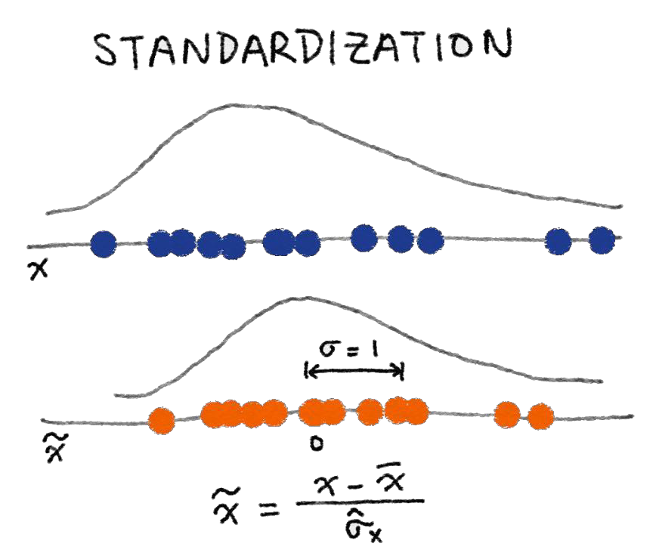
Standard (Z) Scaling
After Standardization, a feature has mean of 0 and variance of 1 (assumption of
many learning algorithms)
>>> from sklearn import preprocessing
>>> import numpy as np
>>> X = np.array([[ 1., -1., 2.],
... [ 2., 0., 0.],
... [ 0., 1., -1.]])
>>> X_scaled = preprocessing.scale(X)
>>> X_scaled
array([[ 0. ..., -1.22..., 1.33...],
[ 1.22..., 0. ..., -0.26...],
[-1.22..., 1.22..., -1.06...]])
>> X_scaled.mean(axis=0)
array([ 0., 0., 0.])
>>> X_scaled.std(axis=0) array([ 1., 1., 1.])
Standardization with scikit-learn

Slide 24
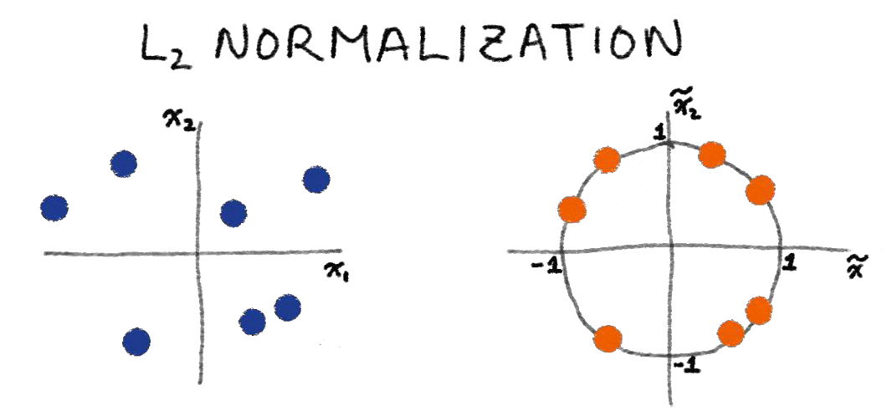

Normalization
Scales individual samples (rows) to have unit vector, dividing values by
vector’s L² norm, a.k.a. the Euclidean norm
Useful for quadratic form (like dot-product) or any other kernel to quantify similarity of pairs of samples. This assumption is the base of the Vector Space Model often used in text classification and clustering contexts
Normalized vector
Euclidean (L²) norm

Slide 25
Normalization
>>> from sklearn import preprocessing
>>> X = [[ 1., -1., 2.],
... [ 2., 0., 0.],
... [ 0., 1., -1.]]
>>> X_normalized = preprocessing.normalize(X, norm='l2')
>>> X_normalized
array([[ 0.40..., -0.40..., 0.81...],
[ 1. ..., 0. ..., 0. ...],
[ 0. ..., 0.70..., -0.70...]])
Normalization with scikit-learn

Slide 26
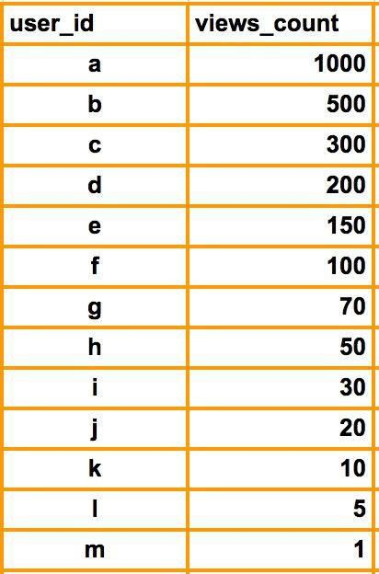
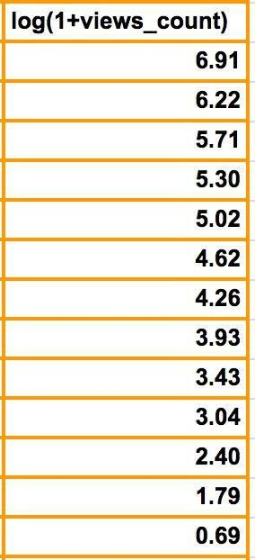
Log transformation
Compresses the range of large numbers and expand the range of small numbers. Eg. The larger x is, the slower log(x) increments.

Slide 27
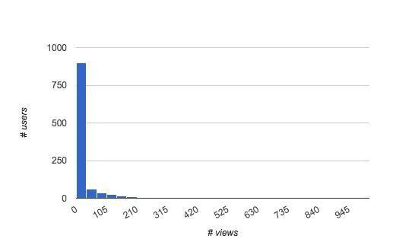
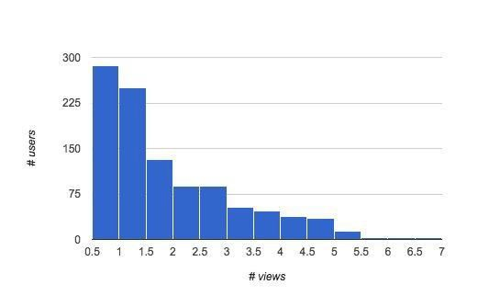
Log transformation
Smoothing long-tailed data with log
Histogram of # views by user
Histogram of # views by user smoothed by log(1+x)

Slide 28
Feature extraction

Slide 29
Interaction Features
>>> import numpy as np
>>> from sklearn.preprocessing import PolynomialFeatures
>>> X = np.arange(6).reshape(3, 2)
>>> X
array([[0, 1],
[2, 3],
[4, 5]])
>>> poly = poly = PolynomialFeatures(degree=2, interaction_only=False,
include_bias=True)
>>> poly.fit_transform(X)
array([[ | 1., | 0., | 1., | 0., | 0., 1.],
[ | 1., | 2., | 3., | 4., | 6., 9.],
[ | 1., | 4., | 5., | 16., | 20., 25.]])
Polynomial features with scikit-learn

Slide 30
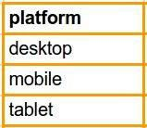
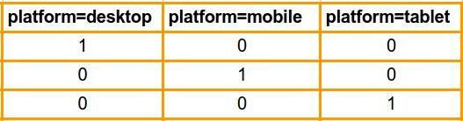
One-Hot Encoding (OHE)
Transform a categorical feature with m possible values into m binary features.
If the variable cannot be multiple categories at once, then only one bit in the
group can be on.
Sparse format is memory-friendly
sklearn.feature_extraction.DictVectorizer

Slide 31
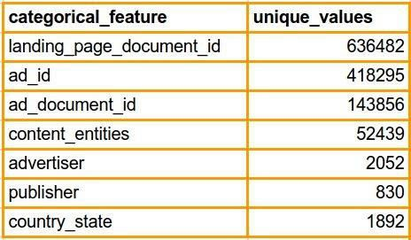
Large Categorical Variables
Common in applications like targeted advertising and fraud detection
Example:
Some large categorical features from Outbrain Click Prediction competition

Slide 32
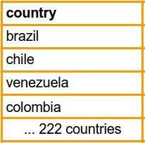
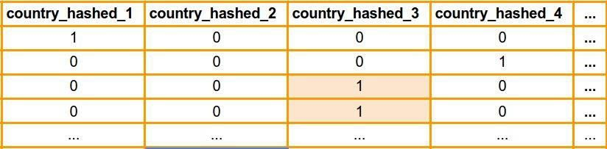
Feature hashing
Hashes categorical values into vectors with fixed-length.
Lower sparsity and higher compression compared to OHE
Deals with new and rare categorical values (eg: new user-agents)
May introduce collisions
100 hashed columns

Slide 33
Bin-counting
Instead of using the actual categorical value, use a global statistic of this category on historical data.
Useful for both linear and non-linear algorithms
May give collisions (same encoding for different categories)
Be careful about leakage
Strategies
Count
Average CTR

Slide 34
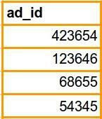
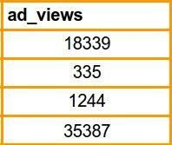
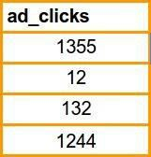
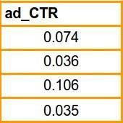
Bin-counting
or
or
Counts
Click-Through Rate
P(click | ad) = ad_clicks / ad_views

Slide 35
Textual features
sklearn.feature_extraction.text
Count, Tf-IDF,
Image features
sklearn.feature_extraction.image
Patches, img to graph,…

Slide 36
Feature selection

Slide 37
Feature selection
Decrease complexity of model
Remove redundant and irrelevant features
sklearn.feature_selection.SelectKBest
Scoring function
K features
Threshold
● …

Slide 38
Model Fitting & Evaluation

Slide 39
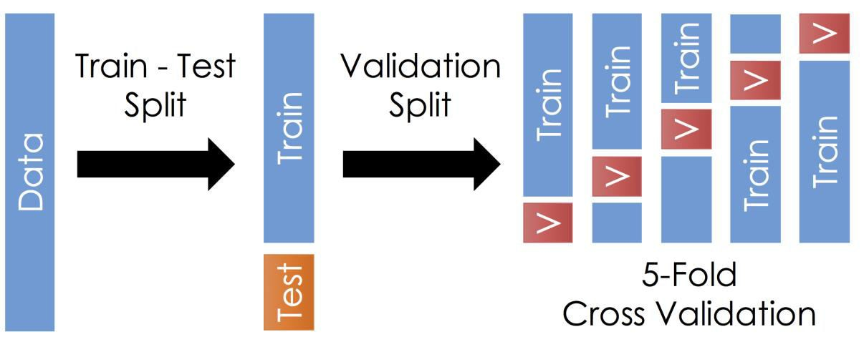
Model Fitting Protocol
How to learn model’s hyperparameters: grid search & cross-validation
Aggregate results
Istead of Train – Test split, you may use additional „outer“
cross-validation
Get results from all parts of the dataset
Never use any knowledge of the test set data
E.g. For mean ratings, object similarities etc

Slide 40
Model Fitting Protocol
Further variants:
Monte-Carlo cross validation:
- random splits, arbitrary size (cold start problems)
Bootstrap validation:
-only one split (if you have abundant data)
-Temporal splits:
-if domain changes over time

Slide 41
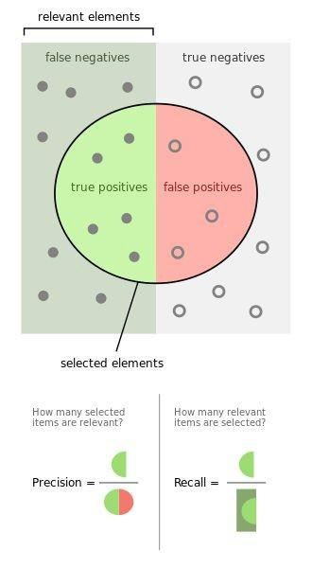
accuracy =
true
positives
+ t rue
negatives
/ t o t a l
precision =
t rue
positives / ( t r u e
positives
+ f a l s e p o s i t i ve s )
recall =
t rue positives / negatives + true
( f a l s e
p o s i t i ve s )
F1 score =
2 * ( ( precision
* recal l) /
(precision
+ r e c a l l ))
https://en.wikipedia.org/wiki/Precision_and_recall

Slide 42
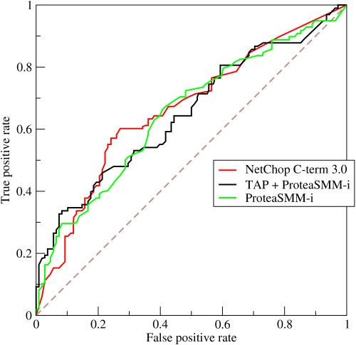
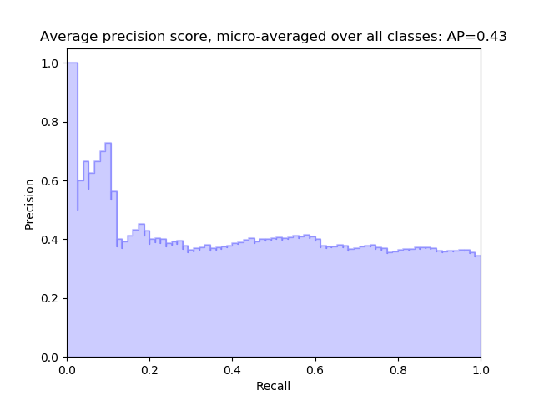
ROC (reciever-operator curve)
True Positive Rate / False Positive Rate
AUC (AUROC) = area under ROC
- probability that random positive example will be ranked higher than random
negative
- calculate empirically from test results
AUPR (area under precision-recall curve)
https://en.wikipedia.org/wiki/Receiver_operating_characteristic http://scikit- learn.org/stable/modules/generated/sklearn.metrics.auc.html#skle arn.metrics.auc

Slide 43



MSE & Coefficient of Determination
MAE / MSE / RMSE
MSE = np.mean((predicted-expected)**2)
Coefficient of determination
R² is a predictor of “goodness of fit” and is a value ∈
[0,1] where 1 is perfectfit.
-the proportion of the variance in the dependent variable that is predictable from the independent variable(s)
-independent from the scale of the output feature

Slide 44
Evaluation - sklearn
sklearn.model_selection
-GridSearchCV
-train_test_split()
-LeaveOneOut (predict for each example separately)
- Split data / Learn hyperparameters / Validate metrics

Slide 45
Evaluation - sklearn
sklearn.metrics: metric(true, predicted/rank,…)
Classification
-classification_report()
-precision, recall, auc, f1_score, jaccard,…
-confusion matrix
Regression
-r2_score(), MAE, MSE
Clustering Pairwise
- cosine / euklidean distance, …
…
-http://scikit-learn.org/stable/modules/classes.html#module-sklearn.metrics

Slide 46
Cross Validation in Scikit-Learn
from from from
sklearn import svm, datasets
sklearn.model_selection import GridSearchCV, train_test_split
sklearn.metrics import classification_report
iris = datasets.load_iris()
parameters = {'kernel':('linear', 'rbf'), 'C':[1, 10]}
svc = svm.SVC() X = iris.data y = iris.target
X_train, X_test, y_train, y_test = train_test_split(X, y, test_size=0.3, random_state=0)
clf = GridSearchCV(svc, parameters) clf.fit(X,y) print(clf.cv_results_['mean_test_score']) print(clf.cv_results_['params']) print(clf.best_params_)
y_pred = clf.predict(X_test) print(classification_report(y_test, y_pred))

Slide 47
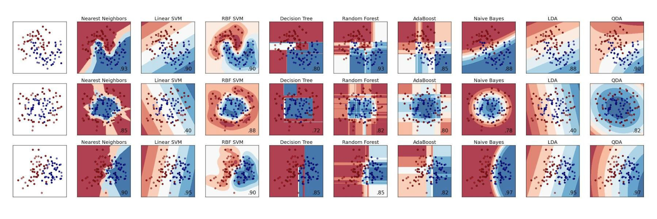
Other Evaluation
How to evaluate clusters? Visualization (but only in 2D)

Slide 48

Unpredictable Future
Machine learning models attempt to predict the future as new inputs come in - but human systems and processes are subject to change.
Solution: Precision/Recall tracking over time

Slide 49
Pipelines

Slide 50

Pipelines
sklearn. pipeline. Pipeline( steps)
Sequentially apply repeatable transformations to final estimator that can be validated at every step.
Each step (except for the last) must implement
Transformer, e.g. f i t and transform methods.
Pipeline itself implements both methods of
Transformer and Estimator interfaces.

Slide 51
>>> from sklearn.preprocessing import PolynomialFeatures
>>> from sklearn.pipeline import make_pipeline
>>> model = make_pipeline(PolynomialFeatures( 2), linear_model.
Ridge())
>>> m o d e l . f i t ( X _ t r a i n , y_ t r a i n )
>>> mean_squared_error(y_test, model. predict( X_ test)) 3.1498887586451594
>>> model.score(X_test, y_ test)
0.97090576345108104
Pipelined Model

