Slide 1
CLASS 12
UNIT 1 : CHAPTER 1
Review of Python

Slide 2
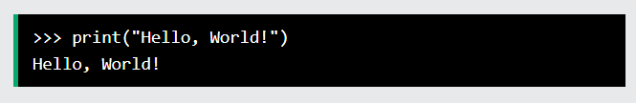
Execute Python Syntax
As we learned in the previous page, Python syntax can be executed by writing directly in the Command Line:
Or by creating a python file on the server, using the .py file extension, and running it in the Command Line:

Slide 3
Compilers and Interpreters
Programs written in high-level languages must be translated into machine language to be executed
Compiler: translates high-level language program into separate machine language program
Machine language program can be executed at any time

Slide 4
Compilers and Interpreters (cont’d.)
Interpreter: translates and executes instructions in high-level language program
Used by Python language
Interprets one instruction at a time
No separate machine language program
Source code: statements written by programmer
Syntax error: prevents code from being translated

Slide 5
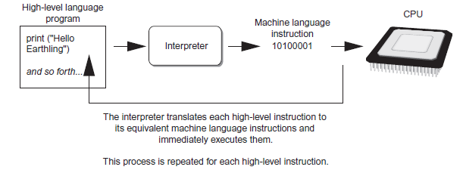
Compilers and Interpreters (cont’d.)
Executing a high-level program with an interpreter

Slide 6
Using Python
Python must be installed and configured prior to use
One of the items installed is the Python interpreter
Python interpreter can be used in two modes:
Interactive mode: enter statements on keyboard
Script mode: save statements in Python script

Slide 7
Interactive Mode
When you start Python in interactive mode, you will see a prompt
Indicates the interpreter is waiting for a Python statement to be typed
Prompt reappears after previous statement is executed
Error message displayed If you incorrectly type a statement
Good way to learn new parts of Python

Slide 8
Writing Python Programs and Running Them in Script Mode
Statements entered in interactive mode are not saved as a program
To have a program use script mode
Save a set of Python statements in a file
The filename should have the .py extension
To run the file, or script, type
python filename
at the operating system command line

Slide 9
Python Scripts
When you call a python program from the command line the interpreter evaluates each expression in the file
Familiar mechanisms are used to provide command line arguments and/or redirect input and output
Python also has mechanisms to allow a python program to act both as a script and as a module to be imported and used by another python program

Slide 10
The IDLE Programming Environment
IDLE (Integrated Development Learning Environment): single program that provides tools to write, execute and test a program
Automatically installed when Python language is installed
Runs in interactive mode
Has built-in text editor with features designed to help write Python programs

Slide 11
Whitespace
Whitespace is meaningful in Python: especially indentation and placement of newlines
Use a newline to end a line of code
Use \ when must go to next line prematurely
No braces {} to mark blocks of code, use consistent indentation instead
First line with less indentation is outside of the block
First line with more indentation starts a nested block
Colons start of a new block in many constructs, e.g. function definitions, then clauses

Slide 12
Enough to Understand the Code
Indentation matters to code meaning
Block structure indicated by indentation
First assignment to a variable creates it
Variable types don’t need to be declared.
Python figures out the variable types on its own.
Assignment is = and comparison is ==
For numbers + - * / % are as expected
Special use of + for string concatenation and % for string formatting (as in C’s printf)
Logical operators are words (and, or, not) not symbols
The basic printing command is print

Slide 13
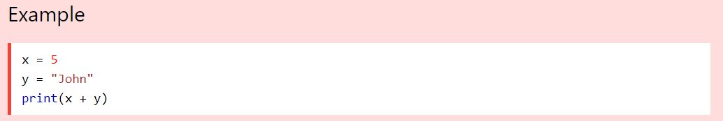
If you try to combine a string and a number, Python will give you an error:

Slide 14
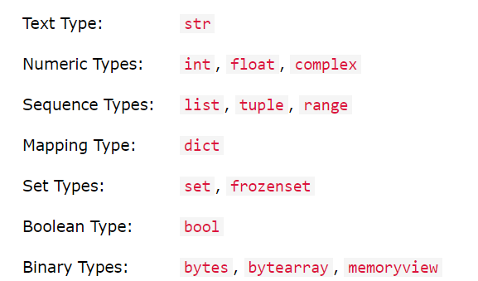
Python Data Types
Built-in Data Types
In programming, data type is an important concept.
Variables can store data of different types, and different types can do different things.
Python has the following data types built-in by default, in these categories:

Slide 15
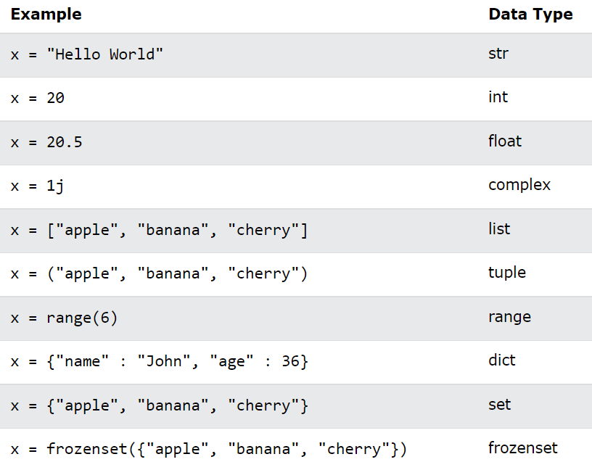
Setting the Data Type
In Python, the data type is set when you assign a value to a variable:

Slide 16
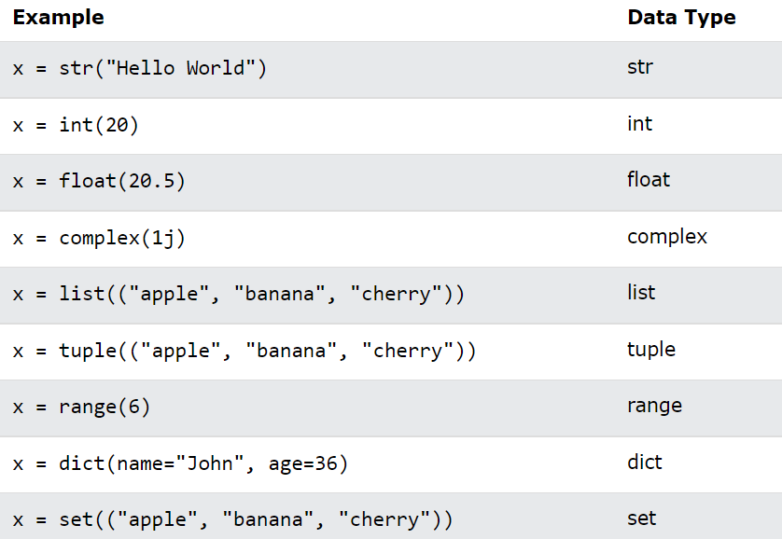
Setting the Specific Data Type
If you want to specify the data type, you can use the following constructor functions:

Slide 17
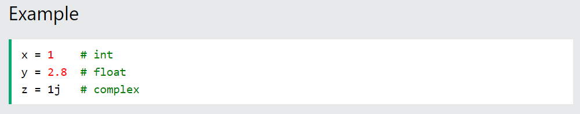
Python Numbers
There are three numeric types in Python:
int
float
complex
Variables of numeric types are created when you assign a value to them:

Slide 18
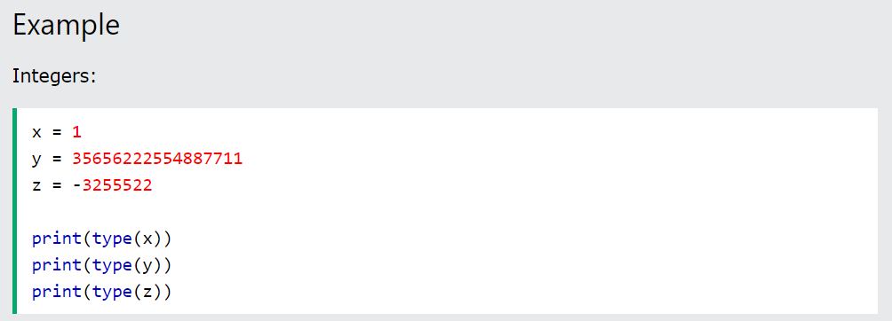
Int
Int, or integer, is a whole number, positive or negative, without decimals, of unlimited length.

Slide 19
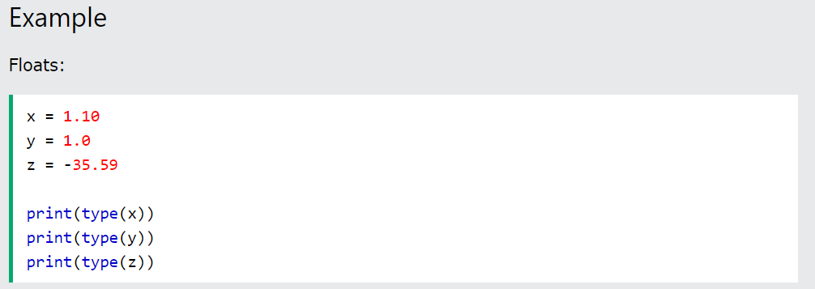

Float
Float, or "floating point number" is a number, positive or negative, containing one or more decimals.
Float can also be scientific numbers with an "e" to indicate the power of 10.
Example :

Slide 20
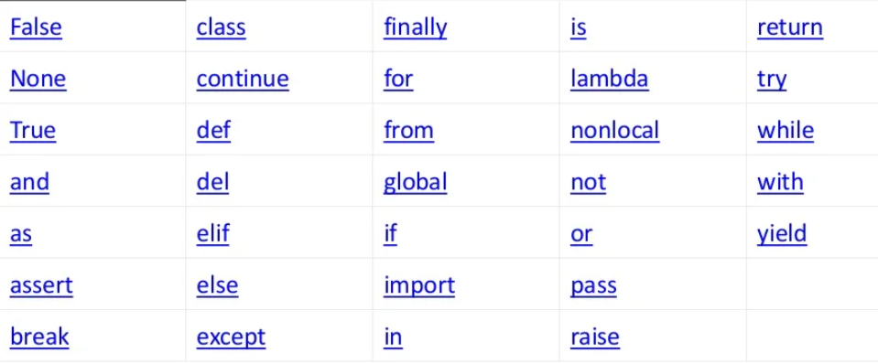
KEYWORDS IN PYTHON

