Slide 1
Introduction to python
Jnana marga tech.

Slide 2
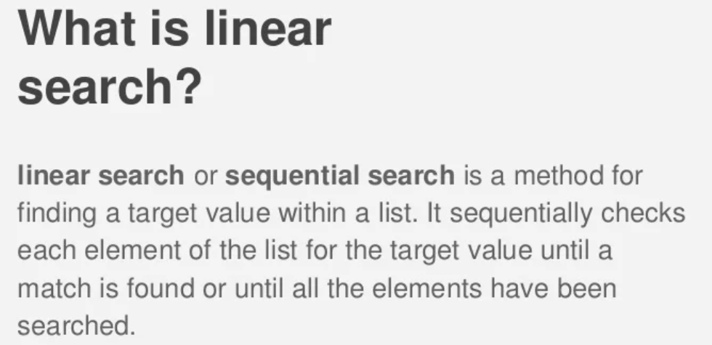

Slide 3
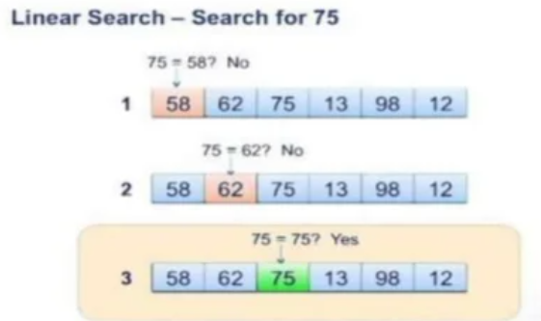

Slide 4
SORTING

Slide 5
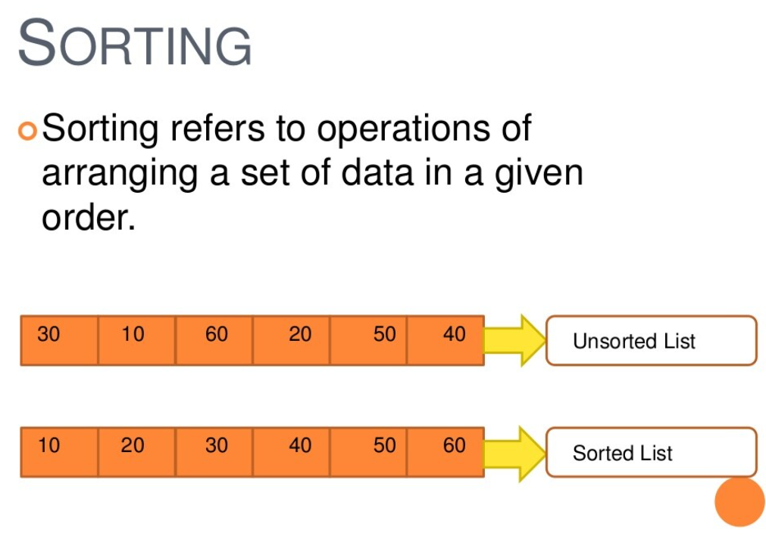

Slide 6
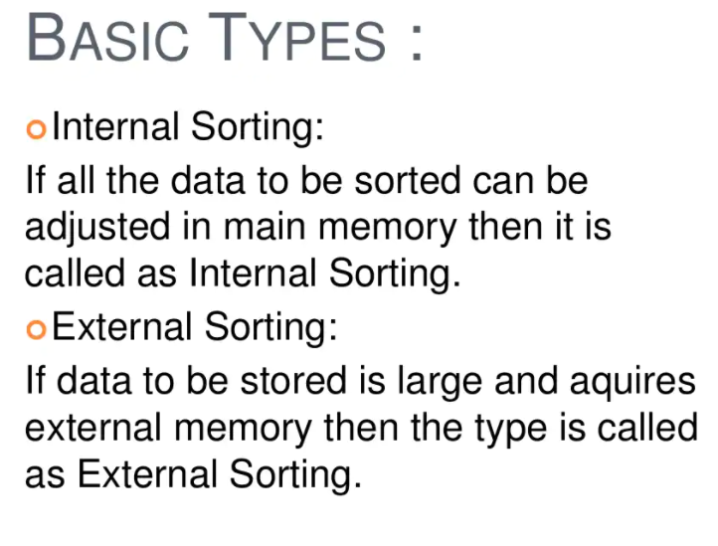

Slide 7
METHODS OF SORTING :
SELECTION SORT
INSERTION SORT
MERGE SORT
QUICK SORT

Slide 8
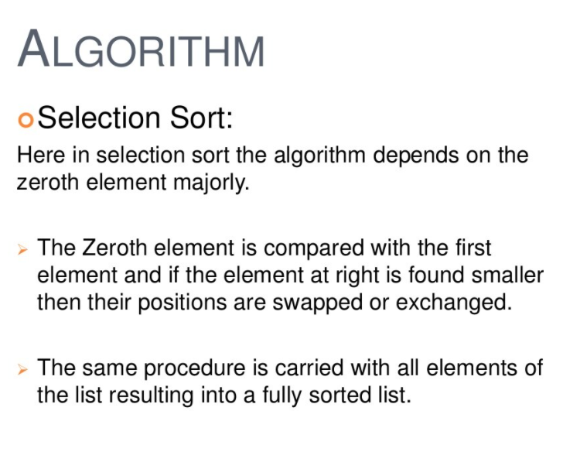

Slide 9
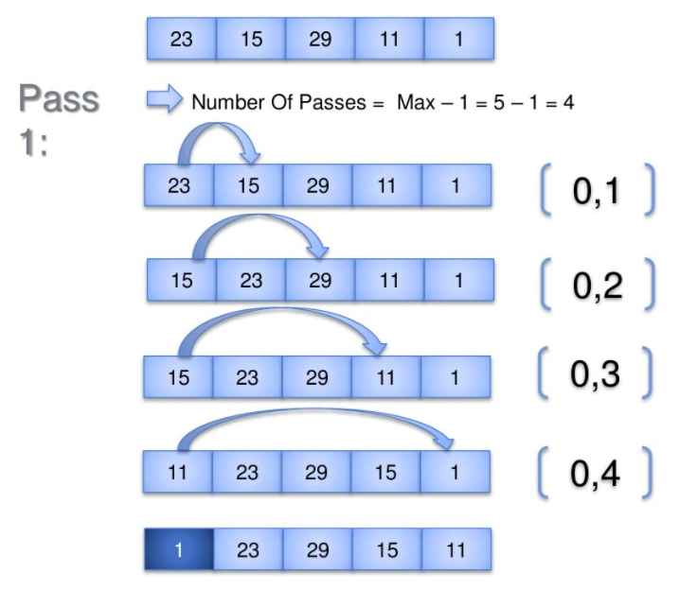

Slide 10
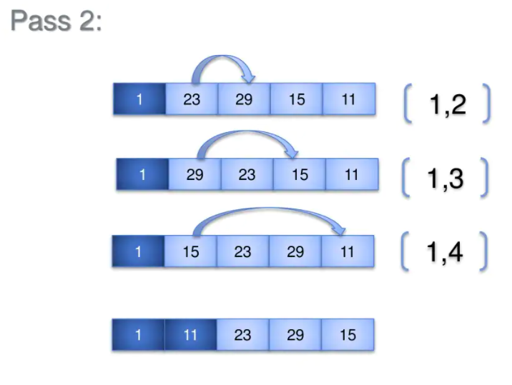

Slide 11
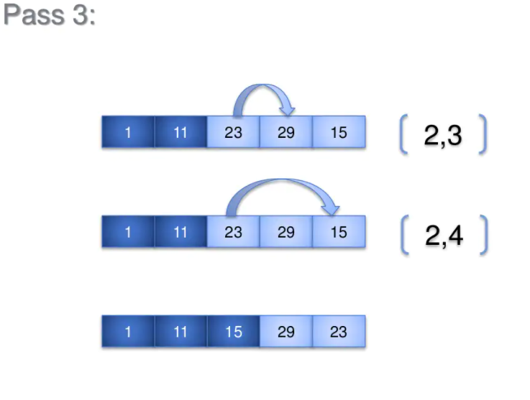

Slide 12
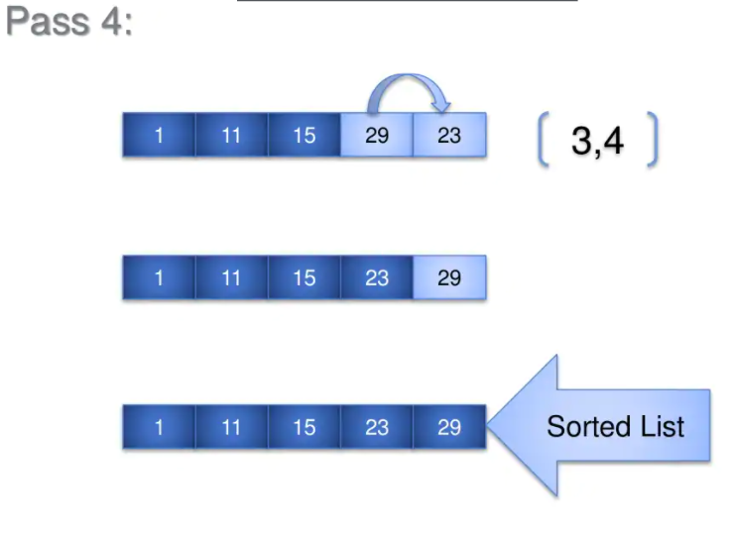

Slide 13
Python Classes/Objects
Python is an object oriented programming language.
Almost everything in Python is an object, with its properties and methods.
A Class is like an object constructor, or a "blueprint" for creating
objects.
To understand the need for creating a class let’s consider an
example, let’s say you wanted to track the number of dogs that may have different attributes like breed, age. If a list is used, the first element could be the dog’s breed while the second element could represent its age. Let’s suppose there are 100 different dogs, then how would you know which element is supposed to be
which? What if you wanted to add other properties to these dogs?
This lacks organization and it’s the exact need for classes.

Slide 14
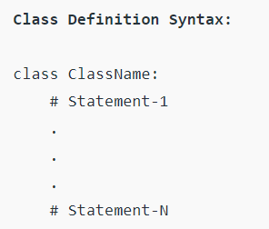
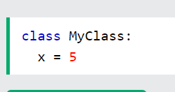
Some points on Python class:
Classes are created by keyword class.
Attributes are the variables that belong to a class.
Attributes are always public and can be accessed using the dot (.) operator. Eg.: Myclass.Myattribute
Create a Class
To create a class, use the keyword class:
Example
Create a class named MyClass, with a property named x:

Slide 15
Class Objects
An Object is an instance of a Class. A class is like a blueprint while an instance is a copy of the class with actual values. It’s not an idea anymore, it’s an actual dog, like a dog of breed
pug who’s seven years old. You can have many dogs to create many different instances, but without the class as a guide, you would be lost, not knowing what information is required.
An object consists of :
State: It is represented by the attributes of an object. It also reflects the properties of an object.
Behavior: It is represented by the methods of an object. It
also reflects the response of an object to other objects. Identity: It gives a unique name to an object and enables one object to interact with other objects.

Slide 16
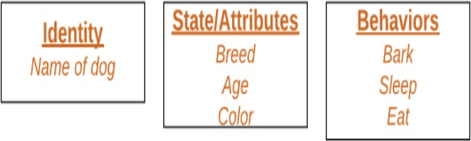
Declaring Objects (Also called instantiating a class) When an object of a class is created, the class is said to be instantiated. All the instances share the attributes and the behavior of the class. But the values of those attributes, i.e. the state are unique for each object. A single class may have any number of instances.

Slide 17
The self
Class methods must have an extra first parameter in the method definition. We do not give a value for this parameter when we call the method,
Python provides it.
If we have a method that takes no arguments, then we still have to have one argument.
When we call a method of this object as
myobject.method(arg1, arg2), this is automatically converted by Python into MyClass.method(myobject, arg1, arg2) – this is all the special self is about.

Slide 18
_init method
Constructors are used to initializing the
object’s state. Like methods, a constructor also contains a collection of statements(i.e. instructions) that are executed at the time of Object creation. It runs as soon as an object of a class is instantiated. The method is useful to do any initialization you want to do with your object.
A Sample class with init method
class Person:
# init method or constructor
def init (self, name): self.name = name
# Sample Method
def say_hi(self):
print('Hello, my name is', self.name)
p = Person('Nikhil') p.say_hi()

Slide 19
STACKS

Slide 20
A stack is an array or list structure of function calls and parameters used in modern computer programming and CPU architecture. Similar to a stack of plates at a buffet restaurant or cafeteria, elements in a stack are added or removed from the top of the stack, in a “last in first, first out” or LIFO order.

Slide 21
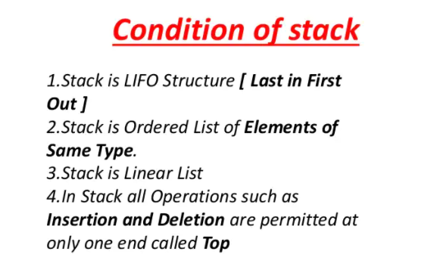

Slide 22
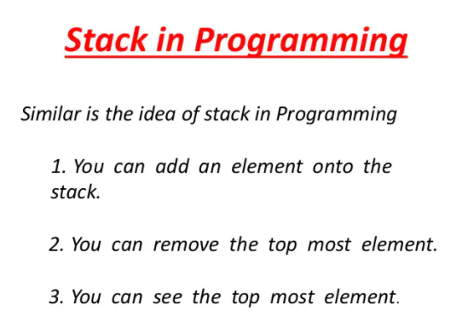

Slide 23
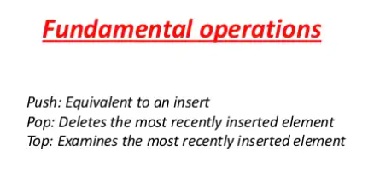

Slide 24
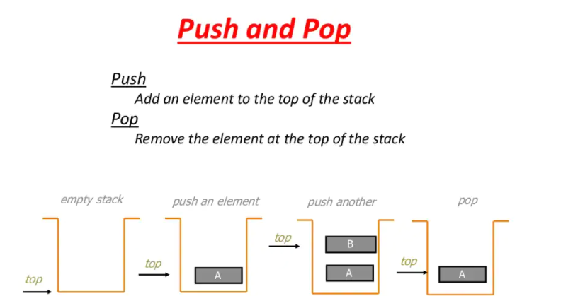

Slide 25
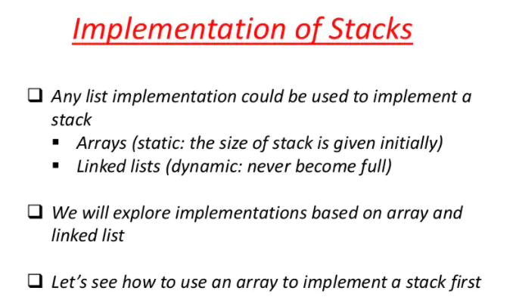

Slide 26
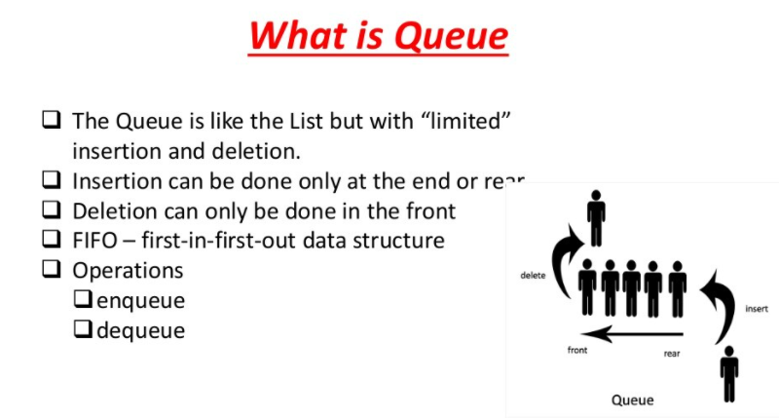

Slide 27
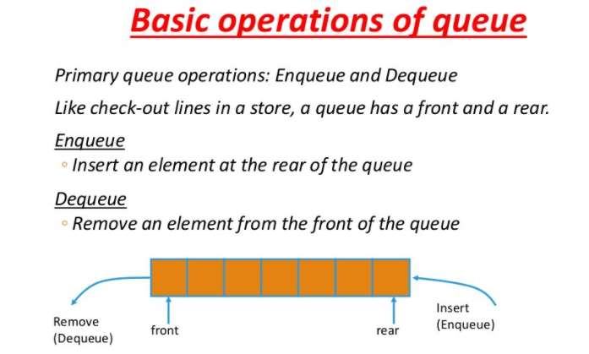

Slide 28
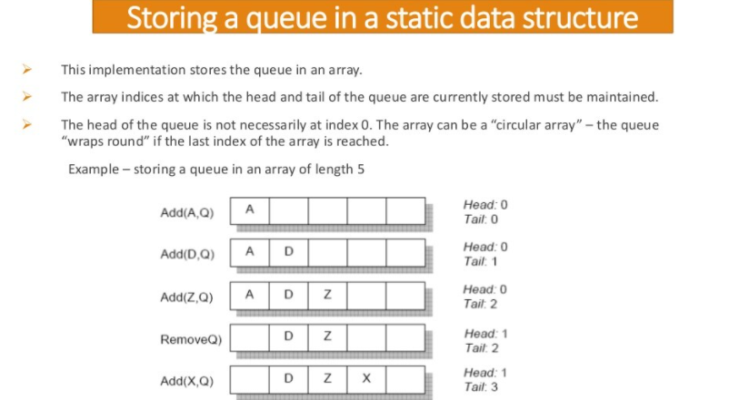

Slide 29
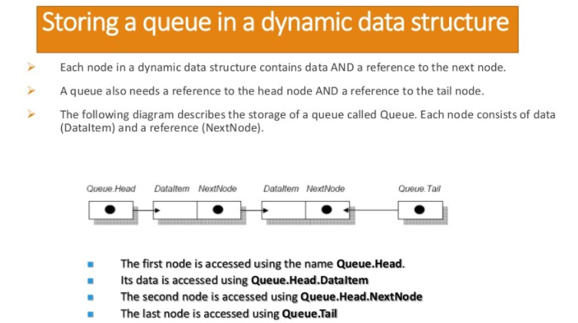

Slide 30
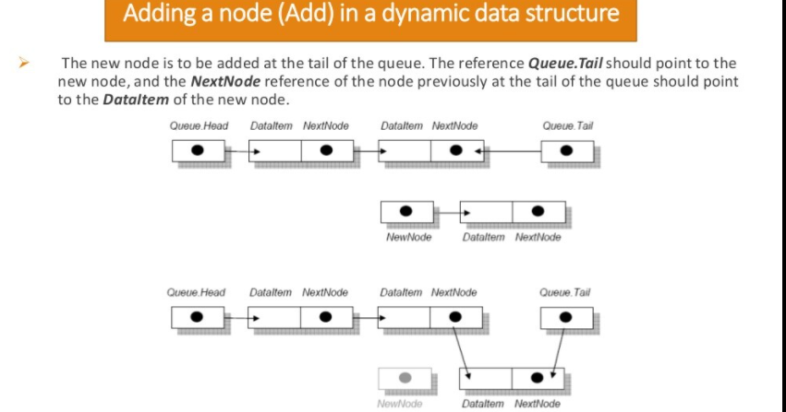

Slide 31
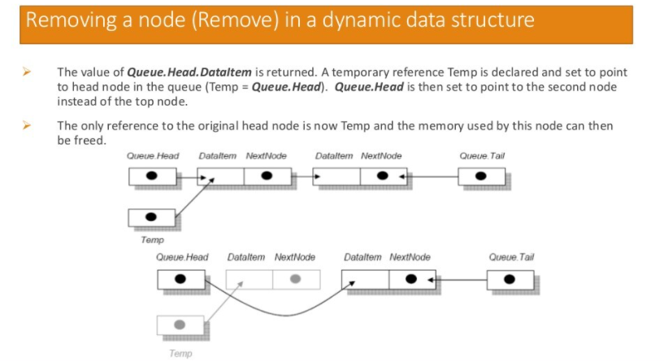

Slide 32
