Slide 1
Twitter Sentiment Analysis
Allan Lo, Prajakta Pandharkar, Eric Yang

Slide 2
Project Overview
Business Problem
Develop a data storage/retrieval system to help companies monitor product sentiment via Twitter tweet data. We’ve used Three major Smartphone manufacturers (Apple, Google, Samsung) as a use case for our system.
Data Storage & Retrieval
Acquiring Data (Velocity) - Daily query of Twitter Search API to acquire tweets on an ongoing basis.
Data Cleaning/Scoring (Variety) - Cleaning of various data types (string, date, etc.) including unstructured tweet data into usable formated data. Create scoring data from tweets to inform sentiment analysis.
Storing/Serving Data (Volume) - Develop scalable solution for incoming tweet data storage via Mongo DB/Hive.
Consuming Data - Provide easily accessible data to end users. Transform data into information - analysis/business insights.

Slide 3








Project Architecture
Query/ Modeling
Data Loading
Data Analysis
Data Serving
Data Extraction
Hive Database
Visualization
Twitter APIs (python)
Transformation - Formating, Deduplication, Sentiment Scoring
Hadoop Distributed File System
Source - Twitter Search API (RESTful)
Ingestion - JSON files loaded into MongoDB
Tableau Server - Sentiment Analysis & Business Insights

Slide 4
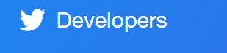
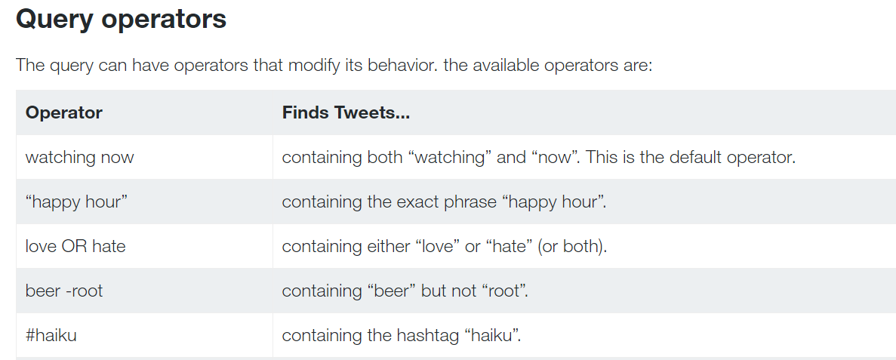
Data Acquisition
Data acquisition stack (python script)
Twitter Search REST API
Tweepy API
Features of twitter search API
Search by keywords/hashtags
Filter by language/region
Returns tweets within the last 7 days
Output in JSON format
Challenges
Rate-limiting query (15 requests per 15 min window)
Connection retry after waiting
Other solutions
Twitter streaming API

Slide 5
Data Loading & Analysis Layer
Data Loading
Data Analysis
Data loading into MongoDB (raw tweet repositories)
mongoimport in parameterized shell script
Data retrieval from MongoDB
pymongo API queries
Data cleaning and parsing
Filters by keywords/language/country/retweets
pandas/numpy
Sentiment Analysis
Data retrieval: pymongo API queries
Python NLTK library - Vader rule-based algorithm
Vader sentiment lexicon corpus
Sentiment scores: pos/neu/neg/compound [-1, 1]
Could include a ML model given a suitable training corpus
Why MongoDB?
NoSQL solution for json objects (documents)
Automatic sharding (horizontal scaling)
Dynamic queries (limit by a time range)
Transformation - Formating, Deduplication, Sentiment Scoring

Slide 6
Data Serving & Hive Database
Query/ Modeling
Data Serving Layer - Hive Database
Data Serving Layer - why not MongoDB?
MongoDB not useful in case of normalization
It slows down with joins and complex queries
Hive Feature | Use Case | Challenge | Solutions
Scalability: Scale up and support load | Tweet-feeds as batches loaded for each brand from low volume to high volume | Misaligned columns in various files created incorrect values in columns issues. | Special HDFS Directory structures for every different structured file.
Schema on Read | Efficiency in load for large volume of tweets per brand. | Encountered special characters as well as text fields characters same as delimiters - (comma) in tweets that needed cleanup | Parsed data files to avoid special characters and changed delimiters to tab
Write once and Read many times | Provision flattened or summarized data to dashboards. (SQL queries and summary tables) | Record level updates and deletes not allowed. | In case of data issues needed clean up in source files rather than just writing an update in place.
Hive Database

Slide 7
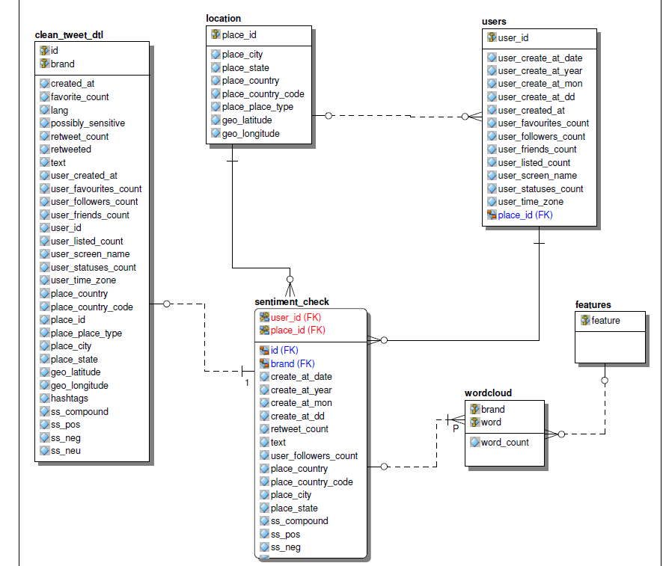
Data Serving & Hive Database
Data Model and Sizing:
Entities
Stage data - clean_tweet_dtl
Location Unique location for tweets and users
Users Unique users information
Sentiment_chk - specific details with transformed data
Wordcloud - extract all words and counts from ‘text’ (brand)
Features - mobile device related keywords
Assumptions: Around 10000 tweets a day per brand will be collected
Estimated Size: (MongoDB and Hive)
1 tweet ~ 280 bytes => 280 * 10000 * 3 = 8400000 bytes
=> 8.4 MB per day * 30 days = 252 MB (detail stage table)
=> 252 * 2 tables + 45 *3 small tables = 639 MB.
=> considered 1 GB per brand
Actual Size: (0.95 GB - apple, 0.9 GB - google, 0.3 GB - samsung)

Slide 8
Tableau Dashboard
Accessing Database
Hive Server 2 - allows remote client to query against Hive database
Tableau connected to Hive via Cloudera Hadoop ODBC
Tableau Dashboard
Extract of data loaded to Tableau Server to allow for public data consumption
Originally considered having Tableau Server query data directly from Hive Server however there has high latency between the connections.
Sacrificed instant access to public data consumption for a better user experience.
Our data is loaded daily so this is not a big drawback
Tableau Demo
Link to w205 Sentiment Dashboard
UserName: ericy330@gmail.com
Password: midsw205

Slide 9
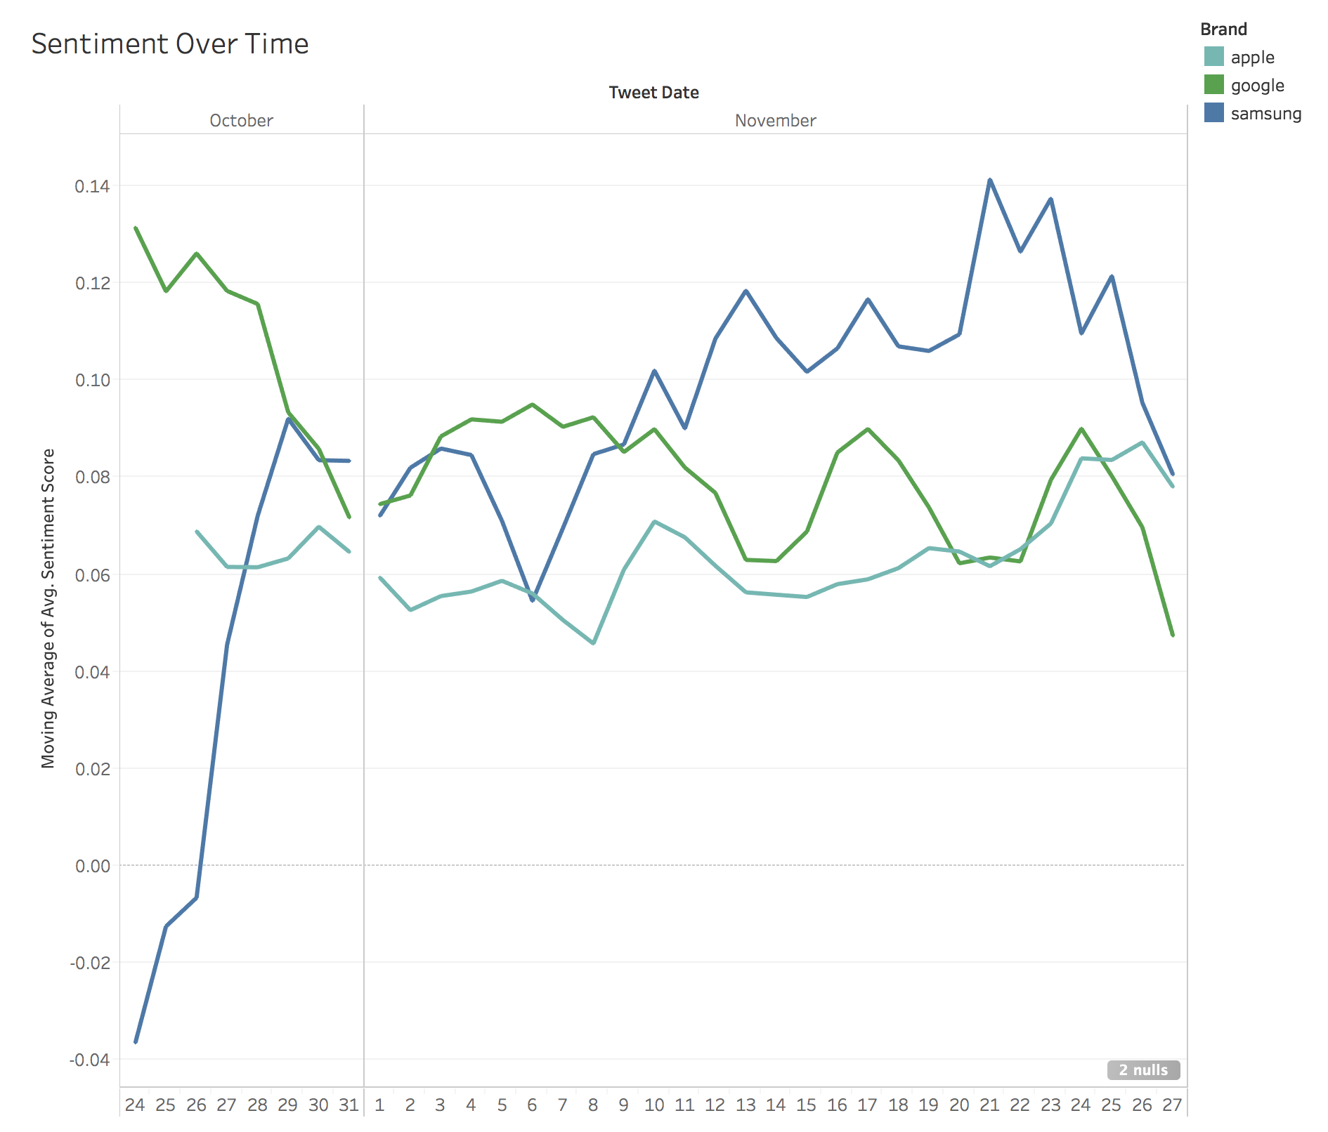
Sentiment Analysis - Time Series
Google’s Pixel Launched 10/20/2016
Sentiment for Apple is largely Neutral
Residual Negative Sentiment From Samsung’s Battery Issues?

Slide 10
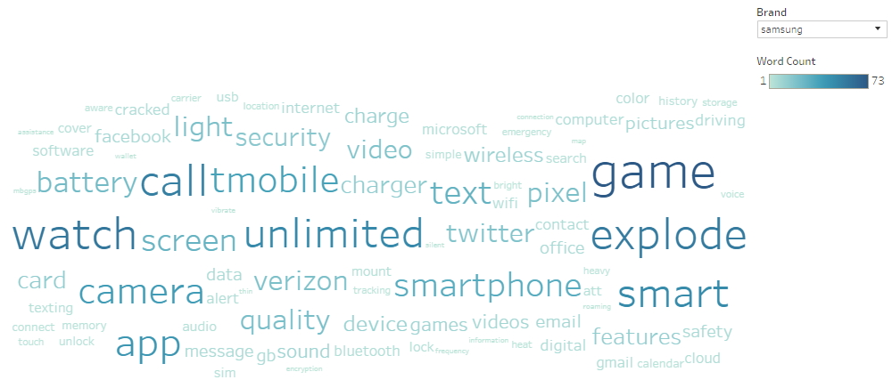
Sentiment Analysis - Word Cloud
Samsung word cloud shows common words being tweeted about the brand

