Slide 1
Social Media Sentiment Analysis System
Allan Lo, Prajakta Pandharkar, Eric Yang

Slide 2
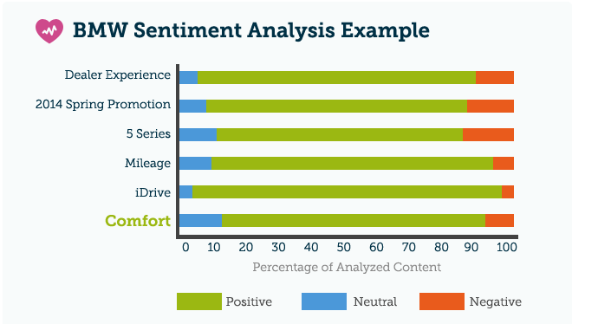
Social media sentiment analysis
Social media platforms are gold mines for customers’ opinions, attitudes, and emotions associated with a company’s products, services, and the entire brand
Sentiment analysis is changing how marketing is done today
Predictive analytics
Brand management
Benefits of sentiment analysis
Build a brand
Attract new customers
Retain and better serve existing customers
Forge new connections with key audiences on social media platforms
Discover market trends
Make better data-driven decisions and accelerate growth
Notes:
Social media platforms offer a tremendous opportunity for companies to learn about their customers’ opinions, attitudes, and emotions associated with their products, services, and the entire brand
• Predictive analytics. Predictive analytics allows businesses to identify patterns in customer behavior based on data from social or other open-sources, opening the door to more efficient targeting. Data gleaned from predictive analytics can even be mapped to the customer journey to ensure audiences get what they need right when they need it.
• Brand management. Sentiment analysis isn’t reserved for only your brand name or your trademarked product. You can use it to track trends in your industry or even your competitors, allowing you better manage your own brand strategy.
Why?
Build a brand
Attract new customers while retain and better serve existing ones
Forge new connections with key audiences on social media platforms
Discover market trends
Make better data-driven decisions and accelerate growth

Slide 3
Data Acquisition Considerations
Data Sources
Considerations for data selection:
Twitter API
Facebook APIs
Google Trends API
LinkedIn API
Data Contents:
Company’s - services, products, and brands
Social Media sentiments (positive and negative) about the company
Sentiment classification indicating rating for brand
Data Collection:
Publicly available API
Daily data feed
Subset of companies, and their products/services for controlled feed
JSON, .csv,
Notes:
Praise
Complaints
Indifferenecs

Slide 4










Data Flow
Query/ Modeling
Twitter
Facebook
Google Trends
Ingest Data via APIs
LinkedIn
Data Source
Cloud Warehouse
Distributed File System
Visualization
Notes:
High level, how do you anticipated the data flow? What types of queries/data access will you need at each stage

Slide 5
Application of Class Concepts
Open Questions / Challenges
Hosting database on AWS via S3/EBS
Data Lake - ELT approach
Schema on read framework
Distributed file system using Hadoop
Using Hive/Spark SQL as our query application
Development / complexity of sentiment model
Contextual complexity
Language is constantly evolving

Slide 6
Initial Project Plan
Data Acquisition
Acquire sample data sets from select sources for exploratory analysis
Create Python script for API Calls
Data Storage
Create architecture for data storage (AWS, HDFS, etc.)
Retrieving Modeling Data
Build queries in Hive/Spark SQL to transform and analyze data
Visualization via Python Libraries
Develop sentiment model to provide current/historical sentiment analysis for select brands

