Slide 1

ENGINEERING
Weekly Operasional Utility
Periode Agenda 12 - 18 Oktober 2026
PRESENTED BY:
PT BUMI ALAM SEGAR

Slide 2

Key Performance Indicator Engineering Utility
SMKP
75
66
95%
*SMKP ENG until September 2026 Achieve
Page 2

Slide 3
Key Performance Indicator Engineering Utility
Internal
Action Plan:
Action Plan:
NO | Project | Due Date | Status | %
1 | Penambahan prv steam to HW tank glukosa WRH |  | Progress PR | 5
2 | Air overflow HW glukosa to tanki kondensat glukosa WRH | W2 Okt 26 | Tunggu EJO | 5%
3 | Pemasangan sightglass untuk monitoring steam PRD | W4 Des 26 | Pengajuan MID baru | 5%
4 | Penambahan pipa input tanki Kondensat |  | Done 4/5 (Review hasil) | 80%
5 | Penggantian flow meter air Boiler | W4 Des 26 | Eta barang di BAS 13 Nov 26 | 25%
NO | Project | Due Date | Status | %
1 | Saving pemakain BB -> trial penambahan zat additive BB |  | Pengajuan proposal | 0%
2 | Review selisih output Produksi Operasional drain startup |  | QCP PRD, QC | 0%
3 | Trial up pressure operated 5.5 ke 7.5 Bar | W3 Sept | Progress trial | 100%
4
5
Page 3

Slide 4
Key Performance Indicator Engineering Utility
Internal
Action Plan:
Action Plan:
NO | Project | Due Date | Status | %
1 | Penambahan prv steam to HW tank glukosa WRH |  | Progress PR | 5
2 | Air overflow HW glukosa to tanki kondensat glukosa WRH | W2 Okt 26 | Tunggu EJO | 5%
3 | Pemasangan sightglass untuk monitoring steam PRD | W4 Des 26 | Pengajuan MID baru | 5%
4 | Penambahan pipa input tanki Kondensat |  | Done 4/5 (Review hasil) | 80%
5 | Penggantian flow meter air Boiler | W4 Des 26 | Eta barang di BAS 13 Nov 26 | 25%
NO | Project | Due Date | Status | %
1 | Project PLTS |  | Tunggu SLO terbit, dan pekerjaan tangga | 90%
2
3
4
5
Page 4

Slide 5
Key Performance Indicator Engineering Utility
Internal
Action Plan:
Action Plan:
NO | Project | Due Date | Status | %
1 | Reuse air pit garam untuk air top up cooling tower |  | Wait Vendor Chemtech kirim proposal | 10%
2 | Reuse air pit garam untuk flush toilet & penyiraman taman | W3 Agu 26 | Progress, Toilet dan taman PRD | 100%
3
4
5
NO | Project | Due Date | Status | %
1 | Aerasi hybrid | W1 Okt 26 | Sisa 1 aerasi 6 (prog perbaikan platform) | 100%
2 | New Anaerob step 3 (debit 1-1.5m3) | W4 Sept 26 | Progress PR material | 20%
3 | Elektrokoagulasi | W4 Okt 26 | Parsial MoC dan pengajuan MID baru | 20%
4 | Optimalisasi influent COD WWTP < 15rb ppm -> semua air pre-rinse tdk masuk WWTP |  | Hasil trial Repro gagal Dedicated tank to WCP | 20%
5
Page 5

Slide 6
Key Performance Indicator Engineering Utility
Internal
2.5%
Action Plan:
Action Plan:
NO | Project | Due Date | Status | %
1 | Optimalisasi influent COD WWTP < 15rb ppm -> semua air pre-rinse tdk masuk WWTP |  | Hasil trial Repro gagal Dedicated tank to WCP | 20%
2 | Trial uji chemical (dosis dan chmeical baru) |  | Hold, lebih murah chemical existing
3 | New Anaerob step 3 (debit 1-1.5m3) | W4 Sept 26 | Progress PR material | 20%
4
5
NO | Project | Due Date | Status | %
1 | Pemasangan Heater HW 10 Ton (For startup Retail) |  | Waiting design from Vendor | 0%
2
3
4
5
Page 6

Slide 7
KPI Engineering Utility (Confirm Acc. s.d September - 2026)
Data menggunakan data accounting sampai bulan September 2026
Tahun | Hasil FG | Hasil Proses | Steam | Batubara | LISTRIK BAS | LISTRIK PRD | BB/FG | BB/Proses | Steam/10 FG | Steam/10 Proses | BB/Steam | Listrik BAS/10 FG | Listrik BAS/10 Proses | Listrik PRD/10 FG | Listrik PRD/10 Proses
2025 | 64.395 | 68.609 | 21.619 | 3.404 | 4.416.847 | 3.377.084 | 52,9 | 49,6 | 3,36 | 3,15 | 157 | 686 | 644 | 524 | 492
2026 | 44.768 | 48.423 | 15.295 | 2.516 | 3.008.714 | 2.326.738 | 56,2 | 52,0 | 3,42 | 3,16 | 164 | 672 | 621 | 520 | 481
Perbandingan Output Perbulan dan Penggunaan Energi 2025 vs 2026 PT BAS
Tahun | Hasil FG | Hasil Proses | Steam | Batubara | LISTRIK BAS | LISTRIK PRD
2025 | 5366,3 | 5717,4 | 1801,6 | 283,7 | 368070,6 | 281423,7
2026 | 4974,2 | 5380,3 | 1699,4 | 279,5 | 334301,5 | 258526,5
Data menggunakan data accounting sampai bulan Agustus 2026, September 2026 menggunakan data tonase produksi
Periode | Data Acounting |  |  | Data PPIC + PO khusus (Ton) |  | BOILER |  |  |  |  |  |  |  |  |  |  |  | UTILITY |  |  |  |  | WWTP |  | Maintenance | COST OPERASIONAL (JT)
 | Hasil Finish Good (BOX) | Hasil Finish Good (ton) | Hasil Proses (ton) | Hasil Finish Good (ton) | Hasil Proses (ton) | Steam (Max 2.8) |  |  |  | Batu Bara (Max 51.2) |  |  |  |  |  |  |  | Listrik (Max 510) |  |  |  | Kuota Fresh Water 5656 m3/bln | Baku Mutu |  | Realisasi Agenda min 95% | Boiler & Utility | WWTP
 |  |  |  |  |  | Steam | Steam/ 10Finish | YTD | Steam/ 10 Proses | Batu Bara | BB/Finish | YTD | BB/Proses | BB/BOX | Max BB/ BOX | YTD | BB/Steam | Listrik PRD (Kwh) | Listrik/ 10Finish | YTD | Listrik/ 10Proses |  | TSS 400 ppm | COD 300 ppm
Jul 26 | 924173 | 5242,9 | 5731,2 | 5197 | 5589 | 1854,48 | 3,54 | 3,4 | 3,2 | 295,98 | 56,5 | 56,4 | 51,6 | 320 | 510 | 334 | 160 | 271524 | 518 | 511 | 473,8 | 7575 | 201 | 929 | 100 % | 86,3 | 102,2
Agu 26 | 793462 | 4688,0 | 5057,7 | 4587,6 | 4869,1 | 1545,6 | 3,30 | 3,4 | 3,1 | 254,26 | 54,2 | 56,1 | 50,3 | 320 | 510 | 332 | 165 | 249518 | 532 | 513 | 493,3 | 7911 | 160 | 782 | 100 % | 58,4 | 122,9
Sep 26 | 913471 | 5250,0 | 5474,3 | 5277,86 | 5473,15 | 1877,8 | 3,58 | 3,4 | 3,4 | 297,88 | 56,7 | 56 | 54,4 | 326 | 510 | 332 | 159 | 297601 | 567 | 520 | 543,6 | 6973 | 149 | 836 | 100 % | 43,9 | 111
Okt 26 | 387542 | 2294,151 | 2128,211 |  |  | 765,6 | 3,34 | 3,4 | 3,6 | 150,8 | 65,7 | 57 | 70,9 | 389 | 510 | 334 | 197 | 123135 | 537 | 521 | 578,6 | 3793 | 120 | 564 |  | 31,6 | 56,2
Target KPI (Monthly) | PIC | Periode
 |  | Jan-26 | Feb-26 | Mar-26 | Apr-26 | Mei | Juni | Juli | Agustus | September | Oktober
Drop Steam(2) | Boiler & Utility | 0 | 0 | 0 | 0 | 0 | 0 | 0 | 0 | 0 | 1
Drop pressure Angin (max 2) |  | 0 | 1 | 0 | 0 | 0 | 0 | 0 | 0 | 0 | 0
Zero breakdown MDP (Max 2) |  | 0 | 0 | 0 | 3 (Mati Listrik PLN) | 0 | 1 (Dip Listrik) | 2 (Dip Listrik) | 1 | 0 | 0
Improvement (3 Judul QCC) |  | 4 | 3 | 3 | 3 | 3 | 3 | 3 | 3 | 2 | 2
Tuang Sludge ke boiler (ton) | WWTP | 0 | 0 | 0 | 1.8 | 3.0 | 2.4 | 1,2 | 1.2 | 0.6 | 1.2
Drain Slury (25%) |  | 32% | 29% | 30% | 32% | 28% | 30% | 30% | 35% | 32% | 36%
Sludge Content (20%) |  | 20% | 20% | 20% | 20% | 22% | 21% | 21% | 23% | 20% | 20%
Total Pengangkutan (4x Bulan) |  | 4 | 3 | 3 | 3 | 3 | 3 | 3 | 3 | 3 | 3
Tonase Sludge |  | 31.3 | 29.76 | 30.90 | 28.66 | 22.62 | 23.28 | 28.02 | 28.28 | 26.36 | 28.86
Improvement (3 Judul QCC) |  | 5 | 5 | 5 | 5 | 5 | 5 | 5 | 5 (2 lanjut) | 2 | 2

Slide 8
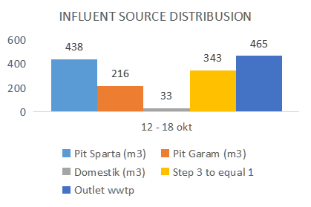
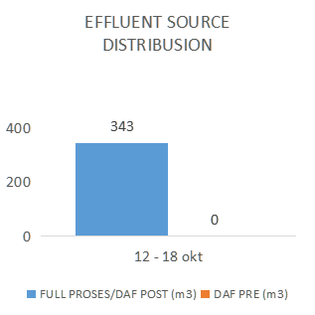
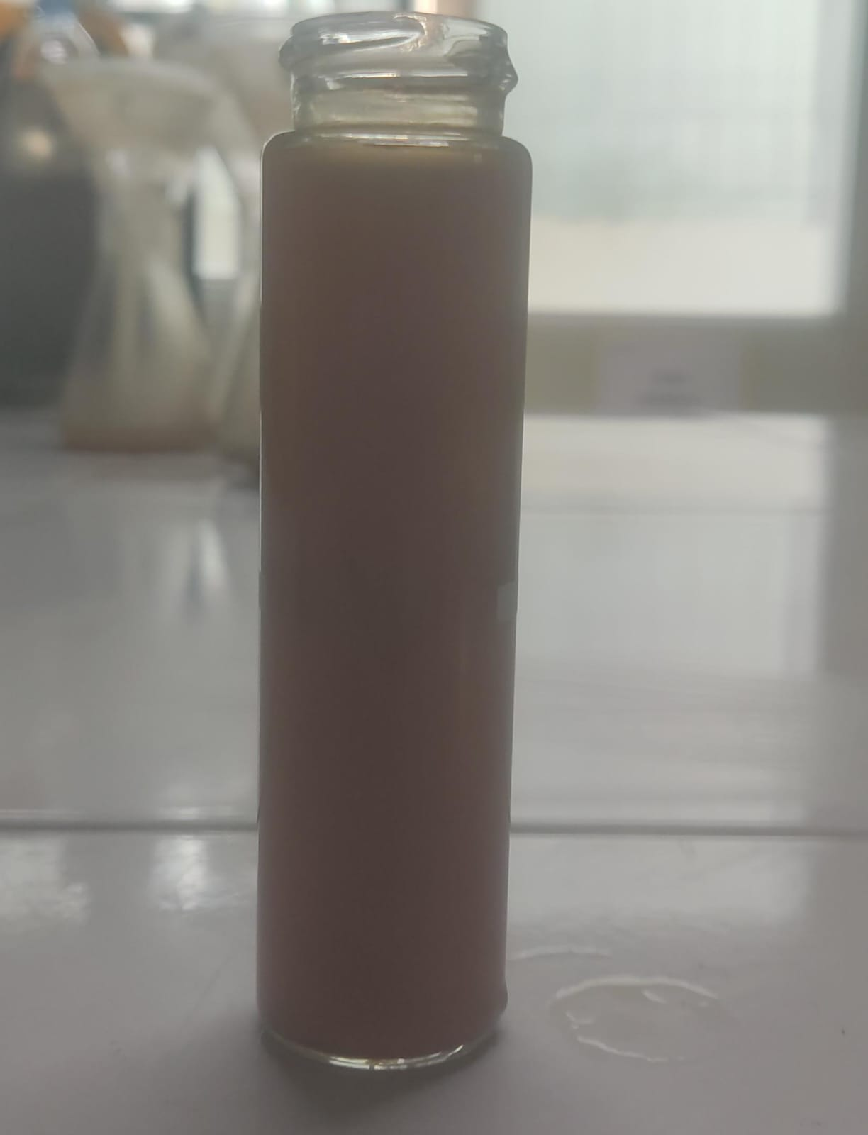
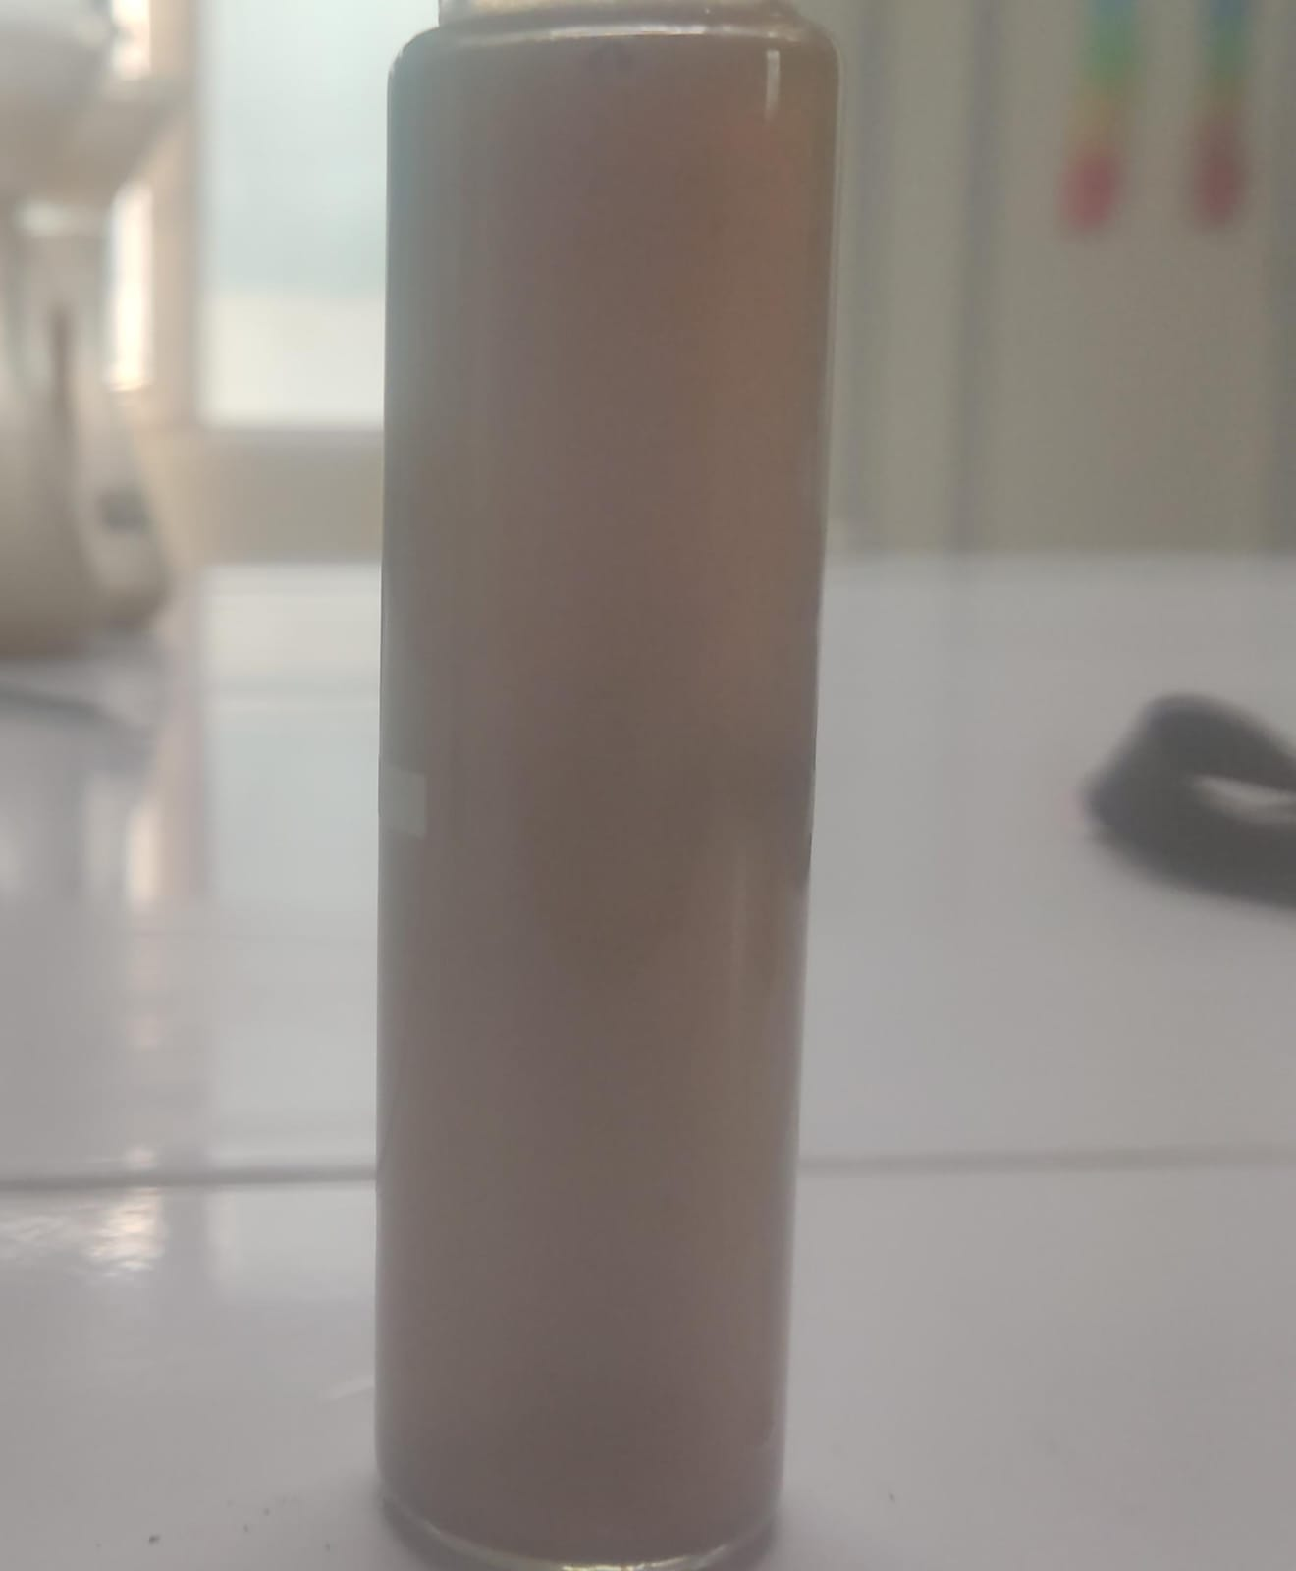
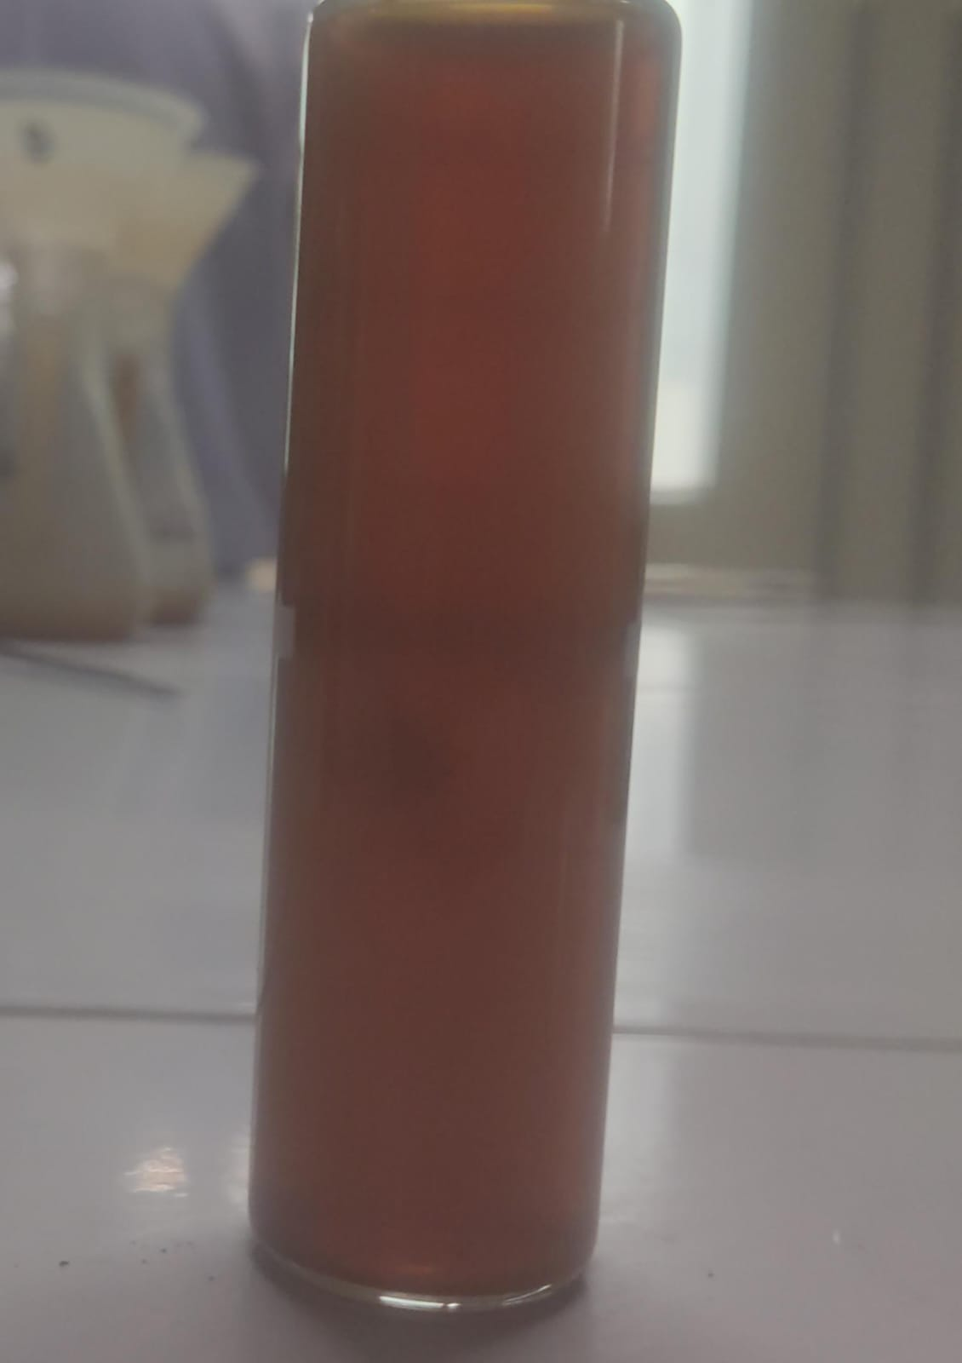
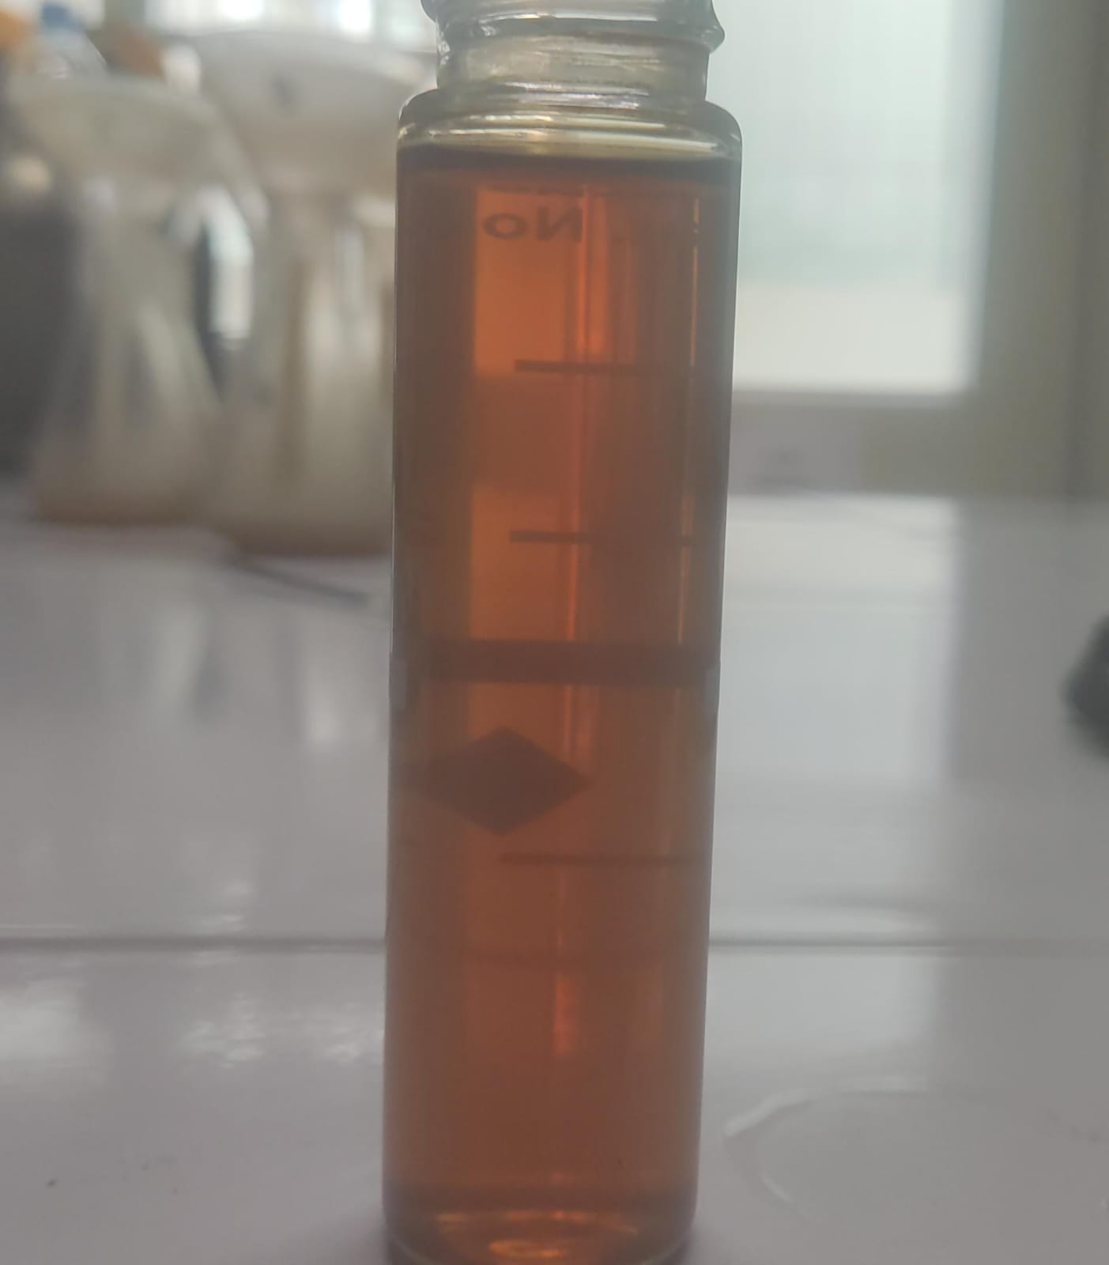
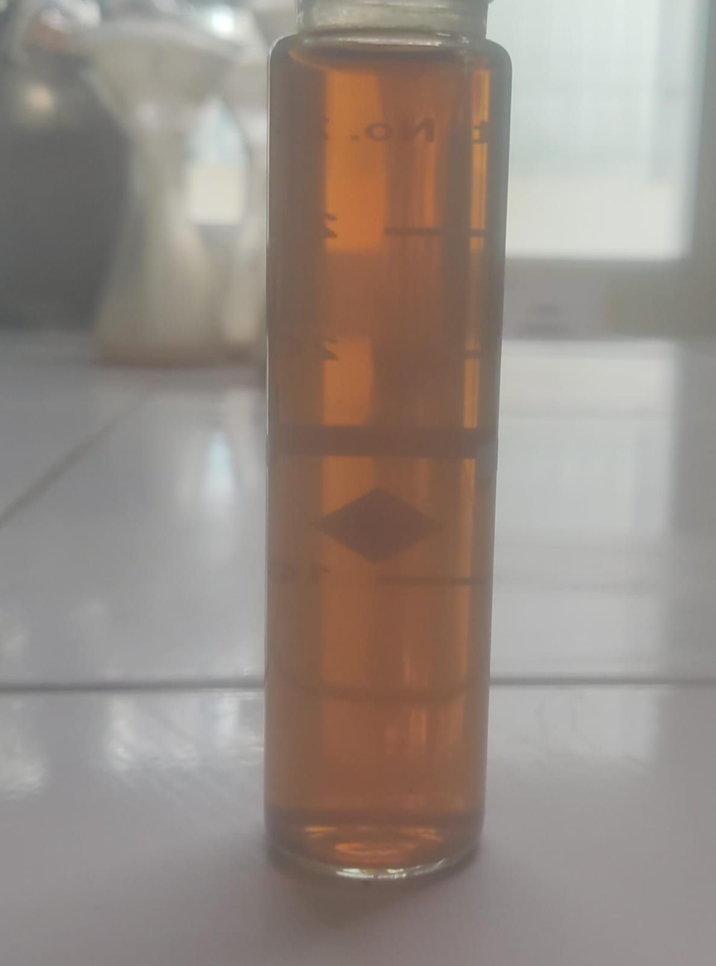
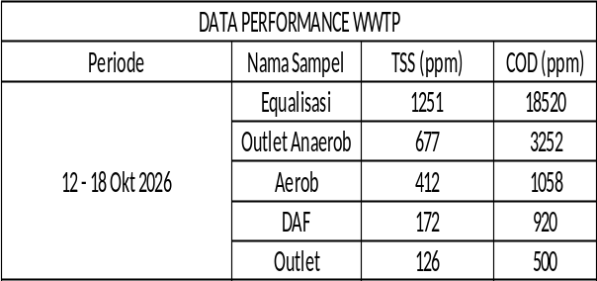
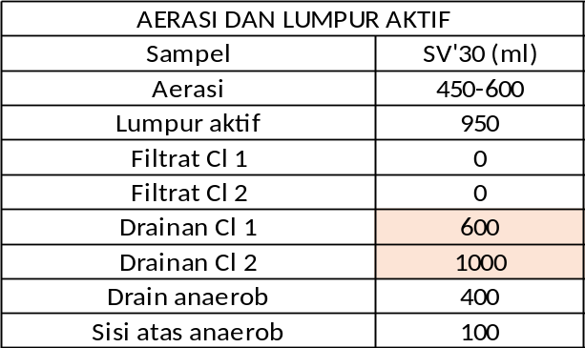
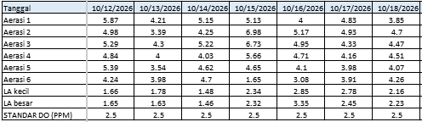
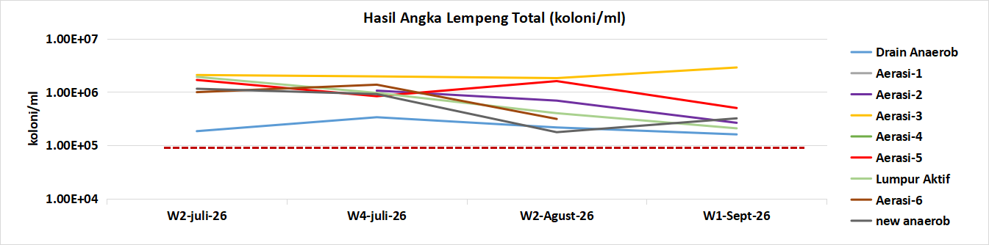
Performance Engineering Utility (12 - 18 Okt 2026)
Boiler & Utility
WWTP
KPI & Performance Boiler 21T/H
Boiler | Target | Aktual
Steam/10 Finish Product | 2.8 | 3.6
Steam/10 Proses | 2.8 | 3.7
Batu bara /Steam | 160 | 203.0
Batu bara / Finish produk | 51.2 | 72.2
Batu bara / Proses | 51.2 | 75.5
Condensate (%) | 85% | 74%
AVG Tds Air Blowdown (ppm) | 3500 | 3405
AVG Sudut Api (°) | 65 | 65
Capacity | 2-4 T/H | 1 - 5T/H
Utility
Listrik/10 FG | 510 | 570
Listrik/10 Proses | 510 | 596
Fresh Water (Okt 26) | 6060 | 3793 (65%)
Output FG (Ton) | 1022.1 | 1098.6
Output Proses (Ton) | 1056.6 | 1049.7
Overtime | 2.5 % | 1.5%
BB vs Steam
Standar Permen LH no 5 Tahun 2014
TSS : 100 ppm COD : 300 ppm
{{chart.bbsteam}}
2.7%
31.1%
0%
29.2%
14.4%
22.9%
100%
Equal
Anaerob
Aerob
Kondensat
Note : week ini tidak DAF Pre dan Target 336 m3/week di 100%
DAF
Outlet
{{chart.kondensat}}
Operasional WS dan RO
Parameter | RO | WS 1 | WS 2
Running hour (Jam) | 67(40%) | 35 | 36
TDS In(ppm) | 500 | 430 | 430
TDS Out(ppm) | 63 | 500 | 500
Hardness IN (ppm) | 10 | 135 | 135
Hardness Out (ppm) | 3 | 0 - 10 | 0 -15
pH | 8.1 | 8.1 | 8.1
Penggunaan Garam | - | 300 | 400
Anti Scalant(Liter) | 4 | - | -
SMBS(Kg) | 4 | - | -
Output Produk | 200 | 711
note : Masih belum dapetnya COD Di outlet wwtp
Unit | Suhu Out | Ampere
AHU 1 | 22.0 | 15.8
AHU 2 | 22.4 | 15.6
AHU 3 | 19.2 | 15.9
AHU 4 | 22.7 | 15.8
Compressor
Unit | RH | DP
IR 55 / Dryer IR | 102 | 1.2
GA 37 / TR 15 | 144 | 1.2
GA55 / FX250 | 54 | 3.0
Nilai DO Aerasi & Lumpur Aktif (std 2.5 ppm)
Cooling tower
Running Fan (unit) | 3
Running Pump (unit) | 1
AVE TDS (900) | 3060
AVE Hardness (70) | 18
Genset
Running hour (Jam) | 0.5
Usage Solar (Liter) | 7
Note :
Note : Pertgl 2/6/2026 Anti Scalant CT dioff
Page 8

Slide 9
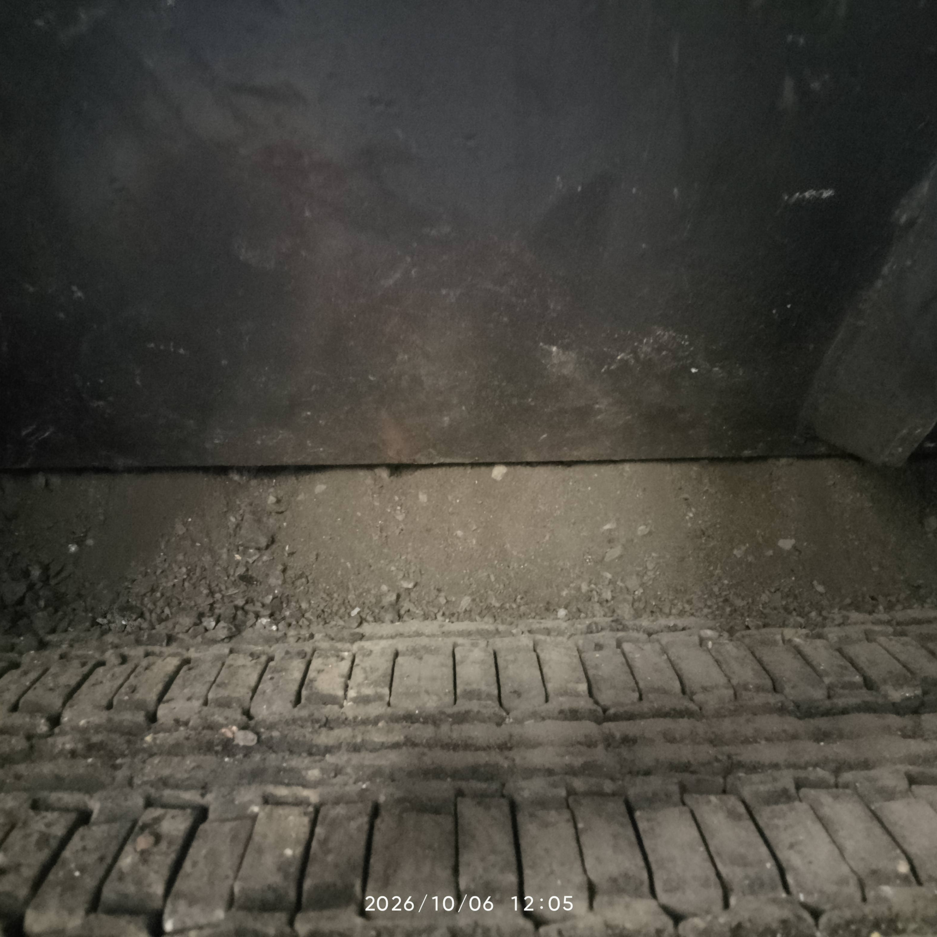
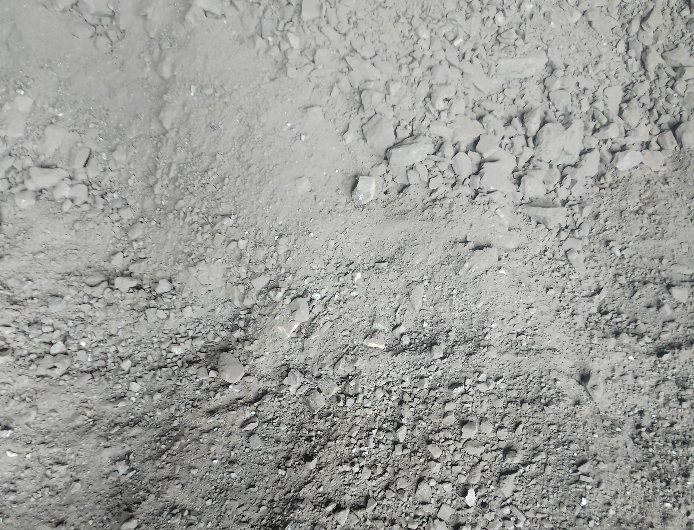
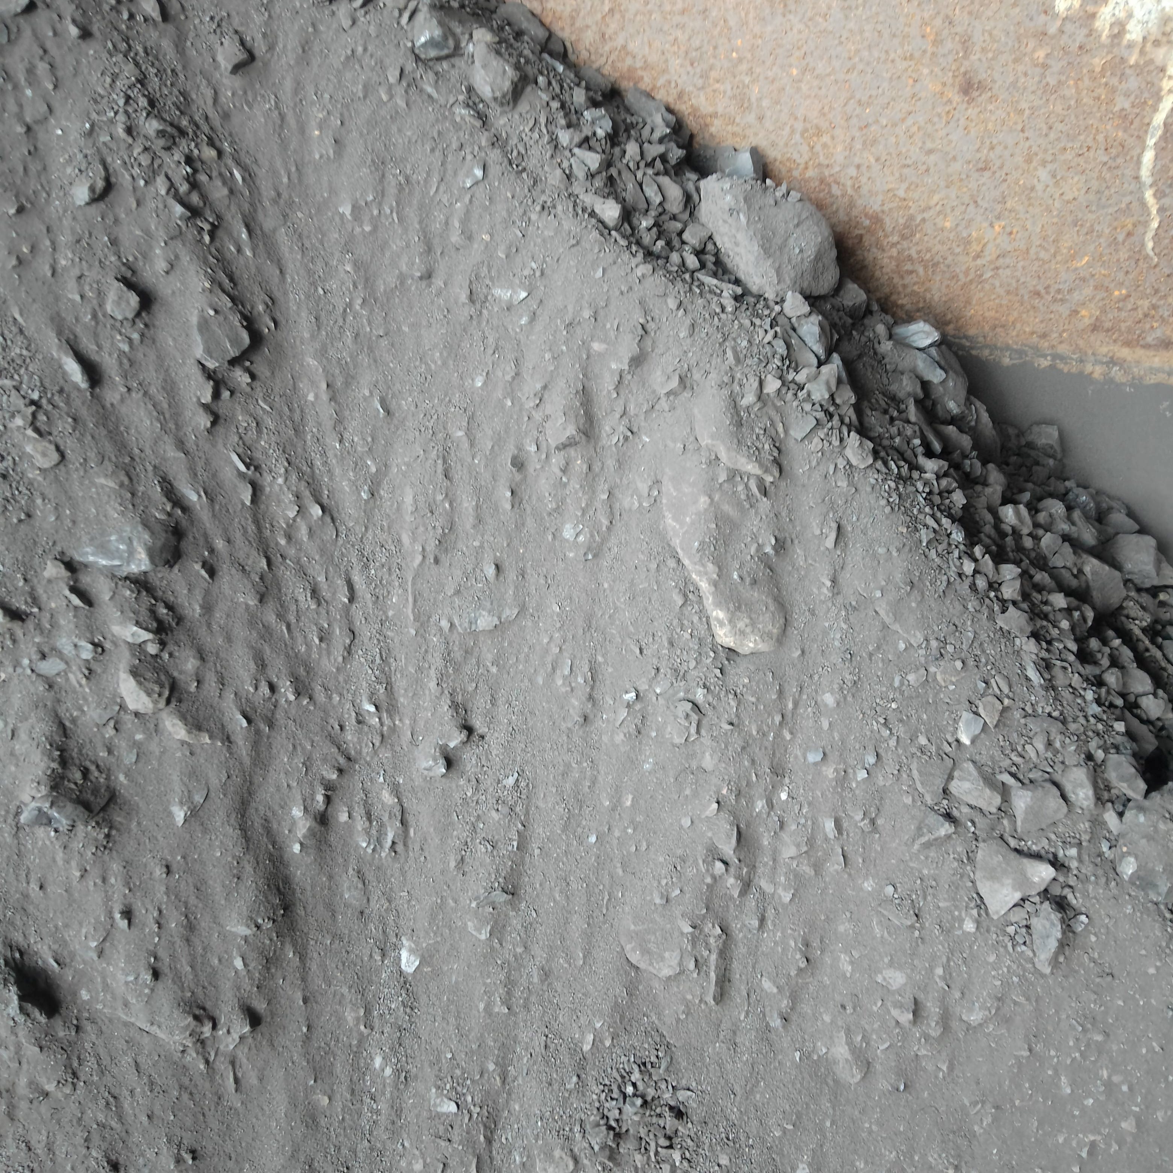
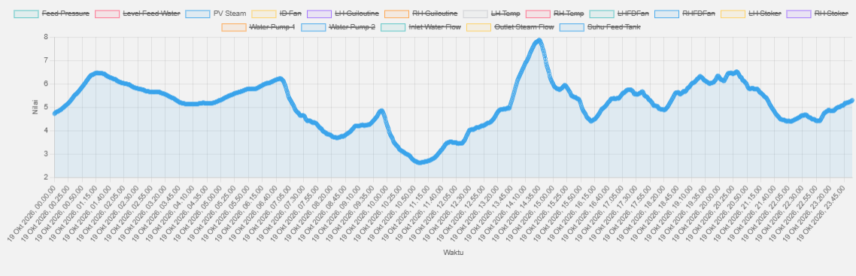
Update Highlight Issue Batubara Barkalin GR 11/09/2026
Problem:
Kedatangan BB tgl 11/09/2026 kondisi sangat berpasir halus.
Kondisi BB di Stoker
Kondisi BB di Gudang BB
Kondisi BB di Feeder
Penggunaan BB harian meningkat 2,6 ton/hari , dari rata2 sebelum di angka 10,9 ton/hari menjadi 13,5 ton/hari.
Komparasi Parameter Boiler dengan jenis BB berbeda
Type BB | Input |  |  |  | Output
 | ID fan (Hz) | Stoker (Hz) | Fd Fan (Hz) | Guillotine (mm) | Suhu Furnace (C) | Rata-Rata Output Pressure (Bar) | BB/Steam
Batu Hitam | 18 | 14,5 | 10 | 114 | 166 | 5,7 | 152,9
Barkalin | 18,7 | 18,1 | 14 | 140 | 169 | 5,6 | 197
Limbah boiler meningkat dengan BB ini dari rata-ratq 30 % ke angka 41,89 %
Perbandingan COA Batubara
Parameter | BB Lama 13/07/2026 | BB Baru 11/09/2026
Gross Caloric Value | 5973 Kcal/Kg | 5873 Kcal/Kg
Fix Carbon | 40,80% | 39,44%
Total Moisture | 11,96% | 7,91%
Persentase Size BB (<2 mm) | 18,73% | 32,01%
Pressure tidak stabil dengan 46 % berada dibawah 5 bar
Kesulitan up pressure steam terhadap sett point

Slide 10

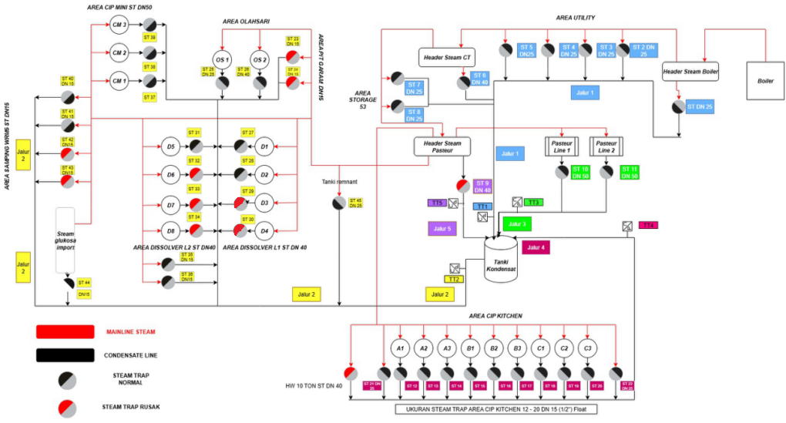
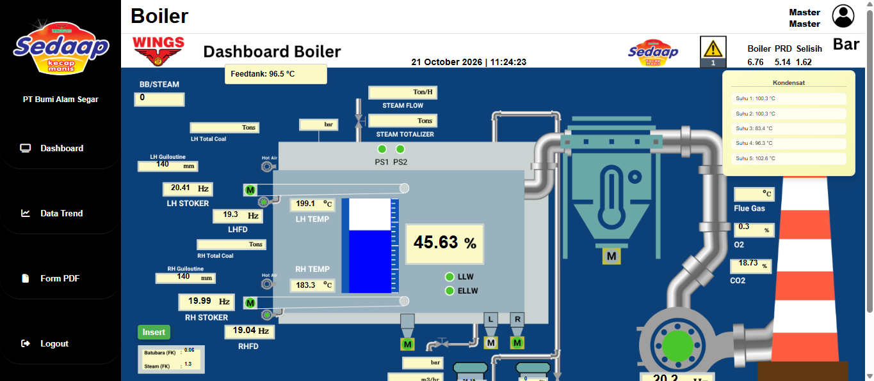
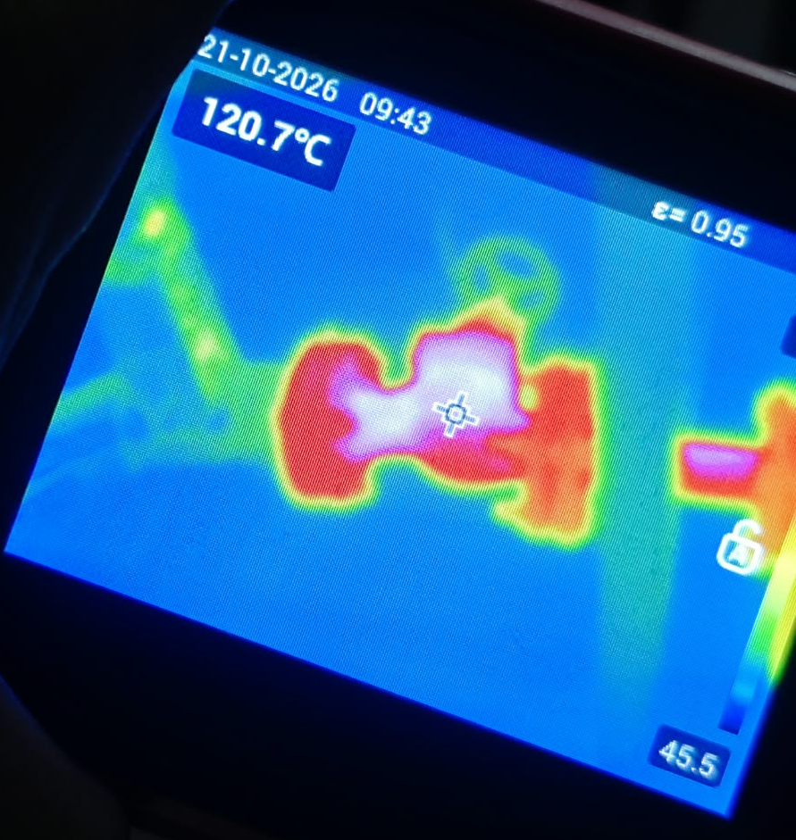
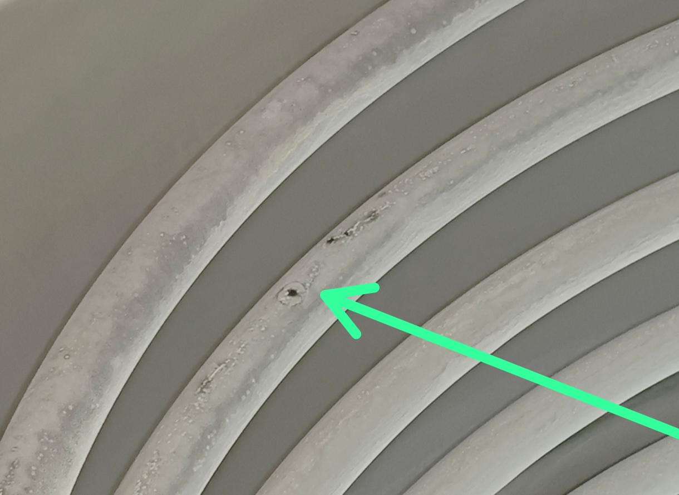
Issue Selisih Pressure Steam Boiler VS Produksi
Summary Hasil Verifikasi Delta P steam PRD dan Boiler 21/10/2026
No | Titik Pengecekan | Selisih Awal OFF (Bar) | Selisih setelah ON (Bar) | Selisih Pressure (Bar)
1 | Tanki 10 T | 1.2 | 1.3 | 0.1
2 | Dissolver 1 | 0.48 | 0.54 | 0.06
3 | Dissolver 2 | 0.52 | 0.62 | 0.1
4 | Dissolver 3 | 0.53 | 0.85 | 0.32
5 | Dissolver 4 | 0.5 | 0.83 | 0.33
6 | Dissolver 5 | 0.54 | 0.54 | 0
7 | Dissolver 6 | 0.46 | 0.71 | 0.25
8 | Dissolver 7 | 0.4 | 0.74 | 0.34
9 | Dissolver 8 | 0.36 | 0.7 | 0.34
10 | HW glukosa | 1.48 | 1.6 | 0.12
Total |  |  |  | 1.96
Suhu pada jalur return Kondensat jalur 2 bersuhu tinggi >120 dC (abnormal) -> cek detail cukup sulit karena banyak instrumen dalam 1 jalur yg indikasi bocor.
Problem Issue
Penyumbang selisih terbesar dari dissolver, potensi dari steam trap tidak perform / valve bypass status sudah tertutup tapi tidak bisa rapat
Perlu dicek coil HW 10 ton karena seperti ada bocoran halus
Untuk steam trap jalur pasteur line 2 juga perlu dicek karena suhu out mencapai 110 dC.
Action Plan
Penggantian instrument yg abnormal
Repair kebocoran pipa coil
Menghilangkan penggunaan direct steam
Coil HW 10 ton indikasi bocoran halus
Page 10

Slide 11
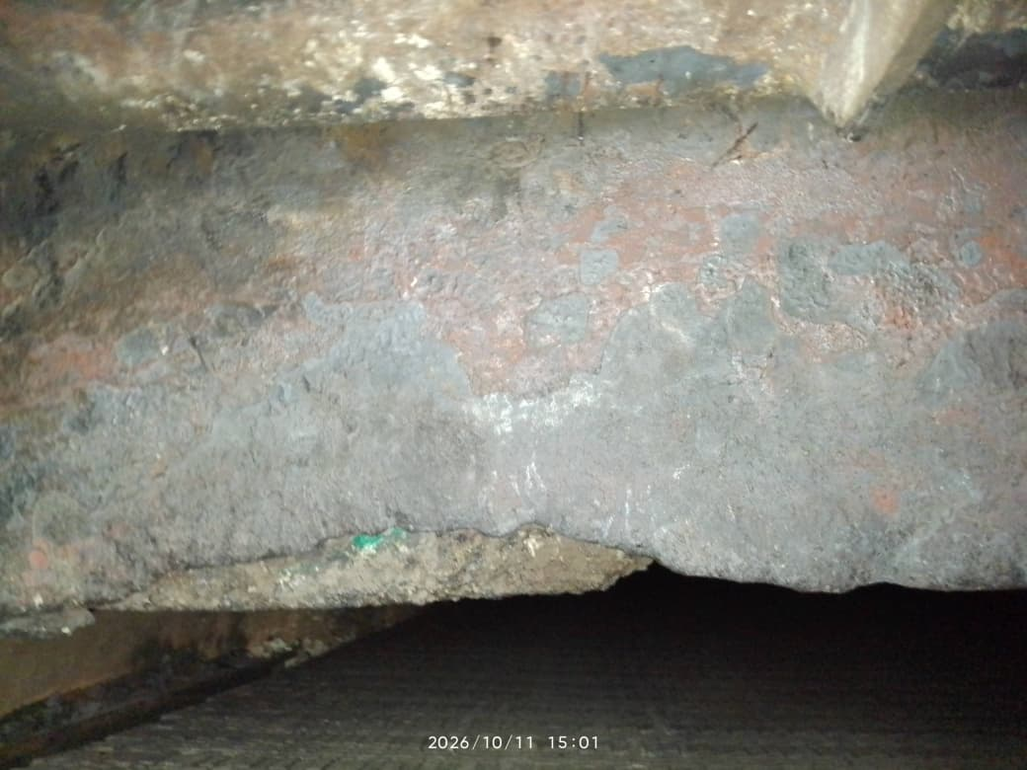
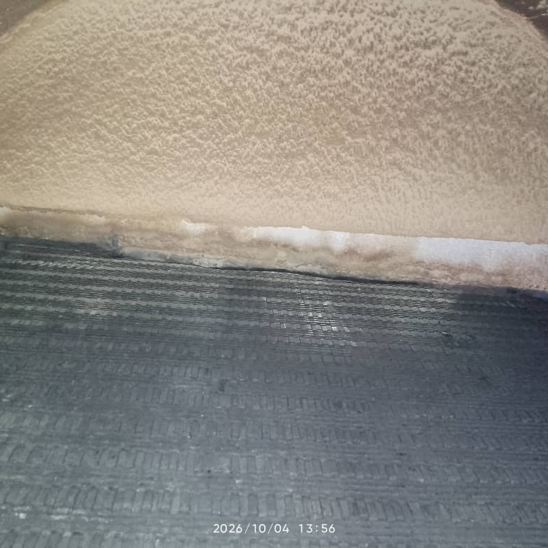
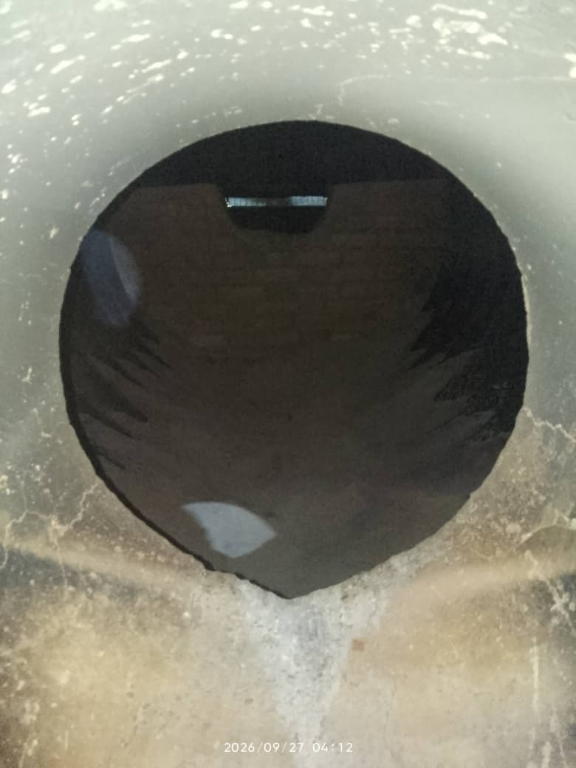
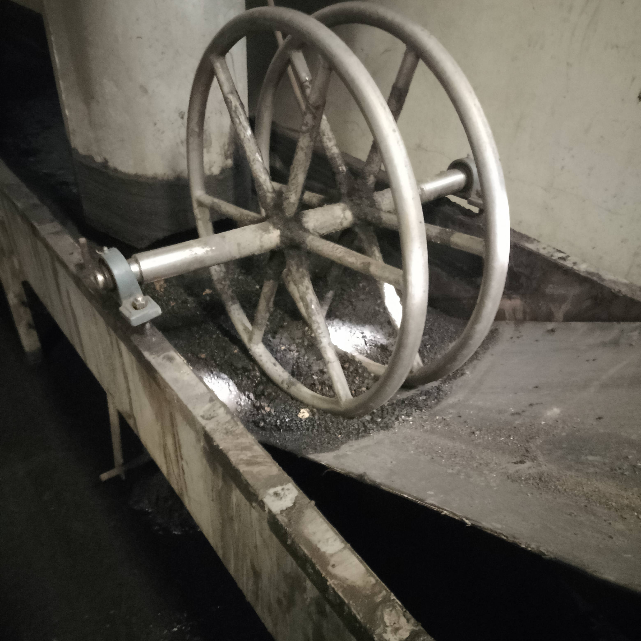
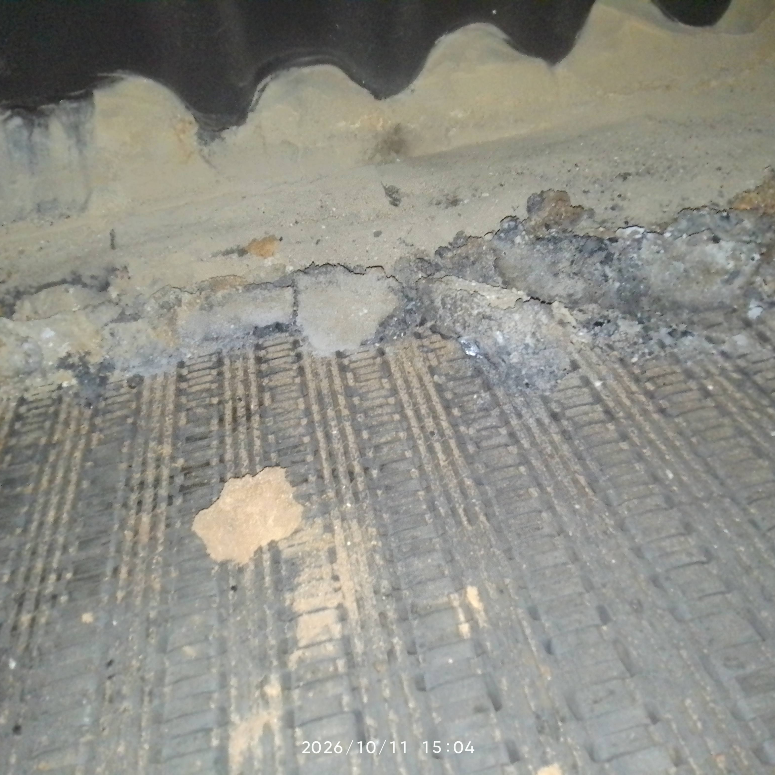
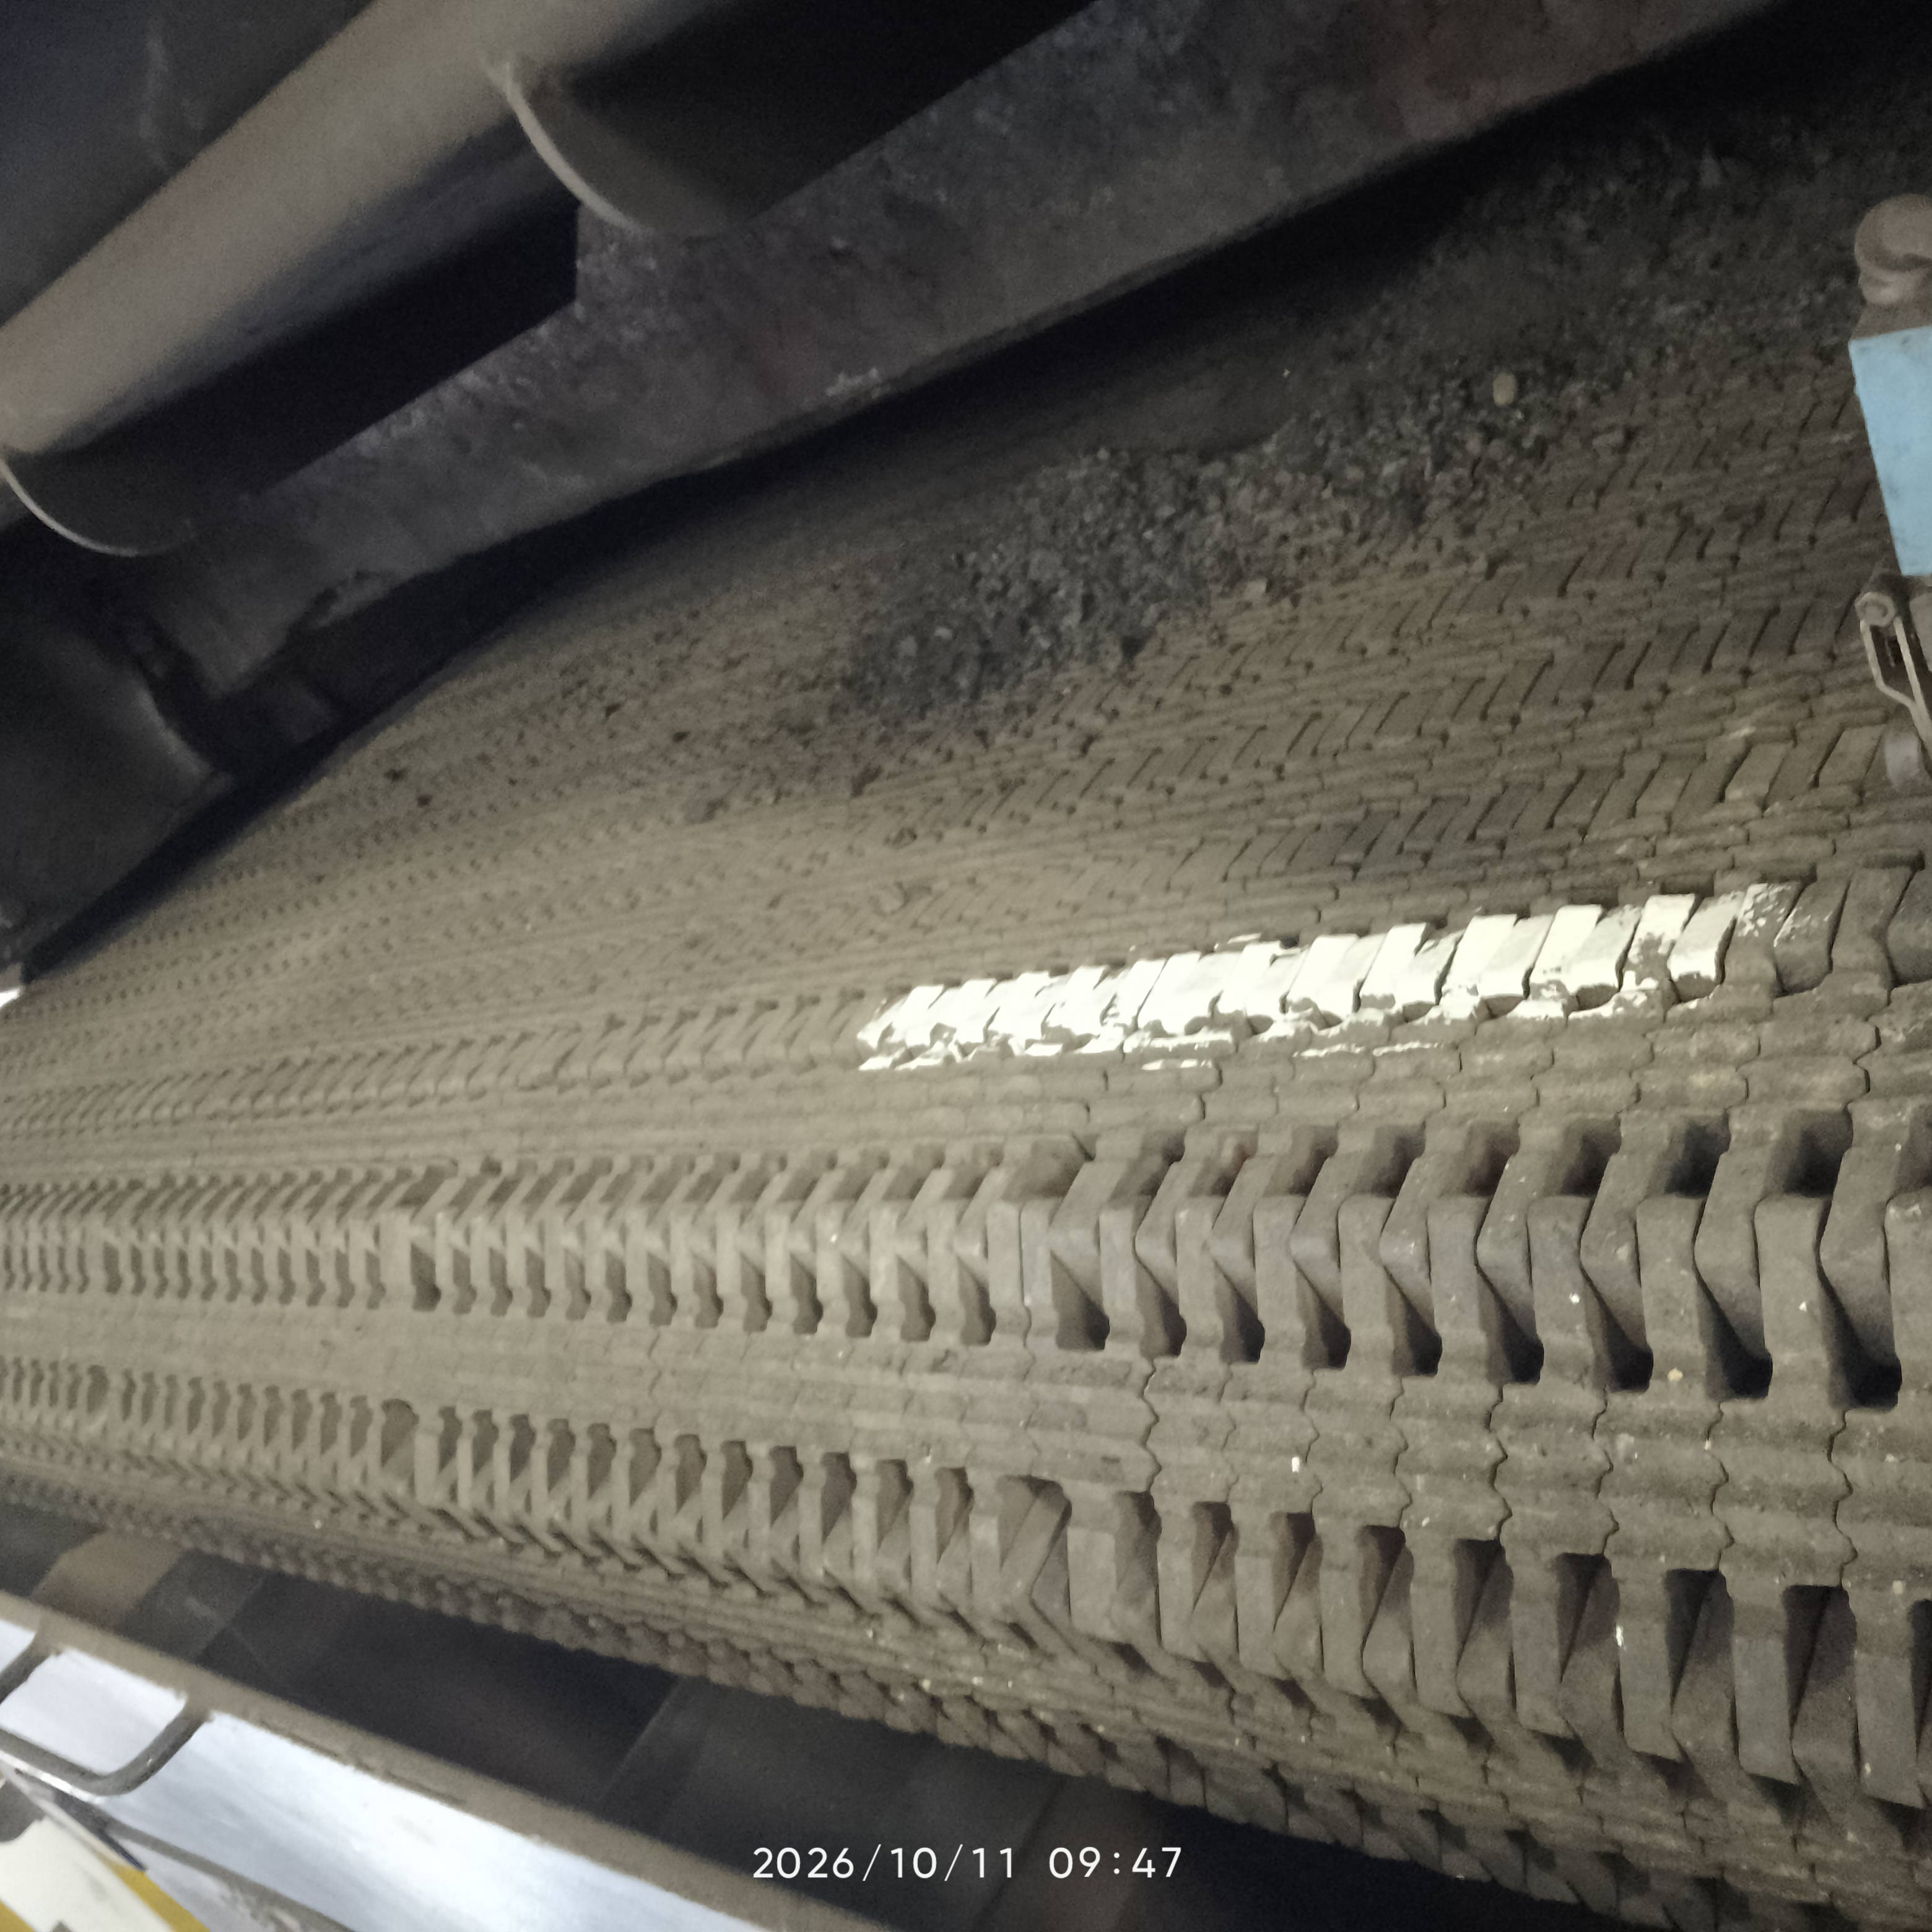
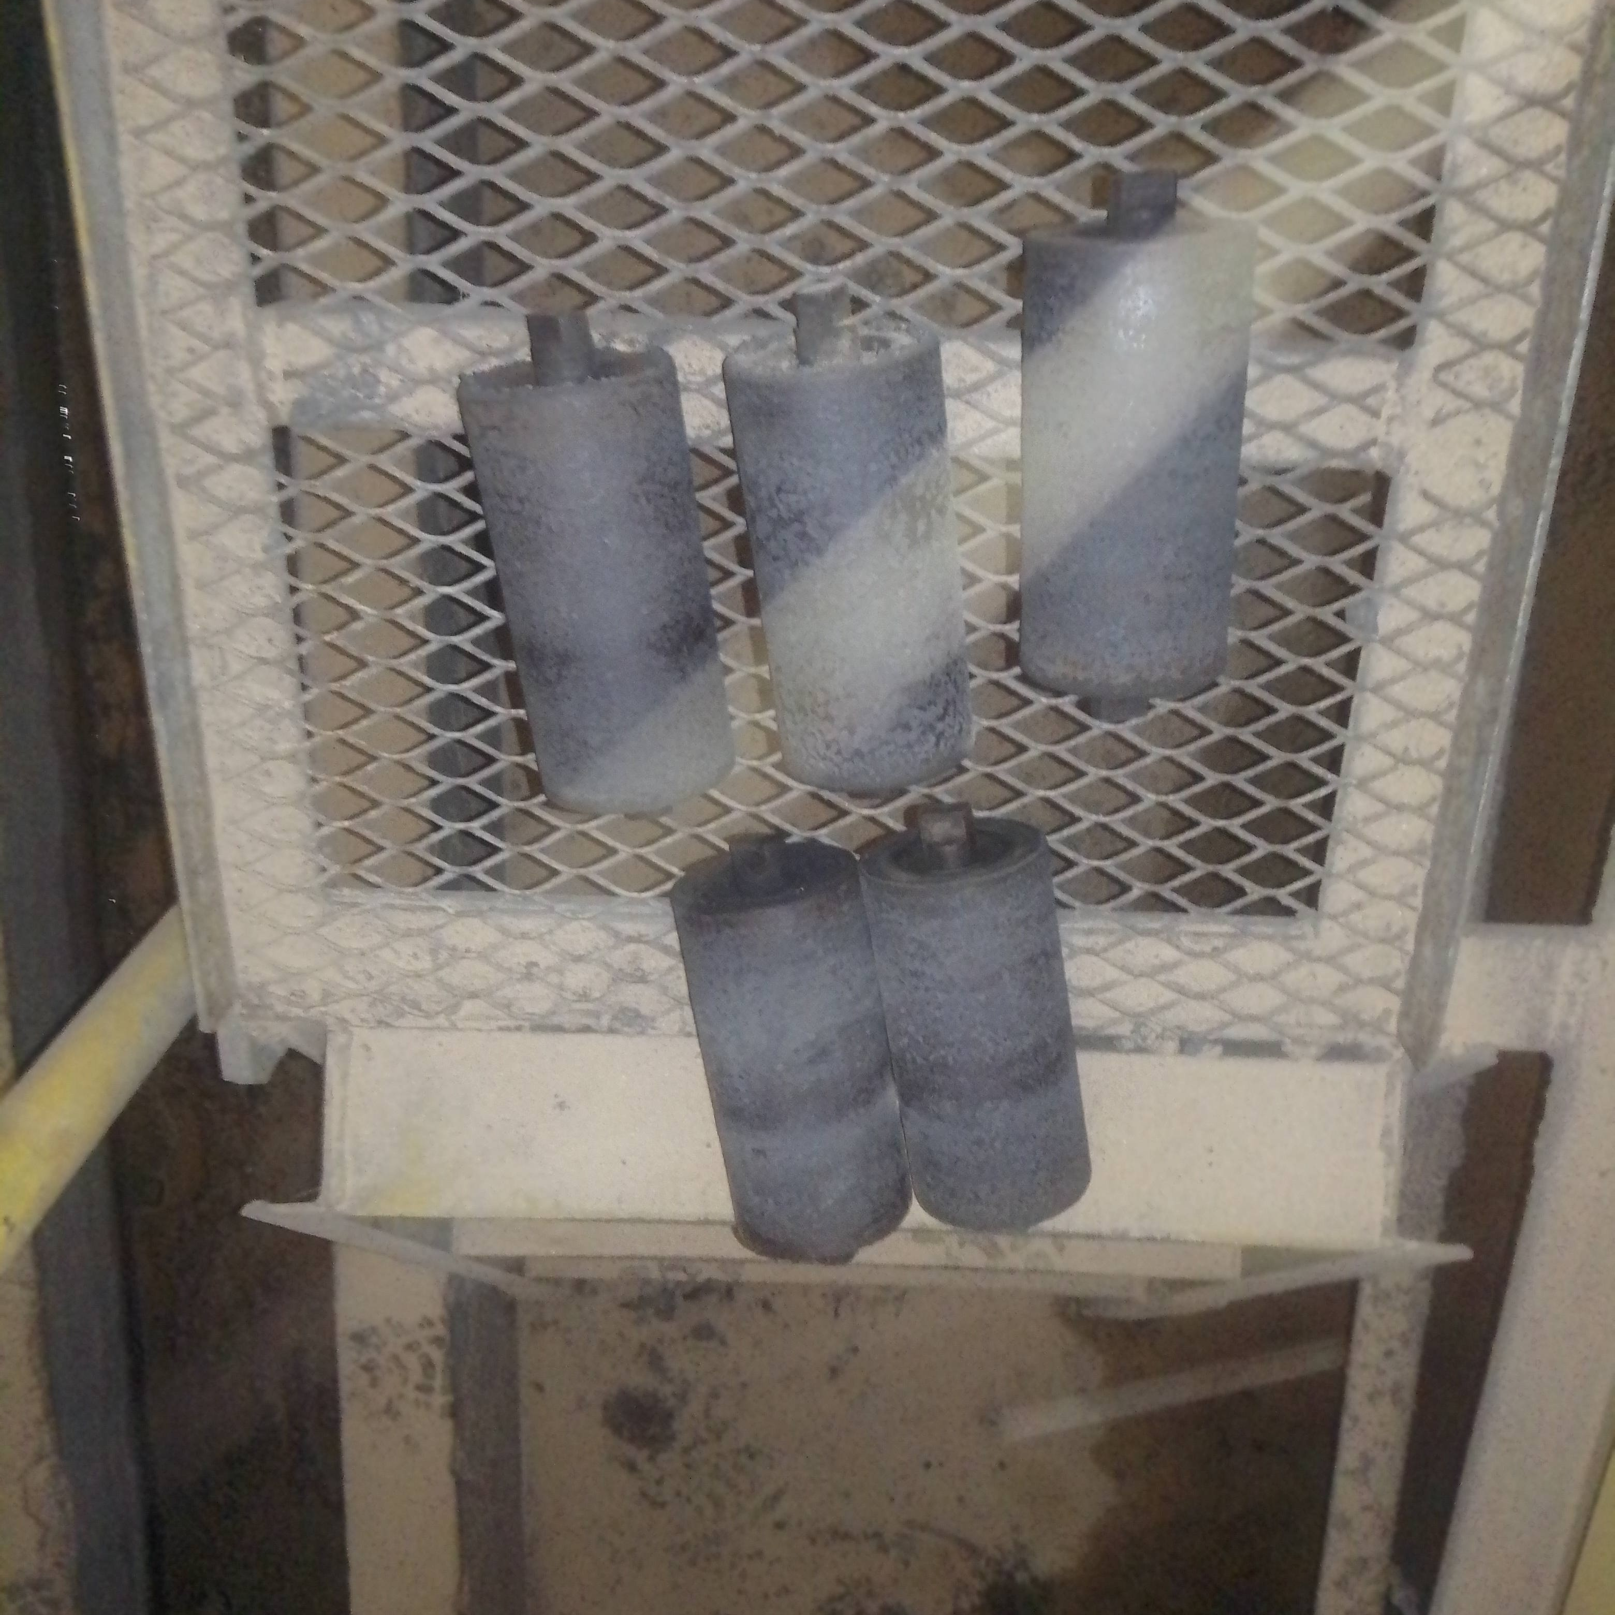
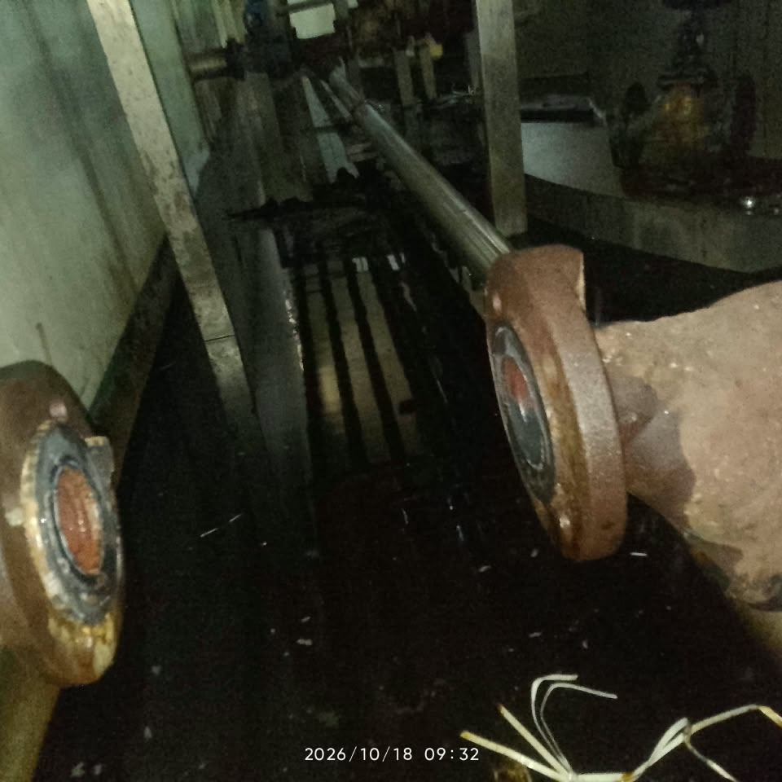
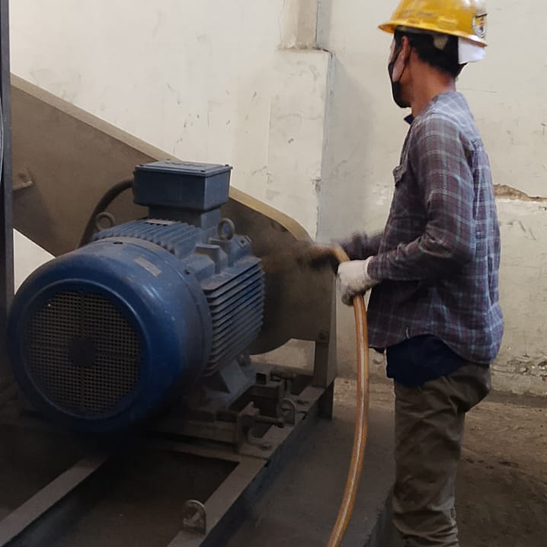
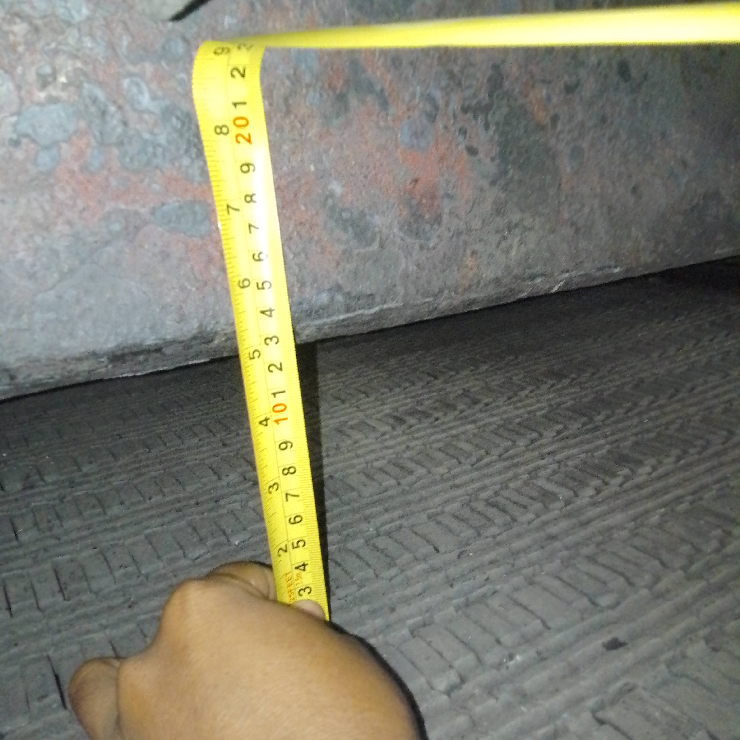
Action Plan Effisiensi Boiler
Masalah | Action Plan | PIC | Target Waktu | Progress | %Progress
Fuel/steam terlalu tinggi | Validasi flowmeter steam dan penimbangan batubara; hitung fuel/steam harian | Boiler | Fabrikasi jalur 25 Okt 26 | Proses PR dan kalibrasi terkait FM steam | 15%
O2 flue gas terlalu tinggi / belum tervalidasi | Repair/kalibrasi analyzer; lakukan combustion test dengan O2 + CO + CO2 bila tersedia | Boiler | Segera | Harga sensor oxigen 190jt Cari opsi lain | 5%
Potensi air leakage pada furnace/ducting | Periksa inspection door, manhole, refractory, expansion joint, ducting, casing dan seal; lakukan smoke test/pressure check sesuai prosedur | Boiler | 1 minggu | Seal corong bottom ash dengan air >> done | 100%
Bottom ash masih memiliki nilai kalor tinggi | Ukur massa bottom ash kg/hari dan lakukan sampling GCV/LOI yang representatif | Boiler | 1 minggu | Naikkan Pengajuan Zat Addictive -> Proposal blm di Approved | 35%
Distribusi udara pembakaran belum optimal | Periksa primary/secondary air, distribusi undergrate air, damper, grate condition dan seal | Boiler | 1–2 minggu | Proses Naik PR untuk Pembelian Unit Sensor Oxygen Baru | 5%
Kemungkinan grate speed / fuel bed tidak optimal | Catat grate speed, ketebalan bed, ukuran batubara, fines, dan kondisi pembakaran; lakukan trial terkontrol | Boiler | 1–2 minggu | Pembuatan Matriks Speed Chaingrate Boiler | 80%
Ukuran dan kualitas batubara perlu dikontrol | Sampling GCV, moisture, ash, volatile matter, fixed carbon dan particle size | Boiler | 2 minggu | Uji ke SMU pada W3 agustus 2026 | 100%
Flue gas temperature perlu dipantau | Trend temperatur flue gas pada load yang sama; inspeksi soot/fouling tube | Boiler | 1–2 minggu | Proses penggantian TT flue gas | 25%
Agenda Autonomous Maintenance Boiler
Agenda 18 Okt 2026
No | Deskripsi Pekerjaan | PIC | Status
1 | Cek aksesoris tiap stoker dan cek putaran L dan R | Tim Boiler | Done
2 | Penggantian valve inlet dissolver | Tim Boiler | Done
4 | Cleaning Chamber Back Boiler L dan R | Tim Boiler | Done
5 | Cleaning Front Chamber Boiler L dan R | Tim Boiler | Done
6 | Cleaning Bak Wet Ash | Tim Boiler | Done
7 | Lubrikasi All roller conveyor bottom ash | Tim Boiler | Done
8 | Cleaning area dosing pump boiler | Tim Boiler | Done
9 | Cleaning area Boiler | Tim Boiler | Done
10 | Maintenance Motor Boiler | Tim MTC | Done
Penggecekan Guillotine Boiler
Cek Kondisi Furnace
Cleaning Back & front Chamber Boiler
Cleaning Bak Wet Ash
Cek Carbofrax boiler
Pengecekan Putaran stoker dan cek aksesoris
Lubrikasi Roller Conveyor Boiler
Penggantian valve inlet dissolver 6
Maintenance motor Boiler
Kalibrasi Guillotine boiler

Slide 12
KPI Engineering Utility (s.d Oktober - 2026)
Bulan Oktober 2026
Schedule Maintenance (min 95%) | Total Breakdown (max 5x) | Total Downtime (<2%) | QCC (min 3) | MTTR (Jam) | MTBF (jam) | Cost Maintenance (Jt)
55% | 10 | 1.89% | 0 | 1.4 | 621 | 43 jt
Motor Pompa
1. Pompa Transfer Glukosa no 1
2. Pompa Hot Water no 1
Otomotif
1. Pallet Mover 15 PRD
Page 12

Slide 13
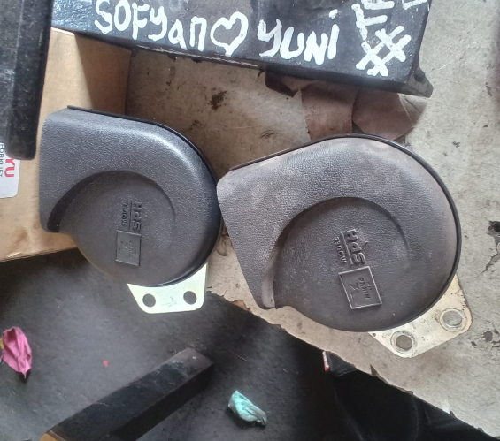
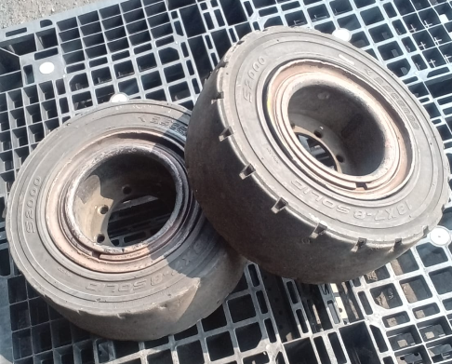
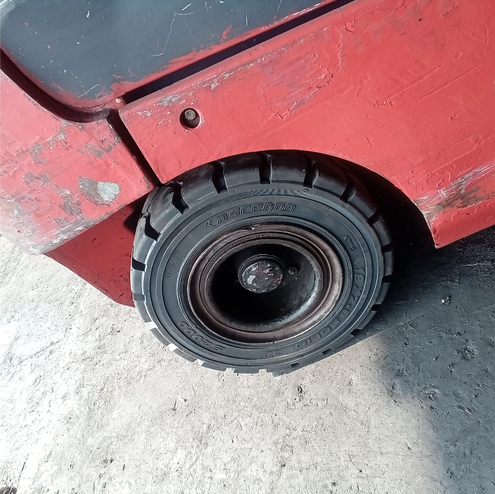
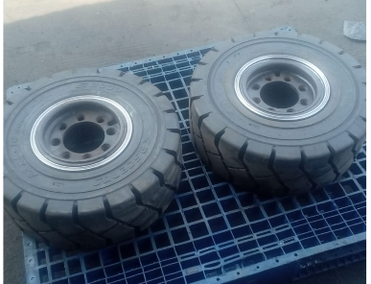
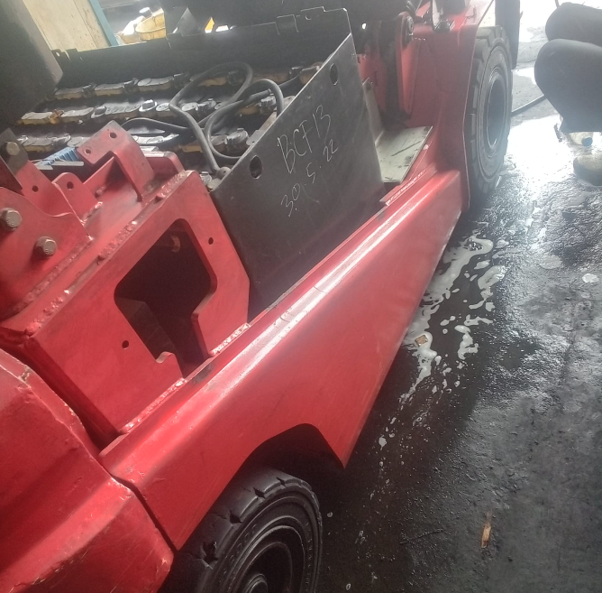
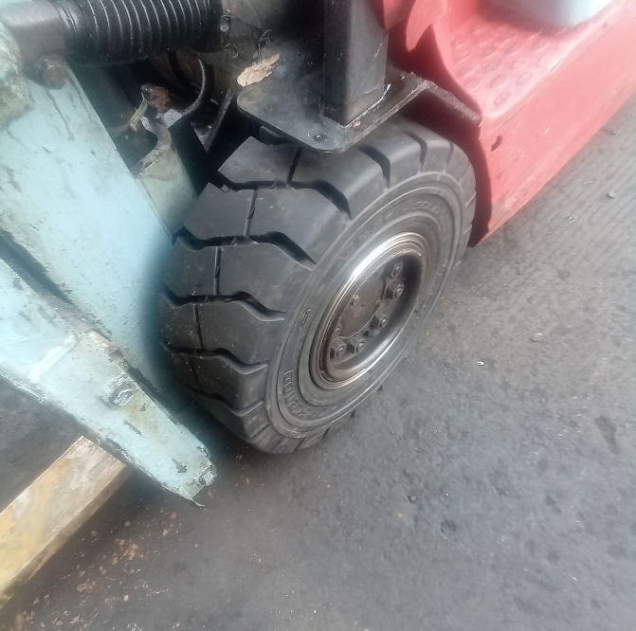
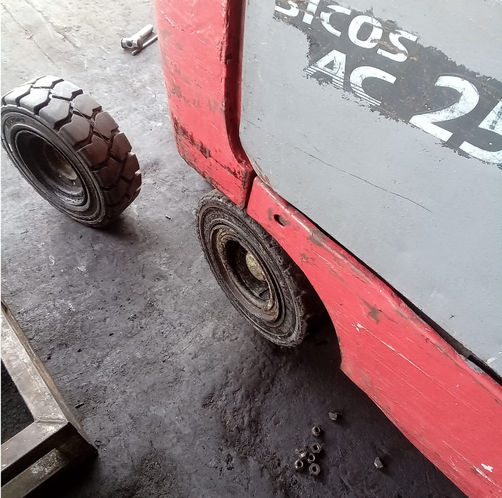
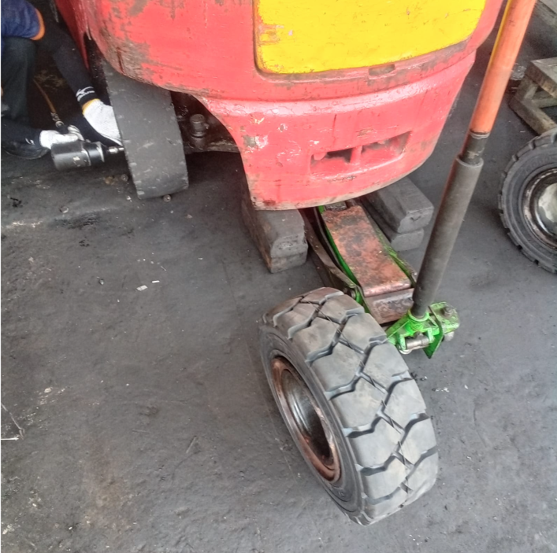
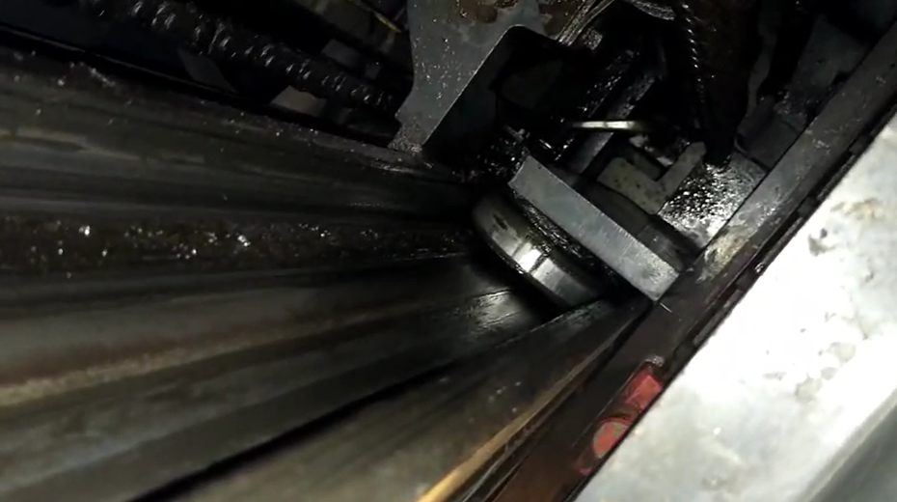
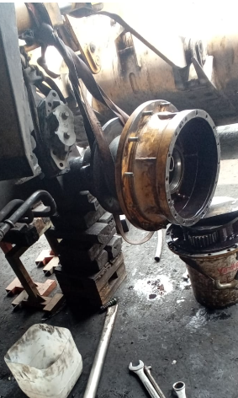
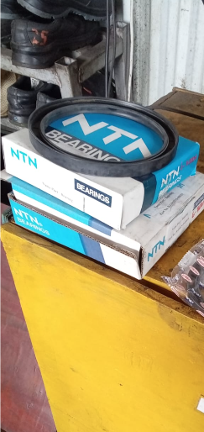
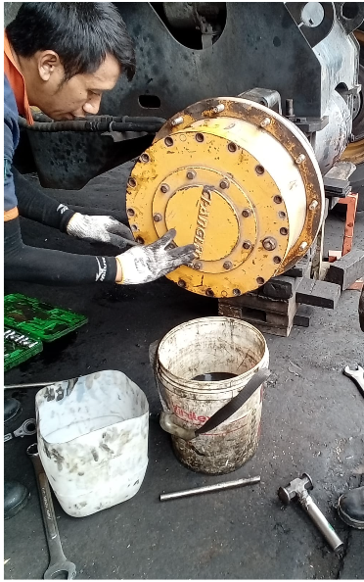
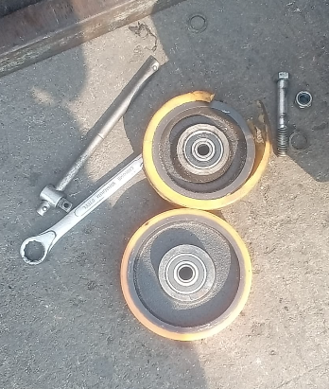
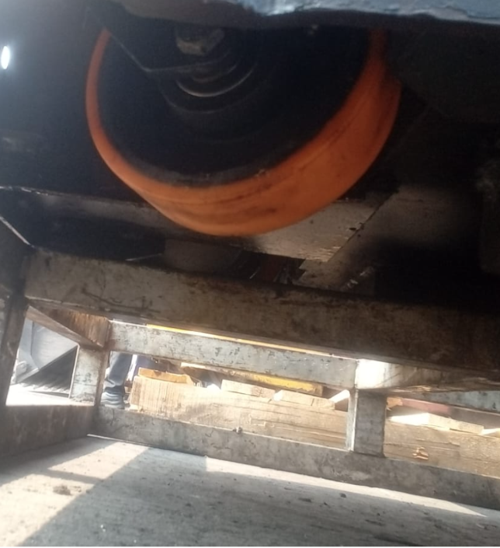
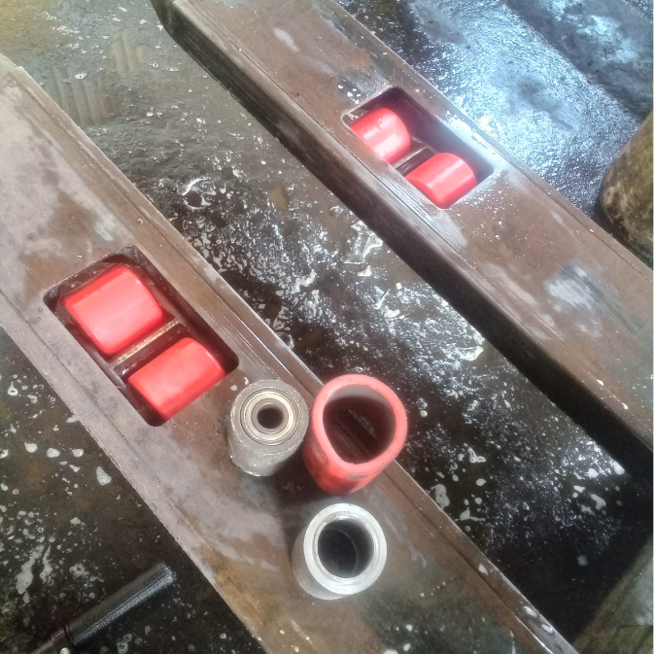
Performance Maintenance ( 12 - 18 Okt 2026)
Realisasi Agenda Otomotif
PM dan CM MHE
Preventive Maintenance
Tanggal | Unit | Temuan | Corrective |  | Status | Dokumentasi
12 Okt 2026 | F06 | 1. Horn Mati 2. Ban Belakang Aus | 1. Penggantian Horn 1 Pcs 2. Penggantian Ban belakang 2 Pcs |  | Close
13 Okt 2026 | F02 | 1. Ban Belakang aus 2. Ban Depan aus 3. Bearing trust rusak | 1. Penggantian Ban belakang 2 pcs 2. Penggantian Ban depan 2pcs 3. Penggantian Bearing trust 2 pcs |  | Close
13 Okt 2026 | F07 | 1. Ban belakang aus | 1. Penggantina ban belakang 2pcs |  | Close
15 Okt 2026 | F12 | 1. Tiang mast goyang 2. Bearing oblak | Perlu dilakukan perbaikan tiang mast |  | Open
16 Okt 2026 | Loader | Terdapat kebocoran oli gardan | 1. Penggantian Seal 2 pcs 1. Penggantian Bearing 2 pcs |  | Close
Corrective Maintenance
Tanggal | Unit | Temuan | Corrective | MTTR | Status | Dokumentasi
17 Okt 2026 | ES01 | 1. Roda Steker Gompal 2. Roller Gompal | 1. Penggantian Roda Steker 2 pcs 2. Penggantian Roller 1 pcs | 87 menit | Close
No | Unit MHE | Status
1 | PRD (6 unit) | 100%
2 | WRH (6 unit) | 100%
Persentase |  | 100%
Cost MHE | W1 | W2 | W3 | W4
PRD | 2 jt | 10.3 jt | 23.3jt
WRH | 1 jt | 1.1 jt | 13.2jt
TOP COST PART TERTINGGI |  |  | Qty
1 | ASCENDO BAN MATI FORKLIFT 18X7-8 | Rp 10.094.000 | 8
2 | PN14600-04361 CAP PIVOT(MAST NICHIYU) | Rp 2.900.000 | 2
MHE
DOWNTIME / JUMLAH UNIT
DEPARTEMENT | Forklift | PM | ES | TRAKTOR | LOADER
PRD | 0/5 | 1/4 | 0/2 | 0/0 | 0/0
WRH | 0/9 | 0/6 | 0/3 | 0/1 | 0/1
Menunggu PR Part Kontaktor
Page 13

Slide 14
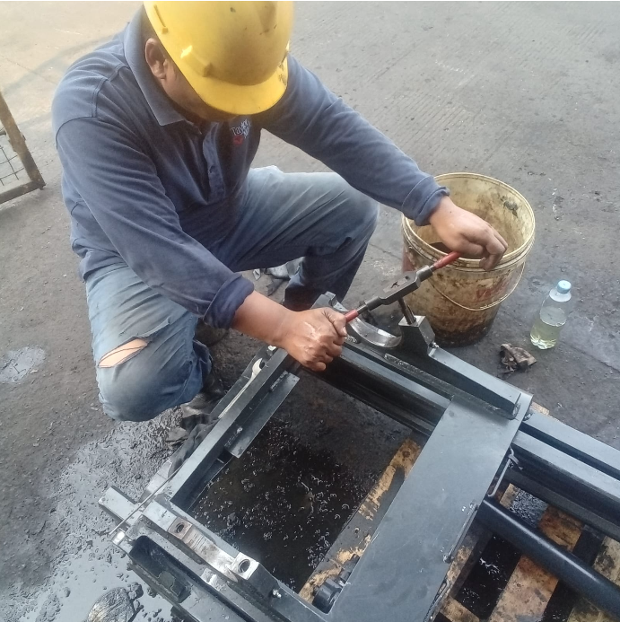
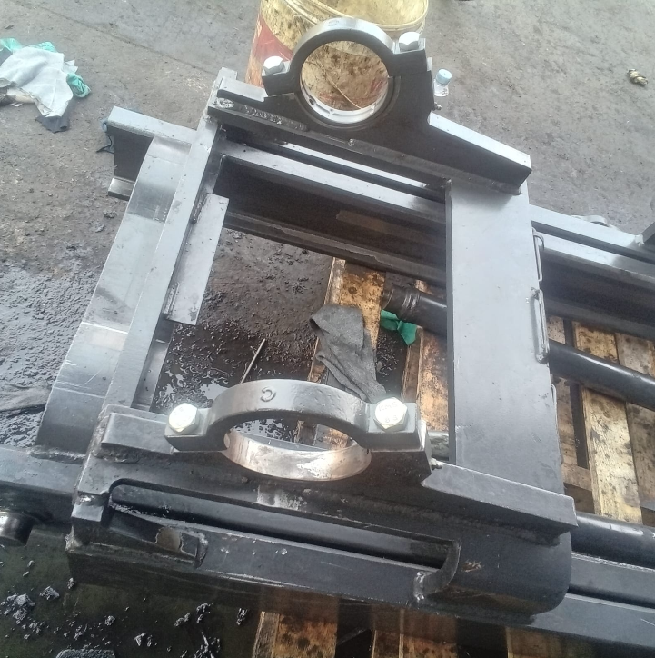
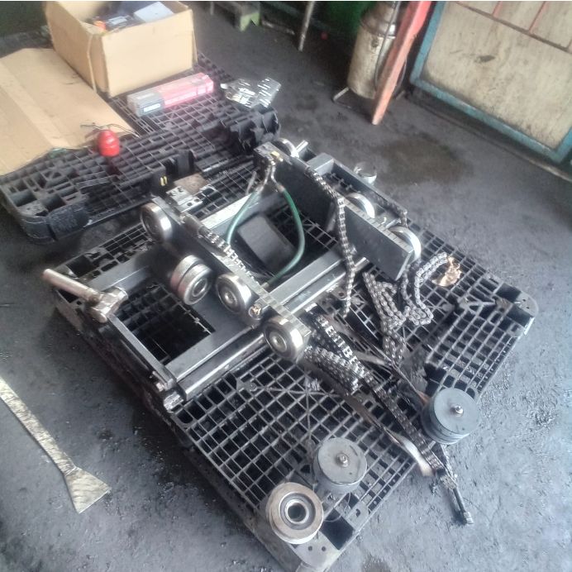
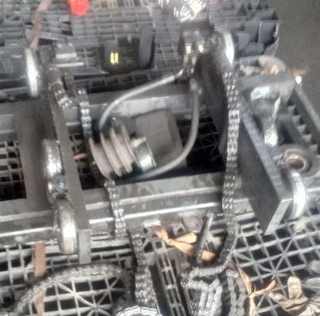
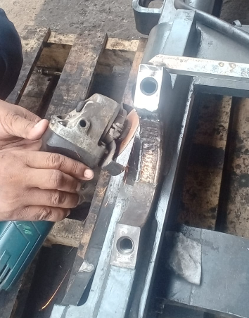
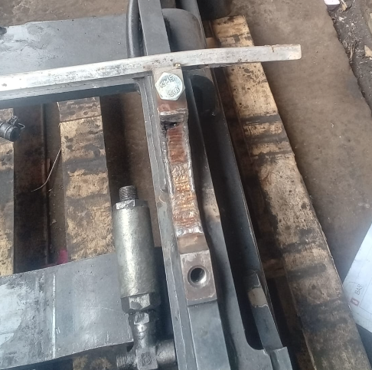


Performance Maintenance ( 12 - 18 Okt 2026)
Perbaikan Tiang Mast F16 WPG
Total Waktu Pengerjaan = 10 Hari (70 jam)
Monitor Agenda Perbaikan Tiang Mast
No | Pekerjaan | Progress
1 | Pembongkaran Tiang mast | 100%
2 | Pengetapan Ulang Bolt Cap | 100%
3 | Penggantian Bearing Abnormal | 100%
4 | Pengelasan Bagian Cap Mast , Support Drive dan Spindel | 100%
5 | Perakitan tiang mast dan Pemasangan ke unit | 100%
6 | Trial | 100%
Total Progress |  | 100%
Rincian Biaya Perbaikan Tiang Mast F16
MID | Nama Part | Qty | Harga
60017532 | PN14602-84530 BUSHING CAP(MAST NICHIYU) | 2 | 1.500.000
60017530 | PN14600-04361 CAP PIVOT(MAST NICHIYU) | 2 | 2.900.000
60017531 | PN0020-16055 BOLT CAP(MAST NICHIYU) | 4 | 121.520
60023908 | RING PER BAJA M16 | 4 | 808.000
60000028 | RING PLAT GLV M16 | 4 | 40.000
60008976 | SPP0000761-MINYAK REM PRESTONE | 1 | 84.040
60029294 | WD MATA GERINDA FLEKSIBLE | 1 | 8.400
60034578 | NICHIYU MAST ROLLER 70001 - 32410 | 2 | 1.566.586
Total Biaya Perbaikan |  |  | 7.028.546
*Next Perbaikan tiang mast forklift 12 PRD
Page 14

Slide 15




Performance Maintenance ( 12 - 18 Okt 2026)
Realisasi Agenda Motor Pompa
PM dan CM Motor Pompa
Preventive Maintenance
Tanggal | Unit | Temuan | Corrective |  | Status | Dokumentasi
15 Okt 2026 | Motor Pompa Outlet 1 | Rubber Kopling Aus | Penggantian Rubber Kopling F36 pcs |  | Close
16 Okt 2026 | Motor Pompa Sand Filter | Vblet Mau putus | Penggantian Vbelt A34 1 pcs |  | Close
Corrective Maintenance
Tanggal | Unit | Temuan | Corrective | MTTR | Status | Dokumentasi
- | - | - | - | - | - | -
No | Area | Status
1. | CT (4 unit) | 100%
2 | WWTP (13 unit) | 100%
3 | Tank Farm (10 Unit) | 100%
4 | Boiler (4 unit) | 100%
5 | Fasum 3 (1 unit) | 100%
Persentase |  | 100%
Cost MP | W1 | W2 | W3 | W4
WWTP | 2.8jt | 2.8jt | 2.8jt
UTY | 0 | 0 | 0
WRH | 280rb | 11 jt | 11 jt
TOP COST PART TERTINGGI |  |  | Qty
1 | DURREX MECHANICAL SEAL 65TLS10-15C | Rp. 11.145.770 | 2
2 | IMPELLER KENFLO CI TYPE XA-40/32 | Rp. 2.750.000 | 1
MOTOR POMPA
DOWNTIME / JUMLAH UNIT
DEPARTEMENT | Motor Pompa/Fan/Blower
ENG | 0/107
WRH | 2/12
PRD | 0/2
Pompa TF Glukosa (proses repair vendor)
Pompa HW Glukosa (proses PR)
Page 15

Slide 16






Performance Maintenance ( 12 - 18 Okt 2026)
Setting Spoket Chaingrate R
Tanggal 18 Oktober 2026
Issue : Sisi kanan Chaingrate R sering ngangkat
Kondisi Marking masih sesuai tidak ada pergeseran
Kondisi Sproket Sudah Mulai Aus
Terdapat temuan sproket kendor di 3 titik dari sebelah kanan.
Dilakukan tightening pada kuncian sproket dan menambahkan locktite untuk memperkuat kuncian.
Dilakukan trial 1 putaran chaingrate dengan hasil aman.
Page 16

Slide 17






Performance Maintenance ( 12 - 18 Okt 2026)
Realisasi Agenda Sipil/AC
Temuan PM dan CM Sipil/AC
Preventive Maintenance
Tanggal | Unit | Temuan | Corrective |  | Status | Dokumentasi
15 Okt 2026 | AC kantin Staff 1 | Kompressor rusak | Penggantian Kompressor baru |  | Close
18 Okt 2026 | AC kantin Staff 2 | Evaporator Kotor | Cuci Turun Evaporator |  | Close
18 Okt 2026 | AC Panel Separator | Evaporator Bocor | Perbaikan Evaporator |  | Close
Corrective Maintenance
Tanggal | Unit | Temuan | Corrective | MTTR | Status | Dokumentasi
- | - | - | - | - | - | -
No | Area | Jumlah
1 | MTC AC HRGA | 10
2 | MTC AC ENG | 8
3 | MTC AC QC | 7
4 | MTC AC PRD | 3
5 | MTC AC WRH | 3
 | Persentase | 100%
REFRIGASI
BREAKDOWN / JUMLAH UNIT
DEPARTEMENT | AC | DEPARTEMENT | AC
ENG | 0/12 | PRD | 0/19
EXP | 0/4 | QC | 0/20
HRGA | 0/33 | WRH | 0/9
Page 17

Slide 18
Cost Operasional Engineering Utility & Project
Data Reservasi Bulanan Engineering Utility & Project
01 - 20 Oktober 2026
TOTAL COST | 111,967,153 | Consumable
155,223,395 | 43,256,242 | Maintenance
 | - | Service Maintenance
Top 10 Cost Consumable
Material | Material Description | Qty | UoM | Total Harga
80000015 | NAOH | 7162 | KG | Rp29,901,350
80002100 | DENFLOC 945 PC | 100 | KG | Rp9,300,000
60038002 | PAC POWDER @25KG | 1000 | KG | Rp6,900,000
60010622 | PRETREAT PLUS 0100 CONC.100%KINGLEE USA | 30 | KG | Rp6,500,520
20000156 | GARAM HALUS | 1000 | KG | Rp3,000,000
80001803 | ASAM SULFAT (H2SO4) 98% MERCK @2,5LTR | 4 | BT | Rp2,680,000
60009005 | PAY OFF CWT B4 @ 30 LITER | 2 | KLG | Rp1,785,000
60011728 | PAY OFF BWT SCF @ 30 LITER | 2 | KLG | Rp1,636,800
60011727 | PAY OFF BWT SRTF @ 30 LITER | 2 | KLG | Rp1,578,000
80003400 | CHEMTECH ALKEM C-9040 FLOCULANT @25KG | 1 | ZAK | Rp1,550,000
Top 5 Cost Maintenance
Material | Material Description | Qty | UoM | Total Harga
60038635 | OIL ROTO SYN FG ULTRA 20L | 1 | KLG | Rp19,175,231
60038680 | ATCO KIT OIL SPARATOR PN2901162600 | 1 | PCS | Rp14,331,200
60045291 | Filter AHU 520x365x8MM York | 12 | PCS | Rp13,200,000
60042796 | ATLASCOPCO AIR/OIL FLTR KIT PN3002600440 | 1 | PCS | Rp6,684,360
60015525 | RESIN BENING FIBERGLASS TYPE LP1Q EX | 36 | KG | Rp4,320,000
Page 18

Slide 19

Summary Project ENG Utility per 21 Oktober 2026
Page 19

Slide 20
Summary Project ENG Utility (Boiler)
No | Project | Target Result | Kategori | Start | Finish | (%) | Status | Note
1 | Penggantian FM Steam Boiler | Untuk digitalisasi penggunaan steam boiler | KPI BB dan Steam | W1 Mar | W2 Juli | 10 | Terlambat | Proses PR Material No. 5000033940
2 | Penambahan Zat Addictive BB | Menurunkan Unburnt carbon BB dari 1500 ke < 1000 Saving cost: 6 ton/week Rp. 10.500.000 | KPI BB dan Steam | W2 Mei | W2 Juli | 10 | Terlambat | Negosiasi Biaya Trial dengan pihak vendor (request free biaya untuk trial)
3 | Pemasangan Heater HW 10 Ton (For startup Retail) | Effisiensi penggunaan batubara dan overtime MP boiler Cost saving: BB: 2.6 ton/day Rp.4,550,000 MP: Reduce overtime 2x8 jam | KPI BB dan Steam | W4 Mei | W2 Agustus | 5 | Terlambat | Menunggu hasil deisgn vendor heater
4 | Perbaikan Plat Furnace Boiler | Untuk Spare Furnace boiler dan menurunkan cost operasional pembelian furnace baru dengan repair yang lama | Maintenance | W2 Juni | W3 Juli | 40 | Terlambat | Penggantian Plat Done > Plat tersimpan di area boiler > Ajukan Cor Furnace (PR Jasa 5000034405 )
5 | Pemasangan Temperatur Transmitter Flue Gas | Indikator Performa pembakaran dan efisiensi Boiler | Maintenance | W1 Sept | W4 Sept | 10 | Terlambat | agenda 25 okt 2026 (arbi)
6 | Air overflow HW glukosa to tanki kondensat glukosa | Mengurangi pemakaian air dan meningkatkan angka kondensat | KPI BB dan Steam | W1 Sept | W2 Okt | 5 | Terlambat | PR material
7 | Pemasangan sight glass Pasteur line 2 | Untuk monitoring performa steam trap dan kondensat | KPI BB dan Steam | W3 Sept | W4 Des | 5 | On Progress | PR material 5000034295
8 | Pemasangan sight glass area dissolver & olah sari | Untuk monitoring performa steam trap dan kondensat | KPI BB dan Steam | W3 Sept | W4 Des | 3 | On Progress | Naik MID Baru
9 | Penggantian Belt Conveyor Bottom Ash | Untuk Maintenance Conveyor bottom yg sudah tipis | Maintenance | W1 Okt | W3 Okt | 5 | Terlambat | PR Urgent material Belt 5000034631 (Sementara Menggunakan belt lama/bekas)
10 | Penggantian Guillotine R | Maintenance lifetime guillotine | Maintenance | W2 Okt | W3 Okt | 5 | Terlambat | Agenda pada 25/10/2026
11 | Coblos jalur FM boiler untuk verifikasi dengan kempu dan timbang | verfikasi hasil KPI Steam | KPI Steam/FG | W3 OKT | W4 OKT | 5 | On Progress | Agenda pada 25/10/2026
Page 20

Slide 21
Summary Project ENG Utility (Utility)
No | Project | Target Result | Kategori | Start | Finish | (%) | Status | Note
1 | Air Mix RO to Handwash | Saran Temuan Audit ISO 2025 TDS max 300 ppm | Compliance | W2 Sept | W1 okt | 10 | Terlambat | Cek kebutuhan Matrial Prioritas 1 = saat off MOC Done 11/09/26
2 | Penambahan ducting cooling tower | Untuk Memaksimalkan kerja Cooling Tower | Compliance | W3 Mei | W3 Juli | 15 | Terlambat | EJO Drawing EJO0134413 naik MOC
3 | Epoxy area RO | GMP area | 5R | W1 Jan 27 | W2 Jan 27 | 25 | Terlambat | EJO0134635 : Material Ready Cek kebutuhan eksekusi Area Prioritas ke 3
4 | Pemasangan Dosing Pump di air RO to PRD | Untuk Standar Kualitas Air proses dengan standar kadar klorin 0,2 - 2 ppm | Compliance | W2 Jun 26 | W4 Jun 26 | 80 | Terlambat | FU material ke team Project EJO0135600
5 | Pembuatan Pembatas Tanki Garam dan Tanki MMF | Memperpanjang part dan pipa tanki MMF akibat semburan/luapan tanki garam | GMP | W4 Sept | W4 Sept | 10 | Terlambat | EJO0135526 Ejo pembuatan/pengerjaan
6 | Instalasi system digitalisasi Capasitor Bank | Untuk Monitoring Performa Capasitor Bank | Digitalisasi | W4 Jun 26 | W2 Ags 26 | 50 | On Progress | On Progress Tim ITE
7 | Pemasangan Sensor Suhu Panel | Monitoring suhu tiap panel listrik utility | Digitalisasi | W3 Juli | W1 September | 25 | Terlambat | Material datang sebagian
8 | Pembuatan ducting hot air dryer Ruang Compressor | Mengurangi Ambient temperatur Ruangan | Improvement | W4 Sept | W1 Okt | 70 | Terlambat | EJO pembuatan EJO0135511
9 | Pembuatan Ducting Fresh air area compressor | Meningkatkan performance dan lifetime compressor dan dryer utility | Improvement | W4 Sept | W1 Okt | 50 | Terlambat | EJO pembuatan EJO0135320
10 | Trial Pasang Paranet di Cooling Tower | Menurunkan beban Cooling Tower saat siang hari dan efisiensi penggunaan listrik | Maintenance | W4 Sept | W4 Sept | 50 | Terlambat | progress 50 %
11 | Penggantian WF gawang pengangkat Pompa RO + Resin | Maintenance pipe bridge area RO | Maintenance | W4 Sept | W2 Okt | 15 | Terlambat | NO EJO0135769
12 | Verifikasi Flow Meter semua sumur BAS | Verfikasi FM sumur bas | KPI Kuota AIR | W3 OKT | W1 NOV | 15 | On Progress | Naik EJO Verifikasi
13 | Pembuatan spray ball tanki pit garam | comply regulasi kuota air | KPI Kuota AIR | W3 OKT | W1 NOV | 15 | On Progress | EJO0135824
Page 21
Page 21

Slide 22
Summary Project ENG Utility (WWTP)
No | Project | Target Result | Kategori | Start | Finish | (%) | Status | Note
1 | New anaerob 200 m3 step 3 (debit 1-1.5 m3/jam) | New anaerob 200 m3 diarahakan ke lumpur aktif kapasitas 160 m3 (1-1.5 m3/jam) Target menurunkan COD removal nya 80-90% | Baku Mutu | W1 Okt 26 | W1 Jan 27 | 21 | Terlambat | mulai pekerjaan atap di area new anaerob step 3
2 | Perbaikan Diffuser Lumpur Aktif Besar | Menaikan nilai standar DO dari 1 ppm menjadi 2.5 ppm | Baku Mutu | W3 Jun 26 | W3 Agus 26 | 15 | Terlambat | Sudah dinaikkan PR (tunggu kedatangan)
3 | Reuse air pit garam untuk air top up cooling tower | mengurangi penggunaan air di area utility dengan saving kuota SB | KPI Air | W1 Jan 26 | W4 Agus 26 | 30 | Terlambat | Chemctech akan kirim proposal nya present MoC 11/09/2026 NOMOR PR 5000034662
4 | Elektrokoagulan | Penambahan pengolahan di akhir proses setelah DAF Menurunkan COD | Baku Mutu | W3 Jul 26 | W4 Okt 26 | 25 | On Progress | IO sedang dinaikkan team project 22/09/2026, PR material sudah dilakukan, tanki sudah di lakukan resin, pembuatan panel done, next pembuatan penahan plat nomor IO sudah ada dan kedatangan materail di 60%
5 | Penambahan kapasitas TPS sludge | Untuk menambah kapasitas sludge agar tidak ada lagi kempu di jalan | 5R | W2 Agus 26 | W2 oktober 26 | 20 | Terlambat | sudah PR material 07/09/2026 sudah datang 62%
6 | Perbaikan Walkway Aerasi | Untuk peremajaan struktur WWTP | Maintenance | W1 Okt 26 | W1 Des 26 | 25 | On Progress | mulai pekerjaan
7 | Reuse air outlet WWTP untuk siram tanaman | Reuse air outlet untuk siram tanaman | KPI Air | W1 Jan 26 | W1 Des 26 | 10 | On Progress | after project elektrokoagulan dan pit garam jika memungkinkan masuk ke pengolahan pit garam akan diarahkan ke sana
8 | Modifikasi Kerangkeng WWTP | untuk peremajaan kerangkeng dan efektifitas penempatan material | 5R | W1 NOV 26 | W2 NOV 26 | 6 | On Progress | Sudah naikkan pr
9 | Peninggian lantai dan pemasangan keramik WWTP | Area kerja berbasis 5R | 5R | W1 Jan 27 | W2 Apr 27 | 2 | Terlambat | Naik ejo drawing EJO0135711 (sudah genba lapangan)
Page 22

