Slide 1


Milestone 5
Group Members
Prajakt Uttamrao Khawase Rahul Mallampati

Slide 2
Agenda
Scope of the Project
What will be in site.
Cost Estimate.

Slide 3
How to Remember 5 Process Groups
1. Initiating - In
2. Planning - Physical
3. Executing - Education
4. Monitoring and Controlling - Mary Cries
5. Closing – Constantly
Phrase :- In physical Education Mary cries Constantly.
Prajakt Uttamrao Khawase

Slide 4
How to Remember 10 Knowledge Areas
Integration. - I
Scope management. - saw
Time management. - six
Cost management. - car's
Quality management. - Quickly
Human Resource Management. - Rip
Communication Management - Car-mans
Risk Management. - Rear
Procurement – Passengers
Stakeholders - side
I saw six car's Quickly Rip Car-mans Rear Passengers side.
Prajakt Uttamrao Khawase

Slide 5
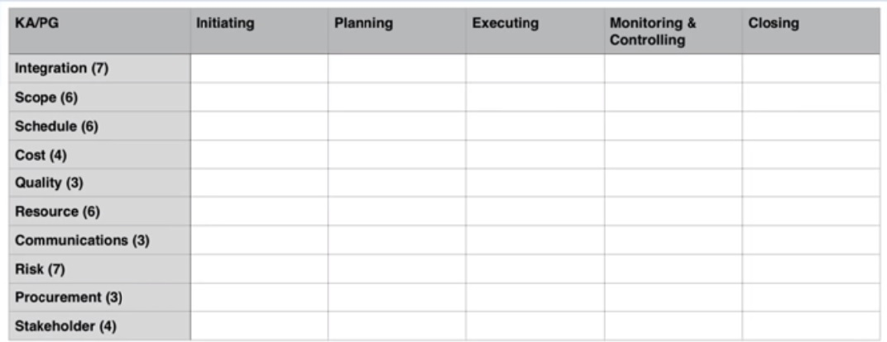
Number of Processes in each Knowledge area
Phone Number Technique 766-436-3734
Prajakt Uttamrao Khawase

Slide 6
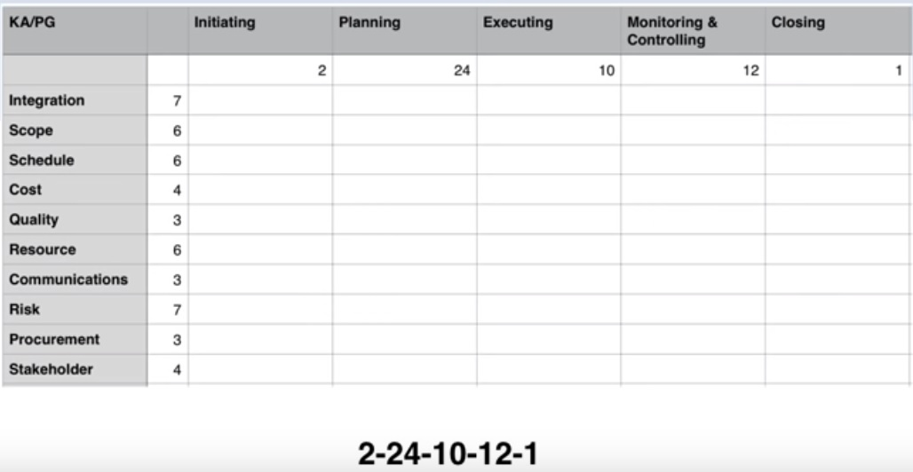
Number of processes across Process Groups
Postal Code Technique :- 2- 24 -10-12-1
Prajakt Uttamrao Khawase

Slide 7
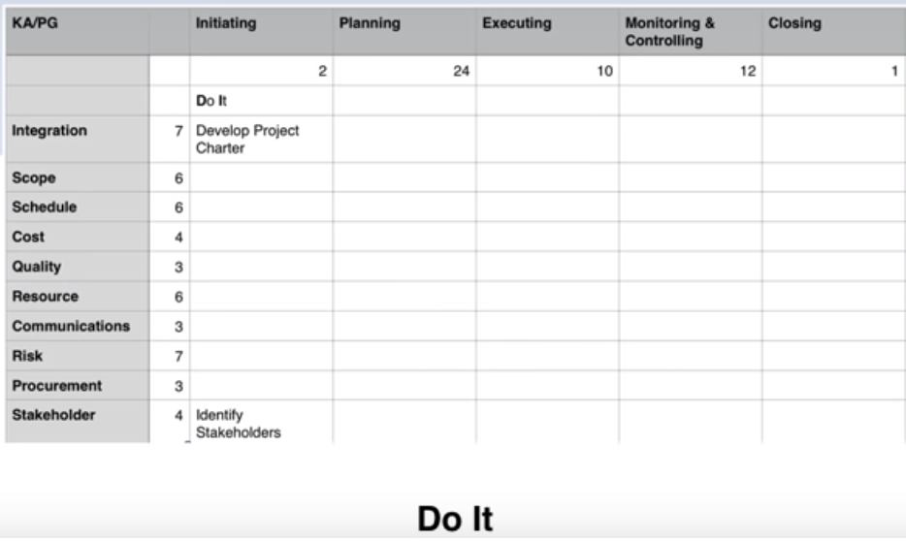
Processes In initiating Process Group
Remember Nike Slogan – Just Do It
Prajakt Uttamrao Khawase

Slide 8
Outcomes
lessons that We learned on this project
The most difficult component of this project .
Techniques did your team use to jell your team.
Most interesting component of this project.

Slide 9
References
https://www.examspm.com/free/
https://www.youtube.com/watch?v=EAz-6M-RAV0

Slide 10
Thanks

