Slide 1
Malaria Detection in Blood Cell Images using ResNet 50
Prajakta Ravindra Deokule
BTECH COMP A
Roll No-4329
C22019221332
Guide-Dr. Anjali Naik

Slide 2
Agenda
Introduction
Methods adopted for Malaria Detection
Related Works
CNN for Malaria Detection
Transfer Learning
Proposed Method using ResNet 50
Data Collection and Pre-processing
Model Training and Results
Conclusion
References

Slide 3
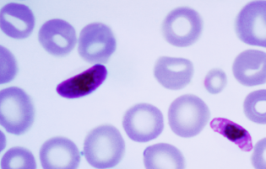
Introduction
Malaria is a deadly disease caused by the Plasmodium parasites transmitted through the bite of the female Anopheles mosquito.
The plasmodium parasites affect the red blood cells and develops into life-threatening symptoms. The typical symptoms of malaria are fever, headache, tiredness, vomiting and coma and death in severe cases.
According to World Health Organization (WHO), in the year 2021, more than two hundred million cases of malaria have been reported and more than 90% of the cases are in the African region.

Slide 4
Methods Adopted for Malaria Detection
In pathology labs, the blood samples are collected and the diagnosis of malaria infection is done by identifying the parasites in blood slides through a microscope by the experts. Giemsa staining is a chemical process is used in the detection of malaria parasites and requires experienced technicians. These processes are time-consuming and exhausting.
To make the diagnosis faster polymerase chain reaction (PCR) and rapid diagnostic test (RDT) came into consideration. But PCR is much costlier than other methods and RDTs are less accurate.
An automatic diagnostic process reduces diagnostic time and improves accuracy.ML methods are also effective for malaria detection but deep learning methods overcome the challenges of devising hand-engineered features to capture variations in the underlying data.

Slide 5
Related Works
P. A. Pattanaik proposed a Computer Aided Diagnosis scheme for identifying the presence of malaria parasites in thick blood smears. They performed 10-fold cross validation and achieved an accuracy of 89.10%.
"Malaria parasite detection using different machine learning classifier”,2017 paper contains various ML techniques(SVM, variations of KNN) for malaria detection in blood smears with their accuracies.
“Pre-trained convolutional neural networks as feature extractors toward improved malaria parasite detection in thin blood smear images” research article was published by Sivaramakrishnan Rajaraman​, Stefan Jaeger, Sameer K. Antani and their co-authors in April 2018.
This article evaluated the performance of pre-trained CNN based DL models as feature extractors toward classifying the parasitized and uninfected cells to aid in improved disease screening and achieved these performance metrics.

Slide 6
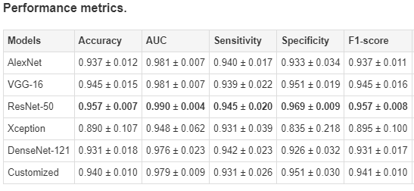

Slide 7
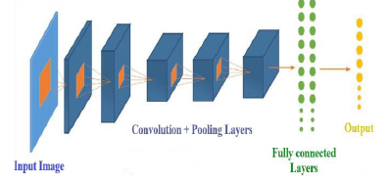
CNN for Malaria Detection
Convolutional Neural Networks, a type of deep learning architecture have proven to be very useful in image recognition, identification and categorization tasks. . CNNs outperform traditional deep learning methods in terms of accuracy and efficiency in disease recognition tasks.
In this report, the overall performance of pre- trained CNN models is examined and as most papers prefer ResNet due to its high accuracy, it is used in this study.

Slide 8
Transfer Learning
In deep learning, transfer learning is a technique whereby a neural network model is first trained on a problem similar to the problem that is being solved and the first problem has more labelled data than the problem to solve. One or more layers from the trained model are then used in a new model trained on the problem of interest.
Transfer learning reduces the training time for a neural network model and can result in lower generalization error.
The weights in re-used layers may be used as the starting point for the training process and adapted in response to the new problem.

Slide 9
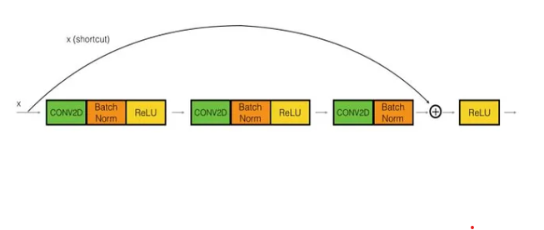
ResNet
ResNet-50 is a deep residual network that is trained on images from the ImageNet database.
ResNet is an artificial neural network that helps to build deeper neural network by utilizing skip connections or shortcuts to jump over some layers.
Before ResNet, teaching very deep neural networks got troublesome due to vanishing gradients i.e. as soon as the model starts to back propagate, the gradient starts getting smaller and smaller. ResNet50 has Skip Connections which is a remarkable advantage and it overcomes the problem of vanishing gradient.
Without skip connections output would be h(x)=f(x) but with skip connections output changes to h(x)=f(x)+x

Slide 10
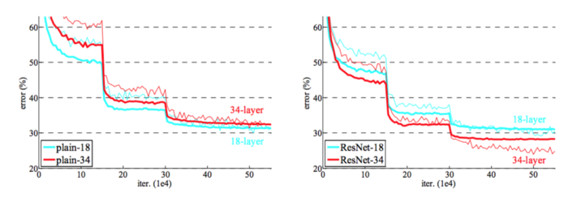
If we see the plain networks, as we increase the layers there is a decrease in train error, but after few layers, the error goes back increasing. But this behavior is solved when it comes to ResNet and as layers are increasing the error only tends to decrease and don’t increase.

Slide 11
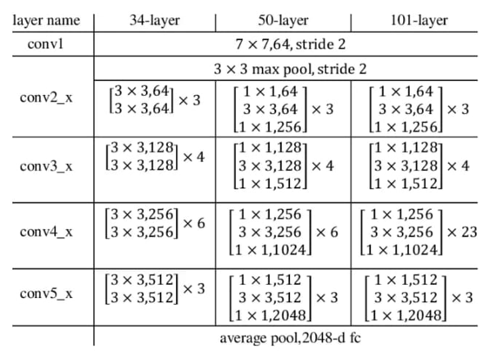
ResNet Architecture

Slide 12
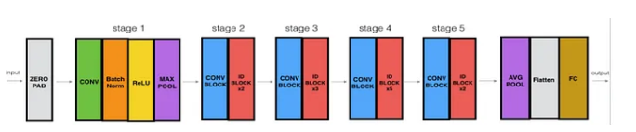
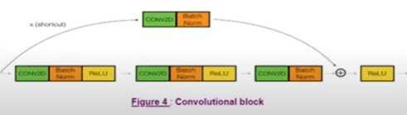
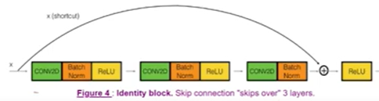
ResNet 50 Architecture

Slide 13
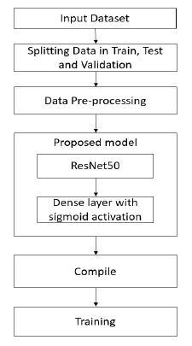
Proposed Method
In this study, for the performance of pre- trained CNN namely ResNet50 is evaluated. ResNet50 is used as a feature extractor is used to classify infected and uninfected cells for diagnosis of Malaria.
The experiment was carried out on Jupyter Notebook using Keras 2.2.4 and Tensorflow 1.13.1.
The input to this model is a RGB image. The image will enter ResNet50 layer with the pretrained weights and the last layer is a classic fully connected dense layer with sigmoid activation function.

Slide 14
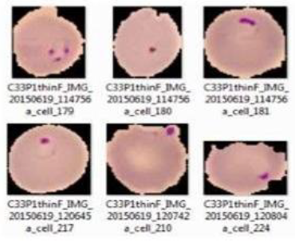
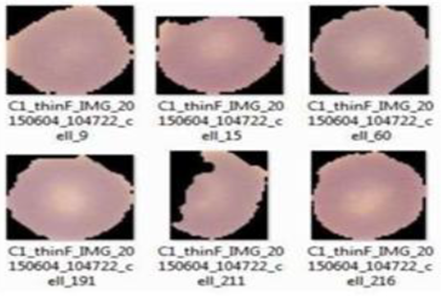
Data Collection and Pre-processing
The Dataset is available on the official website of National Library of Medicine (NLM). The total number of infected and uninfected cell images in the dataset are 27,558.
The data was split in ratio of 70, 15, and 15 percent for train, test and validation.
Randomization of images is done to get good redistribution of data for when we apply the split.
The input image for the ResNet50 layer should be of size 224*224. So, all the images has to be re-sized to the target size of 224*224.

Slide 15
Model Training and Results
The optimizer used for this model is Stochastic Gradient Descent (SGD) and the loss function used is Categorical-Cross Entropy.
Neural network learns through back propagation. The top layers in the ResNet50 aren’t frozen, i.e. those top layers learn through back propagation whereas, other layers of ResNet50 are frozen. The weights getting updated during back-propagation is called fine-tuning. Fine-tuning of the top layers in the ResNet50 should be done.
The accuracy for the testing data is 96.25%
Metrics | Value
Training Accuracy | 95.91%
Validation Accuracy | 95.4%
Training Loss | 0.1134
Validation Loss | 0.1301

Slide 16
Conclusion
Malaria is a life threatening disease and its early diagnosis can save a lot of lives. The accuracy of diagnosing malaria from blood smears relies on the efficiency of medical professionals and the quality of instruments used in the diagnostic process.
Deep learning methods with high accuracy in diagnosing the disease can reduce this strain on healthcare system. It also makes the diagnostic process easier and faster.
The proposed technique using ResNet as pretrained CNN can be an effective medical diagnosis aid due to its high accuracy.

Slide 17
References
A. S. B. R. a. D. S. Juliet, "Transfer Learning withResNet-50 for Malaria," in International Conference on Communication and Signal Processing, India, 2020.
A. K. D. S. D. Amogh Manoj Joshi, "Deep Learning Based Approach For Malaria Detection in Blood Cell Images," in 2020 IEEE REGION 10 CONFERENCE (TENCON), Osaka, Japan, 2020.
M. M. a. M. Z. K. P. A. Pattanaik, "Unsupervised Deep Learning CAD Scheme for the Detection of Malaria in Blood Smear Microscopic Images," IEEE Access vol. 8, pp. 94936-94946, 2020, doi:10.1109/ACCESS.2020.2996022.
Z. W. Adedeji Olugboja, "Malaria parasite detection using different machine learning classifier," in 2017 International Conference on Machine Learning and Cybernetics (ICMLC), 2017.
S. R. E. K. G. Gautham Shekar, "Malaria Detection using Deep Learning," in Fourth International Conference on Trends in Electronics and Informatics (ICOEI 2020), 2020.
M. P. Y. S. K. A. Feng Yang, "Deep Learning for Smartphone-Based Malaria Parasite Detection in Thick Blood Smears," IEEE Journal of Biomedical and Health Informatics, 2019.

Slide 18
Thank you!

