Slide 1
Internship Presentation
By Prajakta Deokule
3330,TY COMP-A
C22019221332
2021-2022

Slide 2
Agenda
Internship Details
Company Profile
Technical Work Done during the Internship
Technology Used in the internship
Skills Gained during the Internship
Conclusion

Slide 3
Internship Details
Duration- 22 weeks (17th January to 15th June 2022)
Role- Software development Intern
Company Name- BMC Software India Private Limited
Mode of Internship- Online
It was a group project
Team Members- Sanyukta Muley, Sampada Joshi

Slide 4
Company Profile
BMC Software is a global leader in software solutions for the Autonomous Digital Enterprise. It is an American multinational IT services, consulting and Enterprise software company based in Houston ,Texas , USA.
As businesses embark on a journey to become an autonomous digital enterprise, BMC Software helps these businesses to overcome the challenges that they face.
BMC Software develops products used for multiple functions including automation, service management, DevOps , workflow orchestration, AIOps and security.
BMC Software India Private Limited is a private subsidiary of BMC Software and was incorporated in 2001.

Slide 5
Problem Statement-Auto verification of data sanity post migration
Migration of data has been performed for latest versions of deployments with same or different underlined databases.
The project aims to ​-
▪ Check if the all the source data is transferred​
▪ Validation of correct values in destination tables​
▪ Check for any data loss post migration
Any attempt towards correction of data in case of invalid or missing data is not done.

Slide 6
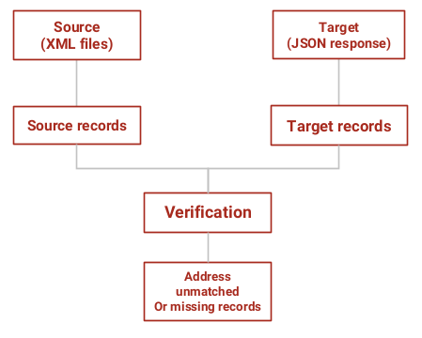
Block diagram of Proposed Solution

Slide 7
Functional Requirements
Source Side Data Module- Source data present in XML file was deserialized into POJO for verifying the field values in the record.
Target Side Data Module- The target data which has been migrated from the source into the BMC Digital Workplace is fetched in form of JSON response using Rest API. After the target data is fetched in JSON format, it is converted into POJO using GSON library.
Comparison of source and target data- Target data POJOs are stored in a hashmap with id field as key. Traverse through source data POJOs and for each object check if the corresponding target POJO has any missing or incorrect record.

Slide 8
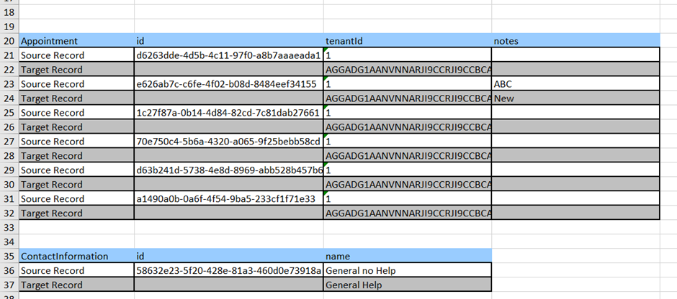
Output of unmatched Records

Slide 9
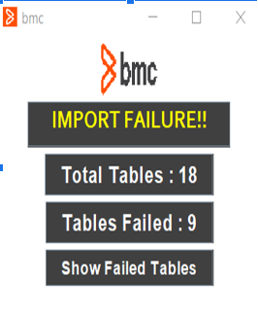
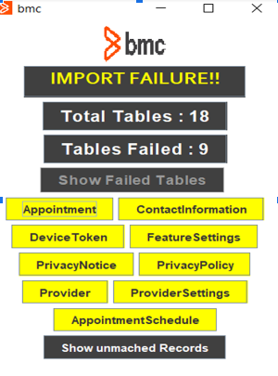
Writing unmatched records in Excel file – Apache POI library has been used for writing unmatched records from the java application into Excel file.
User interface module- UI has been created using java swing package. When the utility is run by the client, a window pops up which displays if the migration has been successful or not.

Slide 10
Creating shareable jar file from application- The user can run the utility application as a jar file along with an application.properties configuration file.
An application.properties file outside the jar is provided to include and update the table names, attributes, any user login details, mapping of values in source and target.
The file path from where the source Xml files are to be read is stored here and the excel file path where the unmatched records will be inserted is also specified here.
The user can update the configuration file is to update the table names and its attributes or any other changes in data specifications

Slide 11
Non Functional Requirement
Security- The utility created can fetch the data from the target only if the login credentials mentioned in the configuration file are valid. Else the target data cannot be fetched by the utility.
Usability- An executable jar file has been created for the utility. On running the jar file with the configuration file, a responsive UI pops up which displays if the migration has been successful.
Load Time- We tried to optimize our code so that the load time was less.

Slide 12
TECHNOLOGY USED
Backend Spring Boot framework
Java Programming language
REST API implemented using Jersey library
XML
JSON
GSON library
JAXB Unmarshaller
Apache POI library
Java Swing for UI
BMC Digital Workplace (target data)

Slide 13
Technical Skills Learnt in Internship
Spring Boot Framework
REST API architecture
Unmarshalling of XML data to POJOs
Deserialization of JSON objects to POJOs
Got exposure of working on a large codebase

Slide 14
Non Technical Skills
Learnt how to use virtual machine due to online internship
Improved my skills of working with a team
Learnt how to present my solution in meetings
Improved my technical content writing and documentation skills

Slide 15
Professional Growth
Got to explore enterprise level application development using Spring boot technology.
Improved my time management skills
Learnt how to give optimum solutions to the real word use cases and problems and will definitely be able to use this in my future career.
While doing this internship I learned the importance and usage of good coding practices and how to write clean code.

Slide 16
Conclusion
The internship has been an excellent and rewarding experience.
I got an insight into professional practice and learned the different facets of working within a large organization, time management and team work skills.
The internship was also good to find out what my strengths and weaknesses are.
This helped me to define what skills and knowledge I have to improve in the coming time and also, I got to know about the current trends and the technologies prevalent in the industry.
At last, this internship has given me new insights and motivation to pursue a career in technology.

Slide 17
Thank you!!

