Slide 1
Cloud Based Content Distribution Network
Prajakta Deosthali
Computer Networks
Notes:
Beg borrow steal

Slide 2
Application Requirements
Scalability
Interactivity
High Availability
Heterogeneity
Security
Quality Of Service
Notes:
Hetero – different devices

Slide 3
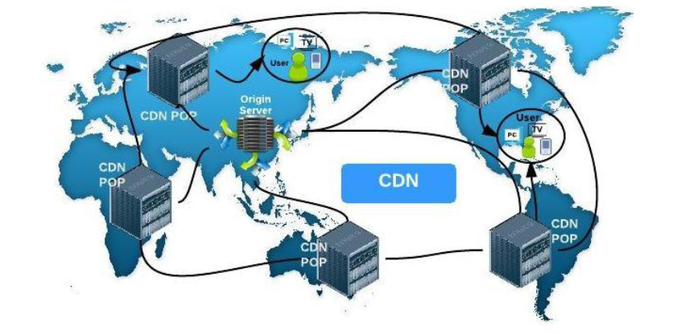
CDN

Slide 4
CDN disadvantages
No support for dynamic content
No content personalization
Inflexible cost model
Limited resource
No support for content creation

Slide 5
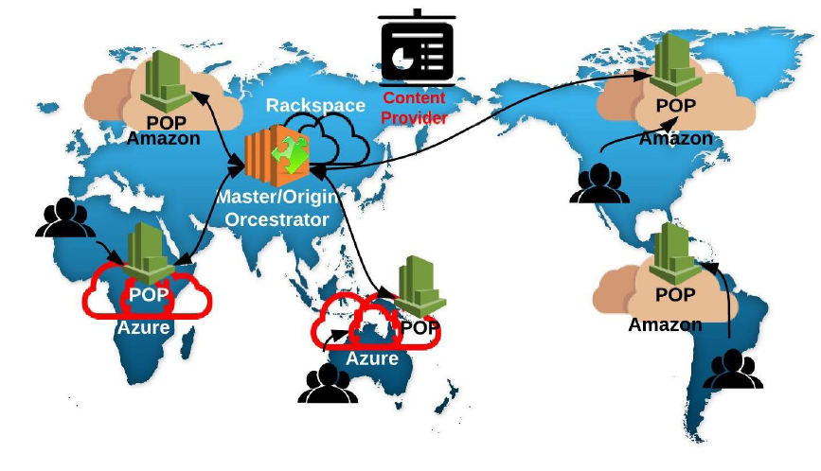
CCDN

Slide 6
Components of CCDN
Cloud orchestrator
It is the master server. It holds all the content and responds to request of slave servers.
Point Of Presence Servers
These are geographically distributed servers.
Part of CDN

Slide 7
Advantages of CCDN
Pay-as-you-go model
Virtual infinite resource
Support of cloud services
CCDN Interoperability
Increased Point of Presence
Content personalization

Slide 8
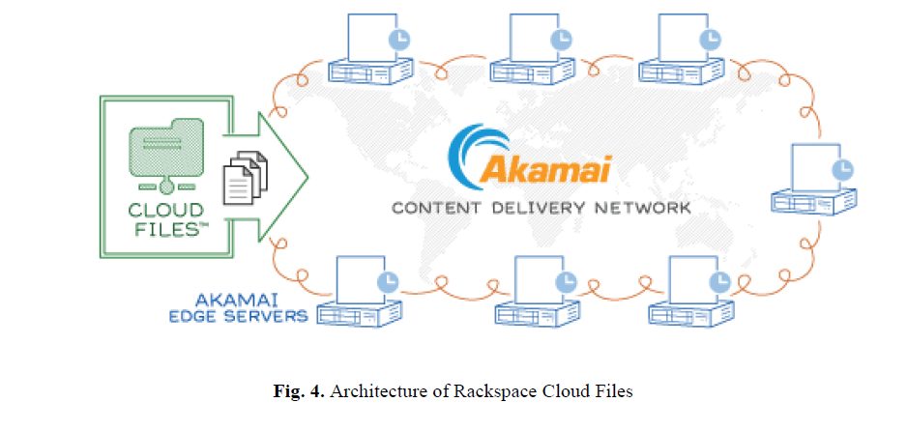
Rackspace Cloud Files

Slide 9
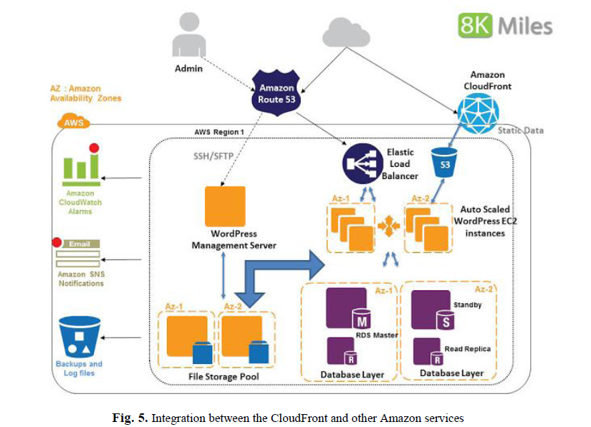
Amazon CloudFront

Slide 10
Road ahead
Support for dynamic content
Ability to create content
Security
Better management of hybrid clouds

