Slide 1

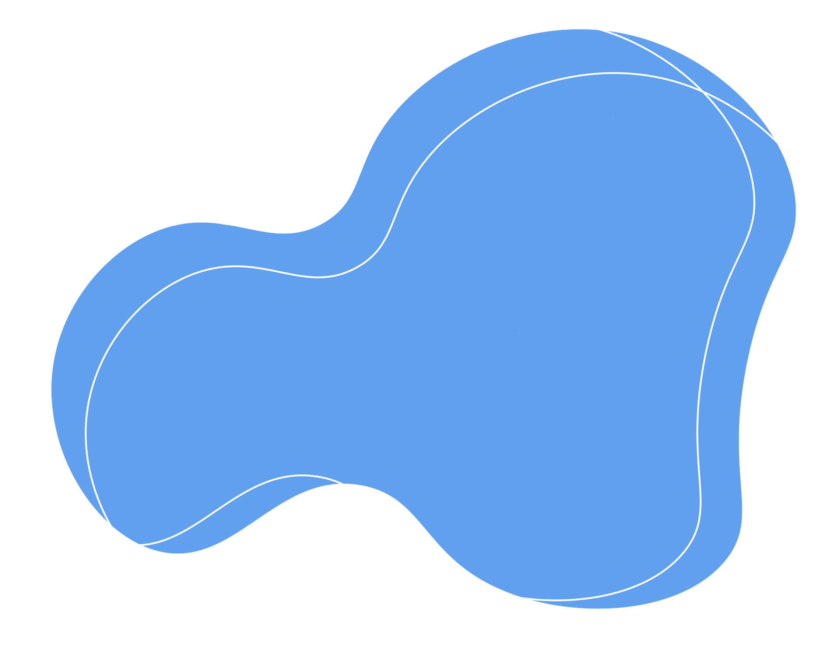


INTERNSHIP PROGRAM TASK 1
INTRODUCTION
TO JAVASCRIPT
BY PRAJAKTA PARE

Slide 2
WHAT WE WILL SEE?
INTRODUCTION TO JAVASCRIPT
SYNTAX & FIRST SCRIPT
HISTORY
SETUP: BROWSER & NODE.JS
COMMENTS

Slide 3

INTRODUCTION TO
JAVASCRIPT

Slide 4


INTRODUCTION
JavaScript is a high-level, interpreted programming language used to create interactive and dynamic web applications.
It runs directly in the browser and also on servers using Node.js.
Today, JavaScript is one of the most widely used programming languages in the world.

Slide 5
CREATION & EARLY DAYS
EVOLUTION & MODERN JAVASCRIPT
Created in 1995
Developed by Brendan Eich
Built in just 10 days
Originally named Mocha
Renamed to LiveScript → then JavaScript
Standardized as ECMAScript (ES)
Major update: ES6 (2015)
Introduced let, const, arrow functions, classes
Now used for frontend & backend (Node.js)
Continues to evolve yearly

Slide 6
FIRST SCRIPT IN JAVASCRIPT
let name = "Intern";
console.log("Hello " + name);

Slide 7
SYNTAX RULES
A JavaScript program is basically a collection of statements.
JAVASCRIPT IS CASE-SENSITIVE
STATEMENTS & SEMICOLON
let name = "John";
let Name = "Mike";
console.log(name); // John
console.log(Name); // Mike
let x = 5; // Statement 1
let y = 10; // Statement 2
console.log(x); // Statement 3
Everything inside { } is one block.
help explain the code and make it easier to understand and maintain.
CURLY BRACES { }
COMMENTS IN JAVASCRIPT
function greet() {
console.log("Welcome");
}
// Single line comment
/*
Multi-line
comment
*/

Slide 8
CLIENT-SIDE JAVASCRIPT
SERVER-SIDE JAVASCRIPT
Runs inside web browsers
Used for interactive web pages
Can access and modify HTML (DOM)
Examples: form validation, animations, buttons
Runs outside the browser
Used for backend/server development
Can access file system and databases
Used to build APIs and web servers

Slide 9
This is the starting point of learning JavaScript.
Thank you

