Slide 1
Name -Talole Prajakta Vijay
Batch -8th July :Data Science Foundation Course

Slide 2

Problem Statement
Develop a predictive model that assesses the claim probability for car insurance policies. The objective would be to understand the factors that influence claim frequency and severity in the period of six months and enable insurance companies to better assess risk and determine appropriate premiums for policyholders.

Slide 3
Dataset Columns
Policy_id: the unique identifier for each insurance policy.
Policy_tenure: the length of time (in years) that the policy has been active.
Age_of_car: the age of the insured car (in years) at the time the policy was taken.
Age_of_policyholder: the age of the policyholder (in years) at the time the policy was taken.
Area_cluster: a categorical variable representing the cluster or category to which the area of residence belongs.
Population_density: a measure of the population density of the area where the policyholder resides.
Make: the make or manufacturer of the insured car.
Segment: the segment or category to which the insured car belongs (e.G., Compact, sedan, SUV).
Model: the specific model or variant of the insured car.
Fuel_type: the type of fuel used by the insured car (e.G., Petrol, diesel, electric).

Slide 4
Max_torque: the maximum torque output of the car's engine.
Max_power: the maximum power output of the car's engine.
Engine_type: the type of engine used in the insured car (e.G., Inline, v-type).
Airbags: the number of airbags installed in the car.
Is_esc: a binary variable indicating whether the car has an electronic stability control (esc) system.
Is_adjustable_steering: a binary variable indicating whether the car has adjustable steering.
Is_tpms: a binary variable indicating whether the car has a tire pressure monitoring system (tpms).
Is_parking_sensors: a binary variable indicating whether the car has parking sensors.
Is_parking_camera: a binary variable indicating whether the car has a parking camera.

Slide 5
Rear_brakes_type: the type of rear brakes used in the car.
Displacement: the engine displacement of the car (typically measured in liters or cubic centimeters).
Cylinder: the number of cylinders in the car's engine.Transmission_type: the type of transmission used in the car (e.G., Manual, automatic).
Gear_box: the number of gears in the car's gearbox.
Steering_type: the type of steering system used in the car.
Turning_radius: the minimum radius of the circular path that the car can make.
Length: the length of the car.
Width: the width of the car.
Height: the height of the car.
Gross_weight: the gross weight or total weight of the car.

Slide 6
Is_front_fog_lights: A binary variable indicating whether the car has front fog lights.
Is_rear_window_wiper: a binary variable indicating whether the car has a rear window wiper.
Is_rear_window_washer: a binary variable indicating whether the car has a rear window washer.
Is_rear_window_defogger: a binary variable indicating whether the car has a rear window defogger.
Is_brake_assist: a binary variable indicating whether the car has a brake assist system.
Is_power_door_locks: a binary variable indicating whether the car has power door locks.
Is_central_locking: a binary variable indicating whether the car has central locking.

Slide 7
Is_power_steering: A binary variable indicating whether the car has power steering.
Is_driver_seat_height_adjustable: a binary variable indicating whether the driver's seat height is adjustable.
Is_day_night_rear_view_mirror: a binary variable indicating whether the car has a day/night rearview mirror
Is_ecw: A binary variable indicating whether the car has an electronic crash warning (ECW) system. ECW systems use sensors and algorithms to detect potential collisions and provide warnings to the driver.
Is_speed_alert: a binary variable indicating whether the car has a speed alert system. Speed alert systems typically monitor the vehicle's speed and provide warnings or alerts to the driver when they exceed a predetermined speed limit.
Ncap_rating- information about the safety rating of the car.
Is_claim-(target column)- 0- no, 1- yes

Slide 8
Steps taken in dataset analysis and model building
Importing necessary libraries.
Fetching information about the data.
Exploratory data analysis.
Dropping the un-necessary columns and fetching the categorical and numerical columns.
Outlier removal using numerical columns.
Use min-max scaler for scaling the numerical columns.
Use label encoder for categorical columns
Dropping the columns using correlation ,skewness and kurtosis.
Oversampling for the unbalanced dataset
Model building using different classification algorithms.
Hyperparameter tuning for random forest
Conclusion

Slide 9
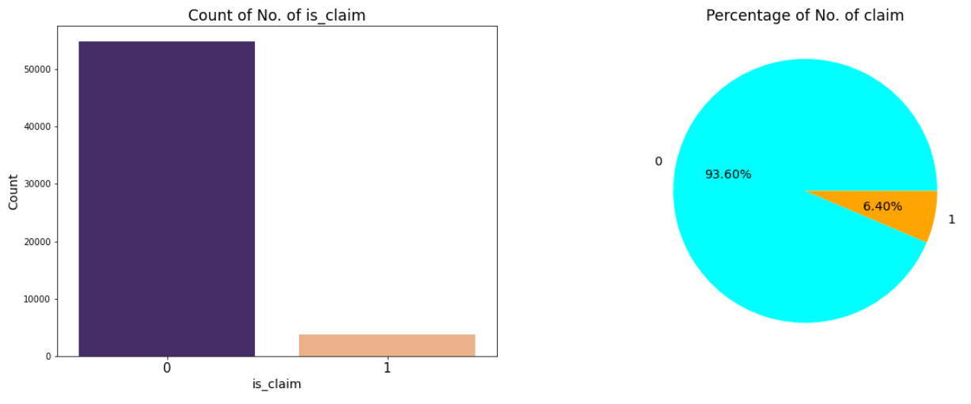
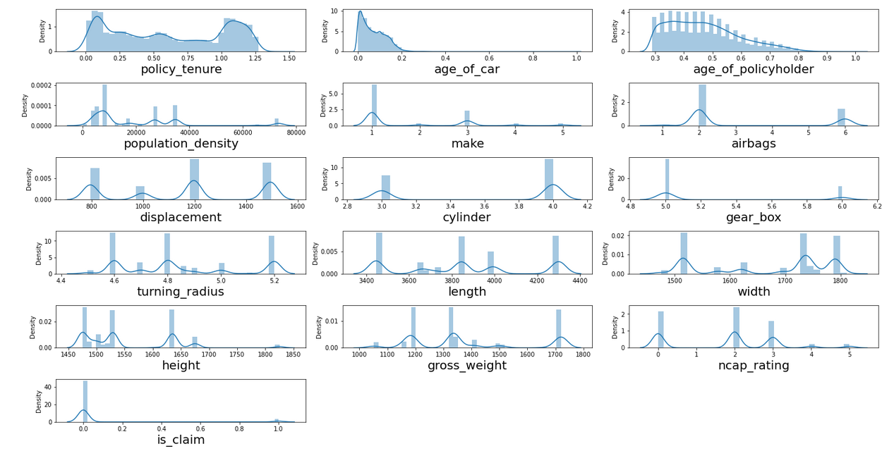
EDA :1) Target Variable : is_claim
2.Distribution of Numerical Columns

Slide 10
Graphs Used for Exploratory Data Analysis
Boxplot
Distribution Plot
Count Plot
Bar plot
Pie plot
Histogram plot
Heatmap

Slide 11
For Encoding : Label Encoder
For Scaling : Min-Max Scaler
Algorithms used :
1. Logistic Regression
2. Decision Tree
3.Random Forest
4.Bagging
5.Adaboost
6.GradientBoosting
7.XGBoost
8.Naive-Bayes
9.K-nearestNeighbor
10.Voting Classifier
11.Extra tree Classifier
12.Hyperparameter Tuning for Random Forest using Randomized Search CV.

Slide 12
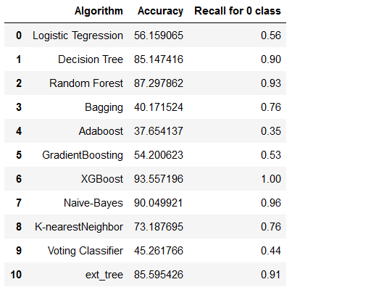
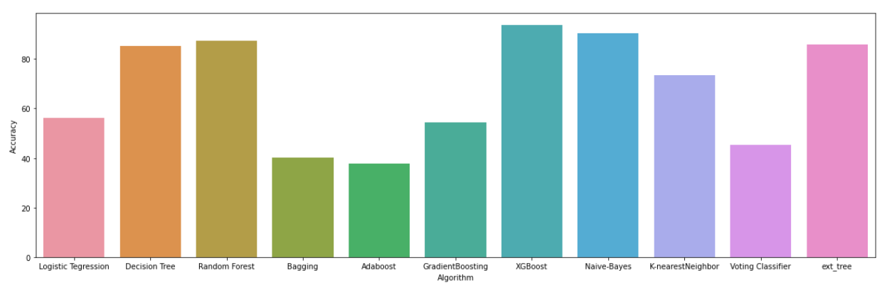
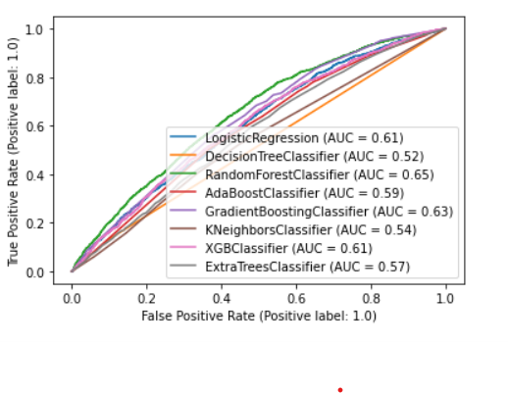
Conclusion

Slide 13
1.From The above slide we can say that Random Forest Classifier ,Decision Tree and Naïve Bayes Classifiers are giving highest good Accuracy .
2. Also the same Algorithms are giving Good recall for the class 0.
So we can say that we can use any of the model by using hyperparameter tuning for the prediction in this Insurance Claim Dataset.

Slide 14
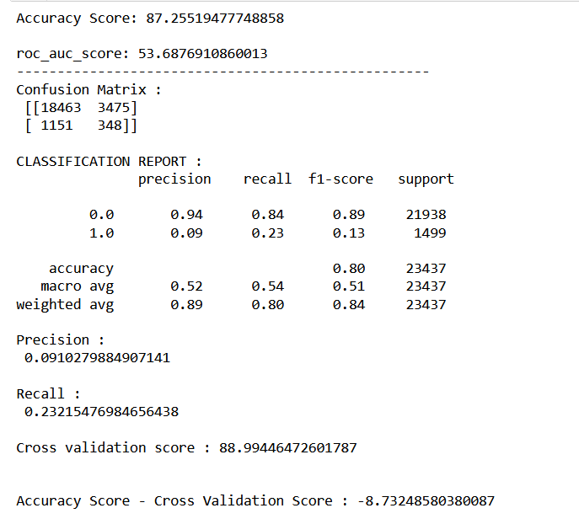
Hyperparameter Tuning for Random Forest Using Randomizerd Search CV gives following Report :
Class 0 recall value is 84 %

Slide 15
Best Algorithm For Prediction : Random Forest
Thank You

