Slide 1
Data Science :
Is an interdisciplinary field which uses statistics ,maths,algorithms to extract information
from structured and unstructured data and uses this information for business descision.

Slide 2
DS ====> Maths ,stats ,Programming ,Domain knowledge.
Structured data ===> Tabular format ====>df
Unstructured data ====>File ,Website ,notebook, Text ,Audio ,Video ,Image
TeXt Audio==>NLP
Image ,Video===>computer vision.

Slide 3
Machine Learning :
Machine learning is a subset of AI, which enables the machine to automatically learn from data, improve performance from past experiences, and make predictions.
Machine learning contains a set of algorithms that work on a huge amount of data. Data is fed to these algorithms to train them, and on the basis of training, they build the model & perform a specific task.

Slide 4
Based on the methods and way of learning, machine learning is divided into mainly four types, which are:
Supervised Machine Learning
Unsupervised Machine Learning
Semi-Supervised Machine Learning
Reinforcement Learning

Slide 5
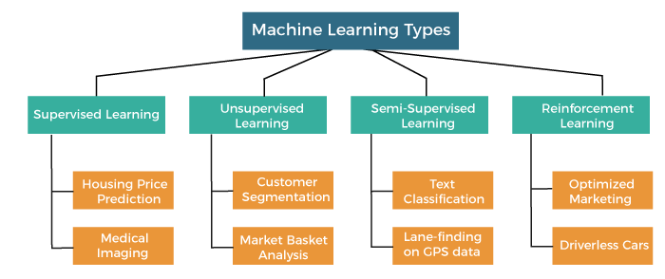

Slide 6
. Supervised Machine Learning
As its name suggests, Supervised machine learning is based on supervision. It means in the supervised learning technique, we train the machines using the "labelled" dataset, and based on the training, the machine predicts the output. Here, the labelled data specifies that some of the inputs are already mapped to the output. More preciously, we can say; first, we train the machine with the input and corresponding output, and then we ask the machine to predict the output using the test dataset.

Slide 7
The main goal of the supervised learning technique is to map the input variable(x) with the output variable(y). Some real-world applications of supervised learning are Risk Assessment, Fraud Detection, Spam filtering, etc.
Categories of Supervised Machine Learning
Classification
Regression

Slide 8
a) Classification
Classification algorithms are used to solve the classification problems in which the output variable is categorical, such as "Yes" or No, Male or Female, Red or Blue, etc. The classification algorithms predict the categories present in the dataset. Some real-world examples of classification algorithms are Spam Detection, Email filtering, etc.
Random Forest Algorithm
Decision Tree Algorithm
Logistic Regression Algorithm
Support Vector Machine Algorithm

Slide 9
b) Regression
Regression algorithms are used to solve regression problems in which there is a linear relationship between input and output variables. These are used to predict continuous output variables, such as market trends, weather prediction, etc.
Some popular Regression algorithms are given below:
Simple Linear Regression Algorithm
Multivariate Regression Algorithm
Decision Tree Algorithm
Lasso Regression

Slide 10
2. Unsupervised Machine Learning
Unsupervised learning is different from the Supervised learning technique; as its name suggests, there is no need for supervision. It means, in unsupervised machine learning, the machine is trained using the unlabeled dataset, and the machine predicts the output without any supervision.
In unsupervised learning, the models are trained with the data that is neither classified nor labelled, and the model acts on that data without any supervision.

Slide 11
The main aim of the unsupervised learning algorithm is to group or categories the unsorted dataset according to the similarities, patter
Unsupervised Learning can be further classified into two types, which are given below:
Clustering
Association

Slide 12
1) Clustering
The clustering technique is used when we want to find the inherent groups from the data. It is a way to group the objects into a cluster such that the objects with the most similarities remain in one group and have fewer or no similarities with the objects of other groups. An example of the clustering algorithm is grouping the customers by their purchasing behaviour.

Slide 13
Some of the popular clustering algorithms are given below:
K-Means Clustering algorithm
Mean-shift algorithm
DBSCAN Algorithm
Principal Component Analysis
Independent Component Analysis

Slide 14
2) Association
Association rule learning is an unsupervised learning technique, which finds interesting relations among variables within a large dataset. The main aim of this learning algorithm is to find the dependency of one data item on another data item and map those variables accordingly so that it can generate maximum profit. This algorithm is mainly applied in Market Basket analysis, Web usage mining,
Some popular algorithms of Association rule learning are Apriori Algorithm, Eclat, FP-growth algorithm.

