Slide 1
MACHINE LEARNING CAPSTONE · REGRESSION
Crop Yield Intelligence
Predicting district-level crop yield across India to spot high- and low-productivity
districts before the season's outcome is known.
7
112
80
49,170
STATES
DISTRICTS
CROPS
RECORDS
1997 – 2014 · Government of India Open Data Platform

Slide 2
01 · BUSINESS PROBLEM
Yield varies district by district —
planners find out only after the season
Target Users
The Gap
The Outcome
The Value
Agriculture departments, crop insurers, agri-input companies, and farmer-advisory services.
Crop yield varies widely by district, crop, and season — with no early warning before harvest.
A district × crop × season yield estimate that flags likely under-performers early.
Better-targeted subsidies and evidence-based planning — business value and social value together.
02

Slide 3
02 · DATA COLLECTION
One dataset, one hard rule
Source
District-wise, Season-wise Crop Production Statistics
Government of India Open Data Platform
THE ONE RULE
Yield = Production ÷ Area
Scale
Production is the target's own ingredient — so Production is never fed to the model as an input. Using it would leak the answer directly into the features.
49,784 raw records → 49,170 after cleaning
1997 – 2014 · 7 states · 112 districts · 80 crops
Zero missing values, zero duplicates — 109 zero-production rows removed
Features used instead: State, District, Crop, Season, Year, Cultivated Area, and engineered historical-yield features.
03

Slide 4
03 · DATA QUALITY & PREPROCESSING
Cleaning decisions, each with a reason
Type correction
Year → int; categorical fields trimmed & cast to string
Invalid records dropped
Area ≤ 0 or Production < 0 removed (109 rows)
Target recomputed
Yield = Production ÷ Area, calculated fresh — not trusted from source
Per-crop outlier capping
±3×IQR computed separately per crop — yield scale differs hugely by crop type
Leakage columns dropped
Production and the source Yield column excluded entirely
Net effect: 1.23% of rows removed, all justified above
04

Slide 5
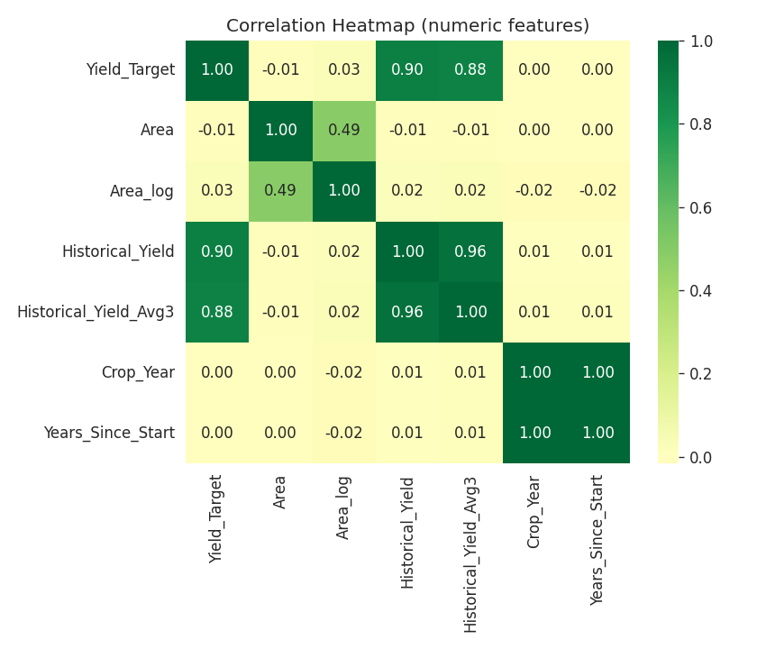
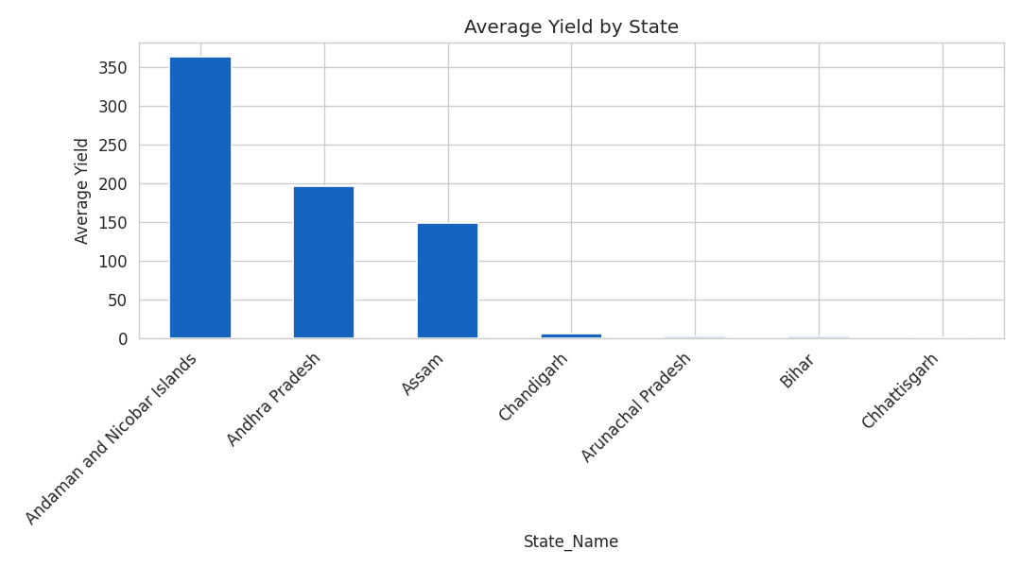
04 · EXPLORATORY DATA ANALYSIS
Past performance beats field size
Historical_Yield correlates with the target at r ≈ 0.90 — while raw cultivated Area barely correlates at all. Past performance, not scale, drives yield.
05

Slide 6
05 · FEATURE ENGINEERING
Built from the past, safely
Historical_Yield
Historical_Yield_Avg3
Area_log
Years_Since_Start
Lag-1 yield for the same State + District + Crop + Season
Trailing 3-year average yield for the same combination
log(1+Area) — tames the heavy right-skew in cultivated area
Linear year-trend feature
Leakage-safe fill: ~11% of rows lack history (first year a combination appears). These are filled using TRAINING-SET-ONLY crop averages, computed after the train/test split — so no future information leaks backward.
06

Slide 7
06 · VALIDATION STRATEGY
Split by time, not at random
TRAIN · 1997 – 2011 · 40,021 rows
TEST
2012–14
9,149 rows
Why not a random split?
Historical_Yield is a lag feature — a random split would let future years leak into earlier ones
Preprocessing (scaling, one-hot encoding) fit ONLY on the training fold via sklearn Pipeline + ColumnTransformer
3-fold cross-validation on the training set adds a stability check alongside the single held-out test score
07

Slide 8
07–09 · MODEL DEVELOPMENT & EVALUATION
Ten models, tested honestly
08

Slide 9
07–09 · MODEL DEVELOPMENT & EVALUATION
Two honest findings worth keeping
AdaBoost failed
Tuning didn't win
Cross-validated R² = −3.47 — a negative score. Its default weak learners and loss weighting are poorly suited to this heavy-tailed, high-cardinality target.
RandomizedSearchCV tuned LightGBM and Random Forest on training-only CV. Neither tuned config beat the untuned LightGBM baseline (0.855) on the test set.
It was tested per the assignment's algorithm list, but correctly NOT selected — models were chosen for suitability, not to force a result.
The pipeline automatically keeps whichever model performs best — so the baseline was retained as final, reported as-is rather than forcing an 'improvement'.
09

Slide 10
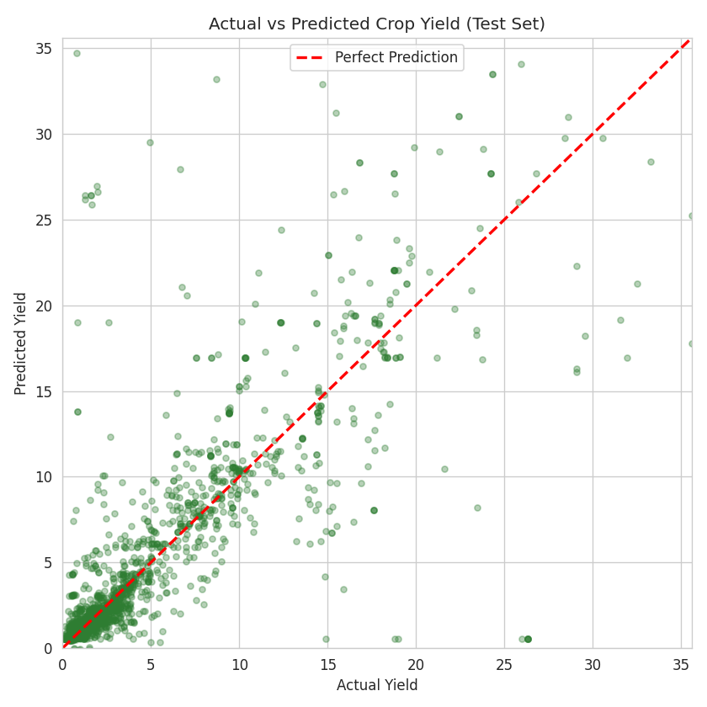
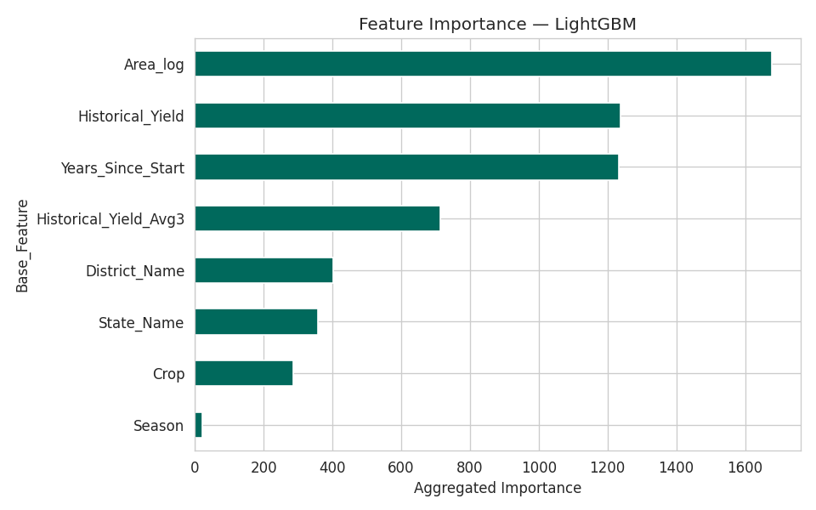
10 · FINAL MODEL
LightGBM — the model in production
0.855
384.2
30.6
0.108
TEST R²
TEST RMSE
TEST MAE
OVERFIT GAP
10

Slide 11
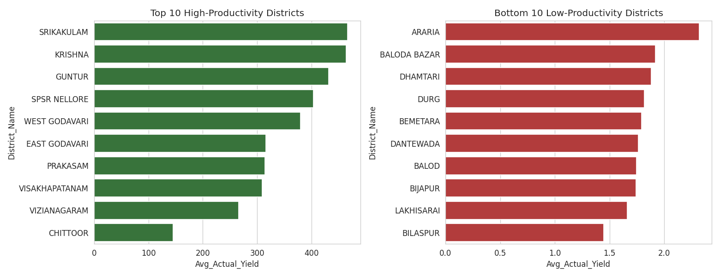
11 · PREDICTION & INTERPRETATION
High- and low-productivity districts
11

Slide 12
12 · RESPONSIBLE AI & ETHICS
What the model shouldn't be trusted for
No sensitive data
Bias disclosed
Not a guarantee
Only aggregated, public agricultural statistics — no personal information.
Error varies by state, mostly driven by how many historical records exist per state — disclosed, not hidden.
Predictions are a planning aid, not a certified yield outcome — never used to unilaterally deny support.
12

Slide 13
13–14 · CONCLUSION & FUTURE WORK
Past performance is the strongest signal we have
The final LightGBM model (Test R² = 0.855) confirms district-crop-season history predicts near-term yield better than any structural feature alone.
Limitations
Future Work
New crop-district combos fall back to a crop average
Coconut & similar crops use non-tonne units, inflating some districts
Add rainfall & soil-quality data
Model unit-mismatched crops separately
Add prediction intervals via quantile regression
Dashboard · Notebook · Full pipeline — all reproducible via requirements.txt

