Slide 1

StudyHub
Technical Project Report
StudyHub
A Premium AI-Powered Learning Management System
Date: 21/08/2026
Name of the Presenter: Prajapati Dev
Email Id: 25smc04007@gsfcuniversity.ac.in
Mobile No.: 7984683571

Slide 2
StudyHub
Problem Statement & Innovation
Study materials are scattered across WhatsApp, Google Drive, email, and physical notes.
No centralized, structured platform for university-level academic content management.
Students lack personalized AI help — dependent on teacher availability for doubt-clearing.
No performance tracking: students can't measure their own progress or study consistency.

Slide 3
StudyHub
Project Overview & Elevator Pitch
StudyHub is a premium AI-powered Learning Management System (LMS) built for Universities and Schools .
Designed for M.Sc. Data Science students — bridging the gap between teachers and students.
Solves fragmented study resources: Centralizes PDFs, videos, notes, PYQs and AI tutoring.
Built with React 18 + Vite (Frontend), Django REST Framework (Backend), PostgreSQL (Database)
Key differentiator: Integrated Google Gemini AI with RAG — answers only from uploaded materials.
Gamification (streaks, badges, XP levels) ensures long-term student engagement and motivation.
Current scope: 12 students, 1 admin, M.Sc. Data Science — Phase 1 of a 6-phase roadmap.

Slide 4
StudyHub
Proposed Solution & Current Status
Frontend: React 18 + Vite with 'Glassmorphic' aesthetic, custom theme engine, micro-animations.
Backend: Django REST Framework (DRF) with JWT authentication, PostgreSQL for data storage.
AI Engine: Google Gemini API + RAG (Retrieval-Augmented Generation) — material-aware chatbot.
Content hierarchy (Course→Subject→Topic→Material) with public/private access control.
Analytics dashboard: performance graphs, study streak tracking, AI interaction history.
Trash/CMS system: multi-select bulk restore/delete for material management by admins.
2FA (TOTP + backup codes), Password History, Login Activity tracking for security.

Slide 5
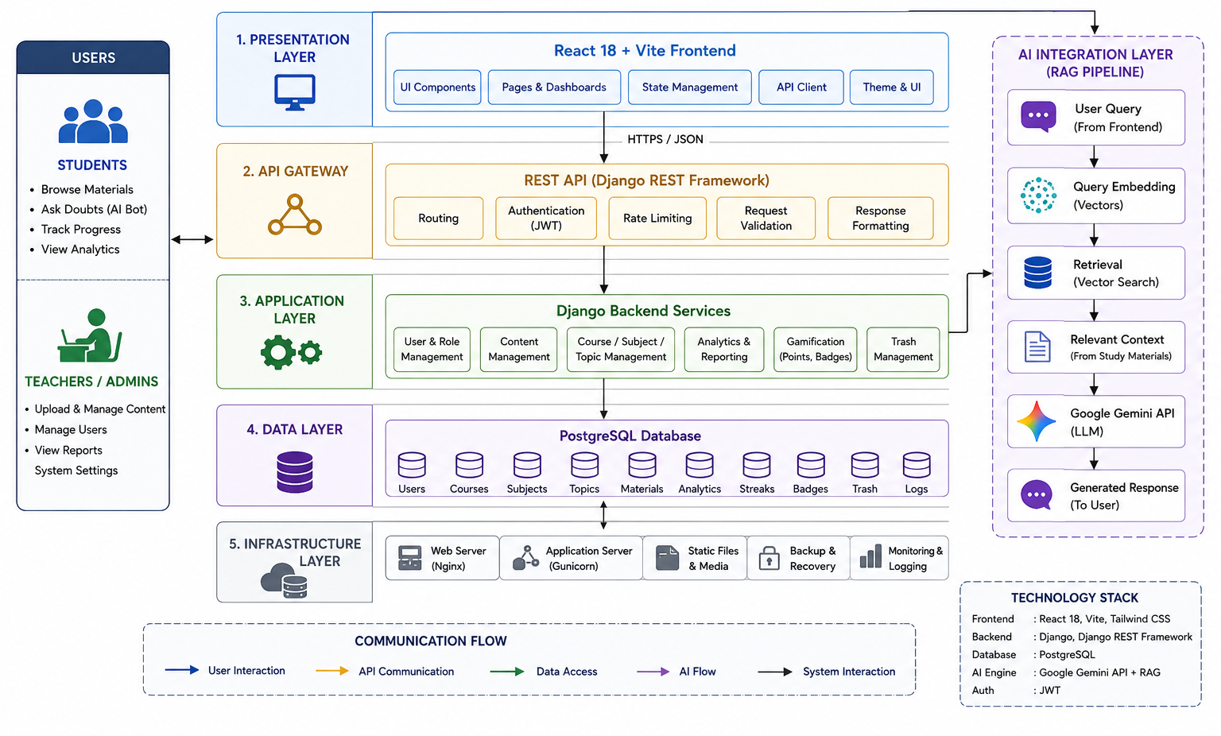
StudyHub
Technical Architecture

Slide 6
StudyHub
Key Features & Product Description
Authentication: JWT login, 2FA (TOTP), session management, auto-credential caching.
CMS (Content Management): Admins upload PDFs, videos, links; 4-level academic hierarchy.
AI Study Bot: Ask questions from study material; auto-generated summaries, memory tricks.
Analytics & Insights: Score trends, daily logs, streak tracking, level progression graphs.
Gamification: XP points, badge system (Fast Learner, Consistent Scholar), study levels.
Focus Mode: Distraction-free study sessions with session logs.
Assessments: Teacher-created objective tests; AI auto-grading with score feedback.

Slide 7
StudyHub
Value Proposition
AI-First: Gemini-powered RAG bot answers from actual uploaded content — not generic internet.
All-in-one: Study materials + Tests + AI tutoring + Gamification in a single platform.
Premium UX: Glassmorphic design with micro-animations — feels like a consumer app, not a tool.
Structured Learning: Course→Subject→Topic hierarchy replaces chaotic folder/WhatsApp groups.
Data-Driven: Real-time performance analytics help students identify weak areas.
Admin Efficiency: Bulk upload, visibility control, student management in one dashboard.
Differentiator
Material-grounded AI (RAG) - not just ChatGPT but a subject-specific tutor.
University-grade security with RBAC, 2FA, and immutable audit logs.
Gamification layer that drives daily engagement and study streaks.
Offline-ready architecture planned for future phases.

Slide 8
StudyHub
User Validation & Target Audience
Deployed for 12 M.Sc. Data Science students (Previous Year & Final Year cohorts).
1 Admin (Professor/Teacher) actively managing materials and tests.
Real academic content uploaded: PDFs, Notes, PYQs, Practice Questions.
Student feedback loop - streaks and badge system validated for engagement.
AI bot tested with actual course material for Q&A accuracy via RAG.
Market Opportunity
Target: Universities, colleges, coaching institutes, and K-12 schools.
Phase 1: GSFC University - 12 students, 1 admin.
Phase 2-3 : Multi-university rollout, school categories (Nursery → Higher Secondary).
Phase 4-6 : Competitive exam prep (JEE, NEET, GATE), external courses with certificates.
Educational Institutions are primary customers.

Slide 9
StudyHub
Competitive Landscape
Platform | Main Focus | AI Capability | LMS Capability | Key Differentiator
Google Classroom | Classroom Management | Advanced | Strong | Google ecosystem
Moodle / Canvas | Enterprise LMS | Integrated | Very Strong | Customization & scalability
ChatGPT / Claude | AI Learning | Very Advanced | Not an LMS | AI tutoring & reasoning
Gemini | AI + Education | Very Advanced | Partial | Google AI ecosystem
Coursera | Online Learning | Advanced | Strong | Courses & certifications
StudyHub | Institutional AI Learning | Advanced | Strong | RAG + Analytics + Focus + Tests + Gamification

Slide 10
StudyHub
Project Roadmap & Development Phases
Phase 1 (Current): M.Sc. Data Science, GSFC University - 12 students, 1 admin
Phase 2: Multi-admin support + additional university courses.
Phase 3: School categories - Nursery, Primary, Secondary, Higher Secondary.
Phase 4: Competitive exam prep - JEE, NEET, GATE modules.
Phase 5: External/Extra courses with Certificate + 100% fee refund program.
Phase 6: Scale to multiple universities and schools across India.

Slide 11
Conclusion
StudyHub is an AI-powered institutional learning platform designed to bring academic materials, AI assistance, assessments, analytics, focus tools, and gamification into one platform.
Unlike a traditional LMS or standalone AI tool, StudyHub focuses on connecting the university's curriculum and learning data with AI to create a more personalized and engaging learning experience.
Next Steps
Complete core LMS features
Improve AI & RAG
Enhance learning analytics
Integrate Google Classroom
Pilot StudyHub at GSFC University
Collect feedback & improve

Slide 12
Thank You..

