Slide 1
SOFT COMPUTING · FUZZY LOGIC
Student Performance
Prediction Using
Fuzzy Logic
A Case Study Based on Fuzzy Logic
Use a Fuzzy Inference System to evaluate and predict academic performance.

Slide 2





THE INPUT PROBLEM
Student performance depends on more than one mark
Student Factors
Fuzzy Logic System
Predicted Performance
→
→
Attendance, internal or exam marks, assignments, and study habits can influence outcomes. Traditional evaluation can struggle with uncertain or qualitative factors.
Fuzzy logic represents human-like categories such as low attendance, good marks, and high study time.
02

Slide 3
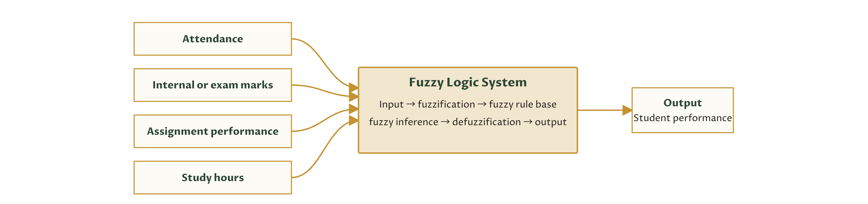
THE PROPOSED MODEL
The proposed model turns mixed inputs into one performance category
03

Slide 4
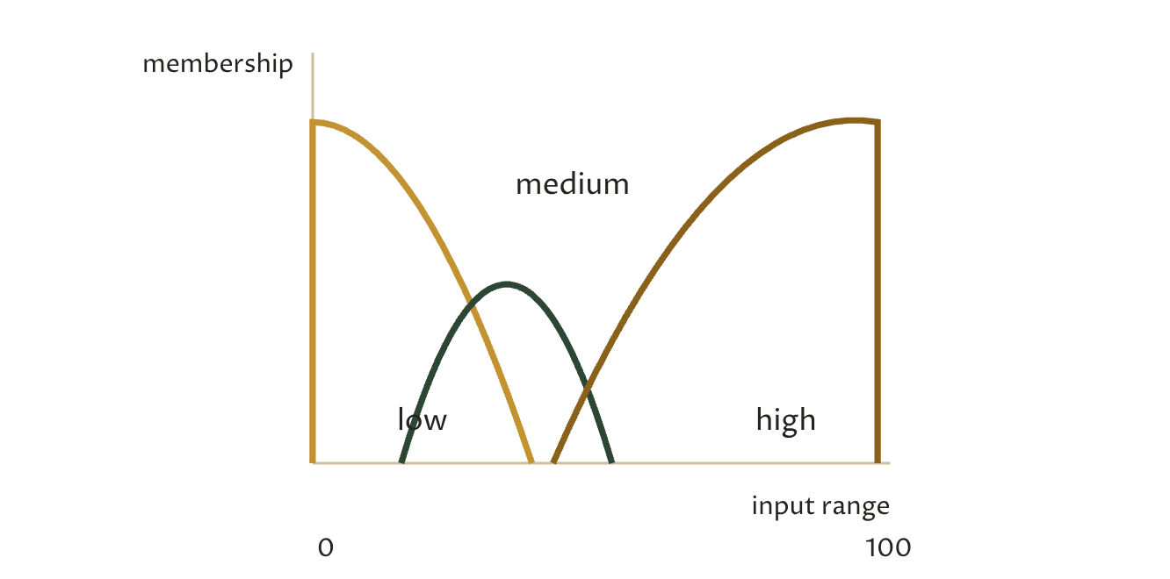
THE RULE BASE
Rules translate academic signals into interpretable decisions
MEMBERSHIP CATEGORIES
Attendance: low / medium / high · Marks: poor / average / good · Study hours: low / medium / high
PERFORMANCE CATEGORIES
Poor / average / good / excellent
Overlapping membership functions let one input belong partly to neighboring categories.
IF attendance is high AND marks are good THEN performance is excellent.
IF attendance is medium AND marks are average THEN performance is average.
IF attendance is low AND marks are poor THEN performance is poor.
IF study hours are high AND marks are good THEN performance is excellent.
04

Slide 5
ILLUSTRATIVE CASE STUDY
An illustrative case study shows how the categories combine
IMPORTANT LABEL
Illustrative case-study data, not actual experimental data from the research paper.
Student | Attendance | Marks | Study Hours | Predicted Performance
A | High | Good | High | Excellent
B | Medium | Average | Medium | Average
C | Low | Poor | Low | Poor
D | High | Average | High | Good
The fuzzy system combines linguistic input categories through rules and maps the result to a performance category.
05

Slide 6

TAKEAWAY
Fuzzy logic makes performance prediction explainable
Handles uncertainty and linguistic variables effectively; evaluates several academic factors together.
Rule-based decisions are easy to interpret and discuss; can help identify students who may need additional academic support.
Future scope: use real student datasets; add previous-semester performance and participation; build a web or mobile system; compare with machine-learning models.
Reference: “Development of Fuzzy Logic Based Student Performance Prediction System.”
Thank You
Academic support remains a practical future use.

