Slide 1
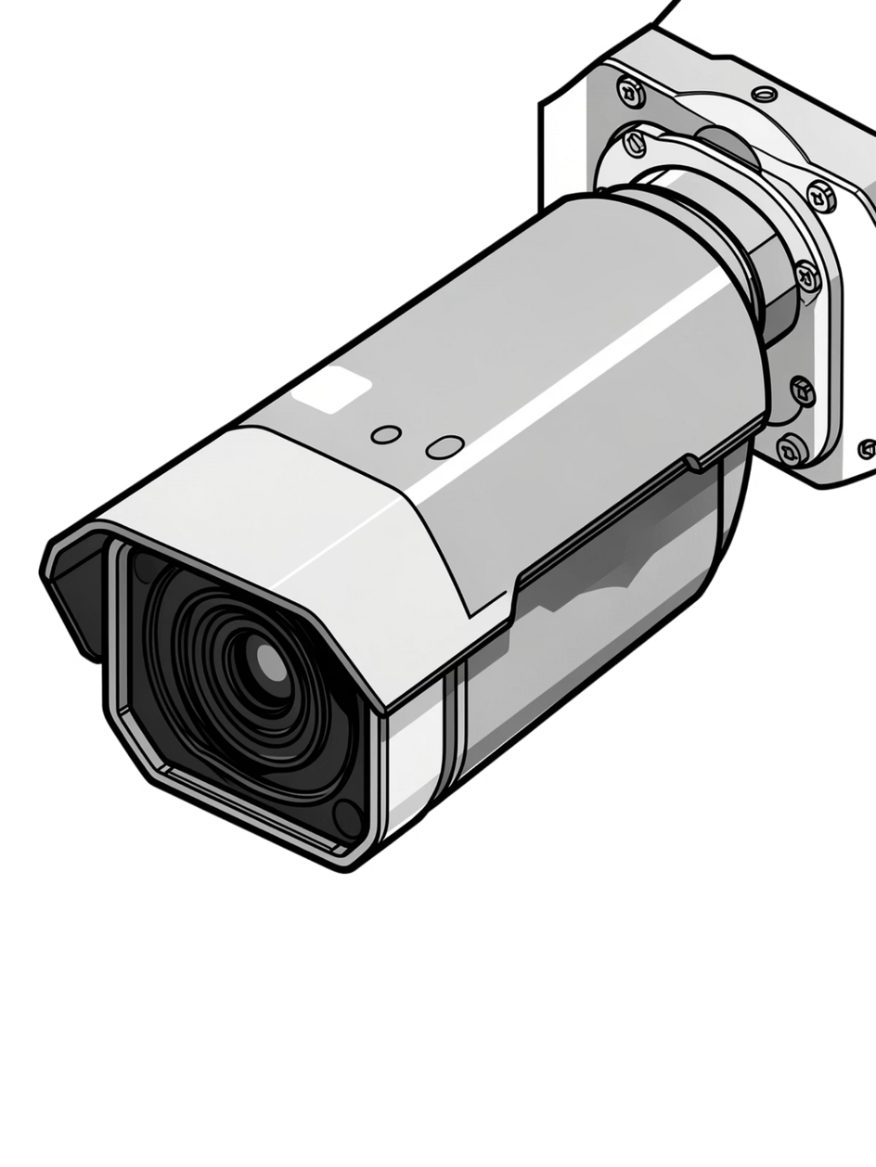

ClarityAI: Redefining Forensic Video Intelligence
An AI-powered forensic enhancement platform that transforms degraded CCTV footage into court-admissible evidence through advanced super-resolution and facial reconstruction techniques.
Notes:
1

Slide 2
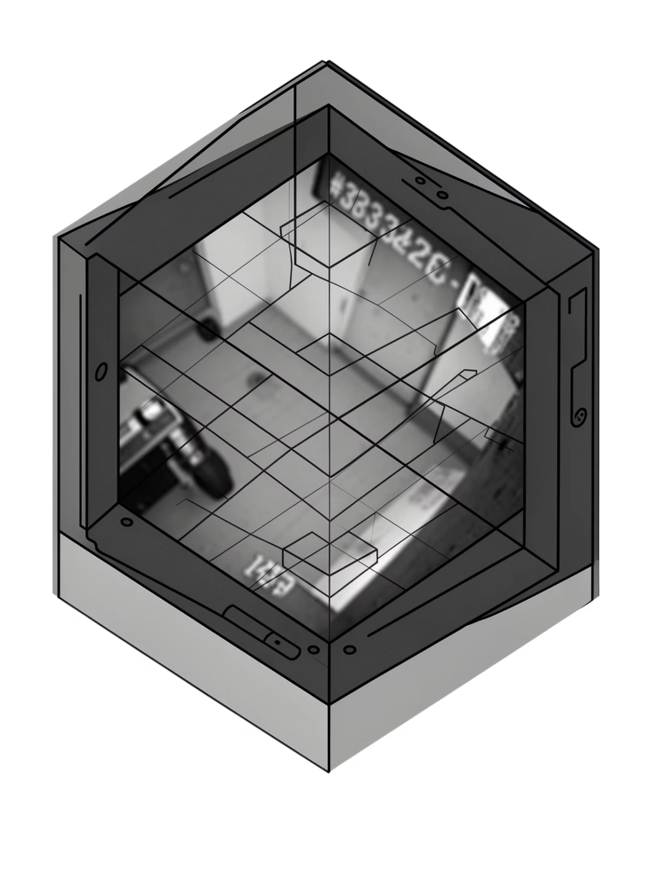
The Forensic Gap: Traditional CCTV Limitations
Critical Challenges
Operational Impact
Severe motion blur from fast-moving subjects
Sub-SD resolutions (320x240 and below)
Extreme pixelation from digital zoom
Noise corruption from low-light sensors
Without clear visual evidence, investigations stall. Traditional enhancement software cannot recover lost high-frequency detail—creating a critical gap between what cameras capture and what investigators need.
Notes:
2

Slide 3




The ClarityAI Solution
An end-to-end enhancement pipeline combining state-of-the-art deep learning models to reconstruct forensic-grade video from severely degraded source material.
Input Processing
Super-Resolution
Adaptive frame extraction with intelligent sampling rates
RealESRGAN x2/x4 upscaling with texture hallucination
Face Restoration
Evidence Extraction
GFPGAN v1.4 facial feature reconstruction
YOLOv8 detection + EasyOCR text recovery
Notes:
3

Slide 4
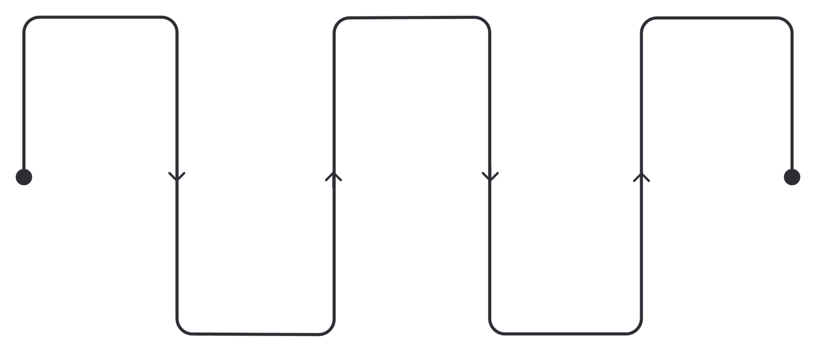
System Architecture: The Enhancement Pipeline
Input Video
RealESRGAN Upscaling
Enhanced Output
Source feeds (H.264, H.265, MJPEG)
Progressive x2/x4 super-resolution
High-quality restored frames
Frame Extraction
GFPGAN Restoration
Smart sampling of key frames
Face-aware enhancement
Stage 1: Frame Extraction
Stage 2: RealESRGAN Upscaling
Stage 3: GFPGAN Restoration
Stage 4: Output Generation
Smart sampling identifies key frames while minimizing redundant processing. Handles multiple codecs (H.264, H.265, MJPEG).
Progressive x2 or x4 super-resolution with texture hallucination. Recovers high-frequency details through deep feature learning.
Blind face restoration reconstructs identifiable features from severely degraded pixels using facial priors.
Lossless encoding preserves enhancement quality. Metadata embedding for chain-of-custody documentation.
Notes:
4

Slide 5
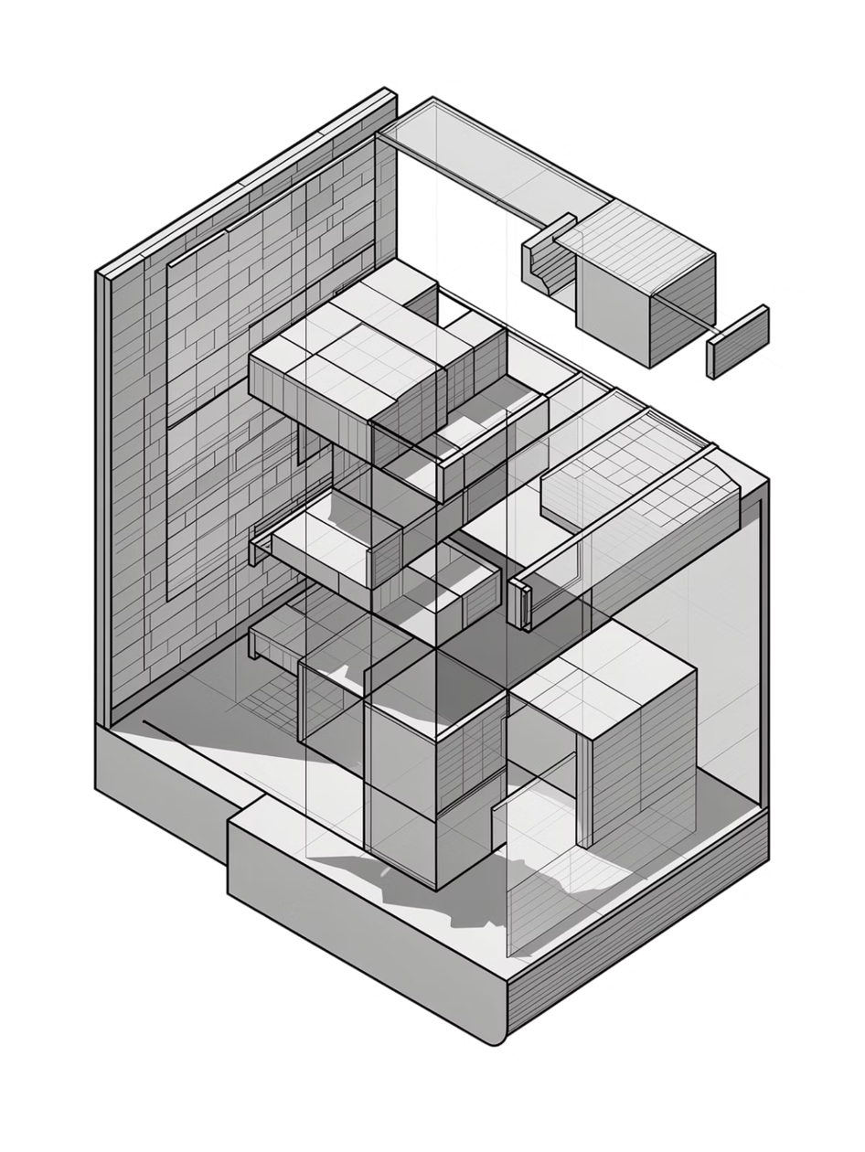
Super-Resolution Engine: RealESRGAN
Architecture
GAN-based network with U-Net skip connections and residual-in-residual dense blocks for multi-scale feature extraction
Upscaling Factors
Configurable x2 or x4 magnification with adaptive noise suppression and texture generation from learned priors
Texture Hallucination
Generates realistic high-frequency details by learning from millions of high-resolution image pairs in training
Notes:
5

Slide 6
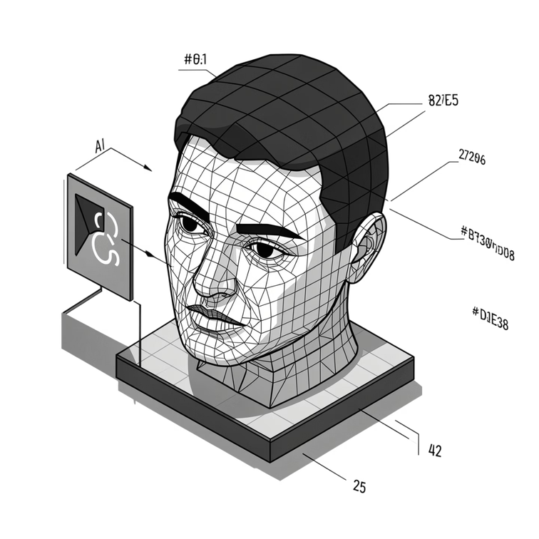
Blind Face Restoration: GFPGAN v1.4
Technology Overview
GFPGAN (Generative Facial Prior GAN) leverages facial priors learned from massive datasets to reconstruct identifiable features from heavily degraded pixels.
Key Capabilities
Age-invariant facial structure recovery
Illumination normalization across frames
Identity-preserving feature reconstruction
Artifact suppression while preserving details
Notes:
6

Slide 7



Automated Evidence Extraction
YOLOv8 Detection
EasyOCR Integration
Metadata Export
Real-time object detection identifies license plates, vehicles, and persons of interest with 85%+ accuracy across varied lighting conditions.
Scene text recovery extracts alphanumeric sequences from license plates, signage, and documents visible in frame.
Structured JSON output with timestamps, coordinates, and confidence scores for evidentiary documentation.
Notes:
7

Slide 8
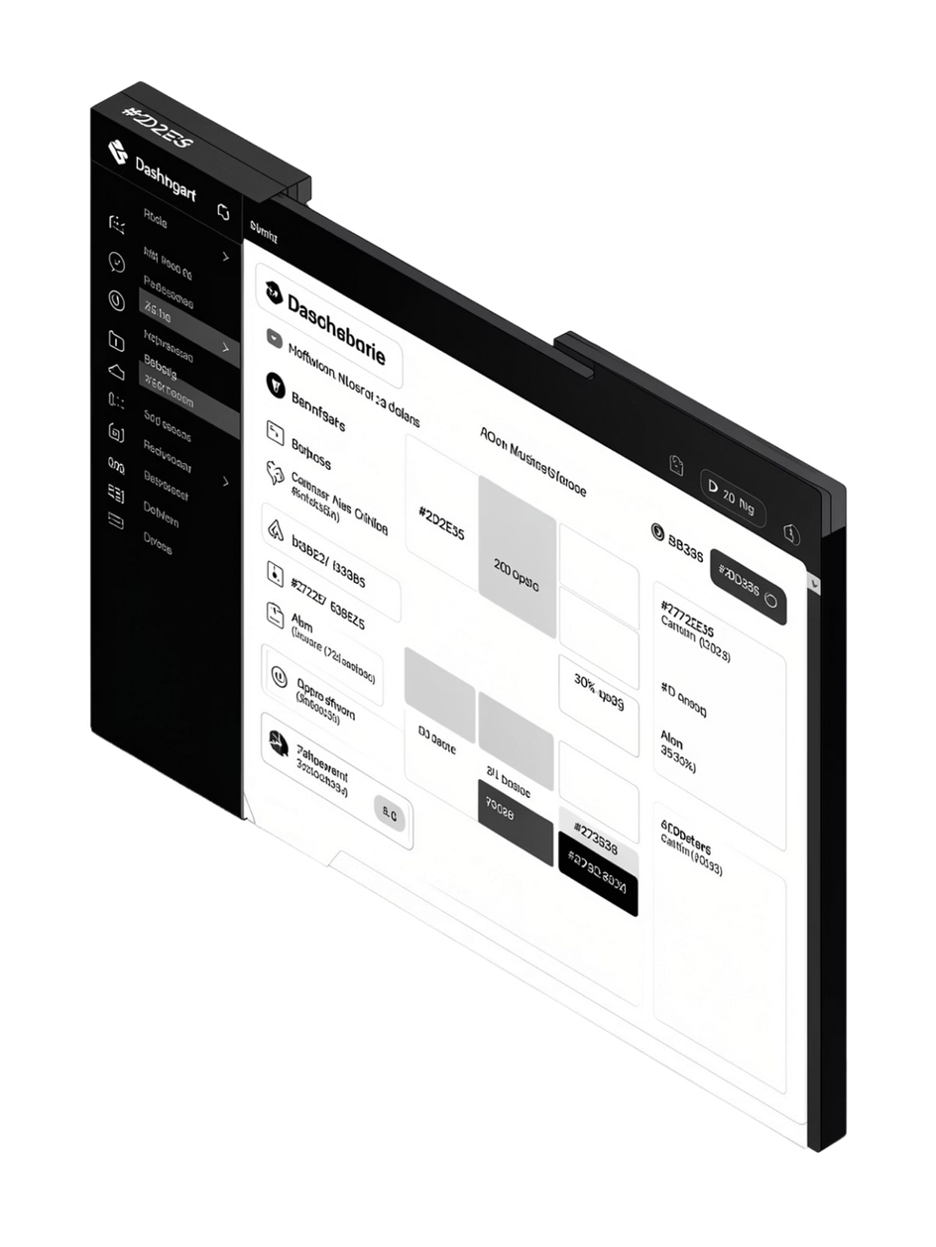

Interactive User Experience
01
02
ROI Selection Tool
Next.js Dashboard
Click-and-drag region of interest targeting specific frame areas for selective enhancement prioritization
Web-based interface with real-time progress monitoring, batch processing queues, and export management
03
Quality Presets
Configurable profiles balancing speed versus fidelity: Draft (fast), Standard (balanced), Forensic (maximum detail)
Notes:
8

Slide 9
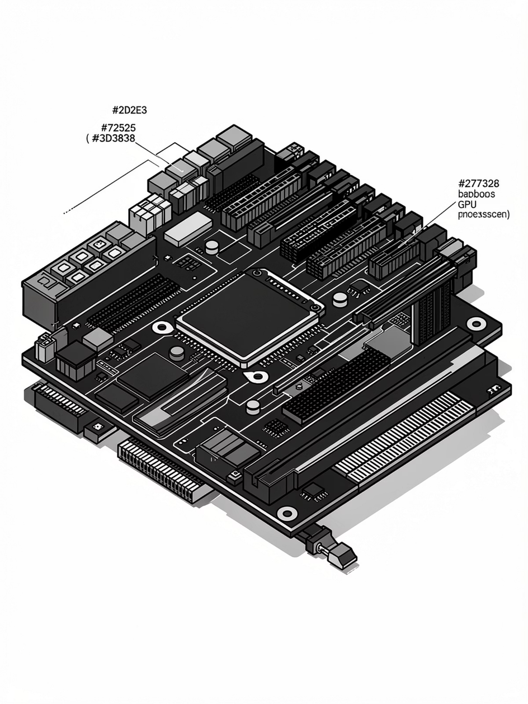
Performance & VRAM Management
GPU Acceleration
Resource Monitoring
CUDA-enabled inference using NVIDIA RTX architecture
45+ FPS real-time processing on 4K inputs
Dynamic batch sizing based on available VRAM
FP16 mixed-precision training for efficiency
NVML integration provides real-time VRAM usage tracking, preventing out-of-memory crashes during extended enhancement sessions.
Notes:
9

Slide 10



Conclusion & Future Scope
Current Impact
Cloud Scaling
Temporal Enhancement
Deployed in 12 law enforcement agencies for evidentiary enhancement and suspect identification workflows
Containerized Docker deployment with Kubernetes orchestration for distributed processing clusters
BasicVSR++ integration for frame interpolation and motion-compensated video restoration
ClarityAI represents the next generation of forensic video intelligence—transforming previously unusable footage into actionable investigative leads through AI-powered enhancement.
Notes:
10

