Slide 1
LUXURY HOUSING SALES ANALYSIS
PRESENTED BY
R.PRAJITH VISHWA
DS-S-WD-T-B66

Slide 2
INTRODUCTION
The luxury housing sector in cities like Bangalore is rapidly growing due to urbanization, rising income levels, and investment demand.
Buyers (NRIs, CXOs, HNIs, Investors) look for premium properties with high amenities, good connectivity,and future appreciation.
Builders and developers need data-driven insights to understand which locations, configurations (3BHK/4BHK/5BHK), and amenities are most in demand.
Analyzing sales data helps identify market patterns, buyer preferences, and pricing trends.

Slide 3
IMPORTANCE OF ANALYSIS
For Builders & Developers:
Decide where to launch new projects (high-demand micro markets like Whitefield, Sarjapur Road, Hebbal).
Optimize pricing based on amenities, connectivity, and locality scores.
For Investors:
Identify areas with highest appreciation potential.
Understand which property configurations (3BHK vs 4BHK) yield better returns.
For Buyers:
Helps compare price per sqft across locations.
Makes informed decisions on amenities vs ticket price vs locality infra score.

Slide 4
OBJECTIVES
Clean and preprocess luxury housing dataset
Load into PostgreSQL (SQL integration)
Perform EDA (Exploratory Data Analysis)
Create Dashboards in Tableau
Derive insights for decision-making

Slide 5
DATA PRE-PROCESSING
Handling Missing Values
Standardizing Text Columns
Derived Features
Encoding Buyer Information
Export Clean Dataset
Raw Data → Cleaning → Transformation → Clean Data

Slide 6
DATABASE INTEGRATION
PostgreSQL schema
Data loaded into SQL using Python (SQLAlchemy)
Sample SQL queries used:
AVG Ticket Price per Micro Market
Configuration demand per area
Amenity Score vs Ticket Price

Slide 7
DATA VISUALIZATIONS

Slide 8
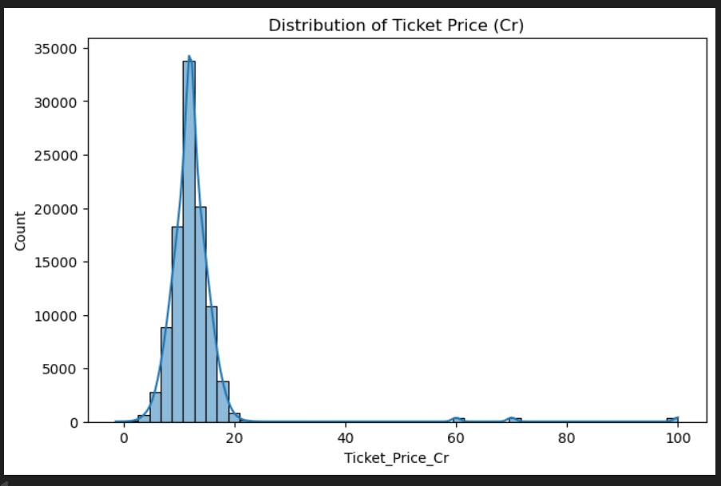
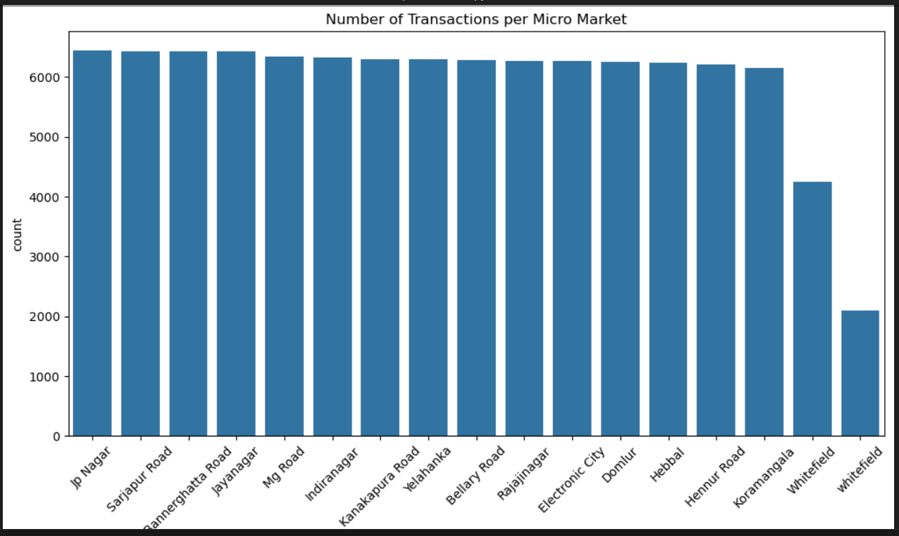

Slide 9
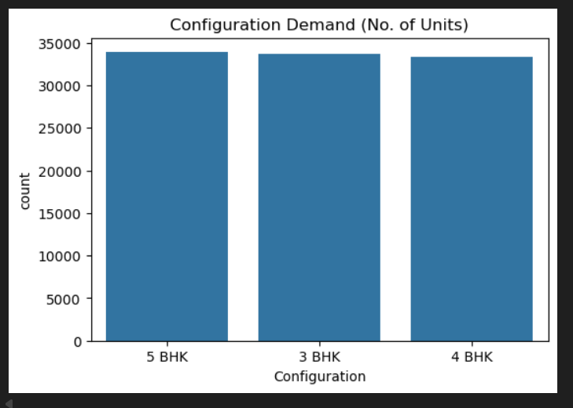
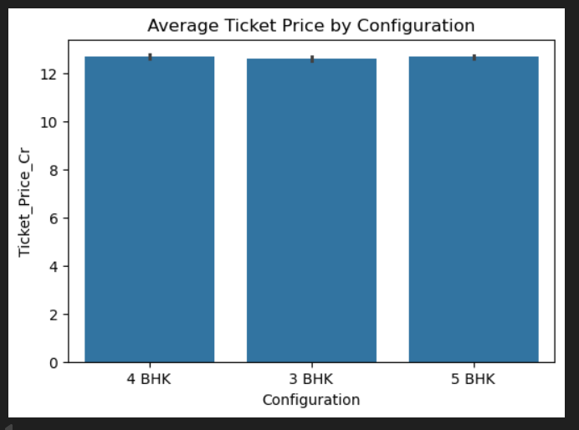

Slide 10
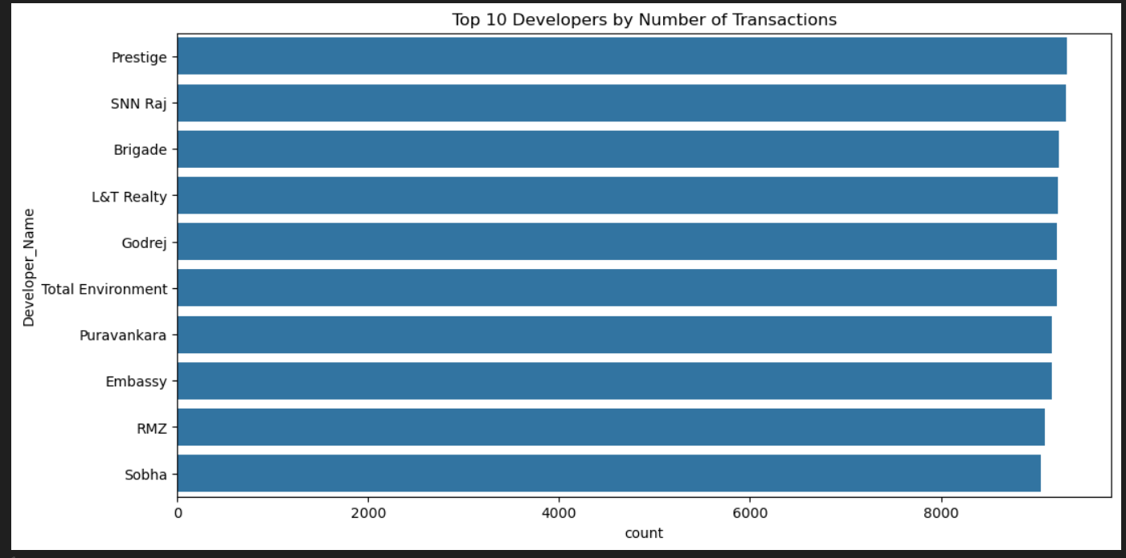
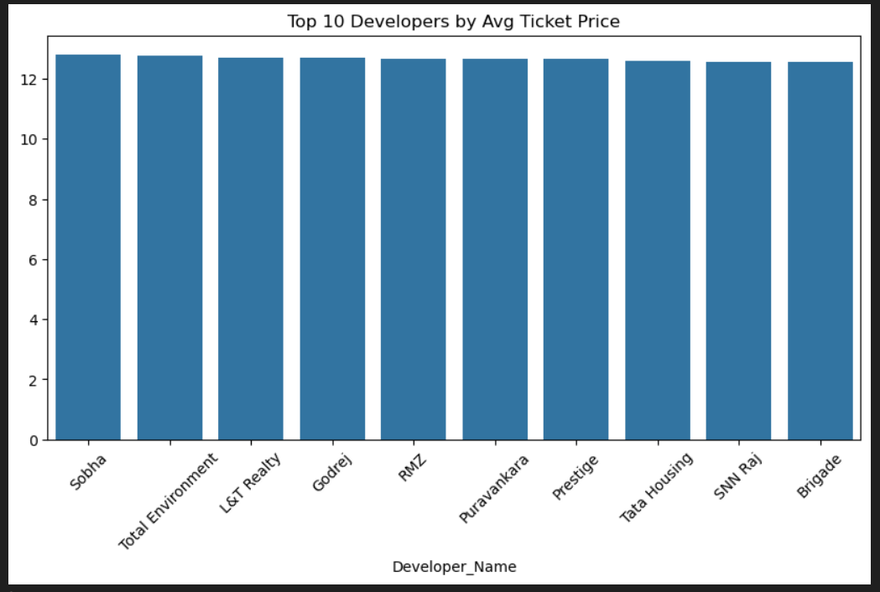

Slide 11
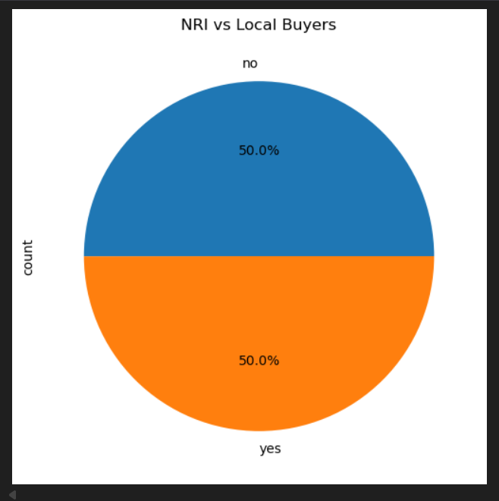
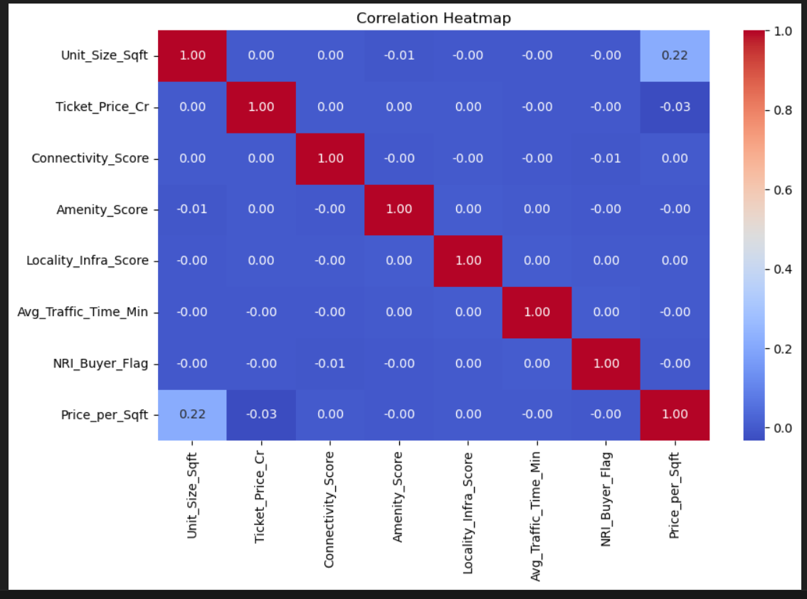

Slide 12
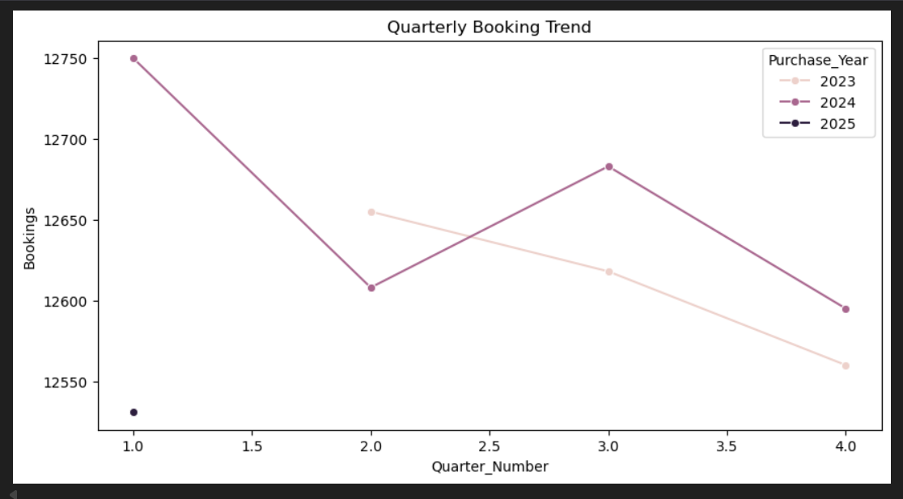
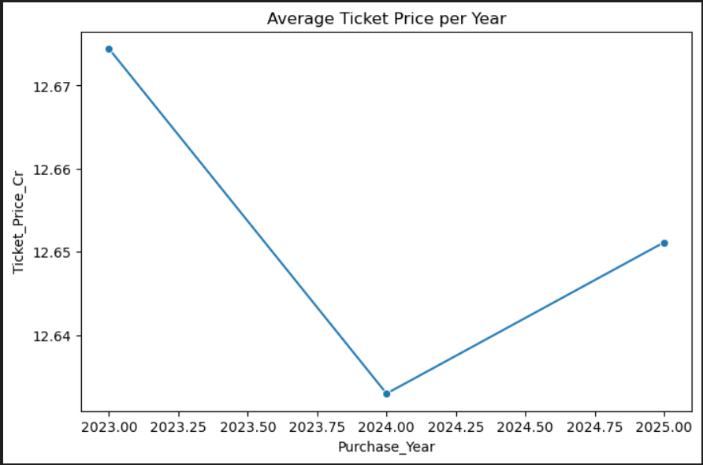

Slide 13
DASHBOARD

Slide 14
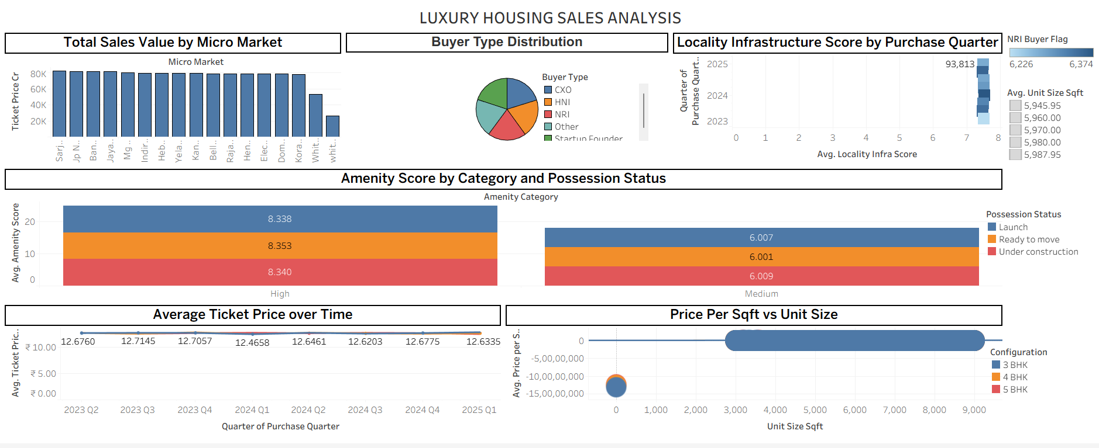

Slide 15
THANK YOU

