Slide 1

MANGALORE INSTITUTE OF TECHNOLOGY & ENGINEERING
(An ISO 9001:2015 Certified Institution)
DEPARTMENT OF COMPUTER SCIENCE AND ENGINEERING
(NBA Accredited)
CITIZEN CENTRIC PANCHAYATH SYSTEM
WITH DIGITAL MANAGEMENT AND AUTOMATION
Under the guidence of
Shivaprasad T K
Assistant Professor, CS&E
Team members :
4MT18CS063 Prajwal Poojary
4MT18CS091 Shraddha Shetty 4MT18CS114 Vineeth serigar
4MT18CS116 Yashwitha

Slide 2
CONTENTS
Introduction
Problem Statement
Objective and scope
Literature Survey
Proposed System
Expected Outcomes
Conclusion
Reference

Slide 3
INTRODUCTION
The main purpose of this project to digitalize and automate the internal workflow processes of Panchayath.
The Panchayats are expected to play an important role in rural development in India.
Various states governments have also taken various innovative steps to promote e-governance.
But still most of the work in grampanchayat is done on paper.
This system could be helpful for the individual to save their valuable time.

Slide 4
PROBLEM STATEMENT
Implementing a Full-stack E-Management system that establish a transparent, user-friendly ecosystem to tackle various problems and provides effective service to the development of the rural areas.

Slide 5
OBJECTIVE AND SCOPE
To provide contactless, transparent, and faster delivery of service
To provide awareness about the new schemes which are provided by government.
To view the development rate at the ward in comparison to other wards.
To know about the availability of the officials in the grama panchayath office.
To provide easier way to request an application, and keep track of it’s status.
Automation can reduce hummon error and standardize the process.
To make users free to raise complaints, feedback and suggestions.

Slide 6
LITERATURE SURVEY
[1] Ch. Leela Poornima, Ch. Pavani, G. Parameswari, K. Subhash Reddy, “Automation of Gram Panchayat”, International Journal of Emerging Trends in Engineering Research, 2016.
They developed a system in which user can request for the certificates online and user will be able to do the activities like raising complaints and suggestions. There are four roles Admin, Secretary, President and User. Admin will create the user id for the officials, and user will register himself and If he want any application he will select the application and apply it.
[2] Prof. S. D. Dhage, Prof. G. A. Ghone, Akash R. Bhojane, Prathamesh B. Thorat, Naim Y. Shaikh,
“E-Gram Panchayat Management System”, International Journal for Scientific Research & Development, 2018.
This system is used for monitoring grama panchayath activities like maintaining all the details about the payments, and providing all the certificates in the site which are manually entered by the panchayath officials.

Slide 7
PROPOSED SYSTEM
Admin
Create login credentials for the officials.
Officials
PDO : accept/reject the application, manage payments, manage complaints/feedback.
Secretary : update service details, manage applications, maintain user details.
President : approval of certificates, manage payment.
User
View information about new schemes.
Pay tax bills online.
Get certificates and licences.
Write feedbacks or complaints.
Watch events that are done in Panchayath office.

Slide 8
PROPOSED SYSTEM
Automation
Payment invoice.
Scraping the data from user applications.
Adding scrapped data into certificate.
Sending messages about the events, schemes, and announcements.
Finding the Low-Cost Tender Quotation.
Generating the Overall Development Chart of Grama Panchayath.

Slide 9
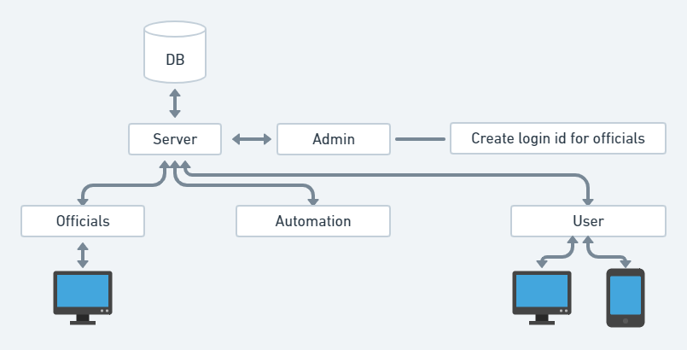
PROPOSED SYSTEM
Architecture

Slide 10
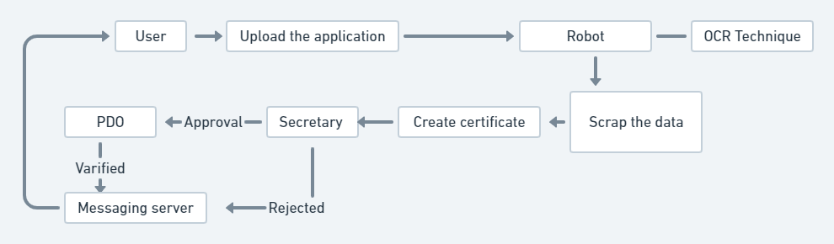
PROPOSED SYSTEM
User application processing flow

Slide 11
POSSIBLE OUTCOMES
Improving delivery of services to citizens.
Tax payment procedure will be optimized.
Automation will reduce the work load of the officials.
Transparency, Accountability, Efficiency and RTI compliance of Panchayath.

Slide 12
HARDWARE & SOFTWARE REQUIREMENTS
Hardware : 500 GB Hard Drive, 8GB RAM or higher
Tools : Android studio, Visual studio code, UiPath Studio
Framework : Express JS, React-Native
Languages :
Front-end : HTML, CSS, JavaScript
Back-end : Node.js
Database : Mongo DB

Slide 13
CONCLUSION
This system provides online services to the people living in that panchayat.
Everything is made online people can request their applications from anywhere at any time.
No need for the people to go to panchayat office every time for the completion of work.
The people can easily view the all the events that are happening in their village.
Optimization in the workload of the Panchayath officials.
People will be aware of all the schemes which are provided by the government.

Slide 14
REFERENCES
[1] Ch. Leela Poornima, Ch. Pavani, G. Parameswari, K. Subhash Reddy, “Automation of Gram Panchayat”, International Journal of Emerging Trends in Engineering Research, 2016.
[2] Prof. S. D. Dhage, Prof. G. A. Ghone, Akash R. Bhojane, Prathamesh B. Thorat, Naim Y. Shaikh,
“E-Gram Panchayat Management System”, International Journal for Scientific Research & Development, 2018.
[3] Pratiksha Dhage1, Shital Wathore2, Prof. Vidya Jagtap3 “E-GRAM PANCHAYAT MANAGEMENT SYSTEM”, open access international journal of science and engineering, 2018.
[4] https://panchatantra.kar.nic.in/panchamitra/
[5] https://rdpr.karnataka.gov.in./english

Slide 15

Thank you

