Slide 1

MANGALORE INSTITUTE OF TECHNOLOGY AND ENGINEERING
(An ISO 9001:2015 Certified Institution)
DEPARTMENT OF COMPUTER SCIENCE AND ENGINEERING
(NBA Accredited)
CITIZEN CENTRIC PANCHAYATH SYSTEM
WITH DIGITAL MANAGEMENT AND AUTOMATION
Under the guidence of
Shivaprasad T K
Assistant Professor, CS&E
Team members :
4MT18CS063 Prajwal Poojary
4MT18CS091 Shraddha Shetty 4MT18CS114 Vineeth serigar
4MT18CS116 Yashwitha

Slide 2
CONTENTS
Introduction
Problem Statement
Objective and scope
Literature Survey
Proposed System
Expected Outcomes
Conclusion
Reference

Slide 3
INTRODUCTION
The main purpose of this project to digitalize and automate the internal workflow processes of Panchayath.
The Panchayats are expected to play an important role in rural development in India.
Various states governments have also taken various innovative steps to promote e-governance.
But still most of the work in grampanchayat is done on paper.
This system could be helpful for the individual to save their valuable time.

Slide 4
PROBLEM STATEMENT
Implementing a Full-stack E-Management system that establish a transparent, user-friendly ecosystem to tackle various problems and provides effective service to the development of the rural areas.

Slide 5
OBJECTIVE AND SCOPE
To provide contactless, transparent, and faster delivery of service
To provide awareness about the new schemes which are provided by government.
To view the development rate at the ward in comparison to other wards.
To know about the availability of the officials in the grama panchayath office.
To provide easier way to request an application, and keep track of it’s status.
Automation can reduce hummon error and standardize the process.
To make users free to raise complaints, feedback and suggestions.

Slide 6
LITERATURE SURVEY
[1] Ch. Leela Poornima, Ch. Pavani, G. Parameswari, K. Subhash Reddy, “Automation of Gram Panchayat”, International Journal of Emerging Trends in Engineering Research, 2016.
They developed a system in which user can request for the certificates online and user will be able to do the activities like raising complaints and suggestions. There are four roles Admin, Secretary, President and User. Admin will create the user id for the officials, and user will register himself and If he want any application he will select the application and apply it.
[2] Prof. S. D. Dhage, Prof. G. A. Ghone, Akash R. Bhojane, Prathamesh B. Thorat, Naim Y. Shaikh,
“E-Gram Panchayat Management System”, International Journal for Scientific Research & Development, 2018.
This system is used for monitoring grama panchayath activities like maintaining all the details about the payments, and providing all the certificates in the site which are manually entered by the panchayath officials.

Slide 7
PROPOSED SYSTEM
The Admin will create the login id and password for the officials. At first User will register himself, If he already registered then he will login into the system.
User will pay the tax through the app/website, then at the backend the bot will process the information and invoice of that payment will be sent to that user through email or text-message.
User will request for a certificate and he will upload the application, the bot will categorize the user application using OCR technique, then the secretary will varify the application and send it to the PDO for the final varification, the PDO will digitally sign it and finish the process, then the bot automatically send the certificate to the particular user.

Slide 8
The secretary will generate the message about the new event, then the bot will send that message to all the users.
The official will post the details about the tenders, and the agents/contractors will apply for that tenders with quotation. Then the system will automatically generate the list of contractors with low cost tender quotation.
The graph/chart will be generated based on the parameters like number of projects that are completed in that ward, number of ongoing projects, number of benificiaries.
Secretary will organize the event live stream and then all the users will get notification about the event live stream.
Secretary will post the pictures/details about the progress/completion of the project.
Users can raise the complaint, feedback and suggestions.

Slide 9
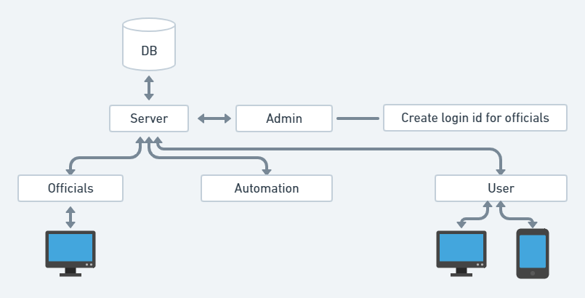
Architecture

Slide 10
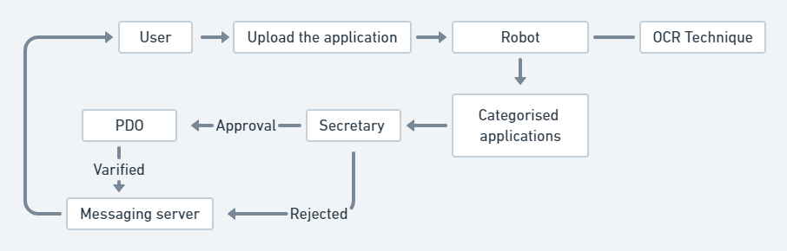
User Application processing flow

Slide 11
POSSIBLE OUTCOMES
Improving delivery of services to citizens.
Tax payment procedure will be optimized.
Automation will reduce the work load of the officials.
Transparency, Accountability, Efficiency and RTI compliance of Panchayath.

Slide 12
CONCLUSION
This system provides online services to the people living in that panchayat.
Everything is made online people can request their applications from anywhere at any time.
No need for the people to go to panchayat office every time for the completion of work.
The people can easily view the all the events that are happening in their village.
Optimization in the workload of the Panchayath officials.
People will be aware of all the schemes which are provided by the government.

Slide 13
REFERENCES
[1] Ch. Leela Poornima, Ch. Pavani, G. Parameswari, K. Subhash Reddy, “Automation of Gram Panchayat”, International Journal of Emerging Trends in Engineering Research, 2016.
[2] Prof. S. D. Dhage, Prof. G. A. Ghone, Akash R. Bhojane, Prathamesh B. Thorat, Naim Y. Shaikh,
“E-Gram Panchayat Management System”, International Journal for Scientific Research & Development, 2018.
[3] Pratiksha Dhage1, Shital Wathore2, Prof. Vidya Jagtap3 “E-GRAM PANCHAYAT MANAGEMENT SYSTEM”, open access international journal of science and engineering, 2018.
[4] https://panchatantra.kar.nic.in/panchamitra/
[5] https://rdpr.karnataka.gov.in./english

Slide 14

Thank you

