Slide 1
Database Management System
(DBMS)

Slide 2
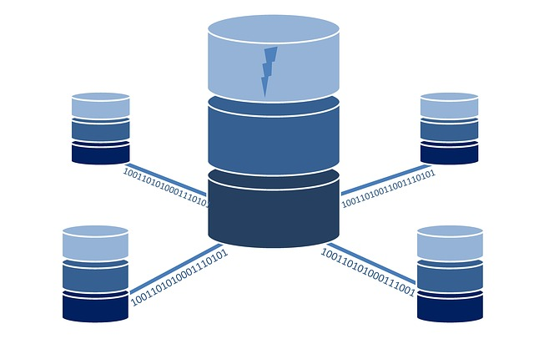
Introduction (Unit-1)
A database is an organized collection of structured or unstructured data that can be accessed, managed, and updated by a computer system.
Data refers to a collection of facts, observations, measurements, or other information that can be processed or analyzed to gain insights, draw conclusions, or make decisions. Data can be in various forms, including numbers, text, images, audio, video, or other formats.
Notes:
For example, consider the names,telephone numbers, and addresses of the people you know. Nowadays, this data is typically stored in mobile phones,

Slide 3
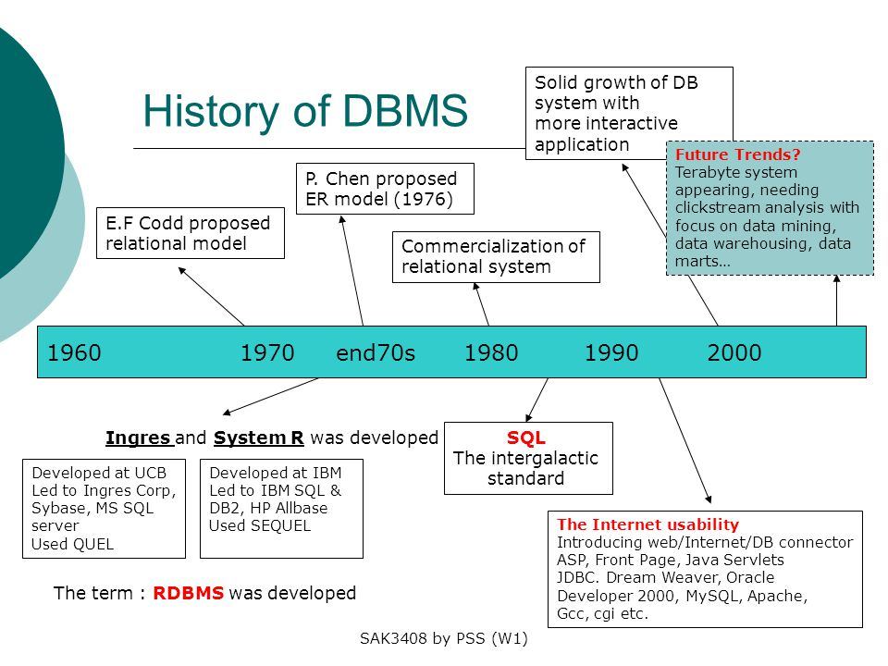

Slide 4
What is Database Management system ?
A database-management system (DBMS) is a collection of interrelated data and a set of programs to access those data.
The primary goal of a DBMS is to provide a way to store and retrieve database information that is both convenient and efficient.
Database systems are designed to manage large bodies of information.
Management of data involves both defining structures for storage of information and providing mechanisms for the manipulation of information.
The database system must ensure the safety of the information stored, despite system crashes or attempts at unauthorized access.

Slide 5
Why we need DBMS ?
Controlling Redundancy
Restricting Unauthorized Access
Providing Storage Structures and Search Techniques for Efficient Query Processing
Providing Backup and Recovery
Providing Multiple User Interfaces
Representing Complex Relationships among Data

Slide 6
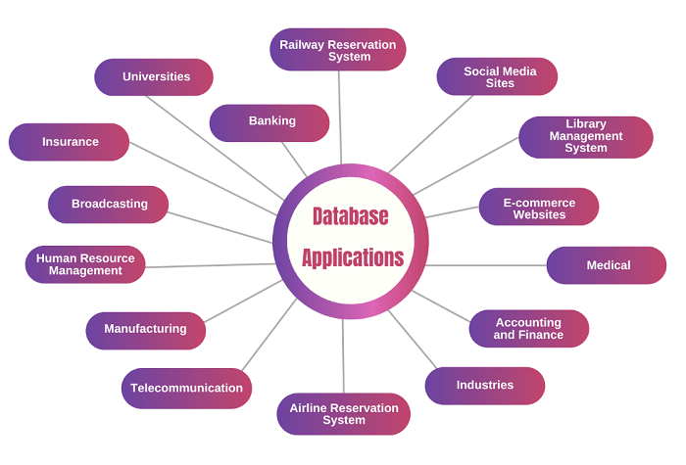
DBMS application
Enterprise Information
Manufacturing
Banking and Finance
Universities
Airlines
Telecommunication
Web-based services
Navigation systems

Slide 7
Purpose of Database system
Avoid data redundancy and inconsistency:
Difficulty in accessing data:
Data isolation:
Integrity problems:
Atomicity of updates:
Concurrent access:
Security problems:
Supports multiple views of data:

Slide 8
Purpose of Database system
Data redundancy and inconsistency
  Data redundancy refers to the duplication of data within a database system. Data inconsistency, refers to a situation where data values in a database are not consistent with each other.
Difficulty in accessing data
  Difficulty in accessing data refers to situations where users or applications are unable to retrieve or use data stored in a database system
Data isolation:
  Data isolation is a property of database systems that ensures that one transaction does not interfere with another transaction and also different data (formats) from different places (location) is causes hard to retrieve an appropriate data.
Atomicity of updates:
  a transaction either completes successfully and commits all its changes, or it fails and rolls back all its changes, leaving the database in its original state.

Slide 9
Purpose of Database system
Concurrent access:
  Concurrent access refers to the ability of multiple users or applications to access a database system simultaneously.
Security problems:
  Database systems are vulnerable to a variety of security problems that can compromise the confidentiality, integrity, and availability of the data they manage.
Supports multiple views of data
  Supporting multiple views of data is an important feature of a database system that allows different users or applications to access the same data in different ways, depending on their specific needs.
Integrity problems
  Integrity problems in a database system refer to situations where the data stored in the database is incorrect, inconsistent, or violates some predefined rules or constraints. (The integrity of data refers to the accuracy, completeness, and consistency of data in a database.)
Notes:
Integrity problem primary key can’t be null

Slide 10
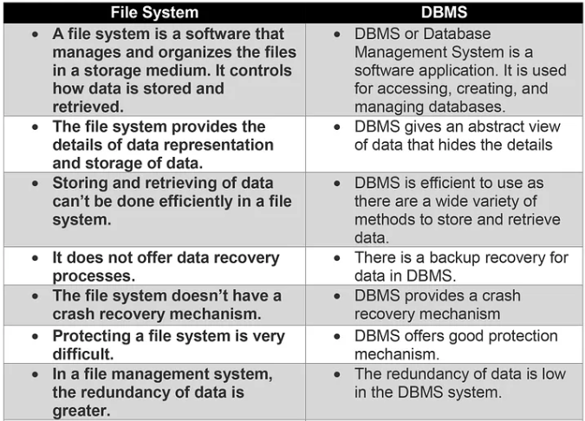
Database System vs File System

Slide 11
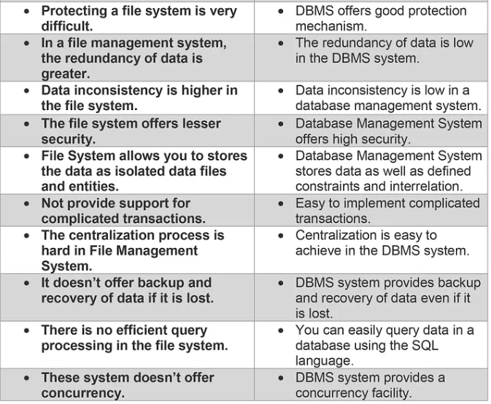

Slide 12
View of Data
A database system is a collection of interrelated data and a set of programs that allow users to access and modify these data.
A major purpose of a database system is to provide users with an abstract view of the data.
That is, the system hides certain details of how the data are stored and maintained.
Notes:
User don’t care how the data is stored in memory, disk blocks, or what indexing is used. That’s abstracted away.

Slide 13
Data Abstraction
Data abstraction is the process of hiding complex details and presenting only essential information to users.
There are three main levels of data abstraction in a database system:
Physical level: This is the lowest level of abstraction and describes how the data is stored on the storage media such as hard disks, solid-state drives, or magnetic tapes. It deals with details such as data organization, access methods, and storage structures.
Logical level: This level of abstraction describes how the data is organized and structured in a database. It provides a conceptual view of the data and is concerned with the relationships between entities, attributes, and constraints.
View level: This is the highest level of abstraction and describes how the data is presented to users. It provides a user-specific view of the data and is concerned with the selection, projection, and restriction of data.
Notes:
The Students table is stored as a B+ tree index on disk with binary files. You don't see this; it's managed by the DBMS.
This is how the DBA or developer sees the database — the logical model, without worrying about how it's stored physically. (Tables, columns, relationships, data types, constraints.)
Multiple users can have different views for security or simplicity (what they can see?)

Slide 14
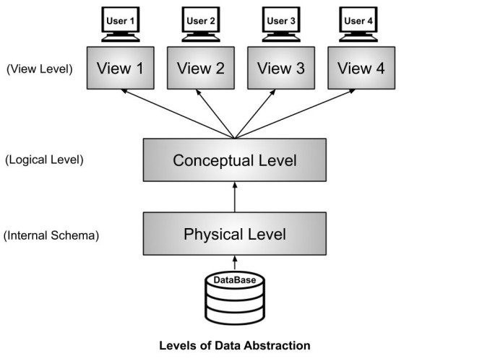

Slide 15
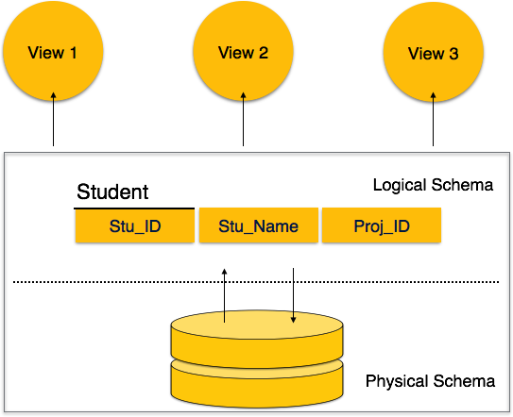

Slide 16
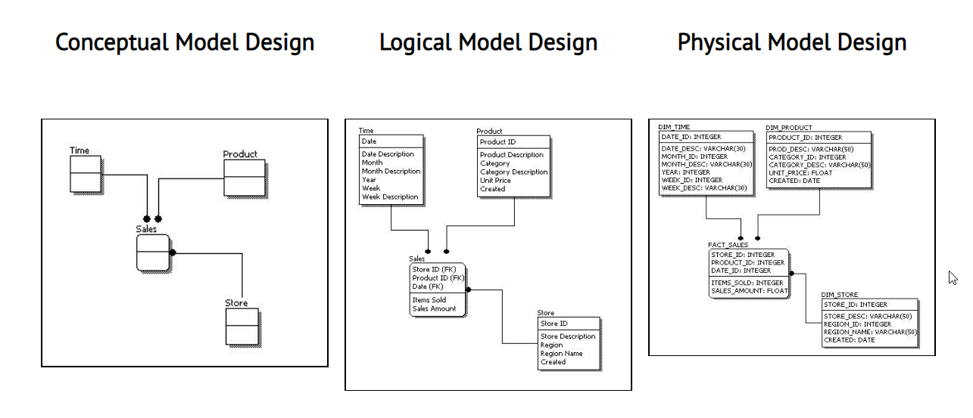

Slide 17
Database independence
Data Independence means the ability of the data to change the schema at one level of the database without having to change the schema at the next higher level.
Physical data independence is the ability to modify the physical schema of a database without affecting the logical schema or the applications that use the database.
Logical Data Independence is a property of a database that can be used to change the logic behind the logical level without affecting the other layers of the database. Logical data independence is usually required for changing the conceptual schema without having to change the external schema or application programs.
Notes:
1. The ability to change the logical schema (like adding new fields or tables) without changing the application programs.
2. The ability to change the physical storage (e.g., indexing, file organization) without affecting the logical structure or application code.

Slide 18
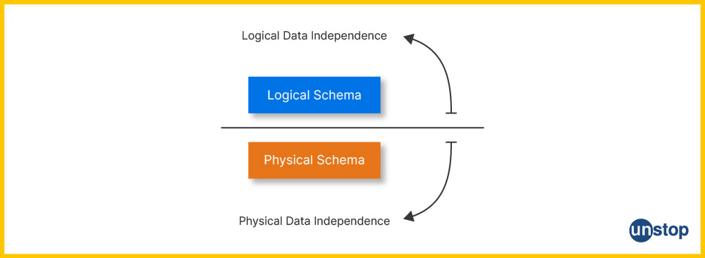

Slide 19
Data Models
The data model is a collection of conceptual tools for describing data, data relationships, data semantics, and consistency constraints.
A data model provides a way to describe the design of a database at the physical, logical, and view levels.
Data relationships define the connections and associations between different data entities in a database.
Data semantics refers to the meaning and interpretation of the data in a database.
Consistency constraints are rules and restrictions that govern the data in a database and ensure its accuracy and integrity.
Notes:
e.g. semantic Date of birth and date of purchase

Slide 20
Data Models
The data models can be classified into four different categories:
  Relational Model
    The relational model uses a collection of tables to represent both data and the relationships among those data. Each table has multiple columns, and each column has a unique name. Tables are also known as relations.
  Entity-Relationship Model
    The entity-relationship (E-R) data model uses a collection of basic objects, called entities, and relationships among these objects.
  Semi-structured Data Model
    A semi-structured data model is a type of data model that does not enforce a specific schema or structure on the data, but allows the data to be organized and represented in a flexible and dynamic manner. (JSON)
  Object-Based Data Model
    An object-based data model is a type of data model that organizes data as a collection of objects, rather than as tables with rows and columns.

Slide 21
Instances and Schemas
The collection of information stored in the database at a particular moment is called an instance of the database.
The overall design of the database is called the database schema or blueprint of the database.
Two Types of Schema:-
Physical schema refers to the way the database is physically stored on a storage device, such as a hard disk or solid-state drive.
Logical schema refers to the high-level representation of the database structure, which defines the logical organization and relationship of the data.
Schemas at the view level, sometimes called subschemas.
Physical data independence is the ability to modify the physical schema of a database without affecting the logical schema or the applications that use the database.
Notes:
For example, An instance of this database might include the names, salaries, and job titles of all employees in the company as of a specific date.
For example, the schema of the "employees" table, which includes columns such as "employee_id", "first_name", "last_name", "salary", and "job_title".
It allows the database administrator (DBA) to make changes to the storage structure, indexing methods, or other physical implementation
Schema = Car design (model, engine type, number of seats)
Instance = A specific car on the road, with a color, mileage, and driver.

Slide 22
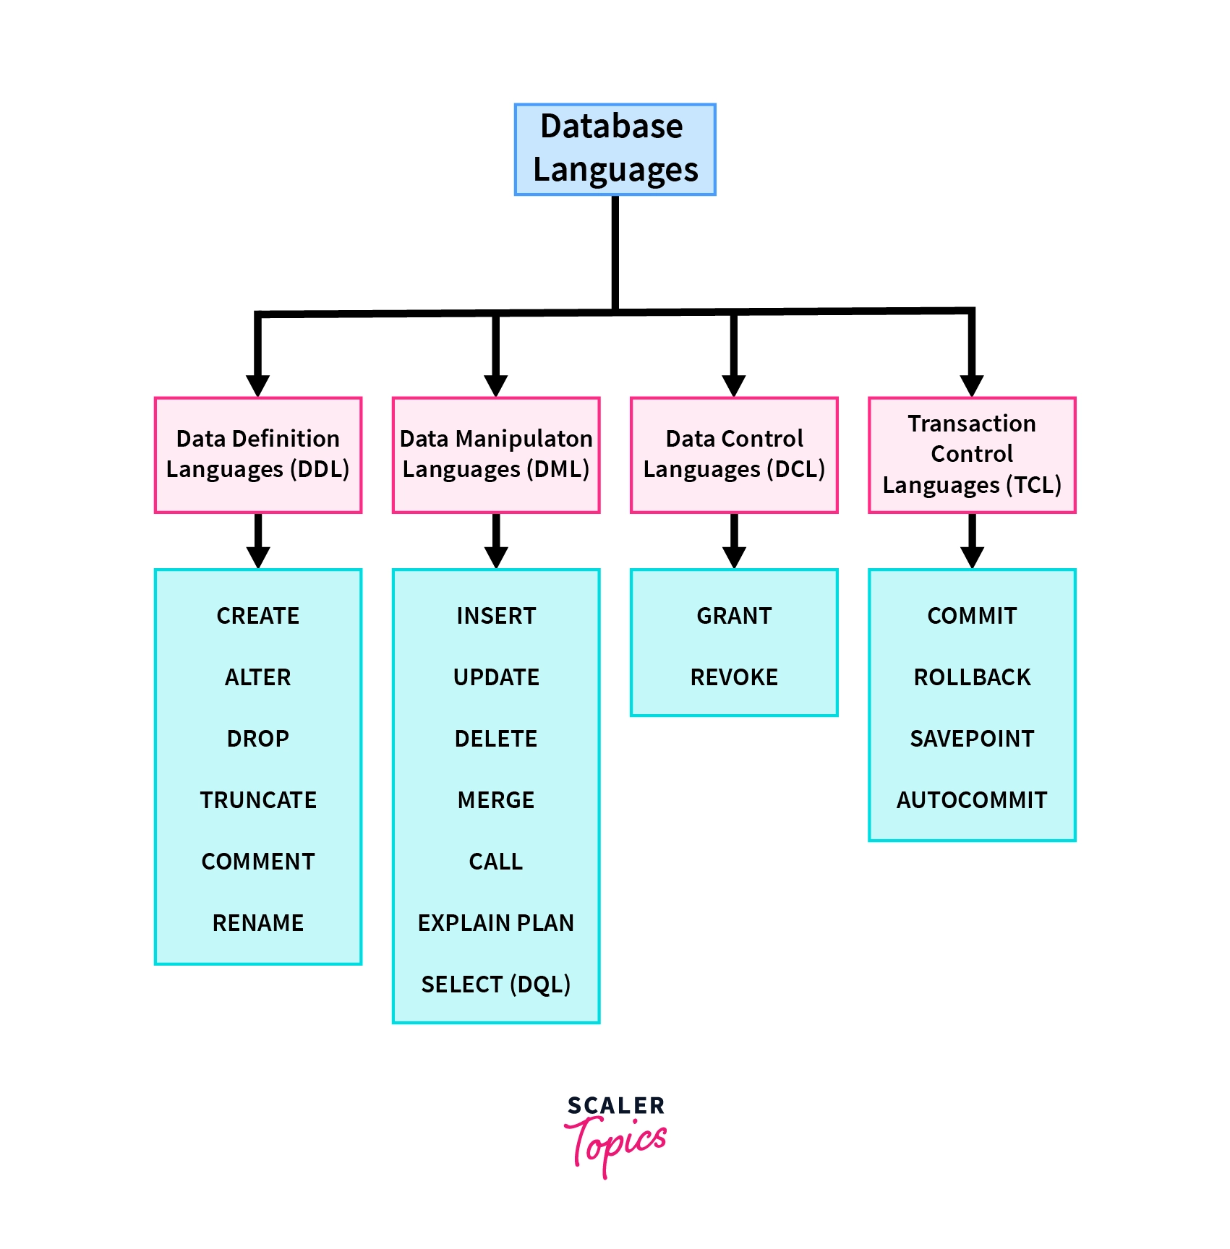

Slide 23
Database Language
A database language is a computer programming language that is used to define, manipulate, and query databases.
A data-manipulation language (DML) is a language that enables users to access or manipulate data as organized by the appropriate data model. The types of access are:
  Retrieval of information stored in the database (SELECT)
  insertion of new information into the database (INSERT)
  Deletion of information from the database (DELETE)
  Modification of information stored in the database (UPDATE)
A query is a statement requesting the retrieval of information.
Notes:
Select, insert, delete, update

Slide 24
Database Language
Data Definition Language (DDL) is a type of database language used to define and manage the structure of a database. It is used to create, modify (Alter), and delete (drop) database objects such as tables, indexes, views, and procedures.
The storage structure and access methods used by the database system by a set of statements in a special type of DDL called a data storage and definition language.
The data values stored in the database must satisfy certain consistency constraints.
Notes:
Drop, alter, drop etc

Slide 25
Database User and Administrators
People who work with a database can be categorized as database users or database administrators.
Database User
There are four different types of database-system users, differentiated by the way they expect to interact with the system.
Naive users are unsophisticated users who interact with the system by invoking one of the application programs that have been written previously.
Application programmers are computer professionals who write application programs. Application programmers can choose from many tools to develop user interfaces.
Rapid application development (RAD)tools are tools that enable an application programmer to construct forms and reports without writing a program.

Slide 26
Database User and Administrators
Sophisticated users interact with the system without writing programs. Instead, they form their requests in a database query language.
Database Administrator
A person who has such central control over the system is called a database administrator (DBA). The functions of a DBA include:
Schema definition
Storage structure and access-method definition
Schema and physical-organization modification
Granting of authorization for data access
Routine maintenance

Slide 27
Application Architecture
The application architecture of a DBMS refers to the way that the DBMS is integrated into an overall application or system.
It includes the design and implementation of the software components that interact with the DBMS and how they are organized to meet the needs of the application.
Centralized, client-server, and distributed are three common architectures for database management systems (DBMS).

Slide 28
Application Architecture
The functional components of a database system can be broadly divided into the storage manager and the query processor components.
The storage manager is important because databases typically require a large amount of storage space.
The query processor is important because it helps the database system simplify and facilitate access to data.

Slide 29
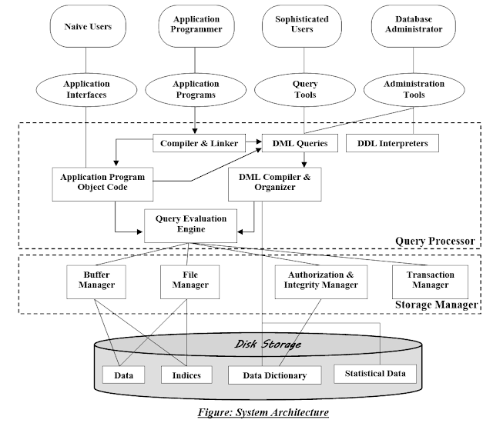
Notes:
Uses

Slide 30
Application Architecture
Two-Tier Architecture: In a two-tier architecture, the client application interacts directly with the database server.
The client application is responsible for user interface and business logic, while the database server handles data storage and retrieval.
client application invoked database system functionality at the server machine through query language statements.
This architecture is also known as client-server architecture.

Slide 31
Application Architecture
Three-Tier Architecture: In a three-tier architecture, the client application is split into two separate parts: the application client and the application layer.
The application client is responsible for user interface(mobile and web), the application layer handles business logic, and the database server handles data storage and retrieval.
The application client communicates with the application layer, which in turn communicates with the database server.
The business logic of the application, which says what actions to carry out under what conditions, is embedded in the application server, instead of being distributed across multiple clients.
Three-tier applications are more appropriate for large applications, and for applications that run on the World Wide Web.

Slide 32
