Slide 1
Emerging Trends In Database
Unit-10

Slide 2
Introduction of OODMS
An object-oriented database stores data as objects, similar to how certain programming languages manage data.
Instead of tables with rows and columns like traditional databases, object databases use complex data structures to represent data.
Object-oriented data model (OODM)
  A logical data model of objects supported in object-oriented programming
Object-oriented database (OODB)
  A persistent and sharable collection of objects defined by an OODM
Object-oriented DBMS (OODBMS)
  The manager of an OODB
Notes:
GemStone/S, db4o (Database for Objects),ObjectDB, Versant

Slide 3
Definition of an object
Objects – User defined complex data types
An object has structure or state (variables) and methods (behaviour/operations)
  Data: This is the stored information. For example, a customer data “object” would include details like the customer's name, address, phone number, and email.
  Actions (methods): Actions are the things that can be done with the data. For example, there may be specific actions needed to update the customer's address or to retrieve their order history.
An object is described by four characteristics
  Identifier: a system-wide unique id for an object
  Name: an object may also have a unique name in DB (optional)
  Lifetime: determines if the object is persistent or transient
  Structure: Construction of objects using type constructors

Slide 4
OOPS
Abstract Data Types
  Class definition, provides extension to complex attribute types
Encapsulation
  Implementation of operations and object structure hidden
Inheritance
  Sharing of data within hierarchy scope, supports code reusability
Polymorphism
  Operator overloading
Objects and classes

Slide 5
object-oriented databases vs relational databases
Relational databases : These databases use a structured format with tables, rows, and columns. Each table represents a different entity (like customers or products), and the rows in these tables are individual records. Columns represent the attributes of these records.
Object-oriented databases: In contrast, OODBs store data as objects. An object can encapsulate complex data structures and their associated actions.

Slide 6
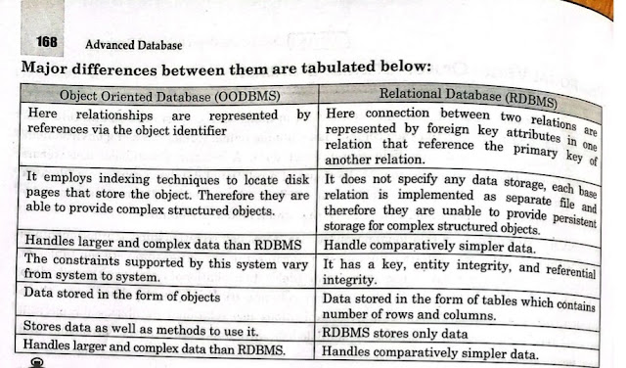

Slide 7
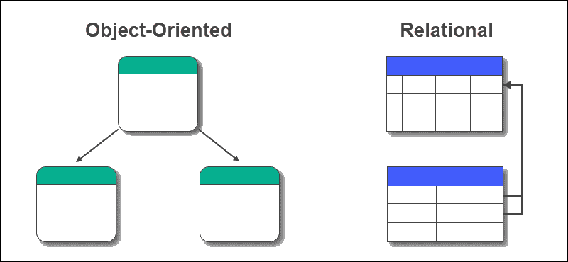

Slide 8
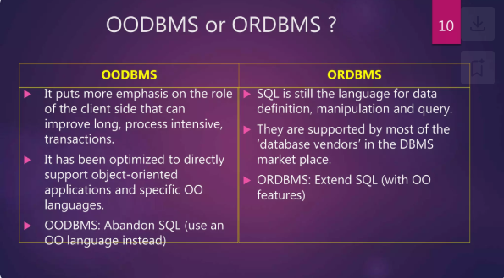
What is ORDBMS?
ORDBMS stands for Object-Relational Database Management System. It provides all the facilities of RDBMS with the additional support of object oriented concepts.

Slide 9
NoSQL databases
NoSQL databases (AKA "not only SQL") store data differently than relational tables. NoSQL databases come in a variety of types based on their data model.
The main types are: document, key-value, wide-column, and graph.
They provide flexible schemas and scale easily with large amounts of big data and high user loads.
Over time, four major types of NoSQL databases have emerged: document databases, key-value databases , wide-column stores, and graph databases.

Slide 10
Characteristics of NoSQL Database
1 - Flexible Data Model: NoSQL databases allow for flexible data models, meaning you can store unstructured, semi structured, and structured data without the need to define a rigid schema.
2) Scalability: NoSQL databases are designed to scale horizontally, which means you can easily add more servers to handle increased load, making them suitable for handling large amounts of data and high traffic.
3) High Performance: NoSQL databases are optimized for high performance and can deliver low latency responses, making them ideal for real time applications and large scale systems.
4) Replication and Fault Tolerance: NoSQL databases typically support automatic data replication and have built in fault tolerance mechanisms, ensuring data durability and high availability even in the event of server failures.

Slide 11
Characteristics of NoSQL Database
5) Distributed Computing: NoSQL databases are designed for distributed computing environments, allowing data to be distributed across multiple nodes in a cluster, which improves data access speed and fault tolerance.
6) Schema less Design: NoSQL databases do not require a fixed schema, allowing for dynamic and evolving data structures, which is particularly useful in scenarios where the data model may change frequently.
7) Support for Big Data: NoSQL databases are well suited for handling large volumes of data, making them a popular choice for big data applications and analytics.
8) Automatic Data Sharding: Many NoSQL databases support automatic data sharding, which allows data to be partitioned and distributed across multiple servers, enabling horizontal scaling and improved performance.
9) Developer friendly: NoSQL databases are often developer friendly, offering flexible APIs, query languages, and data manipulation tools that simplify application development and integration.

Slide 12
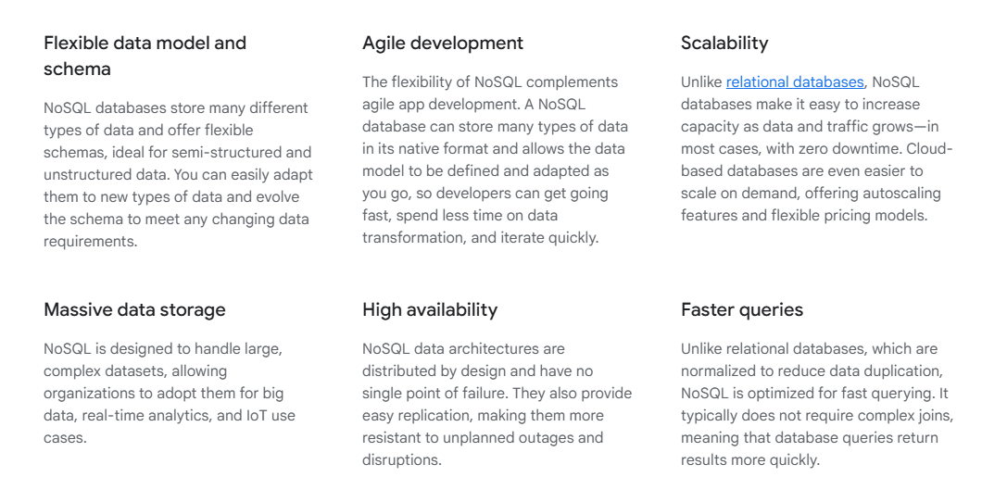
Advantages

Slide 13
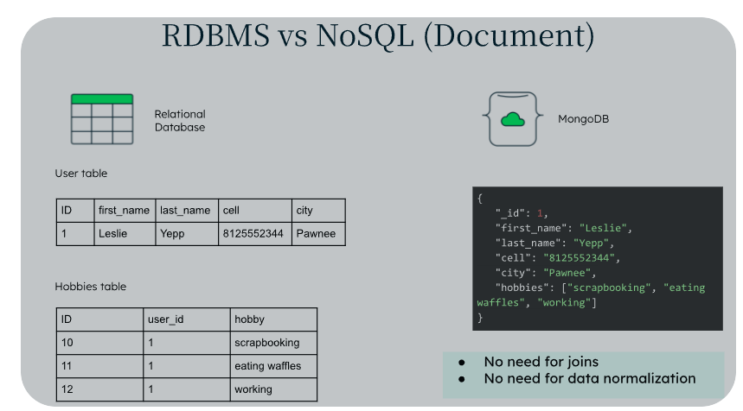

Slide 14
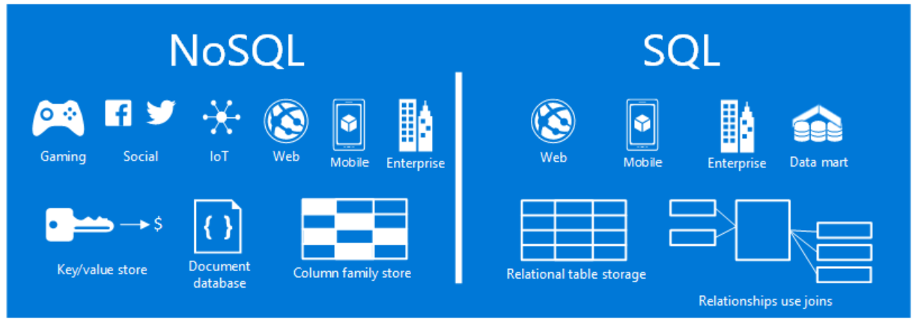
NoSQL vs SQL

Slide 15
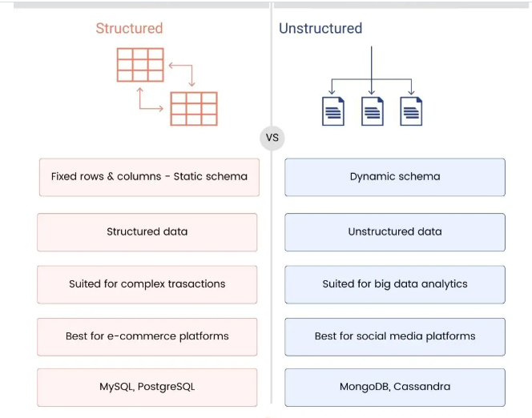
For more content
https://www.mongodb.com/resources/basics/databases/nosql-explained#:~:text=NoSQL%20databases%20provide%20a%20variety,%2C%20and%20multi%2Dmodel%20databases.

Slide 16
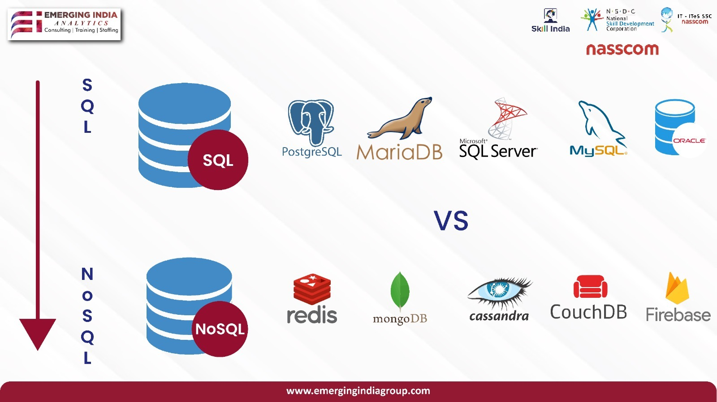

Slide 17
Distributed Databases
a distributed database is a database that stores data in multiple locations instead of one location.
This means that rather than putting all data on one server or on one computer, data is placed on multiple servers or in a cluster of computers consisting of individual nodes.
These nodes are oftentimes geographically separate and may be physical computers or virtual machines within a cloud database.

Slide 18
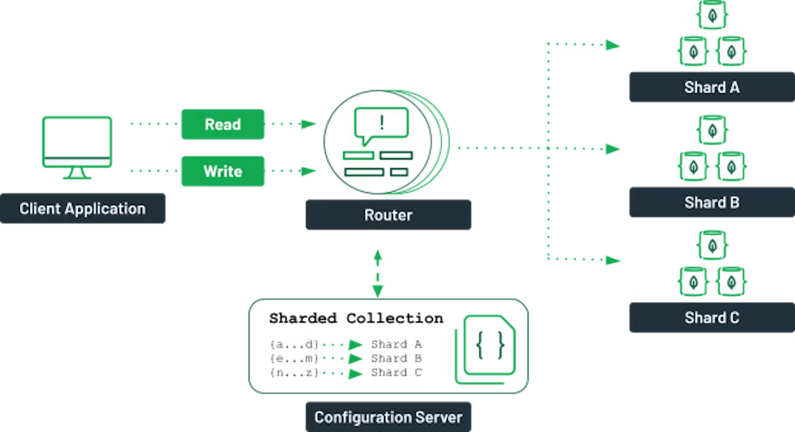

Slide 19
Types of Distributed Databases
In a homogeneous distributed database, the machines, nodes, servers, or sites store the same data, use the same data model, work with the same operating system, and share the same distributed database management system (DDBMS) or occasionally multiple types of DDBMS from the same vendor.
In a heterogeneous distributed database, different machines or sites may house different data sets, use different operating systems, contain different data schemas, and require software to facilitate communication between machines. Further, different sites may not even be aware of the existence of other sites.

Slide 20
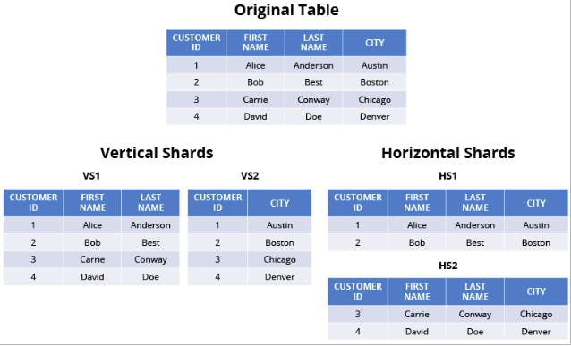

Slide 21
Distributed ledger technology
Distributed ledger technology (DLT) is a digital system for recording the transaction of assets in which the transactions and their details are recorded in multiple places at the same time. Unlike traditional databases, distributed ledgers have no central data store or administration functionality.
DLT refers specifically to the technological infrastructure and protocols that enable the simultaneous access, validation and updating of records that characterize distributed ledgers.
It works on a computer network spread over multiple entities, locations or nodes.
It’s a system where information (like transactions or records) is stored across multiple places (or "ledgers") at the same time, so no one person or organization has control. It’s secure, transparent, and harder to tamper with, because everyone has a copy to check against.

Slide 22
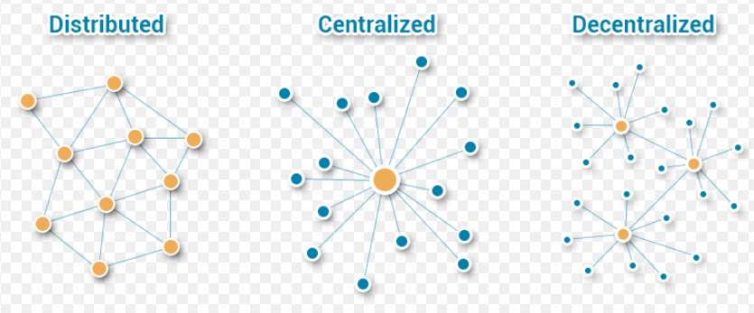

Slide 23
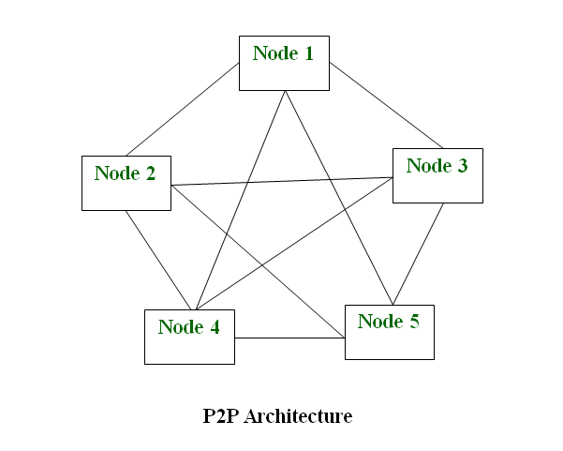
How DLT works
DLT works based on principles of decentralization. Unlike traditional centralized databases, DLT operates on a peer-to-peer (P2P) network, where multiple nodes store, validate and update the ledger simultaneously. This eliminates the need for a central authority and reduces the risk of a single point of failure.

Slide 24
Blockchain
Blockchain is a well-known example of a distributed ledger technology.
Blockchain is a decentralized digital ledger that securely stores records across a network of computers in a way that is transparent, immutable, and resistant to tampering.
Each "block" contains data, and blocks are linked in a chronological "chain.“
They are best known for their crucial role in cryptocurrency systems, maintaining a secure and decentralized record of transactions, but they are not limited to cryptocurrency uses.

Slide 25
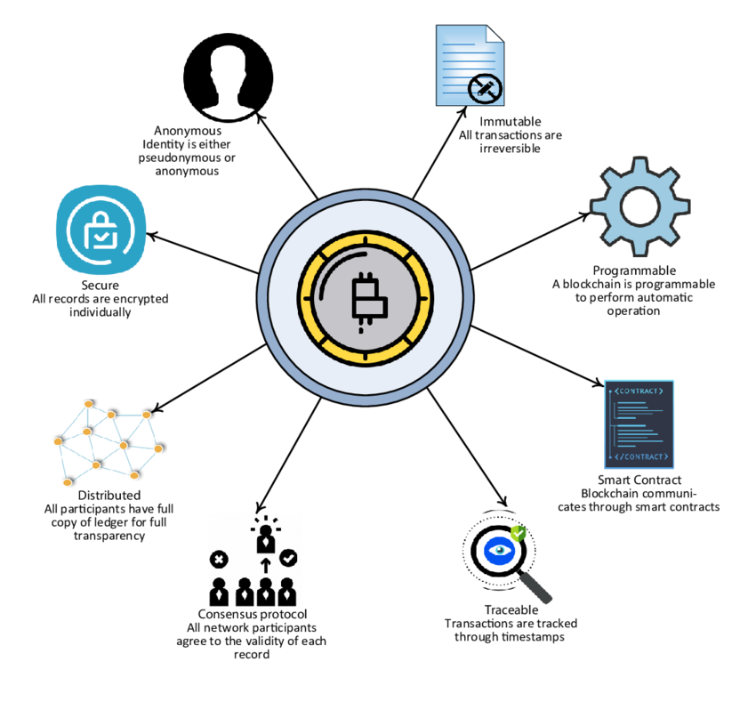

Slide 26
Cryptocurrency
Cryptocurrency is a digital payment system that doesn't rely on banks to verify transactions.
It’s a peer-to-peer system that can enable anyone anywhere to send and receive payments.
Instead of being physical money carried around and exchanged in the real world, cryptocurrency payments exist purely as digital entries to an online database describing specific transactions.
When you transfer cryptocurrency funds, the transactions are recorded in a public ledger.
Cryptocurrency is a type of digital or virtual currency that uses cryptography for security, making it difficult to counterfeit or double-spend.

Slide 27
