Slide 1
ER and Relational Model
Unit-2

Slide 2
E-R Model
A graphical technique for understanding and organizing the data independent of the actual database implementation.
We need the Entity-Relationship (ER) model to help us design and organize data in a way that is easy to understand and maintain.
The ER model provides a graphical representation of the data and the relationships between entities, attributes, and constraints in a database.
The ER model is a conceptual data model that is used to represent the entities, attributes, and relationships involved in a database.
ER modeling is the process of creating an ER model by identifying the entities, attributes, and relationships that exist within a system or organization.

Slide 3
E-R Model
In ER modeling, entities represent objects or concepts in the real world, such as customers, orders, or products.
Each entity is described by a set of attributes, which represent the characteristics of the entity.
  For example, a customer entity might have attributes such as name, address, and phone number.
Relationships describe how entities are related to each other. A relationship between two entities represents a link or association between them.
Relationships are classified based on the number of entities involved and the cardinality of the relationship (e.g., one-to-one, one-to-many, many-to-many).

Slide 4
Entity sets
an entity is a real-world object or concept that has its own unique identity and can be distinguished from other objects or concepts.
Entities can be people, places, things, events, or concepts that are important to the organization or system being modeled.
an entity set is a collection of similar entities.
  For example, in a university database, the entity set "students" represents all the individual students who attend the university.
Entity sets are typically represented as rectangles in an ER diagram, with the entity set name written inside the rectangle.

Slide 5
Entity sets
Strong entity: A strong entity is an entity that can exist independently of other entities.
Weak entity: A weak entity is an entity that cannot exist without a corresponding strong entity.
Associative entity: An associative entity is an entity that represents a many-to-many relationship between two or more other entities.
Entity_Name

Slide 6
Attributes
An attribute is a characteristic or property of an entity or relationship. For example, a person entity may have attributes such as name, date of birth, and address.
  1. Key Attribute/Simple :Key attribute uniquely identifies an entity from an entity set.
  2.Composite Attribute :- An attribute that is composed of several other attributes is known as a composite attribute.
  3.Multivalued Attribute : -Some attributes can possess over one value, those attributes are called multivalued attributes.
  4.Derived Attribute : -An attribute that can be derived from other attributes of the entity is known as a derived attribute.
Notes:
Key attributes – primary key , Composite –Name->first name, last name ,Multivalued – Phone number , Derived → Date of birth , age

Slide 7
Relationship sets
A relationship is a connection between two or more entities. It describes how the entities are related or connected to each other. A relationship set is a collection of relationships of the same type.
A relationship set is a set of relationships of the same type. Formally, it is a math-matical relation on n ≥ 2 (possibly nondistinct) entity sets. If E1 , E2 , . . . , En areentity sets, then a relationship set R is a subset of{(e1 , e2 , . . . , en ) | e1 Ԑ E1 , e2 Ԑ E2 , . . . , en Ԑ En }where (e1 , e2 , . . . , en ) is a relationship.
A relationship instance in an E-R schema represents an association between the named entities in the real-world enterprise that is being modeled.
A relationship may also have attributes called descriptive attributes.
The number of entity sets that participate in a relationship set is also the degree ofthe relationship set. A binary relationship set is of degree 2; a ternary relationship setis of degree 3.
The function that an entity plays in a relationship is called that entity’s role.

Slide 8
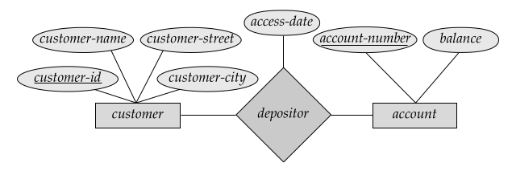

Slide 9
Participation constraints
The participation constraint specifies the number of instances of an entity can participate in a relationship set.
In other words, they specify the degree to which an entity must participate in a relationship.
1.Total participation: In a total participation constraint, each instance of an entity must participate in a relationship. For example, in a university database, each student must be enrolled in at least one course, so the Student entity has a total participation constraint in the Enroll relationship.
2. Partial participation: In a partial participation constraint, some instances of an entity may not participate in a relationship. For example, in a university database, a course may not have any students enrolled yet, so the Course entity has a partial participation constraint in the Enroll relationship.

Slide 10
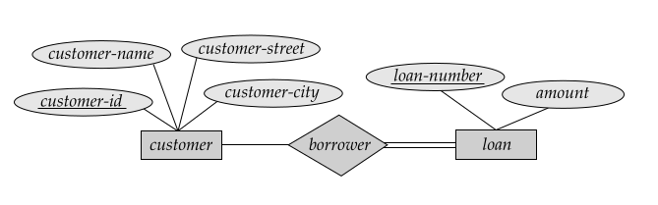

Slide 11
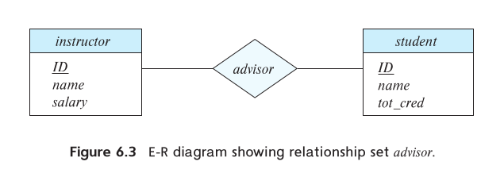
suppose we have
entity sets student and course which participate in a relationship set registered-for. We
may wish to store a descriptive attribute for-credit with the relationship, to record
whether a student has taken the course for credit, or is auditing (or sitting in on) the
course.

Slide 12
Constraints
Constraints define the rules that must be followed by database.
1. Mapping Cardinalities
the relationship between the entities participating in a relationship.
1. One-to-One (1:1): In a one-to-one relationship, each record in the first table is linked to only one record in the second table, and vice versa. For example, each employee may have only one payroll record.
2. One-to-Many (1:N): In a one-to-many relationship, each record in the first table can be linked to many records in the second table, but each record in the second table can only be linked to one record in the first table. For example, each customer can have many orders, but each order can only belong to one customer.
3. Many-to-one (M:1): When more than one element of an entity is related to a single element of another entity, then it is called a many-to-one relationship.For example, students have to opt for a single course, but a course can have many students.
4. Many-to-Many (N:M): In a many-to-many relationship, each record in the first table can be linked to many records in the second table, and vice versa. For example, each student can enroll in many courses, and each course can have many students.

Slide 13
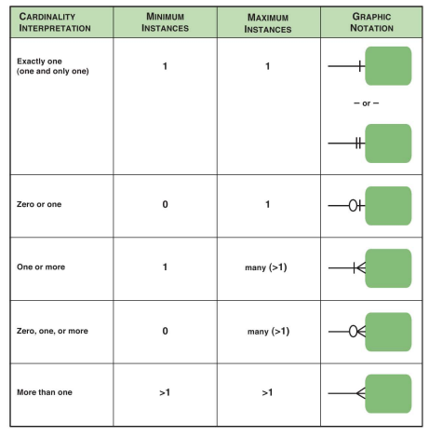

Slide 14
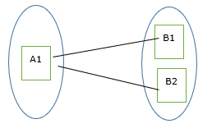
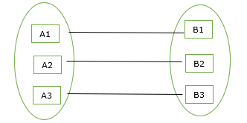
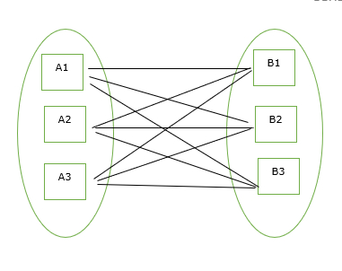
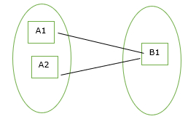
Mapping Cardinalities

Slide 15
Keys
keys represent attributes or sets of attributes that uniquely identify an entity or relationship. Keys are important in database design because they ensure data integrity and help to establish relationships between entities.
1.Primary key: A primary key is an attribute or set of attributes that uniquely identifies an entity in a database. Each entity must have a primary key, which is denoted by underlining the attribute(s) in the ER diagram.
2. Super key: A super key is an attribute or set of attributes that uniquely identifies an entity, but may also contain additional non-essential attributes. It is not always the same as the primary key.
Notes:
Super key can be multiple

Slide 16
Keys
4.Candidate key: A candidate key is a minimal set of attributes that can uniquely identify an entity. It is a subset of the super key, and can be used as an alternative primary key.
5. Foreign key: A foreign key is an attribute or set of attributes in one entity that refers to the primary key of another entity. It is used to establish relationships between entities in a database.

Slide 17
Entity Relationship Diagram
An entity-relationship diagram (ERD) is a graphical representation of entities and their relationships to each other.
Basic Structure
Rectangles: These are classified into two parts. The first half coloured in blue contains the name of the entity set. The second half in white contains the names of all the attributes. The attributes that are part of the key are underlined.
Diamonds: These represent relationship sets.
Undivided Rectangles: These represent the attributes present in a relationship set.
Lines: The lines help us to link entity sets to relationship sets.
Dashed Lines: These help link attributes of a relationship set to another relationship set.
Double Lines: These indicate the total participation of an entity in a relationship set.
Double Diamond: These represent identifying relationship sets that are linked to weak entity sets.
E-R diagrams show a way to point out complex constraints on the number of times every entity takes part in the relationships in a relationship set.

Slide 18
Basic Structure
Entities: These are the main objects or concepts in the system that are represented as rectangles.
Attributes: These are the characteristics or properties of the entities that are represented as ovals or circles.
Relationships: These are the associations or connections between the entities that are represented as diamond shapes.
Cardinality: The cardinality of a relationship is represented by a line connecting the diamond shape to the entity rectangle with a cardinality symbol written on it.
Keys: These are used to uniquely identify each entity instance.
  Primary Key: A primary key is represented by an underline under the attribute name.
  Foreign Key: A foreign key is represented by a dashed underline under the attribute name.

Slide 19
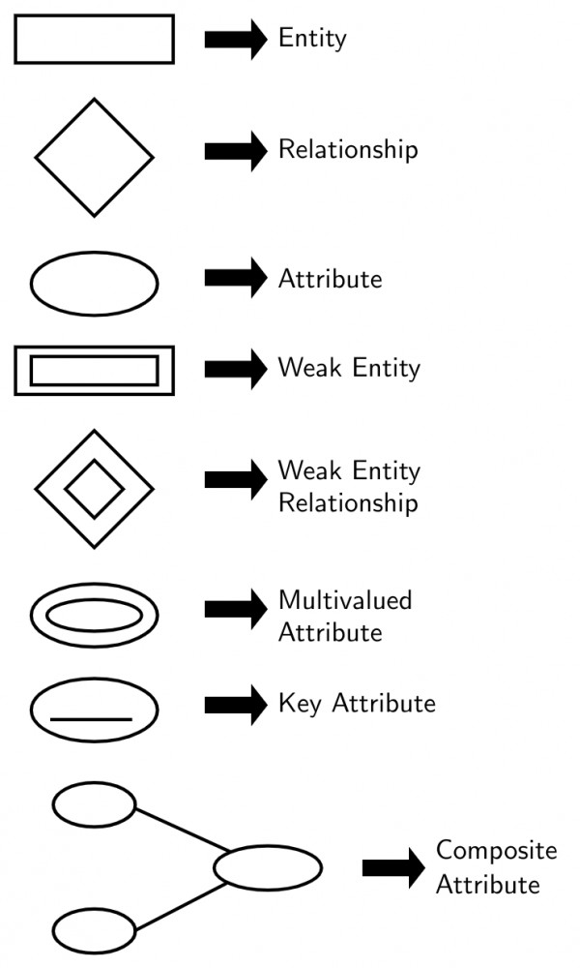

Slide 20
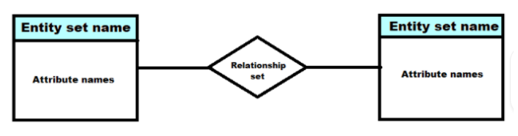

Slide 21
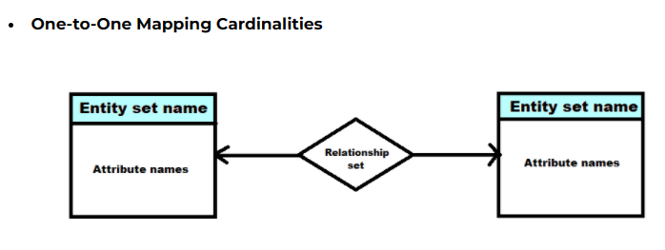
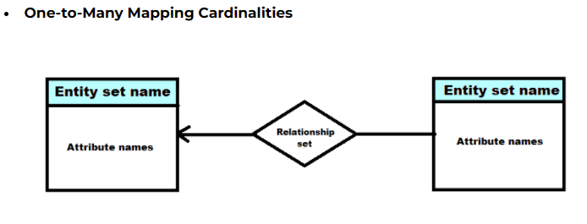
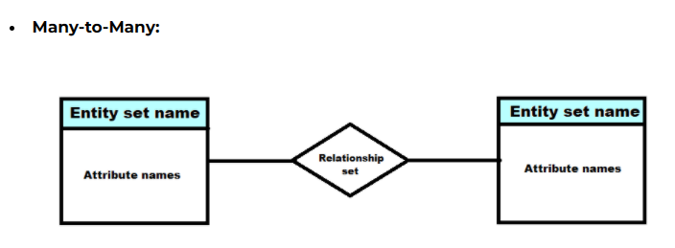
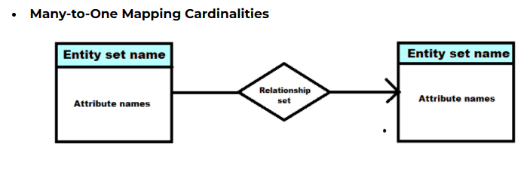
Mapping Cardinalities

Slide 22
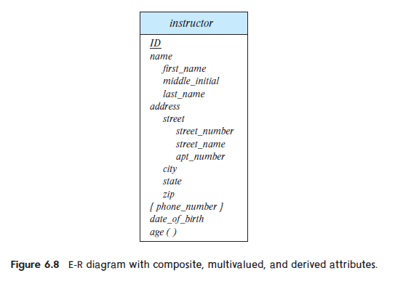
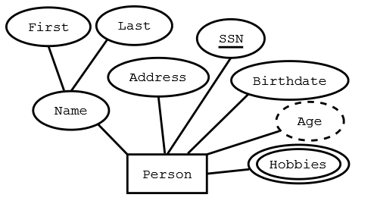
Complex Attributes

Slide 23
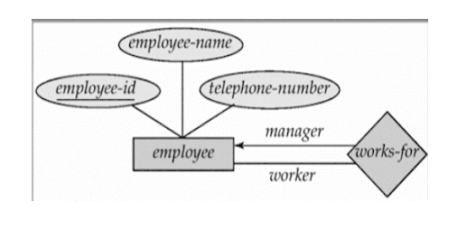
Roles
Roles are indicated in E-R diagrams by labeling the lines that connect diamonds to rectangles.
Roles are normally explicit and not specified.
Example, The relationship works-for define in employees as manager or worker. The labels “manager” and “worker” are called roles; they specify how employee entities interact via the works-for relationship set.

Slide 24
Roles
A role is a label or name associated with an entity's participation in a specific relationship.
It defines the function or purpose of the entity within that particular relationship. Roles are typically placed near the connecting lines between entities and relationships in the diagram.
Roles are especially useful in situations where the same entity participates in multiple relationships with another entity. For instance, in a university database, the "Student" entity might have roles like "Student" in the "Enrolls In" relationship and "Teaching Assistant" in the "Assists In" relationship, indicating that students can have different roles in different contexts.
They provide a way to distinguish between different uses of the same entities in various parts of the database schema.

Slide 25
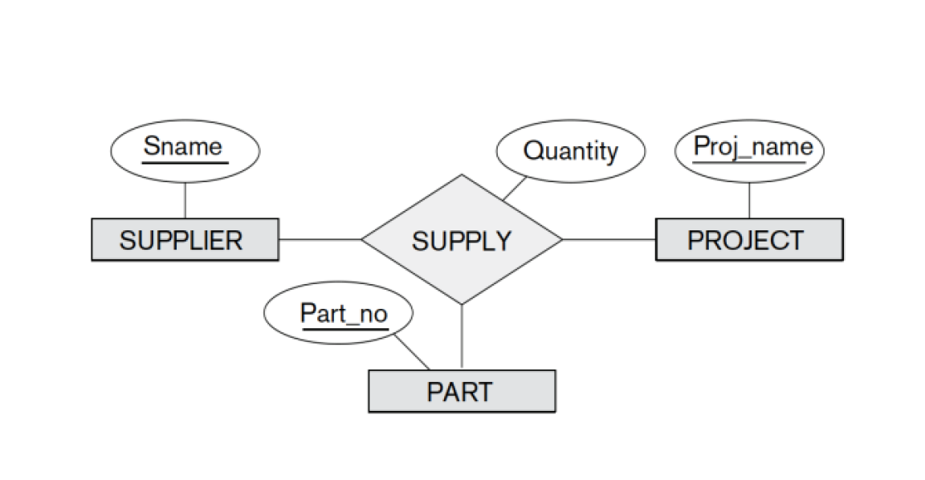
Nonbinary Relationship sets
A nonbinary relationship set is a relationship between two or more entities that is not a binary relationship.
A binary relationship is a relationship between two entities. A nonbinary relationship can be a ternary relationship, a quaternary relationship, or a relationship between any number of entities.

Slide 26
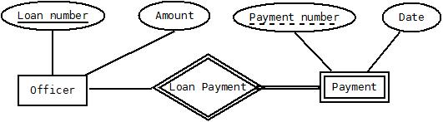
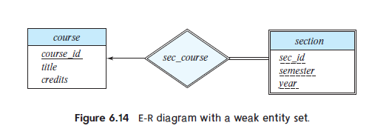
Weak Entity Set
A weak entity set is an entity set that cannot be uniquely identified by its attributes alone.
(participation constraint)

Slide 27
Strong Entity Set
a strong entity set is an entity set that has a primary key attribute, which uniquely identifies each entity in the set.
A strong entity can exist independently of any other entity in the database.

Slide 28
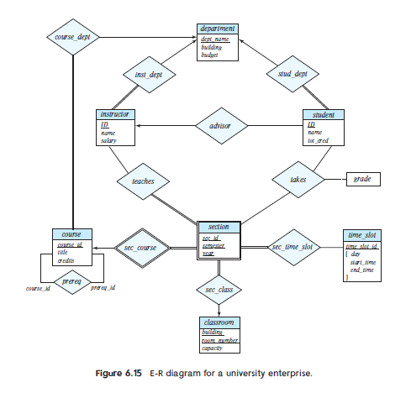

Slide 29
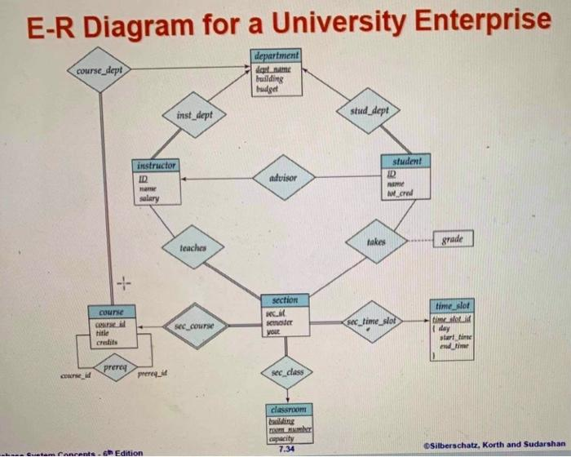

Slide 30
Extended E-R Features
The ER model with extended features is an enhancement of the traditional ER model, which includes additional modeling constructs to provide more expressiveness and flexibility in modeling complex data scenarios.

Slide 31
Specialization
It allow you to model hierarchical relationships between entities.
It will inherit the attributes from main entity(superclass).
Specialization can also be used to improve the security of a database. (Role based)
an entity is divided into sub-entities(subclasses) based on their characteristics. It is a top-down approach where higher level entity is specialized into two or more lower level entities.
Specialization is the process of dividing an entity set into a set of more specialized entity sets.
  For example, you could have an entity set called "Vehicle" that is specialized into the entity sets "Car", "Truck", and "Motorcycle".

Slide 32
Generalization
It is the process of combining two or more entity sets into a single, more general entity set.
Generalization is a Bottom up process.
  "Person" is the general entity type, and "Student," "Faculty," and "Staff" are the specialized entity types.

Slide 33
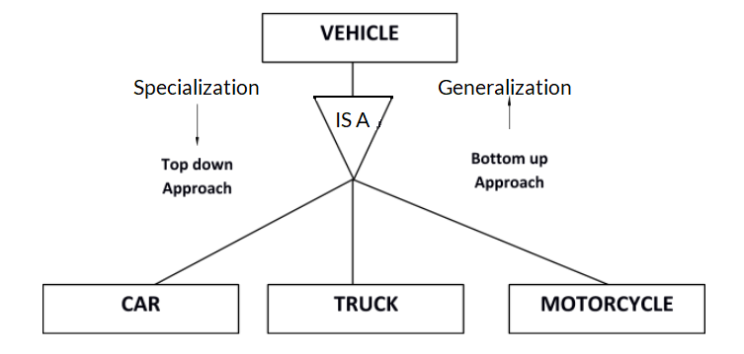
subclasses can share attributes with their superclass and vice varsa. In fact, this is one of the main benefits of using generalization and specialization. By sharing attributes, you can reduce the amount of data that needs to be stored in the database.

Slide 34
Constraints on Generalization
Constraints on Generalization specify the rules that need to be followed when converting a superclass entity to a subclass entity.
A condition-based constraint is a type of constraint that is based on a condition.
if a condition-based constraint is applied to a generalization, then the database will not allow an entity to belong to a subclass if the condition is not met.
This can help to prevent errors in data entry and to ensure that the data is consistent.
  For example, you could create a condition-based constraint that specifies that an employee can only be a full-time employee if their salary is greater than $50,000.

Slide 35
Constraints on Generalization
user-defined constraint is a constraint that is defined by the user, rather than by the database.
These constraints can be specific to the business rules and requirements of a particular system.
  For Examples :-a check constraint can be used to ensure that the value entered in a date column is a valid date. a unique constraint can be used to ensure that there are no duplicate customer names in a customer table.

Slide 36
Constraints on Generalization
Disjoint – The requirement of this constraint is that an entity should not belong to no more than one lower-level entity set.
  For example, an employee can only be a full-time employee or a part-time employee, but not both.
Overlapping – In this category of generalizations, within a single generalization, the same entity may belong to more than one lower-level entity set.
  For example, a person can be a student and an employee at the same time.

Slide 37
Constraints on Generalization
Total Completeness Constraint: This constraint ensures that every superclass entity must belong to one of the subclasses.
  A comprehensive completeness requirement makes sure that all potential values are taken into consideration in order to prevent mistakes or inconsistencies in the data.
Partial Completeness Constraint: This constraint allows superclass entities to not belong to any of the subclasses.
  A partial completeness constraint is used to allow for flexibility in the data while still guaranteeing the validity and accuracy of any data that is there.

Slide 38
Aggregation
Aggregation is a modeling technique in which a relationship between entities is treated as a higher-level entity.
In other words, it is a way to represent a relationship between entities as a single entity.
Aggregation is an abstraction through which we can represent relationships as higher level entity sets.

Slide 39
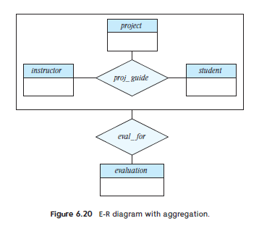

Slide 40
Introduction to Relational Model
E.F. Codd proposed the relational Model to model data in the form of relations or tables. After designing the conceptual model of the Database using ER diagram, we need to convert the conceptual model into a relational model which can be implemented using any RDBMS language like Oracle SQL, MySQL, etc. So we will see what the Relational Model is.
The relational model represents how data is stored in Relational Databases.
A relational database consists of a collection of tables, each of which is assigned a unique name.
  Consider a relation STUDENT with attributes ROLL_NO, NAME, ADDRESS, PHONE, and AGE shown in the table

Slide 41
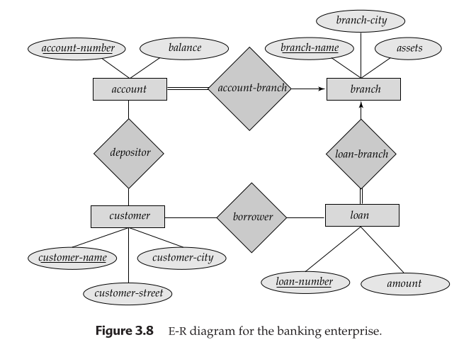
Reducing ER to Relational Schema

Slide 42
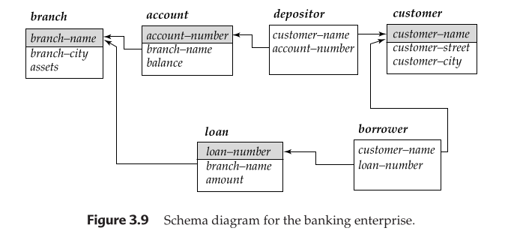
Reducing ER to Relational Schema

Slide 43
Structure of Relational Database
A relational database is a type of database that organizes data into rows and columns, which collectively form a table where the data points are related to each other.
the database schema, which is the logical design of the database, and a database instance, which is a snap-shot of the data in the database at a given instant in time.

Slide 44
Design an E-R diagram;
Design a database for an automobile company to provide to its dealers to assist them in maintaining customer records and dealer inventory and to assist sales staff in ordering cars. Each vehicle is identified by a vehicle identification number (VIN). Each individual vehicle is a particular model of a particular brand offered by the company (e.g., the XF is a model of the car brand Jaguar of Tata Motors). Each model can be offered with a variety of options, but an individual car may have only some (or none) of the available options. The database needs to store information about models, brands, and options, as well as information about individual dealers, customers, and cars.

Slide 45
Entity and attributes
Brand: brand_id (primary key), brand_name.
Model: model_id (primary key), model_name, brand_id (foreign key).
Option: option_id (primary key), option_name.
Model_Option: model_id (foreign key to Model), option_id (foreign key to Option).
Dealer: dealer_id (primary key), dealer_name, dealer_address, dealer_phone.
Customer: customer_id (primary key), customer_name, customer_address, customer_phone.
Vehicle: vin (primary key), model_id (foreign key to Model), year, color, price.
Inventory: inventory_id (primary key), vin (foreign key to Vehicle), dealer_id (foreign key to Dealer), date_added, price.
Ordering: order_id (primary key), vin (foreign key to Vehicle), dealer_id (foreign key to Dealer), date_ordered, expected_delivery_date, price.
Car: vin (primary key, foreign key to Vehicle), num_doors.

Slide 46
Case Study
Major airlines companies that provide passenger service in Nepal are Nepal Air, Buddha Airways, Yeti airline etc. Nepal Civil Aviation Authority keeps a database with lots of information on all airlines. This information is made accessible to all airlines in Nepal with the intention of helping the companies assess their competitive position in the domestic market. The information kept consists of:
Each airlines has an identification number, name of the contact person and mobile number..
For each aircraft identification number, capacity and model is recorded.
Each employee has an employee identification number, name address, birth date, sex, position with the company and qualification
Each route has identification number, origin, destination, classification(onto domestic or international route), distance of the route and price charged per passenger.
Each airline keeps information about their buy/selling transaction (for example, selling an airplane ticket is a sell transaction, paying for maintenance is buy transition). Each transaction has a transaction identification number, date, description and amount of money paid /received

Slide 47
Case study
Do the following.
a) Identify entity, attribute and relationship.
b) Draw an E-R

Slide 48
Case study
Airlines and Aircraft:
One airline can have multiple aircraft (one-to-many relationship)
One aircraft is associated with only one airline (one-to-one relationship)
Airlines and Employee:
One airline can employ multiple employees (one-to-many relationship)
One employee works for only one airline (one-to-one relationship)
Airlines and Route:
One airline can operate multiple routes (one-to-many relationship)
One route is operated by only one airline (one-to-one relationship)
Airlines and Transaction:
One airline can have multiple transactions (one-to-many relationship)
One transaction is associated with only one airline (one-to-one relationship)

Slide 49
Relational Algebra
The relational algebra is a procedural query language. It consists of a set of operations that take one or two relations as input and produce a new relation as their result.
The fundamental operations in the relational algebra are select, project, union, set difference, Cartesian product, and rename.

Slide 50
Relational Algebra/ Query Language
A procedural language consisting of a set of operations that take one or two relations as input and produce a new relation as their result.
Six basic operators
  select: σ
  project: ∏
  union: ∪
  set difference: –
  Cartesian product: x
  rename: ρ

Slide 51
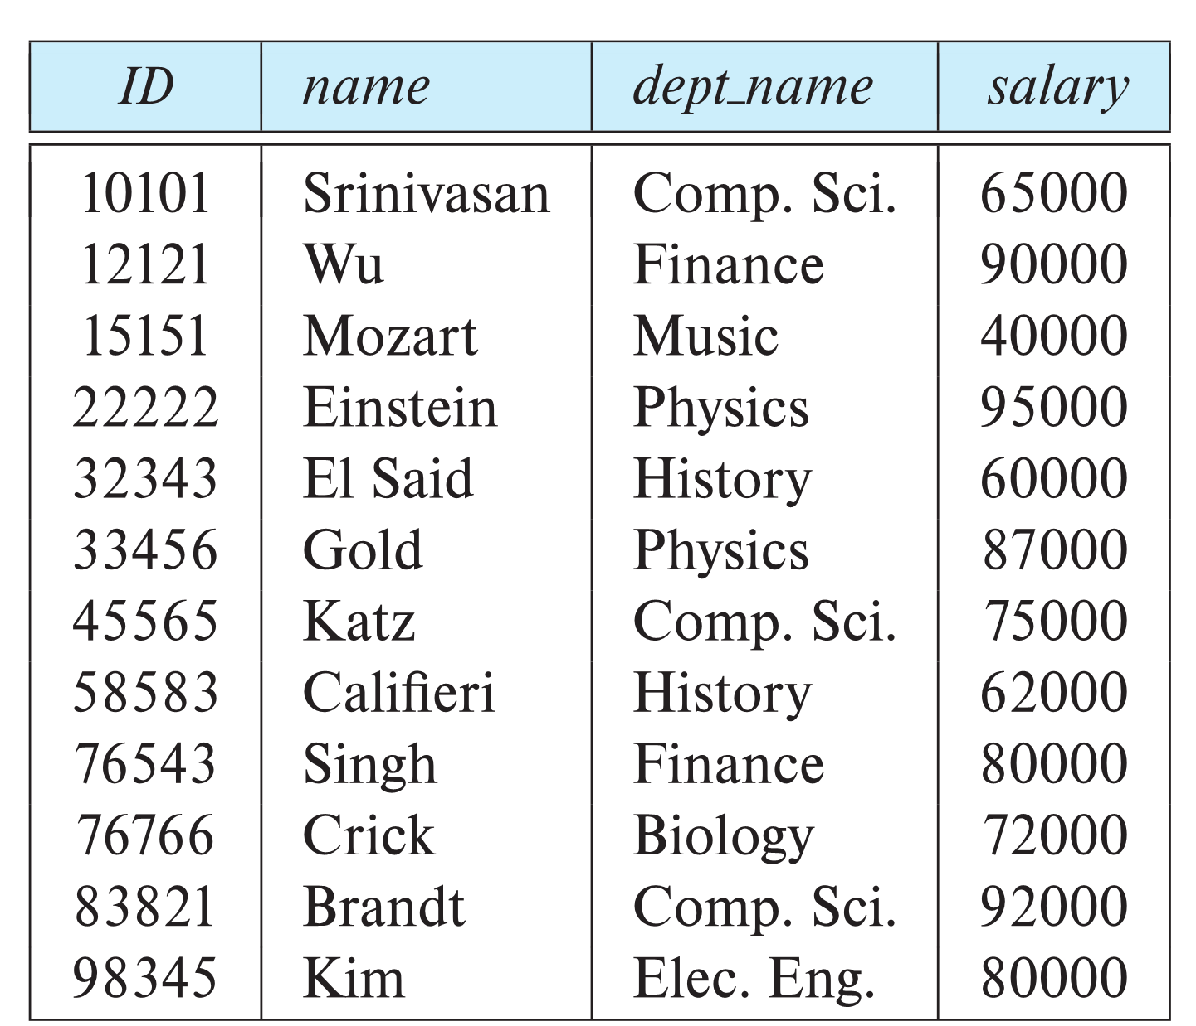
Example of a Instructor Relation
attributes
(or columns)
tuples
(or rows)

Slide 52
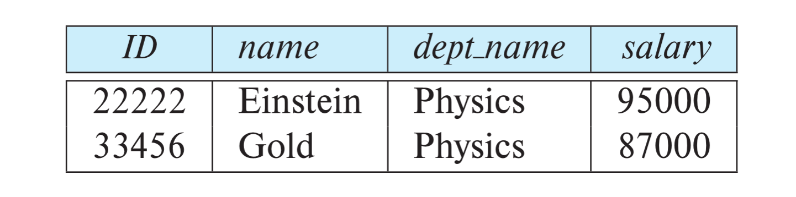
Select Operation
The select operation selects tuples that satisfy a given predicate.
Notation: σ _{p} (r)
p is called the selection predicate
Example: select those tuples of the instructor relation where the instructor is in the “Physics” department.
  Query
  σ _{dept_name=“Physics”} (instructor)
  Result

Slide 53
Select Operation
We allow comparisons using =, ≠, >, ≥. <. ≤ in the selection predicate.
We can combine several predicates into a larger predicate by using the connectives:
∧ (and), ∨ (or), ¬ (not)
Example: Find the instructors in Physics with a salary greater $90,000, we write:
σ _{dept_name=“Physics”} ∧ _{salary >} _{90,000} (instructor)
The select predicate may include comparisons between two attributes.
  Example, find all departments whose name is the same as their building name:
  σ _{dept_name=building} (department)

Slide 54
Project Operation
A unary operation that returns its argument relation, with certain attributes left out.
Notation:
∏ _{A1,A2,A3 ….Ak} (r)
where A₁, A₂, …, A_{k} are attribute names and r is a relation name.
The result is defined as the relation of k columns obtained by erasing the columns that are not listed
Duplicate rows removed from result, since relations are sets.

Slide 55
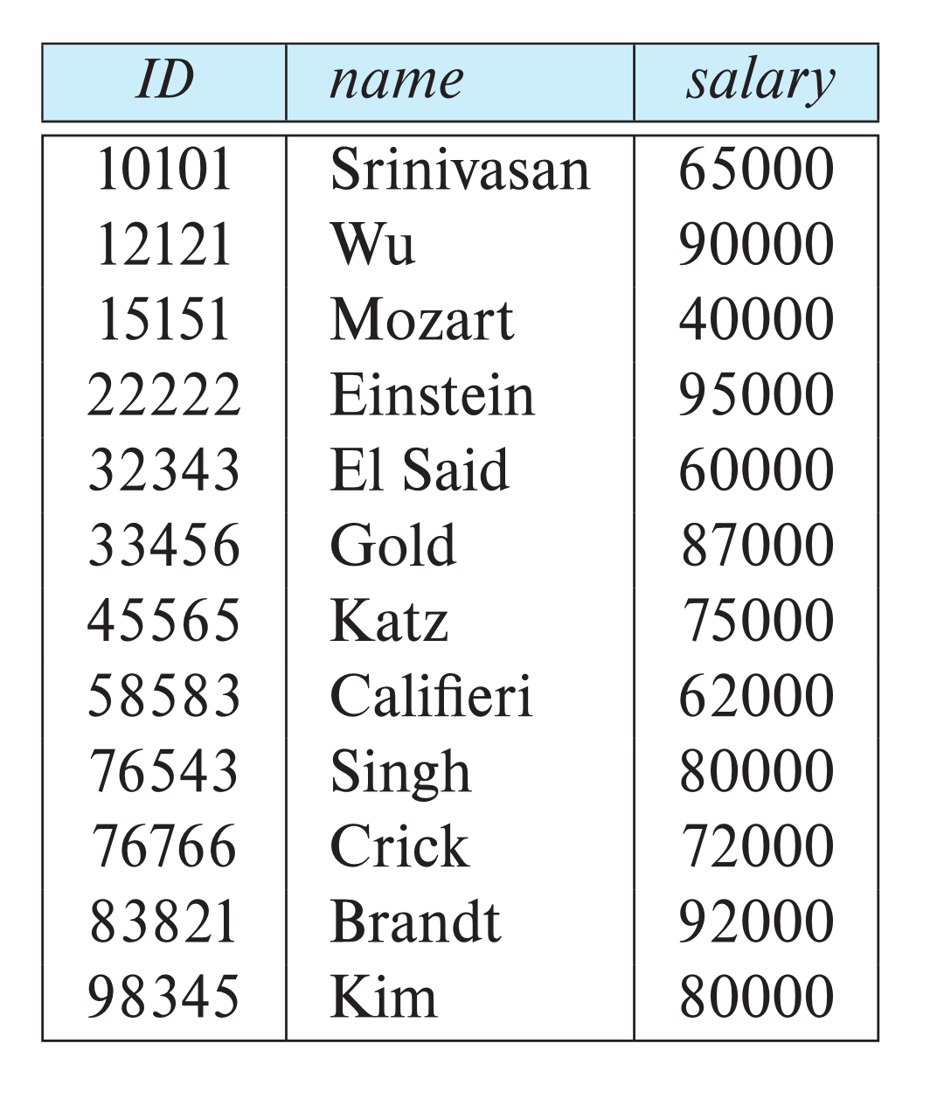
Project Operation
Example: eliminate the dept_name attribute of instructor
Query:
∏_{ID, name, salary} (instructor)

Slide 56
Composition of Relational Operations
The result of a relational-algebra operation is relation and therefore of relational-algebra operations can be composed together into a relational-algebra expression.
Consider the query -- Find the names of all instructors in the Physics department.
∏_{name}(σ _{dept_name} _{=“Physics”} (instructor))
Instead of giving the name of a relation as the argument of the projection operation, we give an expression that evaluates to a relation.

Slide 57
Questions
Q: Suppose we have the following relation:
Employee(person_name, city, salary, company_name)
Write relational algebra expression for following queries:
Find the name of all the employee who live in ‘Butwal’ and whose salary is less than Rs. 50,000.
Find the names and cities of residence of all employees who work for “Global bank”
Find the name of all the employees who works for “Nabil Bank Limited”

Slide 58
Cartesian-Product Operation
The Cartesian-product operation (denoted by X) allows us to combine information from any two relations.
Example: the Cartesian product of the relations instructor and teaches is written as:
instructor X teaches
We construct a tuple of the result out of each possible pair of tuples: one from the instructor relation and one from the teaches relation (see next slide)
Since the instructor ID appears in both relations we distinguish between these attribute by attaching to the attribute the name of the relation from which the attribute originally came.
  instructor.ID
  teaches.ID

Slide 59
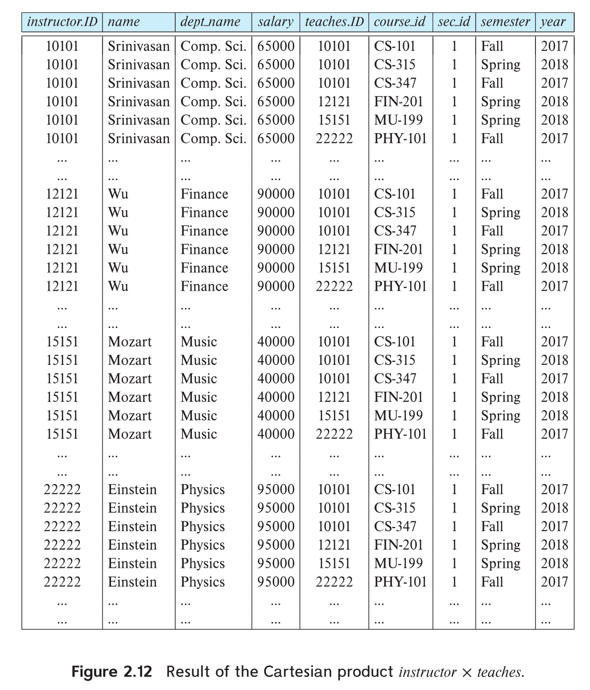
The instructor X teaches table

Slide 60
Join Operation
The Cartesian-Product
instructor X teaches
associates every tuple of instructor with every tuple of teaches.
  Most of the resulting rows have information about instructors who did NOT teach a particular course.
To get only those tuples of “instructor X teaches “ that pertain to instructors and the courses that they taught, we write:
σ _{instructor.id = teaches.id} (instructor x teaches ))
  We get only those tuples of “instructor X teaches” that pertain to instructors and the courses that they taught.
The result of this expression, shown in the next slide

Slide 61
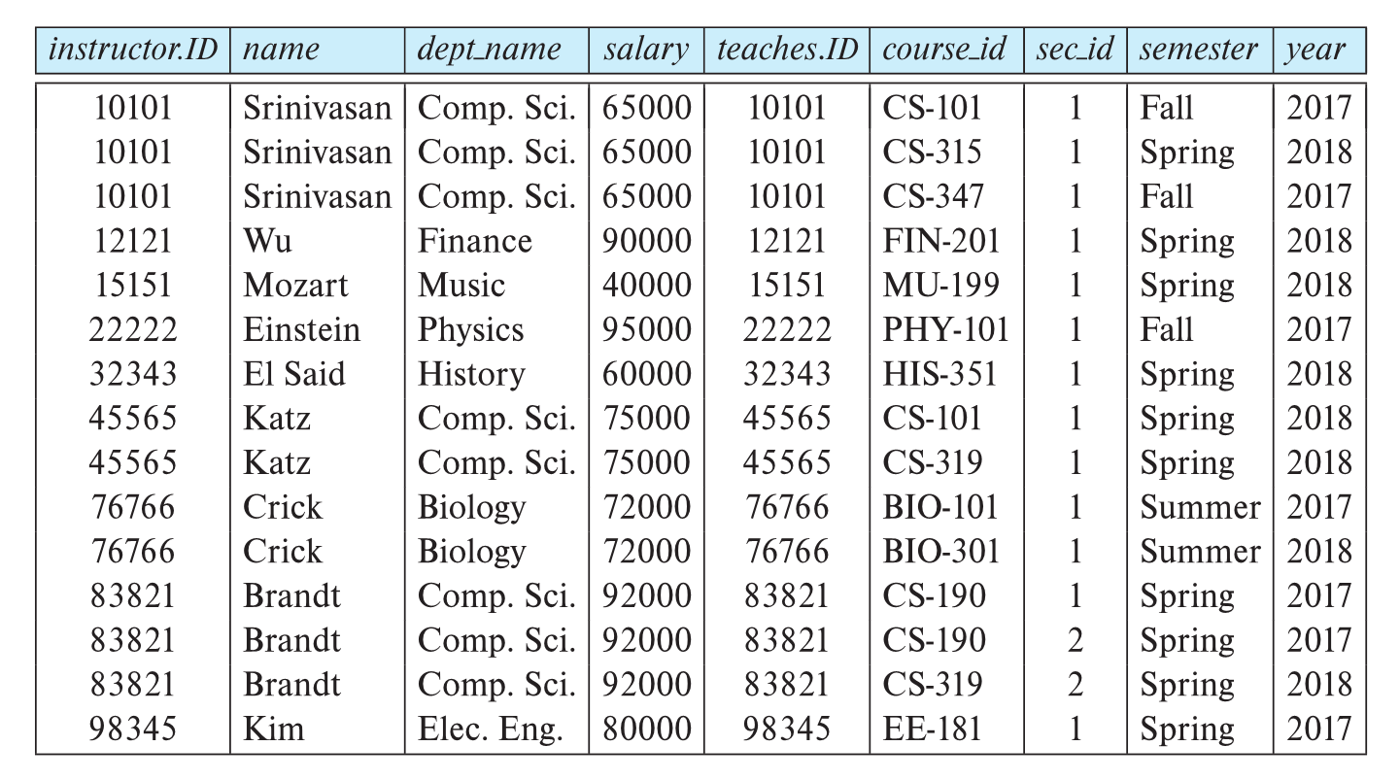
Join Operation
σ _{instructor.id = teaches.id} (instructor x teaches ))

Slide 62
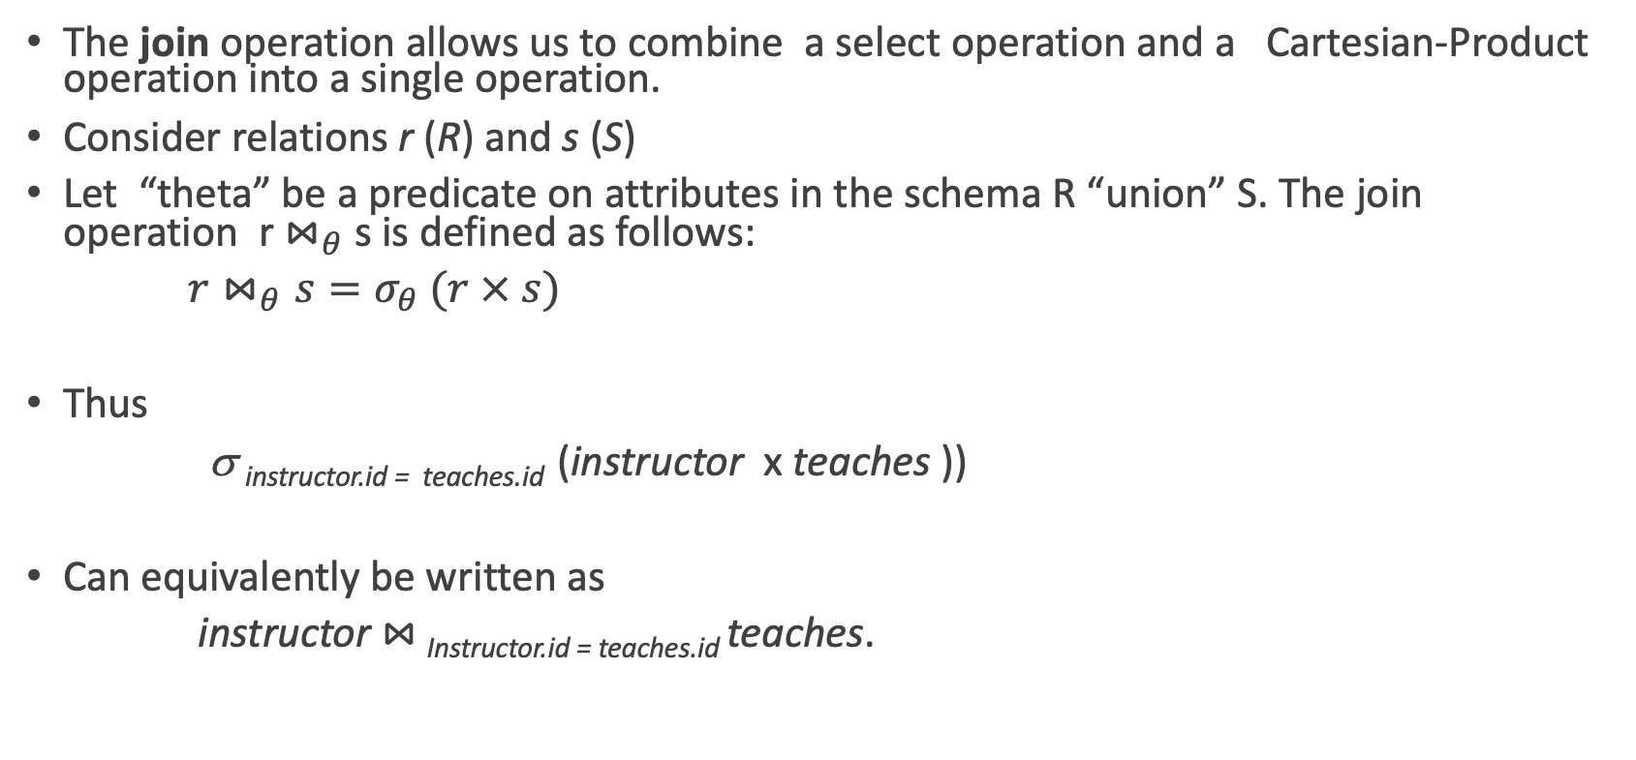
Join Operation

Slide 63
Union Operation
The union operation allows us to combine two relations
Notation: r ∪ s
For r ∪ s to be valid.
  r, s must have the same arity (same number of attributes)
  The attribute domains must be compatible (example: 2nd column of r deals with the same type of values as does the 2nd column of s)
Example: to find all courses taught in the Fall 2017 semester, or in the Spring 2018 semester, or in both
∏_{course_id} (σ _{semester=“Fall” Λ year=2017} (section)) ∪
∏_{course_id} (σ _{semester=“Spring” Λ year=2018} (section))

Slide 64
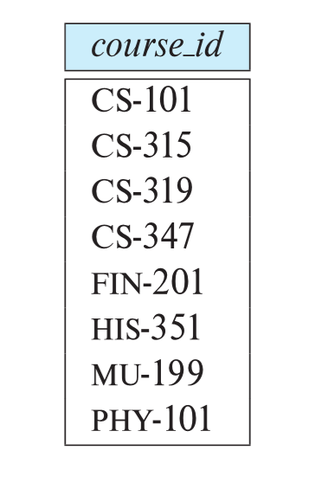
Union Operation
∏_{course_id} (σ _{semester=“Fall” Λ year=2017} (section)) ∪
∏_{course_id} (σ _{semester=“Spring” Λ year=2018} (section))

Slide 65
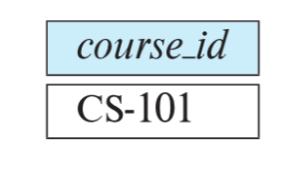
Set - Intersection Operation
The set-intersection operation allows us to find tuples that are in both the input relations.
Notation: r ∩ s
Assume:
  r, s have the same arity
  attributes of r and s are compatible
Example: Find the set of all courses taught in both the Fall 2017 and the Spring 2018 semesters.
∏_{course_id} (σ _{semester=“Fall” Λ year=2017} (section)) ∩
∏_{course_id} (σ _{semester=“Spring” Λ year=2018} (section))

Slide 66

Set Difference Operation
The set-difference operation allows us to find tuples that are in one relation but are not in another.
Notation r – s
Set differences must be taken between compatible relations.
  r and s must have the same arity
  attribute domains of r and s must be compatible
Example: to find all courses taught in the Fall 2017 semester, but not in the Spring 2018 semester
∏_{course_id} (σ _{semester=“Fall” Λ year=2017} (section)) −
∏_{course_id} (σ _{semester=“Spring” Λ year=2018} (section))

Slide 67
The Assignment Operation
It is convenient at times to write a relational-algebra expression by assigning parts of it to temporary relation variables.
The assignment operation is denoted by ← and works like assignment in a programming language.
Example: Find all instructor in the “Physics” and Music department.
Physics ← σ _{dept_name=“Physics”} (instructor)
  Music ← σ _{dept_name=“Music”} (instructor)
  Physics ∪ Music
With the assignment operation, a query can be written as a sequential program consisting of a series of assignments followed by an expression whose value is displayed as the result of the query.

Slide 68
The Rename Operation
The results of relational-algebra expressions do not have a name that we can use to refer to them. The rename operator, ρ , is provided for that purpose
The expression:
ρ_{x} (E)
returns the result of expression E under the name x
Another form of the rename operation:
ρ_{x(A1,A2, .. An)} (E)

Slide 69
Equivalent Queries
There is more than one way to write a query in relational algebra.
Example: Find information about courses taught by instructors in the Physics department with salary greater than 90,000
Query 1
σ _{dept_name=“Physics”} ∧ _{salary > 90,000} (instructor)
Query 2
σ _{dept_name=“Physics”} (σ _{salary > 90.000} (instructor))
The two queries are not identical; they are, however, equivalent -- they give the same result on any database.

Slide 70
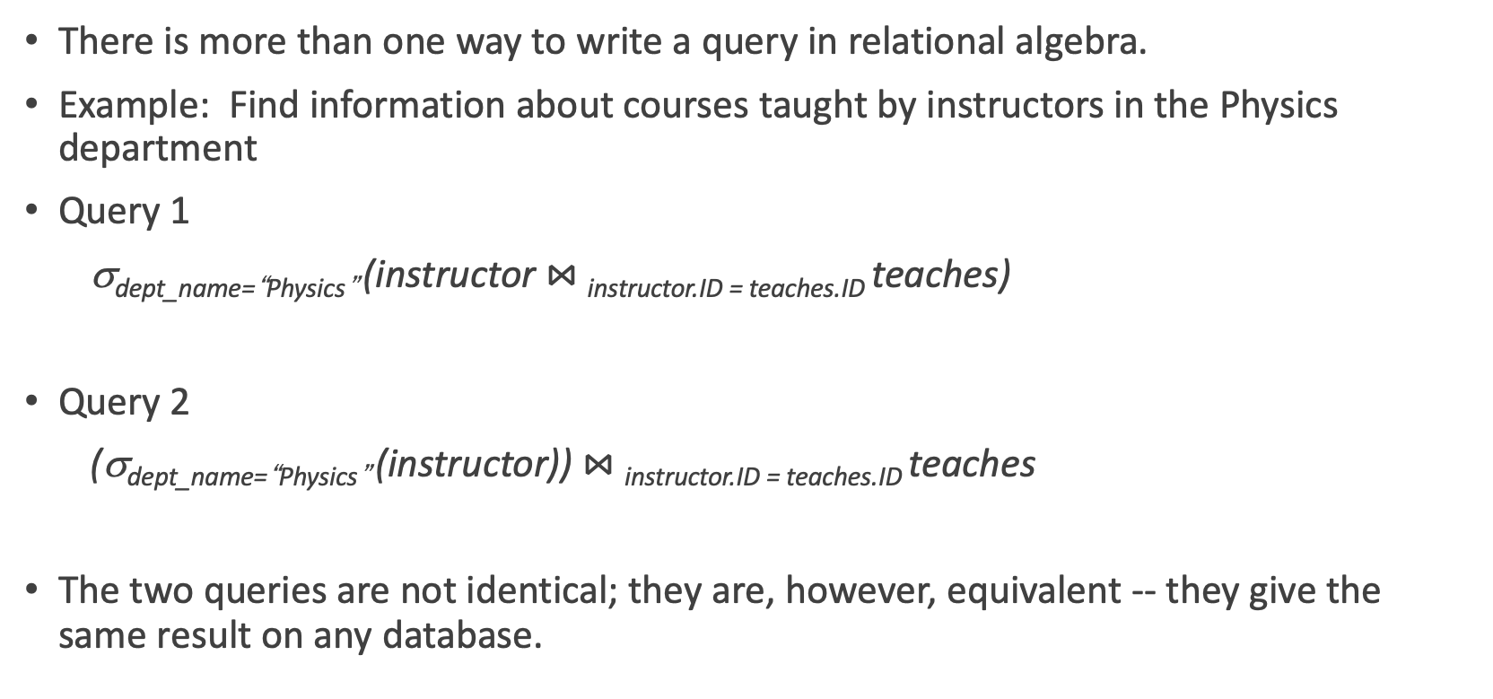
Equivalent Queries

Slide 71
More
1.Relational Calculus vs Relational algebra
  https://www.geeksforgeeks.org/difference-between-relational-algebra-and-relational-calculus/
  Tuple Relational Calculus (TRC)
  Domain Relational Calculus (DRC)
2. UML
  https://www.geeksforgeeks.org/unified-modeling-language-uml-introduction/

